Slide 1


PCF Operations Workshop -
Application Security Groups

Slide 2
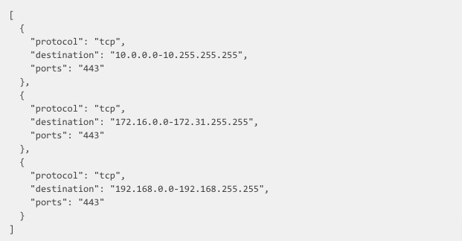
Create a Rules JSON File

Slide 3
Create the Security Group

Slide 4
Bind Security Group to a Org and Space

Slide 5
Bind Security Group to all Spaces in a Org

Slide 6
Bind to the Default Staging Security Group

Slide 7
Bind to the Default Running Security Group

