Slide 1


PCF Operations Workshop –
Authentication and Authorization

Slide 2

Services Overview
Platform Installation & Setup
Role Based Access Control
Platform & Application Scaling
Health, Events, & Logging
Platform & Application Patching
Security Overview
Authentication & Authorization
Operations Workshop Agenda

Slide 3


Key Themes
Speed
Scale
Security
Stability

Slide 4
User Authentication and Authorization (UAA) Server- Overview (1 of 2)
Multi-tenant component of the Elastic Runtime
Secures Elastic Runtime components, applications and APIs (e.g. Apps Manager and Cloud Controller API)
Can also secure access to other applications/APIs using the Pivotal Single Sign-On (SSO) Service
Open source component based on industry standards such as SAML, OAuth 2.0 and OpenID Connect

Slide 5
User Authentication and Authorization (UAA) Server- Overview (2 of 2)
Authenticates users
Can store user credentials internally or using an external identity provider (Ping Identity, CA SSO, Azure ADFS, Okta ...)
Acts as an authorization server
Issues tokens to client applications on behalf of users
Enables the convenience and security of single sign-on (SSO) for platform applications (e.g. Apps Manager) and other applications (using the Pivotal SSO Service)

Slide 6
Cloud Foundry Platform Users
Cloud Foundry platform users are developers and operators using platform applications like Apps Manager or the cf CLI
There are three ways to store platform user credentials:
Internal store - user information is stored in the UAA database
LDAP - user information is stored in an LDAP server
Configured on the Elastic Runtime’s LDAP Config tab
Enterprise Identity Provider - user information is stored in an external service like CA SSO or ADFS
Configured on the Elastic Runtime’s SSO Config tab
This is the recommended approach for external platform users-it is more secure than LDAP
Note: Populate the LDAP Config tab or the SSO Config tab, but not both

Slide 7
1) Using the Internal Store for Platform Users
The internal store uses the UAA database
Users can be added using Apps Manager
They can also be added with the cf CLI

Slide 8
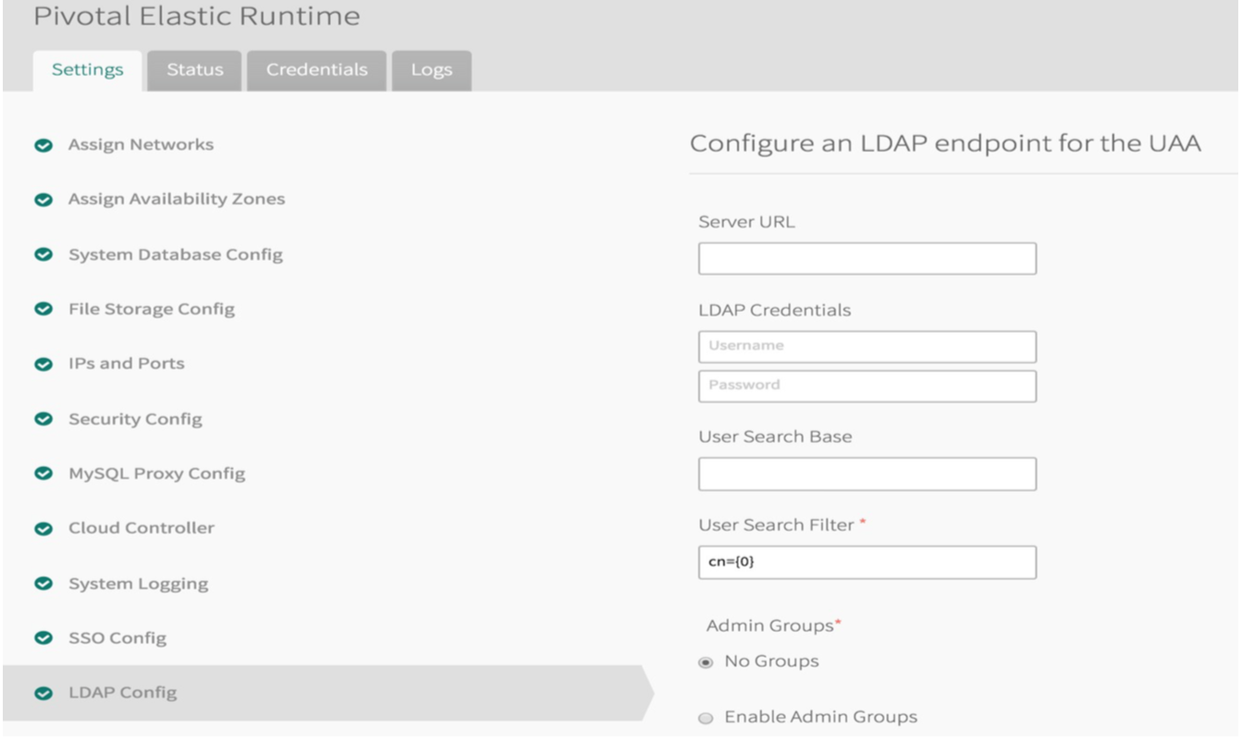
2) Using LDAP for Platform Users
The Elastic Runtime's LDAP Config tab configures the LDAP integration with the UAA

Slide 9
Demo
ADFS Integration

Slide 10

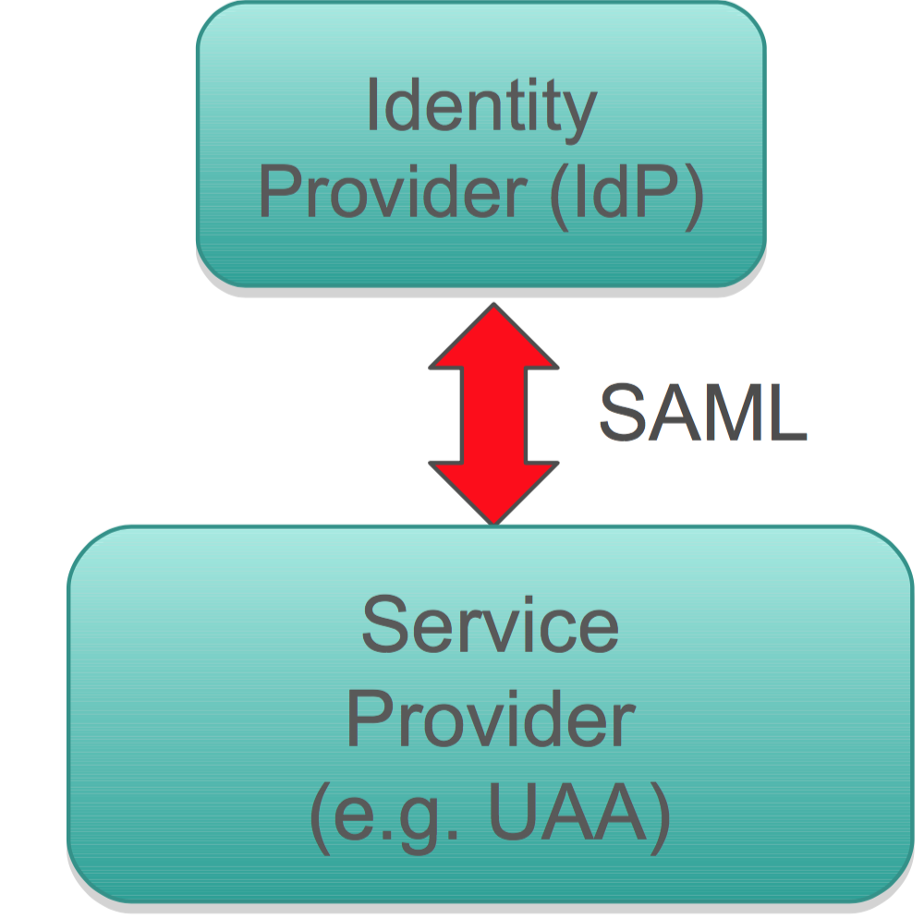
Security Assertion Markup Language (SAML)
XML-based, open-standard for exchanging authentication and authorization data between security domains
In Cloud Foundry, used to exchange user data between an external identity provider and the UAA
The UAA acts as the service provider

Slide 11
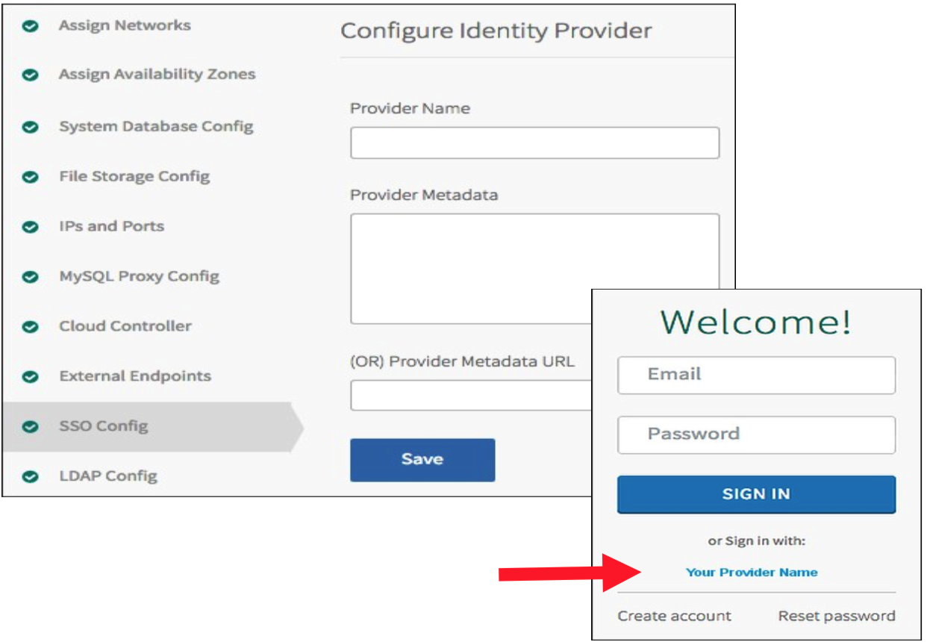
3) Configuring the UAA as a SAML Service Provider
Use the Elastic Runtime SSO Config tab to configure the UAA as a SAML service provider
Platform users will have the option to click on the “Your Provider Name” link on the login page
Your identity provider must also be configured to recognize Cloud Foundry as a service provider

Slide 12
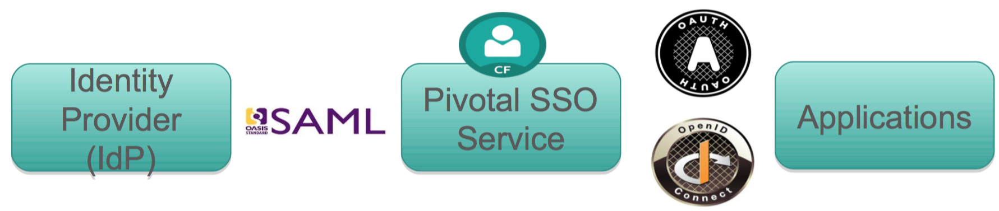
Pivotal Single Sign-On Service for Applications
Provides SSO security and convenience to applications hosted on or external to the Cloud Foundry platform
Uses an internal user store (the UAA database) or an external SAML 2.0 compliant federated identity provider
Certified with Ping Identity, CA SSO, Azure ADFS, ForgeRock Open AM, VMWare Identity Management, Okta
Implemented as a managed service (available in the marketplace)

Slide 13
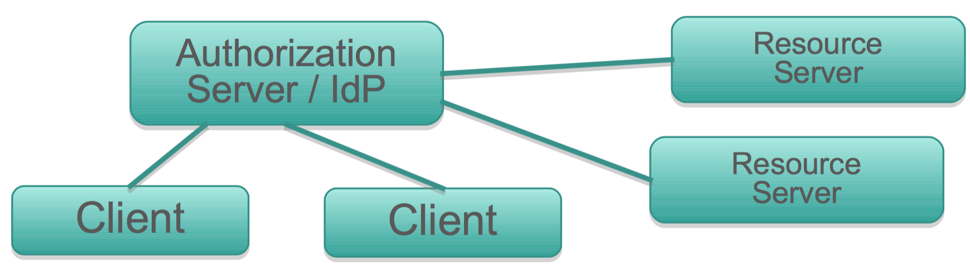
The Benefits of SSO
A main point of SSO is to prevent clients from directly passing user credentials to resource servers
Pass tokens from the authorization server instead
Centralized identity and security policy management
Better user experience / avoids multiple logins
More secure
Scales well in distributed environments (e.g. microservices)

Slide 14
Platform vs. Application SSO
Platform SSO- Used for securing platform components and applications such as the Cloud Controller or the cf CLI
Users are Cloud Foundry operators and developers
Application SSO- The Pivotal Single Sign-On Service can be used to add security and SSO capabilities to applications
The applications can be hosted on or external to the platform

Slide 15
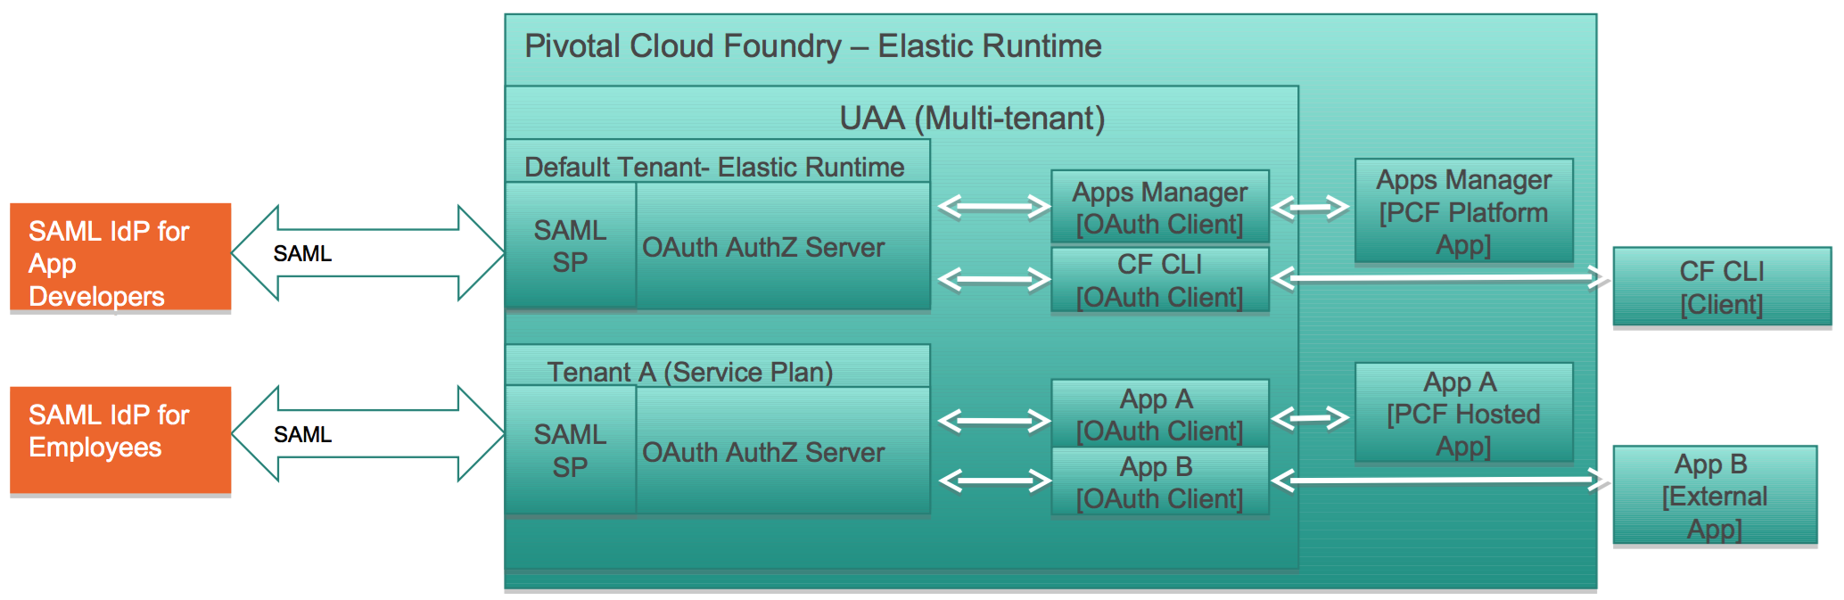
Pivotal Single Sign-on Architecture
Single high availability multi-tenant UAA for securing platform and hosted applications
Each tenant gets its own virtual authorization server
Multiple SAML 2.0 external identity providers are supported
Each application has an associated OAuth client in the UAA
All applications must be OAuth 2.0-aware

Slide 16
Managed Service
The Pivotal Single Sign-On service is implemented as a managed service
Available in the marketplace as service plans
Installing the SSO service creates a System > identity-service-space containing an identity-service-broker app
Can access SSO logs from Apps Manager or the cf CLI
Enable SSO for an application in one of two ways:
Bind the application to the service instance
Register the application with the Pivotal Single Sign-On service dashboard
The application must be OAuth 2.0 aware
Use https://p-identity.[system domain] to create and view service plans (UAA tenants)

Slide 17
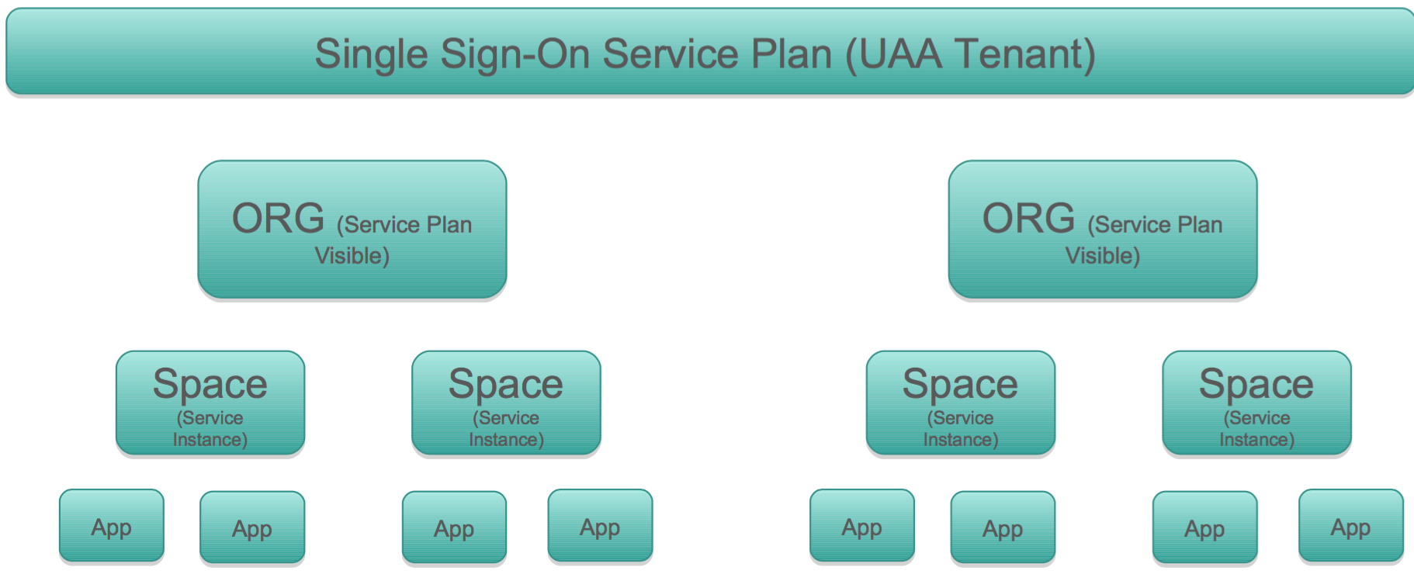
Service Plan Visibility
Enable a service plan for an org with cf enable-service-access

Slide 18
Demo
SSO Integration

Slide 19
Questions
How does your organization provide system level access (AD, LDAP, SAML, etc)?
Has your organization implemented SSO?
Do your applications need to provide SSO capability?

