Slide 1


PCF Operations Workshop –
Service Overview
<Presenter>
<Title>

Slide 2

Pivotal Cloud Foundry Operations Workshop Agenda
Services Overview
Platform Installation & Setup
Role Based Access Control
Platform & Application Scaling
Health, Events, & Logging
Platform & Application Patching
Security Overview
Authentication & Authorization

Slide 3


Key Themes
Speed
Scale
Security
Stability

Slide 4
Cloud-Native Application Platform - Services
Cloud-Native
Data Services
Professional Services for Agile, CI/CD
Data
Services
Pivotal
Labs
Pivotal Cloud Foundry
PCF
Mobile
Services
Spring
Cloud
Services
Cloud-Native
Mobile Services
Cloud-Native
Application Framework

Slide 5
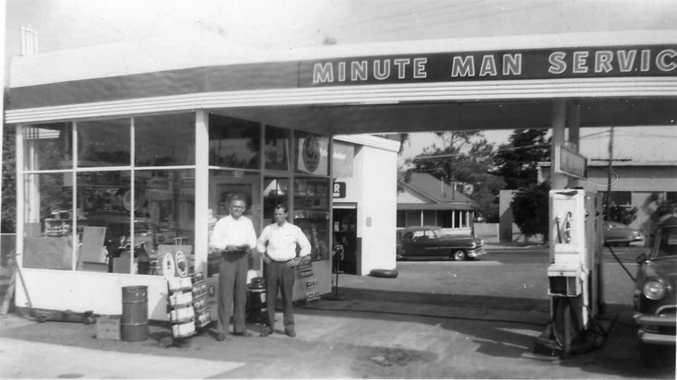
What is a Service
Allows resources to be easily provisioned on-demand
Typically middleware, frameworks, and other “components” necessary for applications
Can be a persistent, stateful layer

Slide 6

Three Types of Services
Managed - Fully integrated and managed by PCF
Brokered - Provision & integrate with services hosted outside of the platform
User-Provided – Provide service credentials to an application inside PCF

Slide 7
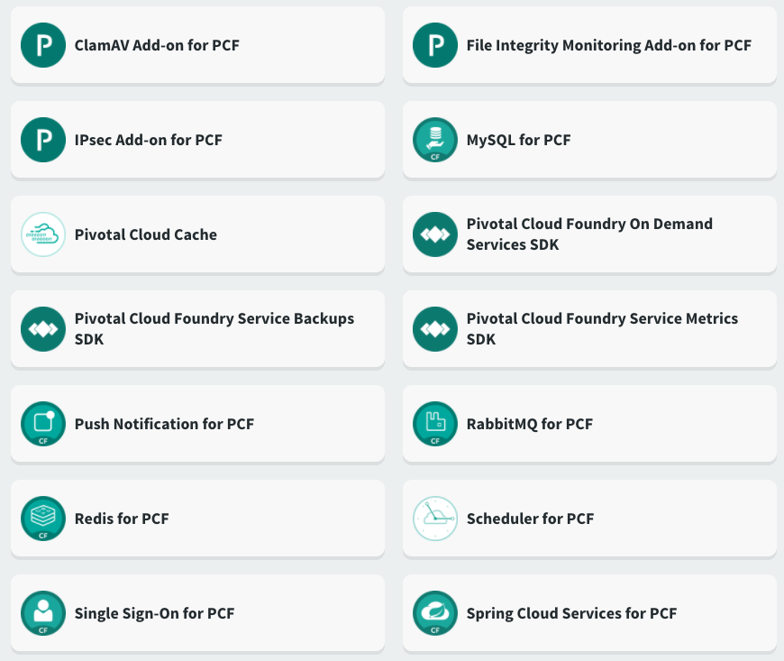
PCF Services

Slide 8
Service Broker
Flexible, RESTful API
Allows Service Authors to provide self-provisioning Services to developers
Cloud Controller
Create
Service Broker
Service Nodes
Bind
Connect
Cell
Apps

Slide 9
Creating and Binding a Service
Service
credentials
DB
CLI
create service (HTTP)
Cloud Controller
create service (HTTP)
Service
Broker
reserve resources
Data
Service
Router
bind service (HTTP)
bind service (HTTP)
obtain connection data
Pivotal Cloud Foundry
Elastic Runtime

Slide 10

Pivotal Cloud Foundry Services
Operated ‘as a Service’
Configured and integrated to enable push button deployment
Full lifecycle management - software updates and patching
Bind to apps through an easy-to-use interface
Common view into access control and audit trails across a breadth of services
EASY

Slide 11
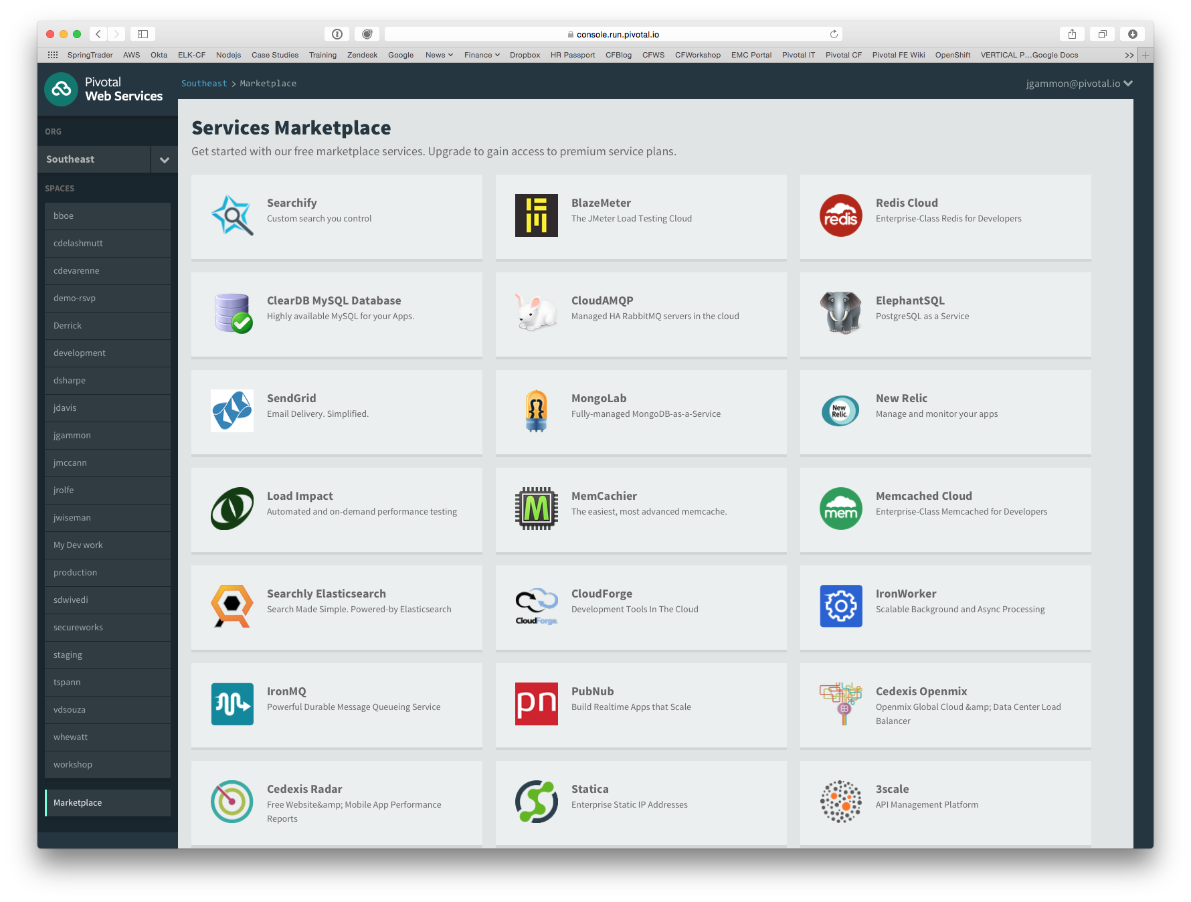
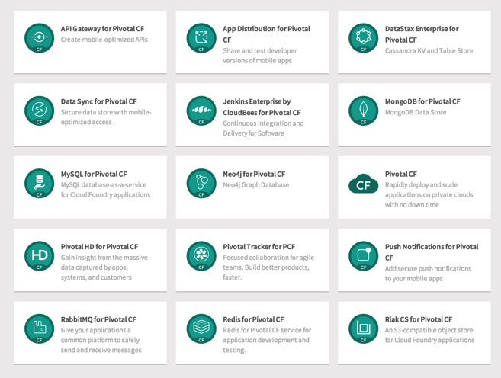
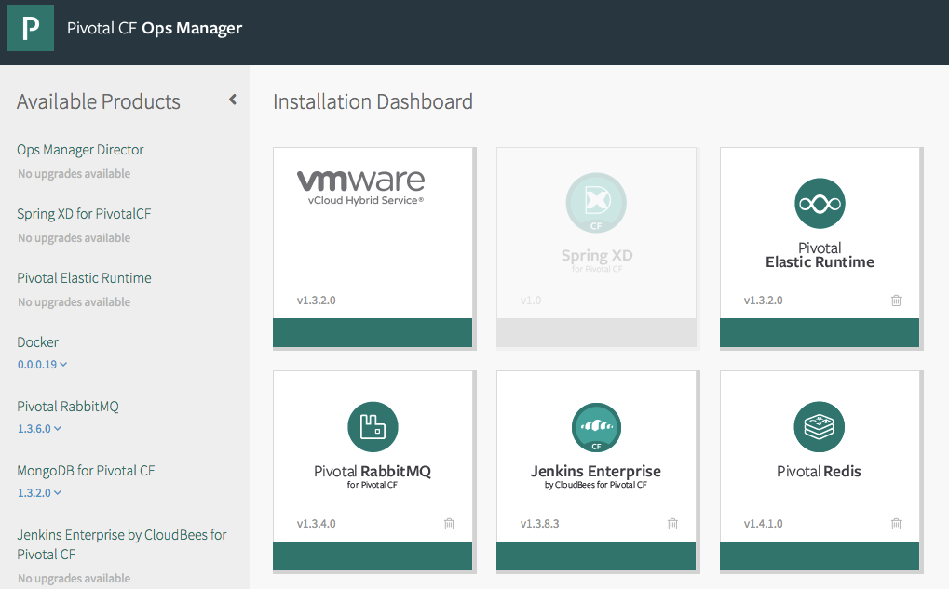
PCF Marketplace
Broad Services Ecosystem
Easy accessibility
Quick, self-provisioning

Slide 12
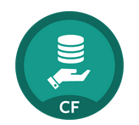
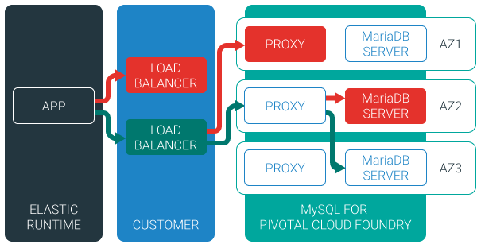
MySQL for Pivotal Cloud Foundry
Relational Database as a Service for Your Applications
Minimized effort to create, configure, and manage a MySQL cluster
Multi-node cluster
Data replication across nodes
Failover functionality ensures app traffic only routed to healthy nodes

Slide 13

Redis for Pivotal Cloud Foundry
Advanced Key-Value Store and Cache as a Service
On-Demand Redis Instances
Supports persistence to disk
Consolidated logging and monitoring
VM health monitoring, and recovery
User Application
Binding
Instance (Redis process)
VM
VM
VM
Pre-provisioned VMs in the ‘pool’
Ready to be created as instances and bound with apps

Slide 14

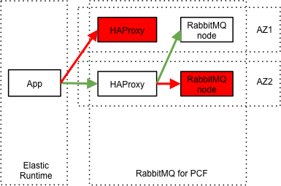
RabbitMQ for Pivotal Cloud Foundry
Apps safely send and receive messages at scale
Messaging broker for communication between servers, applications and devices
Highly available queues, flexible routing, support for multiple protocols and client libraries
Wide range of client libraries, in all languages
Push button deployment and upgrades of a RabbitMQ Cluster

Slide 15
Platform Installation & Setup
Marketplace Walkthrough
Create/Bind MySQL Database

Slide 16
Questions
How do you provision test database instances?
What are your “production approved” database products?
What are the data products would you like to use in production but cannot?

