Slide 1


PCF Operations Workshop –
Platform Installation & Setup
<Presenter>
<Title>

Slide 2



Services Overview
Platform Installation & Setup
Role Based Access Control
Platform & Application Scaling
Health, Events, & Logging
Platform & Application Patching
Security Overview
Authentication & Authorization
Operations Workshop Agenda

Slide 3
Key Themes
Speed
Scale
Security
Stability

Slide 4
The Sys Admin’s Dream Haiku
Here are my servers,
go make them a Cloud Foundry,
I do not care how

Slide 5
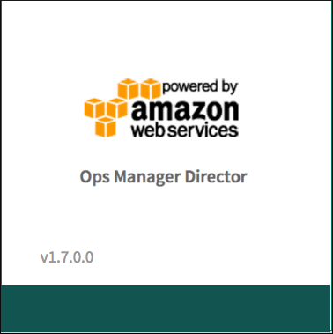

PCF Core Installation Components

Slide 6
Platform Installation & Setup
Ops Manager Demo

Slide 7
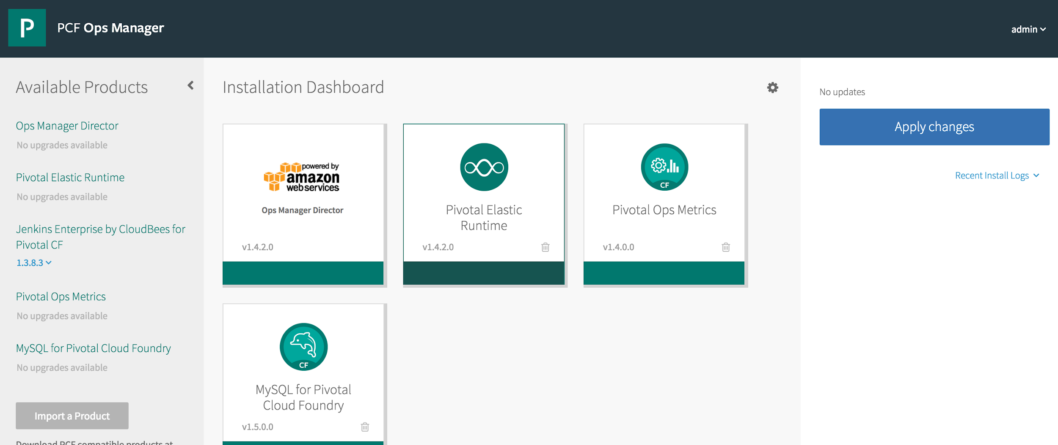

Ops Manager and BOSH
Ops Manager is a user interface on top of BOSH
When you install or make changes in Ops Manager, BOSH-level changes are being made
Each tile is tied to a bosh deployment

Slide 8
BOSH Functionality
BOSH
Software Deployment
Monitoring
Software Updates
Process Management
Resource Provisioning
Failure Recovery
BOSH Cloud Provider Interface (CPI)
IaaS Application Provider Interface (API)
IaaS
(AWS, vSphere, OpenStack, etc.)
...
Resource
Resource
Resource
Resource

Slide 9

BOSH Deployment Components
Stemcell: A template VM used for the cluster
Release: Software and information on how to build the VMs in a cluster
Manifest: Describes the cluster using configuration (YAML file)
Stemcell
Agent
Manifest
Release
‹#›

Slide 10
BOSH Deployment (1 of 4)
2
Upload stemcell (VM template) to blobstore
Register in director's DB
DB
BOSH CLI
or Ops Mgr
BOSH Director
upload stemcell
Blobstore
1
NATS
Health
Monitor

Slide 11
BOSH Deployment (2 of 4)
Upload release (software to install) into blobstore
Register in director's DB
2
DB
BOSH CLI
or Ops Mgr
BOSH Director
upload release
Blobstore
1
NATS
Health
Monitor

Slide 12
BOSH Deployment (3 of 4)
Pass manifest (deployment instructions) to director
DB
1
BOSH CLI
or Ops Mgr
BOSH Director
deployment (manifest)
Blobstore
NATS
Health
Monitor

Slide 13
BOSH Deployment (4 of 4)
2
IaaS
DB
1
Worker VMs
BOSH CLI
or Ops Mgr
BOSH Director
deploy
Target VM
Blobstore
3
NATS
Target VM
Health
Monitor
4
Target VM
BOSH agent
Director runs deployment
Drives worker VMs
Workers deploy desired VMs (from stemcells)
Director & HM updated with new system status

Slide 14
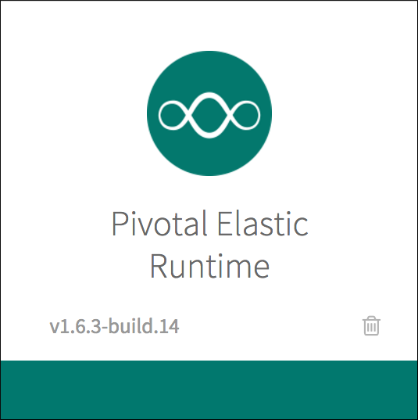
Elastic Runtime
The Elastic Runtime is an example of the distributed software that BOSH can manage
The Elastic Runtime is a set of components/VMs used to run highly available, scalable applications in containers
‹#›

Slide 15
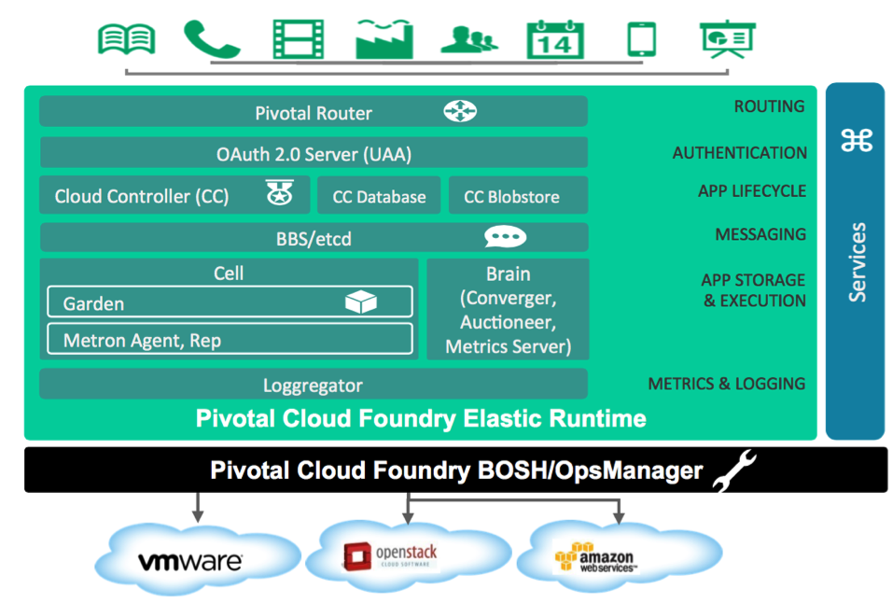
Elastic Runtime
‹#›

Slide 16
Platform Installation & Setup
BOSH Logging Demo

Slide 17
Application Instances Run Inside Containers
App
Instance
App
Instance
App
Instance
App
Instance
...
container
container
container
container
Virtual Machine or Operating System
Containers provide isolated environments for applications
They are resource-friendly and start very quickly
Application instances in Cloud Foundry run inside containers
One app instance per container
See http://en.wikipedia.org/wiki/LXC (Linux containers)

Slide 18
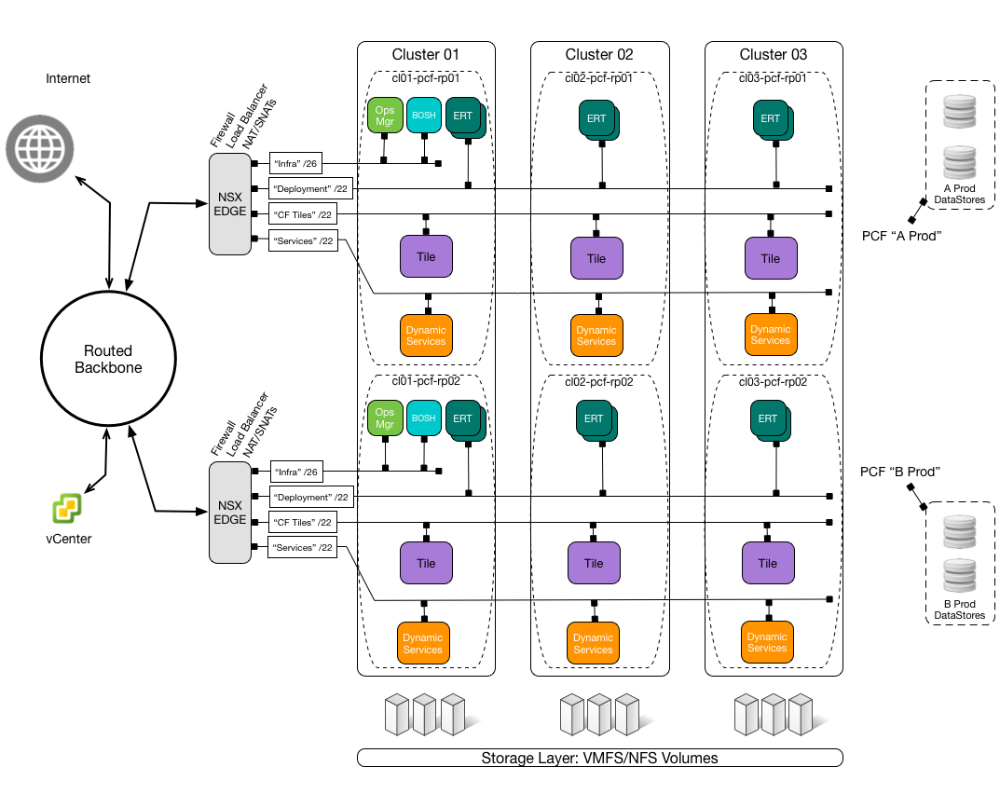
Network Layout - vSphere
‹#›

Slide 19
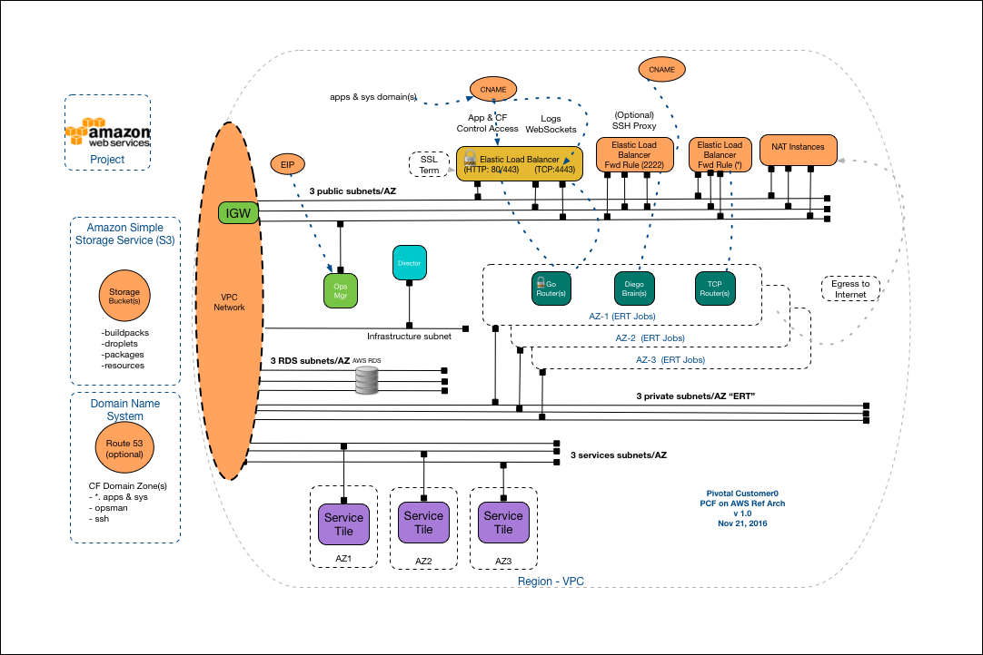
Network Layout - AWS
‹#›

Slide 20
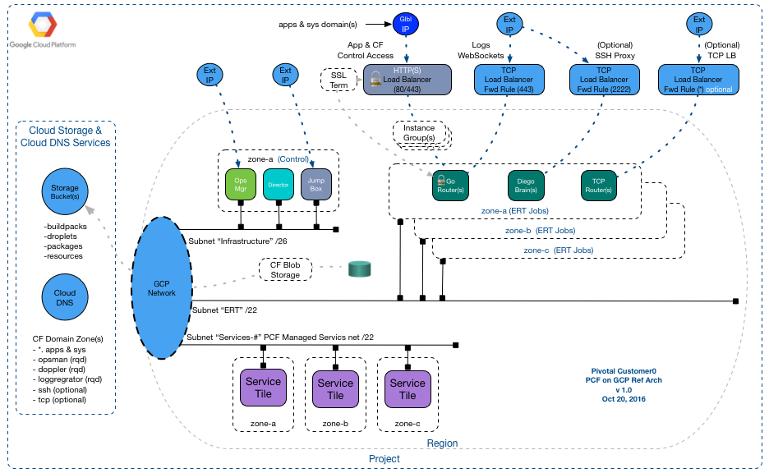
Network Layout - GCP
‹#›

Slide 21
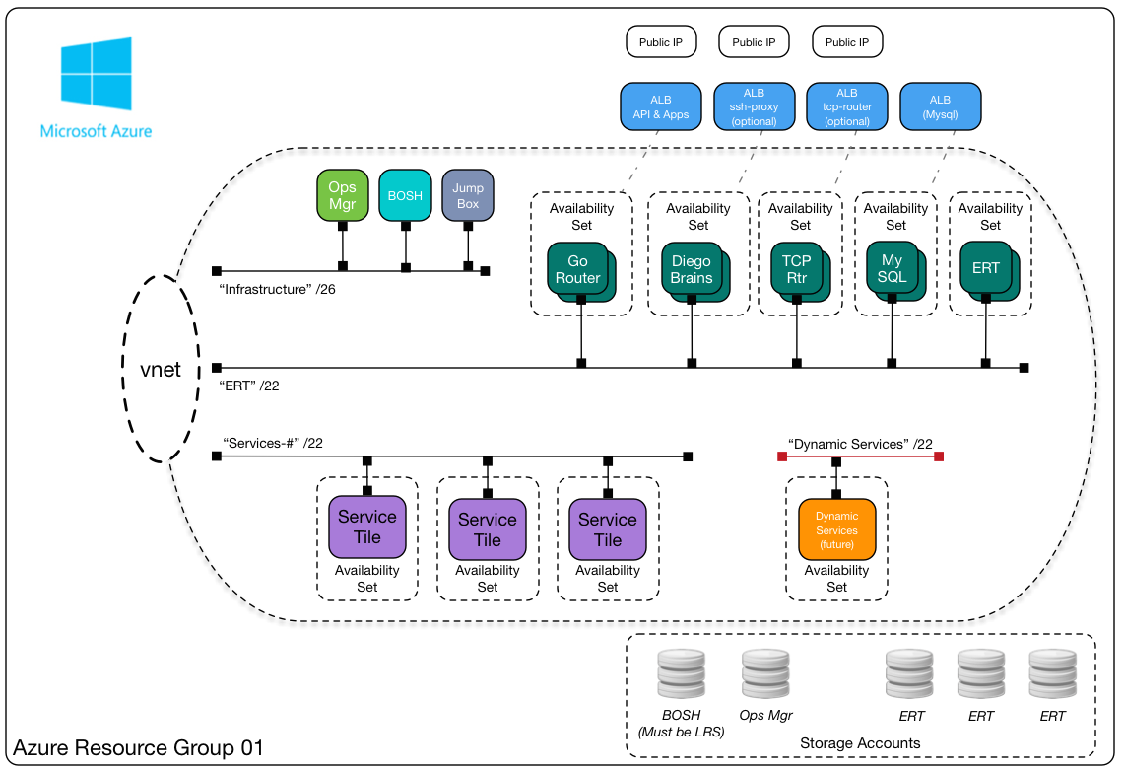
Network Layout - Azure
‹#›

Slide 22
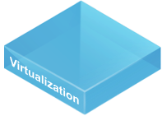
Networking Prerequisites
Provide 3 isolated networks per availability zone:
1 for Management (BOSH, Ops Man, etc)
1 for Elastic Runtime Components
1 for Services
Operators define networks in Ops Manager
DNS
Wildcard System Domain
ex: *.sys.example.com
Wildcard Apps Domain
ex: *.apps.example.com
Wildcard SSL Certificates
Elastic
Runtime
Network
Infrastructure Network

Slide 23
Load Balancer Configuration
Configure a CNAME wildcard DNS entry that points to your load balancer, which points to Cloud Foundry's router
The router uses the host to map to application instance(s)
*.example.com
Load Balancer
Router
app1.cfapps.io
app1.cfapps.io
app1.example.com
app1.cfapps.io
...
app1.cfapps.io
app2.example.com
app3.example.com

Slide 24
Firewall Prerequisites
Ops Manager and Elastic Runtime require TCP ports to be opened in order to access platform services.
Ex: 443 from the load balancer to the platform
Up-to-date requirements can be located at the following URL:
http://docs.pivotal.io/pivotalcf/1-7/customizing/config_firewall.html

Slide 25
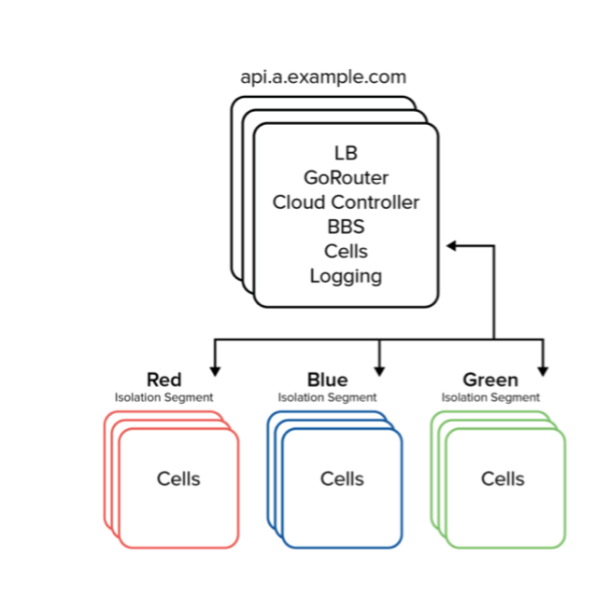
Isolation Segments: Compute Isolation
Direct group of applications to specific host VMs (Diego Cells)
Use cases:
Specialized hardware (e.g. CPU intensive), chargebacks, isolation of BOSH Add-Ons, individual segment spin downs, etc)
What is Shared?
Management, Routing, Logging
What is Dedicated?
Compute resources

Slide 26
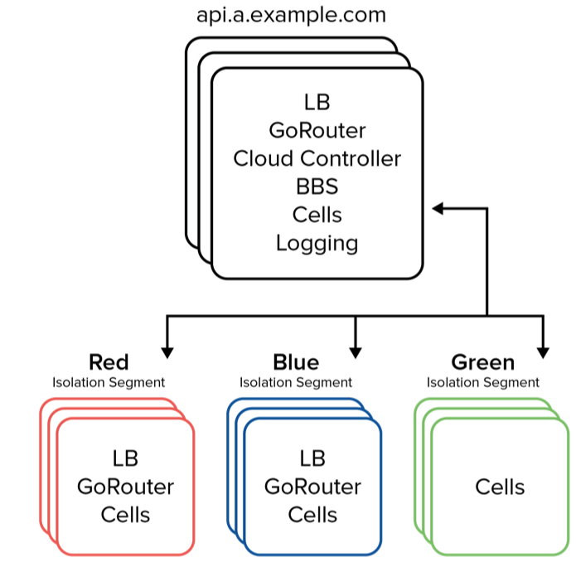
Isolation Segments: Routing and Compute Isolation
Isolate application traffic from the Gorouter down to the app
Additional use cases:
A building block for PCI compliance
What is Shared?
Management, Logging
What is Dedicated?
Routing, Compute resources

Slide 27
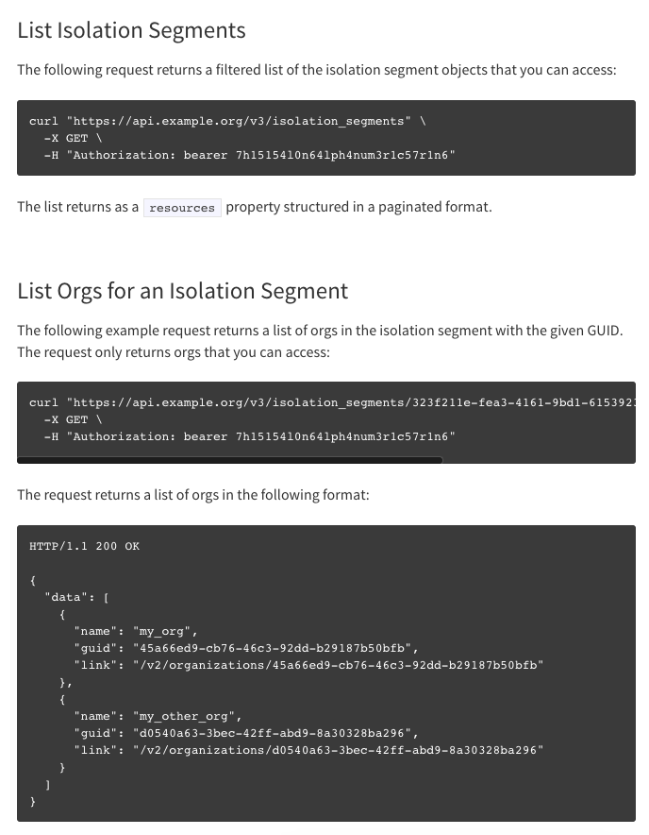
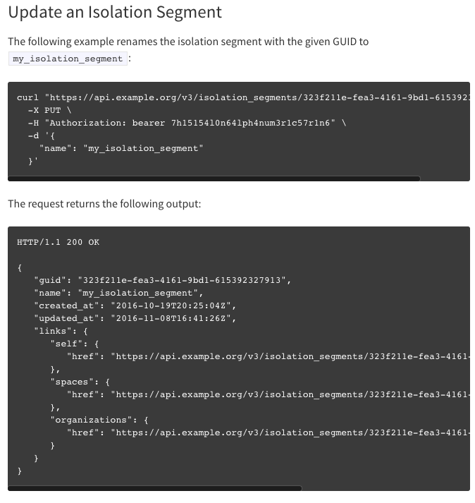
Isolation Segments: Management via the API
Refer to docs.pivotal.io

Slide 28
Isolation Segments: Management in the cli
$ cf create-isolation-segment secured
$ cf enable-org-isolation finance secured
$ cf set-space-isolation-segment production secured
$ cf app transfers restart
$ cf app transfers
...
Name: transfers
Requested state: started
Instances: 10/10
Isolation segment: secured
...
NOTE: cli support for this feature is available here.

Slide 29
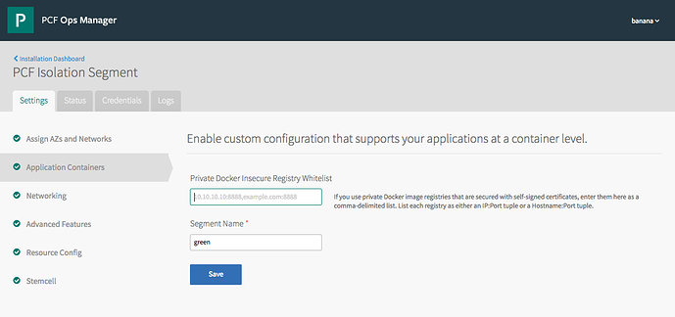
Isolation Segments: UX in ERT
NOTE: Administrators will need to use the replicator binary to create multiple segments.

Slide 30
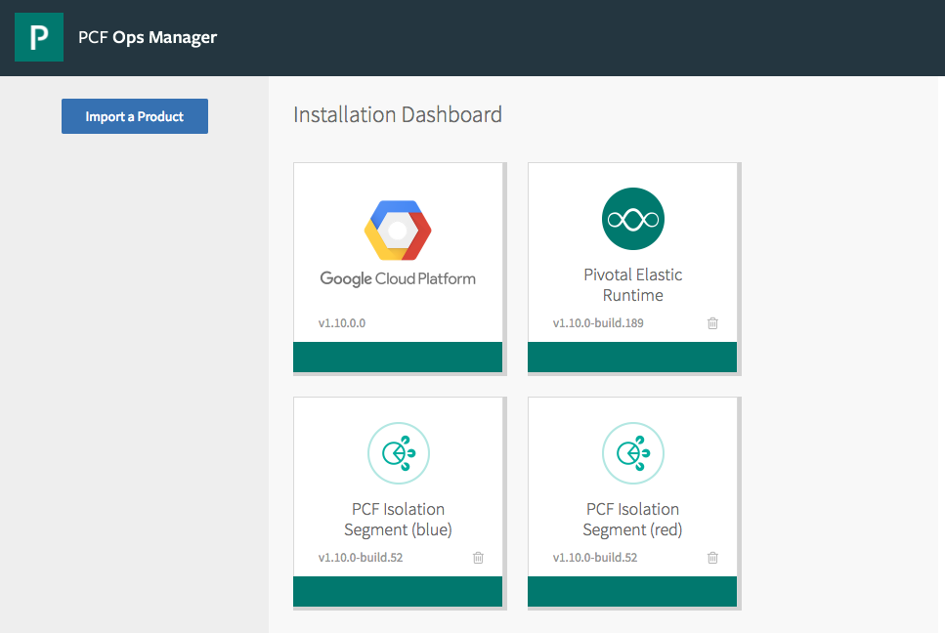
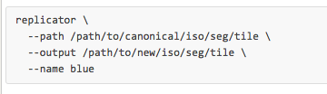
Creating Multiple Isolation Segments: UX
Download the Isolation Segment Tile, then run this command to create additional segment tiles...
...This creates additional segment tiles. From there, you can upload and deploy them.

Slide 31
Questions
What IaaSes are you using or are looking to implement?
What tool(s) do you use to provision infrastructure?
How many teams are involved in order to provision an application environment?

