Slide 1


PCF Operations Workshop –
Role Based Access Control
<Presenter>
<Title>

Slide 2


Services Overview
Platform Installation & Setup
Role Based Access Control
Platform & Application Scaling
Health, Events, & Logging
Platform & Application Patching
Security Overview
Authentication & Authorization
Operations Workshop Agenda

Slide 3

Key Themes
Speed
Scale
Security
Stability

Slide 4
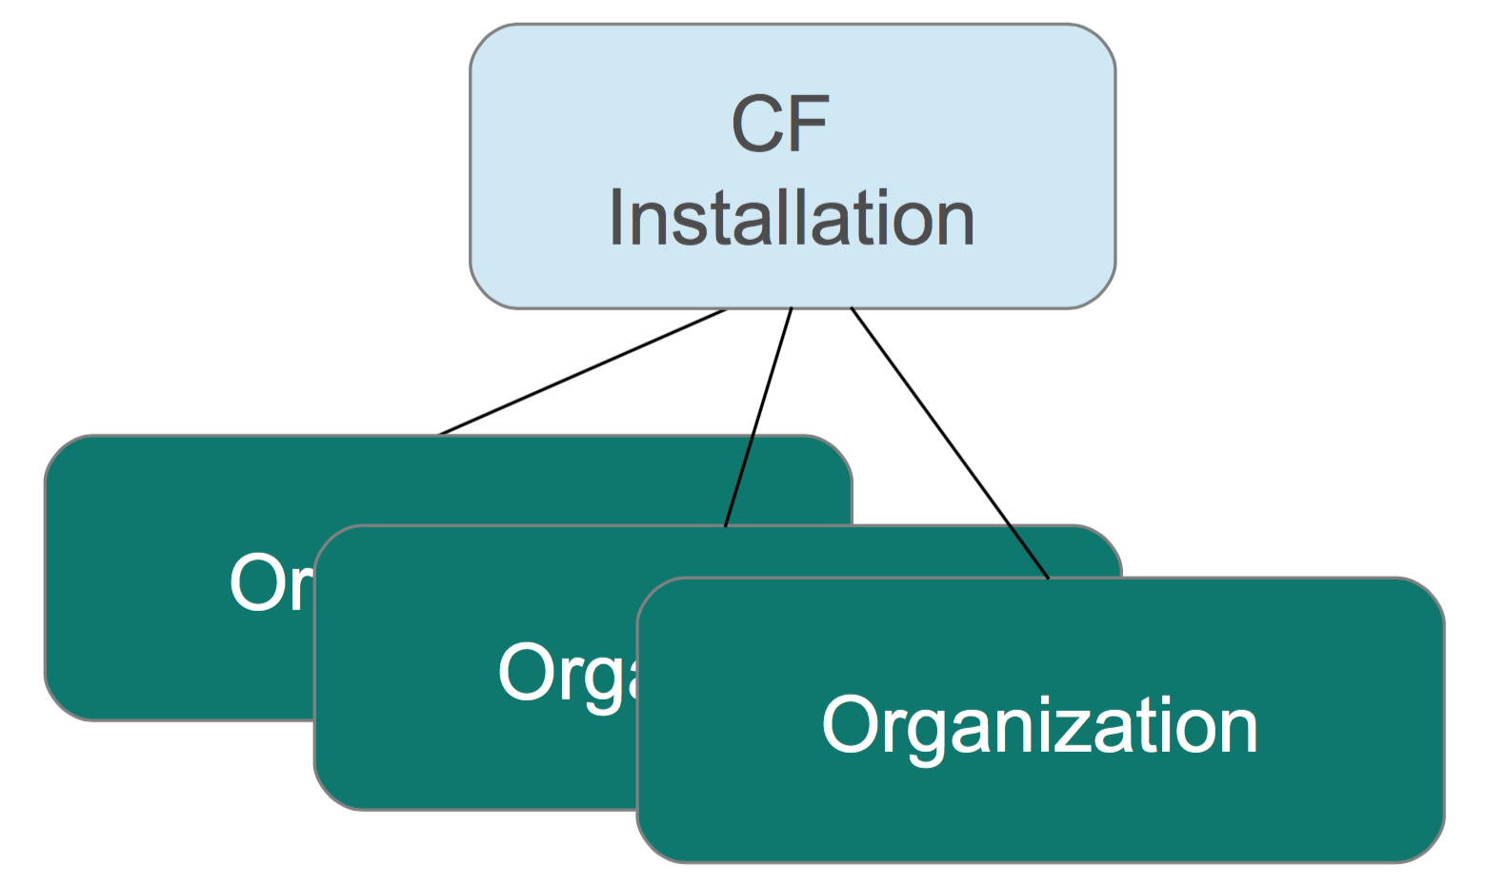
Organizations
Top-most administrative unit
Any Cloud Foundry installation
Can have multiple organizations defined in any way
A logical way to organize users and resources
Typically a company, department, application suite or large project
Designed to support many users working collaboratively

Slide 5
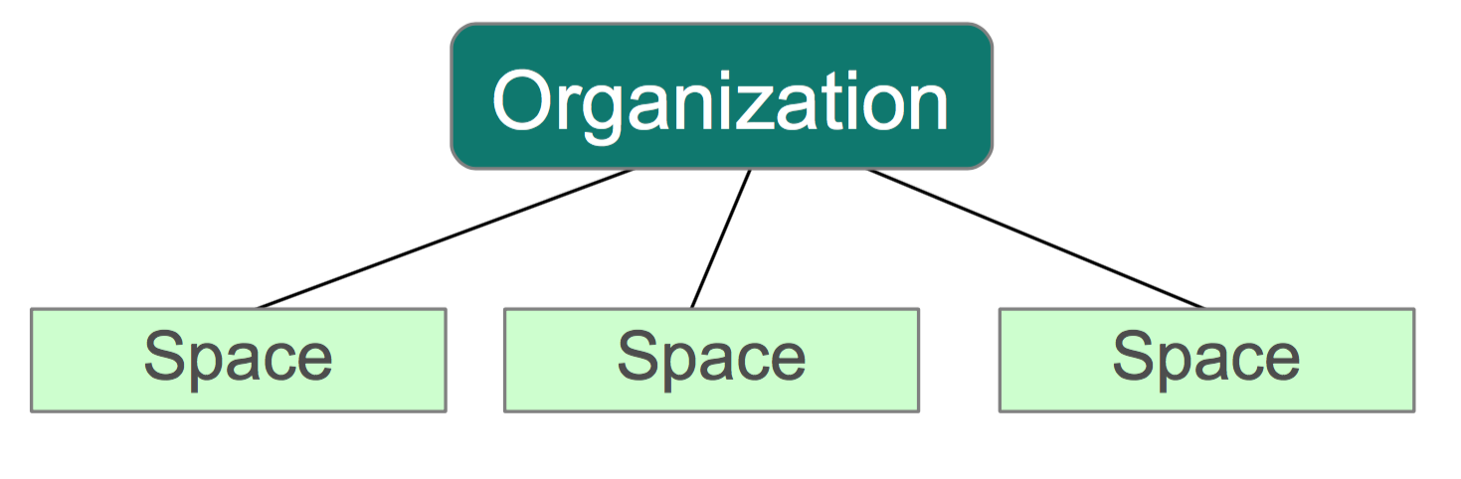
Spaces
Organizations contains multiple spaces
A logical way to organize users and resources
For example, staging and production

Slide 6
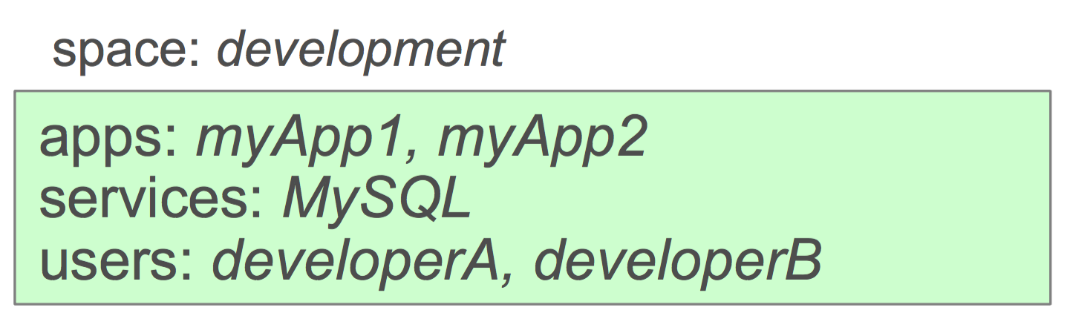
Spaces: Applications, Services and Users
Applications and services are scoped to a space
Provides a set of users access for:
Application development
Functionality and/or performance testing
Quality assurance
Deployment to production
Maintenance

Slide 7
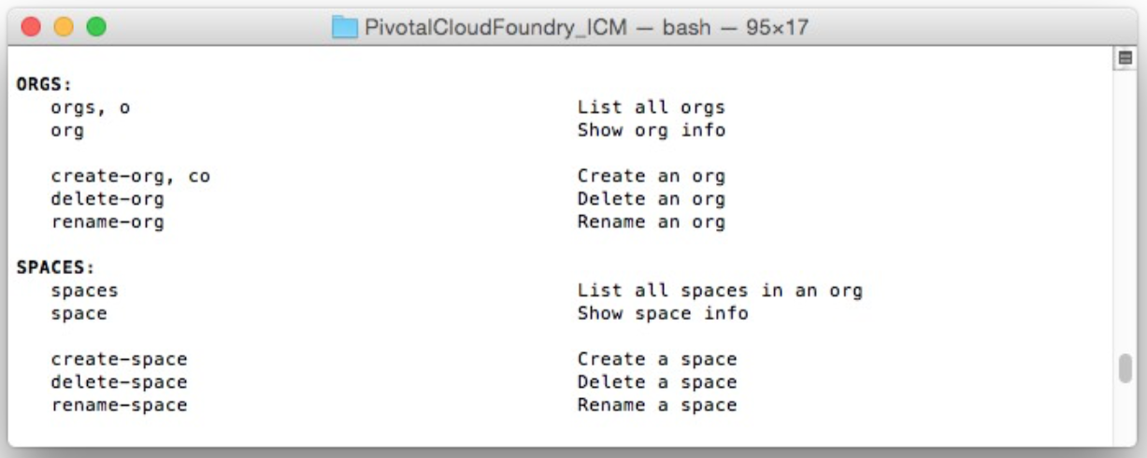
Organizations and Spaces with the cf CLI
You can use the cf CLI to work with organizations and spaces
From $ cf help

Slide 8

Users and Roles
Users are members of an organization
Usually they are operators or developers (not application end users)
Users are sent an email invite and asked to create an account
Users have specific organization and space roles
Organization roles grant permissions in an organization
Space roles grant permissions in a particular space
A combination defines the user's overall permissions

Slide 9
Organization Roles
Organization Manager
Can do things like invite/manage users and roles, manage spaces, view application usage Organization Auditor
Organization Auditor
View only access to all org and space info, settings, reports
Billing Manager
Sets org spending limits, and works with invoices and payments
Only relevant for Cloud Foundry environments deployed with a billing engine

Slide 10
Space Roles
Space Manager
Can invite/manage users, enable features for a given space
Can manage applications and services in a space
Space Auditor
View only access to all space information, settings, reports, logs
Space Developer
Can create, delete, manage applications and services, full access to all usage reports and logs

Slide 11
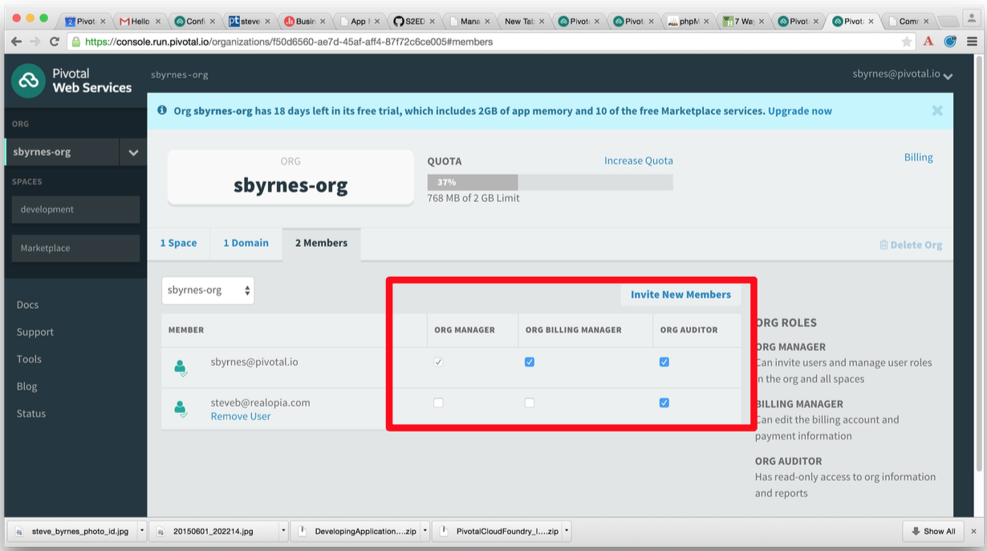
Users and Roles with Apps Manager
Invite members and assign roles with Apps Manager

Slide 12
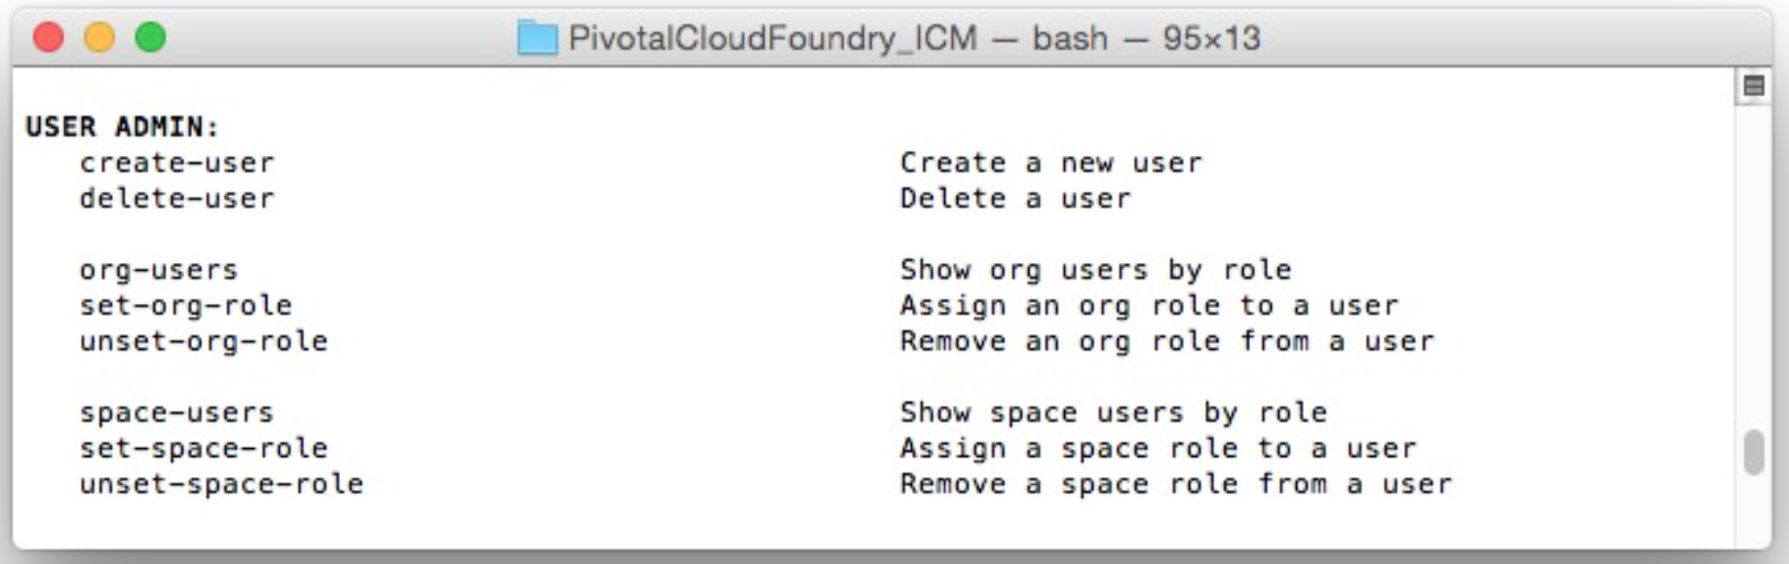
Users and Roles with the CLI
You can use the cf CLI to work with users and roles
From $ cf help

Slide 13
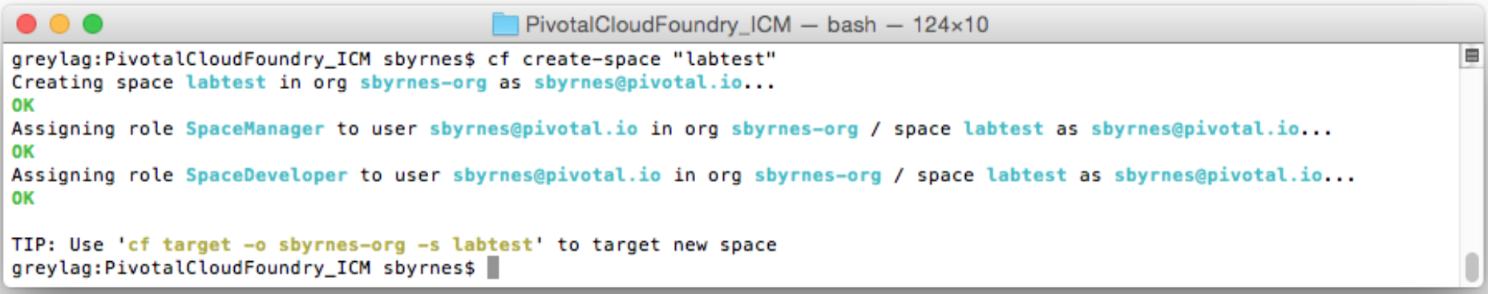
Roles when Creating a Space
Creating a space adds new roles for the organization manager in the new space
SpaceManager
SpaceDeveloper

Slide 14

The Administrator User
Special Administrator user / role defined
Defined for the Cloud Foundry installation
Separate from users defined at organization / space
Several cf commands restricted to Administrator only
Setting organization and space quotas
Defining security groups
Administering services
Adding, modifying and removing user accounts
Use without the right role, the cf CLI returns:

Slide 15
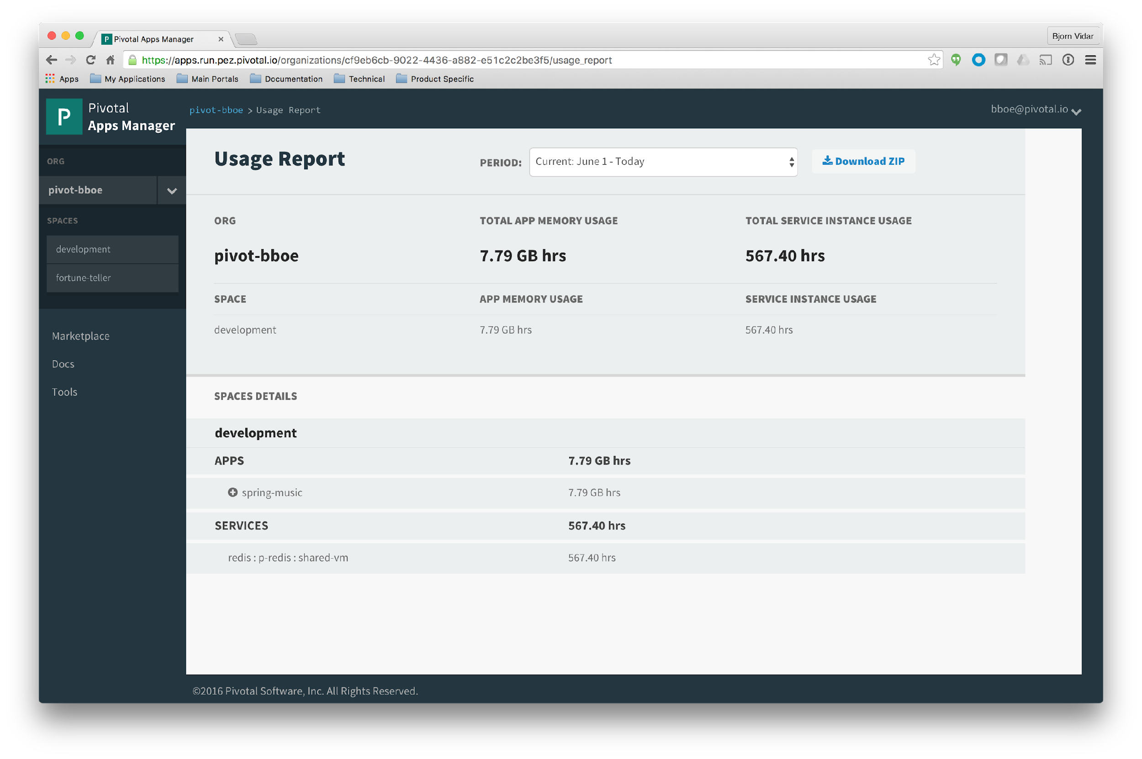
Platform Consumption & Chargeback
Download ZIP

Slide 16
Questions
What tool(s) are used to authenticate users?
How does your team manage/assign quotas to resources?
Have you implemented chargeback or looking to implement that functionality?

