Slide 1


PCF Operations Workshop -
Platform & Application Scaling
<Presenter>
<Title>

Slide 2
Services Overview
Platform Installation & Setup
Role Based Access Control
Platform & Application Scaling
Health, Events, & Logging
Platform & Application Patching
Security Overview
Authentication & Authorization
Operations Workshop Agenda

Slide 3



Key Themes
Speed
Scale
Security
Stability

Slide 4
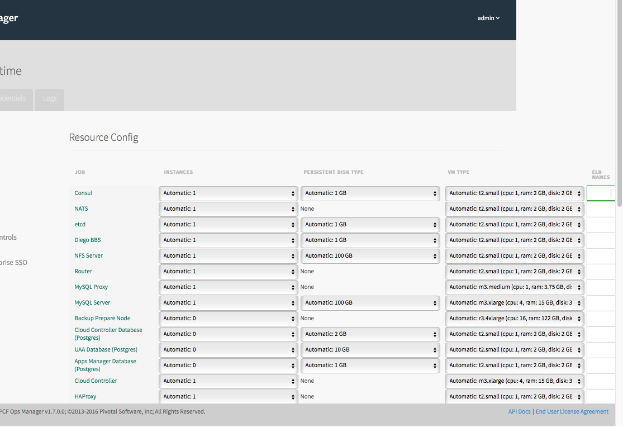
Platform Scaling
Ops Manager allows administrators to quickly and easily scale PCF components using the “Resource Config” workflow of the Elastic Runtime tile
Administrators can select machine sizes for their components
Additional information can be located at the following URL: http://docs.pivotal.io/pivotalcf/1-7/concepts/high-availability.html#availability

Slide 5
Platform & Application Scaling
Ops Manager Platform Scaling Demo

Slide 6
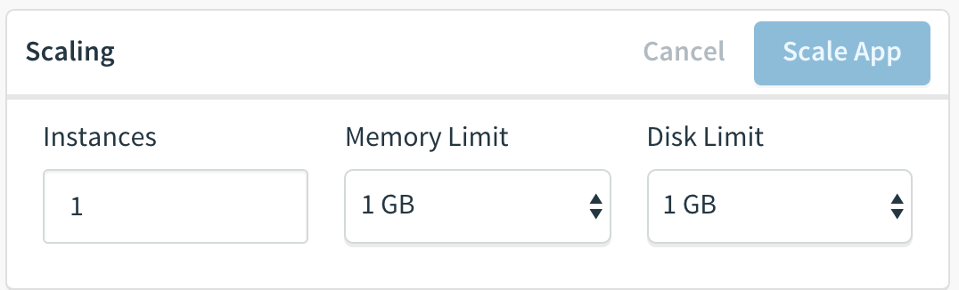
Applications - Vertical Scaling
Cloud Foundry enables vertical scaling of instances
Users can modify Memory and Disk limits via:
Apps Manager console
cf CLI
manifest.yml

Slide 7
Applications - Horizontal Scaling
Cloud Foundry enables rapid horizontal scaling of applications via containers
Users can modify the number of instances via:
App Autoscaler tile
Apps Manager console
cf CLI
manifest.yml

Slide 8
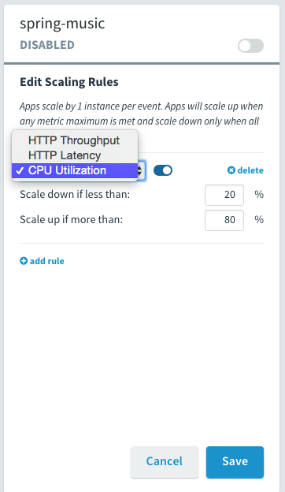
App Autoscaler
Application Autoscaling service included with PCF
Scaling parameters:
CPU Utilization
HTTP Latency (ms)
HTTP Throughput (/s)

Slide 9
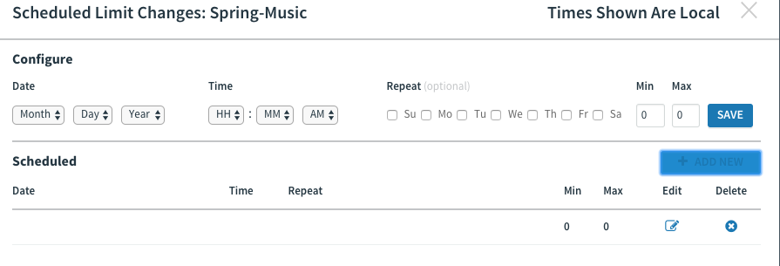
App Autoscaling – Scheduling
2
5

Slide 10
App Autoscaling – Scheduling
2
5

Slide 11
Auto Scaling – Moving Average
Scaling activity based on moving averages
Softens effect of temporary spikes
Manual scaling disables autoscaling
Spikes do not
trigger auto-scaling
Moving average exceeds
threshold, add instances
80%
CPU
Moving average drops
remove instances
20%

Slide 12
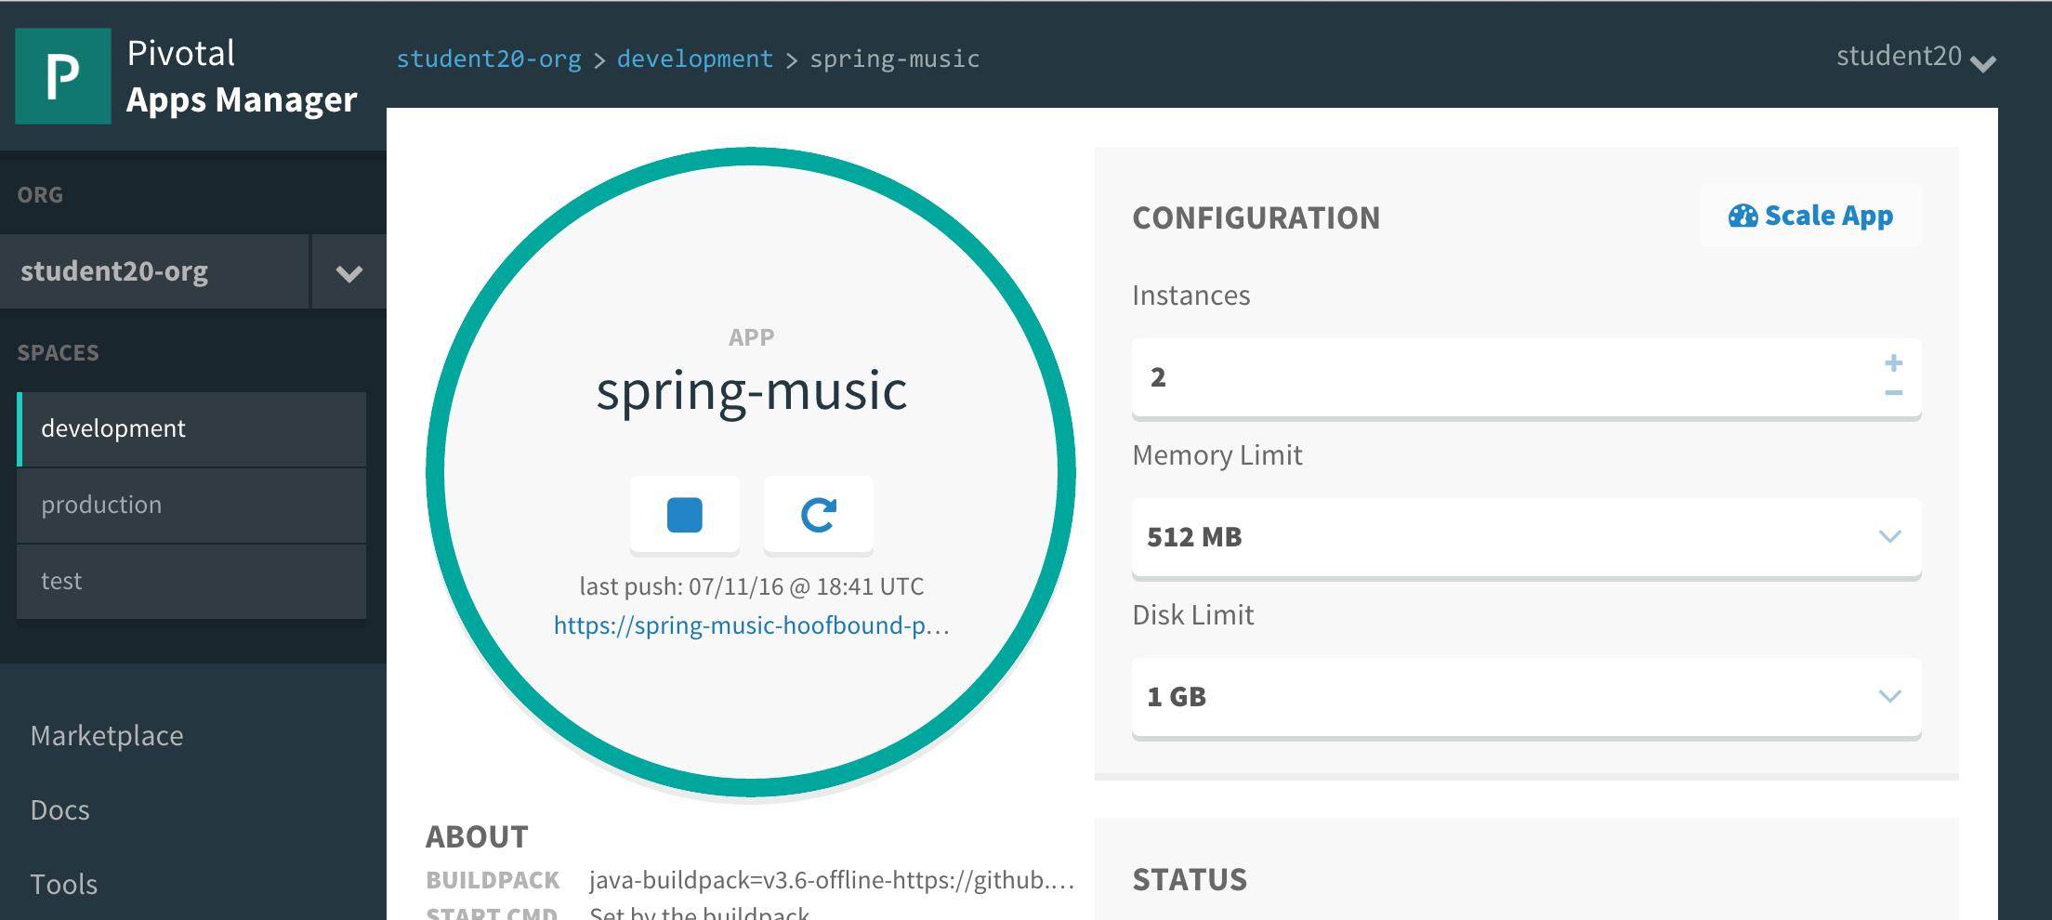
Apps Manager Scaling

Slide 13
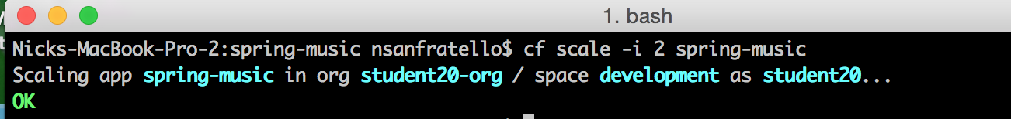
CLI Scaling
cf scale -i 2 “my-application-name”

Slide 14
Manifest Scaling
---
applications:
- name: spring-music
memory: 64M
instances: 5 # <-- Increase
host: myspringmusic
domain: example.com
# comment
- name: nextapp
memory: 256M
...

Slide 15
Platform & Application Scaling
Application Scaling & Autoscaler Service Demo

Slide 16
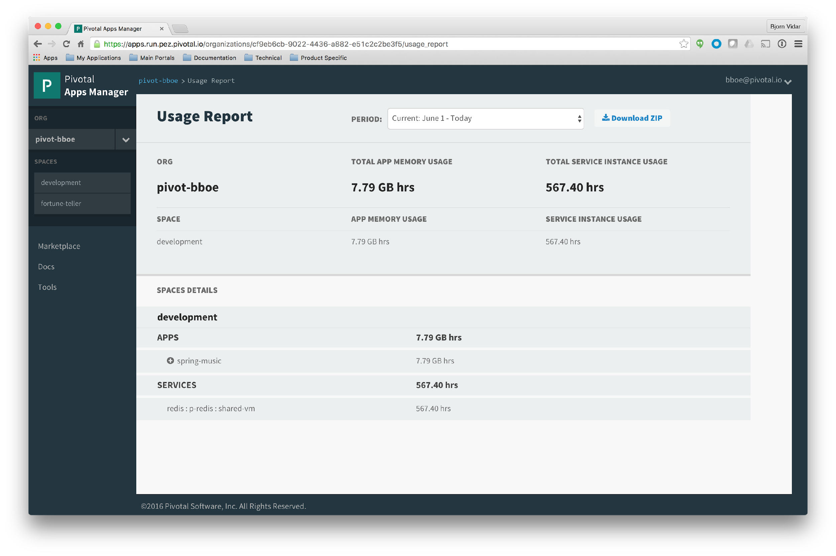
Platform Consumption & Chargeback
Download ZIP

Slide 17
Questions
What metrics does your team use in order to determine when you should scale a application?
How do you scale Virtual Machines and applications?
Have you implemented any tools that automatically scale your applications?

