Slide 1


PCF Operations Workshop –
Platform & Application Patching
<Presenter>
<Title>

Slide 2


Services Overview
Platform Installation & Setup
Role Based Access Control
Platform & Application Scaling
Health, Events, & Logging
Platform & Application Patching
Security Overview
Authentication & Authorization
Operations Workshop Agenda

Slide 3

Key Themes
Speed
Scale
Security
Stability

Slide 4
Detecting & Responding to Vulnerabilities
Detection
Secure Disclosure Process: Customers & Partners
Monitor public repositories
Respond
Assess vulnerability
If impacted, update components and test changes
Announce
Post fix to Pivotal Network (email alerts available)
Post to https://pivotal.io/security

Slide 5
Categorizing Vulnerabilities
Ubuntu provided packages: Canonical’s priority levels are followed:
http://people.canonical.com/~ubuntu-security/cve/priority.html
Other vulnerabilities for Common Vulnerability Scoring System v3.0 standards
https://www.first.org/cvss/specification-document
Release Frequency
Low/Medium – 1st week each month
High - ASAP

Slide 6
Platform Upgrades and Patches
Canary-style deployments to minimize downtime
Also known as rolling upgrades
Number of “canary” VMs are deployed
Smoke test new VMs
Remaining VMs are deployed
Otherwise the upgrade is halted

Slide 7
Upgrade and patch with rolling “canary” deploys
A
B
M
N
X
Y
A,B,M,N,X,Y
- Application instances
- VM prior to update
‹#›

Slide 8
Upgrade and patch with rolling “canary” deploys
A
B
M
N
X
Y
A
B
M
X
N
Y
Apps redeployed to clear VMs
‹#›

Slide 9
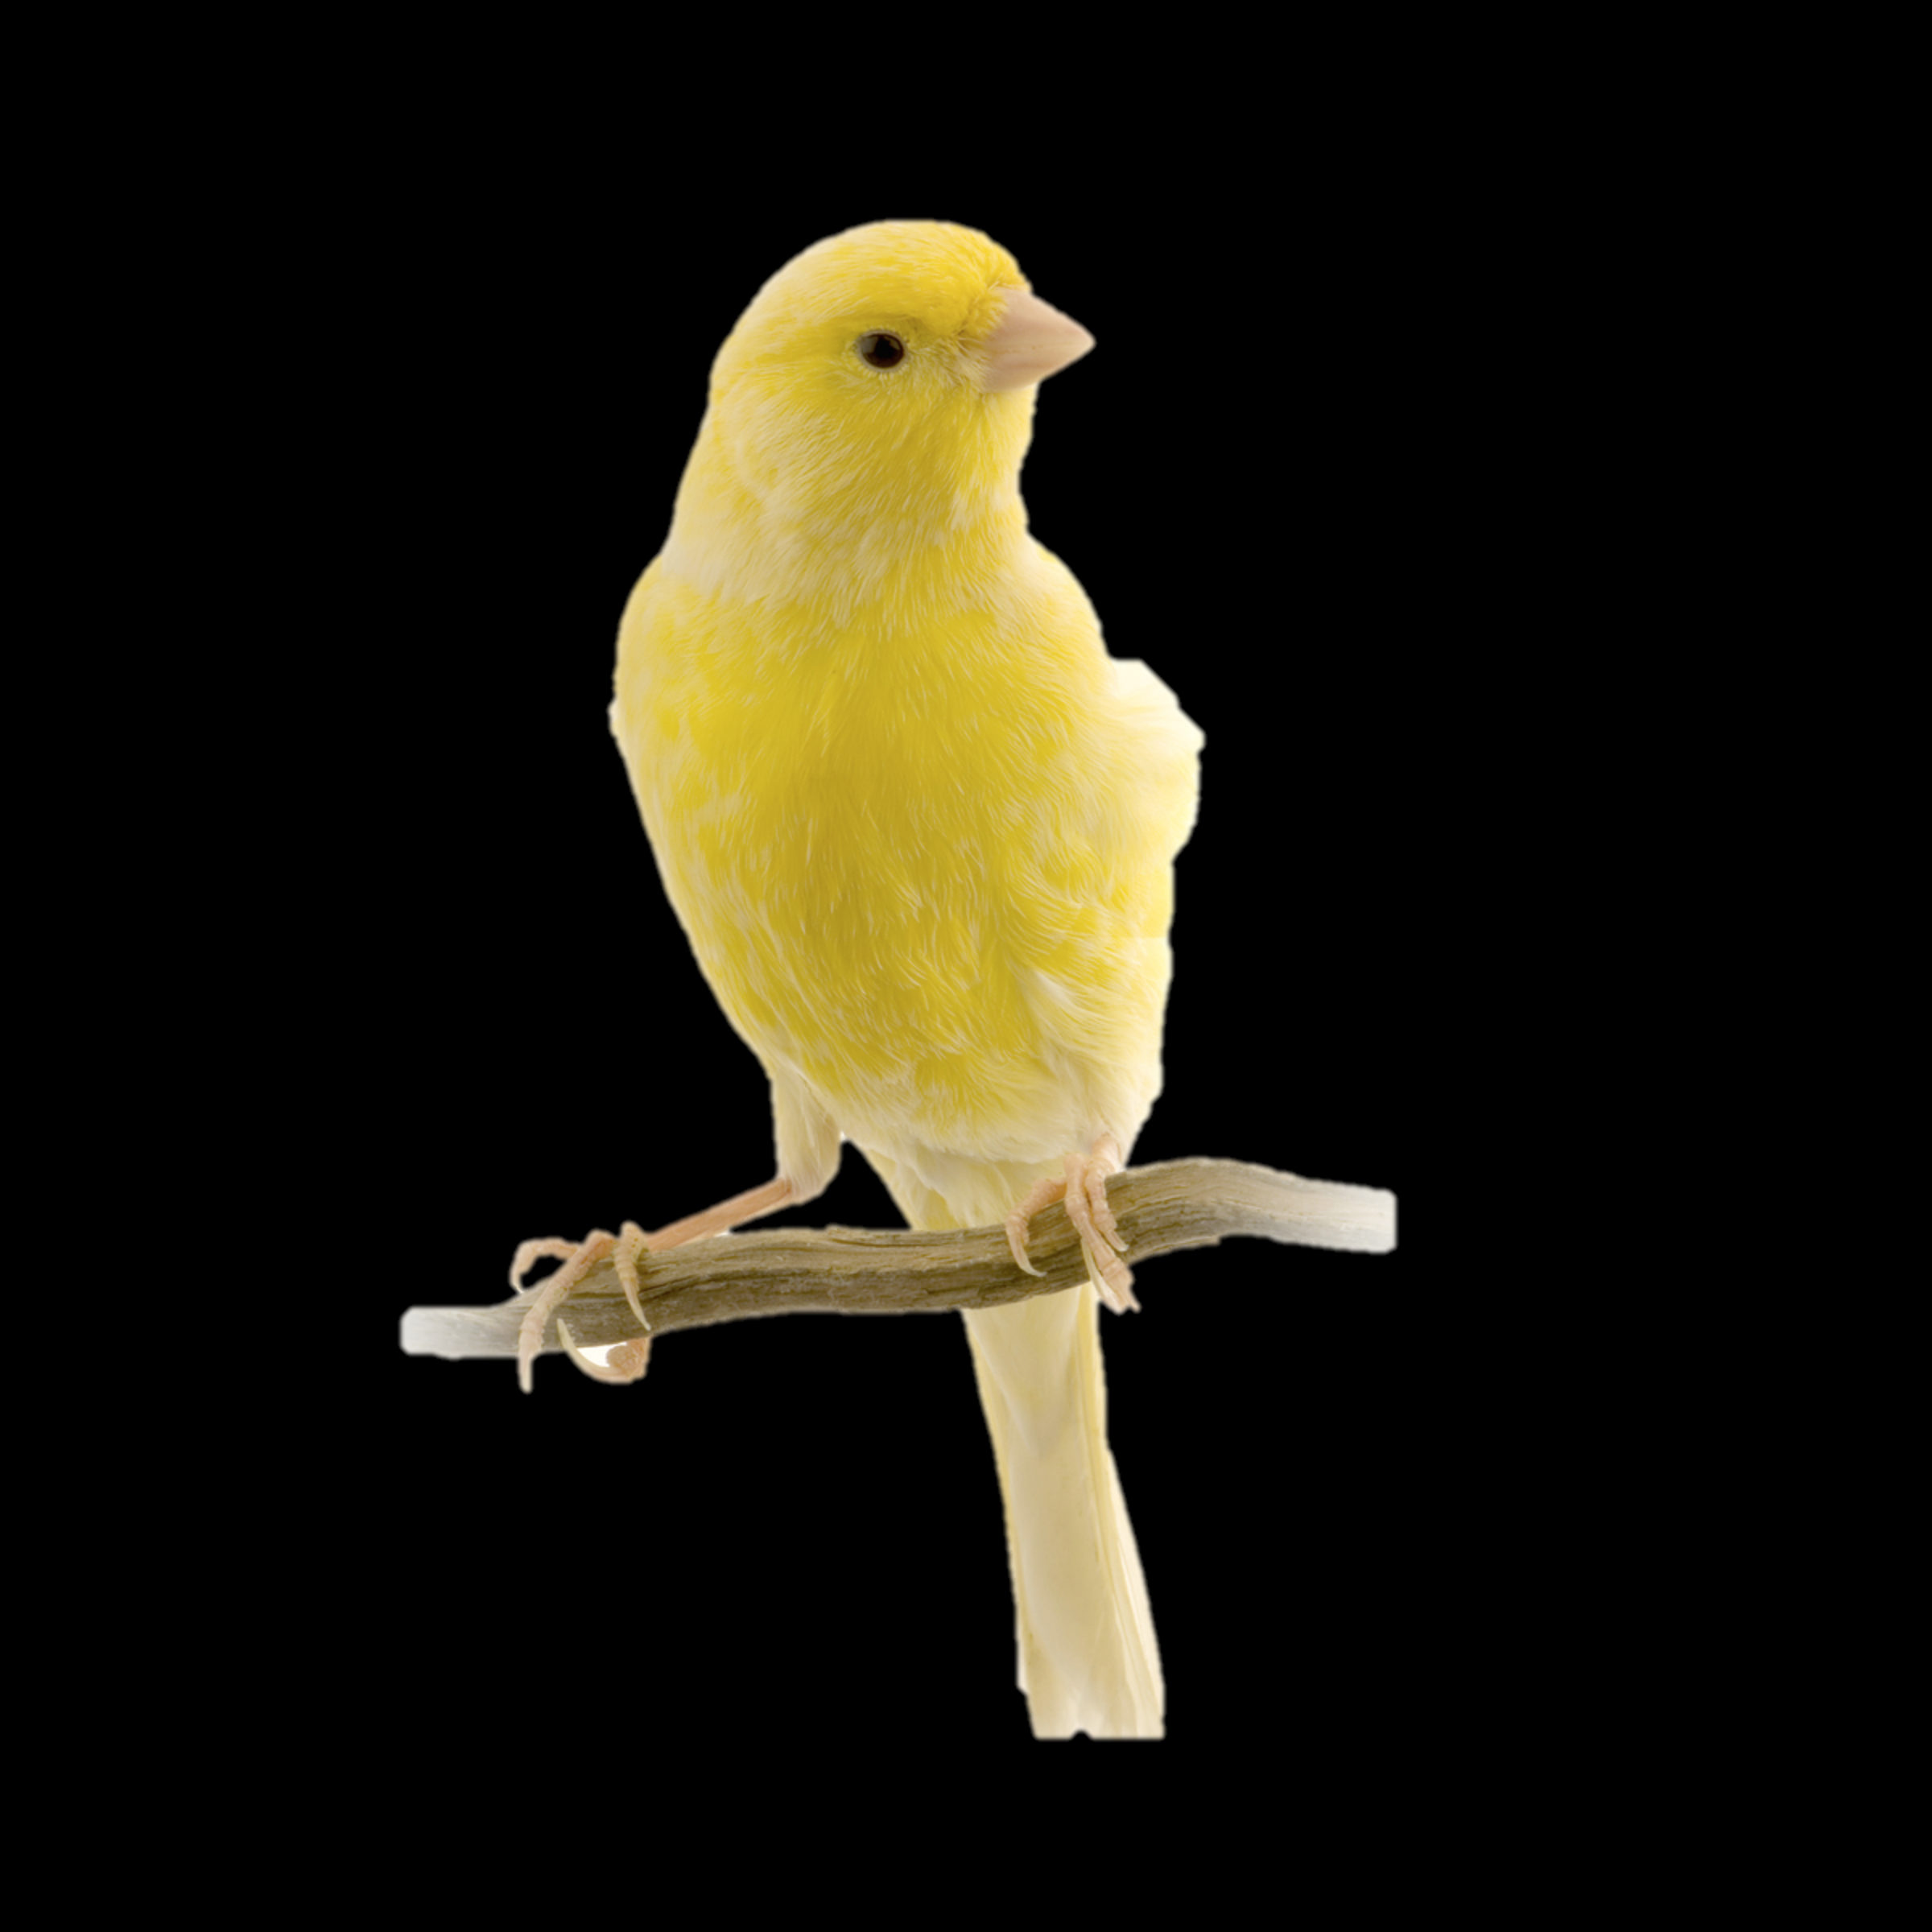
Upgrade and patch with rolling “canary” deploys
A
B
M
N
X
Y
A
B
M
X
N
Y
A
B
M
X
N
Y
Update introduced. If the tests pass, keep going
‹#›

Slide 10

Upgrade and patch with rolling “canary” deploys
A
B
M
N
X
Y
A
B
M
X
N
Y
A
B
M
X
N
Y
Apps redeployed to updated VMs
A
B
M
X
N
Y
‹#›

Slide 11
Upgrade and patch with rolling “canary” deploys
A
B
M
N
X
Y
A
B
M
X
N
Y
A
B
M
X
N
Y
A
B
M
X
N
Y
A
B
M
X
N
Y
Remaining VMs updated same way
‹#›

Slide 12
Upgrade and patch with rolling “canary” deploys
A
B
M
N
X
Y
A
B
M
X
N
Y
A
B
M
X
N
Y
A
B
M
X
N
Y
A
B
M
X
N
Y
A
B
M
X
N
Y
Automated, No downtime
Atomic rolling update
‹#›

Slide 13

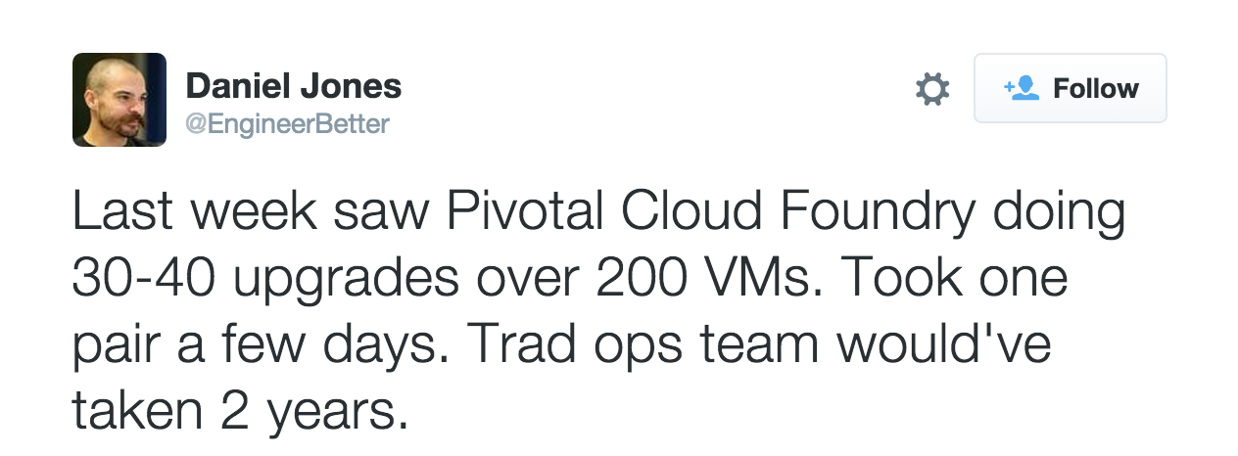

Upgrade and patch with rolling “canary” deploys

Slide 14
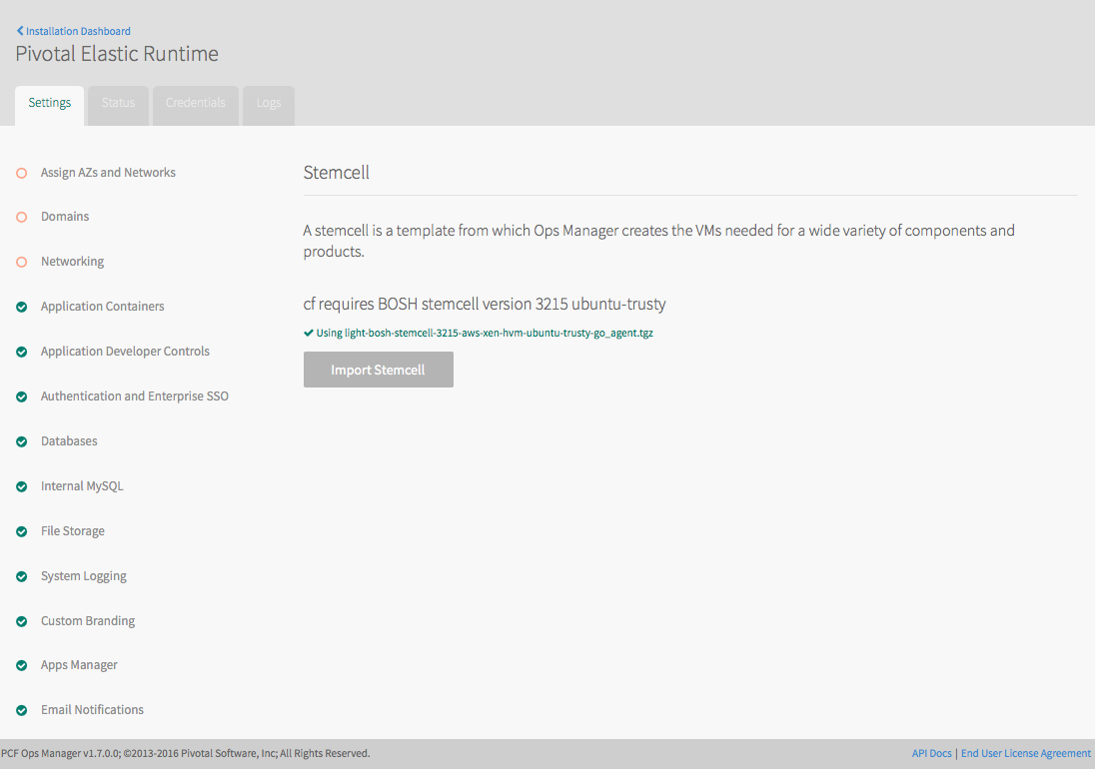
Elastic Runtime Patching
The Elastic Runtime (ERT) needs a new stemcell to be applied for a proper upgrade
The stemcell can easily be selected and applied from the ERT’s Setting tab.

Slide 15
Canary-Style Deployment: Implications
Elastic Runtime can be upgraded to new versions with no application downtime
“Apply changes” does not mean “wait for it to finish”
You will have limited ability to deploy applications during Elastic Runtime upgrades
Installing or modifying other tiles does not affect the Elastic Runtime
For the ops team- upgrade the system during working hours!

Slide 16
Blue-Green Deployments
Blue-green deployment is an approach to upgrading applications with minimal downtime
It also enables easy rollback to the old version if the new version experiences problems
It works by keeping both versions online, and switching from the old version to the new version
live
traffic
app 1.0
app 1.0
live
traffic
app 1.1
app 1.1
before
after

Slide 17
Blue-Green Deployment - Routes
Multiple applications can use the same route
An application can have more than 1 route
Allows administrators to safely redistribute live traffic to updated applications (ex: 80% v1 20% v2)
myapp.cfapps.io
myapp.cfapps.io
app1.0
app1.0
app1.0
myappdev.cfapps.io
myapp.cfapps.io
myapp.cfapps.io
app1.1
app1.1
app1.1
before
(working on version 1.1)
during (version 1.1 is ready)
after
(version 1.1 in Prod)

Slide 18
Platform & Application Health
Blue Green Demo

Slide 19
Questions
How quickly is your team required to respond to High, Medium, or Low vulnerabilities?
What teams need to be involved during a patch cycles?
Do you have the ability to do zero downtime patching of the infrastructure and apps?

