Slide 1


PCF Operations Workshop –
Security Overview
<Presenter>
<Title>

Slide 2

Services Overview
Platform Installation & Setup
Role Based Access Control
Platform & Application Scaling
Platform & Application Health
Patching & Updates
Security Overview
Authentication & Authorization
Operations Workshop Agenda

Slide 3


Key Themes
Speed
Scale
Security
Stability

Slide 4
Security Philosophy
Minimized Network Attack Surface
Network Encryption and Traffic Rules
Role-based Access Controls (Foundation, Org, Space)
Data Encryption for Application Bits
Audit Trails & Centralized Logging
Centralized Identity Management for Authentication and Authorization
Support for LDAP and SAML

Slide 5
Stemcell Hardening
Stemcell
Bare minimal OS
PCF specific utilities and configuration files
Incorporated hardening guidance from both commercial and government sources
Detailed Description of Stemcell Modifications:
http://docs.pivotal.io/pivotalcf/1-9/security/pcf-infrastructure/stemcell-hardening.html

Slide 6
Container Security
Namespacing kernel resources
Resource control via cgroups
Unprivileged containers
Drops Linux capabilities for all container processes
AppArmor enforced by default
Seccomp enforced by default

Slide 7
Each Layer Upgradable with Zero Downtime
Application Layer
Blue Green Deployment
Runtime Layer
Blue Green Deployment
OS Image
Canary style
No downtime
Linux Host & Kernel

Slide 8
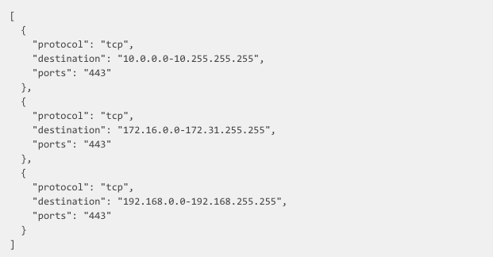
Application Security Groups
Egress rules that define where traffic can be sent.
Define protocols, ports, and IP addresses
Staging and Running ASGs can be configured

Slide 9
PCF Security
Application Security Groups Demo

Slide 10

BOSH Add-on | IPsec
Network layer security
strongSwan implementation of IPsec
Encrypts IP data flow between hosts

Slide 11

BOSH Add-on | Antivirus
Antivirus for machines
Scan on-demand or via a schedule
Configurable update mirror
Alerts sent to syslog
Helps comply with PCI DSS or HIPPA Standards

Slide 12
BOSH Add-on | File Integrity Monitoring
File Integrity Monitoring
Default policy setup to monitor a set of critical system directories.
Alerts sent to syslog
Helps comply with PCI DSS or HIPPA Standards

Slide 13

Partner Service Broker | Signal Services
Easily integrate Signal Sciences with apps running on PCF
Embeds Signal Sciences agent in app code
Provides visibility into malicious traffic

Slide 14
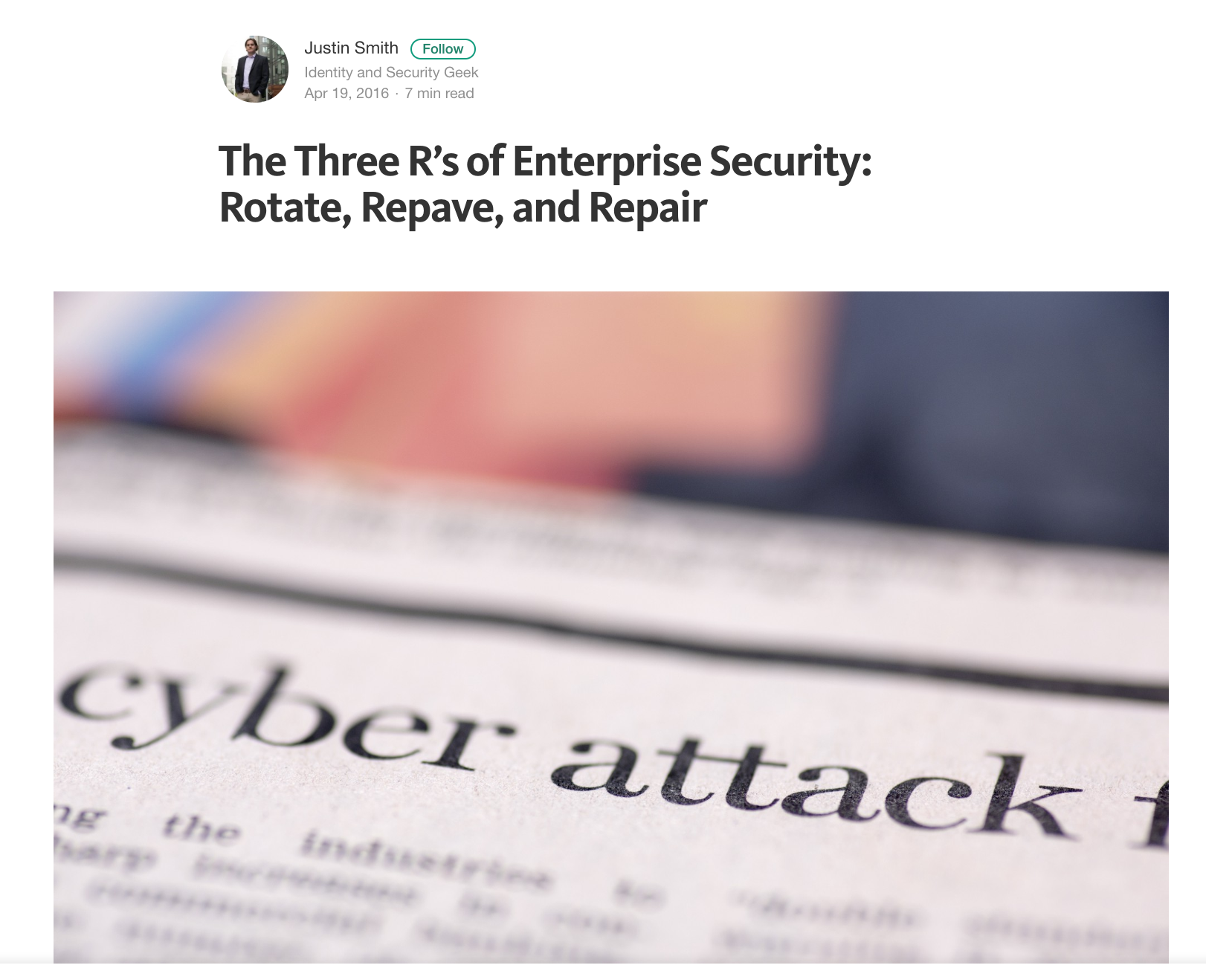

Slide 15
Resources
https://pivotal.io/security
Stemcell Hardening Guide
Adopting The runC Container Standard In Cloud Foundry
The Three R’s of Enterprise Security: Rotate, Repave, and Repair

Slide 16
Questions
Is your organization required to abide by any security policies (ex: PCI, HIPAA, etc)?
What tools do you currently use to combat breaches?
What are the steps required to roll out a new version of an Operating System?

