Slide 1
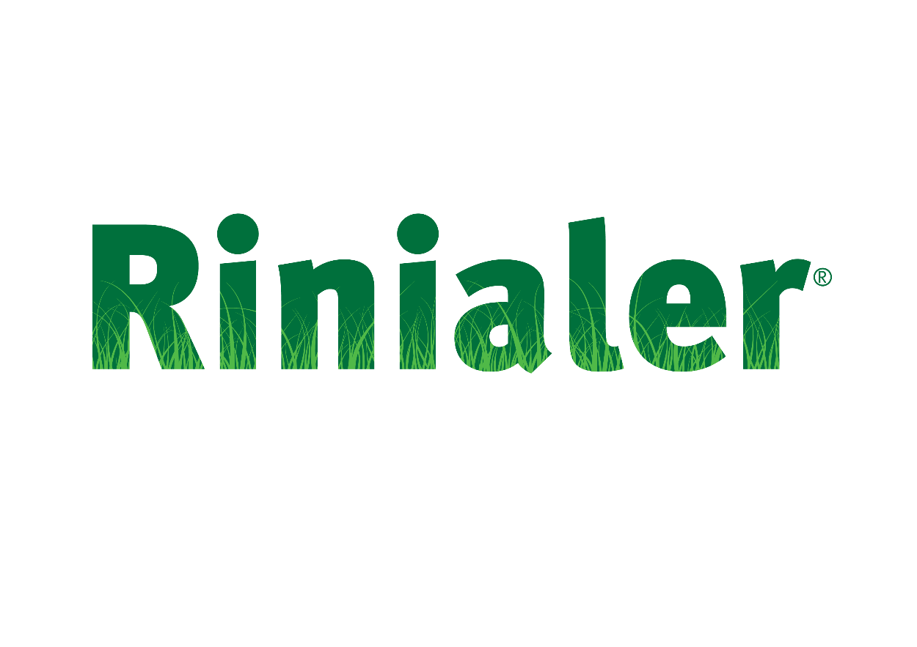


RI/NOV22/EM/009
Evento
Local e data
Nome do palestrante

Slide 2
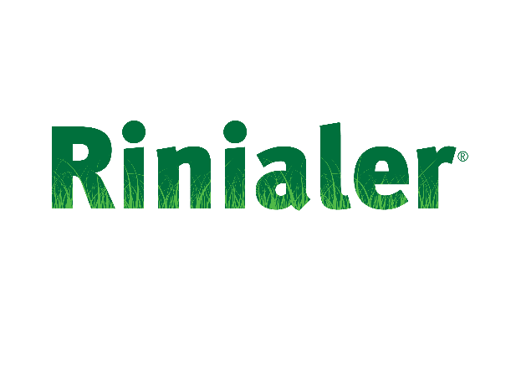

ÍNDICE
RINIALER em Pediatria (< 12 anos)
  Rinite alérgica: Eficácia clínica
  Urticária: Eficácia clínica
  Segurança e Tolerabilidade
Conclusões
Indicações terapêuticas

Slide 3

RINIALER em Pediatria (< 12 anos)
  Rinite alérgica: Eficácia clínica
  Urticária: Eficácia clínica
  Segurança e Tolerabilidade
Conclusões
Indicações terapêuticas

Slide 4
Eficácia clínica da Rinialer em crianças com rinite alérgica: estudo de fase II
Rinialer em crianças dos 6 aos 11 anos de idade com rinite alérgica
Desenho/duração | Ensaio aberto de fase II Desenho em duas partes Parte I: estudo farmacocinético de dose única ao longo de 24 horas Parte 2: período de tratamento de 28 dias
Tratamentos/ Doentes (n) | 11 crianças (5 do sexo masculino, 6 do sexo feminino) com idades compreendidas entre os 6 e os 11 anos sofrendo de rinite alérgica sazonal RUP solução oral: < 25 kg: 2,5 ml (2,5 mg) ≥ 25 kg: 5 ml (5 mg)
Izquierdo I. Pediatr Allergy Immunol. 2009; 20(2).
RINIALER na Rinite Alérgica e Urticária
Notes:
Part one of this trial involved single-dose pharmacokinetic sampling over 48 hours, and part two involved a 28 days administration of rupatadine pediatric oral solution 1 mg/mL once daily.
Children with bodyweight < 25 kg received 2.5 mL (2.5 mg) once daily, and children with bodyweight ≥25 kg received 5 mL (5 mg) once daily.
Besides pharmacokinetic assessments, this open-label trial involved evaluations of the peripheral H1-antihistamine activity of rupatadine, the effects of rupatadine on allergic symptom control, and rupatadine tolerability.
Flare testing was conducted at 5 sites on each child’s back at pre-study screening and at visit 3: intradermal provocation injections comprised control and histamine 0,1, 0,2, 0,4 and 0,8 µg, each in 0.05 mL saline. Flare areas were recorded every 2 minutes after injection, for 10 minutes, by placing an appropriately labelled acetate sheet over each flare and tracing around the flare. The diameter of each flare was measured from acetate sheets using a Visitrack image analyser. At pre-study screening, to enter to the trial, each child had to have a negative response (flare diameter < 20 mm) to the saline control, and a positive response (flare diameter > 20 mm) to each histamine concentration.
Reference
Izquierdo I, Cranswick N, McCreanor J, et al. Rupatadine oral solution in children aged 6-11 years with allergic rhinitis: a proof of concept evaluation by a 4 weeks treatment follow-up study. Pediatr Allergy Immunol. 2009; (suppl.20):2.

Slide 5
Phase II study: Efficacy assessment
Design of a phase II study of Rinialer paediatric oral solution 1 mg/mL
in children aged 6-11 years with seasonal allergic rhinitis
Part one
Pharmacokinetic assessment
Part two
PD and Efficacy assessment
Day 1-2
+ Day 14
+ Day 28___+24h
PK and PD
-21 days
PD
Screening
V1
onset
V2
end dose
V3
0
30’
1h
2h
4h
8h
12h
24h
48h
Single Oral Dosing Rupatadine
Once Daily x 28 days Rupatadine
end
study
PK = pharmacokinetic; PD = pharmacodynamic; V = visit
Izquierdo I, et al. Pediatr Allergy Immunol. 2009; 20(Suppl 20):2.
RINIALER na Rinite Alérgica e Urticária
Notes:
Part one of this trial involved single-dose pharmacokinetic sampling over 48 hours, and part two involved a 28 days administration of rupatadine pediatric oral solution 1 mg/mL once daily.
Children with bodyweight < 25 kg received 2.5 mL (2.5 mg) once daily, and children with bodyweight ≥25 kg received 5 mL (5 mg) once daily.
Besides pharmacokinetic assessments, this open-label trial involved evaluations of the peripheral H1-antihistamine activity of rupatadine, the effects of rupatadine on allergic symptom control, and rupatadine tolerability.
Flare testing was conducted at 5 sites on each child’s back at pre-study screening and at visit 3: intradermal provocation injections comprised control and histamine 0,1, 0,2, 0,4 and 0,8 µg, each in 0.05 mL saline. Flare areas were recorded every 2 minutes after injection, for 10 minutes, by placing an appropriately labelled acetate sheet over each flare and tracing around the flare. The diameter of each flare was measured from acetate sheets using a Visitrack image analyser. At pre-study screening, to enter to the trial, each child had to have a negative response (flare diameter < 20 mm) to the saline control, and a positive response (flare diameter > 20 mm) to each histamine concentration.
Reference
Izquierdo I, Cranswick N, McCreanor J, et al. Rupatadine oral solution in children aged 6-11 years with allergic rhinitis: a proof of concept evaluation by a 4 weeks treatment follow-up study. Pediatr Allergy Immunol. 2009; (suppl.20):2.

Slide 6
Estudo de Fase II: Resultados
Rinialer resulta numa melhoria dos sintomas de rinite alérgica
em crianças (fase IIa) após 4 semanas de administração
*
**
*p = 0,041; **p = 0,021, Rinialer (4 semanas) vs valor basal
TSS = total symptom score (pontuação total dos sintomas)
Izquierdo I, et al. Pediatr Allergy Immunol. 2009; 20(Suppl 20):2.
RINIALER na Rinite Alérgica e Urticária
Notes:
Rupatadine pediatric oral solution 1 mg/mL provided significant peripheral antihistamine activity after 4 weeks in children aged 6-11 years with allergic rhinitis; this marked efficacy was attained at levels of rupatadine exposure similar to those previously reported in adults. A significant (p < 0.001) increase in flare size was evident in line with increasing histamine concentrations, but at 4 weeks, analysis of variance revealed a statistically significant (p = 0.026) effect for rupatadine in reducing mean flare size.
Significantly improved symptoms of allergic rhinits were also noted after 4 weeks’ rupatadine administration. Rupatadine significantly reduced Total Five Symptoms Score (T5SS) by 67% from baseline (p = 0.041) and total nasal symptom score (T4SS) by 63% from baseline (p = 0.021).
Reference
Izquierdo I, Cranswick N, McCreanor J, et al. Rupatadine oral solution in children aged 6-11 years with allergic rhinitis: a proof of concept evaluation by a 4 weeks treatment follow-up study. Pediatr Allergy Immunol. 2009; (suppl.20):2.

Slide 7
Estudo de Fase II: Principais conclusões
Rinialer proporcionou um efeito anti-histamínico periférico significativo em crianças com rinite alérgica após 28 dias de tratamento.
Foi obtida uma melhoria nas pontuações dos sintomas individuais e do total dos sintomas (TSS), revelando um efeito protector significativo da Rinialer ao longo dos 28 dias.
Izquierdo I, et al. Pediatr Allergy Immunol. 2009; 20(Suppl 20):2.
RINIALER na Rinite Alérgica e Urticária
Notes:
Reference
Izquierdo I, Cranswick N, McCreanor J, et al. Rupatadine oral solution in children aged 6-11 years with allergic rhinitis: a proof of concept evaluation by a 4 weeks treatment follow-up study. Pediatr Allergy Immunol. 2009; (suppl.20):2.

Slide 8
Estudo fundamental de fase III em crianças entre 6-11 anos de idade que sofrem de rinite alérgica (I)
Rinialer solução oral em crianças com rinite alérgica perene
Desenho/duração | Estudo de grupos paralelos aleatorizado com dois braços, em dupla ocultação, controlado por placebo 6 semanas (2 semanas de selecção prévia)
Tratamentos/ Doentes (n) | Número de doentes: 360 crianças com idades compreendidas entre os 6 e os 11 anos sofrendo de rinite alérgica perene Rinialer solução 1 mg/ml Dose ajustada ao peso corporal: 2,5 mg (equivalente a 2,5 ml) uma vez ao dia em crianças com peso < 25 kg 5 mg (equivalente a 5 ml) uma vez ao dia em crianças com peso ≥ 25 kg
Parâmetros de avaliação | Alteração da pontuação 4TSS (Four Total Symptom Score – pontuação total de 4 sintomas) Melhoria da qualidade de vida (Pediatric Rhinoconjunctivitis Quality of Life Questionnaire, PRQLQ – avaliação da qualidade de vida num quadro de rinoconjuntivite) Avaliação da segurança: ECG e análises ao sangue; registo de eventos adversos
Potter P, et al. Pediatr Allergy Immunol. 2013; 24(2):144-50.
RINIALER na Rinite Alérgica e Urticária
Notes:
A multicentre phase III study was conducted to demonstrate the efficacy of rupatadine paediatric oral solution 1 mg/mL in improving nasal symptom control over 4-6 weeks in children aged 6-11 years with ARIA-defined persistent allergic rhinitis. This randomised, double-blind, placebo controlled study was performed at 34 sites in Argentina, Hungary, South Africa and Spain.
Reference
Potter P, Maspero JF, Vermeulen J, et al. Rupatadine oral solution in children with persistent allergic rhinitis: A randomized, double-blind, placebo-controlled study. Pediatrc Allergy Immunol 2013;24(2):144-50.

Slide 9
Estudo fundamental de fase III em crianças entre 6-11 anos de idade que sofrem de rinite alérgica (II)
Study design
Screening visit
Visit 0
Visit 1
Visit 2
Day -14
Day 0
Day 28
Day 42
Rinialer oral solution 1 mg/mL
Treatment dosage:
2,5 mg equivalent to 2.5 mL o.d., bodyweight < 25kg
5 mg equivalent to 5 mL o.d., bodyweight ≥ 25 kg
Placebo o.d.
Screening phase
- no treatment
Treatment phase – double blind
o.d. = once daily
Potter P, et al. Pediatr Allergy Immunol. 2013;24(2):144-50.
RINIALER na Rinite Alérgica e Urticária
Notes:
Principal inclusion criteria comprised: persistent allergic rhinitis for ≥ 12 months; a total nasal symptom score (T4SS; nasal congestion, itching, sneezing, rhinorrhea) of ≥ 24 over 4 days during the 2-week screening period; a positive skin-prick test (>3 mm more than a negative control) to house dust mites, fungal spores and/or grass pollens; and bodyweight ≥ 16 kg.
Reference
Potter P, Maspero JF, Vermeulen J, et al. Rupatadine oral solution in children with persistent allergic rhinitis: A randomized, double-blind, placebo-controlled study. Pediatrc Allergy Immunol 2013;24(2):144-50.

Slide 10
Estudo fundamental de fase III em crianças entre 6-11 anos de idade que sofrem de rinite alérgica (III)
Patient randomisation
N = 445
PATIENTS SCREENED
N = 85 Screening failures
Incl/Excl. Criteria (78)
Patient decision (5)
Other reasons (2)
N = 360
PATIENTS RANDOMIZED
N= 360
Patients receiving
double-blind medication
N = 180
PLACEBO
N = 180
RUPATADINE
N = 161
COMPLETED Study
N = 19
WITHDRAWN
N = 164
COMPLETED Study
N = 16
WITHDRAWN
Potter P, et al. Pediatr Allergy Immunol. 2013;24(2):144-50.
RINIALER na Rinite Alérgica e Urticária
Notes:
Among a total of 445 patients screened, 360 were randomised to receive rupatadine (as per the dosage shedule in the phase II trial; n = 180) or placebo for 6 weeks. That means rupatadine-treated patients received 2.5 mg (2.5 mL) once daily (bodyweight < 25 kg) or 5 mg (5 mL) once daily (bodyweight ≥ 25 kg).
Reference
Potter P, Maspero JF, Vermeulen J, et al. Rupatadine oral solution in children with persistent allergic rhinitis: A randomized, double-blind, placebo-controlled study. Pediatrc Allergy Immunol 2013;24(2):144-50.

Slide 11
Estudo fundamental de fase III em crianças entre 6-11 anos de idade que sofrem de rinite alérgica (IV)
Patient characteristics
Characteristics | Rinialer (n = 180) | Placebo (n = 180)
Age in yearsª | 8.7 (1.7) | 8.8 (1.7)
Sex; number of males (%) | 106 (58.9) | 111 (61.7)
Race; number of individuals (%)
Asian | 20 (11.1) | 19 (10.6)
Black | 31 (17.2) | 32 (17.8)
Caucasian | 84 (46.7) | 88 (48.9)
Other | 45 (25.0) | 41 (22.8)
Height in metresª | 1.33 (0.1) | 1.34 (0.1)
Bodyweight in kilogramsª | 31.0 (9.3) | 31.8 (9.8)
Body mass index (kg/m²)ª | 17.1 (2.8) | 17.4 (3.0)
ªMean (±SD)
Potter P, et al. Pediatr Allergy Immunol. 2013;24(2):144-50.
Notes:
Reference
Potter P, Maspero JF, Vermeulen J, et al. Rupatadine oral solution in children with persistent allergic rhinitis: A randomized, double-blind, placebo-controlled study. Pediatrc Allergy Immunol 2013;24(2):144-50.

Slide 12
Estudo fundamental de fase III em crianças entre 6-11 anos de idade que sofrem de rinite alérgica (V)
Resultados: Rinialer melhora significativamente os sintomas nasais (T4SS) em crianças
Variação média no valor de 4TSS em relação ao valor basal
Melhoria
-2,5
-3,1
-2,7
-3,3
**
*
*p = 0,048; **p = 0,018, Rinialer vs placebo
Potter P, et al. Pediatr Allergy Immunol. 2013;24(2):144-50.
RINIALER na Rinite Alérgica e Urticária
Notes:
This phase III study is the first to provide definitive clinical evidence of efficacy for an oral H₁-receptor antagonist in children with persistent allergic rhinitis. Despite a marked placebo effect, rupatadine paediatric oral solution 1 mg/mL reduced T4SS over 4 and 6 weeks and T5SS over 4 weeks, to a significantly greater extent than placebo.
The mean baseline T4SS was 7.2 in both groups, but mean reductions in this parameter over 4 weeks were 3.1. (-43.1% from baseline) in the rupatadine group compared with 2.5 (-34,7%) in the placebo group (analysis of covariance [ANCOVA]: p=0.018 for difference). Corresponding decreases at 6 weeks were 3.3 (-45.8%) and 2.7 (-37.5%) [p=0.048; ANCOVA].
In summary, rupatadine paediatric solution 1 mg/mL is significantly more effective than placebo in reducing nasal symptoms over 4 and 6 weeks in children with persistent allergic rhinitis.
Reference
Potter P, Maspero JF, Vermeulen J, et al. Rupatadine oral solution in children with persistent allergic rhinitis: A randomized, double-blind, placebo-controlled study. Pediatrc Allergy Immunol 2013;24(2):144-50.

Slide 13
Estudo fundamental de fase III em crianças entre 6-11 anos de idade que sofrem de rinite alérgica (VI)
Resultados: Rinialer melhora significativamente os sintomas nasais e não nasais (T5SS) em crianças
Variação média no valor de T5SS em relação ao valor basal
Melhoria
-2,8
-3,5
-3,1
-3,8
*
*p = 0,03, Rinialer vs placebo
Potter P, et al. Pediatr Allergy Immunol. 2013;24(2):144-50.
RINIALER na Rinite Alérgica e Urticária
Notes:
Regarding T5SS, mean values at baseline were 8.5 in the rupatadine group and 8.4 in the placebo group. Respective mean decreases at week 4 were 3.5 (-41.2% from baseline) and 2.8 (-33.3%) [p.0.03 for difference; ANCOVA]. Decreases at week 6 revealed no statistically significant difference between groups: 3.8 (-44.7%) in the rupatadine group, compared with 3.1 (-36.9%) in the placebo group (p=0.08) for difference; however, at 6 weeks in the per-protocol population, rupatadine was significantly more effective than placebo regarding patient-assessed and investigator-assessed redutions from baseline in instantaneous T5SS values (p = 0.005 and p = 0.034, respectively).
Reference
Potter P, Maspero JF, Vermeulen J, et al. Rupatadine oral solution in children with persistent allergic rhinitis: A randomized, double-blind, placebo-controlled study. Pediatrc Allergy Immunol 2013;24(2):144-50.

Slide 14
Estudo fundamental de fase III em crianças entre 6-11 anos de idade que sofrem de rinite alérgica (VII)
Rinialer apresenta um rápido início de ação e efeito sustentado de redução dos sintomas
12 horas após a primeira dose p<0,05 rupatadine vs placebo
Média da pontuação T5SS diária
Melhoria
Tempo (dias)
Placebo
Rinialer
Potter P, et al. Pediatr Allergy Immunol. 2013;24(2):144-50.
RINIALER na Rinite Alérgica e Urticária
Notes:
Throughout the trial, mean daily T5SS values were markedly lower in rupatadine than placebo recipients. Moreover, a rapid onset of action was significantly evident for rupatadine: 12 h after the first ingestion of study medication, the mean daily T5SS value was 6.1 in the rupatadine group compared with 6.8 in the placebo group (p = 0.032; ANOVA).
Reference
Potter P, Maspero JF, Vermeulen J, et al. Rupatadine oral solution in children with persistent allergic rhinitis: A randomized, double-blind, placebo-controlled study. Pediatrc Allergy Immunol 2013;24(2):144-50.

Slide 15
Estudo fundamental de fase III em crianças entre 6-11 anos de idade que sofrem de rinite alérgica (VIII)
Results: Rupatadine improves individual symptoms in children
with persistent allergic rhinitis (6 weeks)
Mean decrease from
baseline in DSS
Melhoria
**
*
*p = 0.04; **p = 0.023, rupatadine vs placebo
DSS = daily symptom score
Adapted from Potter P, et al. Pediatr Allergy Immunol. 2013;24(2):144-50.
RINIALER na Rinite Alérgica e Urticária
Notes:
Mean reductions in daily scores for individual symptoms were markedly greater with rupatadine compared with placebo from baseline to week 6. After 6 weeks of treatment statistically significant differences between rupatadine and placebo were seen for “runny nose” (p = 0.023) and “itchy nose, mouth, throat and/or ears” (p = 0.04).
Reference
Potter P, Maspero JF, Vermeulen J, et al. Rupatadine oral solution in children with persistent allergic rhinitis: A randomized, double-blind, placebo-controlled study. Pediatrc Allergy Immunol 2013;24(2):144-50.

Slide 16
Estudo fundamental de fase III em crianças entre 6-11 anos de idade que sofrem de rinite alérgica (IX)
Subanalysis on efficacy (I)
After 6 weeks of treatment Rupatadine improves individual symptoms
in children ≥ 25 kg, including nasal congestion
0.0
-0,2
-0.7
-1.1
-0.9
-1.0
-0.9
-1.0
-0.4
-0.6
Mean decrease from
baseline in DSS
*
Melhroia
*
**
*p < 0.05; **p < 0.01, rupatadine vs placebo
DSS = daily symptom score
Adapted from Izquierdo I, et al. Clin Trans Allergy 2013; 3(suppl.2): P33.
RINIALER na Rinite Alérgica e Urticária
Notes:
Differences after 6 weeks treatment between rupatadine and placebo in individual symptoms were also more marked in the subgroup of children weighing ≥ 25 kg then in the total study population.
The most significant reductions were seen for sneezing, itchy and red eyes, and for nasal congestion.
This slide shows mean reductions from baseline in daily symptom score for individual symptoms with rupatadine or placebo for 6 weeks in children with persistent allergic rhinitis and bodyweight ≥ 25 kg.
Statistical significance: *p < 0.05; **p < 0.01 for rupatadine vs placebo.
Reference
Izquierdo I, Potter P, Maspero J, Vermeulen J, Barkai L, Nemeth I, et al. Rupatadine oral solution improves rhino-conjunctive symptoms control in children with 6-11 years weighing ≥25 kg with persistent allergic rhinitis. Clin Trans Allergy. 2013; 3(Suppl 2):P33.

Slide 17
Estudo fundamental de fase III em crianças entre 6-11 anos de idade que sofrem de rinite alérgica (X)
Subanalysis on efficacy (II)
Rupatadine significantly improves nasal symptoms (T4SS)
in children ≥ 25 kg at 4 and 6 weeks
Mean change in T4SS value from baseline
Melhoria
-2.4
-3.1
-2.6
-3.4
*
*
*p < 0.01, rupatadine vs placebo
Izquierdo I, et al. Clin Trans Allergy. 2013; 3(suppl.2): P33.
RINIALER na Rinite Alérgica e Urticária
Notes:
The efficacy subanalysis in children weighing ≥ 25 kg (n = 266) showed statistically significant outcomes with rupatadine compared with placebo for the primary and main secondary efficacy outcomes, as well as for the QoL assessment. Furthermore, statistical significance was observed in all cases, including those in which no statistical significance was achieved in analyses of the total study population. In the subgroup of children weighing ≥ 25 kg , there were 266 children out of total of 360 children, allowing a more robust statistical analyses in the subgroup of children with bodyweight < 25 kg.
This slide shows the main efficacy outcomes and QoL assessment for the subgroup of children with bodyweight ≥ 25 kg. For the primary endopoint (reduction in T4SS), rupatadine demostrated significantly greater reductions than placebo at weeks 4 and 6 (similar to the outcomes achieved in the total study population).
Reduction in nasal symptom (T4SS) scores after 4 and 6 weeks of treatment with rupatadine or placebo in children with persistent allergic rhinitis and bodyweight > 25 kg. T4SS is a total symptom score for 4 nasal symptoms: congestion; sneezing; runny nose; itchy nose, mouth, throat and/or ears. Statistical significance: p < 0.01 for rupatadine vs placebo.
Reference
Izquierdo I, Potter P, Maspero J, Vermeulen J, Barkai L, Nemeth I, et al. Rupatadine oral solution improves rhino-conjunctive symptoms control in children with 6-11 years weighing ≥ 25 kg with persistent allergic rhinitis. Clin Trans Allergy. 2013;3(Suppl 2):P33.

Slide 18
Estudo fundamental de fase III em crianças entre 6-11 anos de idade que sofrem de rinite alérgica (XI)
Subanalysis on efficacy (III)
Rupatadine significantly improves nasal and non-nasal symptoms (T5SS)
in children ≥ 25 kg at 4 and 6 weeks
Mean change in 5TSS value from baseline
Melhoria
-2.7
-3.7
-2.9
-4.0
*
*
**p < 0.01, rupatadine vs placebo
Izquierdo I, et al. Clin Trans Allergy. 2013; 3(suppl.2): P33.
RINIALER na Rinite Alérgica e Urticária
Notes:
In children weighing ≥ 25 kg, statistically significant difference between the rupatadine and placebo treatment groups were also observed at 4 and 6 weeks for the mean reduction from baseline in T5SS score. This outcome is in contrast to that seen in the total study population, where between-group differences were only statistically significant at week 4.
T5SS is a total symptom score for: nasal congestion; sneezing; runny nose, mouth, throat and/or ears; and itchy, watery and red eyes. Statistical significance: p < 0.01 for rupatadine vs placebo.
Reference
Izquierdo I, Potter P, Maspero J, Vermeulen J, Barkai L, Nemeth I, et al. Rupatadine oral solution improves rhino-conjunctive symptoms control in children with 6-11 years weighing ≥25 kg with persistent allergic rhinitis. Clin Trans Allergy. 2013; 3(Suppl 2):P33.

Slide 19
Estudo de Fase III: Resultados globais em relação à QoL (I)
Resultados: Rinialer melhora a qualidade de vida (QoL) às 4 semanas
em crianças com rinite alérgica perene (RAP)
*
**
*
*
*
Melhoria
*p < 0,05; **p < 0,01, Rinialer vs placebo
Potter et al. Pediatr Allergy Immunol. 2013; 24(3) 144-50.
RINIALER na Rinite Alérgica e Urticária
Notes:
Validated in children, the PRQLQ consists of 23 items in five domains (nose symptoms, eye symptoms, practical problems, activity limitation and other symptoms). Responses are given on a seven-point scale (0 = not bothered/none of the time, 6 = extremely bothered/all of the time), and children are asked to score their experiences during the previous 7 days.
“Practical problems” and “activity limitation” domains contain questions that are not directly symptom-related (practical problems: rub nose and eyes, blow nose, carry tissues, take medications, feel embarrassed; activity limitation: playing outdoors, hard to get to sleep at night; hard to pay attention; wake up during the night).
“Other symptoms” domain covers items such as feeling thirsty, tired, not well at all or irritable, or having a headache or a scratchy ant itchy throat.
Rupatadine versus placebo produced significantly better mean total PRQLQ scores at week 4 and week 6. Furhermore, rupatadine versus placebo was associated with significantly better domain scores for nose symptoms at weeks 4 and 6, and for eye symptoms, practical problems and activity limitations at week 4.
Reference
Potter P, Maspero JF, Vermeulen J, et al. Rupatadine oral solution in children with persistent allergic rhinitis: A randomized, double-blind, placebo-controlled study. Pediatrc Allergy Immunol 2013;24(2):144-50.

Slide 20
Estudo de Fase III: Resultados globais em relação à QoL (II)
Resultados: Rinialer melhora a qualidade de vida
às 6 semanas em crianças com RAP
**
*
Melhoria
*p < 0,05; **p < 0,01, Rinialer vs placebo
Potter et al. Pediatr Allergy Immunol. 2013; 24(3) 144-50.
RINIALER na Rinite Alérgica e Urticária
Notes:
Rupatadine also improves quality of life at 6 weeks in children with persistent allergic rhinitis.

Slide 21
Estudo de Fase III: Sub-análise dos resultados de QoL (I)
Rinialer melhora a QoL em todos os domínios às 4 semanas
em crianças com peso ≥ 25 kg
*
**
*
*
**
*
Melhoria
*p < 0,05; **p < 0,01, Rinialer vs placebo
Potter P. et al. Allergy 2013; 68 (Suppl 97):275
RINIALER na Rinite Alérgica e Urticária
Notes:
The QoL assessment in the subgroup of children weighing ≥ 25 kg demonstrated even better outcomes than those observed in the total study population. Of interest, at 4 weeks and 6 weeks, some individual QoL domains showed differences with rupatadine compared with placebo which were statistically significant in the subgroup compared with the overall study population.
Mean total and individual domain PRQLQ scores over 4 weeks with rupatadine or placebo in children with persistent allergic rhinitis and bodyweight ≥ 25 kg.
PRQLQ: Paediatric Rhinoconjunctivitis Quality of Life Questionarire.
Statistical significance: *p < 0.05; **p < 0.01 for rupatadine vs placebo.
Reference
Potter P, Maspero J, Vermeulen J, Barkai L, et al. Subanalysis of quality of life in children with 6-11 years weighing ≥25 Kg with persistent allergic rhinitis: rupatadine results. Allergy. 2013; 68 (Suppl 97). Abstract 686 (p.275).

Slide 22
Estudo de Fase III: Sub-análise dos resultados de QoL (II)
Rinialer melhora a QoL às 6 semanas em crianças com peso ≥ 25 kg
**
*
*
Melhoria
*p < 0,05; **p < 0,01, Rinialer vs placebo
Potter P. et al. Allergy 2013; 68 (Suppl 97):275
RINIALER na Rinite Alérgica e Urticária
Notes:
Mean total and individual domain PRQLQ scores over 6 weeks with rupatadine or placebo in children with persistent allergic rhinitis and bodyweight ≥ 25 kg.
PRQLQ: Pediatric Rhinoconjunctivitis Quality of Life Questionnaire. Statistical significance; *p < 0.05; **p < 0.01 for rupatadine vs placebo.
Reference
Potter P, Maspero J, Vermeulen J, Barkai L, et al. Subanalysis of quality of life in children with 6-11 years weighing ≥25 Kg with persistent allergic rhinitis: rupatadine results. Allergy. 2013; 68 (Suppl 97). Abstract 686 (p.275).

Slide 23
Estudo fundamental de fase III: Conclusões
Primeira evidência clínica a partir de um estudo de grande escala de um antagonista do receptor H₁ em crianças (entre os 6 e os 11 anos de idade) sofrendo de rinite alérgica perene.
Rinialer solução oral (1 mg/ml) é eficaz na melhoria significativa dos sintomas nasais e não nasais às 4 e 6 semanas (globalmente e em crianças com peso ≥ 25 kg).
Rinialer solução oral (1 mg/ml) tem um rápido início de acção às 12 horas após a primeira dose.
RINIALER na Rinite Alérgica e Urticária

Slide 24
Estudo fundamental de fase III: Conclusões
Rinialer melhorou significativamente a QoL (benefício PRQLQ), em comparação com o placebo, às 4 e 6 semanas
Rinialer obtém pontuações significativamente superiores em todos os domínios da QoL, em comparação com o placebo, após 4 semanas de tratamento em crianças com peso ≥ 25 kg
RINIALER na Rinite Alérgica e Urticária

Slide 25
Farmacocinética de Rinialer em crianças entre os 2 e os 5 anos de idade sofrendo de rinite alérgica: estudo de fase II
Estudo farmacocinético em crianças entre os 2 e os 5 anos de idade que sofrem de rinite alérgica
Desenho/duração | Ensaio aberto de fase II período de tratamento de 28 dias
Parâmetro de Avaliação | Primário: Farmacocinética Secundário: Alteração em relação ao valor basal na pontuação dos sintomas dos doentes no dia 28.
Tratamentos/ Doentes (n) | 44 crianças com idades compreendidas entre os 2 e os 5 anos sofrendo de rinite alérgica RUP solução oral: < 25 kg: 2,5 ml (2,5 mg) ≥ 25 kg: 5 ml (5 mg)
Dados Uriach em arquivo
RINIALER na Rinite Alérgica e Urticária
Notes:
A phase II trial of rupatadine was conducted in Hungary and South Africa in 44 children aged 2-5 years with seasonal allergic rhinitis. The main aim of this study was to complete the available PK information with a subset of children aged 2-5 years with AR.
Mean age was 3.9 years, mean height 1.0 m, and mean body mass index (BMI) 15.3 kg/m².
All the patients weighted less than 22 kg, therefore all received 2.5 ml of rupatadine oral solution (2.5 mg of rupatadine)

Slide 26
Estudo de farmacocinética de fase II em crianças entre os 2 e os 5 anos de idade: Resultados de Eficácia
Rinialer resulta numa melhoria dos sintomas de rinite alérgica
em crianças entre os 2 e os 5 anos de idade após 2 e 4 semanas de administração
Valor basal
Após o Tratamento
Melhoria
Valor médio T5SS
14 dias
28 dias
Não foi realizada uma comparação estatística
Dados Uriach em arquivo
RINIALER na Rinite Alérgica e Urticária
Notes:
Rupatadine pediatric oral solution 1 mg/mL provided significant peripheral antihistamine activity after 2 and 4 weeks in children aged 2-5 years with allergic rhinitis; this efficacy was attained at levels of rupatadine exposure similar to those previously reported in 6-11 year old children and adults. Although no statistical comparison was performed, it can be observed that total symptoms (T5SS) were amealiorated.
Rupatadine solution 1 mg/ml reduced the total score of patient symptoms (T5SS) from baseline in a 26.6% at 14 days and 37.4% at 28 days.

Slide 27

RINIALER em Pediatria (< 12 anos)
  Rinite alérgica: Eficácia clínica
  Urticária: Eficácia clínica
  Segurança e Tolerabilidade
Conclusões
Indicações Terapêuticas

Slide 28
Estudo de Fase III em urticária crónica espontânea: Materiais e métodos
Eficácia e segurança de Rinialer solução no tratamento de urticária crónica espontânea (UCE) em doentes entre os 2 e os 11 anos de idade
Desenho/duração | Estudo de Fase III, paralelo, multicêntrico, aleatorizado, em dupla ocultação, com 3 braços de tratamento, controlado por placebo e substância activa 6 semanas
Tratamentos/ Doentes (n) | Crianças com idades compreendidas entre os 2 e os 11 anos de idade que sofrem de urticária crónica espontânea Rinialer 1 mg/ml solução Rinialer solução 1 mg/ml: 2,5 ml uma vez ao dia (peso corporal ≥ 10 kg a < 25 kg) ou 5,0 ml uma vez ao dia (peso corporal ≥ 25 kg) Desloratadina solução 0,5 mg/ml: 2,5 ml uma vez ao dia (peso corporal ≥ 10 kg a < 25 kg) ou 5,0 ml uma vez ao dia (peso corporal ≥ 25 kg) Solução de placebo
Parâmetros de avaliação | Eficácia e segurança da Rinialer no tratamento de sintomas de UCE
Dados Uriach em arquivo
Potter P. et al. Pediatr Allergy Immunol 2016:27:55-61
RINIALER na Rinite Alérgica e Urticária
Notes:
A multicentre phase III study was conducted to demonstrate the efficacy of rupatadine paediatric oral solution 1 mg/mL in improving urticaria symptoms control over 6 weeks in children aged 2-11 years with Chronic Spontaneous Urticaria. Chronic spontaneous urticaria is defined as a skin condition characterized by recurrent itchy wheals and/or angioedema for a minimum of 6 weeks.
This randomised, double-blind, placebo and active comparator (desloratadine) study was conducted at 19 centres, in South Africa and Hungary.

Slide 29
Phase III study in chronic spontaneous urticaria: Study design
Efficacy and safety of Rinialer solution in the treatment
of CSU in patients aged 2-11 years
Treatment (double-blind)
Follow-up
Day -14
Screening visit
Day 0
Visit 0
Day 21
Visit 1
Day 42
Visit 2
Day 84
Follow-up visit
Screening
Rupatadine solution 1 mg/mL
No study treatment
Screening
Desloratadine 0.5mg/ml
No study treatment
Screening
Placebo
No study treatment
Physical exam
Physical exam
CDLQI
UAS7
Physical exam
UAS7
Physical exam
CDLQI
UAS7
Physical exam
CDLQI = Children's Dermatology Life Quality Index
UAS7 = Urticaria Activity Score
Uriach data on file
Potter P. et al. Pediatr Allergy Immunol 2016:27:55-61
RINIALER na Rinite Alérgica e Urticária
Notes:
The study was designed as a three-arm trial including an active control (desloratadine) as well as a placebo control group following the recommendations from the EMEA Paediatric Committee.
The study population consisted of boys and girls between 2 and 11 years old, weighting ≥ 10 kg. Documented history of chronic spontaneous urticaria (urticarial itchy wheals) with or without angioedema of at least 6 weeks before the selection visit. Patients with a cumulative score ≥ 12 points in the adapted Urticaria Activity Score of the 7 days (adapted UAS7) before Visit 0. UAS is defined as the sum of the scores (0-3) of the two symptoms assessed (pruritus and number of wheals) in a daily basis. A 12 lead ECG obtained at screening within acceptable limits, QTc interval values (msec) after Fridericia’s correction had to be normal (< 450 msec).
Efficacy evaluation was performed in terms of symptoms evolution. UAS7 score is a cumulative 7 days score that integrates both wheals and pruritus symptomatology evaluation by the patient/parent. Quality of Life assessment was performed using Children’s Dermatology Life Quality Index.

Slide 30
Phase III study in chronic spontaneous urticaria: Results (I)
Patient randomisation
Patients
N = 257
Screened
N = 51
Screen
Failures
Inc
/
Exc
Criteria
Reasons
:
N = 206
(
adapted
UAS>12)
Patients
Randomized
N = 66
N = 69
N = 71
Rupatadine
(1mg/
mL
)
Placebo
Desloratadine
(0.5mg/
mL
)
N = 63
Failures
:
N = 67
Failures
:
N = 69
Failures
:
ITT
Efficacy
recording
(3)
ITT
Efficacy
recording
(2)
ITT
Efficacy
recording
(2)
N = 48
Failures
:
N = 45
Failures
:
N = 52
Failures
:
PP: per protocol
ITT: intention to treat
PP
Medication
(5)
PP
Medication
(6)
PP
Medication
(4)
Dosification
(3)
Dosification
(4)
Dosification
(2)
Abnormal
EOS (2)
Abnormal
EOS (5)
Abnormal
EOS (3)
Efficacy
recording
(2)
Efficacy
recording
(4)
Efficacy
recording
(2)
Other
Violations
(3)
Other
Violations
(3)
Other
Violations
(6)
N = 15 “Failures
N = 22 “Failures
N = 17 “Failures
Uriach data on file
Potter P. et al. Pediatr Allergy Immunol 2016:27:55-61
RINIALER na Rinite Alérgica e Urticária

Slide 31
Phase III study in chronic spontaneous urticaria: Results (II)
Subject distribution
Population | South Africa | Hungary | Total
Safety | 172 (83%) | 34 (17%) | 206
ITT | 165 (83%) | 34 (17%) | 199
PP | 117 (81%) | 28 (19%) | 145
Percentages of total population
Uriach data on file
Potter P. et al. Pediatr Allergy Immunol 2016:27:55-61
RINIALER na Rinite Alérgica e Urticária
Notes:
The study was initially planned to be conducted in three European countries: Germany, Romania and Hungary; and in South Africa. However, the European authorities in Germany and Romania did not accept placebo use in paediatric trials. For this reason only Hungary and South Africa participated in the study.

Slide 32
Phase III study in chronic spontaneous urticaria: Results (III)
Demographic Data: Race
Uriach data on file
RINIALER na Rinite Alérgica e Urticária

Slide 33
Phase III study in chronic spontaneous urticaria: Primary and secondary endpoints
Primary
Secondary 1
Secondary 2
UAS7
Wheals
Pruritus
QoL
Investigator’s, parent’s and patient’s
global assessment of efficacy
Time to discontinuation due to treatment
failure
UAS, MNW & MPS progression
(week by week) over the 42 day
treatment period
Patients’ responder profile
Use of rescue medication
Onset of action
UAS7: urticaria activity score of the 7 days (adapted UAS7)
MNW: mean number of wheals
MPS: mean pruritus score
QoL: quality of life using the validated CDLQI
RINIALER na Rinite Alérgica e Urticária
Notes:
UAS is defined as the sum of the scores (0-3) of the two symptoms assessed (pruritus and number of wheals) in a daily basis, as shown below:
Number of Wheals:
Score
(0) = symptom is absent
(1) = mild:(1-<10 wheals/24 h)
(2) = moderate: (10-30 wheals/24 h)
(3) = intense: (>30 wheals/24 h or large confluent areas of wheals)
Pruritus:
Score
(0) = symptom is absent
(1) = mild: present but not annoying or troublesome
(2) = moderate: troublesome but does not interfere with normal daily activity or sleep
(3) = intense: severe pruritus, which is sufficiently troublesome to interfere with normal activity or sleep)
UAS7: The primary endpoint of the study consisted on the cumulative adapted UAS of the 7 prior days (adapted UAS7).

Slide 34
Estudo da Fase III em urticária crónica espontânea: Resultados
UAS7 Basal
MNW Basal
22,06
10,86
9,81
11,1
20,45
22,29
p = NS
p = NS
Pontuação máxima UAS7 → 42; MPS & MNW → 21; CDLQI → 30
11,21
MPS Basal
CDLQI Basal
10,64
11,19
11
10,32
10,09
p = NS
p = NS
NS: Estatisticamente não significativo
RINIALER na Rinite Alérgica e Urticária
Notes:
There were no differences in the basal values of the efficacy and Quality of life variables between treatment groups. Demonstrating that randomisation worked well, and that the three groups of treatment were comparable in terms of disease activity at the begining of the study.
UAS7: cumulative 7 days Urticaria Activity Score (Wheals + Pruritus)
MNW: (cumulative 7 days) Mean Number of Wheals Score
MPS: (cumulative 7 days) Mean Pruritus Score
Maximum UAS7 value: 42= (3score 2items) 7days
Maximum MNW value: 21= (3score 1item) 7days
Maximum MPS value: 21= (3score 1item) 7days
Maximum CDLQI value: 30= 5score 6domains

Slide 35


Estudo da Fase III em urticária crónica espontânea: Análise de subgrupos:
Análise da eficácia por categorias de dosagem
Grupo que recebeu 2,5 ml (< 25 kg)
Grupo que recebeu 5 ml (≥ 25 kg)
RINIALER na Rinite Alérgica e Urticária
Notes:
A subanalysis of efficacy was performed based on the dose received, it grouped the patients dosed with 2.5 mL separately from those dosed 5 mL.

Slide 36
Estudo de Fase III em urticária crónica espontânea: Resultados (I)
Rinialer é eficaz no alívio dos SINTOMAS DE URTICÁRIA (UAS7)
após 6 semanas (42 dias) de tratamento
P = 0,001
P = 0,013
Rinialer
-30,3 %
Melhoria
-48,4 %
-55,8 %
Potter P. et al. Pediatr Allergy Immunol 2016:27:55-61
RINIALER na Rinite Alérgica e Urticária
Notes:
Rupatadine was statistically better than placebo, in reducing the UAS7 from baseline over the 42-days treatment period in the ITT population. The mean greatest change was obtained with rupatadine for both absolute (-11.8, p<0.001 vs placebo) and percentage change (-55.8%, p= 0.001 vs placebo), followed by desloratadine (-10.6, p= 0.001 vs placebo; -48.4%, p= 0.013 vs placebo) and placebo (-5.6; -30.3%).

Slide 37
Estudo de Fase III em urticária crónica espontânea: Análise de subgrupos (I)
Dose 2,5 ml ≡ < 25 kg
Dose 5 ml ≡ ≥ 25 kg
% Variação UAS7
(2,5 ml ≡ < 25 kg)
% Variação UAS7
(5 ml ≡ ≥ 25 kg)
-27,2 %
-49,9 %
-45,5 %
-31,9 %
-63,6 %
-52,4 %
p < 0,001
p = NS
Dados Uriach em arquivo
RINIALER na Rinite Alérgica e Urticária
Notes:
In the 5mL dose the % of UAS7 change showed statistically significant differences for rupatadine compared to placebo (p<0.001), but not for desloratadine compared to placebo.
Although in the 2.5mL statistical significant were not detected, rupatadine and desloratadine effects showed a trend of superiority in comparison with placebo.

Slide 38
Estudo da Fase III em urticária crónica espontânea: Resultados (II)
Rinialer reduz significativamente o NÚMERO DE PÁPULAS (MNW)
após 6 semanas (42 dias) de tratamento, em maior medida que a desloratadina
P < 0,001
P = 0,003
-22,7 %
Melhoria
-49,4 %
-56,7 %
Potter P. et al. Pediatr Allergy Immunol 2016:27:55-61
RINIALER na Rinite Alérgica e Urticária
Notes:
Rupatadine was statistically better than placebo in reducing the MNW score from baseline over the 42-days treatment period in the ITT population. The mean greatest change was obtained with rupatadine for both absolute (-5.8 p<0.001 vs placebo) and percentage change (-56.7% p< 0.001 vs placebo), followed by desloratadine (-5.15, p= 0.001 vs placebo; -49.4% p= 0.003 vs placebo) and placebo (-2.3; -22.7%).

Slide 39
Estudo de Fase III em urticária crónica espontânea: Resultados (III)
Rinialer (mas não desloratadina) reduz significativamente o PRURIDO (MPS)
em comparação com o placebo após 6 semanas (42 dias) de tratamento
P = 0,005
P = NS
-33,4 %
-46,7 %
Melhoria
-56,8 %
Potter P. et al. Pediatr Allergy Immunol 2016:27:55-61
RINIALER na Rinite Alérgica e Urticária
Notes:
Rupatadine was statistically better than placebo in reducing the MPS score from baseline over the 42-days treatment period in the ITT population. Desloratadine was statistically better than placebo for absolute change, but not for percentage change calculation. The mean greatest change was obtained with rupatadine for both absolute (-5.9 p= 0.001 vs placebo) and percentage change (-56.8%,p= 0.005 vs placebo), followed by desloratadine (-5.40, p= 0.008 vs placebo; -46.7% not significant vs placebo) and placebo (-3.3; -33.4%).

Slide 40
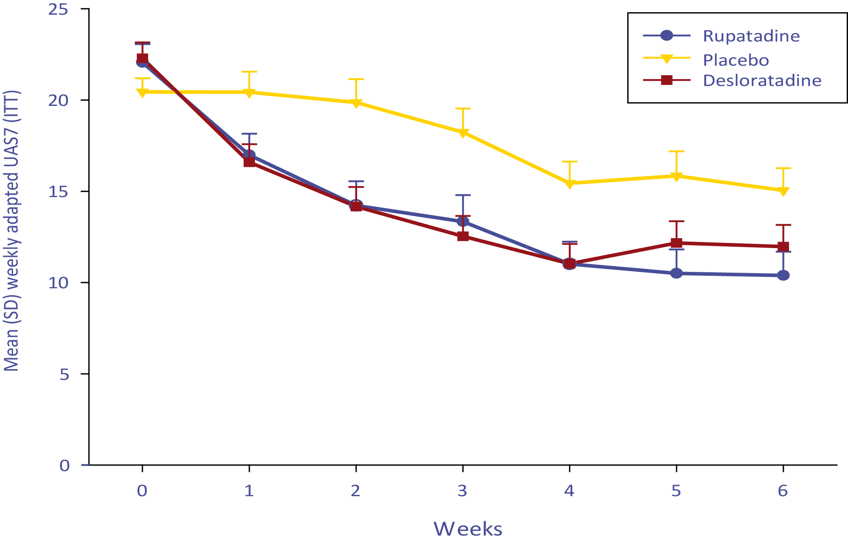
Estudo de Fase III em urticária crónica espontânea: Resultados (IV)
Rinialer reduz significativamente os sintomas de urticária
a partir da semana 1 e ao longo do período do estudo
Rinialer
Placebo
Desloratadina
*
*
Média (DP) da UAS7 semanal adaptada (ITT)
*
*
*
*
*p < 0,05 Rinialer e desloratadina vs placebo
Potter P. et al. Pediatr Allergy Immunol 2016:27:55-61
RINIALER na Rinite Alérgica e Urticária
Notes:
Regarding the symptoms’ progression, UAS7 weekly scores showed statistically significant differences by treatment, from the first week (week 1) after starting treatment administration until the end of the treatment period (week 6), being rupatadine and desloratadine scores always lower than placebo. Onset of action was achieved one week after treatment was started.

Slide 41
Estudo da Fase III em urticária crónica espontânea: Resultados (V)
Rinialer melhora significativamente a QoL em crianças
com urticária após 6 semanas de tratamento
**
*
Significância estatística: **p = 0,003 Rinialer vs placebo *p = 0,012 desloratadina vs placebo
RINIALER na Rinite Alérgica e Urticária
Notes:
Quality of Life (QoL) was evaluated using the validated Children Dermatology Life Quality Index (CDLQI) for children aged ≥ 4 years old. The questionnaire was completed both at baseline and the end of treatment (Visit 2), the change in overall score from baseline to Visit 2 was evaluated. The following six domains were evaluated by the children in this QoL questionnaire: symptoms/feelings, daily activities, school/holiday activities, personal relations, sleep and treatment. The final score at Visit 2 of these six domains was also compared among treatment groups.
Statistical significant differences were found in the change of overall CDLQI score among treatment groups (p= 0.006 in absolute change; p= 0.001 in percentage change). Rupatadine and desloratadine changes in CDLQI scores were higher than for placebo. When absolute changes of the six domains comprised in the CDLQI questionnaire were individually analysed, statistical differences were only found in “school/holidays activities” and “daily activities” domains. However, a trend of superiority of rupatadine over placebo was seen in all domains.

Slide 42
Estudo de Fase III em urticária crónica espontânea: Conclusões sobre eficácia e QoL
Rinialer é eficaz no alívio dos sintomas de urticária com uma acção sustentada.
Rinialer (mas não desloratadina) reduz significativamente o prurido (MPS), em comparação com o placebo, após 6 semanas (42 dias) de tratamento.
Rinialer reduz significativamente o número de pápulas (MNW) após 6 semanas (42 dias) de tratamento em maior medida que a desloratadina.
RINIALER na Rinite Alérgica e Urticária

Slide 43
Estudo de Fase III em urticária crónica espontânea: Conclusões sobre eficácia e QoL
Rinialer melhorou a QoL (CDQLI) significativamente, em comparação com o placebo, às 6 semanas.
Os resultados de Eficácia estão em conformidade com os resultados obtidos em adolescentes/adultos.
RINIALER na Rinite Alérgica e Urticária

Slide 44

RINIALER em Pediatria (< 12 anos)
  Rinite alérgica: Eficácia clínica
  Urticária: Eficácia clínica
  Segurança e Tolerabilidade
Conclusões
Indicações terapêuticas

Slide 45
Perfil de segurança em crianças com idades compreendidas entre os 2 e os 11 anos
Rinialer é seguro e bem tolerado (semelhante ao placebo)
em crianças entre os 2 e os 11 anos de idade
N.º de Doentes
Dados Uriach em arquivo
RINIALER na Rinite Alérgica e Urticária

Slide 46
Reacções adversas mais comuns por nível de dosagem de Rinialer
Classe de Sistemas e Órgãos |  | Rinialer 2,5 mg | Rinialer 5 mg | Placebo
 |  | (n=147) | (n=159) | (n=249)
Distúrbios do sistema nervoso
Frequentes | Cefaleias | 2 (1,36%) | 4 (2,52%) | 4 (1,61%)
 | Sonolência | 0 | 2 (1,26%) | 0
RINIALER na Rinite Alérgica e Urticária
Notes:
Complete AEs in the SmPC (including uncommon AEs)
Rupatadine 2.5mg Rupatadine 5mg Placebo
Frequency Preferred term (n=147) (n=159) (n=249)
(INFECTIONS AND INFESTATIONS)
Uncommon Influenza 0 1(0.63%) 0
Uncommon Nasopharyngitis 1 (0.68%) 0 0
Uncommon Upper respiratory tract infection 1 (0.68%) 0 0
(BLOOD AND LYMPHATIC SYSTEM DISORDERS)
Uncommon Eosinophilia 0 1(0.63%) 0
Uncommon Neutropenia 0 1(0.63%) 0
(NERVOUS SYSTEM DISORDERS)
Common Headache 2 (1.36%) 4 (2.52%) 4 (1.61%)
Common Somnolence 0 2 (1.26%) 0
(GASTROINTESTINAL DISORDERS)
Uncommon Dizziness 0 1 (0.63%) 1 (0.40%)
Uncommon Nausea 0 1 (0.63%) 2 (0.80%)
(SKIN AND SUBCUTANEOUS TISSUE DISORDERS)
Uncommon Eczema 0 1 (0.63%) 1 (0.40%)
Uncommon Night sweats 0 1 (0.63%) 0
(GENERAL DISORDERS AND ADMINISTRATION SITE CONDITIONS)
Uncommon Fatigue 0 1 (0.63%) 0

Slide 47

RINIALER em Pediatria (< 12 anos)
  Rinite alérgica: Eficácia clínica
  Urticária: Eficácia clínica
  Segurança e Tolerabilidade
Conclusões
Indicações terapêuticas

Slide 48
Perfil de segurança em crianças com idades compreendidas entre os 2 e os 11 anos: Conclusões
A incidência de reacções adversas em crianças entre os 2 e os 11 anos de idade tratadas com Rinialer em solução oral pediátrica é MENOR que aquela relatada em doentes adultos.
Rinialer foi bem tolerado, de forma semelhante ao placebo.
As RA mais frequentes foram dores de cabeça, porém, a sua incidência com Rinialer foi semelhante àquela verificada com o placebo.
Não foram comunicadas RA graves.
Não se detectaram problemas relacionados com o ECG (prolongamento do intervalo QTc).
RINIALER na Rinite Alérgica e Urticária

Slide 49

RINIALER em Pediatria (< 12 anos)
  Rinite alérgica: Eficácia clínica
  Urticária: Eficácia clínica
  Segurança e Tolerabilidade
Conclusões
Indicações terapêuticas

Slide 50
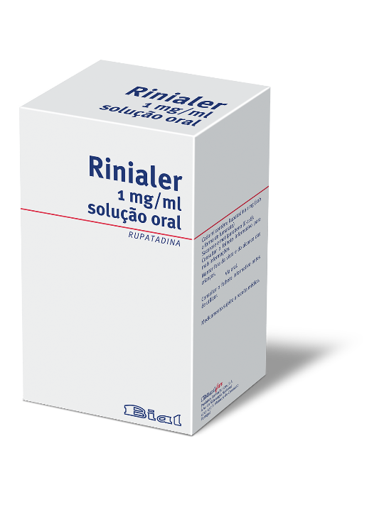
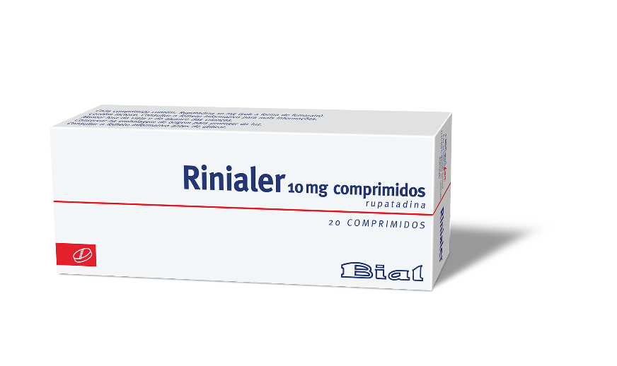
Indicações terapêuticas
Rinialer solução oral 1 mg/ml está indicada para o tratamento sintomático de rinite alérgica (incluindo rinite alérgica perene) e urticária em crianças entre os 2 e os 11 anos de idade.
Posologia:
  Em crianças com peso igual ou superior a 10 kg e inferior a 25 kg: 2,5 ml (2,5 mg de Rinialer) em solução oral.
  Em crianças com peso igual ou superior a 25 kg: 5 ml (5 mg de Rinialer) em solução oral.
Uma vez ao dia, com ou sem alimentos.
RINIALER na Rinite Alérgica e Urticária

Slide 51
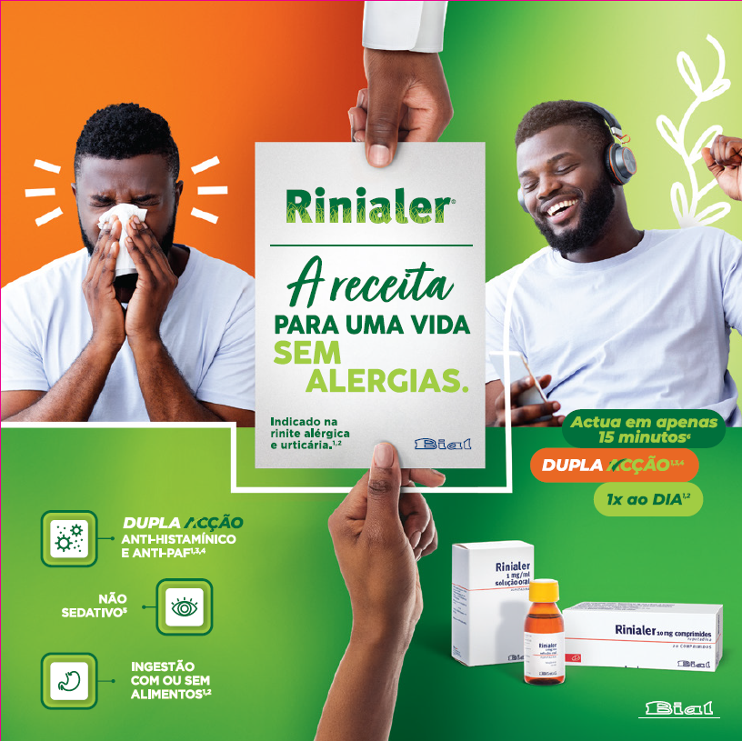

Slide 52
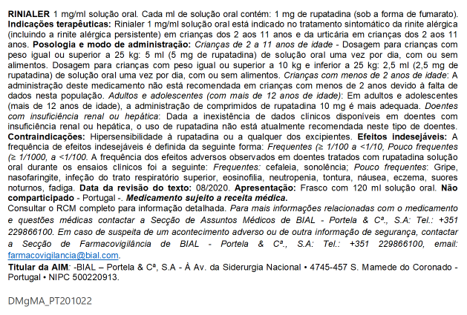
IEC (Informações essenciais compatíveis com o Resumo das Características do Medicamento)
RINIALER na Rinite Alérgica e Urticária

Slide 53
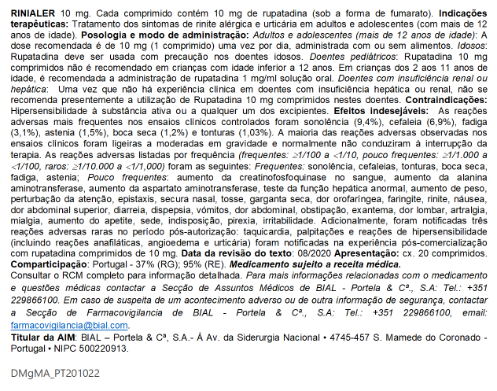
IEC (Informações essenciais compatíveis com o Resumo das Características do Medicamento)
RINIALER na Rinite Alérgica e Urticária

Slide 54

Obrigado.

