Slide 1
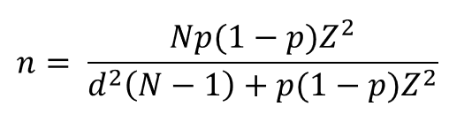
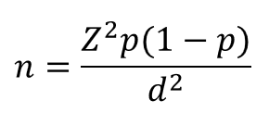
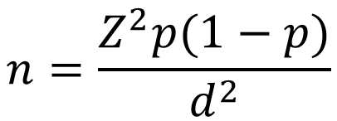
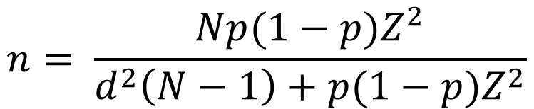
$$n= \frac{Np(1−p)Z^{2}}{d^{2}\left(N−1\right)+p(1−p)Z^{2}}$$
$$n=\frac{Z^{2}p(1−p)}{d^{2}}$$

Slide 2
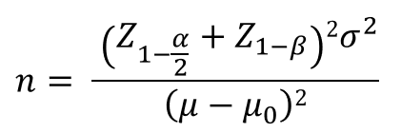
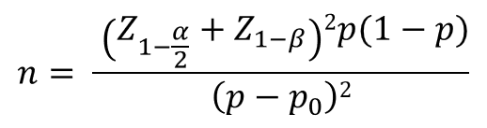
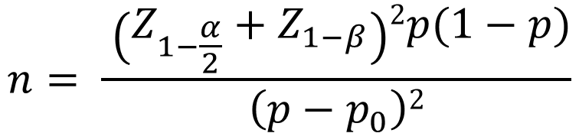
$$n= \frac{ \left(Z_{1−\frac{α}{2}}+Z_{1−β}\right)2p(1−p)}{\left(p−p_{0}\right)2}$$

Slide 3
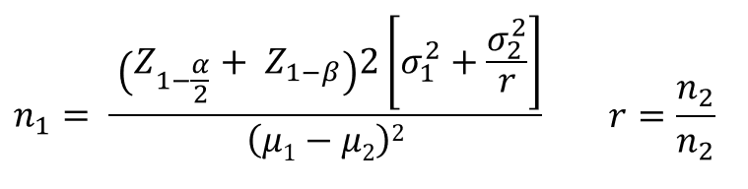
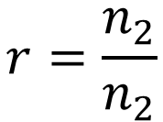
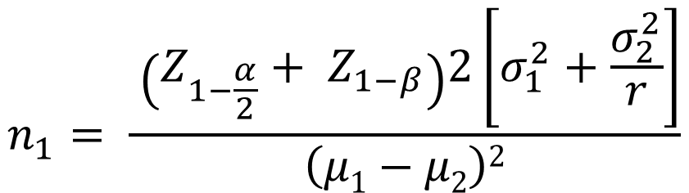
$$n_{1}= \frac{ \left(Z_{1−\frac{α}{2}}+ Z_{1−β}\right)2\left[σ_{1}^{2}+\frac{σ_{2}^{2}}{r}\right]}{\left(μ1−μ2\right)2}$$
$$r=\frac{n_{2}}{n_{2}}$$

Slide 4
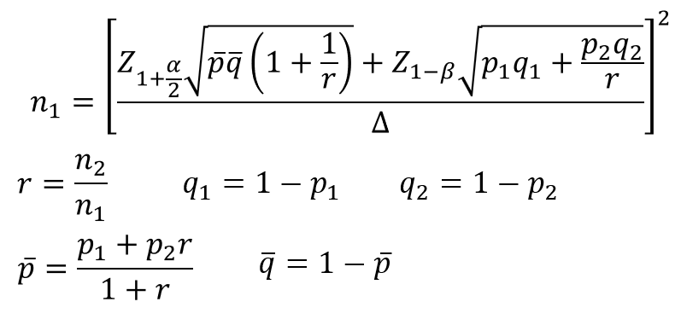
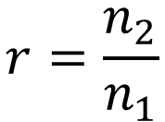

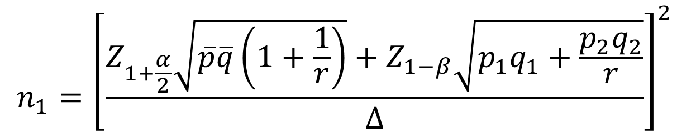



$$n_{1}={\left[\frac{Z_{1+\frac{α}{2}}\sqrt{\overline{p}\overline{q}\left(1+\frac{1}{r}\right)}+Z_{1−β}\sqrt{p_{1}q_{1}+\frac{p_{2}q_{2}}{r}}}{∆}\right]}^{2}$$
$$r=\frac{n_{2}}{n_{1}}$$
$$q_{1}=1−p_{1}$$
$$q_{2}=1−p_{2}$$
$$\overline{p}=\frac{p_{1}+p_{2}r}{1+r}$$
$$\overline{q}=1−\overline{p}$$

Slide 5
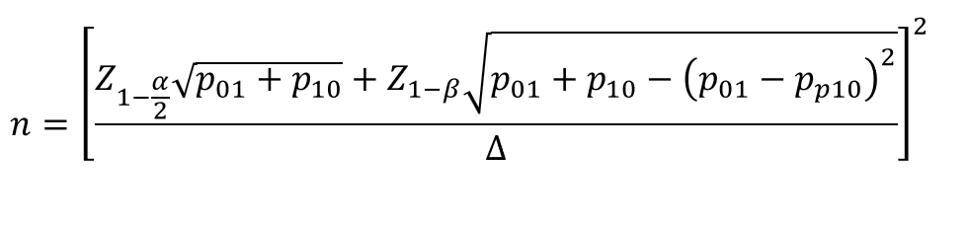
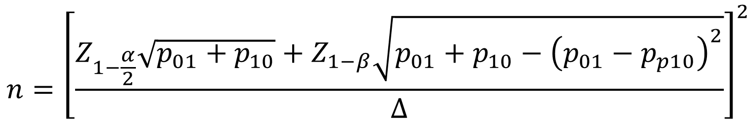
$$n={\left[\frac{Z_{1−\frac{α}{2}}\sqrt{p_{01}+p_{10}}+Z_{1−β}\sqrt{p_{01}+p_{10}−{\left(p_{01}−p_{p10}\right)}^{2}}}{∆}\right]}^{2}$$

