Slide 1

Daddy-phat-sacks
Kevin Heaney, Rodney Mosquito, Abiel Ogbe, John Sachs
Team Blue

Slide 2
327,200,000
8,623,000
15,400
5,200
1

Slide 3
327,200,000
8,623,000
15,400
5,200
1
Total U.S. Pop
Total NY Pop
NY Professional/Biz jobs
NY Information jobs
Only one Team Blue!

Slide 4
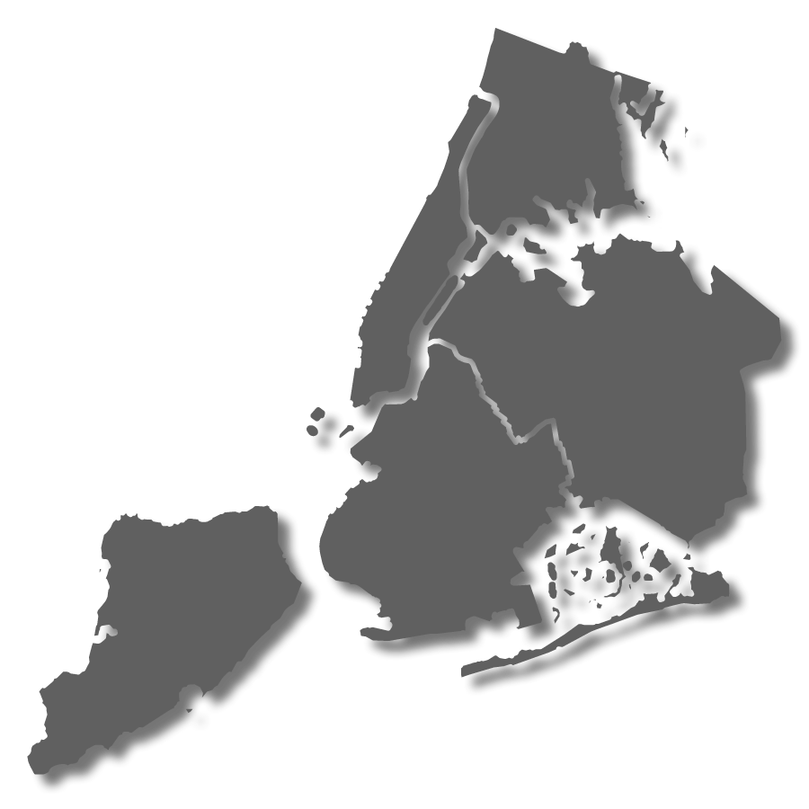
Agenda
The Research Question
The Challenge
The Choice (Demo)
The Impacts
The End (Questions)
THE
BRONX
MANHATTAN
QUEENS
BROOKLYN
STATEN
ISLAND

Slide 5
Agenda
The Research Question
The Challenge
The Choice (Demo)
The Impacts
The End (Questions)
THE
BRONX
MANHATTAN
QUEENS
BROOKLYN
STATEN
ISLAND

Slide 6
The research question
Job relocation is stressful
Large cities (New York) can increase stress levels
Understanding job distribution reduces stress
Research Question: How are job vacancies geospatially distributed across New York City boroughs?

Slide 7
Agenda
The Research Question
The Challenge
The Choice (Demo)
The Impacts
The End (Questions)
THE
BRONX
MANHATTAN
QUEENS
BROOKLYN
STATEN
ISLAND

Slide 8
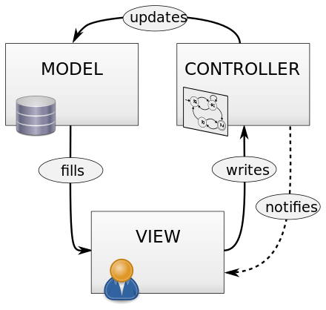
THE CHALLENGE(S)
(Put stuff that gave us headaches here)
(What challenged us?)
i.e., lat/longs; commas in source csv to SQL; story map function; getting the heat map to work
Python
Flask
SQLAlchemy
PostgreSQL
Leaflet.storyMap
HTML/CSS
JavaScript

Slide 9
Agenda
The Research Question
The Challenge
The Choice (Demo)
The Impacts
The End (Questions)
THE
BRONX
MANHATTAN
QUEENS
BROOKLYN
STATEN
ISLAND

Slide 10
The choice
DEMO!

Slide 11
Agenda
The Research Question
The Challenge
The Choice (Demo)
The Impacts
The End (Questions)
THE
BRONX
MANHATTAN
QUEENS
BROOKLYN
STATEN
ISLAND

Slide 12
The impacts
What value does our app provide the user?
(Project value #1)
(Project value #2)
(Project value #3)

Slide 13
Agenda
The Research Question
The Challenge
The Choice (Demo)
The Impacts
The End (Questions)
THE
BRONX
MANHATTAN
QUEENS
BROOKLYN
STATEN
ISLAND

