Slide 1


Daddy-phat-sacks
KevinHEANEY, RodneyMOSQUITO, AbielOGBE, JohnSACHS
Team Blue

Slide 2
327,200,000
8,623,000
15,400
5,200
1

Slide 3
327,200,000
8,623,000
15,400
3,200
1
Total U.S. Pop
Total NY Pop
NY Professional/Biz jobs
NYC Government jobs
Only one Team Blue!

Slide 4
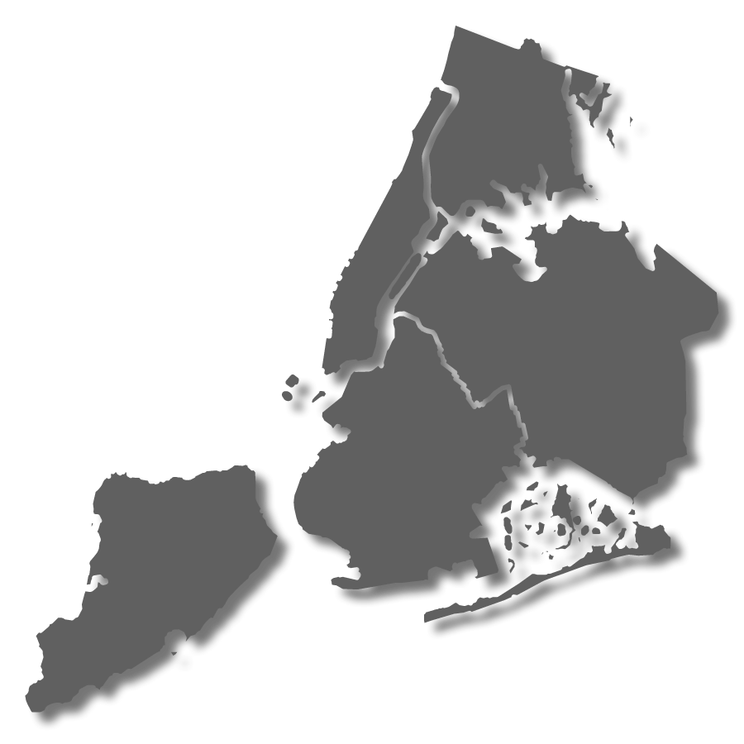
Agenda
The Research Question
The Challenge
The Choice (Demo)
The Impacts
The End (Questions)
THE
BRONX
MANHATTAN
QUEENS
BROOKLYN
STATEN
ISLAND

Slide 5
Agenda
The Research Question
The Challenge
The Choice (Demo)
The Impacts
The End (Questions)
THE
BRONX
MANHATTAN
QUEENS
BROOKLYN
STATEN
ISLAND

Slide 6
The research question
Job relocation is stressful
Large cities (New York) can increase stress levels
Understanding job distribution reduces stress
Research Question: How are government job vacancies geospatially distributed across New York City boroughs?

Slide 7
Agenda
The Research Question
The Challenge
The Choice (Demo)
The Impacts
The End (Questions)
THE
BRONX
MANHATTAN
QUEENS
BROOKLYN
STATEN
ISLAND

Slide 8
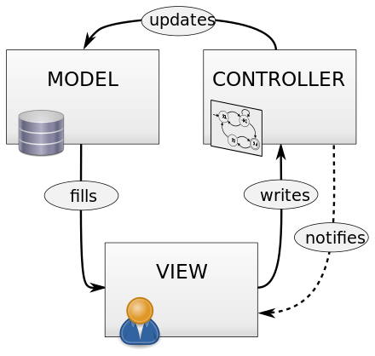
Python
Flask
SQLAlchemy
PostgreSQL
Leaflet.StoryMap
HTML/CSS
JavaScript

Slide 9
THE CHALLENGE(S)
Getting the components to talk to one another (mo modules mo problems!)
Importing data from Pandas into PostgreSQL (commas)
Converting Lat/Longs form addresses
JavaScript code running into each other (StoryMap prevents you from using many of the markers)
THE
BRONX
MANHATTAN
QUEENS
BROOKLYN
STATEN
ISLAND

Slide 10
Agenda
The Research Question
The Challenge
The Choice (Demo)
The Impacts
The End (Questions)
THE
BRONX
MANHATTAN
QUEENS
BROOKLYN
STATEN
ISLAND

Slide 11
The choice
DEMO!

Slide 12
Agenda
The Research Question
The Challenge
The Choice (Demo)
The Impacts
The End (Questions)
THE
BRONX
MANHATTAN
QUEENS
BROOKLYN
STATEN
ISLAND

Slide 13
The impacts
Strategic Value: Geolocates government jobs (Where are the jobs? How many are there?)
Financial Value: Identifies the salary ranges in each borough (Where is the money?)
Personal Value: Saves the candidate time and makes job search easier

Slide 14
Agenda
The Research Question
The Challenge
The Choice (Demo)
The Impacts
The End (Questions)
THE
BRONX
MANHATTAN
QUEENS
BROOKLYN
STATEN
ISLAND

