Slide 1
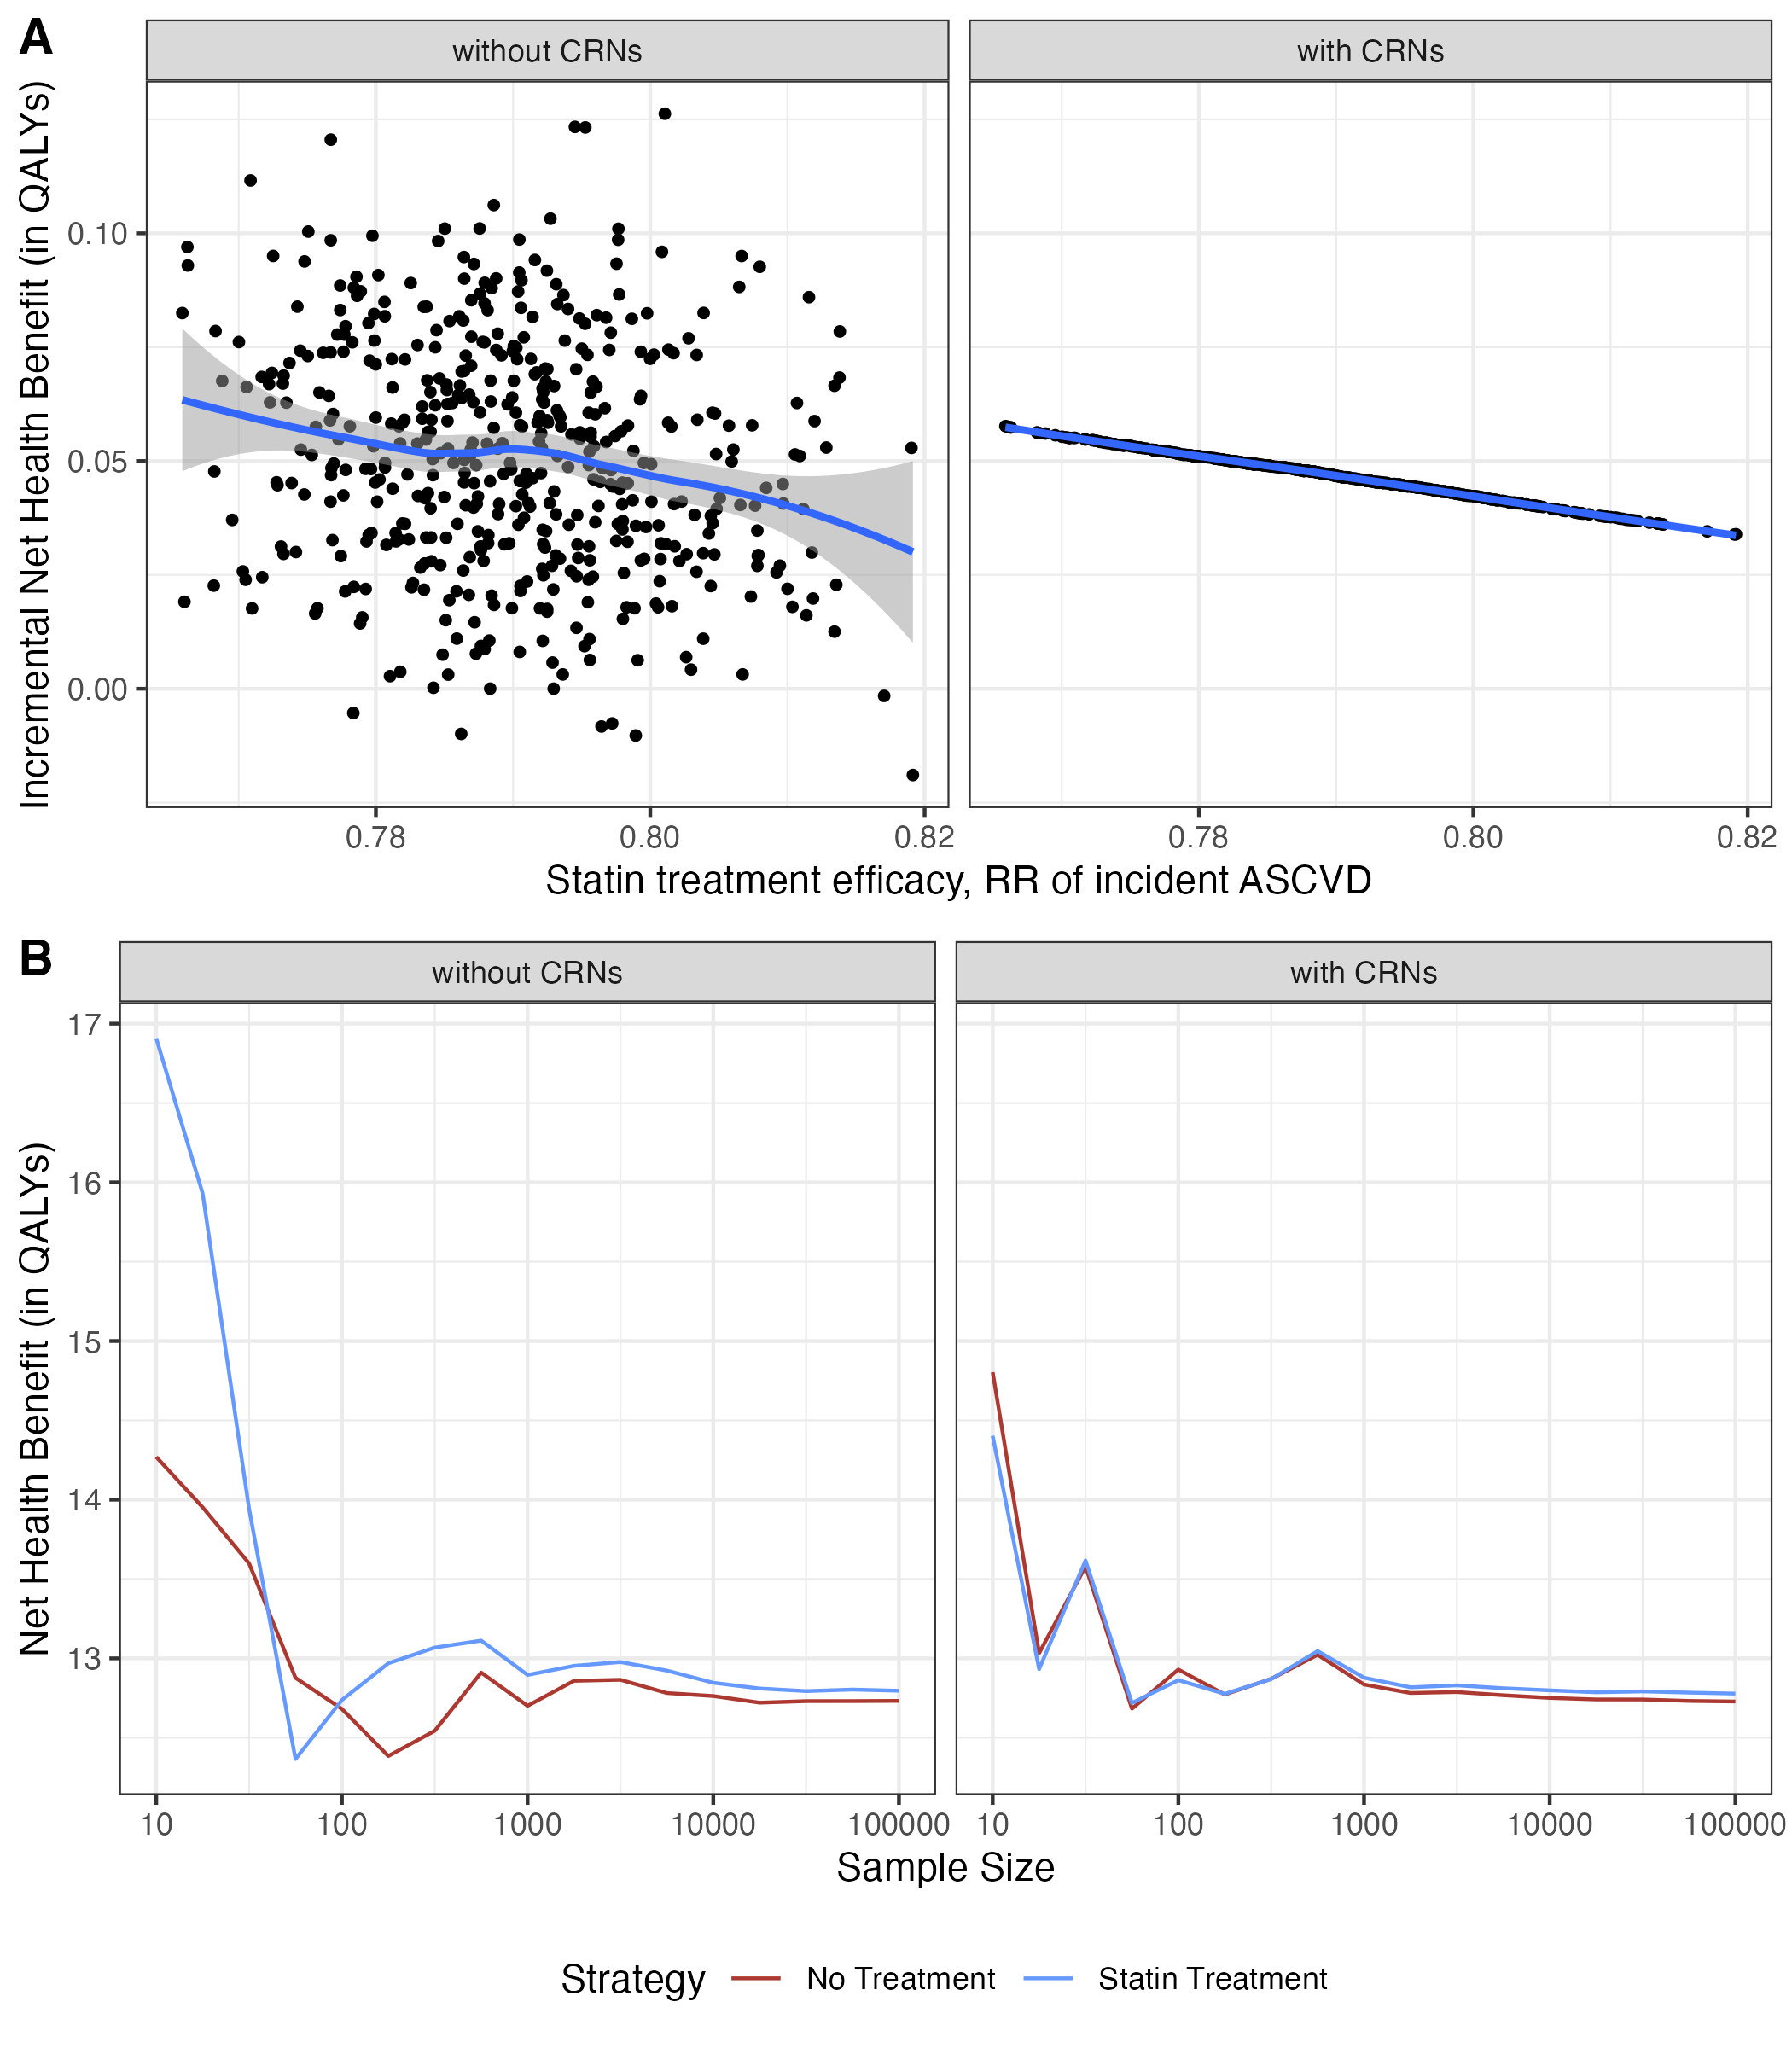
Figure. Panel A shows the effect of CRNs (left: No CRNs; right: With CRNs) on model outputs through runs with varying relative risks (RR) of ASCVD. The blue line is the smooth trend line and the band is the 95% confidence interval. Panel B shows the convergence progress (left: No CRNs; right: With CRNs) for both strategies with varying sample sizes.

