Slide 1
COMP3211 LAB02 Single-cycle processor core
Phot Koseekrainiramon
z5387411

Slide 2
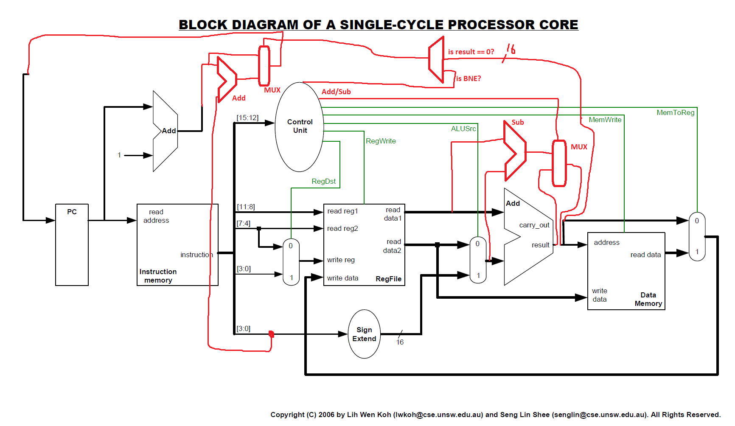
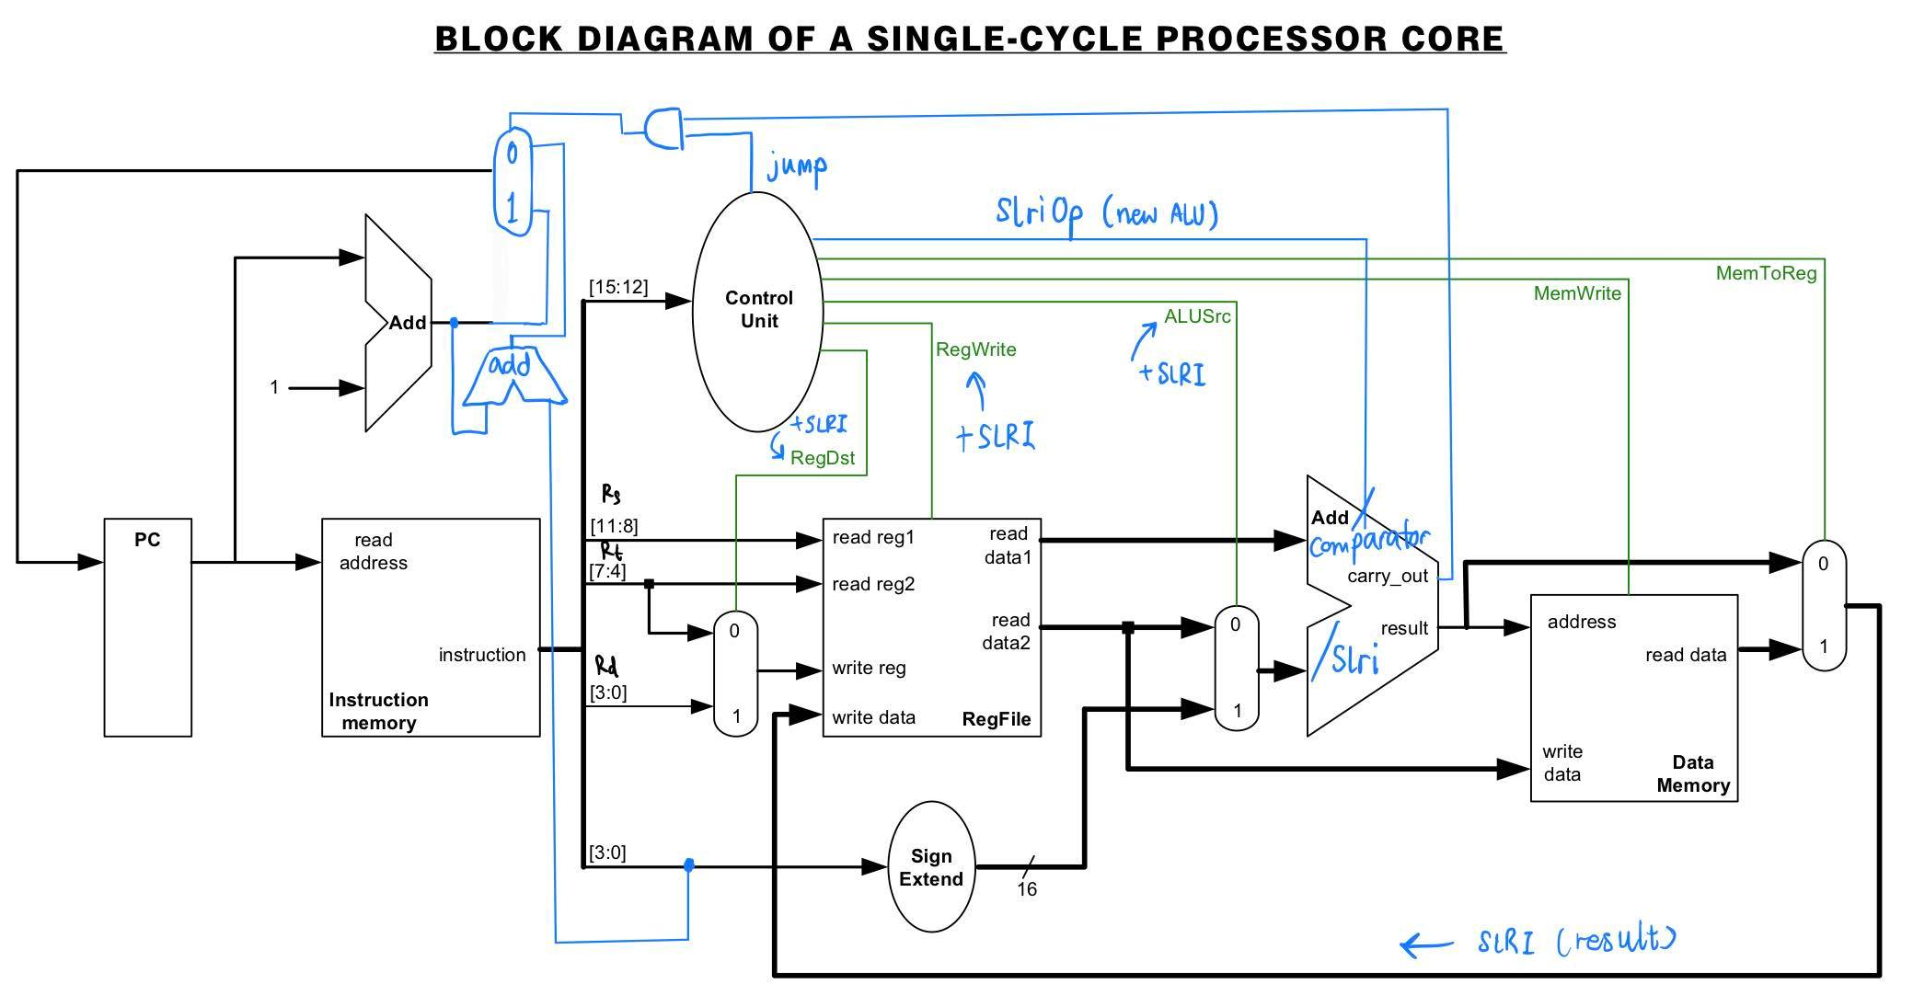
1
2
3
5
4
1
3
2
4

Slide 3
equal or not?
BNE Rs, Rt, Imme

Slide 4
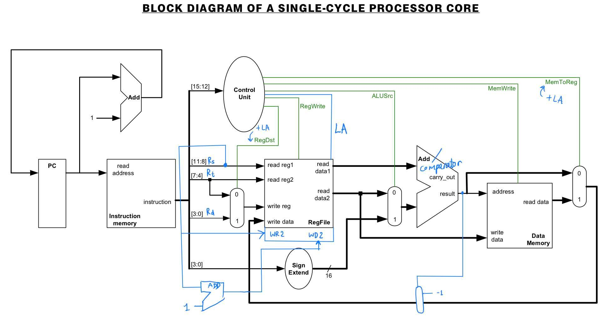
LA Rd, Rs+, Rt

Slide 5
SLRi Rd, Rs, Imme

Slide 6
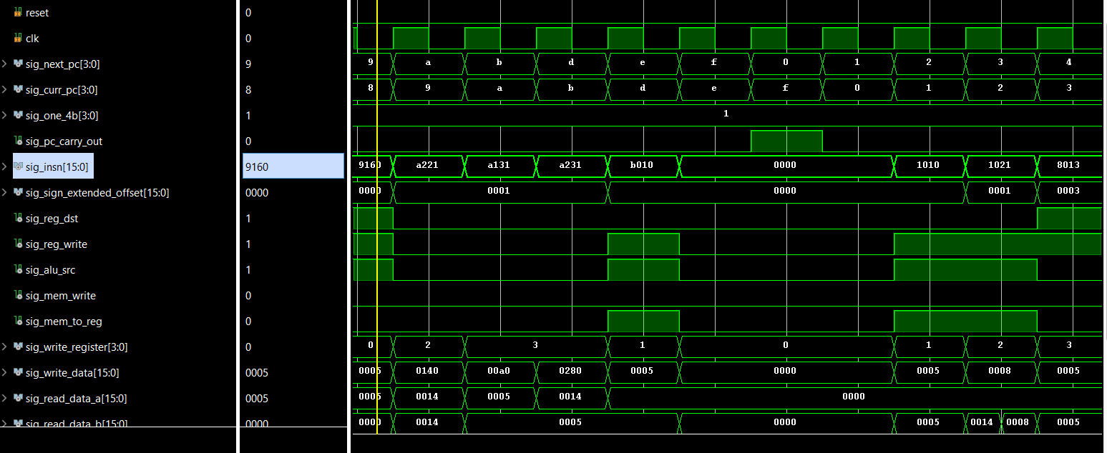

Slide 7
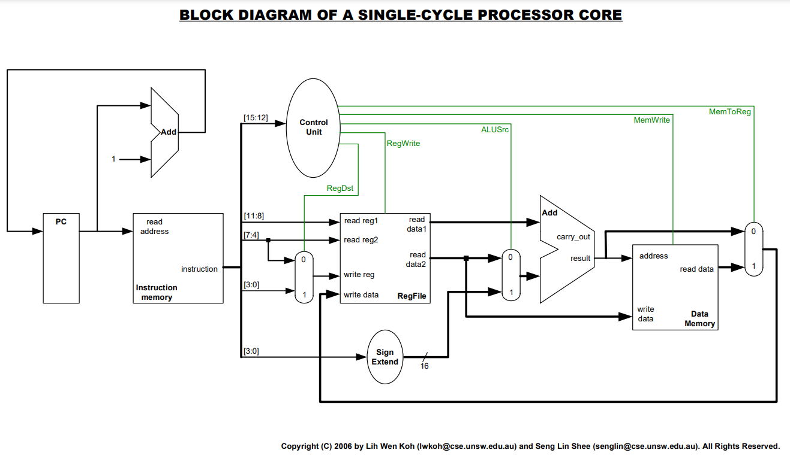
THANK YOU

