Slide 1

ISM 6419 Final Project
Topic: COVID -19 Tracking
Raghav Dasari (U22335720)

Slide 2
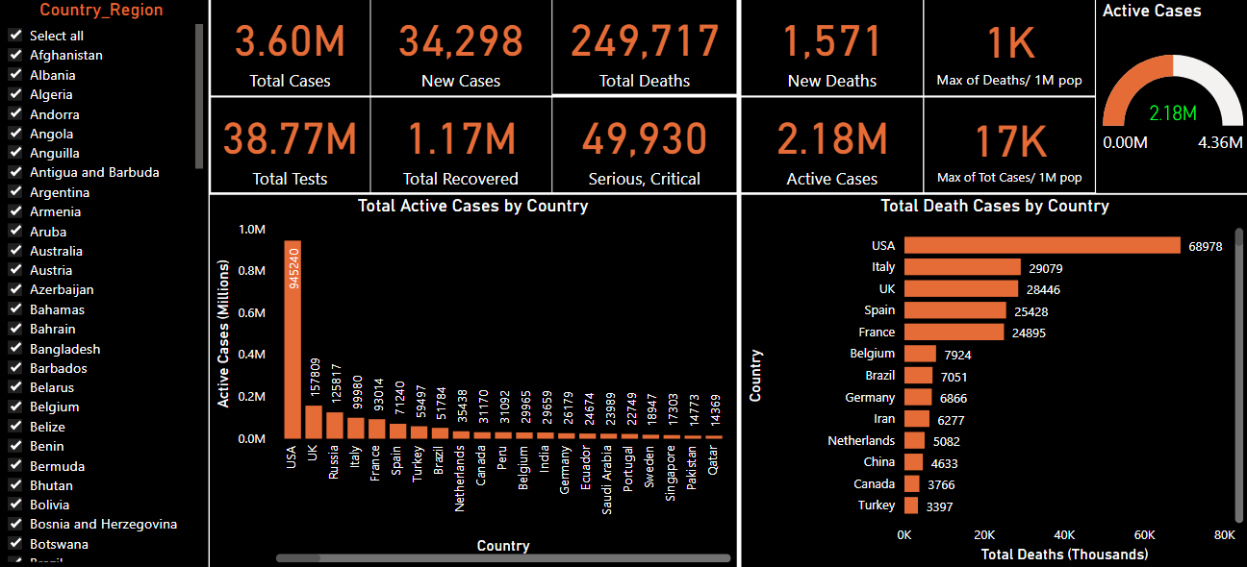
COVID-19 World Wide Live Monitor

Slide 3
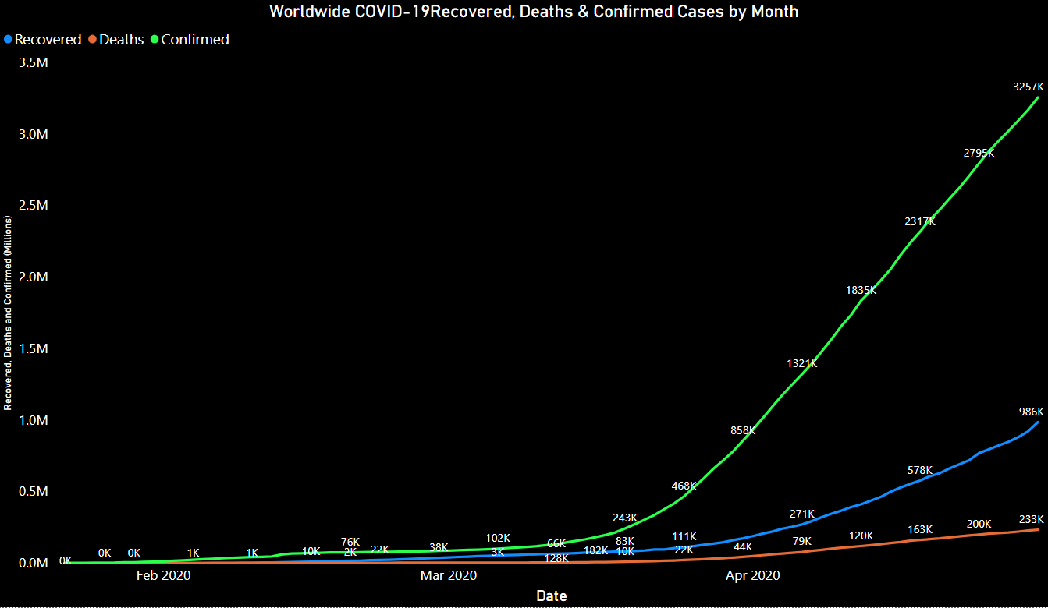
Monthly Tracking of COVID-19

Slide 4
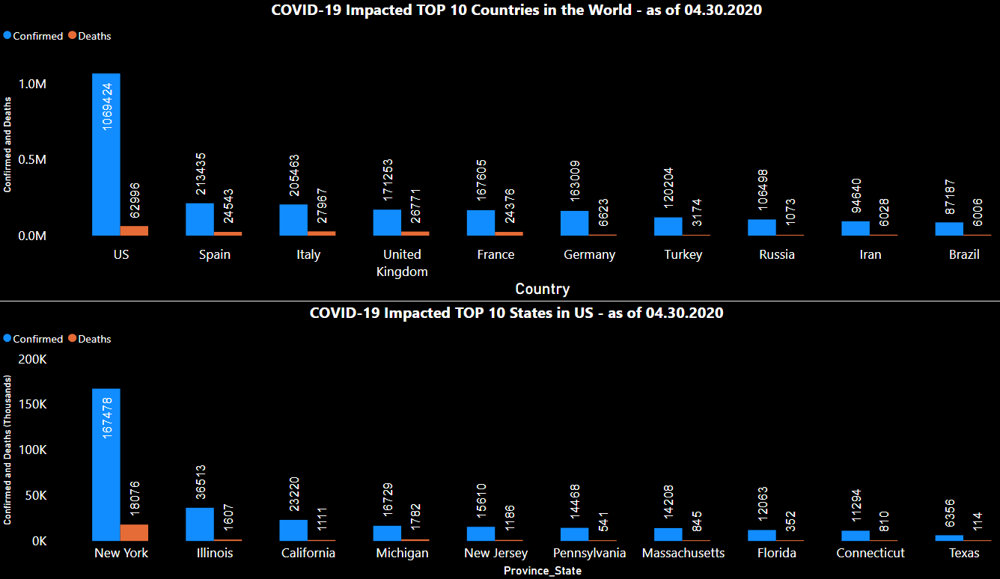
Top 10 By World/US

Slide 5
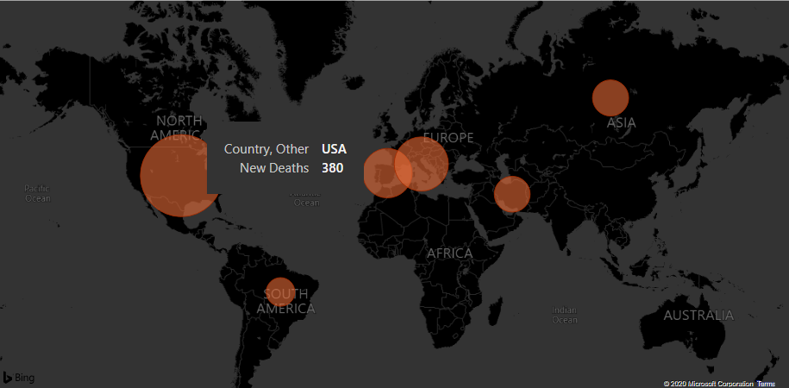
COVID-19 Death Cases Track in map

