Slide 1



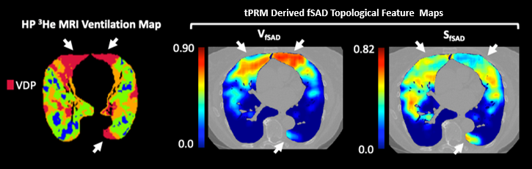
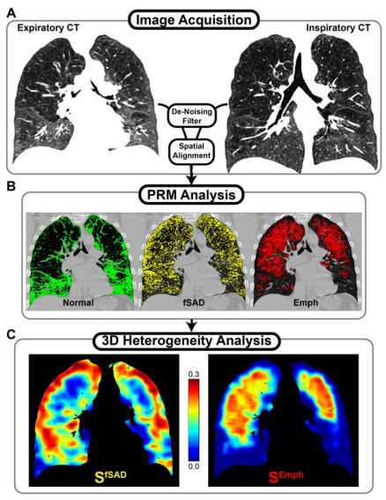
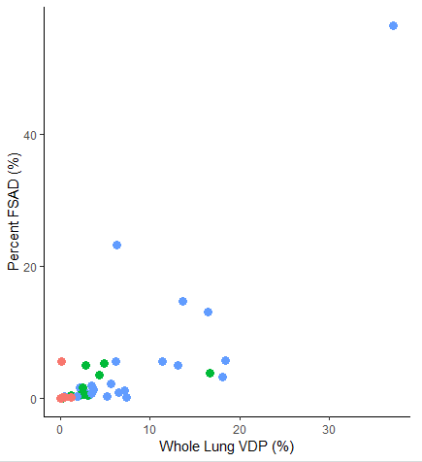
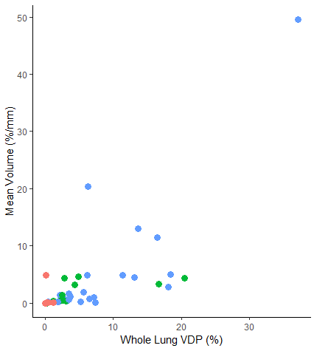
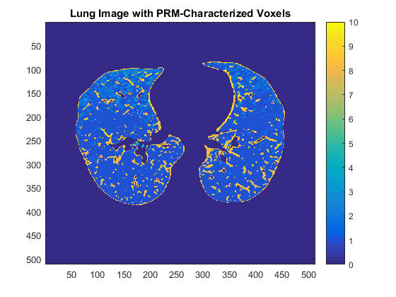
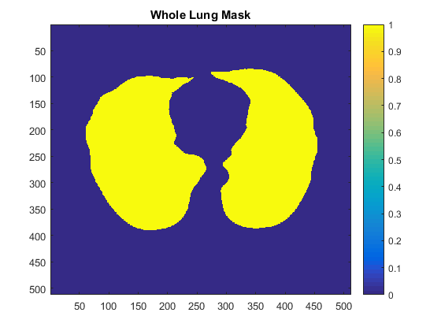
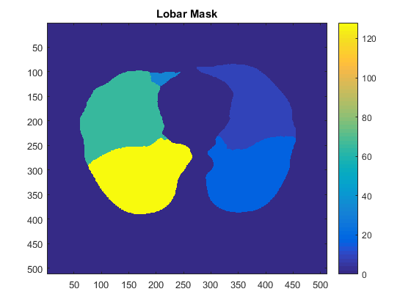
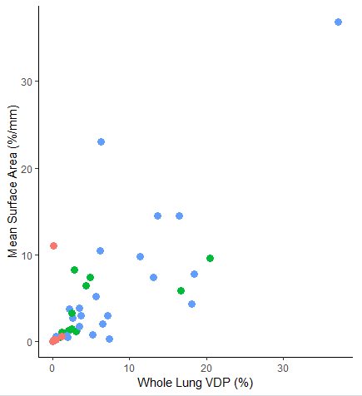
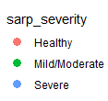

Validation of Quantitative Air-Trapping on CT using Ventilation Imaging on Hyperpolarized Gas MRI
P. Hotvedt¹, K.J. Carey², C. Hatt³, C.J. Galbán³, S.B. Fain^{2,4,5}
¹Nuclear Engineering (Radiation Sciences), ²Medical Physics, University of Wisconsin – Madison, ³Radiology, University of Michigan ⁴Biomedical Engineering, and ⁵Radiology, University of Wisconsin – Madison,
Introduction
Results
Lobar Analysis
The obstruction of small airways (< 2mm in diameter) is an important aspect of functional small airway disease (fSAD), such as asthma, that can often be missed in conventional clinical biomarker tests, such as spirometry.
New imaging techniques provide a possible alternative to characterize regions of fSAD in asthma.
Advances in quantitative measures of lung density on computed tomography (CT) have developed alongside direct ventilation measures using magnetic resonance imaging (MRI).
Parametric response mapping (PRM) and topological PRM (tPRM) are recent techniques utilizing inspiratory and expiratory CT to spatially characterize fSAD in low density regions of lung parenchyma.
Ventilation defects on hyperpolarized helium-3 MRI (HP ³He MRI) have previously been linked to whole lung air trapping on CT.
This study’s purpose is to characterize tPRM-derived measurements of functional small airways disease in asthma and assess associations with ventilation defect percent (VDP) from HP ³He MRI. We hypothesize that tPRM quantitative density measures will be highly associated with VDP from HP ³He MRI regionally and globally.
 | Healthy | Mild/Moderate | Severe
N | 6 | 13 | 23
Sex | 5F (83.3%) | 8F (61.5%) | 13F (56.5%)
Age (years) | 35.5 ± 14.7 | 46.0 ± 14.0 | 53.8 ± 12.3
BMI | 25.1 ± 3.1 | 27.6 ± 5.2 | 31.7 ± 5.5
FEV1 PP | 107.22 ± 15.5 | 94.6 ± 17.6 | 81.3 ± 19.3
FEV1/FVC PP | 101.1 ± 4.1 | 93.4 ± 10.3 | 89.6 ± 11.1
%PRM fSAD | 105.5 ± 16.2 | 101.8 ± 16.3 | 89.9 ± 12.9
fSAD Surface Area (%/mm) | 0.98 ± 2.2 | 1.8 ± 2.0 | 6.3 ± 12.3
fSAD Volume (%) | 2.0 ± 4.4 | 3.6 ± 3.4 | 6.9 ± 8.7
VDP (%) | 0.9 ± 2.0 | 1.8 ± 1.8 | 5.6 ± 10.8
Percent fSAD
Lobe | rho | p-value
LUL | 0.519386 | 9.87 E-04
LLL | 0.456545 | 4.51 E-03
RUL | 0.539661 | 5.67 E-04
RML | 0.530057 | 0.0007403
RLL | 0.470892 | 3.27 E-03
Table 3: The statistical correlations for lobar data against %fSAD.
Table 1: Summary of population characteristics. Results separated into the patient case severity and given as mean ± standard deviation. Spirometry and VDP are post-bronchodilator. PP – percent predicted
Mean fSAD Volume
Lobe | rho | p-value
LUL | 0.550213 | 4.19 E-04
LLL | 0.438404 | 6.65 E-03
RUL | 0.56705 | 2.53 E-04
RML | 0.559699 | 3.16 E-04
RLL | 0.477887 | 2.78 E-03
Materials and Methods
Our study population was gathered from the National Heart, Lung, and Blood Institute (NHLBI) Severe Asthma Research Program III (Sarp III) population.
Table 4: The statistical correlations for lobar data against mean fSAD Volume
Figure 3: A subject with severe asthma with HP ³He MRI ventilation map on the left, and tPRM-derived maps of V_{fSAD} and S_{fSAD} at the middle and right positions respectively. Subject had a VDP of 24.4%, mean V_{fSAD} 10.9% and mean S_{fSAD} 14.9%/mm .
Mean fSAD Surface Area
All subjects underwent spirometry to gather forced expiratory volume in one second (FEV₁), forced vital capacity (FVC) as well as an FEV₁ /FVC.
Percent predicted (PP) values were calculated using reference values from the Global Lung Function Initiative Standard [1].
CT and MRI images were gathered after bronchodilation using the inhalation of albuterol. The CT was acquired at both total lung capacity (TLC) and functional residual capacity (FRC).
MRI was acquired at FRC plus the volume of an approximately one-liter gas bag which was normalized to the subjects TLC.
Lobe | rho | p-value
LUL | 0.550213 | 4.19 E-04
LLL | 0.438404 | 6.65 E-03
RUL | 0.56705 | 2.53 E-04
RML | 0.559699 | 3.16 E-04
RLL | 0.477887 | 2.78 E-03
Whole Lung Analysis
Percent fSAD
Mean fSAD Volume
Figure 1: Workflow as presented in Hoff et al. [2] for deriving topological PRM. CT images at FRC and TLC (A) are processed to generate standard PRM (B) from which 3D topological maps (C) are derived.
Figure 2. A cross section of a subject’s lung with PRM-characterized voxels and the whole lung and lobar masks
This process yields conventional PRM fSAD as well as tPRM measures of fSAD volume and surface area.
To quantify ventilation defect regions as shown on the HP ³He MRI images, a semi-automated algorithm developed by Zha et al. [4] was used to measure whole lung VDP.
Lobar masks were generated from CT using VIDA software (Coralville, IA) (Right-most image in Figure 2), which were then applied to the whole-lung measures by a simple matrix product in MATLAB in order to isolate each lobe’s individual measurements.
Correlation coefficients and p-values were generated in R via Spearman correlation testing, with values obtained from the observed metrics given by the whole lung and lobar mask testing.
Table 5: The statistical correlations for lobar data against mean fSAD Surface Area
Discussion and Conclusion
Based on these results, we can further understand how ventilation defects in small airways disease impacts topological measurements of the lung on a global (whole-lung) level as well as a local (lobar) level, which can lead to better assessments of suitability for patient therapy.
The correlations on a lobar level suggest that areas with ventilation defects are spatially correlated with the areas of fSAD as determined by tPRM
Continued studies will map tPRM metrics and PRM metrics to segmental ventilation defect regions to establish structure-function relationships, which will develop the utility of tPRM as a measurement of airway obstruction in asthma
Our results suggest that ventilation defects observed on the HP ³He MRI images plays a direct role in identifying regions of air trapping on CT.
Mean fSAD Surface Area
Severity
Digital Copy
Metric | rho | p-value
Percent fSAD | 0.73 | < 0.0000001
Mean fSAD Volume | 0.73 | < 0.0000001
Mean fSAD Surface Area | 0.71 | < 0.0000001
References
[1] D.P.I. Capaldi et al., Radiology, 2016. 279(2), 597.
[2] B.A. Hoff et al., Scientific Reports, 2017. 7(1), 2999.
[3] C.J. Galbàn et al., Nature Medicine, 2012. 18(11), 1711.
[4] W. Zha, et al., Academic Radiology, 2018. 25(2) 169-178
[5] Mummy et al. UW-Madison, 2018.
Table 2: Spearman correlations for whole lung data against %fSAD, mean fSAD Volume and mean fSAD Surface Area gathered from Mummy et al. [5]
Acknowledgements
The Severe Asthma Research Program (SARP)
NIH/NHLBI R01 HL115118
NIH/NHLBI U10 HL109168
NIH S10 OD016394
Wisconsin Alumni Research Foundation (WARF)
GE Healthcare
Figure 5: The scatterplots of the whole lung comparisons of VDP and PRM gathered from Mummy et al. [5]
Notes:
More bullet points, less paragraphs

