Slide 1
Cordova移动端开发
2016/10/28

Slide 2
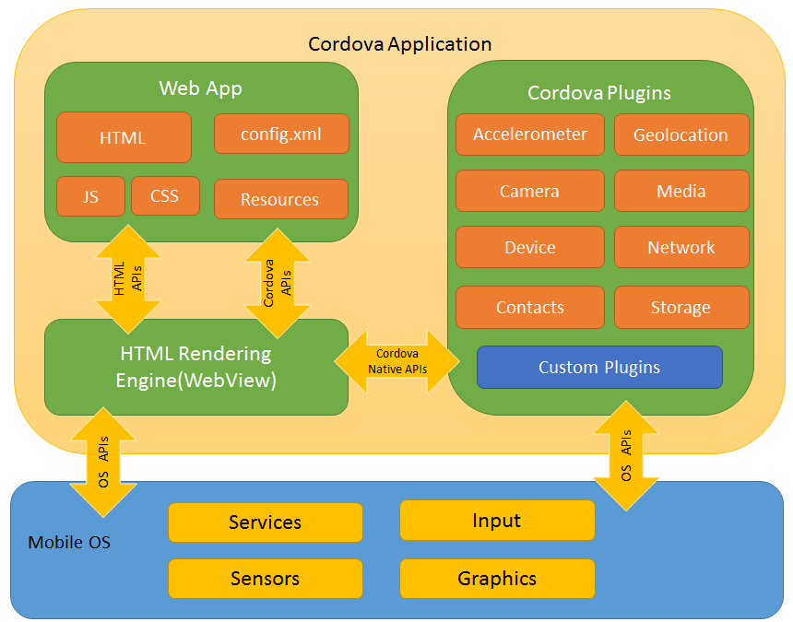
Cordova介绍

Slide 3
准备
安装JDK1.8
http://www.oracle.com/technetwork/java/javase/downloads/jdk8-downloads-2133151.html
安装Android SDK
http://android-sdk.en.softonic.com/
安装cordova CLI
IOS: $ sudo npm install -g cordova
window: npm install -g cordova

Slide 4
创建第一个cordova应用
cordova create ...
cordova platform add android
cordova requirements
cordova build (--release)
cordova run
参考http://cordova.apache.org/docs/en/latest/guide/cli/index.html

Slide 5
调试工具
Android Virtual Device
Genimotion
Weinre - WEb INspector REmote.
真机

Slide 6
Cordova plugins使用
intall
cordova plugin add cordova-plugin-device
device.XXX

Slide 7
cordova build
debug: cordova build
release: (build | sign | align)
1.cordova build --release
2.keytool -genkey -v -keystore release-key.keystore -alias cordova-demo -keyalg RSA -keysize 2048 -validity 10000
3.jarsigner -verbose -sigalg SHA1withRSA -digestalg SHA1 -keystore release-key.keystore platforms/android/build/outputs/apk/android-release-unsigned.apk cordova-demo
4.zipalign -v 4 platforms/android/build/outputs/apk/android-release-unsigned.apk platforms/android/build/outputs/apk/cordova-demo.apk

Slide 8
build.json
{
"android": {
"release": {
"keystore": "release-key.keystore",
"alias": "cordova-demo",
"storePassword": "test123456",
"password": "test123456"
}
}
}

Slide 9
PDA项目
页面简单
cordova + SPA
app 与 静态资源分离
gulp打包

Slide 10
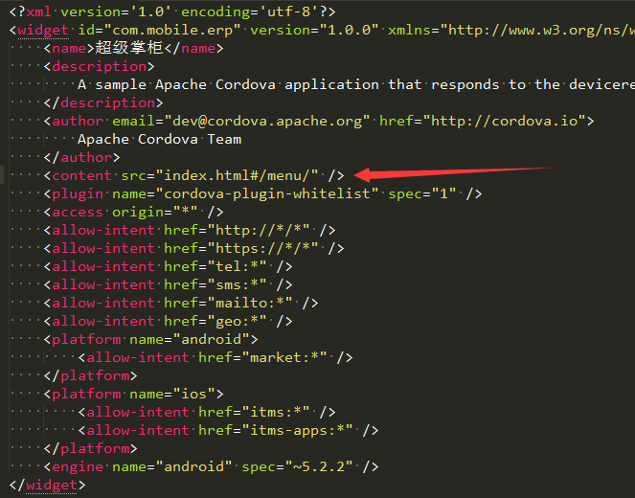
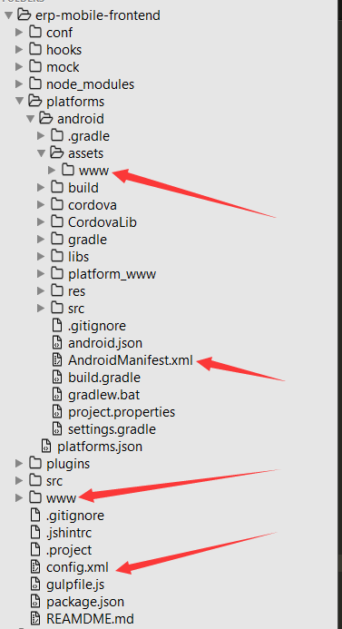
关键文件

Slide 11
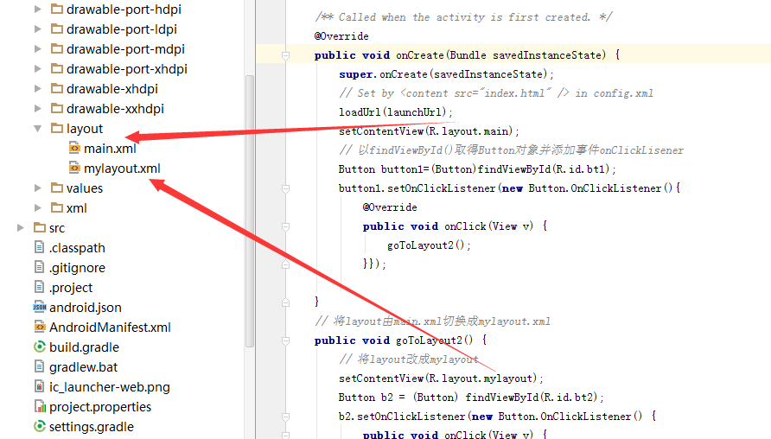
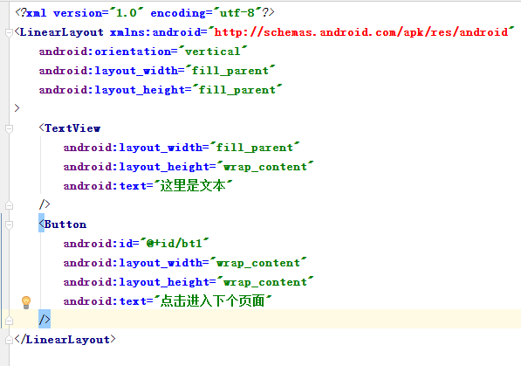
Android native UI
布局参数详解： http://blog.csdn.net/hyz4287010/article/details/6880647

Slide 12
Android 组件库
http://blog.csdn.net/boonya/article/details/38704229

Slide 13
Android native components VS React native

