Slide 1


G H PATEL COLLEGE OF ENGINEERING & TECHNOLOGY
(THE CHARUTAR VIDYA MANDAL (CVM) UNIVERSITY)
DEPARTMENT OF COMPUTER ENGINEERING
“MAT System - Momentum based Algorithmic Trading System”
MINI PROJECT (202040601)
Internal Presentation
10th January, 2026
Presented By
Internal Guide
Prabhav Patel, Raj Ghoniya
(12302040501042) , (12302040501048)
CP, GCET
CP Department, GCET,
Vallabh Vidyanagar

Slide 2
Outline
Introduction
Problem Statement
Motivation / Need of problem
Objectives
Scope
Methodology/Approach
Tools and Technologies
Conclusion
references
12302040501042, 48
MAT System

Slide 3
Introduction
Stock Market
The stock market is a place where people buy and sell shares of companies. It helps companies raise money and allows investors to grow their money over time.
Momentum-Based Investing
Momentum strategy focuses on stocks that have shown good performance in the recent past.
It is based on the idea that stocks moving upward often continue to move in the same direction for some time.
This strategy uses past price data to identify strong stocks instead of predicting future prices.
Momentum investing helps investors follow market trends rather than going against them.
12302040501042, 48
MAT System

Slide 4
Problem Statement
Mutual funds follow fixed rules and regulations, such as limited rebalancing frequency (for example, once in 6 months).
Because of these restrictions, mutual funds may miss short-term market opportunities.
Investors also face exit load charges when they withdraw or rebalance their investments early.
There is no simple system where users can test momentum strategies with their own parameters.
12302040501042, 48
MAT System

Slide 5
Motivation
Most investors want to generate more money than normal market returns.
Traditional investment options often give average returns over a long time.
Index | 3 Year | 5 Year | 10 Year
Nifty 50 | 13.67 % | 13.69 % | 14.35 %
Nifty Midcap 150 | 24.74 % | 23.18 % | 18.76 %
Nifty Midcap 150 Momentum 50 | 25.13 % | 28.25 % | 21.76 %
12302040501042, 48
MAT System

Slide 6
Objectives
To aim for better returns in capital markets using a momentum-based approach.
To design an algorithm that tracks high-momentum stocks without any expense ratio, unlike mutual funds.
To reduce the time and effort needed for stock research and order execution through automation.
To allow users to backtest their own momentum strategies using historical market data.
12302040501042, 48
MAT System

Slide 7
Scope
Included
Works only on Nifty 250 stocks
Uses a momentum-based strategy to select stocks
Allows custom rebalancing frequency and strategy parameters
Supports backtesting using historical market data
Connected with Fyers API for live order execution
Dashboard shows live portfolio value and PnL
(Note: The stock market is unpredictable, and this platform does not guarantee any returns.)
12302040501042, 48
MAT System

Slide 8
Scope
Not Included
Prediction of future stock prices
Guaranteed returns or fixed profits
Support for stocks outside Nifty 250
Brokerage charges, taxes, and other trading costs
Slippage between expected and executed prices
Handling of failed, rejected, or partial orders
(Note: The stock market is unpredictable, and this platform does not guarantee any returns.)
12302040501042, 48
MAT System

Slide 9
Approach
Our approach involves 4 phase :
Data Ingestion phase
Algorithm & Back Testing stage
Ranking & Rebalancing stage
Monitoring stage
12302040501042, 48
MAT System

Slide 10
Data Ingestion
Initial Bootstrapping: One time ingestion of 10 + 1 years of daily OHLCV data for top 250 stocks via Yahoo Finance.
Automatic calculation of 1-year rolling standard deviation for volatility normalization.
Daily Sync of stock prices in the DB.
So the backend will be automatically fetching previous day’s data at 7:00 am before market open via y-finance.
12302040501042, 48
MAT System

Slide 11
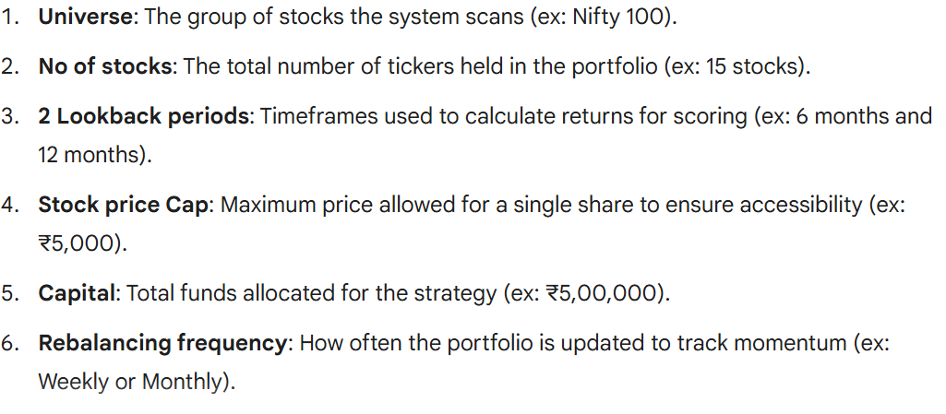
Algorithm & Backtesting
User creates a new strategy based on his/her custom parameters.
The user parameters include:
User can backtest on various combinations of parameters and deploy his choice of strategy.
12302040501042, 48
MAT System

Slide 12
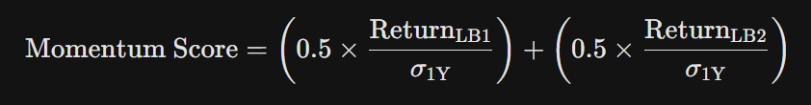
Ranking & Rebalancing
The algorithms works by creating a portfolio of top ‘N’ stocks based on momentum score. (equal weight).
Momentum Score is defined by :
This process repeats at each rebalancing date after data ingestion (7:00am).
The old portfolio is compared with new target portfolio and based on the difference and available capital , new orders are calculated and punched at market open (9:00am) automatically via Fyers API.
12302040501042, 48
MAT System

Slide 13
Monitoring
At last the user is able to monitor his deployed strategy via the portal.
The dashboard shows the current portfolio along with its live market value.
Performance metrics like max drawdown, PnL, Cagr will be displayed.
This live feed will be possible by websockets provided by the fyers api.
12302040501042, 48
MAT System

Slide 14
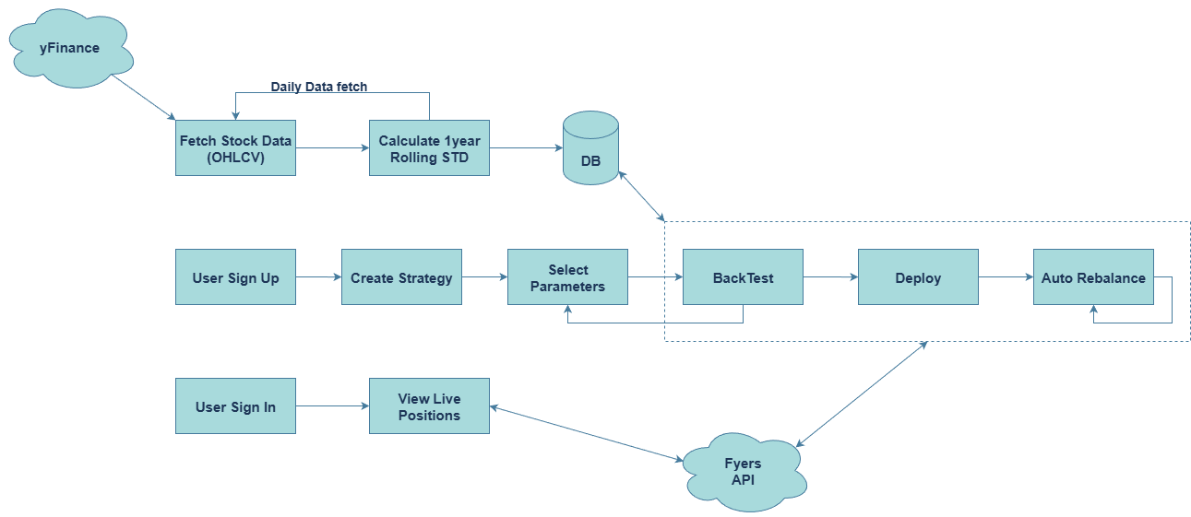
Piecing It Together
12302040501042, 48
MAT System

Slide 15









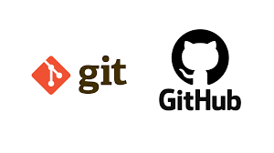
Tools & Technologies
Programming Language: Python | Data Handling & Backtesting: Pandas, NumPy
Frontend & Dashboard: HTML, CSS, JavaScript, React.js | Historical Data: yfinance
Backend Framework: FastAPI | Trading & Order Execution: Fyers API
Database: PostgreSQL | Version Control: Git & GitHub
12302040501042, 48
MAT System

Slide 16
Conclusion
The MAT System shows how momentum-based strategies can be implemented using algorithms.
The project highlights the use of automation in trading, from data analysis to order execution.
Gives Practical exposure to broker APIs and live market data handling.
The system provides a platform to experiment and learn without relying on fixed investment rules.
Hands-on experience in building end-to-end financial systems (data → logic → execution → dashboard).
Overall, the project bridges software engineering and financial markets.
12302040501042, 48
MAT System

Slide 17
References
NSE India – Historical Market Data : https://www.nseindia.com/all-reports
Nifty Indices Documentation: https://www.niftyindices.com/market-data/return-profile
Fyers API Documentation: https://myapi.fyers.in/docsv3
yFinance Docs: https://ranaroussi.github.io/yfinance/reference/index.html
Momentum Investing: https://groww.in/blog/momentum-funds
12302040501042, 48
MAT System

Slide 18
Thank You…
12302040501042, 48
MAT System

