Slide 1
Booking Options
START BOOKING
@ Joe Backpacker
1.1. Book through Atlas
1.2. Booking using widget from myallocator.com
1.3. Booking appears in Loventis PMS
2.1. Book through 3rd party
2.2. Booking made through third party, confirmation email sent
2.3. Booking synced to PMS and displayed on Calender
2.4 Booking appears in Loventis PMS

Slide 2
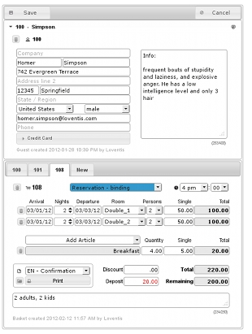
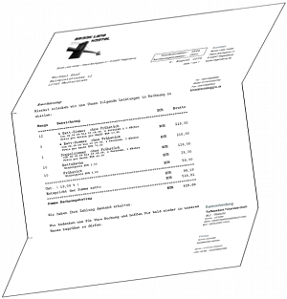
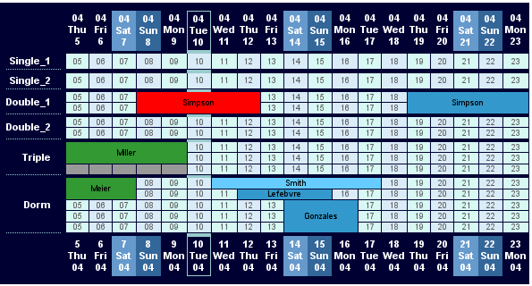
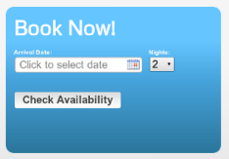
Booking Through AtlasHostels.com
Joe
Backpacker
(Start Booking)
Loventis - Property Management
System (PMS)
http://www.loventis.com/PRS
STEP 3: manage booking on loventis.com
STEP 1: Book
through
Atlas
Guest Management
Receipts
Atlas Website
MyAllocator.com Booking
STEP 2: Booking using widget from myallocator.com
Booking Calender View

Slide 3





Booking Through Third Parties
Joe
Backpacker
(Start Booking)
Loventis - Property Management
System (PMS)
http://www.loventis.com/PRS
STEP 1: Book
through
3rd party
STEP 2: Booking through 3rd party, confirmation email sent
Guest Management
Receipts
Loventis – Central
Reservation System
(CRS)
http://www.loventis.com/CRS
Two way sync
between channels
& booking
calender
STEP 3: Booking synced to PMS and displayed on Calender
Booking Calender View

