Slide 1


StudyEase
StudyEase
India's Largest And The Best
Studying App

Slide 2
What will be discuss ?
01
What is StudyEase
02 About
03 Courses / Study Subjects + Quiz
topics to be discussed
04
Contact / Thankyou

Slide 3

About StudyEase & Team
Hello We are the team who built StudyEase website working day and night to make student's work easier
We have taken 4 days to build this product
We are a team of 3 including me - Aditya singh, Ayush Kumar singh & NVSK Vishvesh

Slide 4
Deisgn Process + Fun Fact
Fun Fact
Why our logo blue
Yes it is blue in color a?s blue is favored by so many people, it is often viewed as a non-threatening color that can seem conservative and traditional. Blue calls to mind feelings of calmness or serenity
2004
2005
Website Design
Before getting started we have choosen few color blue, black & white as our main color for the website. and design the website on paper to get started
Logo Design
Our Logo is simple and clean so that it is easy to remeber by the people

Slide 5



Darkmode Feature
in our website there is a dark mode as many students study at night but more than that they study day and night to get better and better in study's so we decided to put some effort and create a darmode feature which will require less power for eyes to see and their will be less chance that the eye will get damaged for someone who dont like it they can switch back to light mode.

Slide 6

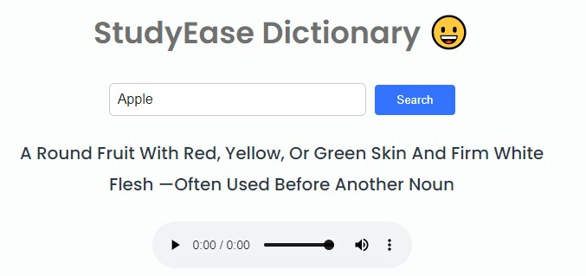
Dictionary
Most of the students want to improve their english skills and want to know meaning of words to improve their vocabulary therefore we have provided a 100% accurate dictionary where it gives you result for any word exist in the world you search...

Slide 7

About Courses & Quiz
In studyease there are 4 Competetive Exams courses and also study subjects where students ranging from class 9 - 12 can study. After learning all things our website also provides you a Quiz where you can revise the chapter or get extra knowledge / test knowledge that how much you know

Slide 8
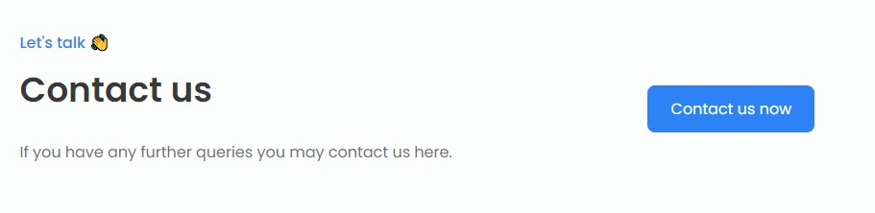
Contact Us
You can contact us regarding the feedback by click on the button in the bottom of the website.
After click on the contact us button you will be redirect to your default email sender ( Gmail or if on computer your computer default email app )

Slide 9
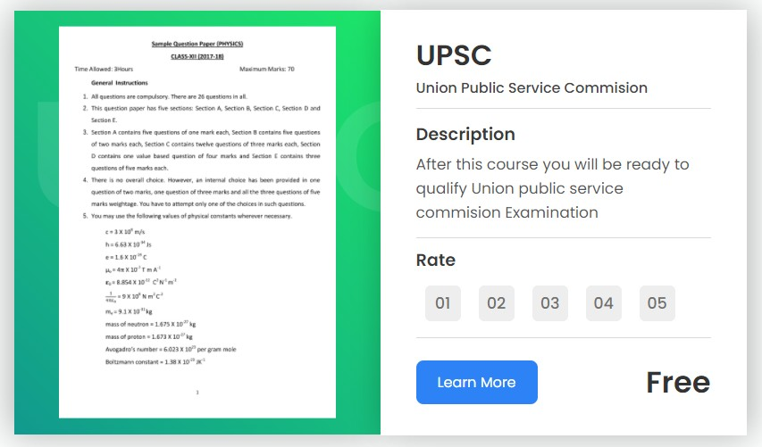
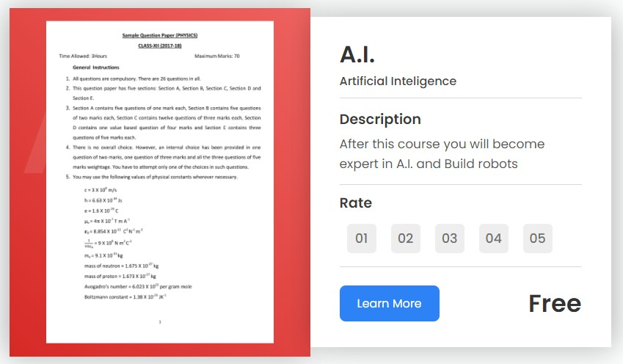
Sample Paper
Dont know how to practice then practice it from our sample papers section where we provide sample papers for all the competetive exams in our website.

Slide 10
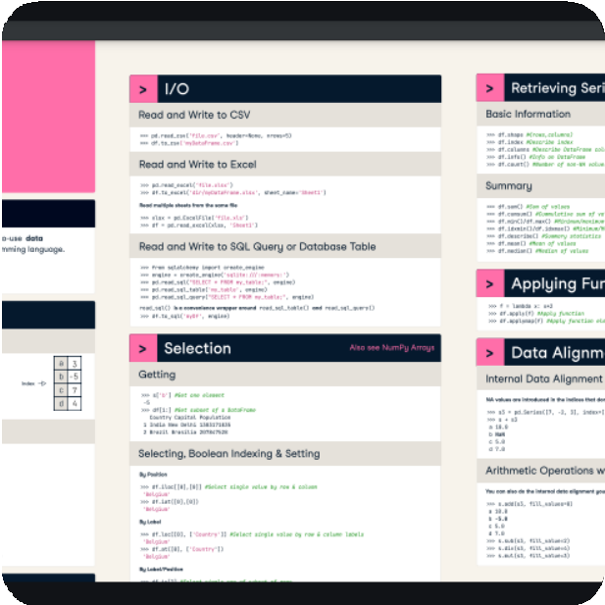
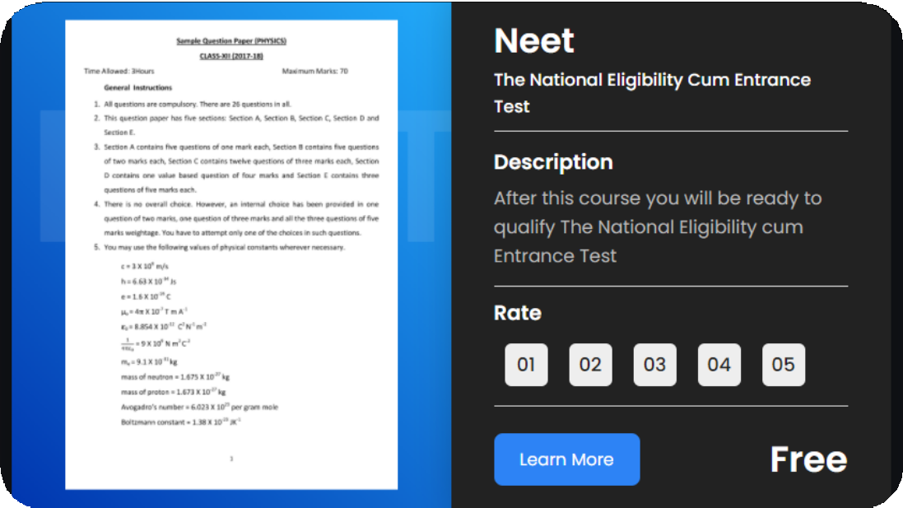
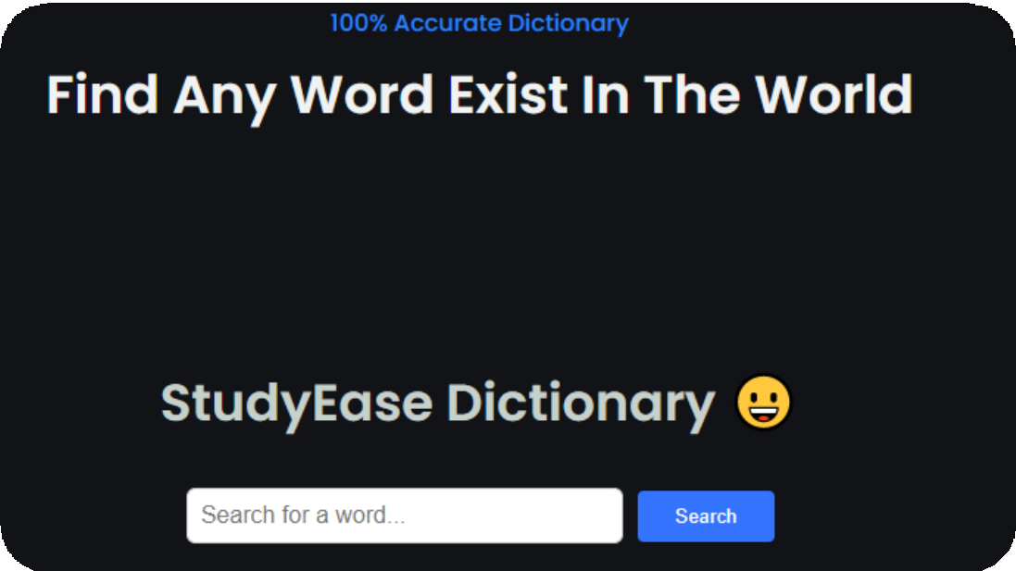
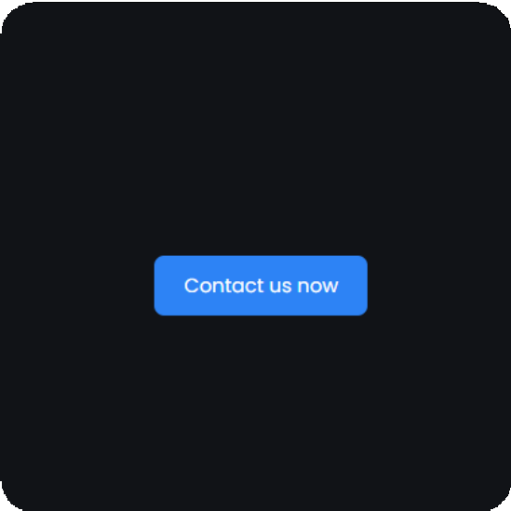
Some pictures of our website
Here are some pictures of our website.

Slide 11




Advantages of studyease
You will be ahead of everyone
you will have a cheatsheet for quick revision
you will have extra knowledge
To prepare you can get sample paper from sample paper section or by clicking on link
You can revise from the quiz button for every subjects
No need to go to google and search for word again and again we have built in dictionary to help students study
Studyease advantages

Slide 12

Contact Us
Let's Talk
Phone Number
8582944585
Email Address
adityasingh.nasa@gmail.com
Website
https://studyease.netlify.app

Slide 13
Thankyou

