Slide 1

Autosys Monitoring Tool
Enhancing Job Execution Visibility and Reliability
Objective: Introduce an automated monitoring solution to enhance real-time visibility into Autosys job executions and improve operational efficiency across data platforms.
Audience: Management and technical leadership teams responsible for data operations and service reliability.
Focus Areas: Operational visibility, proactive alerting, consolidated reporting, and system reliability improvements.
Photo by James Lee on Unsplash
Notes:
Welcome everyone. Today’s presentation introduces the Autosys Monitoring Tool—a solution designed to address visibility and reliability challenges in batch job execution. Our goal is to enhance control over job monitoring, reduce missed SLAs, and ensure early detection of potential issues. The following slides will walk through the current challenges, proposed solution, architecture, and the strategic benefits for the organization.

Slide 2
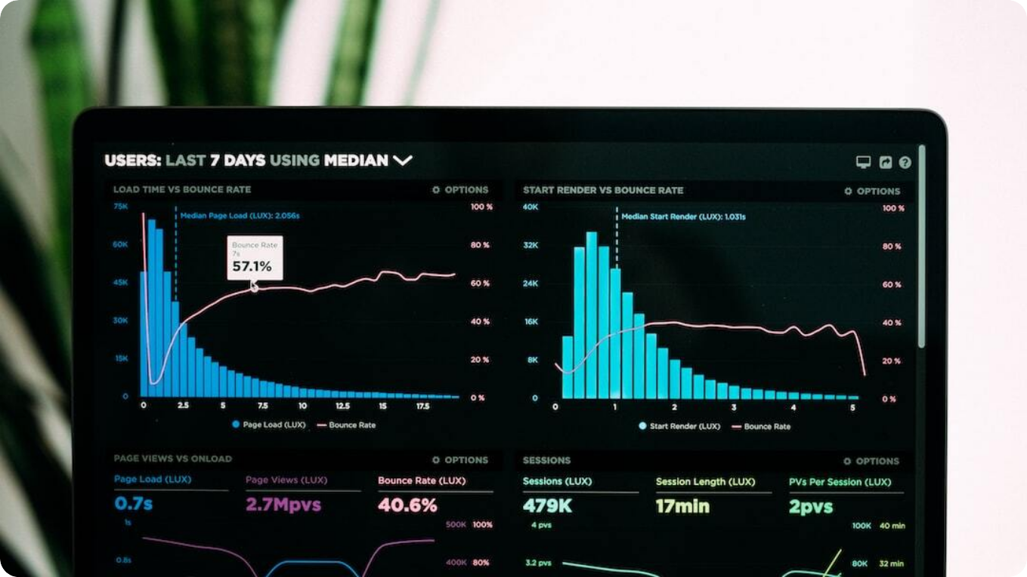
Problem Statement
Challenges in Job Execution Visibility and Monitoring
Delayed Issue Detection: Jobs running excessively long do not trigger immediate alerts, causing delays in identifying performance or runtime anomalies.
Lack of Proactive Alerts: The absence of automated notifications for stalled or failed jobs increases the likelihood of downstream process failures and SLA breaches.
Limited Visibility: Inadequate consolidated reporting makes it challenging to assess overall batch health and identify recurring operational patterns.
Photo by Luke Chesser on Unsplash
Notes:
The Control Data Platform currently faces operational blind spots in Autosys job execution. Long-running or stalled jobs often go unnoticed until they impact downstream processes. Without proactive alerting, operations teams rely on manual checks and delayed escalations. Furthermore, the absence of consolidated reporting complicates root-cause analysis and daily performance tracking. These visibility gaps directly contribute to missed SLAs and inefficiencies across critical data pipelines.

Slide 3



Business Impact
Risks of Missed SLAs and Operational Delays
SLA Breaches
Without early alerts, delayed job executions cascade through dependent workflows, increasing the risk of missed SLAs and business disruptions.
Operational Inefficiency
Manual monitoring consumes valuable engineering time and introduces delays in triaging and recovery, reducing overall productivity.
Reduced Decision Agility
Lack of timely visibility into job health prevents leadership from making proactive operational and resource decisions.
Notes:
Missed SLAs are not just operational challenges—they directly affect business performance and client trust. Manual job monitoring and delayed detection of failures cause downstream delays, making teams reactive rather than proactive. Improved visibility can significantly enhance reliability and empower data-driven operational decisions, reducing both downtime and effort.

Slide 4

Proposed Solution Overview
Automated Monitoring and Proactive Alerting for Autosys
Automated Monitoring Framework: Implements a recurring Autosys job that captures job metadata and runtime details from the scheduling environment, eliminating manual oversight.
Centralized Visibility: Consolidates job status, start time, and duration insights into a unified dashboard for comprehensive visibility.
Proactive Alerting: Generates early notifications for long-running or failed jobs, allowing teams to mitigate issues before they escalate.
Photo by Teemu Paananen on Unsplash
Notes:
The proposed Autosys Monitoring Tool automates and centralizes job tracking. It collects execution data, analyzes performance, and issues alerts—all without manual intervention. The goal is to improve operational visibility, reduce response time, and ensure critical workflows meet their SLAs through proactive management.

Slide 5

Solution Architecture Diagram
Conceptual Overview of the Autosys Monitoring Tool
Autosys Scheduler: Acts as the source of job execution data, including status, start and end times, and dependency relationships.
Monitoring Engine: A periodic Autosys job queries metadata tables, validates run metrics, and detects anomalies in job performance.
Reporting and Alerting Layer: Aggregates monitoring results into dashboards and sends proactive notifications through email or monitoring systems.
Photo by Adrien WIESENBACH on Unsplash
Notes:
This conceptual architecture illustrates the end-to-end data flow of the Autosys Monitoring Tool. Autosys provides raw job execution data to the monitoring engine, which then performs validation and anomaly detection. Results are passed to the reporting and alerting layer, ensuring operational teams have actionable insights through unified dashboards and alerts.

Slide 6




Core Functionalities
Monitoring Logic, Analysis, and Reporting Features
Start Time Monitoring
Tracks job initiation times and compares them against historical baselines to detect delays in execution cycles.
Run Duration Monitoring
Evaluates job runtime against thresholds to identify performance anomalies and resource bottlenecks.
Failure and Dependency Tracking
Detects failed jobs and maps their downstream dependencies to anticipate potential impact areas.
Consolidated Reporting
Provides unified reports summarizing job health, trends, and SLA compliance across environments.
Notes:
The Autosys Monitoring Tool offers a comprehensive set of functionalities that go beyond basic job tracking. It evaluates job start times and durations, detects failures early, and analyzes dependency chains to assess potential impacts. The system’s reporting component then aggregates these insights into consolidated dashboards, helping both technical and management teams quickly grasp operational health.

Slide 7




Benefits and ROI
Operational and Strategic Advantages of the Monitoring Tool
Enhanced Reliability
Continuous automated monitoring reduces unplanned downtime and ensures timely completion of critical batch jobs.
Operational Efficiency
Eliminates manual job tracking, allowing teams to focus on analysis and optimization rather than reactive firefighting.
Faster Issue Resolution
Proactive alerting enables earlier detection of anomalies, minimizing service disruption and recovery times.
Strategic Visibility
Unified reporting provides leadership with data-driven insights for capacity planning and SLA management.
Notes:
The Autosys Monitoring Tool creates measurable value across operations. By automating the monitoring process, it strengthens system reliability and reduces operational overhead. Teams can focus on optimization rather than manual triage, and management gains clear visibility into performance trends. Together, these benefits translate into a more resilient and insight-driven data platform.

Slide 8




Implementation Roadmap
Phased Approach to Deployment
Phase 1 – Design & Planning
Define scope, identify Autosys job categories, and finalize metadata schema for monitoring integration.
Phase 2 – Development
Implement the monitoring job, validation logic, and initial alerting mechanisms using Autosys and database scripts.
Phase 3 – Testing & Optimization
Conduct performance testing, validate accuracy of alerts, and tune thresholds for optimal detection sensitivity.
Phase 4 – Rollout & Training
Deploy to production, onboard support teams, and provide training on dashboard usage and incident response.
Notes:
Implementation will follow a structured, four-phase approach. Starting with design and planning, we establish scope and metadata architecture. The development phase builds the monitoring engine and alerting workflows. Rigorous testing ensures system accuracy before rollout, where teams are trained to fully leverage monitoring dashboards and respond efficiently to alerts.

Slide 9




Future Enhancements
AI-Driven Monitoring and Predictive Capabilities
Predictive Analytics
Leverage AI to forecast potential job delays or failures based on historical trends and workload patterns.
Anomaly Detection
Implement machine learning models to identify unusual runtime behaviors and automatically flag high-risk executions.
Intelligent Root Cause Analysis
Use natural language processing and correlation algorithms to suggest probable causes for job failures.
Self-Healing Workflows
Enable automated job restarts or dependency adjustments based on predefined recovery logic to minimize downtime.
Notes:
The next evolution of the Autosys Monitoring Tool integrates AI to move from reactive to predictive operations. By analyzing historical job performance, machine learning models can anticipate failures before they occur. Intelligent root cause analysis and self-healing workflows will further automate recovery actions, paving the way for a truly autonomous and resilient monitoring ecosystem.

Slide 10

Conclusion & Next Steps
Driving Proactive, Intelligent Operations
Strategic Alignment: The Autosys Monitoring Tool aligns with enterprise goals of operational excellence, reliability, and data-driven decision-making.
Immediate Priorities: Finalize testing, deploy dashboards, and establish governance processes for alert management and ownership.
Future Direction: Integrate AI-based predictive insights, expand coverage across systems, and mature toward autonomous operations.
Photo by Cytonn Photography on Unsplash
Notes:
In conclusion, the Autosys Monitoring Tool represents a key step in modernizing batch operations management. It directly supports the organization’s mission to achieve proactive, reliable, and insight-driven data operations. The immediate focus should be on completing deployment and embedding the tool into daily workflows, while strategically advancing toward AI-driven automation in the future.

