Slide 1

Notes:
Open with the reassurance: most people with type 1 can book a massage like anyone else. This deck is about the handful of things that are different &mdash; mainly insulin, sensors and feet &mdash; not a list of reasons to stay away.

Slide 2
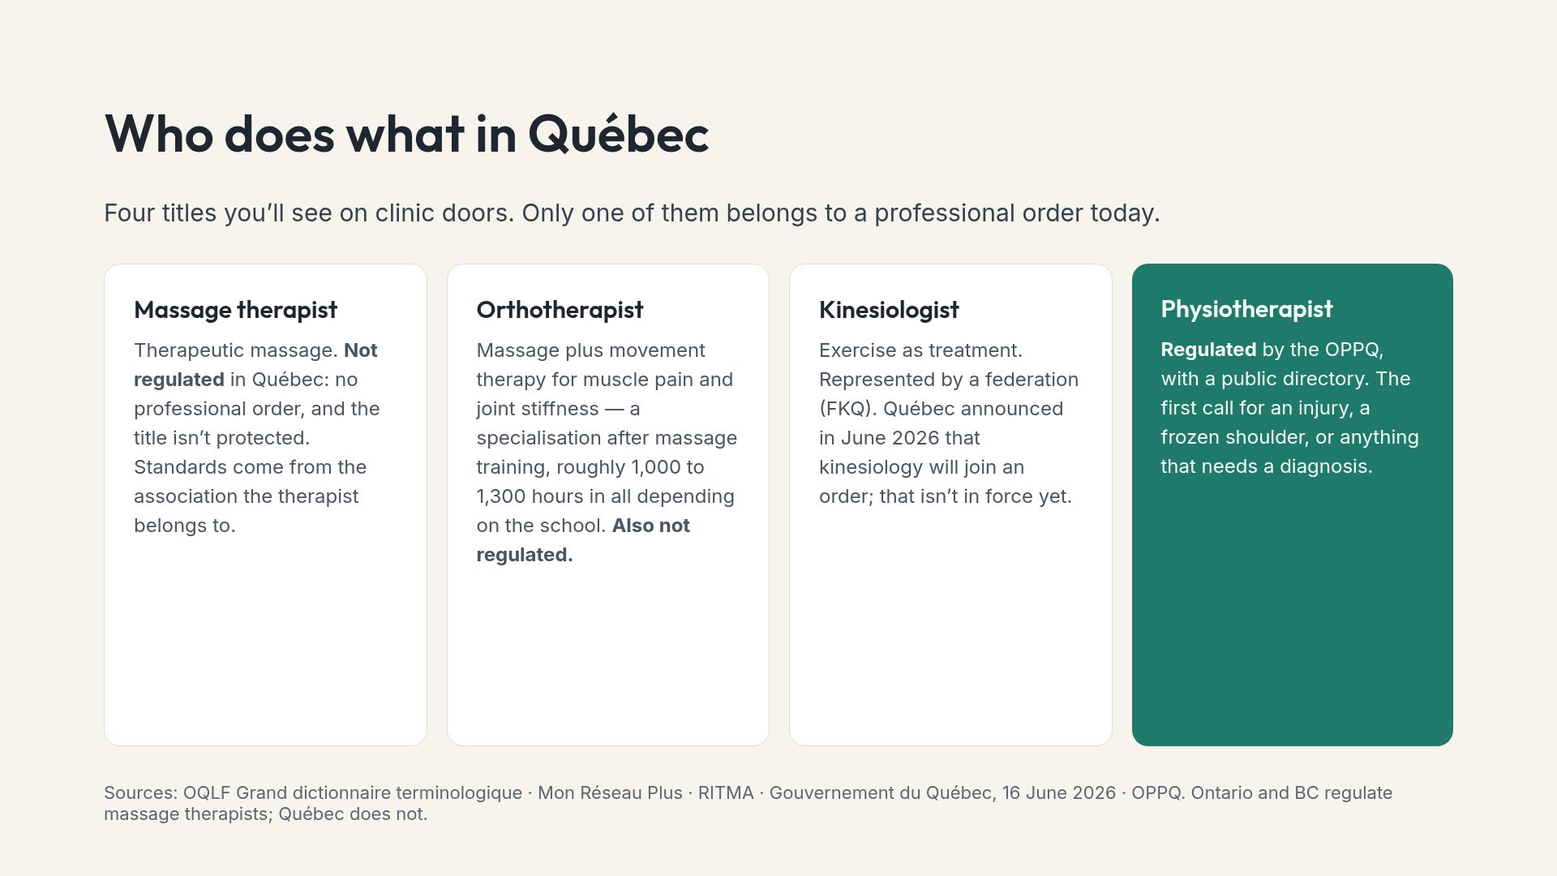
Notes:
In Qu&eacute;bec a kin&eacute;sith&eacute;rapeute is an unregulated movement therapist, not the regulated French masseur-kin&eacute;sith&eacute;rapeute. People who have lived in France mix these up.

Slide 3
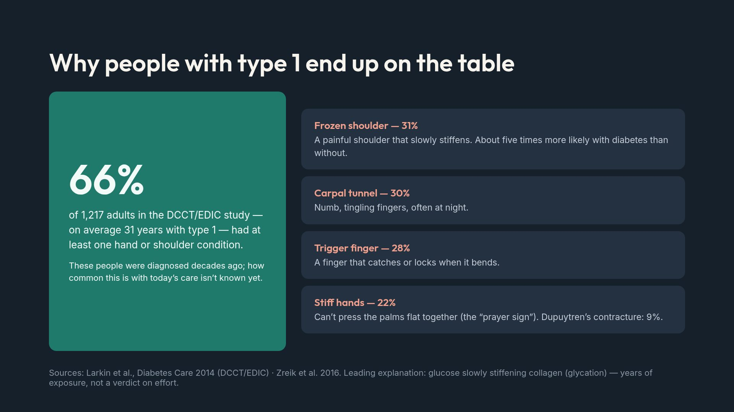
Notes:
These are common, under-recognised and treatable; many people assume a stiff shoulder is just age. Intensive versus conventional treatment in the original trial: 64% versus 68%, not a significant difference. This is not a scorecard.

Slide 4
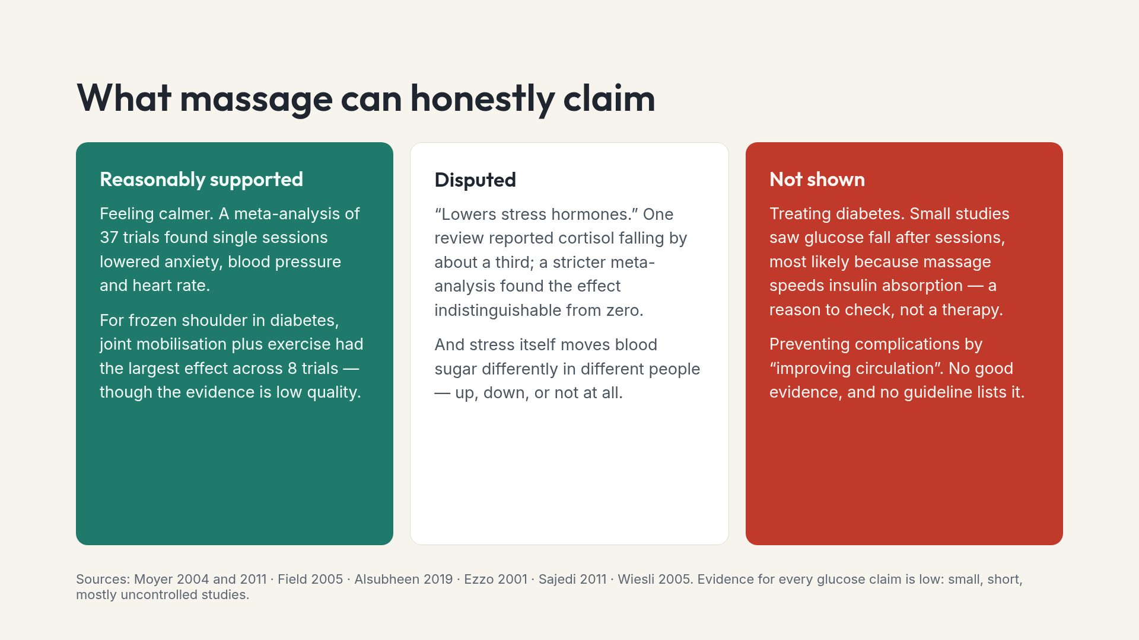
Notes:
This slide exists because the claims circulating online &mdash; lowers cortisol, improves circulation, helps manage glucose &mdash; are stronger than the research. Say it plainly: go because it feels good and helps you move, not to treat diabetes.

Slide 5
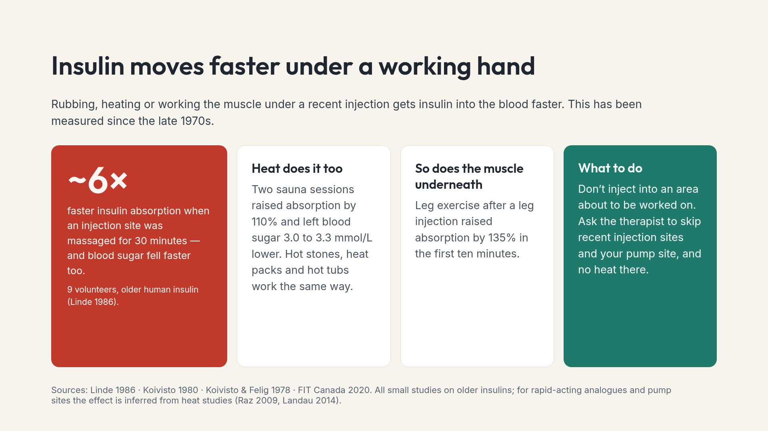
Notes:
FIT Canada: massaging the injection site immediately before or after an injection is not recommended, because it makes insulin action unpredictable. How long to keep clear depends on the insulin; your team can tell you how long yours stays active.

Slide 6
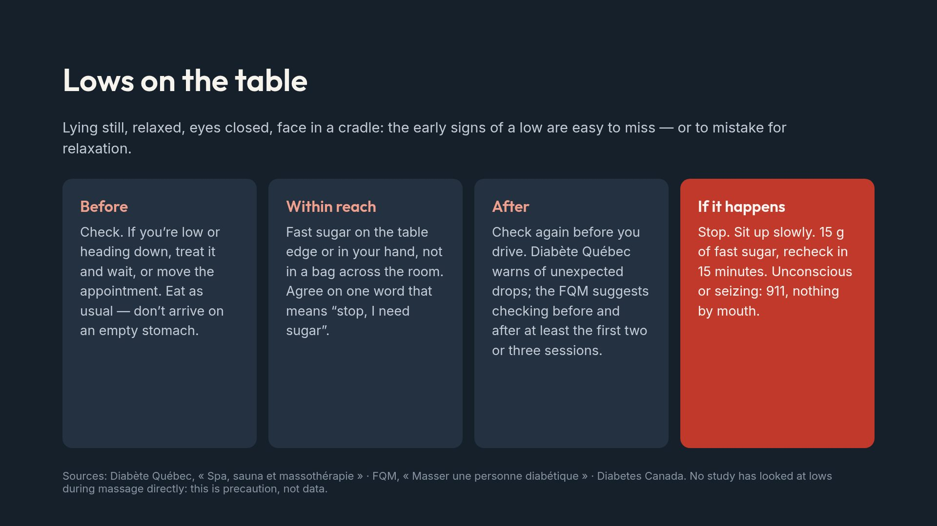
Notes:
The one word matters. Many people with type 1 won&rsquo;t interrupt a session they are paying for. Give them permission in advance.

Slide 7
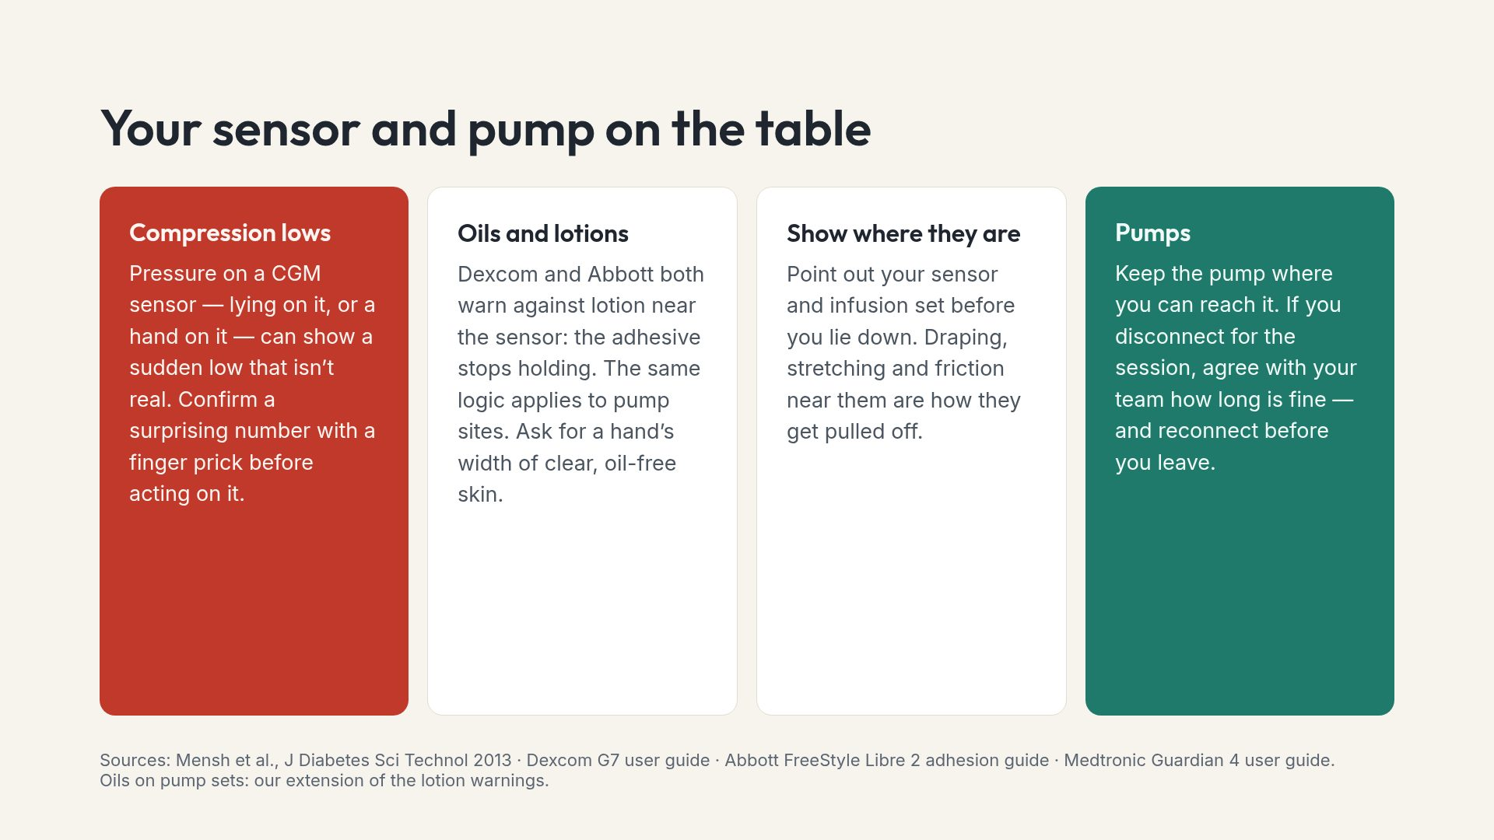
Notes:
&ldquo;Compression low&rdquo; is the community name; the literature calls it pressure-induced sensor attenuation. Every manual says to check with a meter whenever the reading doesn&rsquo;t match how you feel.

Slide 8
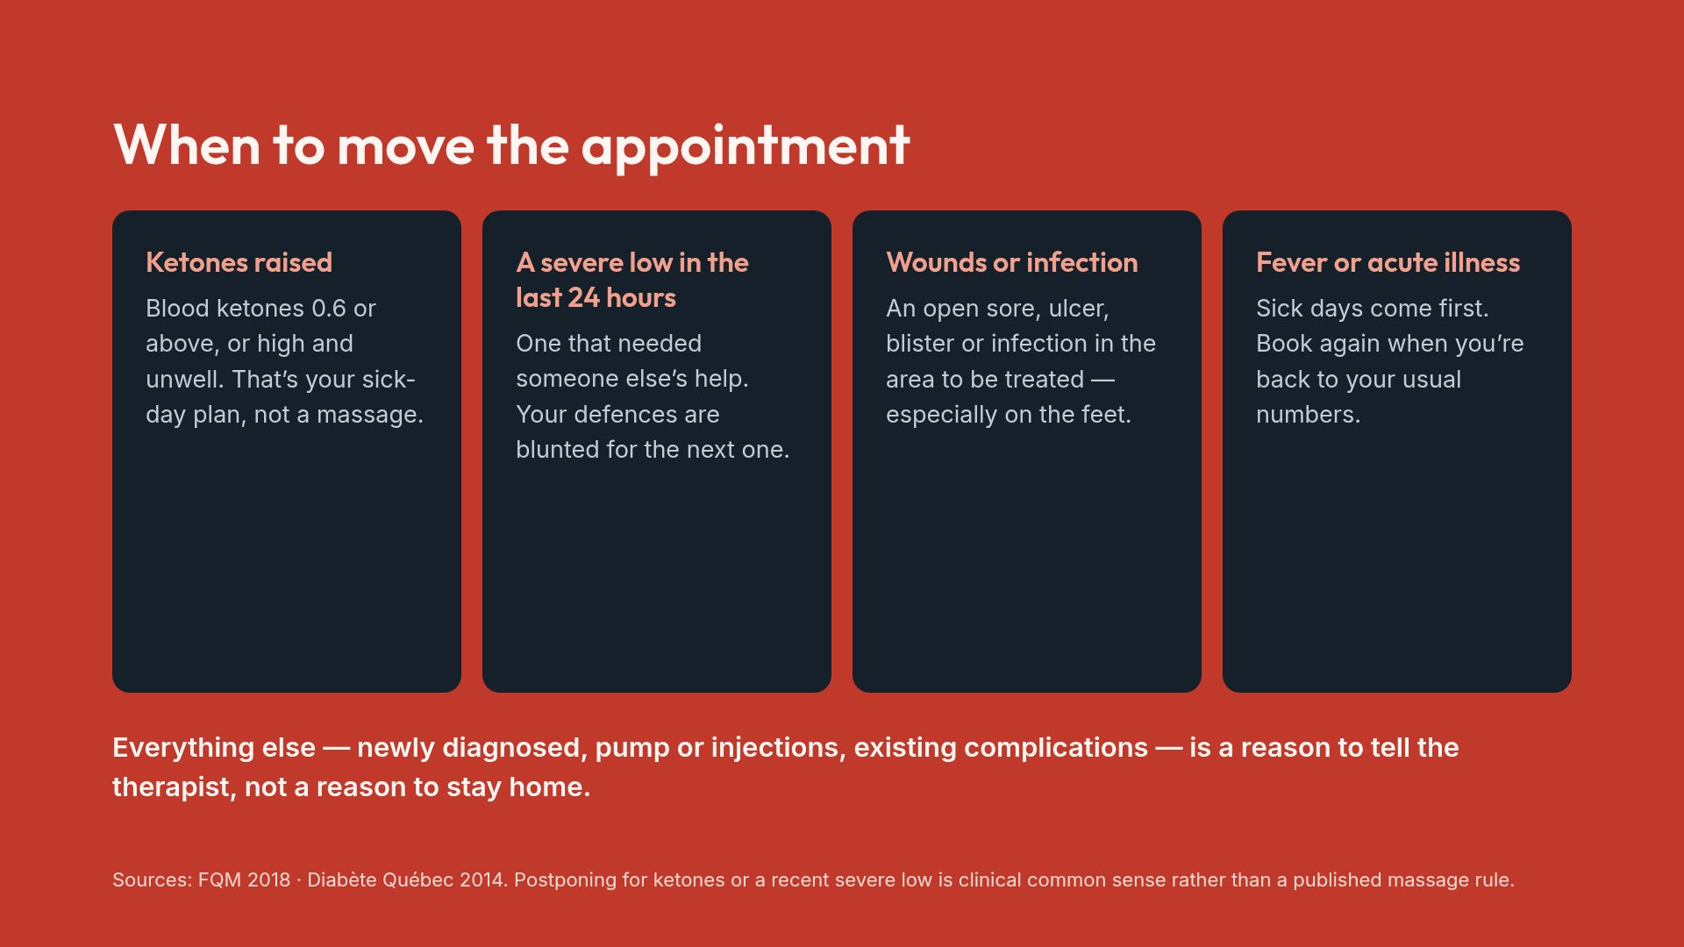
Notes:
The draft advice circulating online calls for a doctor&rsquo;s clearance before every booking. The FQM asks for one only when in doubt. Don&rsquo;t medicalise a massage.

Slide 9
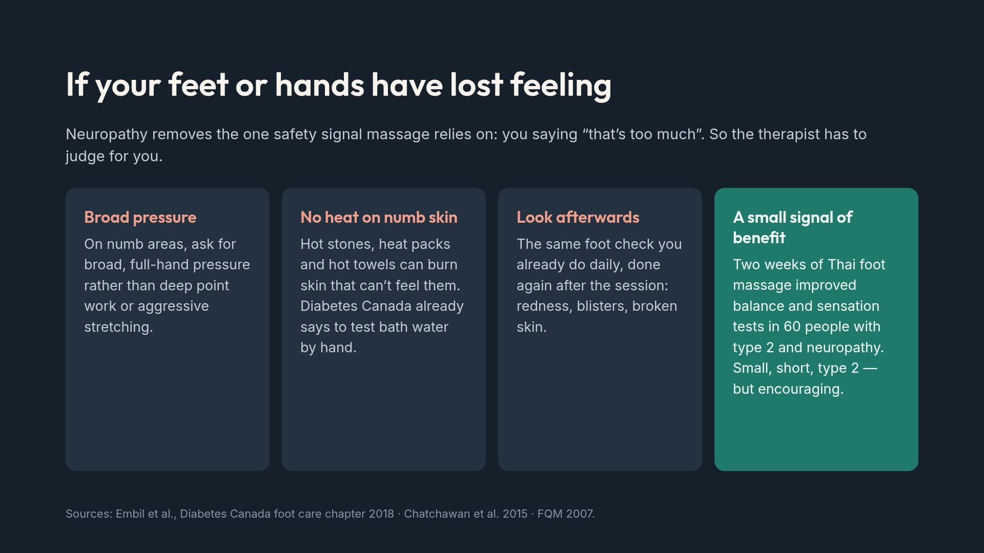
Notes:
Tell the therapist where the numbness starts and stops. A map is more useful than the word &ldquo;neuropathy&rdquo;.

Slide 10
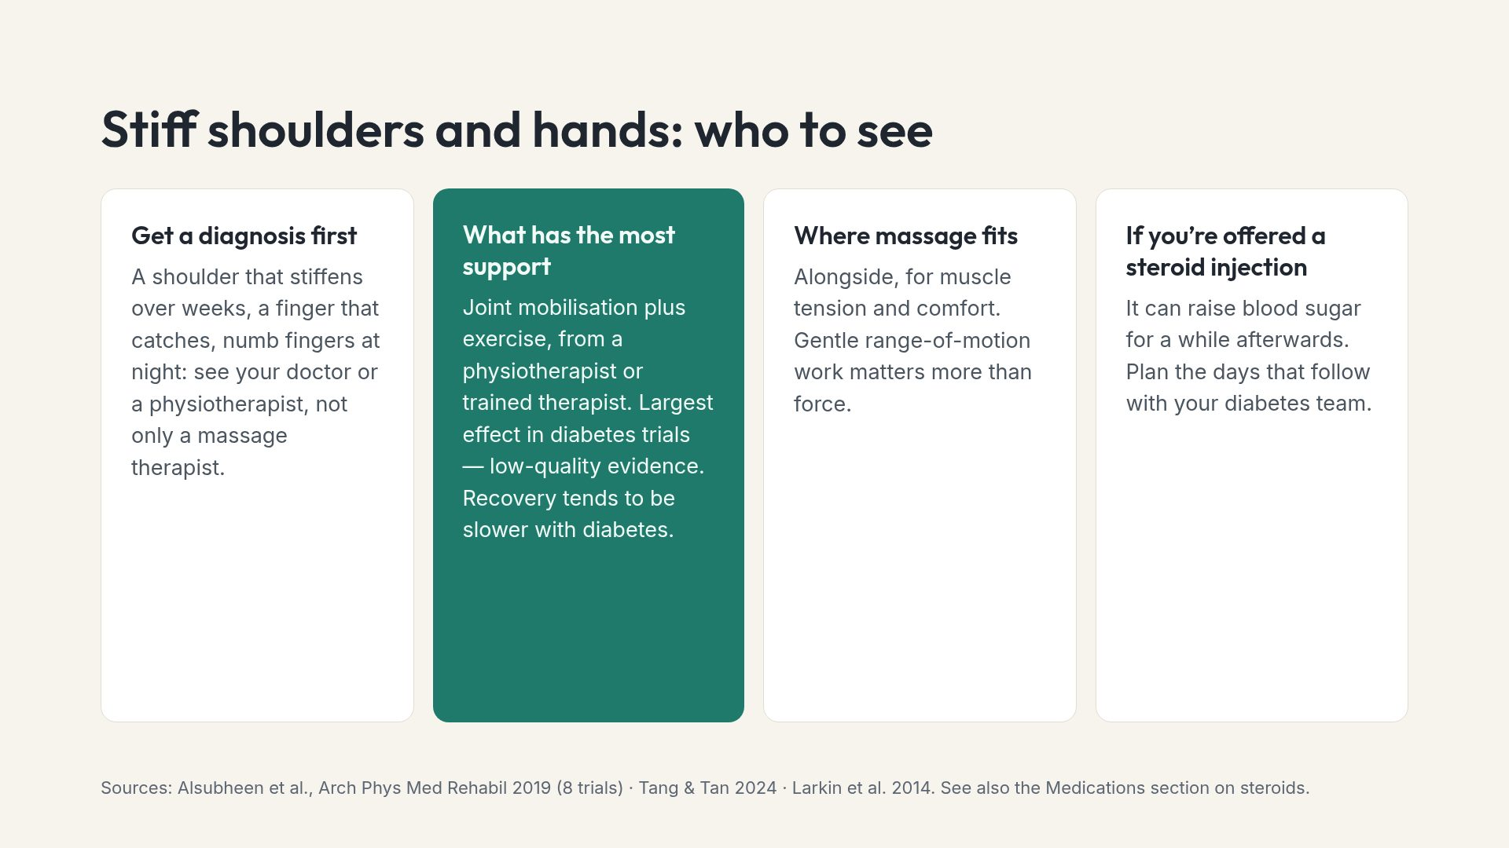
Notes:
Orthotherapists often see these first, because people book for &ldquo;a stiff shoulder&rdquo;. The most useful thing a therapist can say is &ldquo;have you mentioned this to your diabetes team?&rdquo;

Slide 11
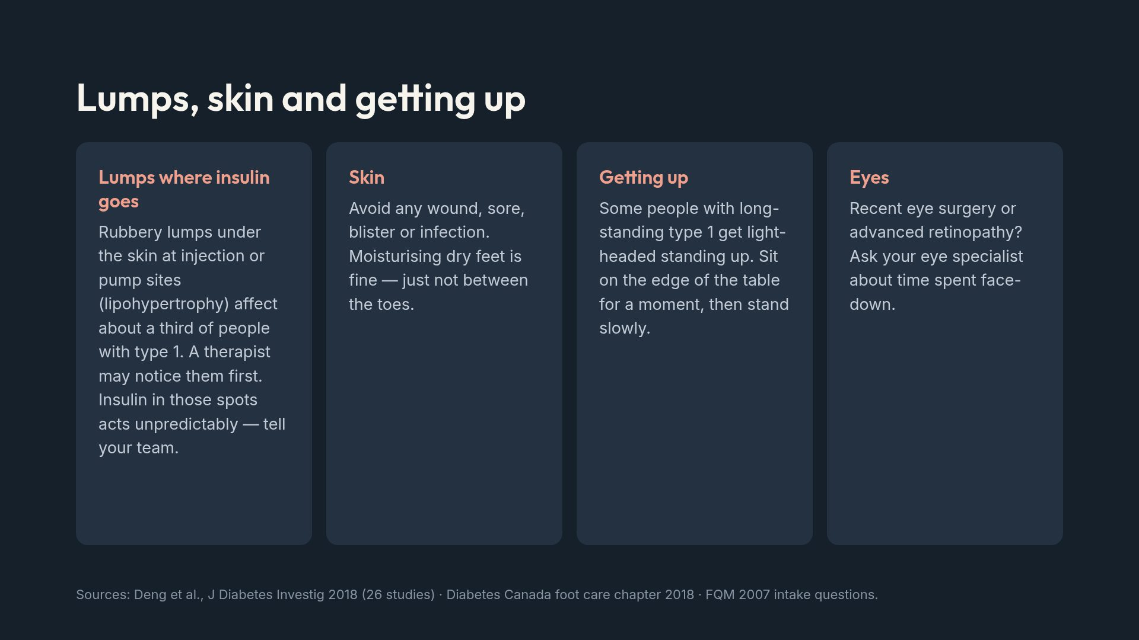
Notes:
Lipohypertrophy is a genuinely useful thing for a therapist to spot, and it is a site-rotation issue, not a personal failing.

Slide 12
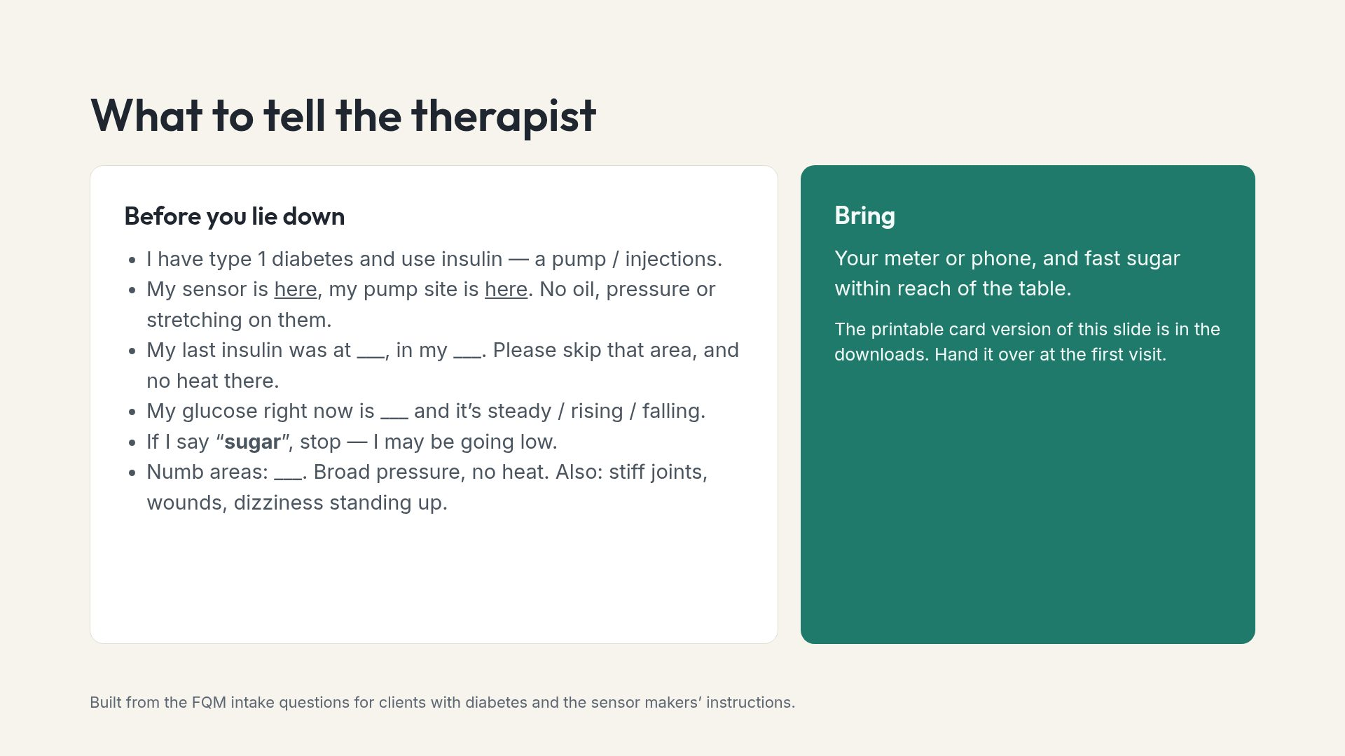
Notes:
Practise saying this once at home. People skip it at the clinic because it feels like a lot to explain to a stranger. The card does the explaining.

Slide 13
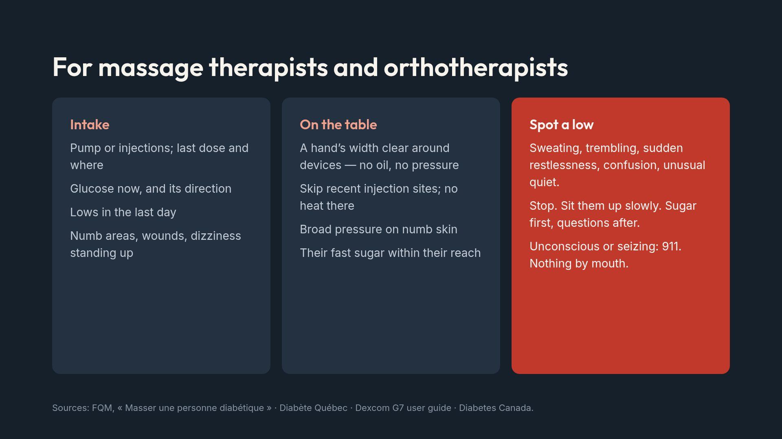
Notes:
A sensor alarm during a session is not an interruption to apologise for. Give the client a moment to read it.

Slide 14
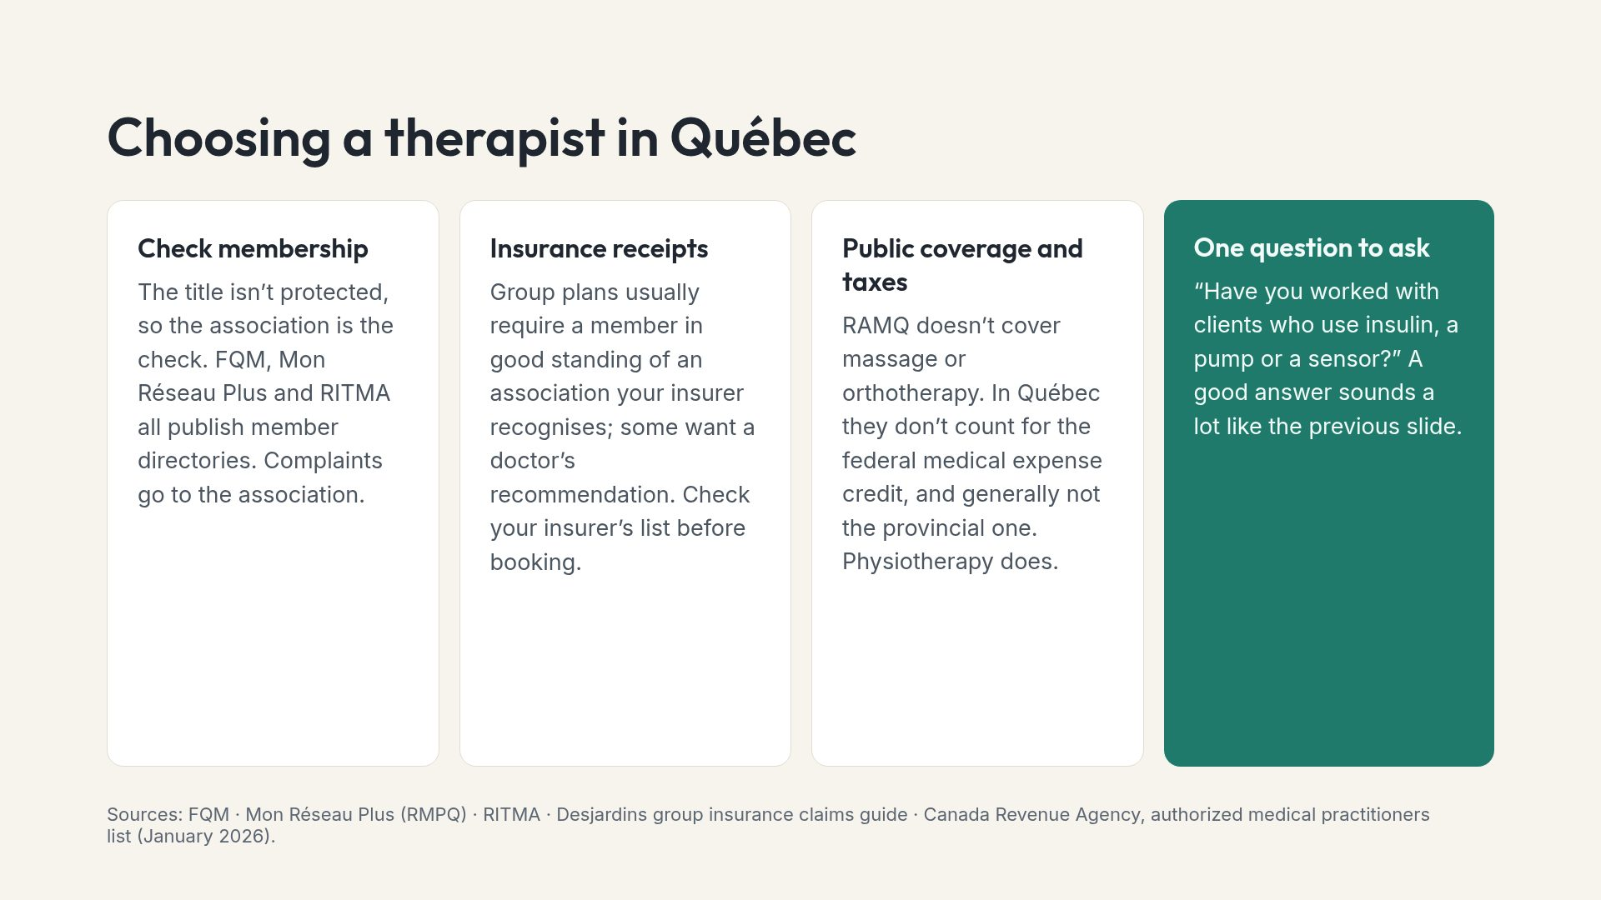
Notes:
We don&rsquo;t recommend specific clinics or associations. The point is that, in Qu&eacute;bec, the patient does the checking that an order would do elsewhere.

Slide 15
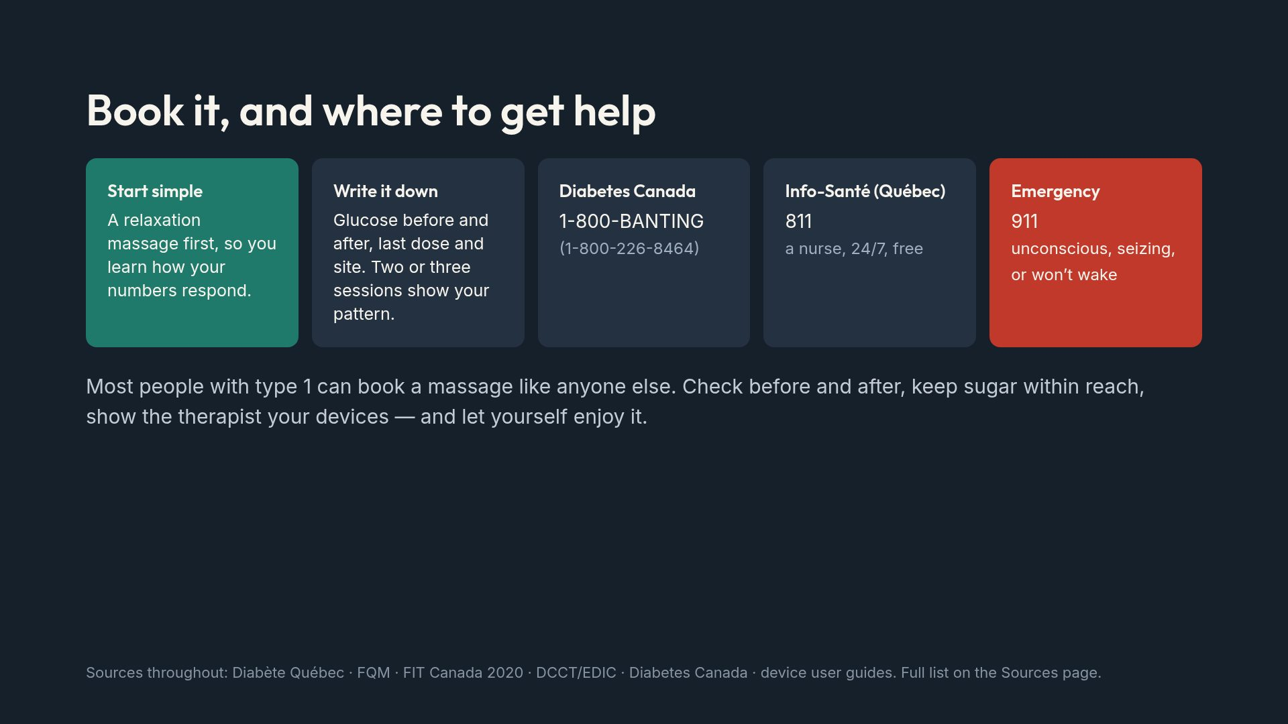
Notes:
Close on permission. The aim of this deck is that someone with type 1 books the appointment, not that they are scared out of it.

