Slide 1
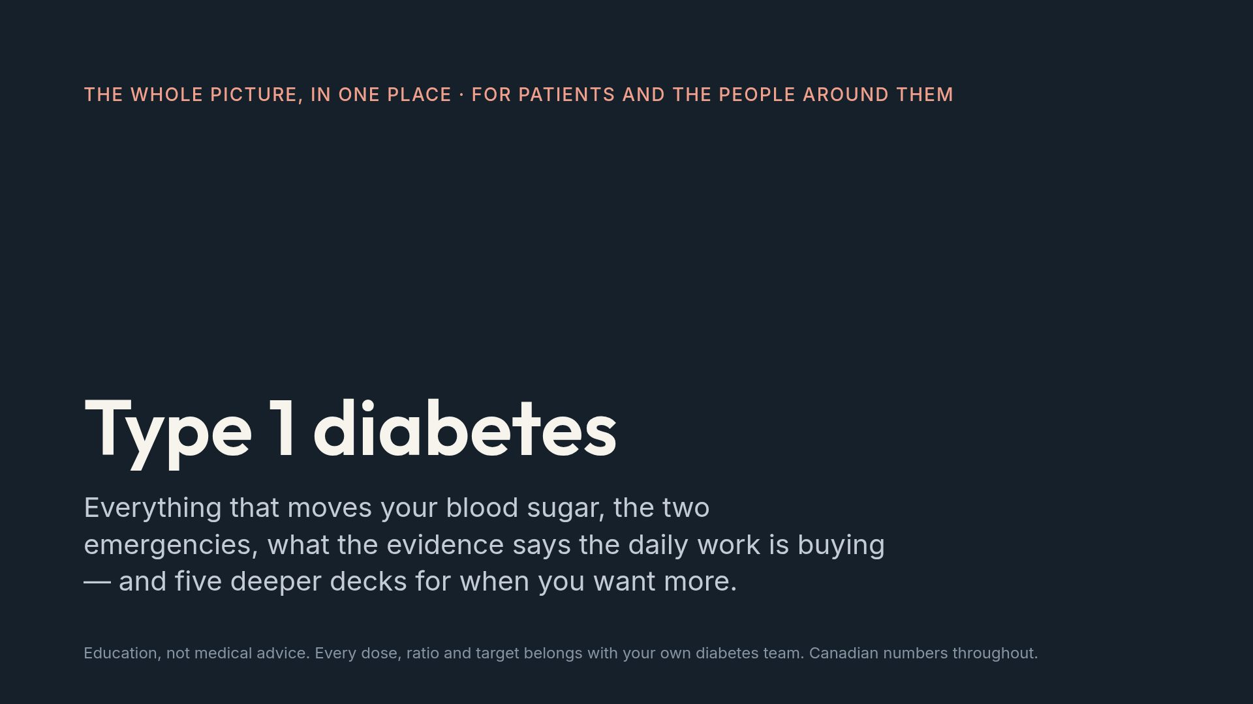
Notes:
This deck stands alone. It is also the front door to five subject decks — food, movement, medications, recreational drugs, and complications — and the last two slides point the way.

Slide 2
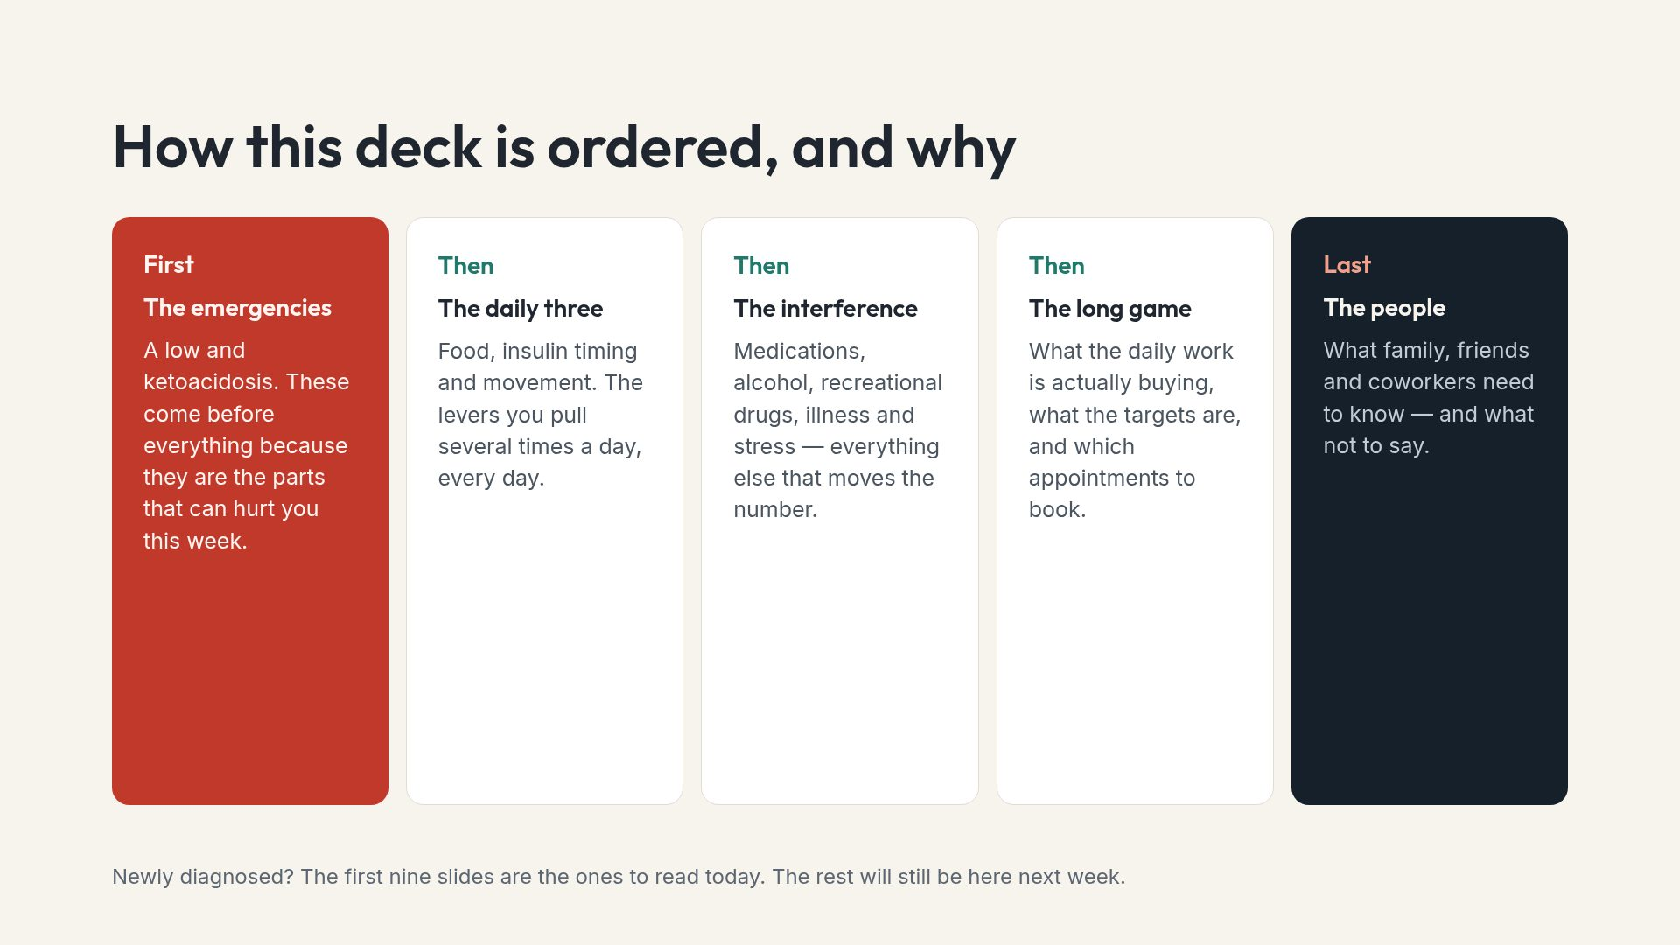
Notes:
Giving people permission to stop after the emergency section is deliberate. Newly diagnosed people are usually overwhelmed, and safety is the only part that cannot wait.

Slide 3
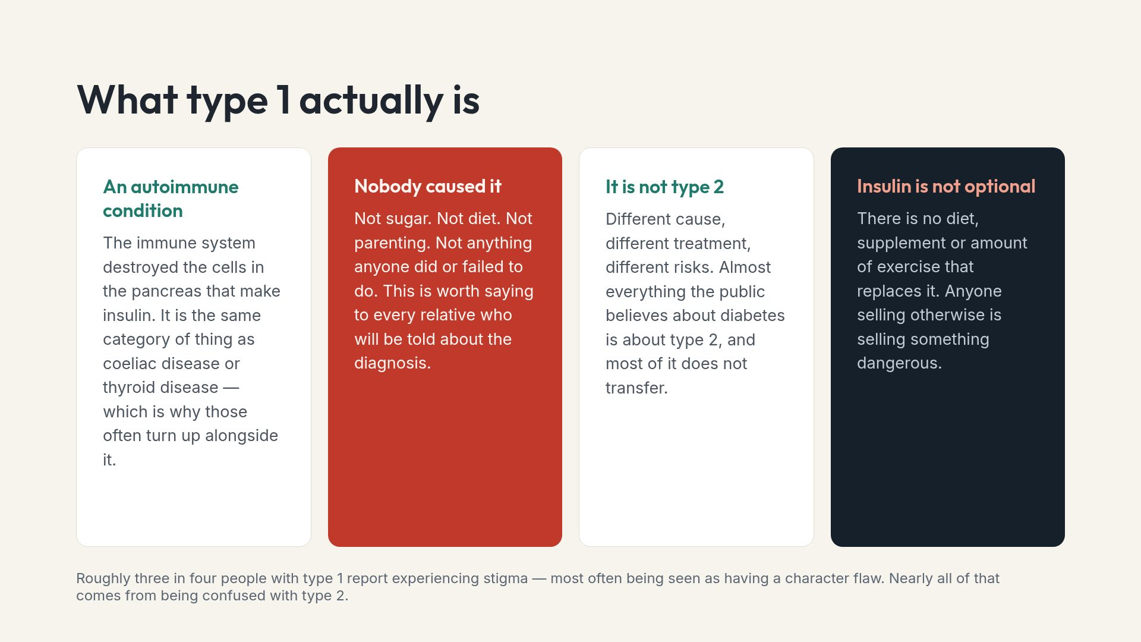
Notes:
The stigma figure explains a lot of what people with type 1 experience socially, and it tends to land hard with families who have unknowingly contributed to it.

Slide 4
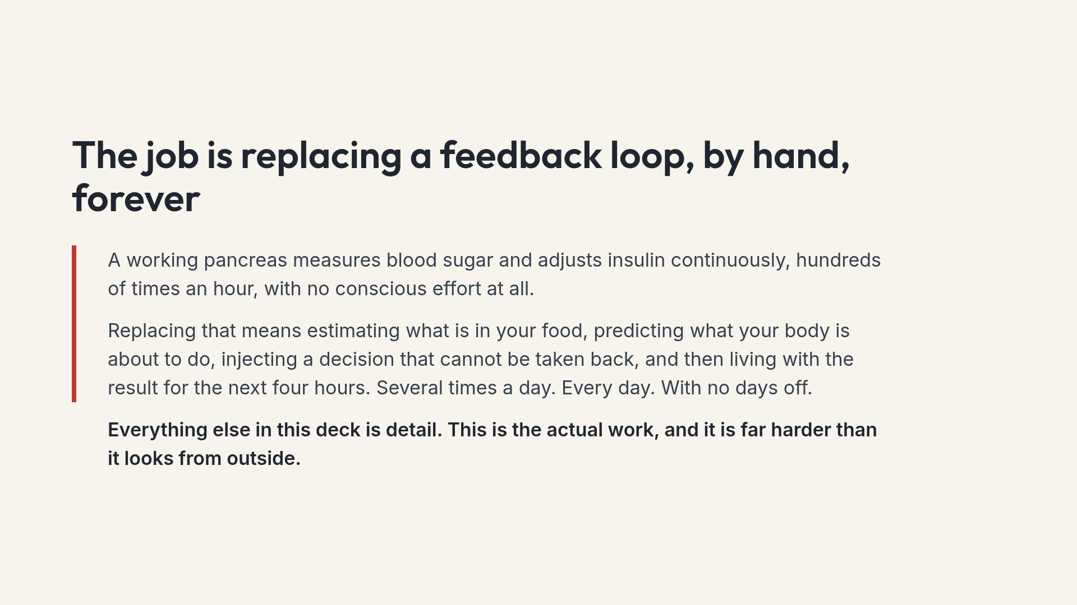
Notes:
For family members in the room, this is the slide that conveys the scale. The decision-cannot-be-taken-back point is what separates insulin from most medication.

Slide 5
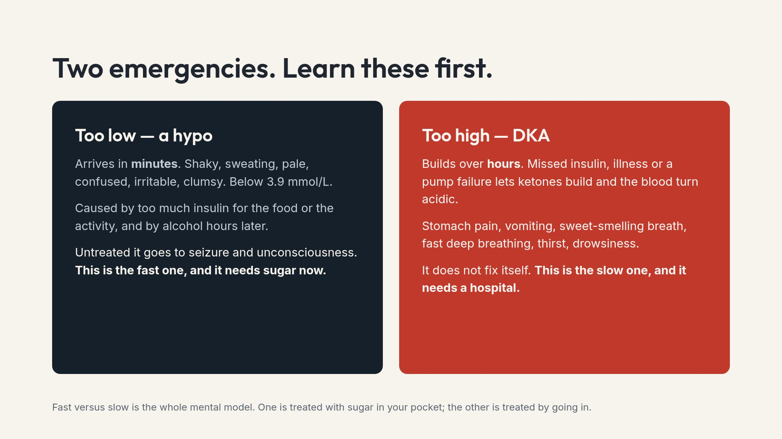
Notes:
Anyone who spends time with the person — partner, roommate, coworker, coach — should be able to describe both of these. It takes two minutes to teach.

Slide 6
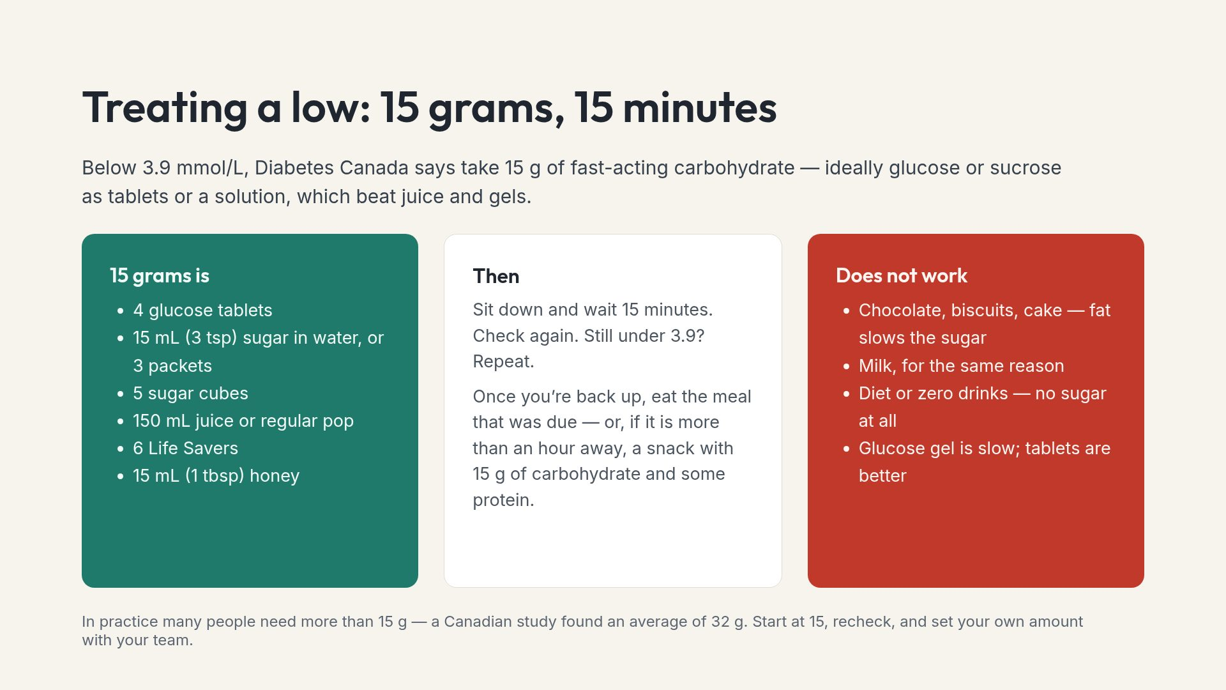
Notes:
The diet drink error is the classic one at a family table, where both cans sit in the same fridge and look identical.

Slide 7
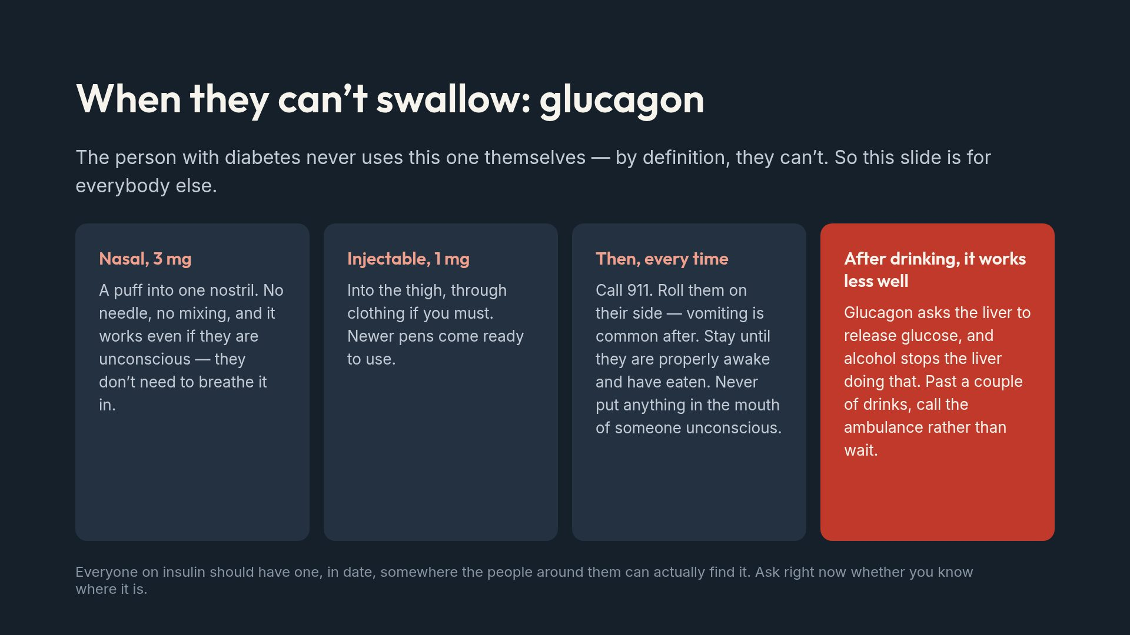
Notes:
Ask the room the question in the footer. The answer is usually no, and that is the point of the slide.

Slide 8
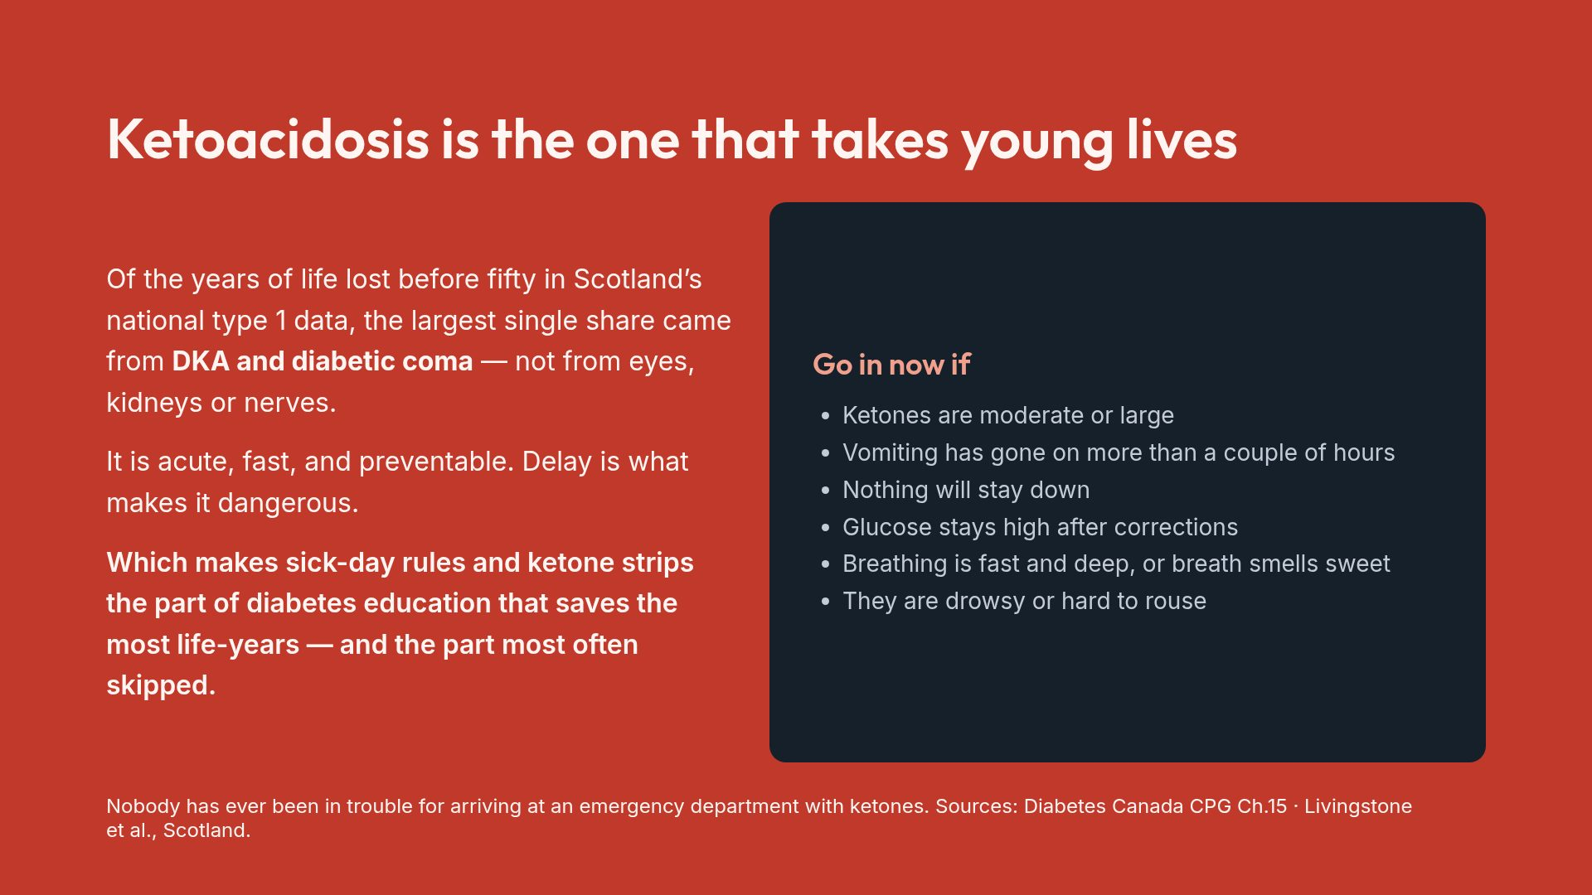
Notes:
Most patient material gives DKA a footnote and retinopathy a chapter. The mortality data say to do the reverse for a young audience.

Slide 9
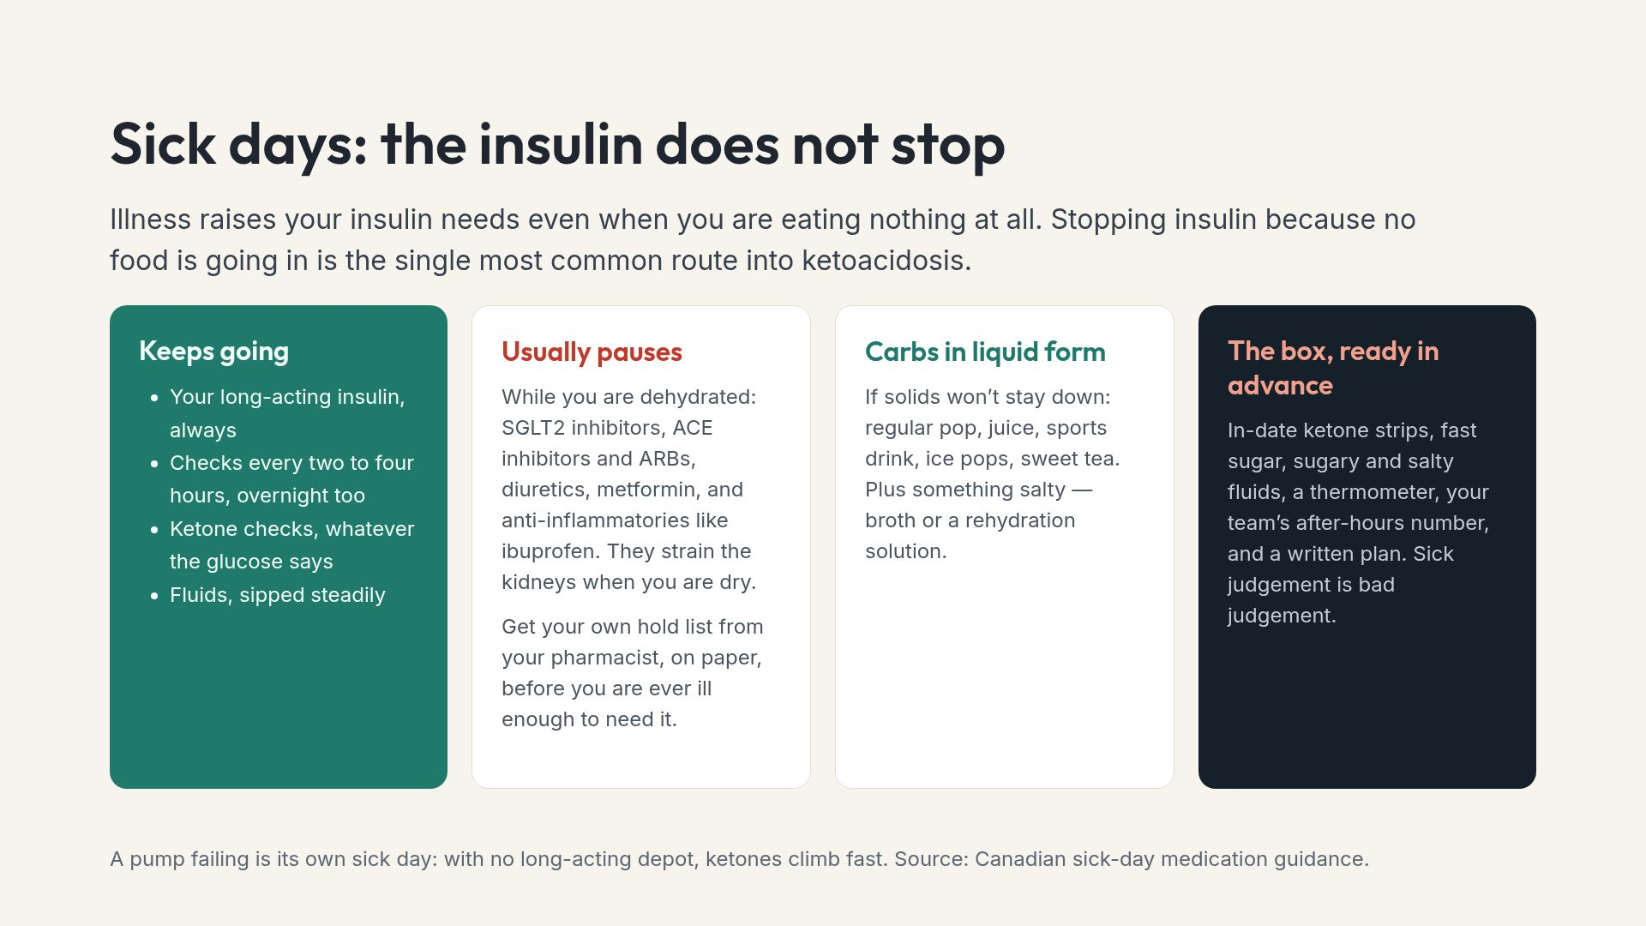
Notes:
The written plan matters because the person reading it may be a parent or partner while the patient is too unwell to think.

Slide 10
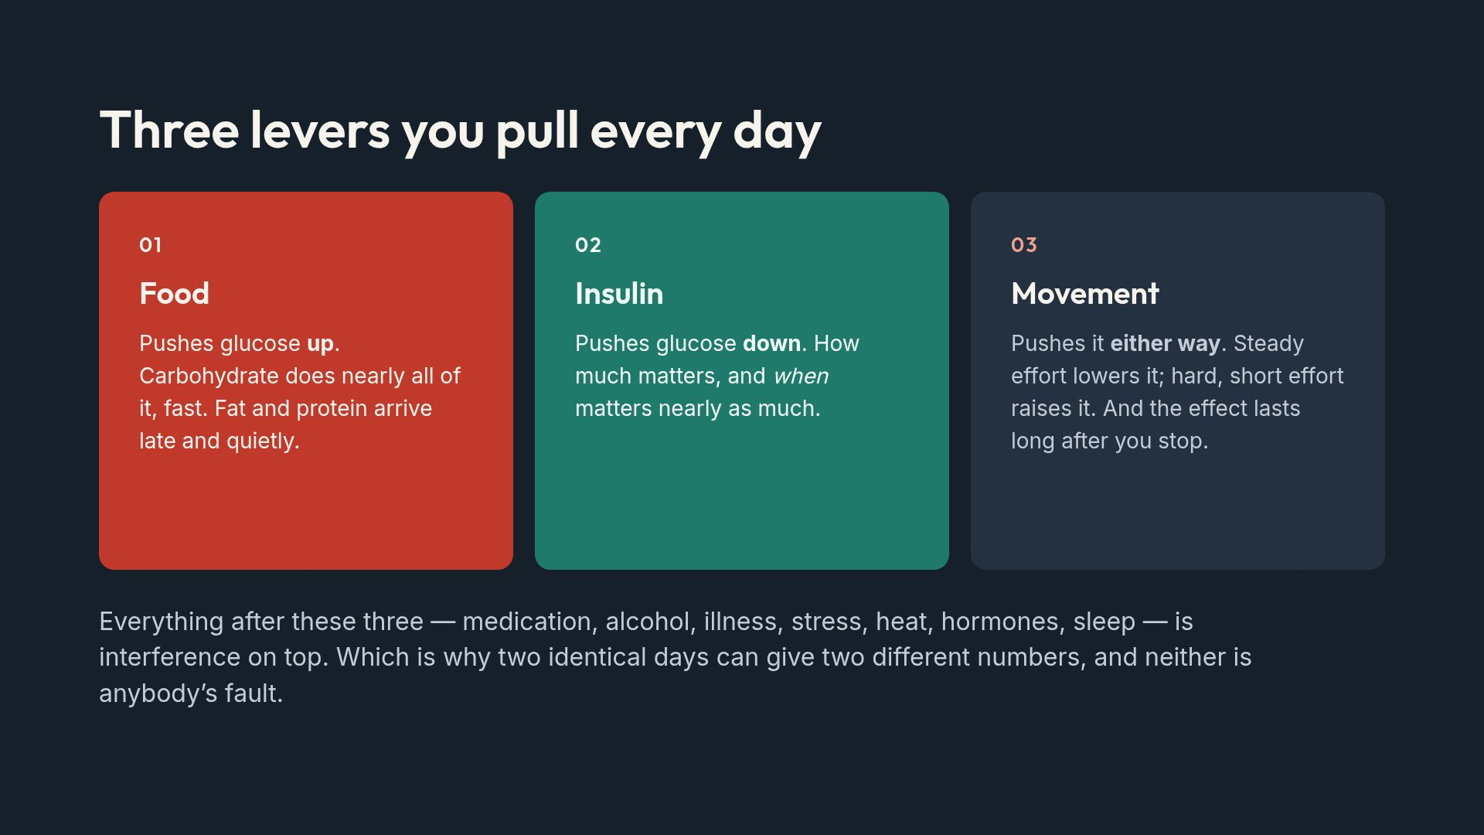
Notes:
The closing line pre-empts the most common source of self-blame: doing the same thing twice and getting different results.

Slide 11
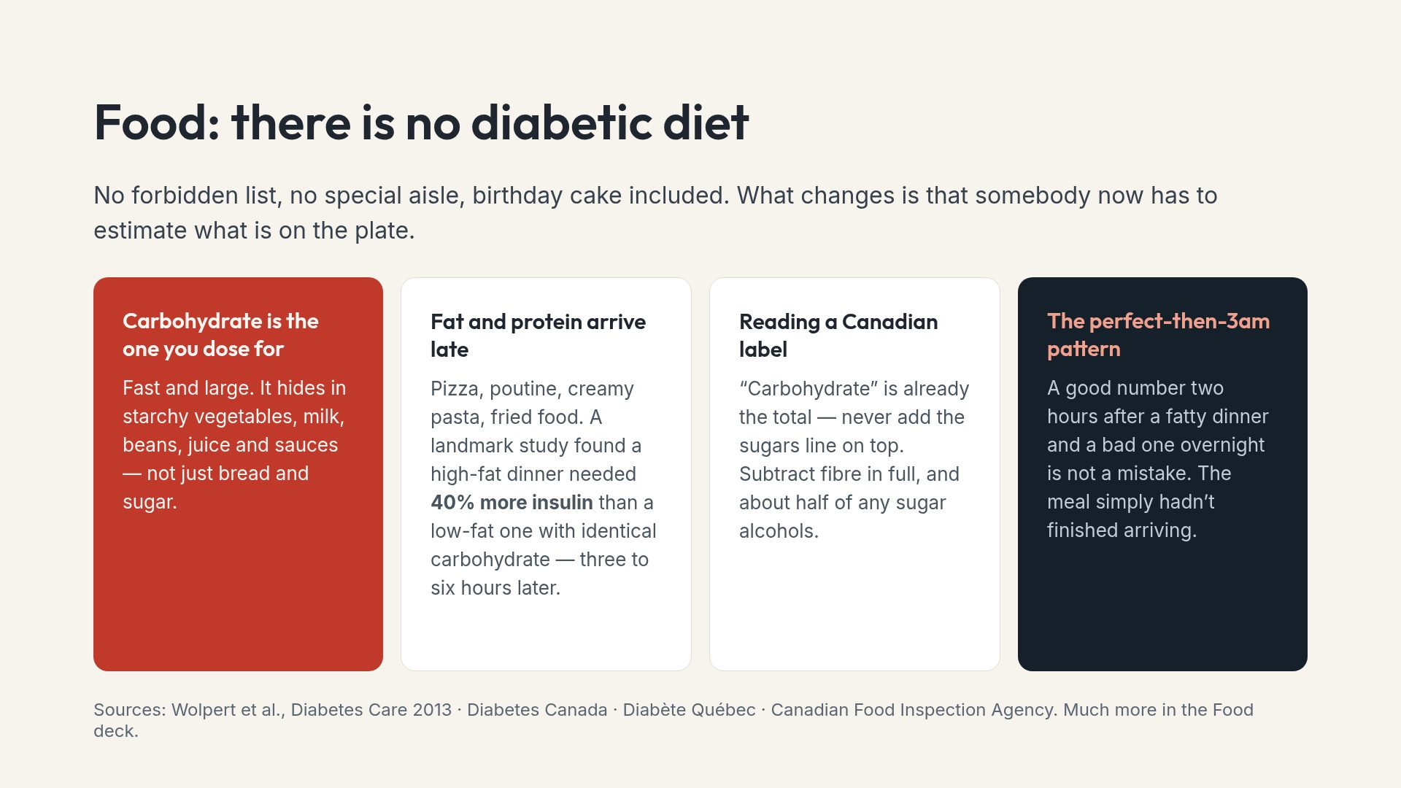
Notes:
The late-rise concept explains a failure nearly everyone has already experienced and blamed themselves for.

Slide 12
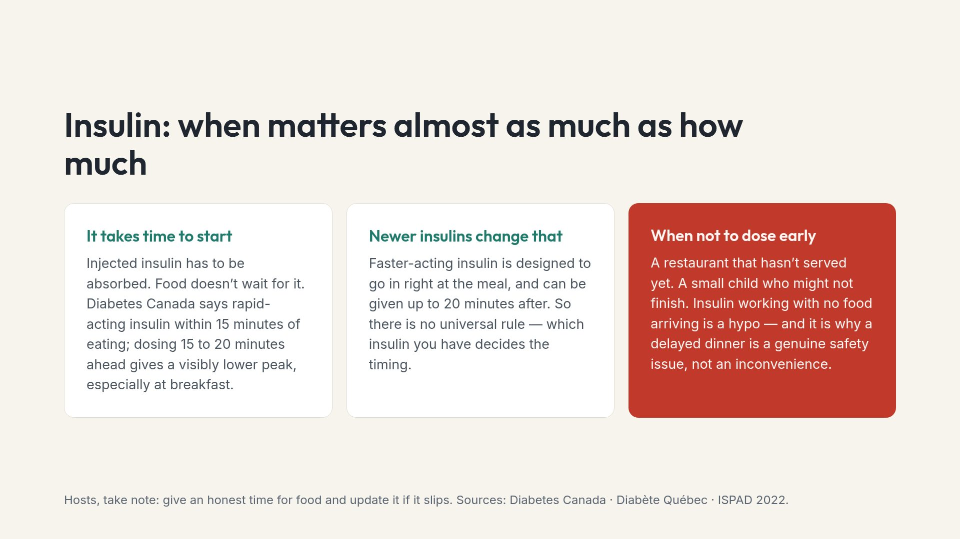
Notes:
The hosting point connects the clinical fact to something a family member can actually act on tonight.

Slide 13
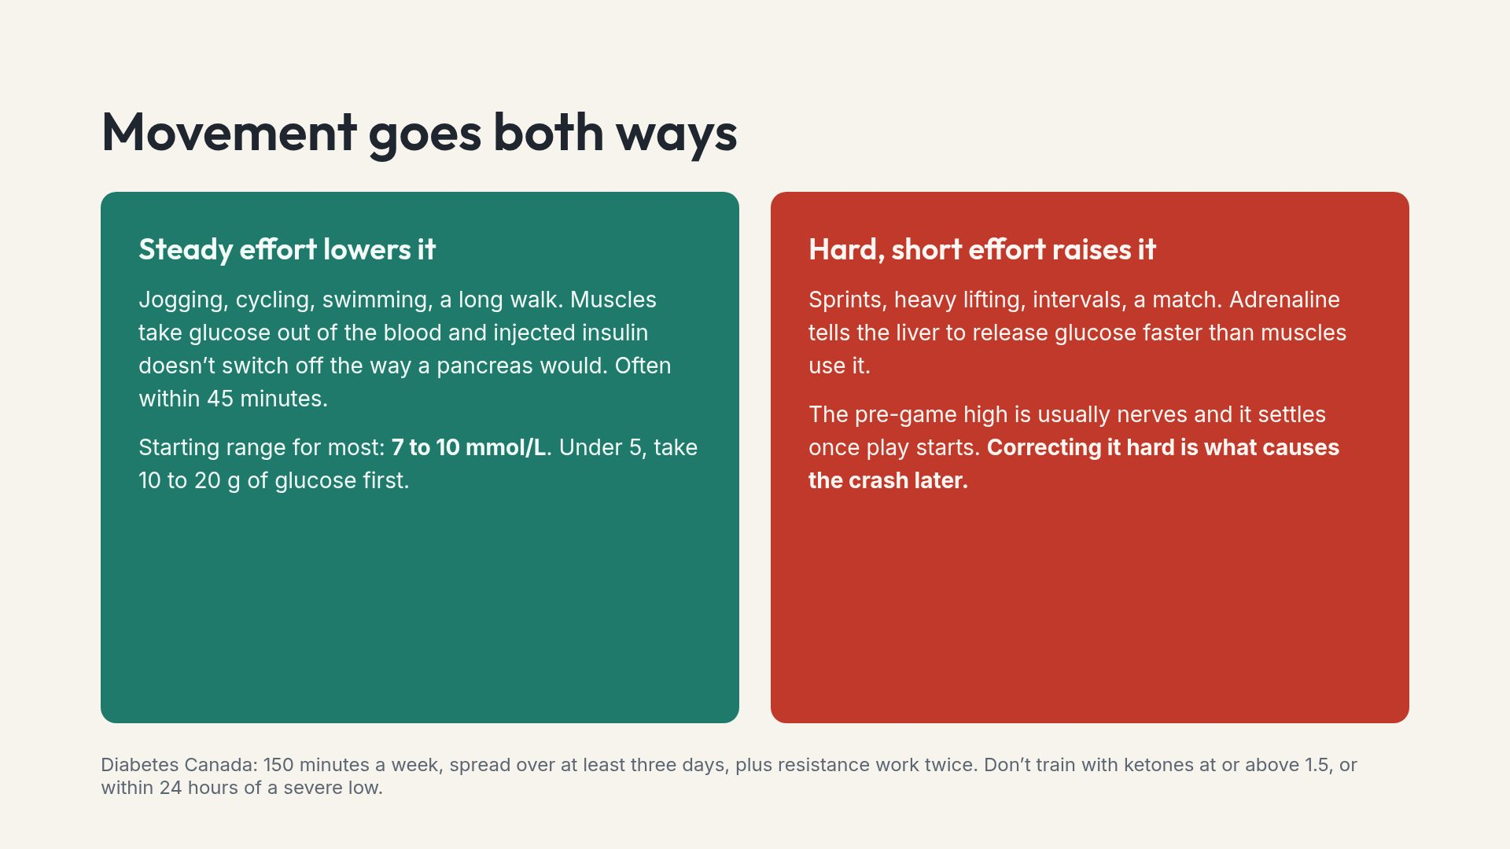
Notes:
The two-directions idea removes most of the confusion people bring to exercise, and with it a lot of the fear that stops them.

Slide 14
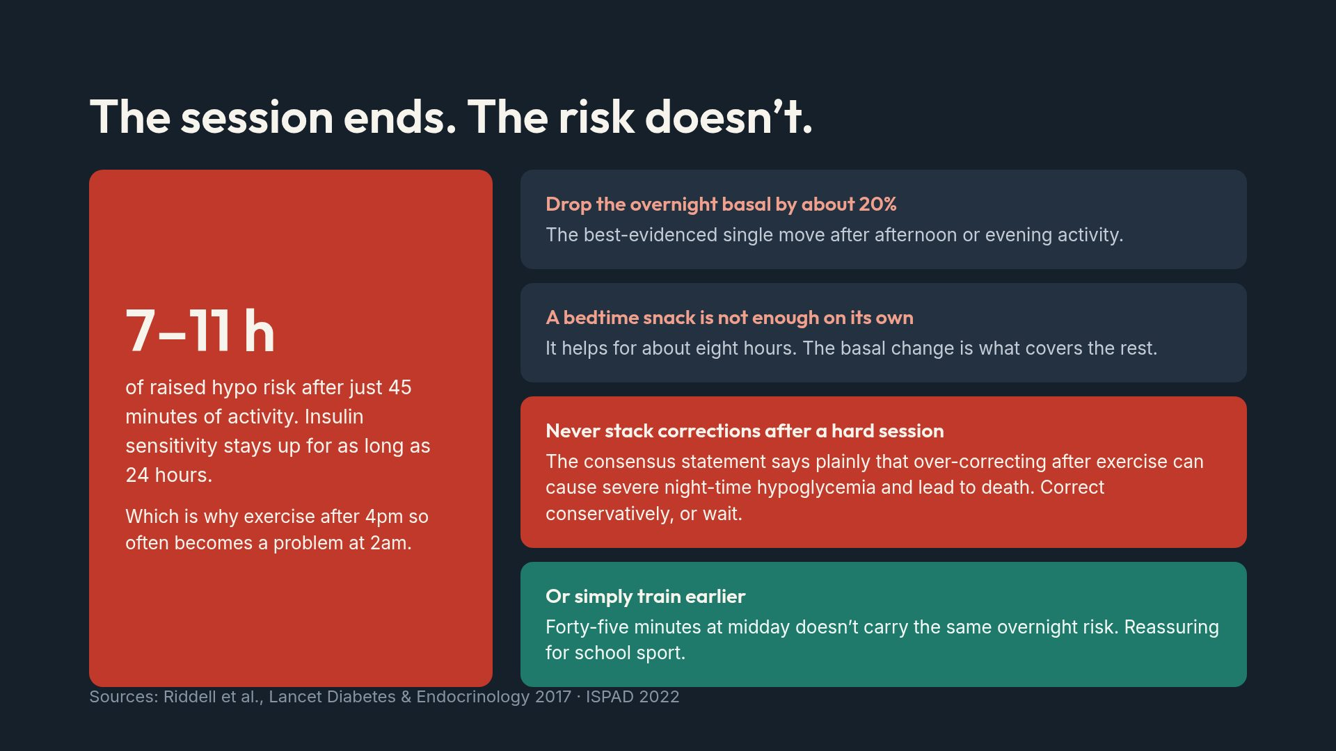
Notes:
The stacking warning is the single most dangerous behaviour in the exercise literature and it comes from a well-meaning instinct.

Slide 15
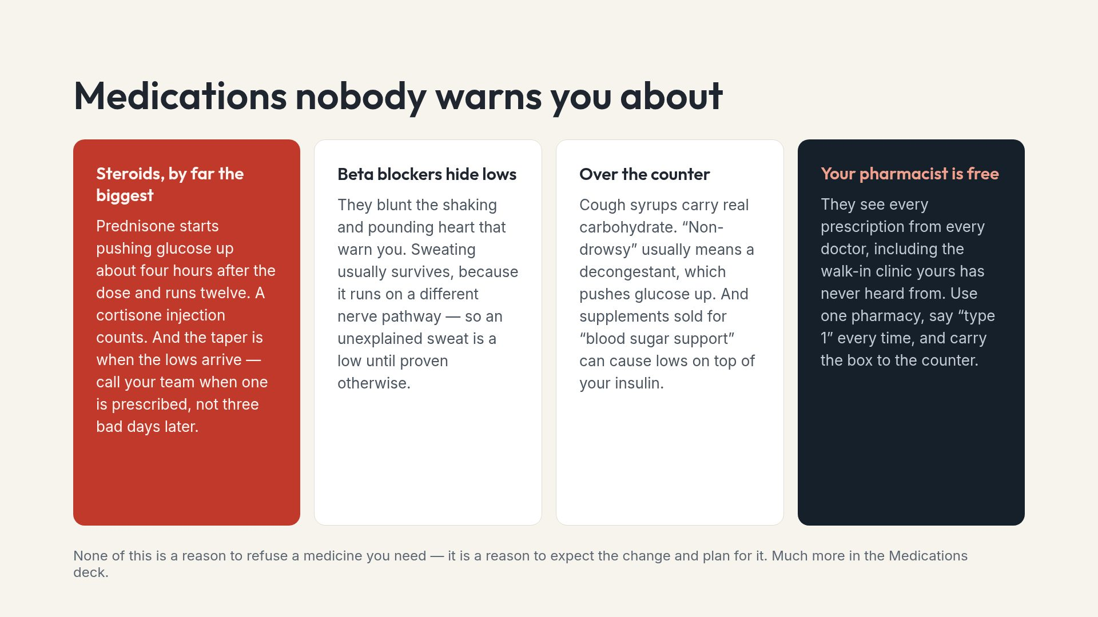
Notes:
People do stop needed medication after slides like this. Say the footer out loud.

Slide 16
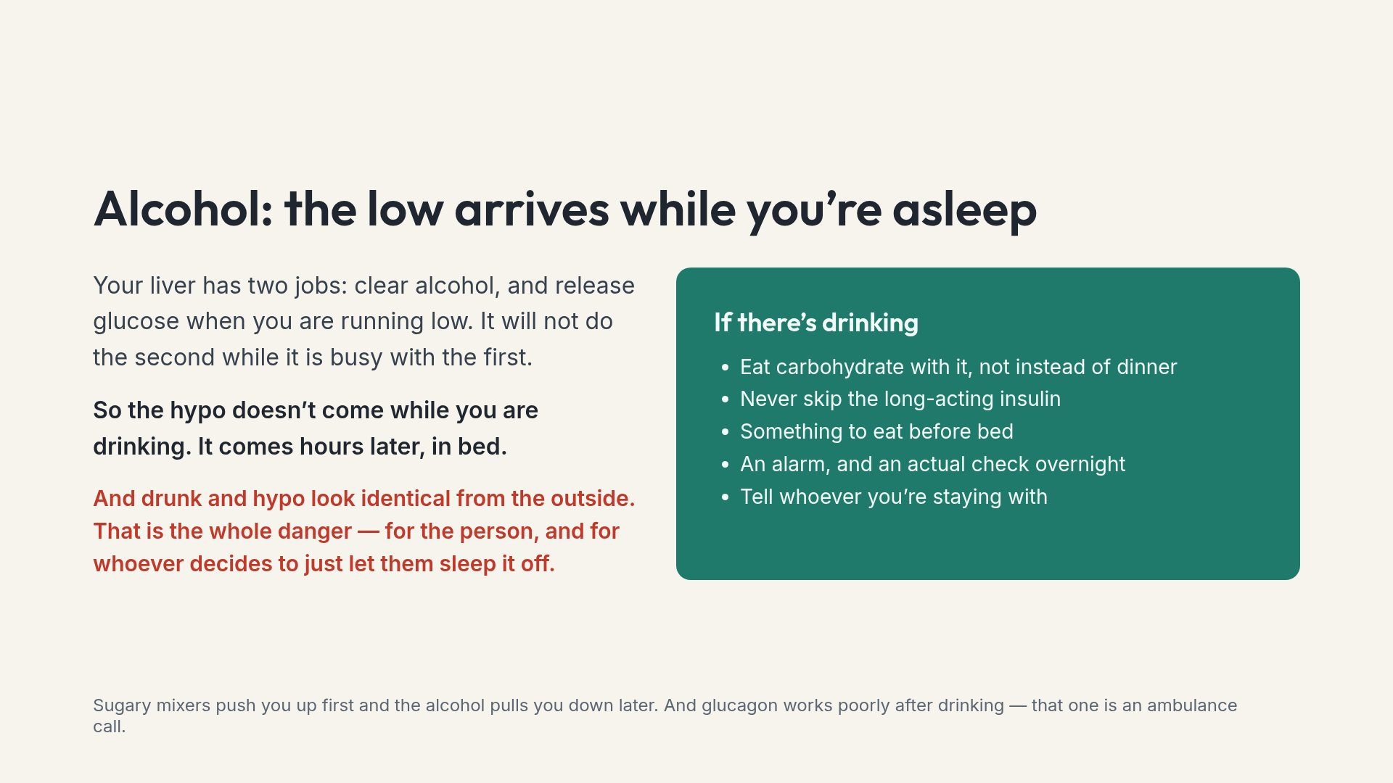
Notes:
Alcohol is statistically the first substance most people meet, so it gets the same weight here as anything illegal.

Slide 17
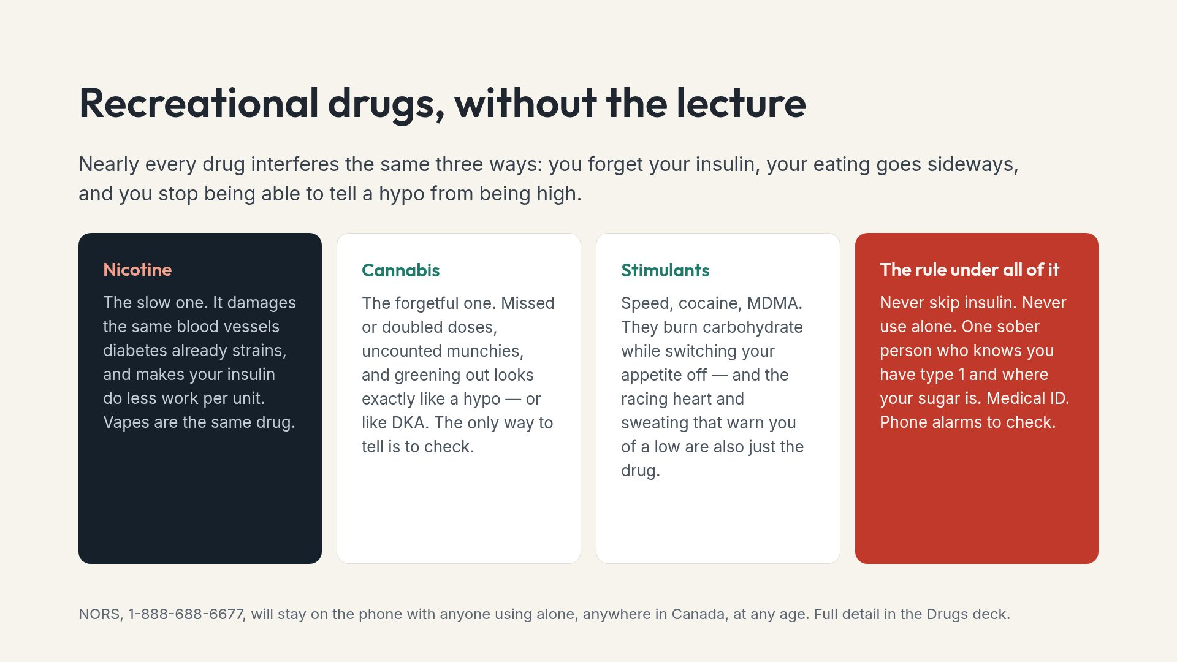
Notes:
This is harm reduction, not permission. The alternative to saying it is people doing all of it with none of the safeguards.

Slide 18
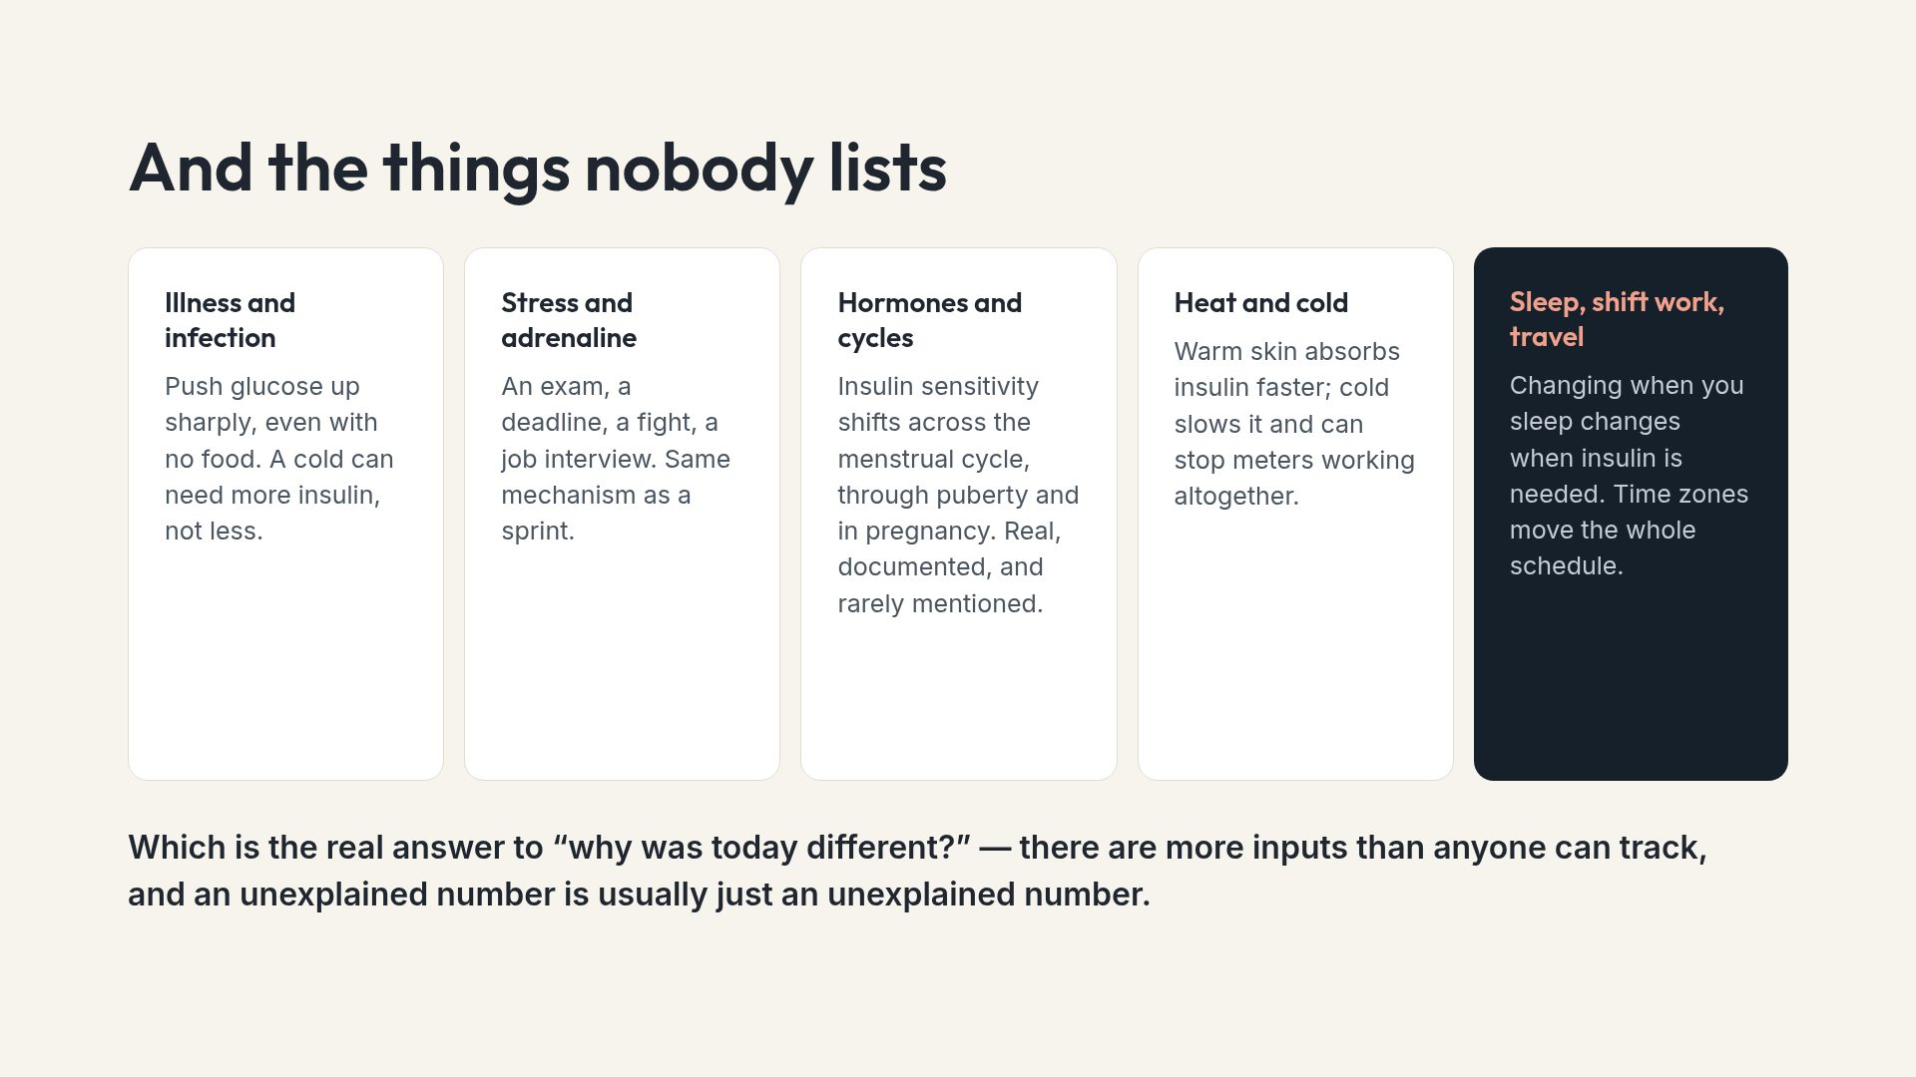
Notes:
This slide exists to defuse self-blame. Most people are never told how many variables are genuinely in play.

Slide 19
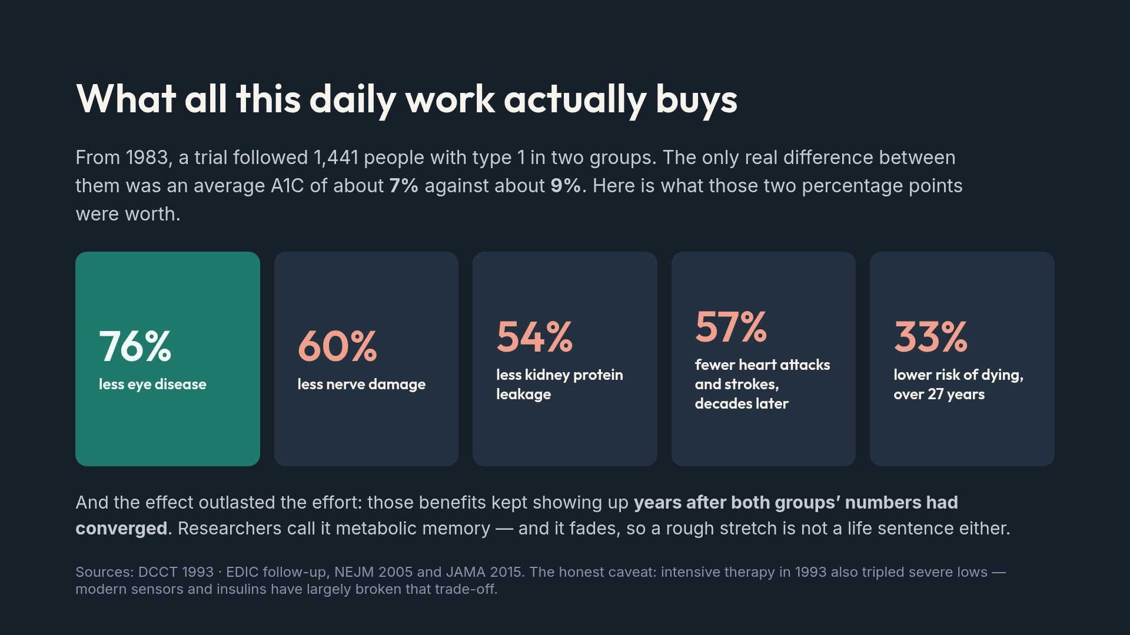
Notes:
This is the most hopeful evidence in all of diabetes medicine, and the reason the daily work is not arbitrary.

Slide 20
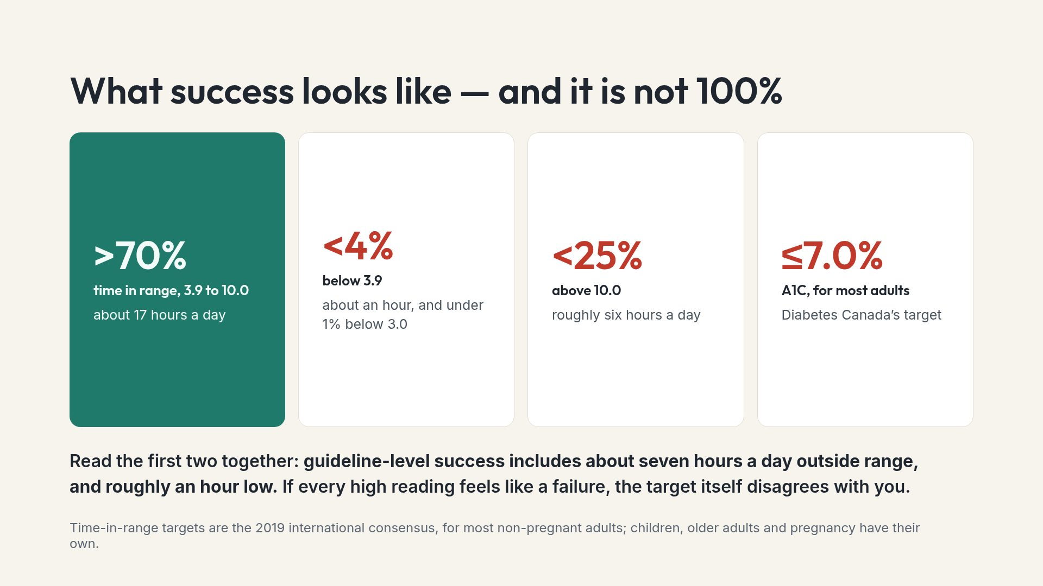
Notes:
Perfectionism is what drives burnout, and the guideline is the best available argument against it.

Slide 21
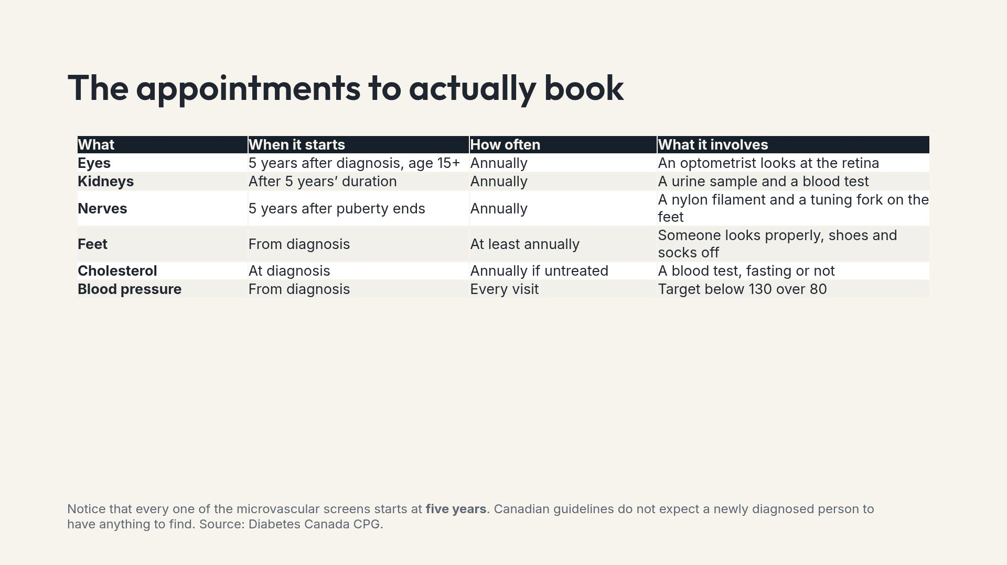
Notes:
If one person leaves having booked one overdue appointment, this deck has done more good than everything else on it combined.

Slide 22
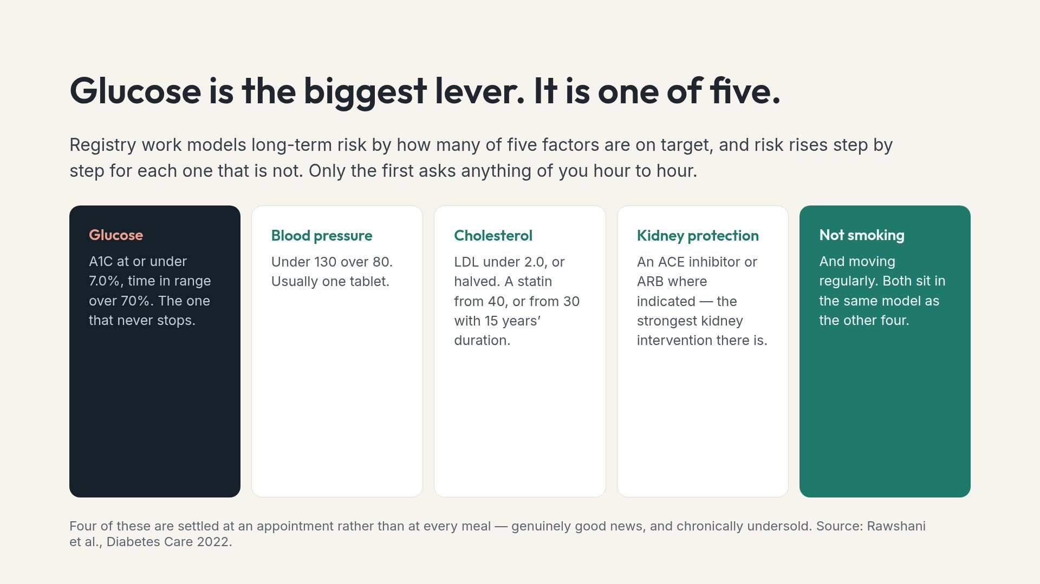
Notes:
Most people with type 1 have never been walked through the other four. Asking about them is a concrete action item.

Slide 23
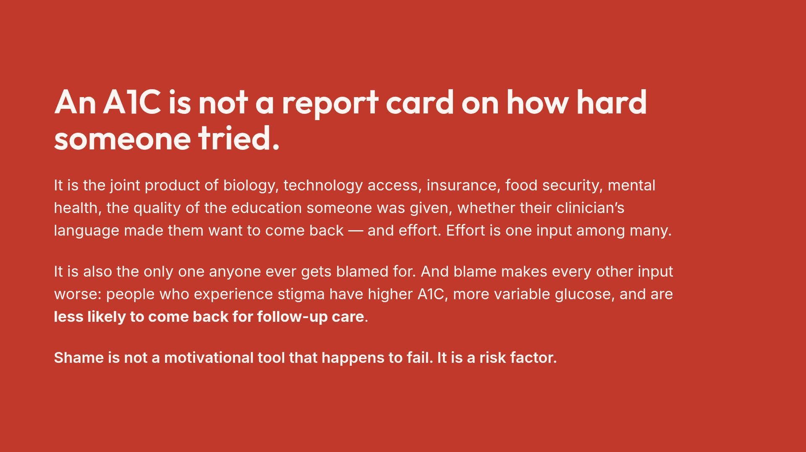
Notes:
In a room with families, this is the sentence the person with diabetes most needs the others to hear.

Slide 24
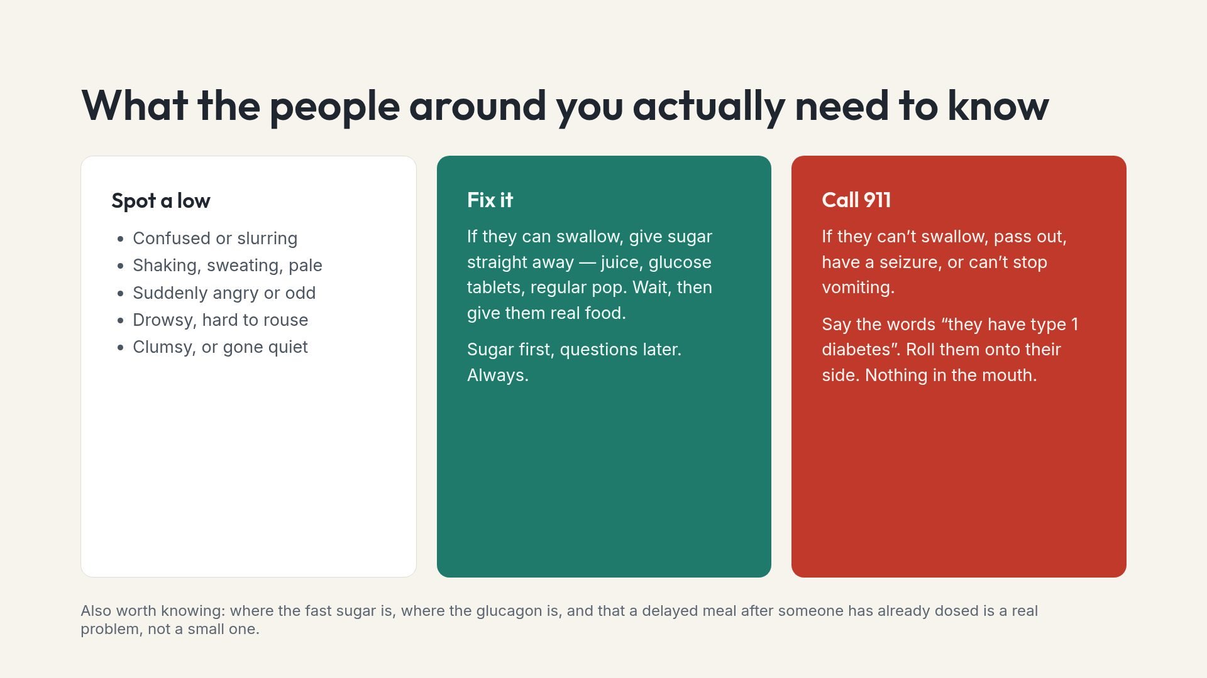
Notes:
Ask people to show this slide to two others — a partner, a roommate, a sibling, a coworker. A plan nobody else knows about is not a plan.

Slide 25
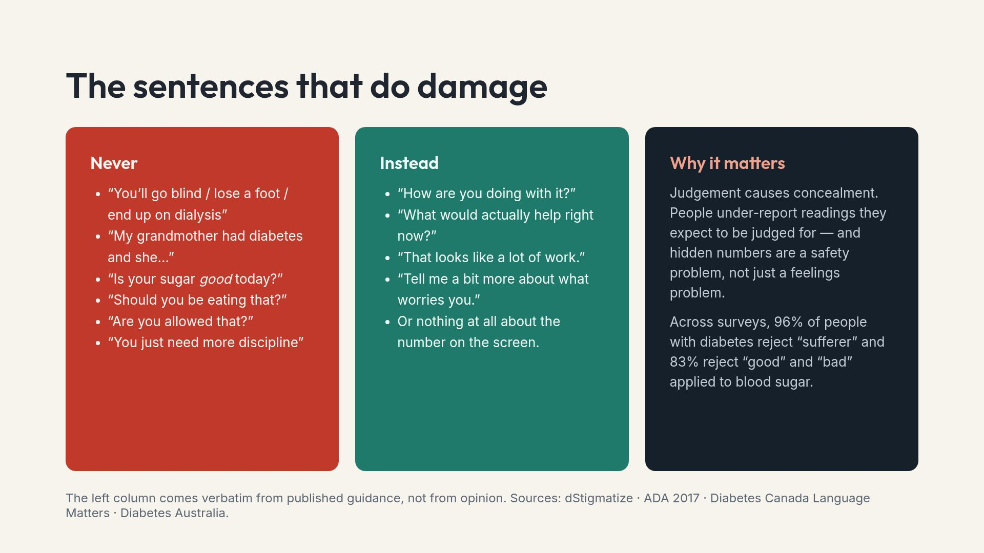
Notes:
Saying these are published avoid-lists stops the slide being heard as a personal rebuke to someone in the room.

Slide 26
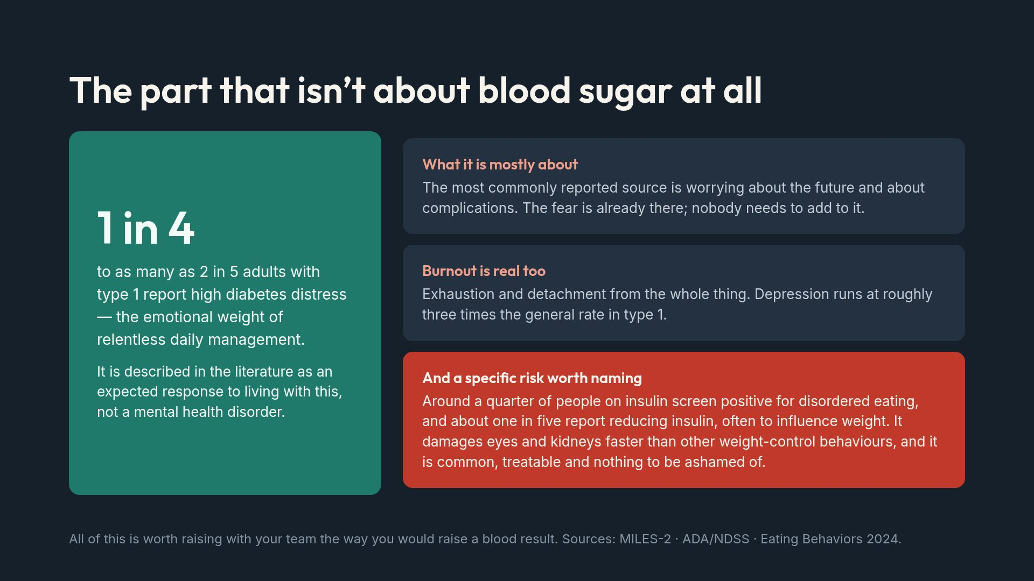
Notes:
Handle gently. If someone recognises themselves, the next step is a clinician — offer to help find one rather than pressing for detail.

Slide 27
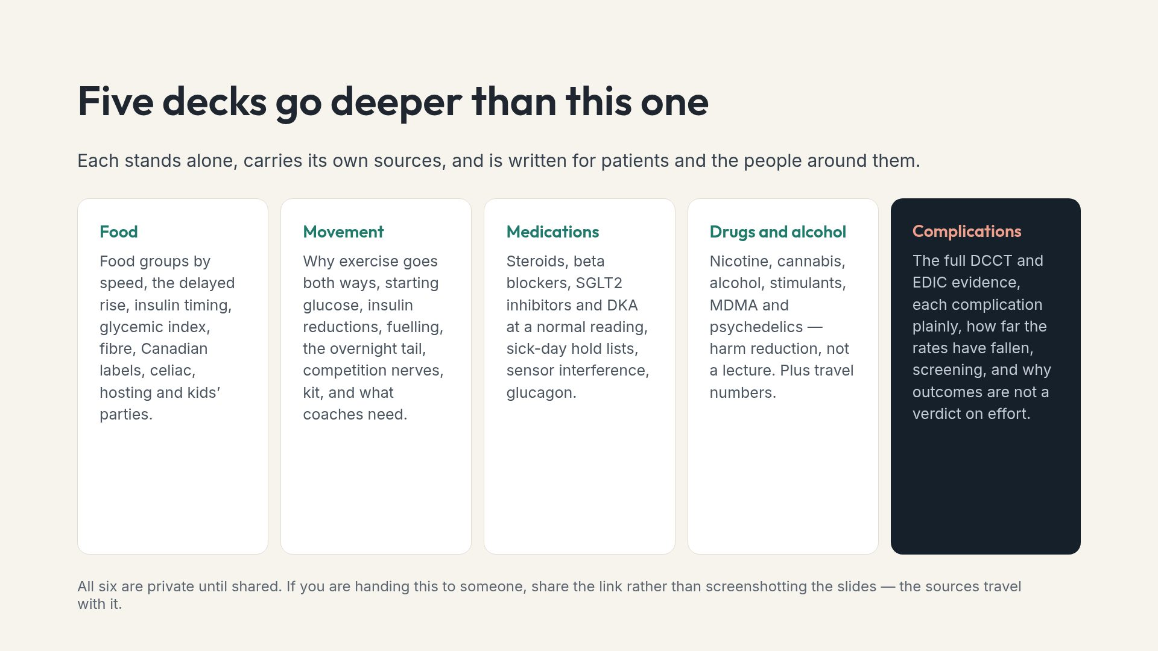
Notes:
Point people at the deck that matches their situation rather than asking anyone to read all six.

Slide 28
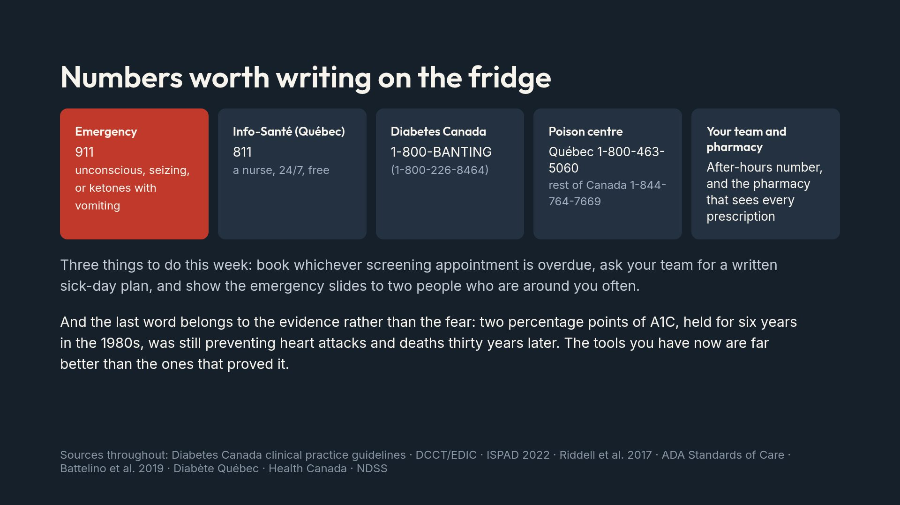
Notes:
End on the legacy effect. There is direct evidence that hope delivered at diagnosis still shapes behaviour one to five years later, so the closing line is doing real work.

