Slide 1
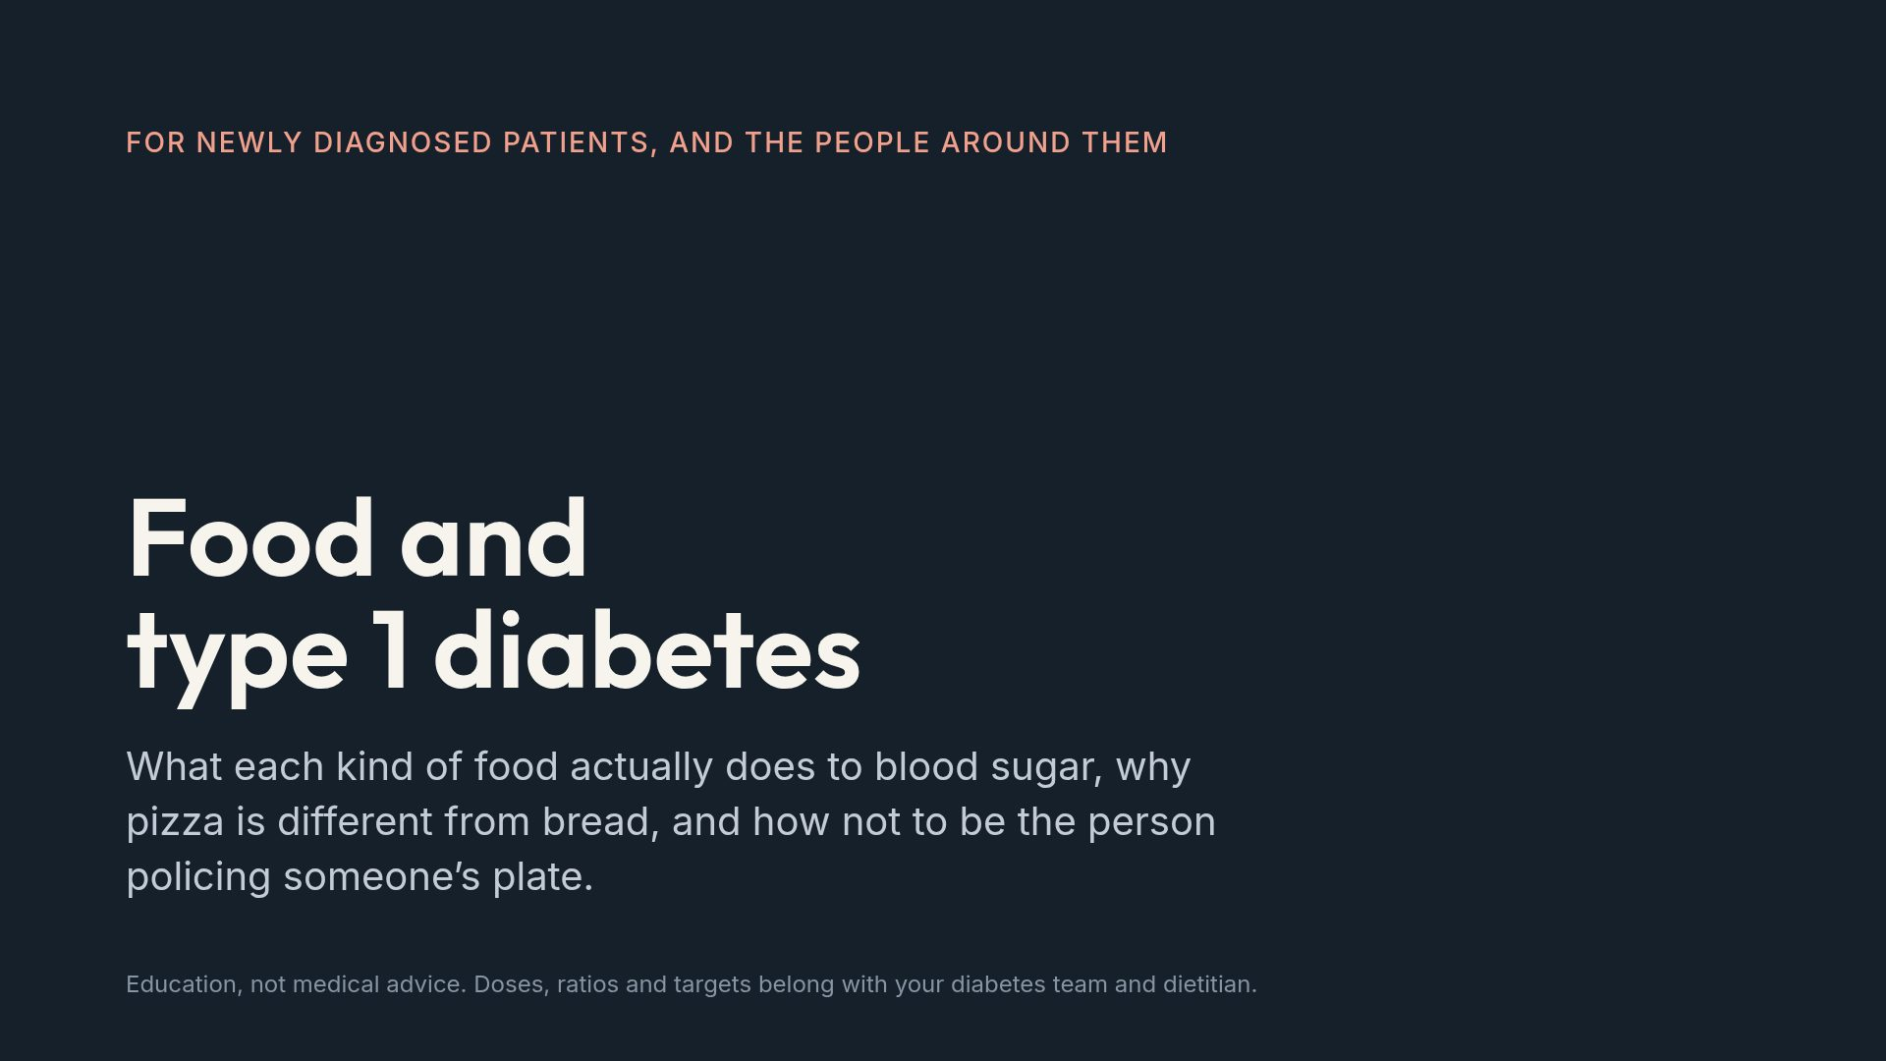
Notes:
Say early that nobody here is going to be told what they may eat. That expectation is what most people walk in with.

Slide 2
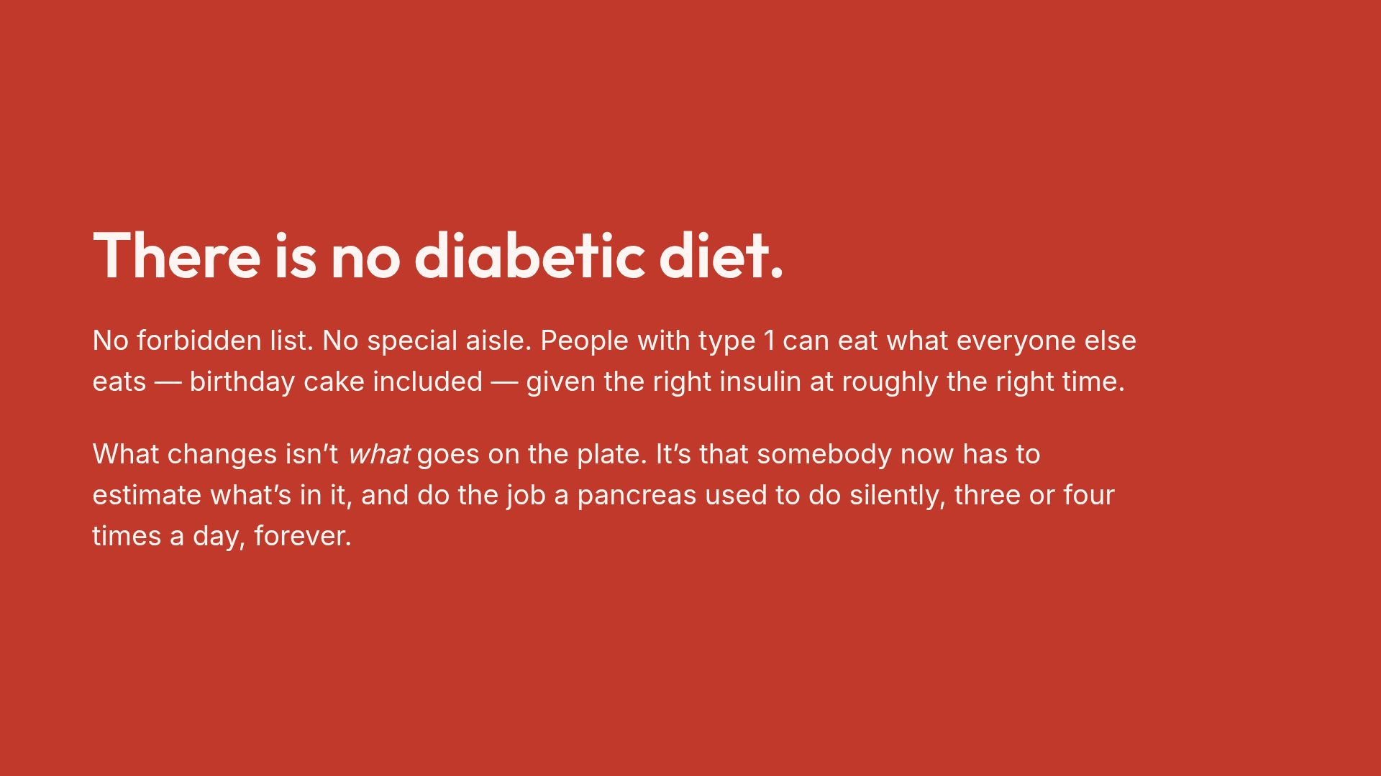
Notes:
Kill this myth first. Everything else in the deck is easier to hear once the audience stops expecting a list of banned foods.

Slide 3
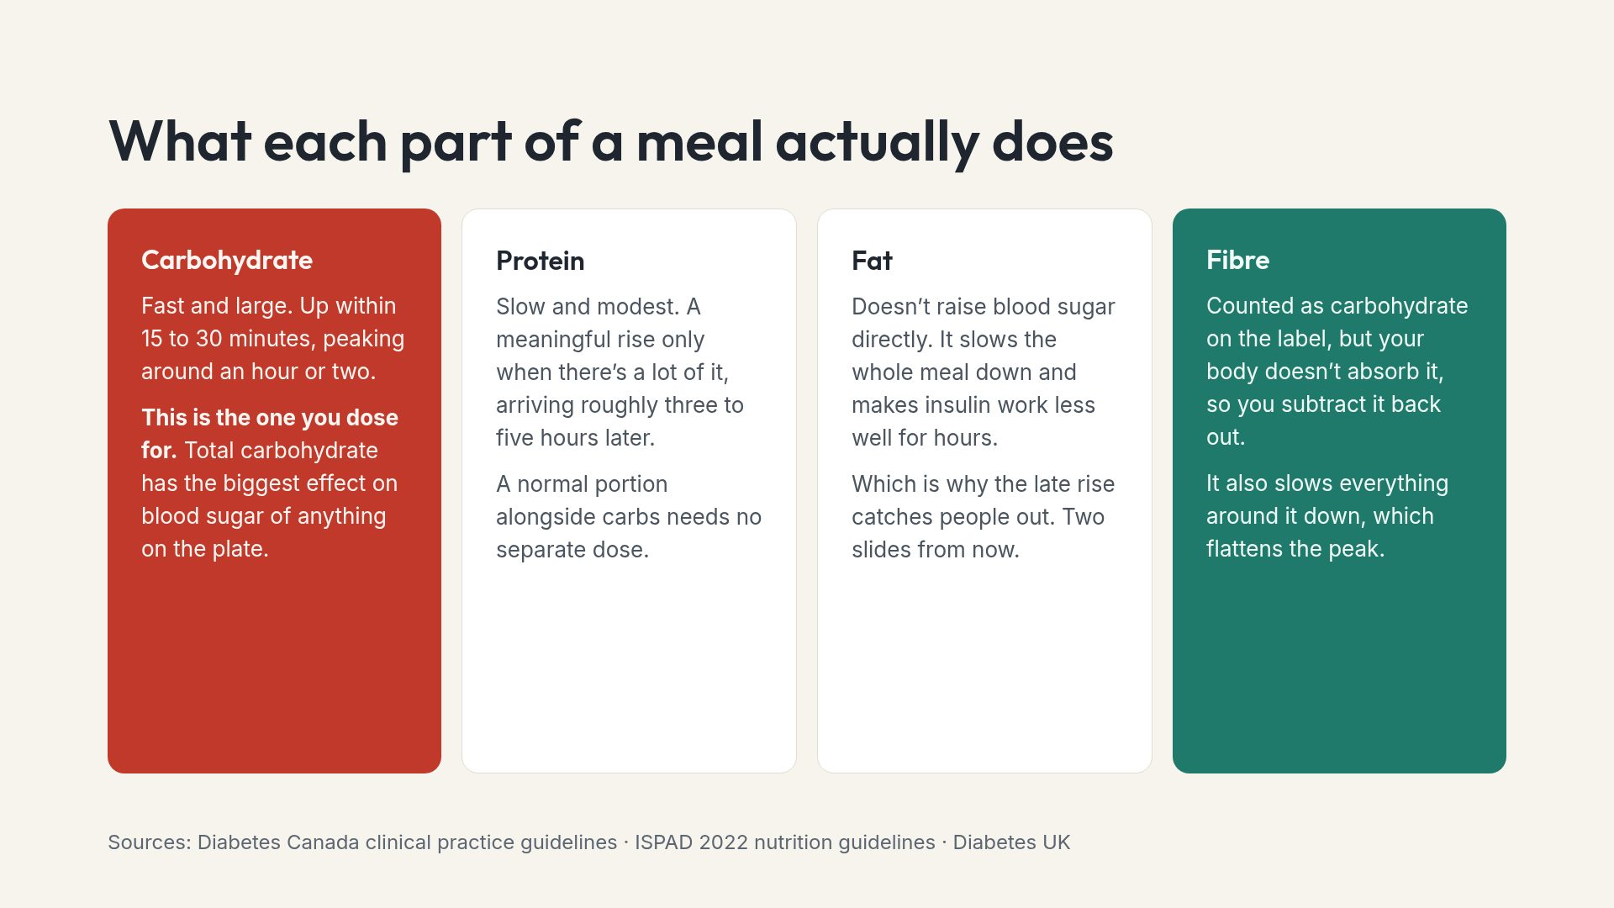
Notes:
Four cards, left to right, fastest to slowest. That ordering is the mental model the rest of the deck builds on.

Slide 4
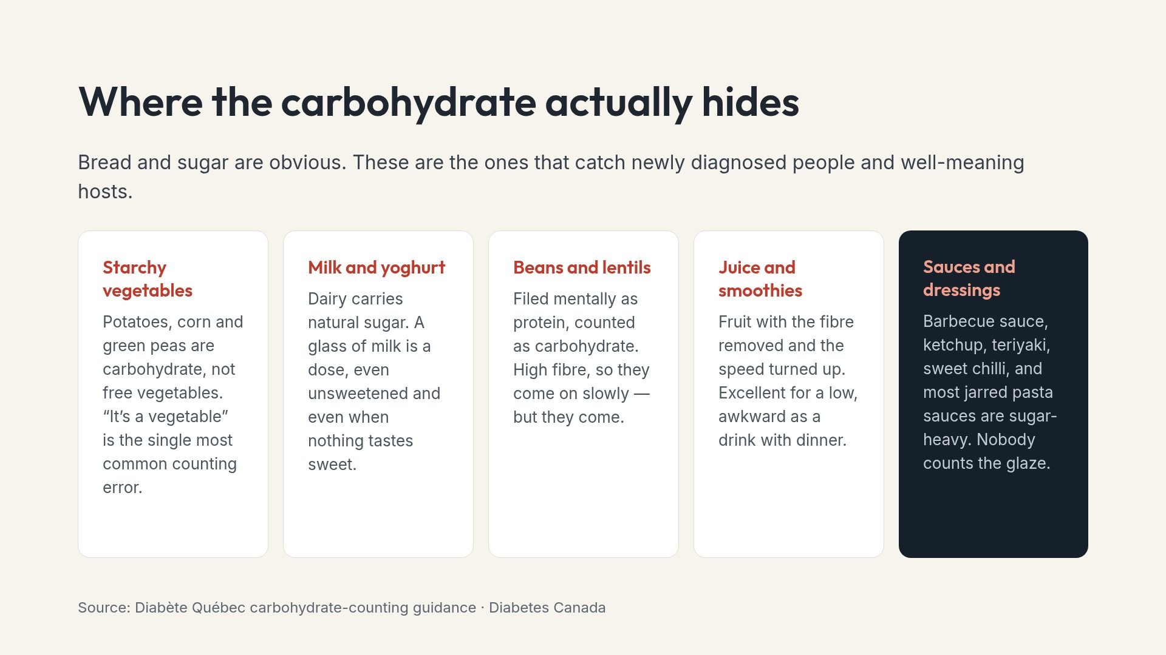
Notes:
Ask a host which of these five are in tonight's meal. Usually three, and usually none of them were mentioned.

Slide 5
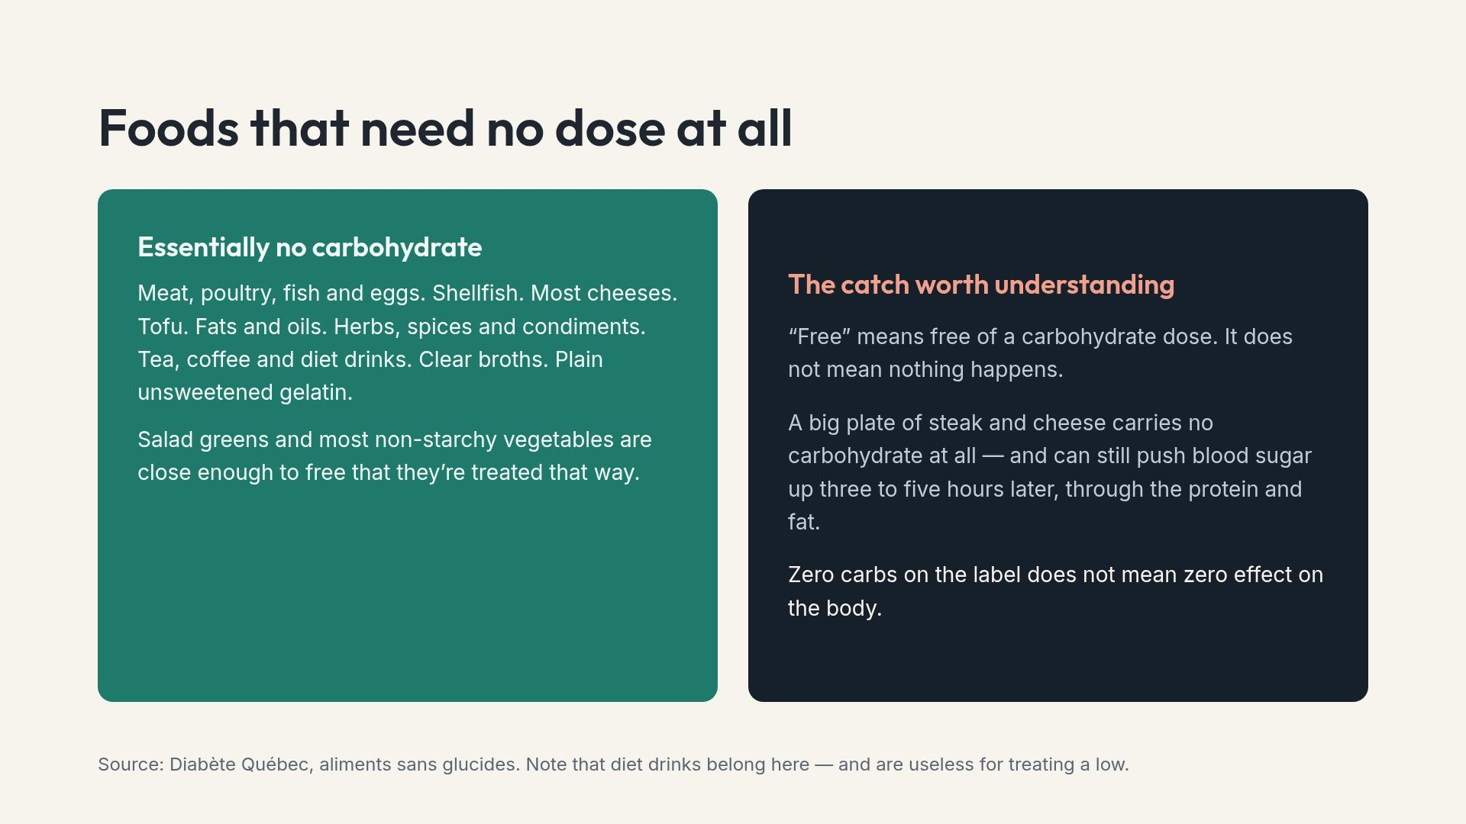
Notes:
This contradiction confuses newly diagnosed people constantly, which is why it gets its own half of the slide rather than a footnote.

Slide 6
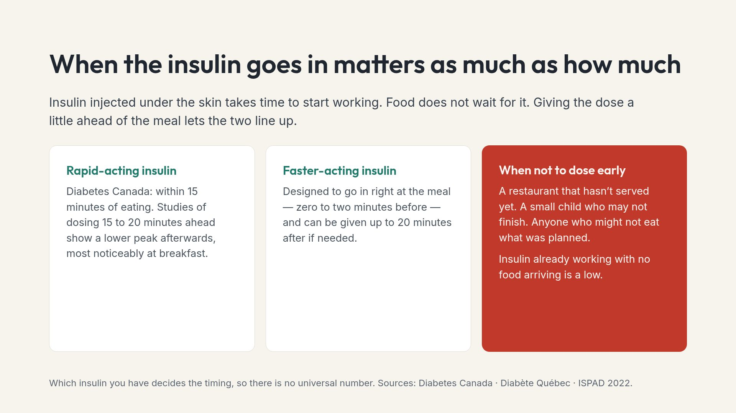
Notes:
Note that pre-meal dosing did not increase lows in the studies, contrary to what most parents assume. The exception is genuine uncertainty about whether the food will arrive or be eaten.

Slide 7
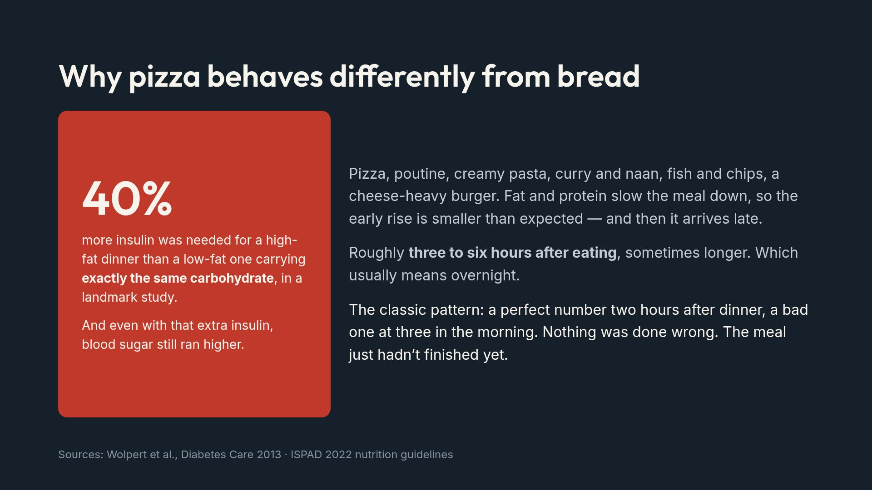
Notes:
This is the single most useful concept for a newly diagnosed audience, because it explains a failure they will already have experienced and blamed themselves for.

Slide 8
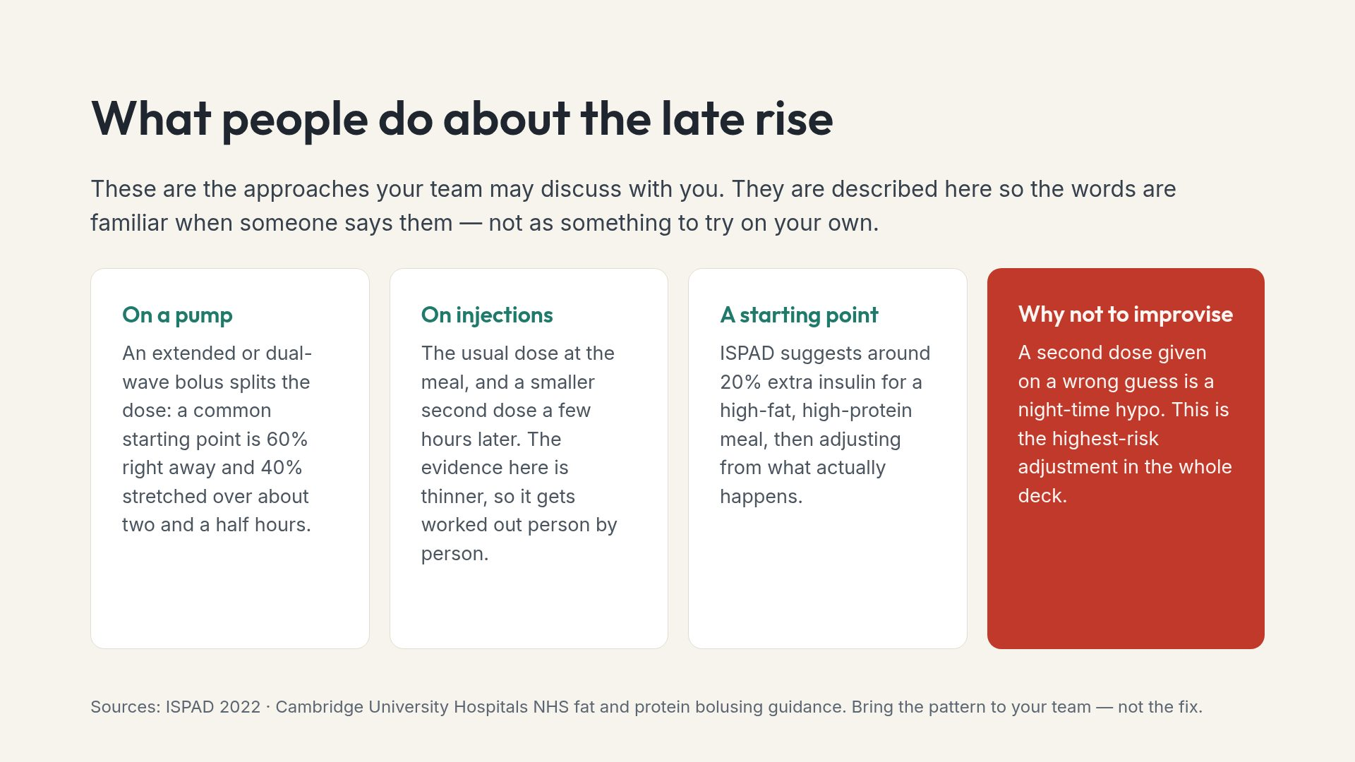
Notes:
Say plainly that the right move here is showing your team three nights of data, not experimenting alone.

Slide 9
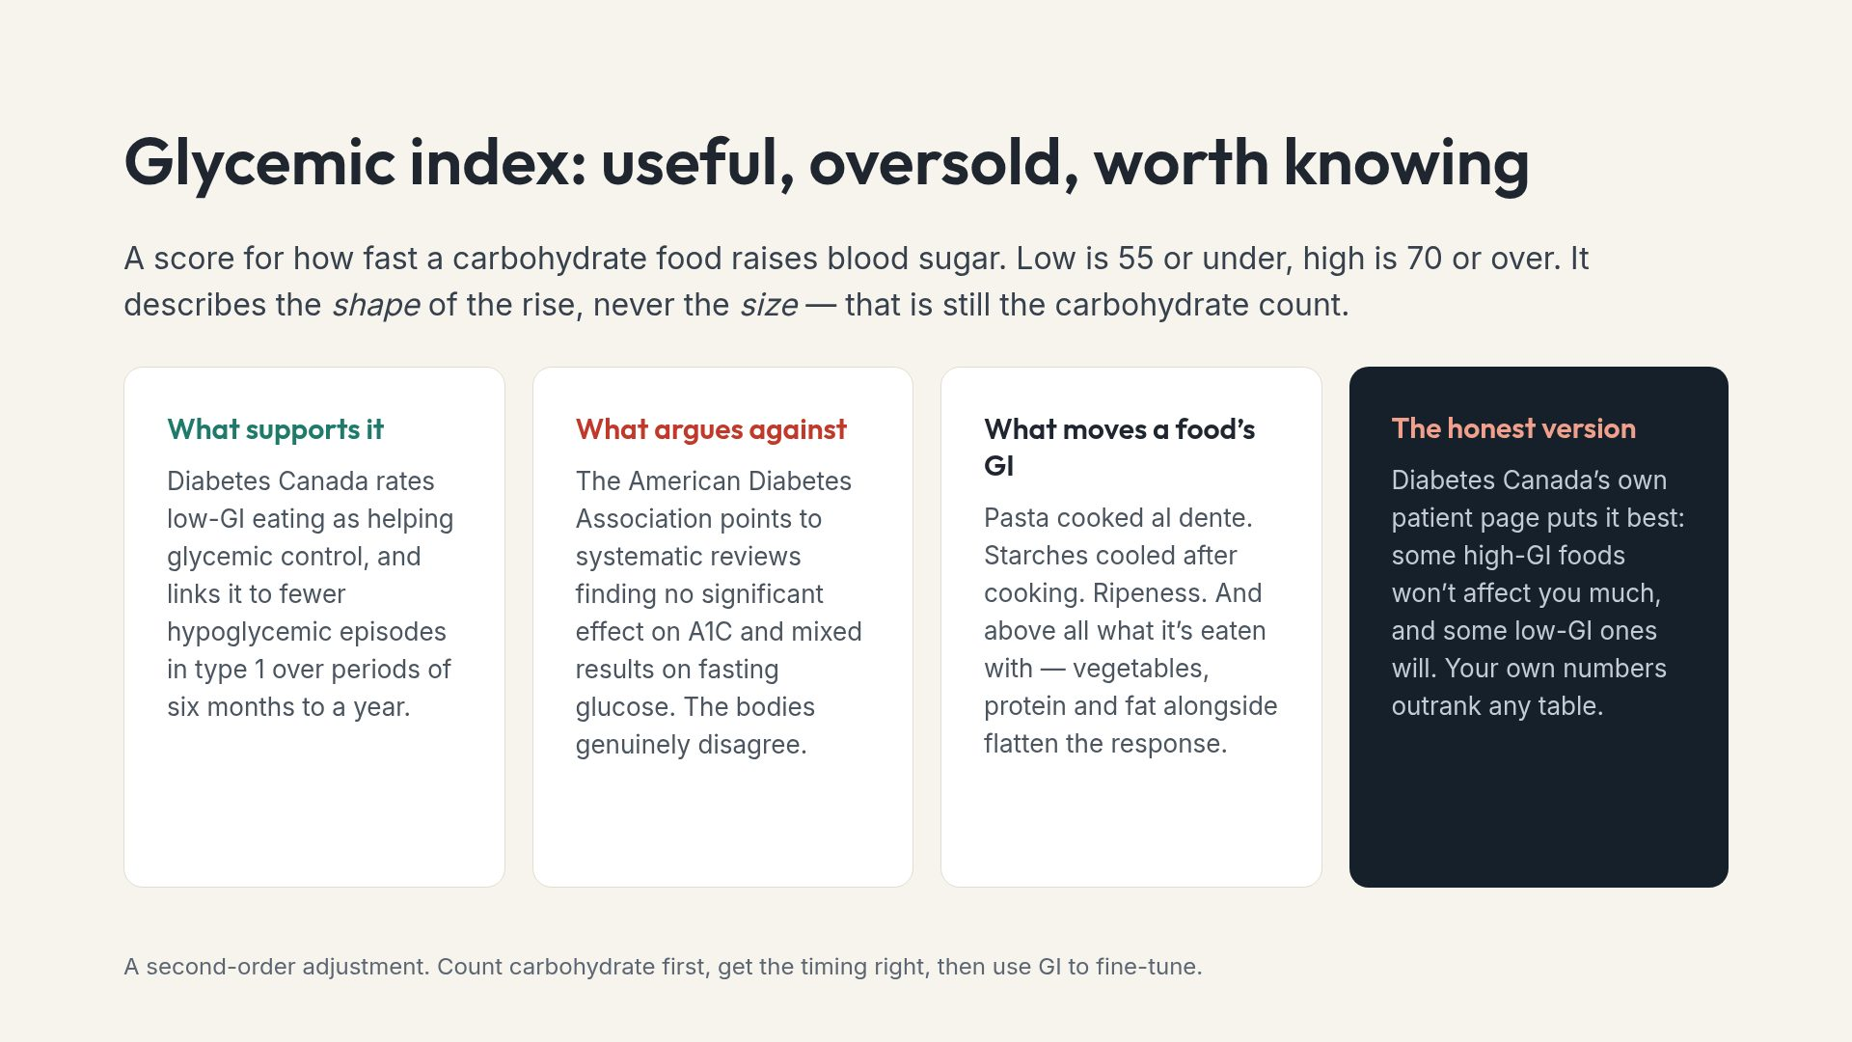
Notes:
Presenting the disagreement honestly is better than picking a side. People meet both positions online and lose trust in whichever source hid the other.

Slide 10
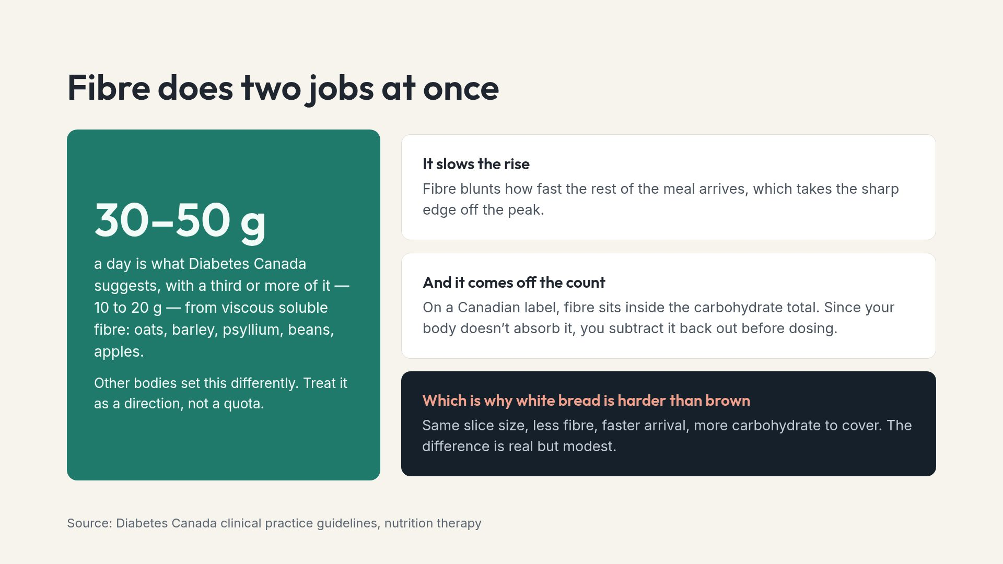
Notes:
Increase fibre gradually. A sudden jump is uncomfortable and people abandon the change within a week.

Slide 11
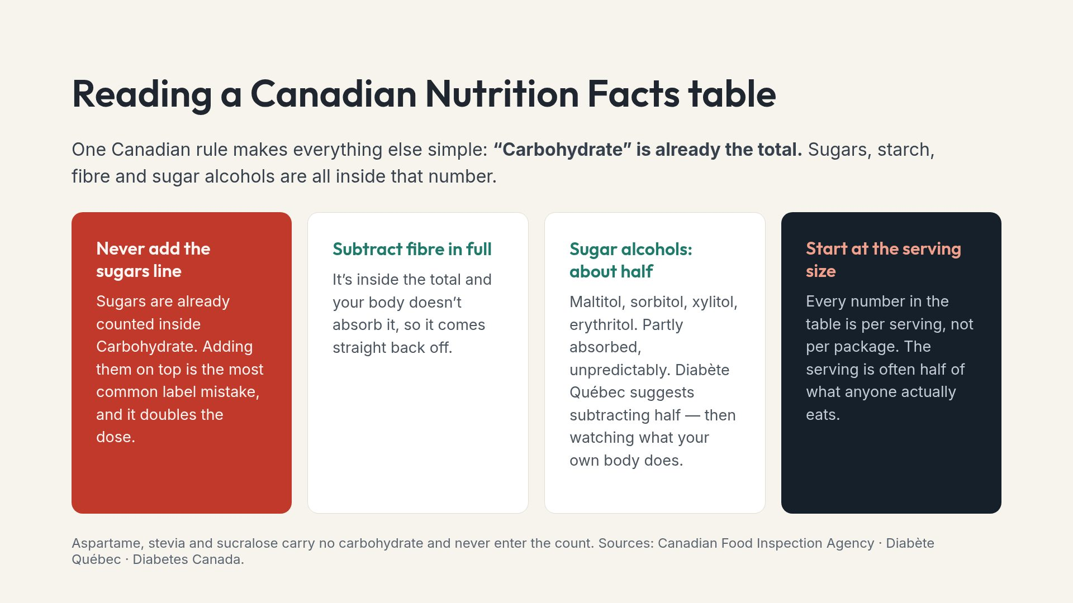
Notes:
Guidance on sugar alcohols is genuinely split between subtracting all of them and half. Half is the conservative choice and matches the Quebec source.

Slide 12
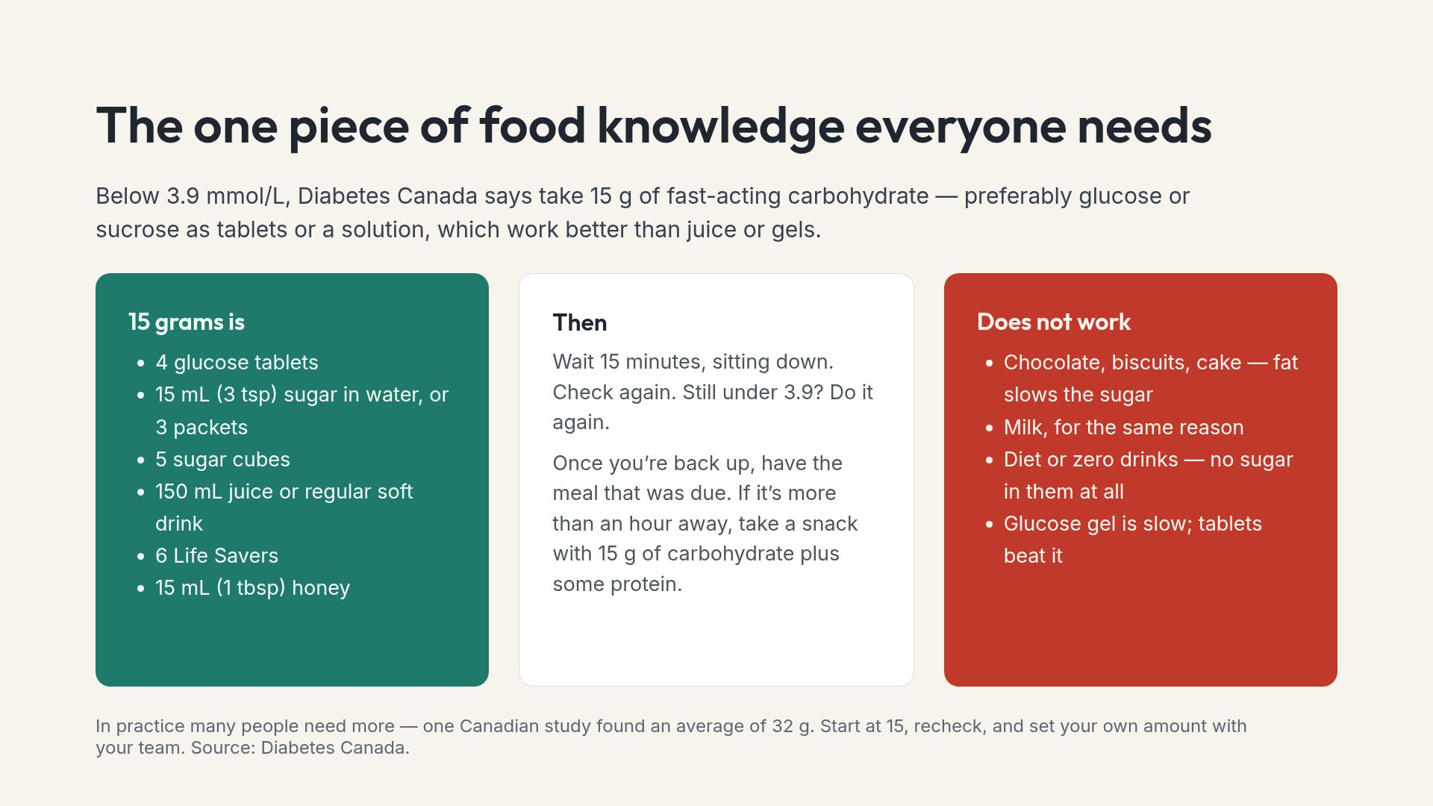
Notes:
The diet drink mix-up is the one that catches hosts, where both cans sit in the same fridge and look identical.

Slide 13
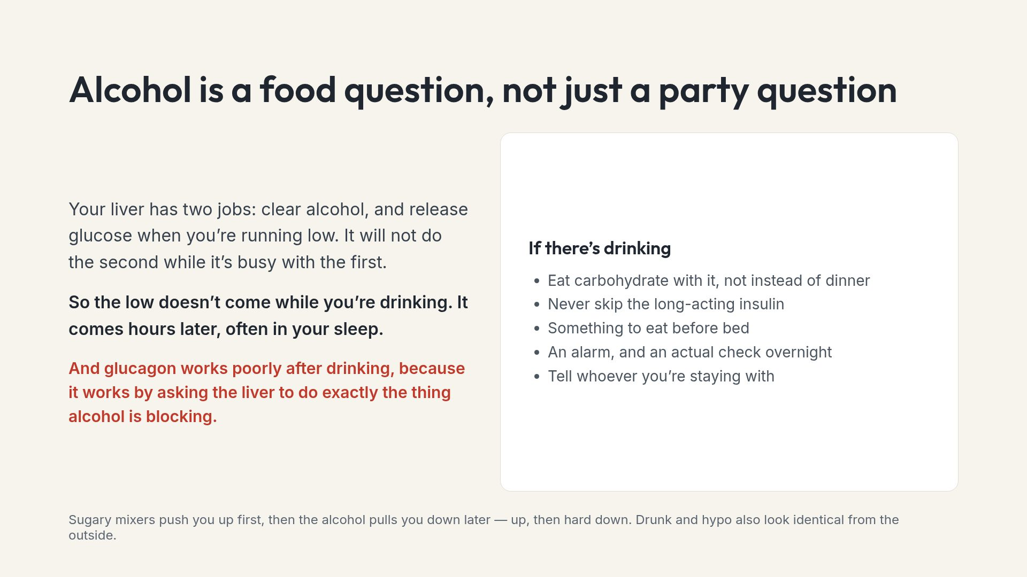
Notes:
Worth naming for caretakers: at a party, the person slurring may not be drunk. Check before assuming.

Slide 14
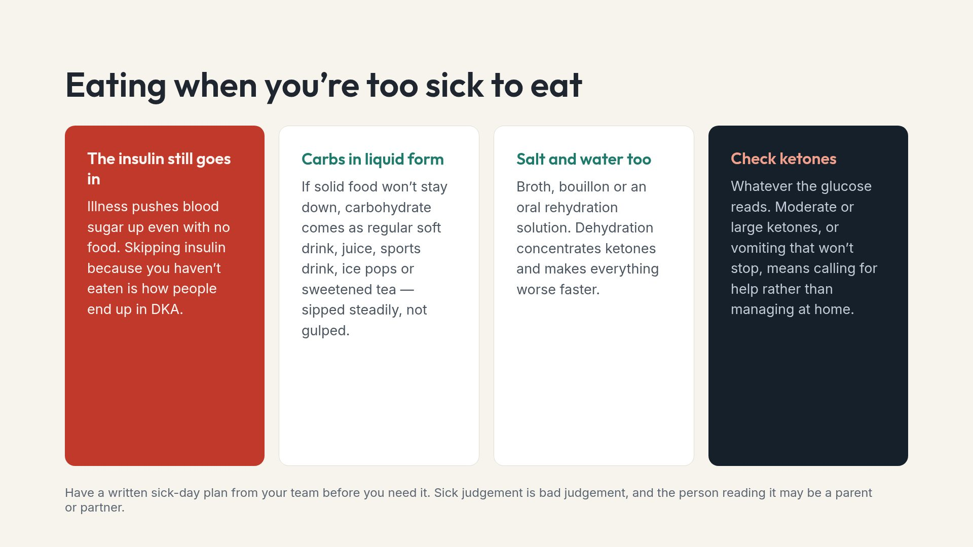
Notes:
If the audience is caretakers, this slide and the hypo slide are the two they should photograph.

Slide 15
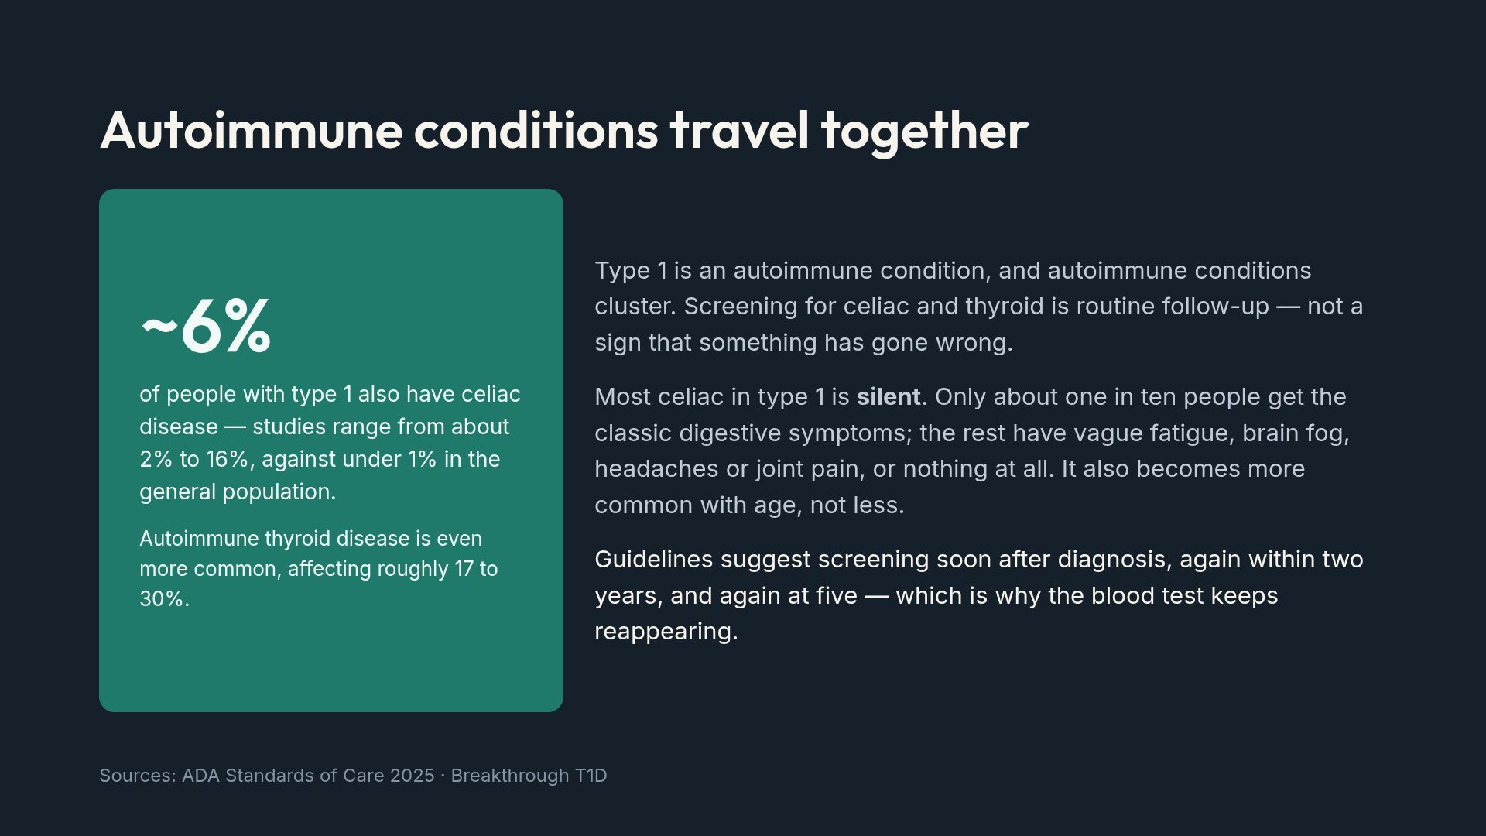
Notes:
Families often read repeat screening as suspicion that something is wrong. Framing it as scheduled and normal removes that.

Slide 16
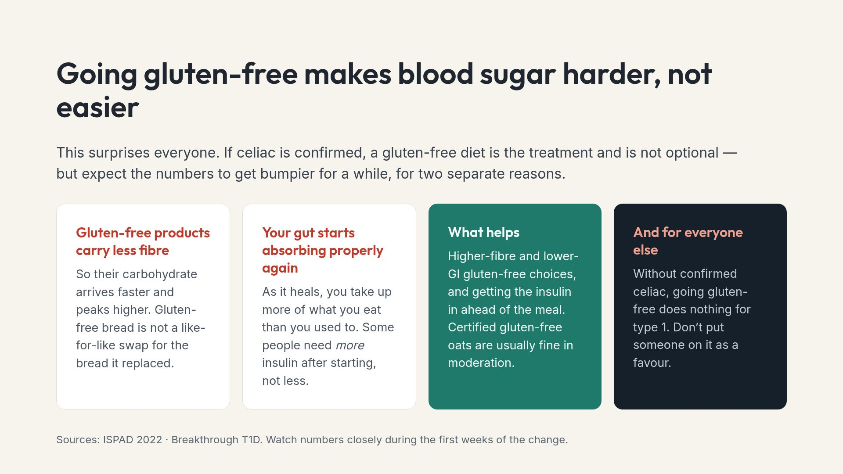
Notes:
The last card matters for families. Well-meaning relatives put people on elimination diets that help nothing and complicate dosing.

Slide 17
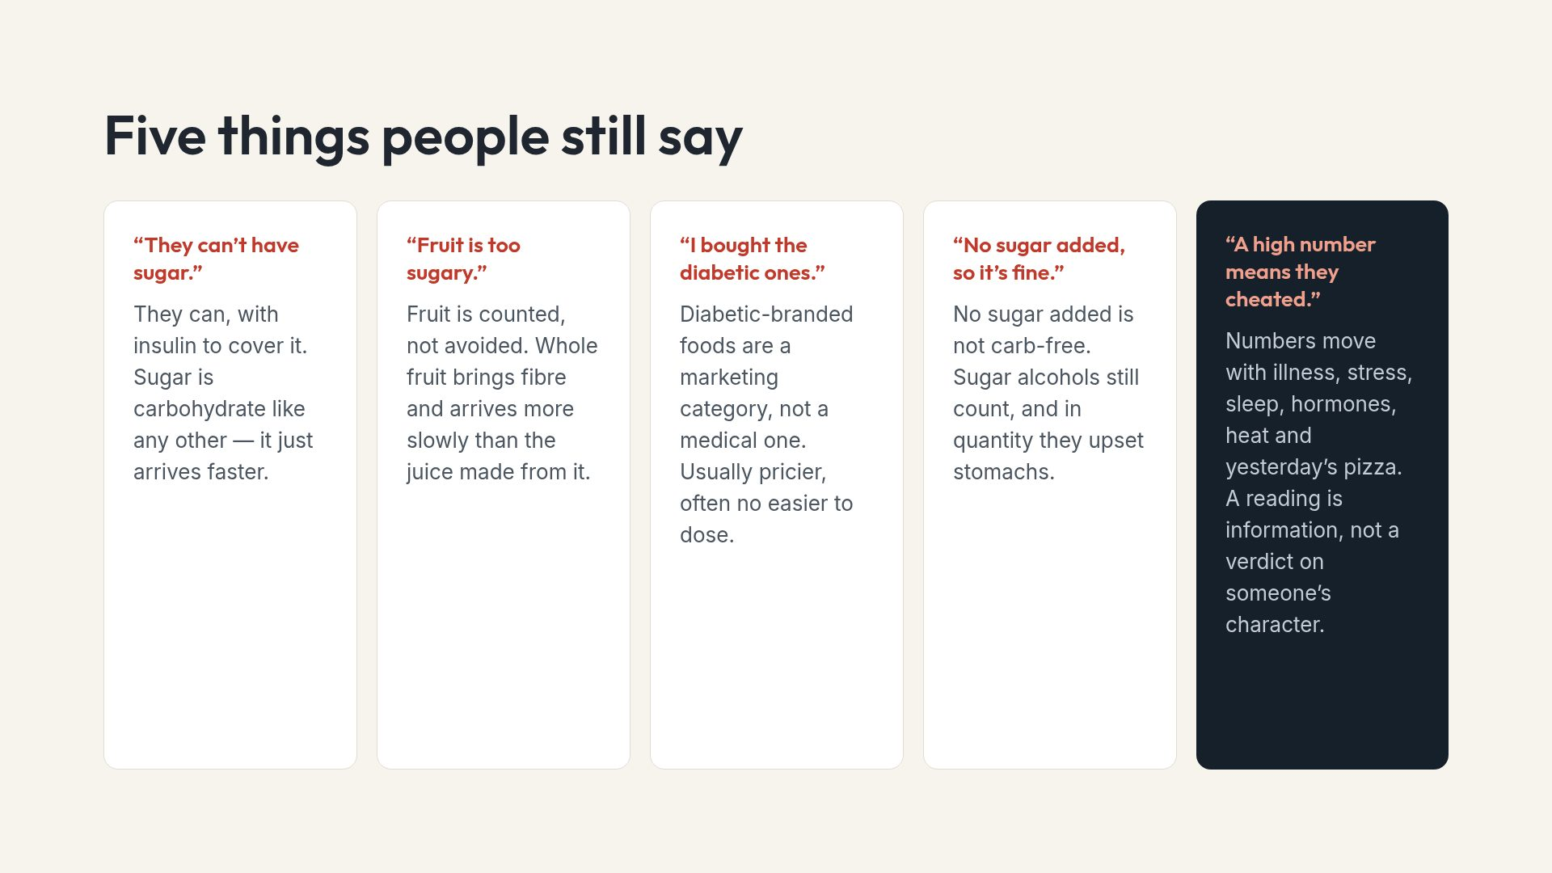
Notes:
The last card is the one to dwell on. It reframes every number in the deck as data rather than as a moral score.

Slide 18
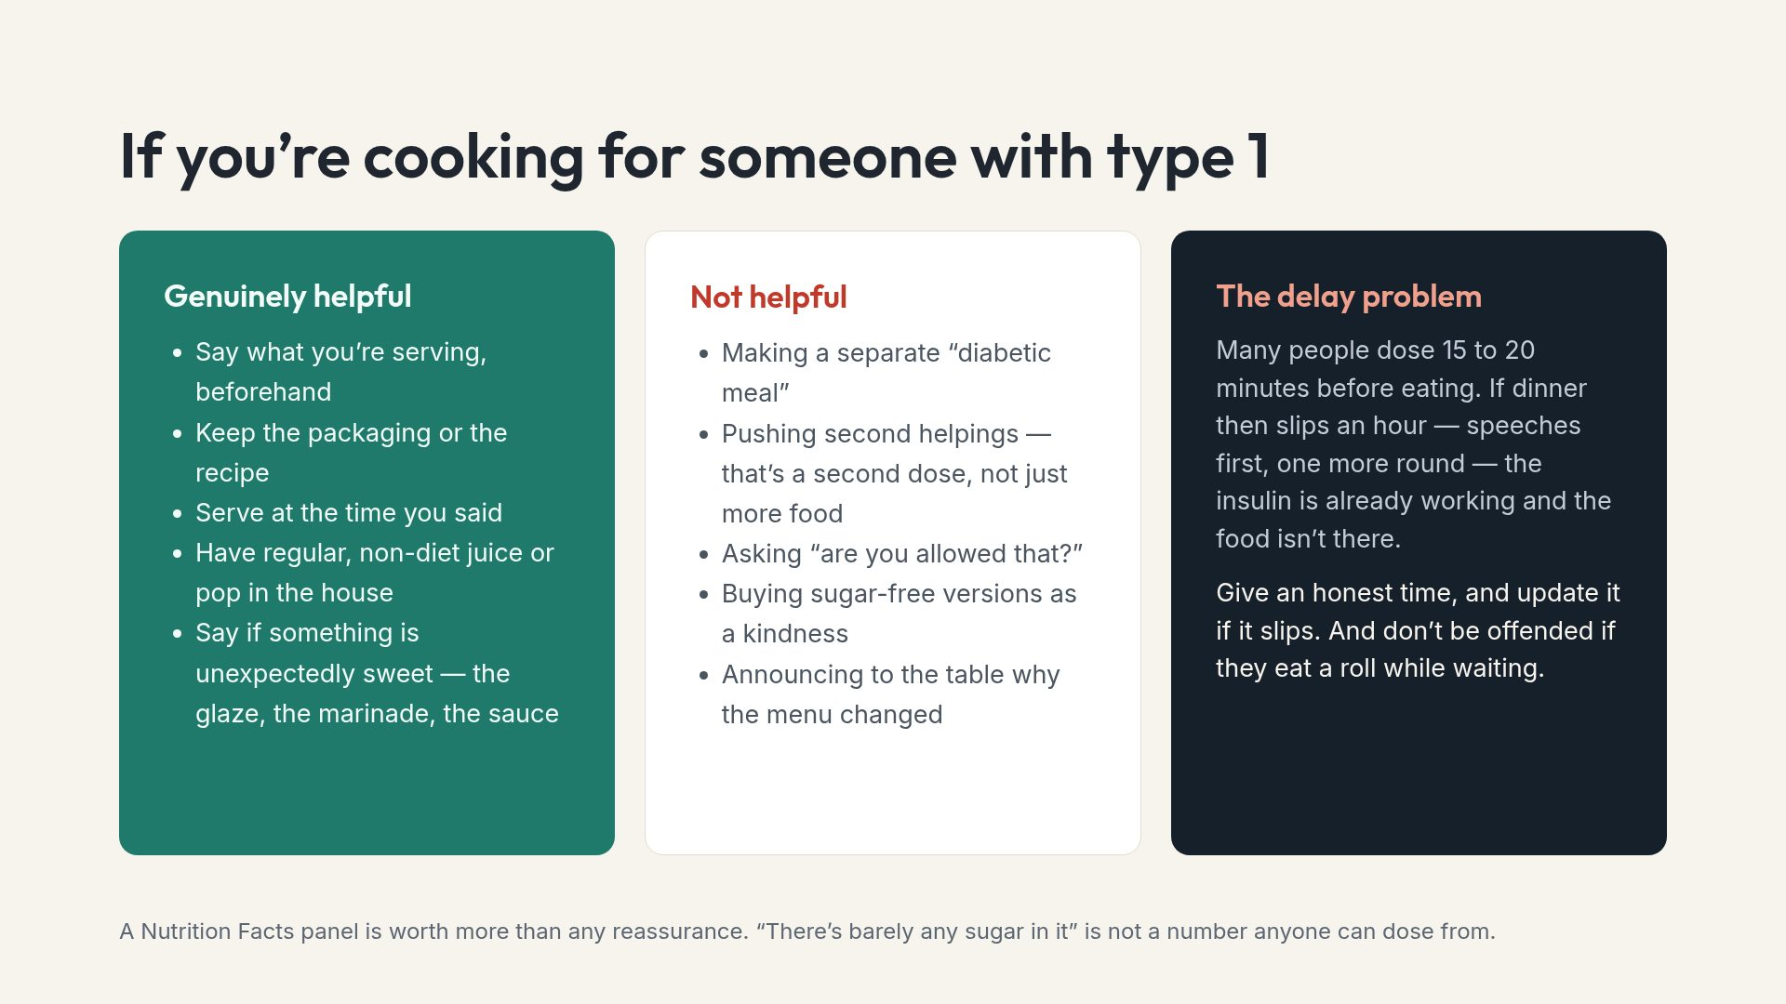
Notes:
The delay problem is rarely explained to hosts, and it is one of the most common causes of a hypo at a family dinner.

Slide 19
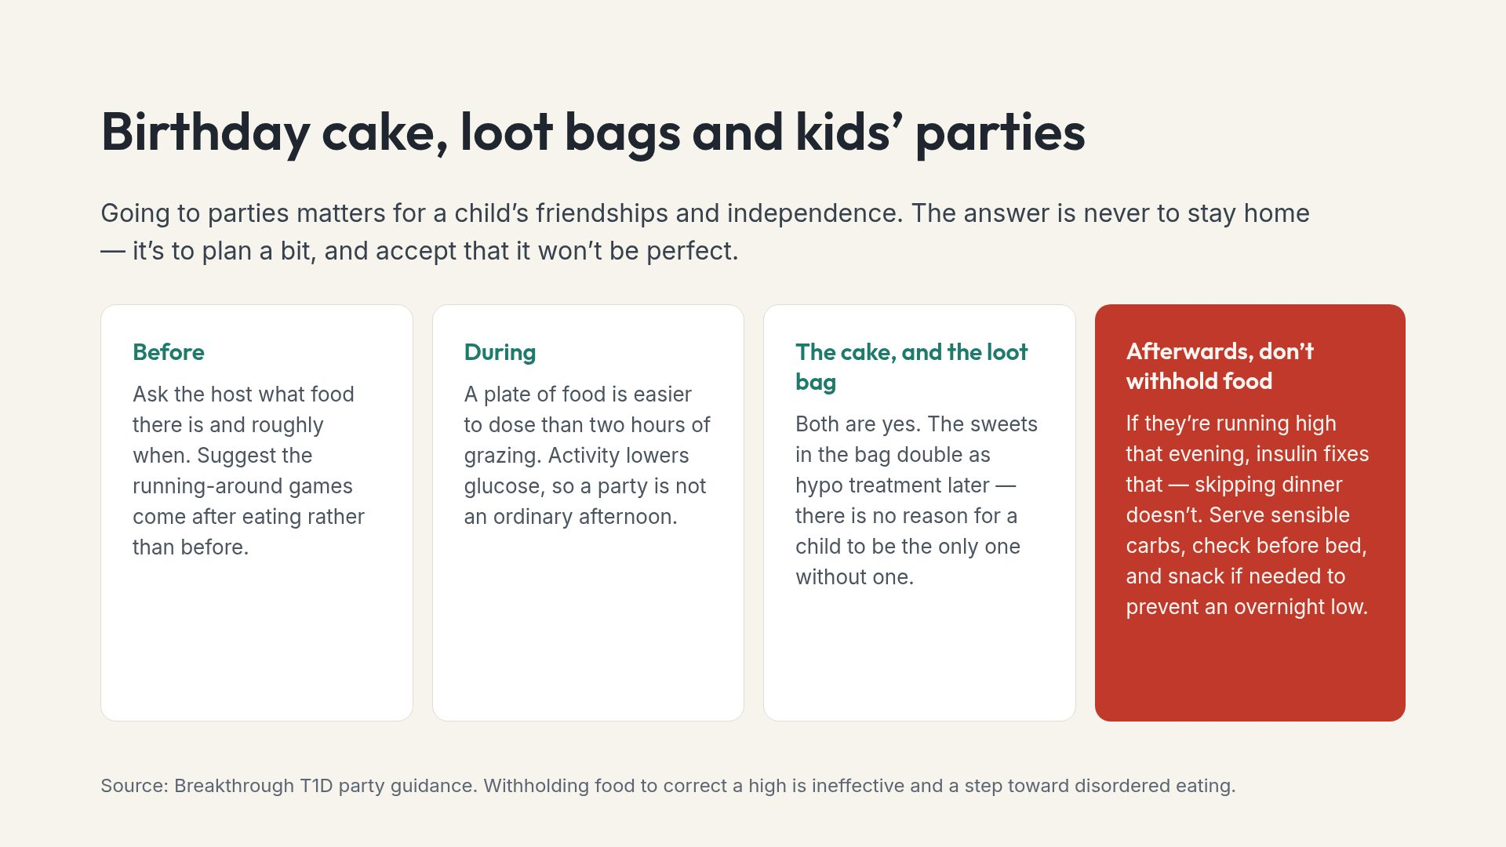
Notes:
The last card is counterintuitive and worth saying twice. The instinct to compensate by restricting is strong and it does real harm.

Slide 20
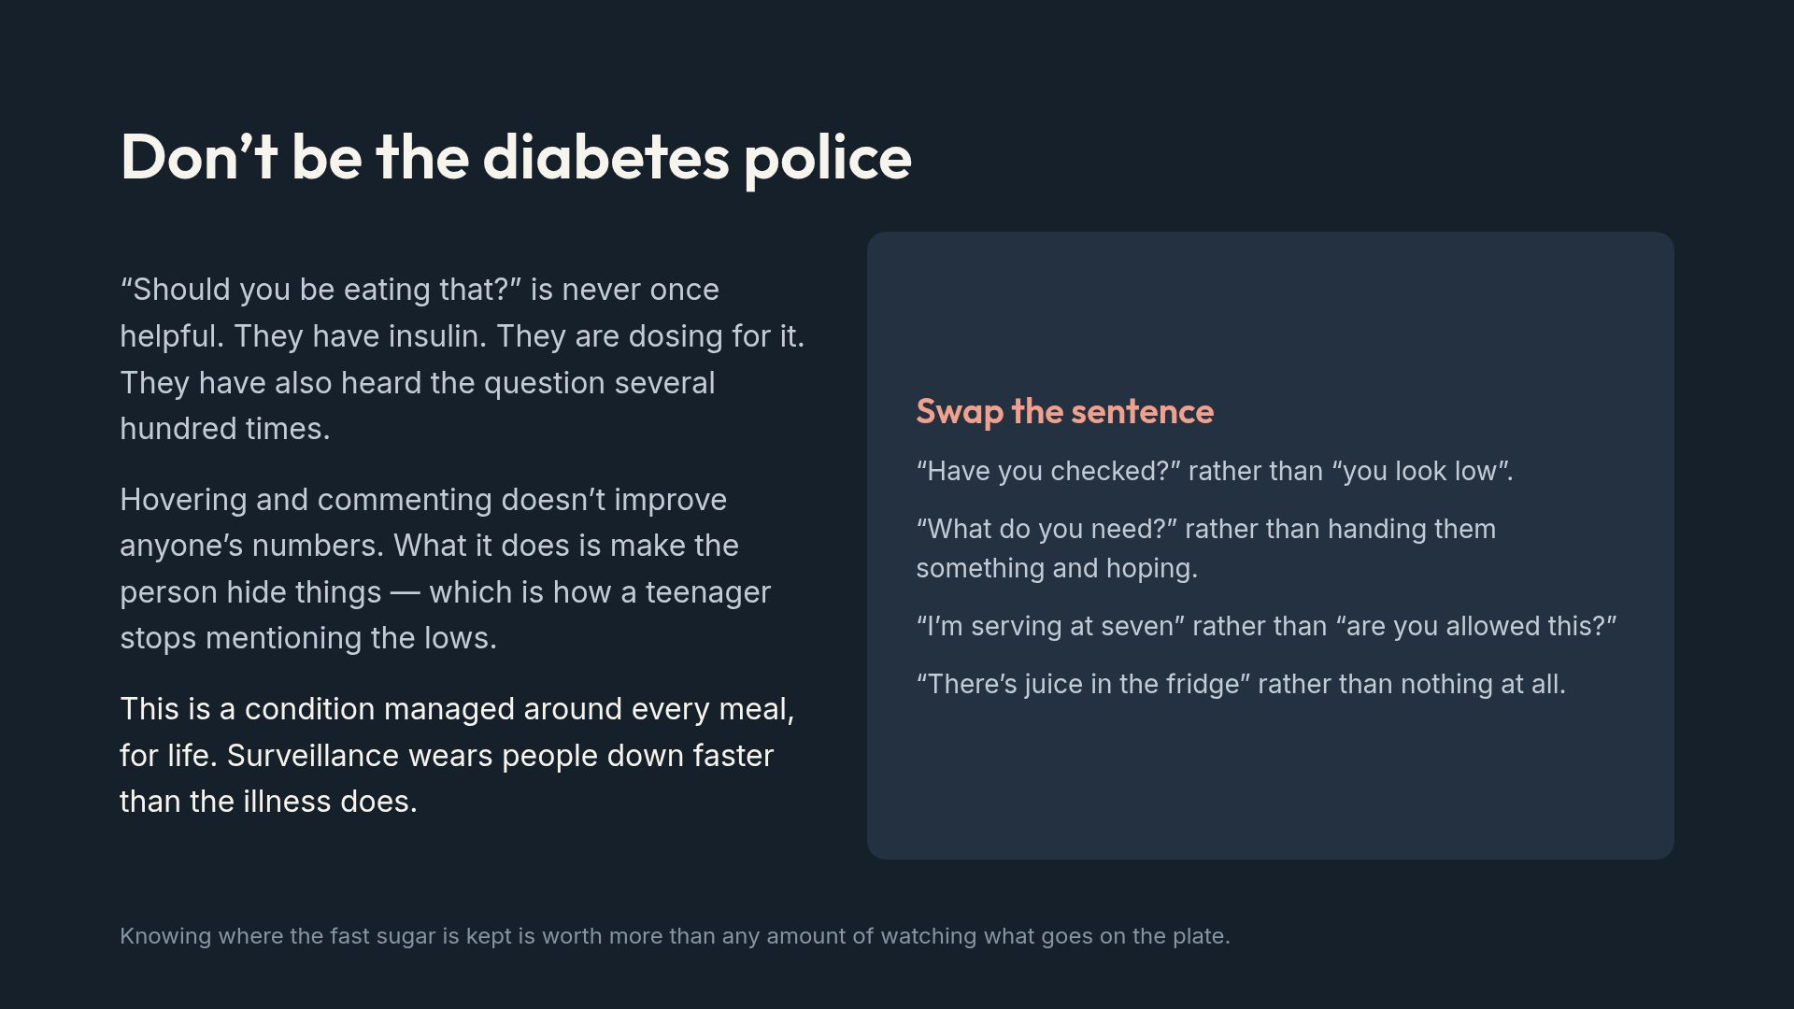
Notes:
If caretakers remember one slide from this deck, make it this one. Good intentions cause most of what is listed here.

Slide 21
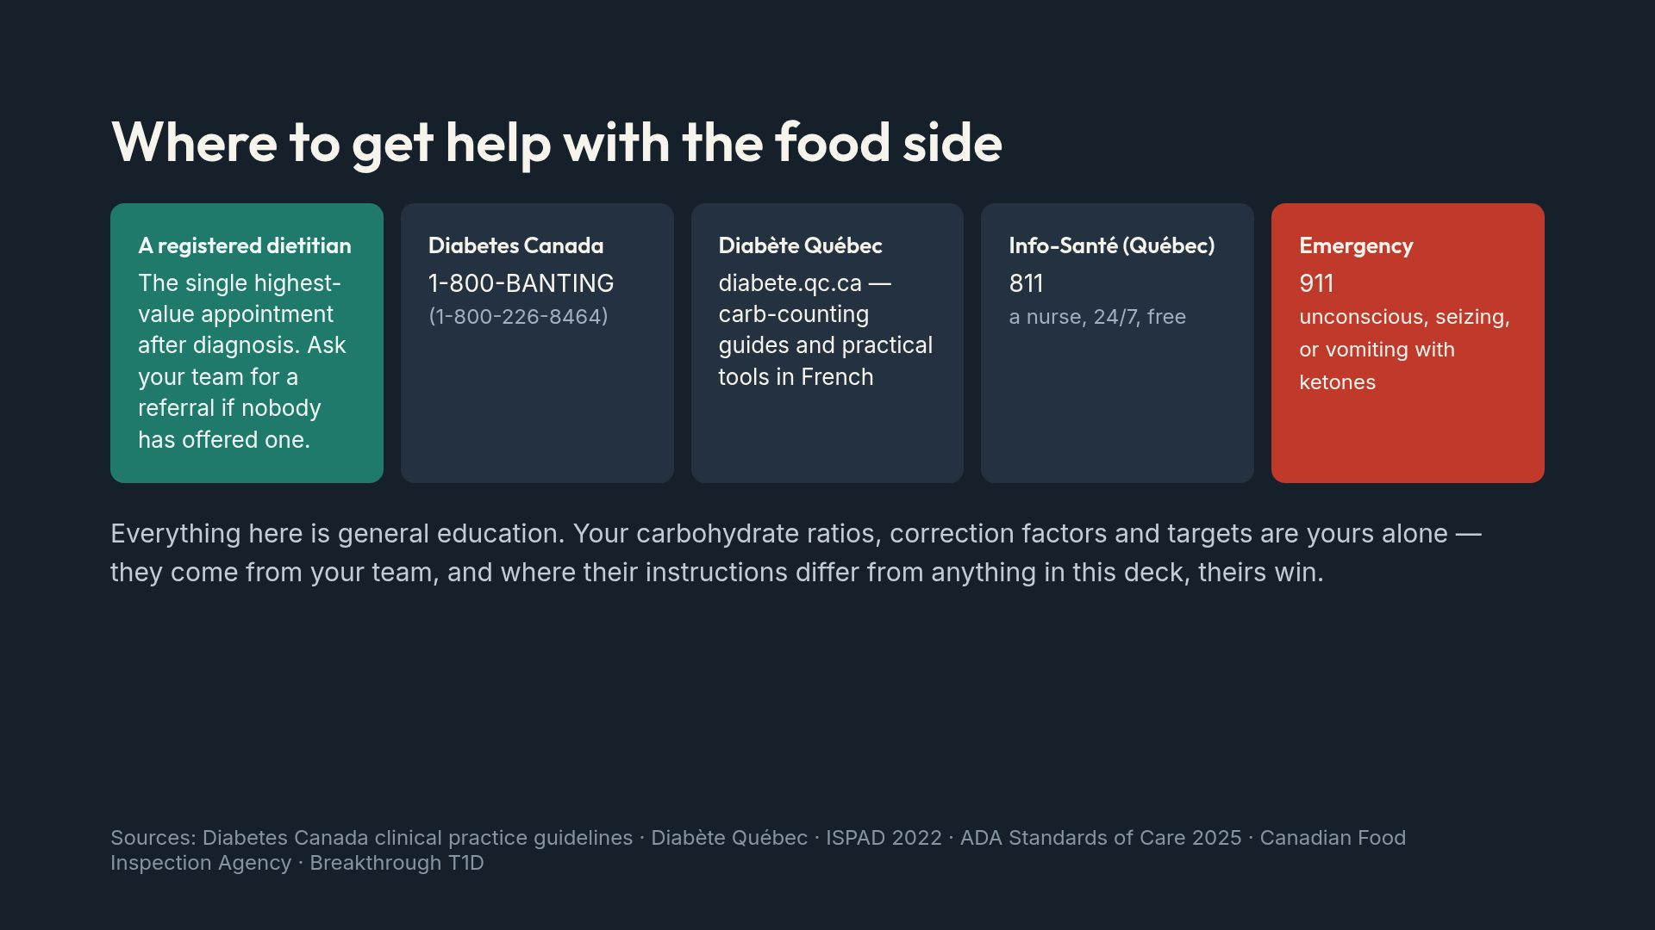
Notes:
Close on the dietitian. Many newly diagnosed people are never referred to one and do not know they can ask.

