Slide 1
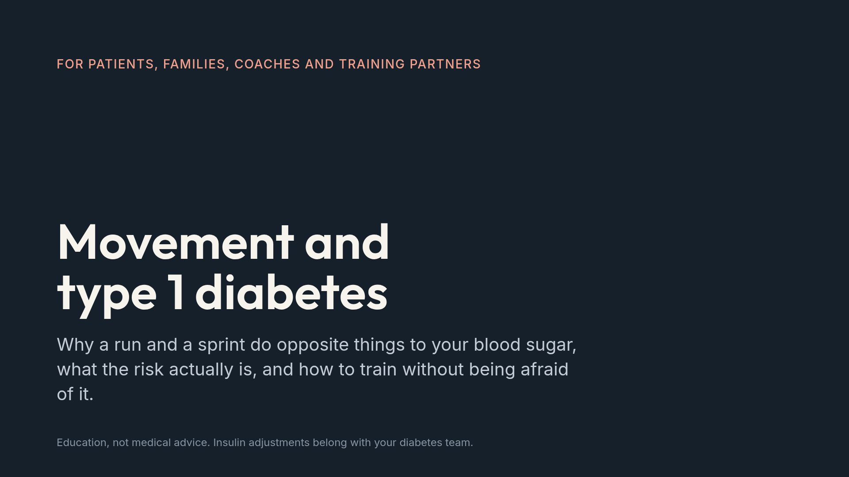
Notes:
Open by naming the fear. Fear of hypoglycemia is the single most documented reason people with type 1 stop exercising, and in children it is often the parent's fear rather than the child's.

Slide 2
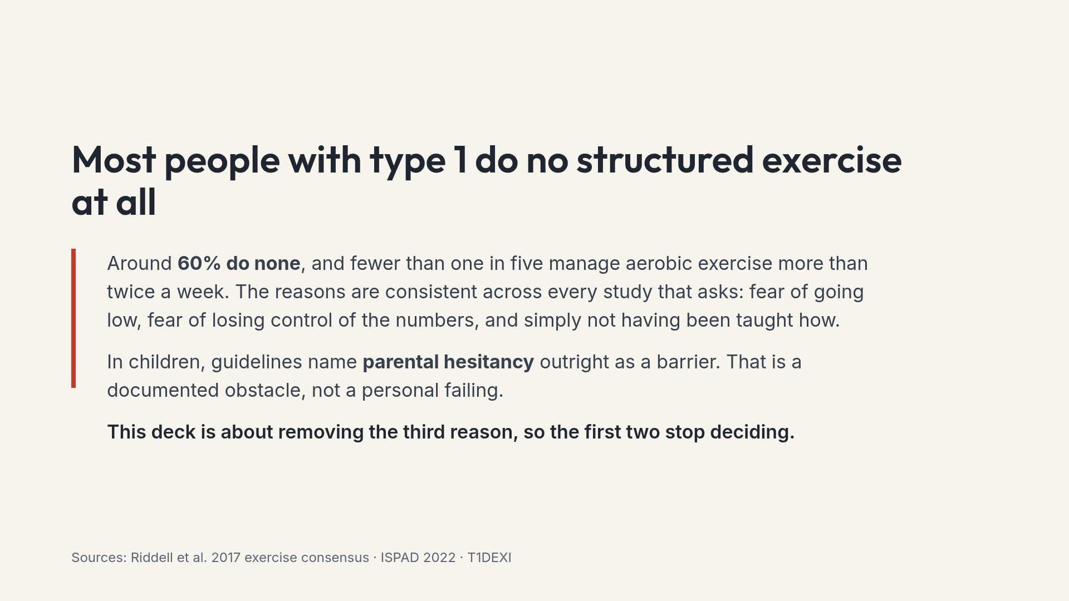
Notes:
Naming parental fear openly tends to land well. Parents rarely hear it described as a known, expected obstacle rather than overprotectiveness.

Slide 3
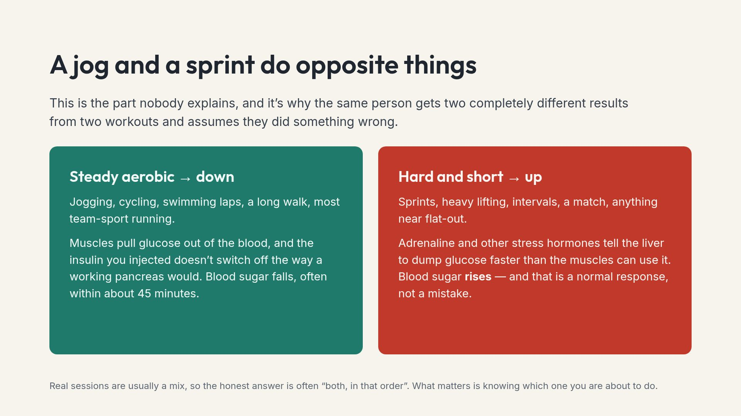
Notes:
If a slide from this deck gets photographed, it will be this one. The two-direction idea explains most of the confusion people arrive with.

Slide 4
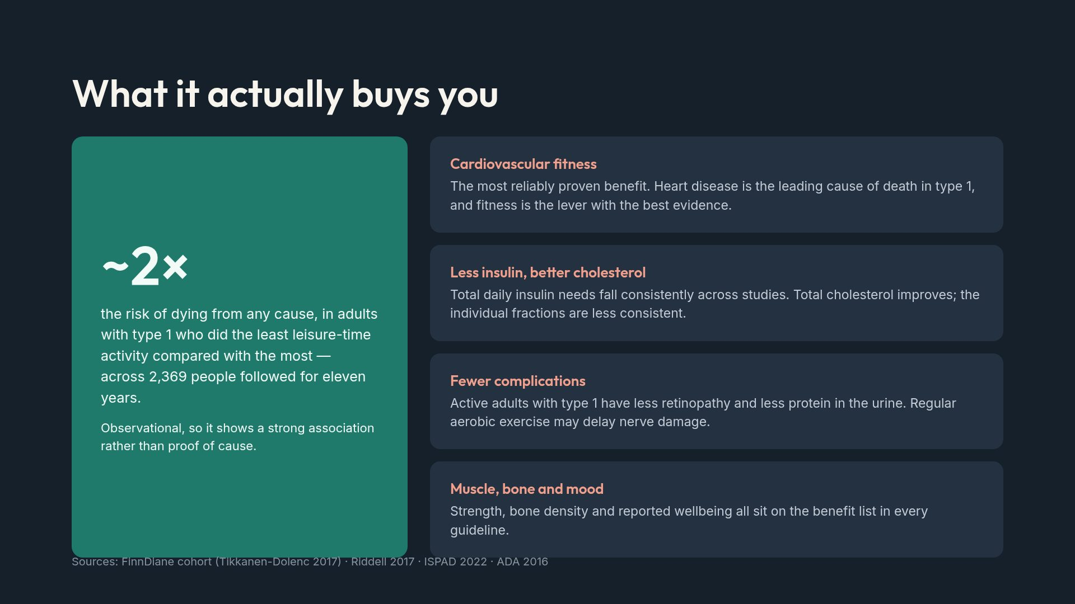
Notes:
Be careful with the 2x figure. It is a hazard ratio from an observational cohort; reverse causation is plausible since sicker people move less. Say that out loud.

Slide 5
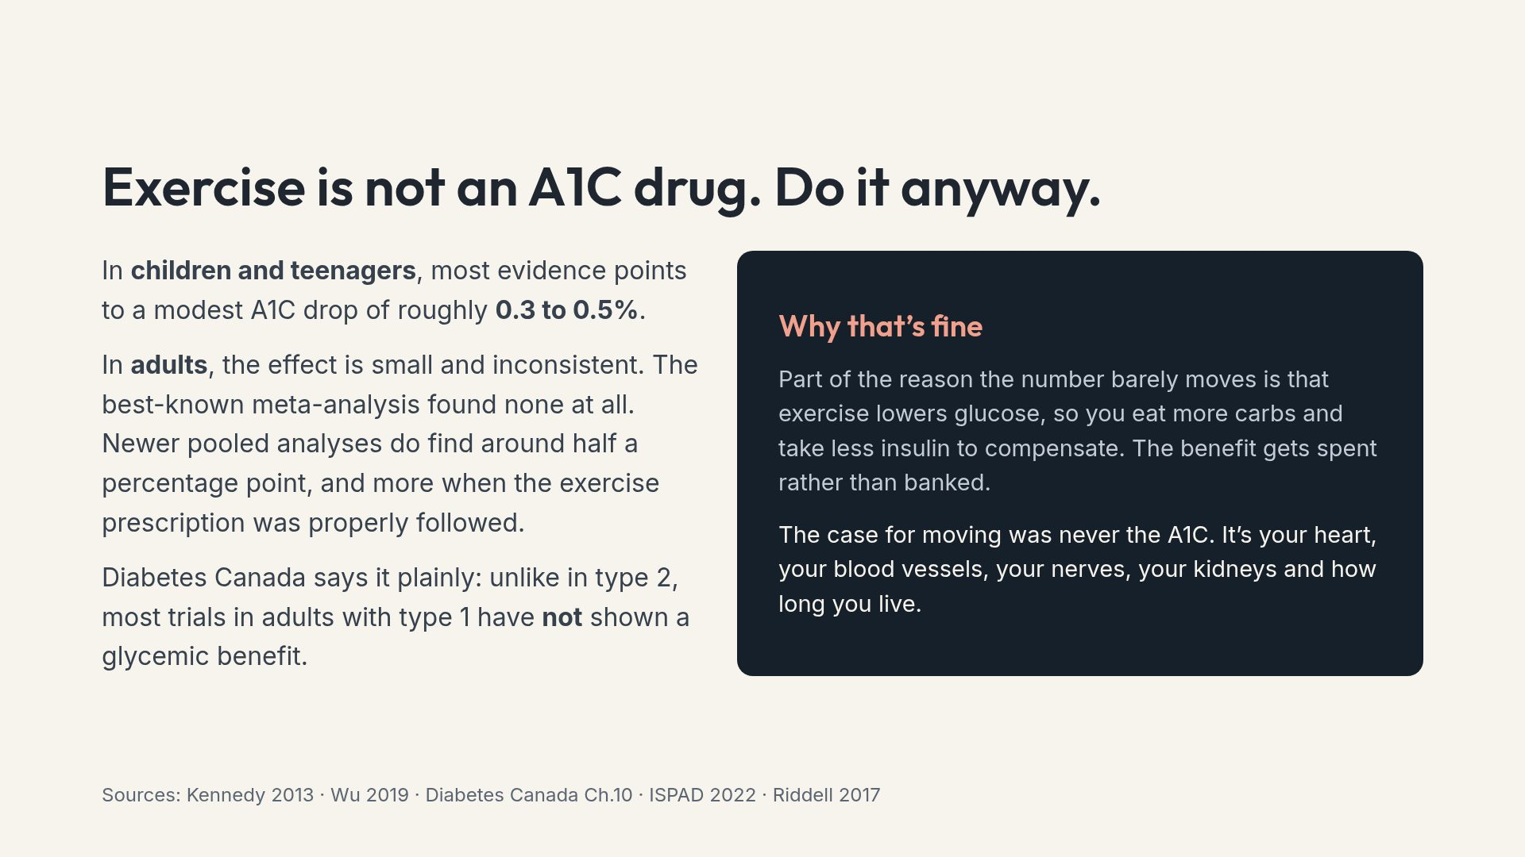
Notes:
Including this builds credibility. People who are told exercise will fix their A1C, and then watch it not move, conclude the whole enterprise was a lie.

Slide 6
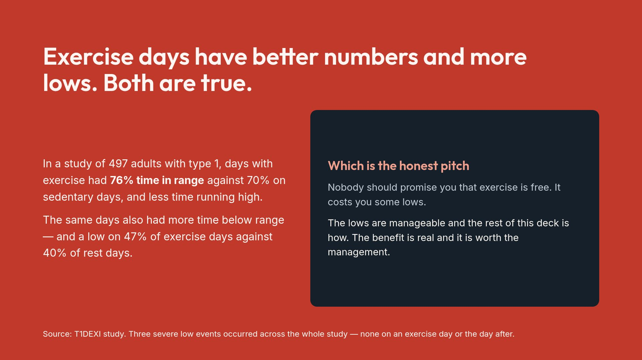
Notes:
Present this as the deck's honesty test. If the audience believes this slide, they will believe the management advice that follows it.

Slide 7
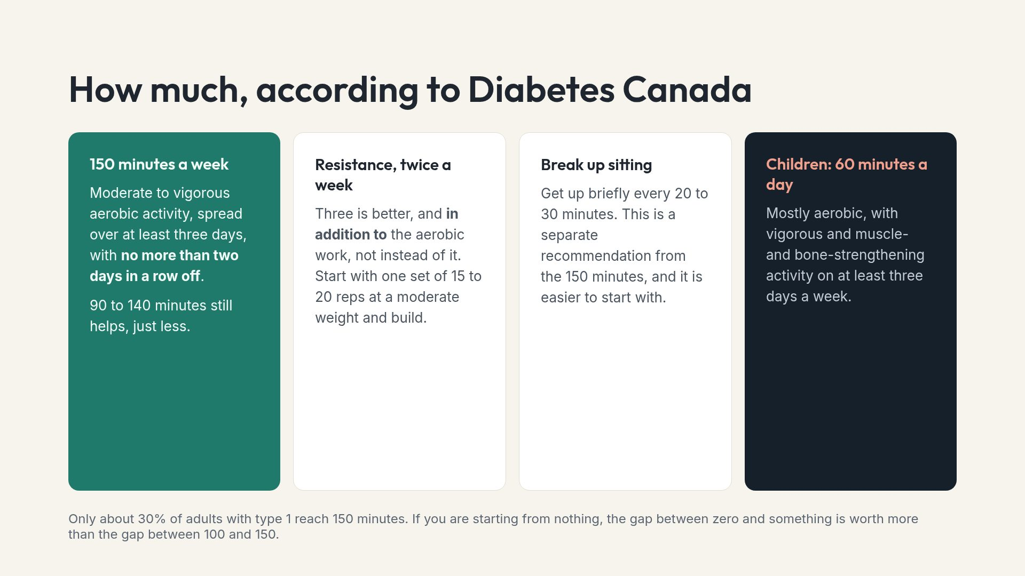
Notes:
The two-consecutive-days rule is the one people miss. It exists because the insulin-sensitivity benefit fades within roughly 48 hours.

Slide 8
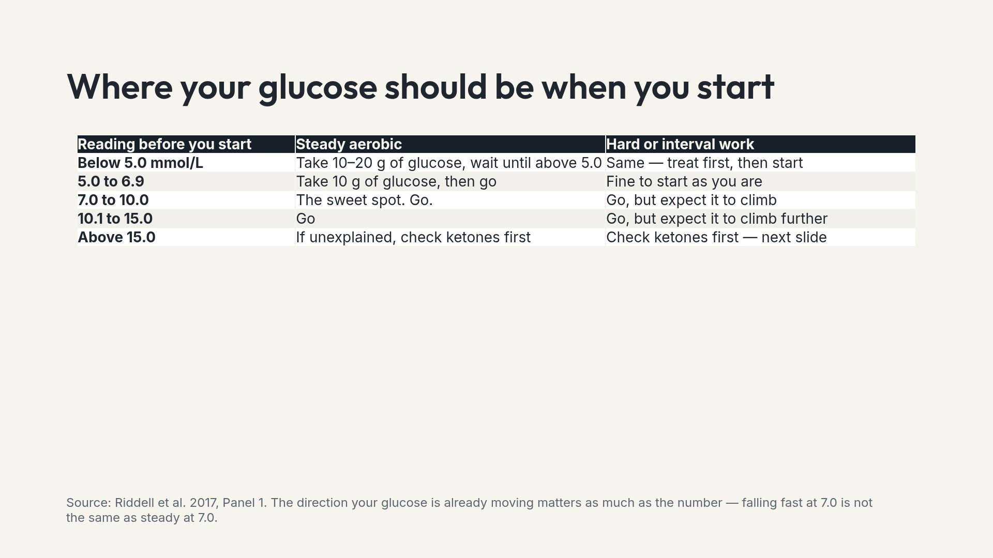
Notes:
Point at the trend arrow, not just the number. A CGM arrow pointing down at 7 mmol/L means treat before starting.

Slide 9
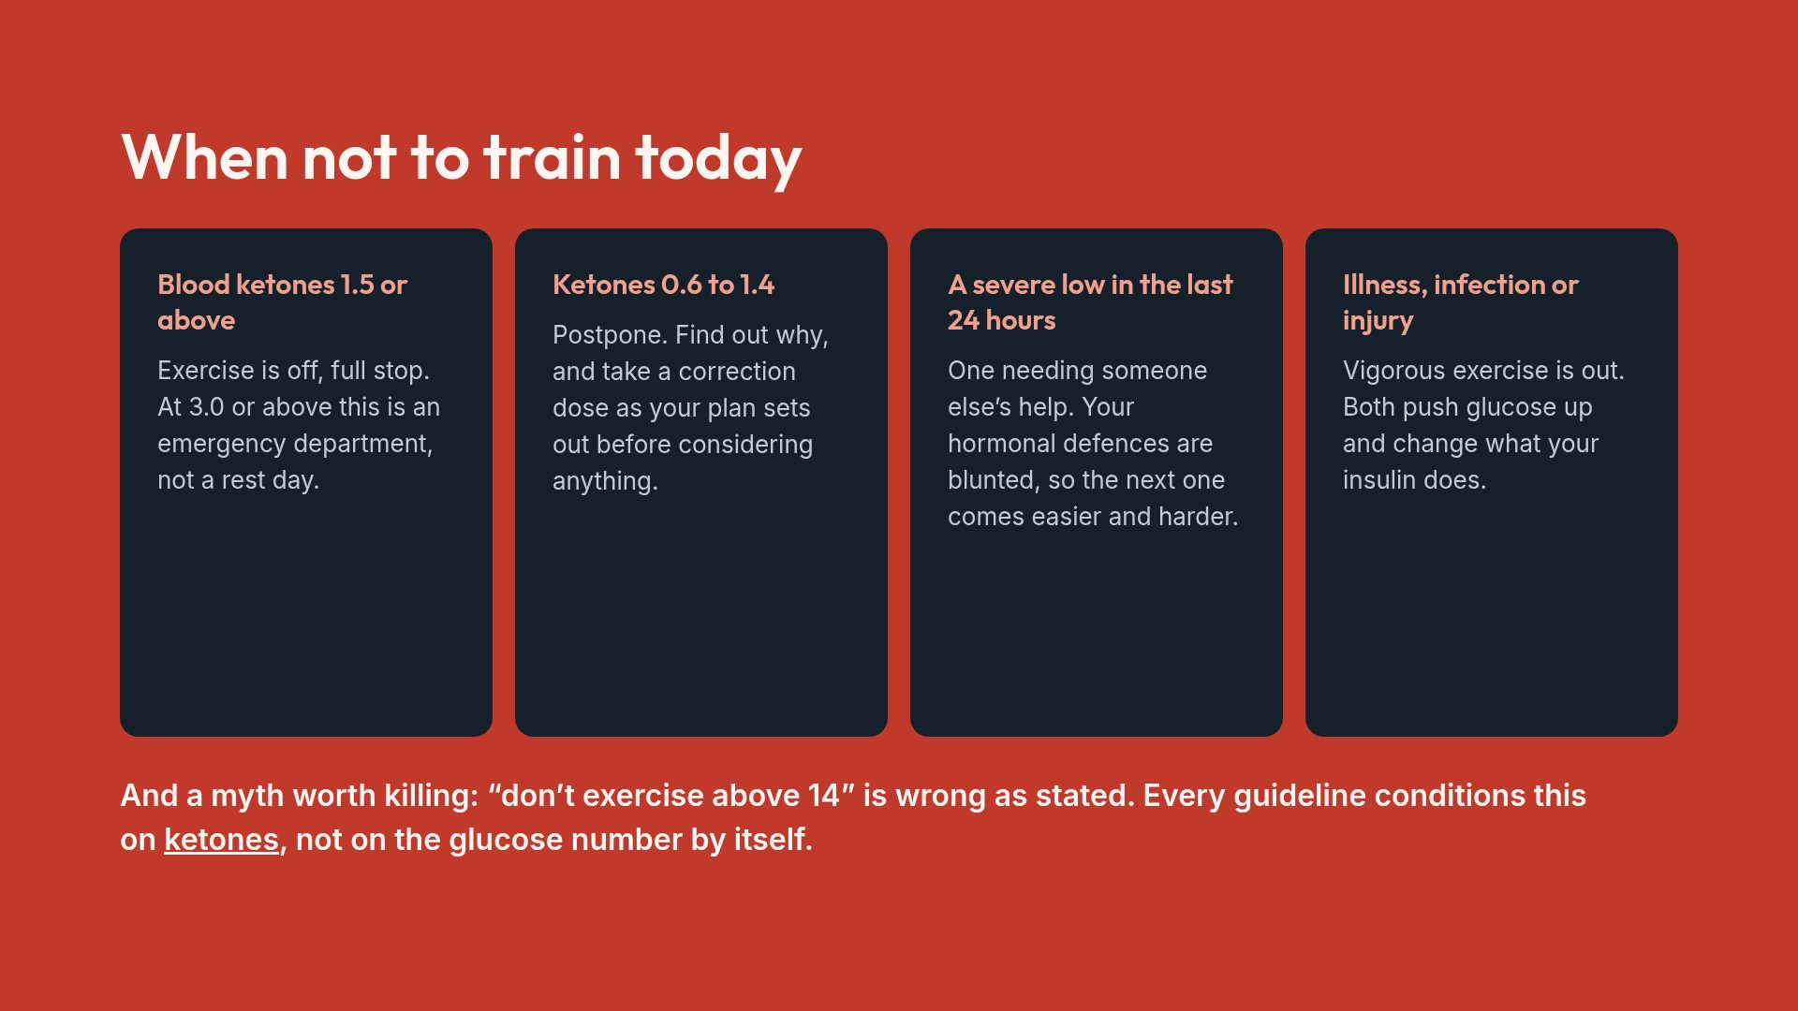
Notes:
Mild high glucose does not measurably hurt exercise capacity. It is insulin deficiency with ketones that makes exercise dangerous, and those are different things.

Slide 10
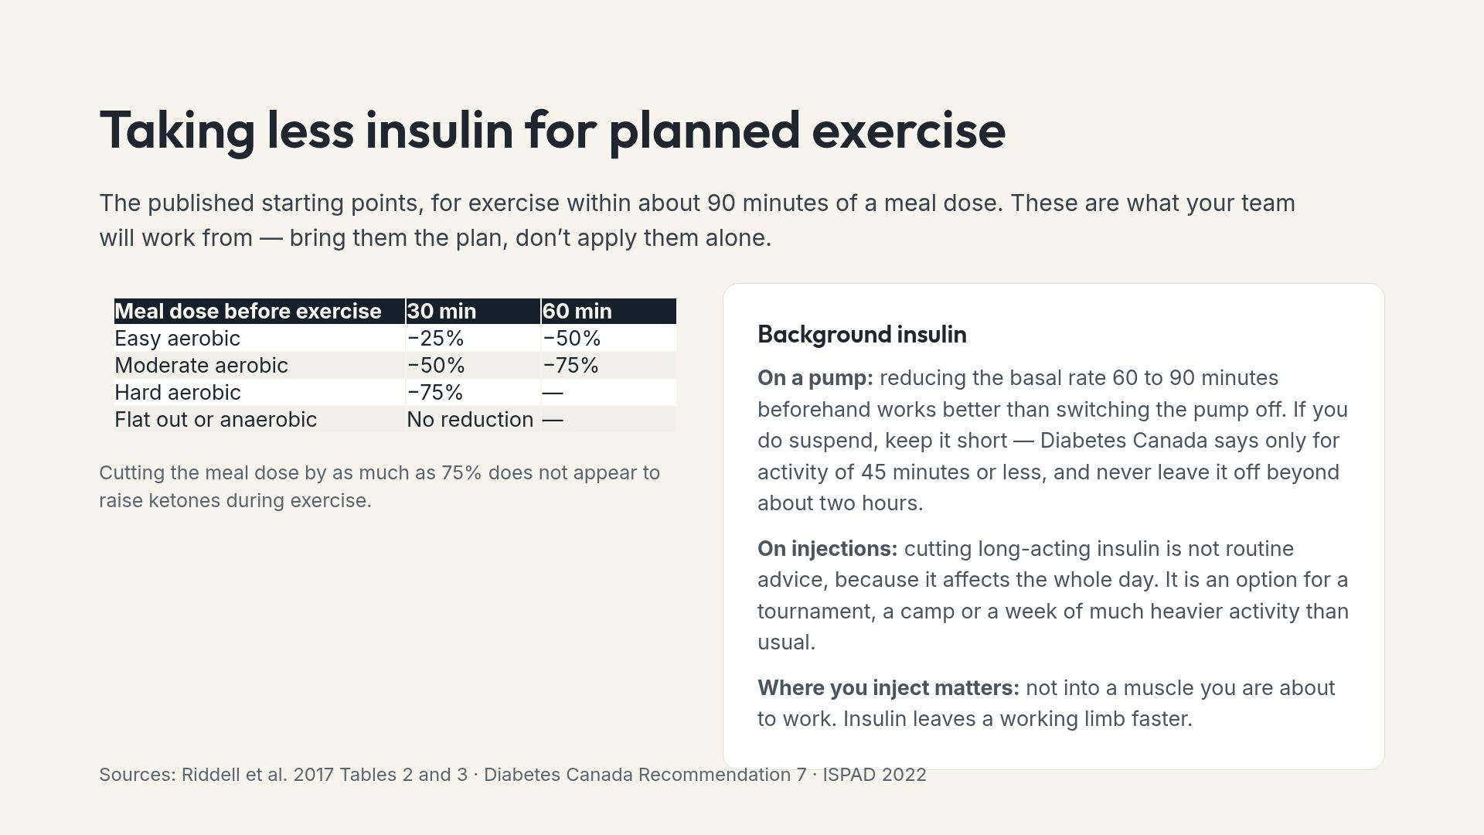
Notes:
The last line is small and practical: quads before a run, abdomen before leg day. People rarely hear it and it changes results immediately.

Slide 11
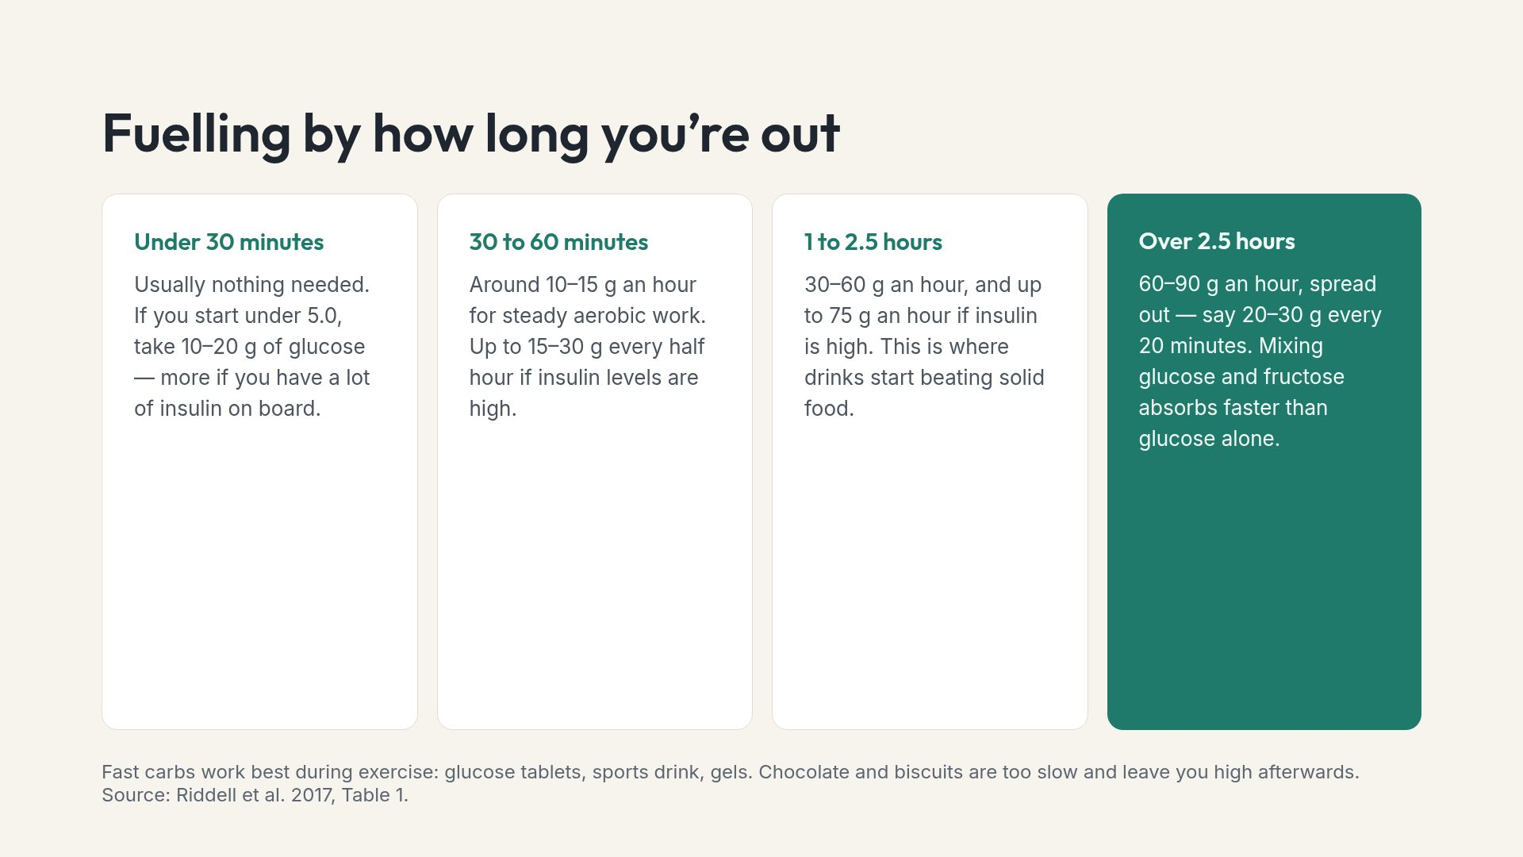
Notes:
Note that very high carbohydrate rates upset some stomachs. Athletes train their gut for this; a beginner should build up.

Slide 12
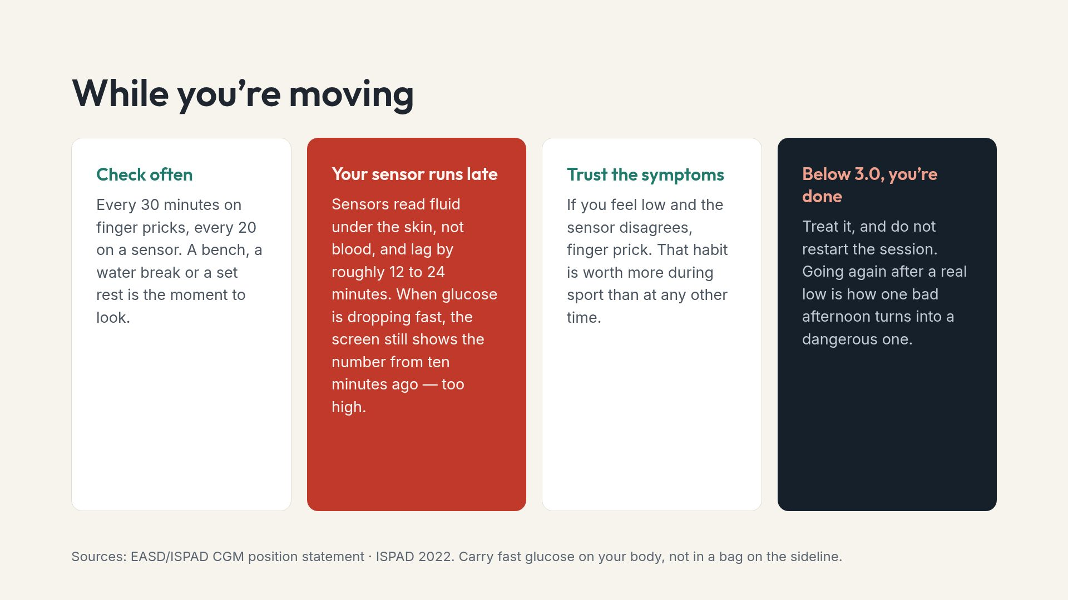
Notes:
Compression lows are worth mentioning to cyclists and anyone in tight kit: pressure on a sensor gives falsely low readings.

Slide 13
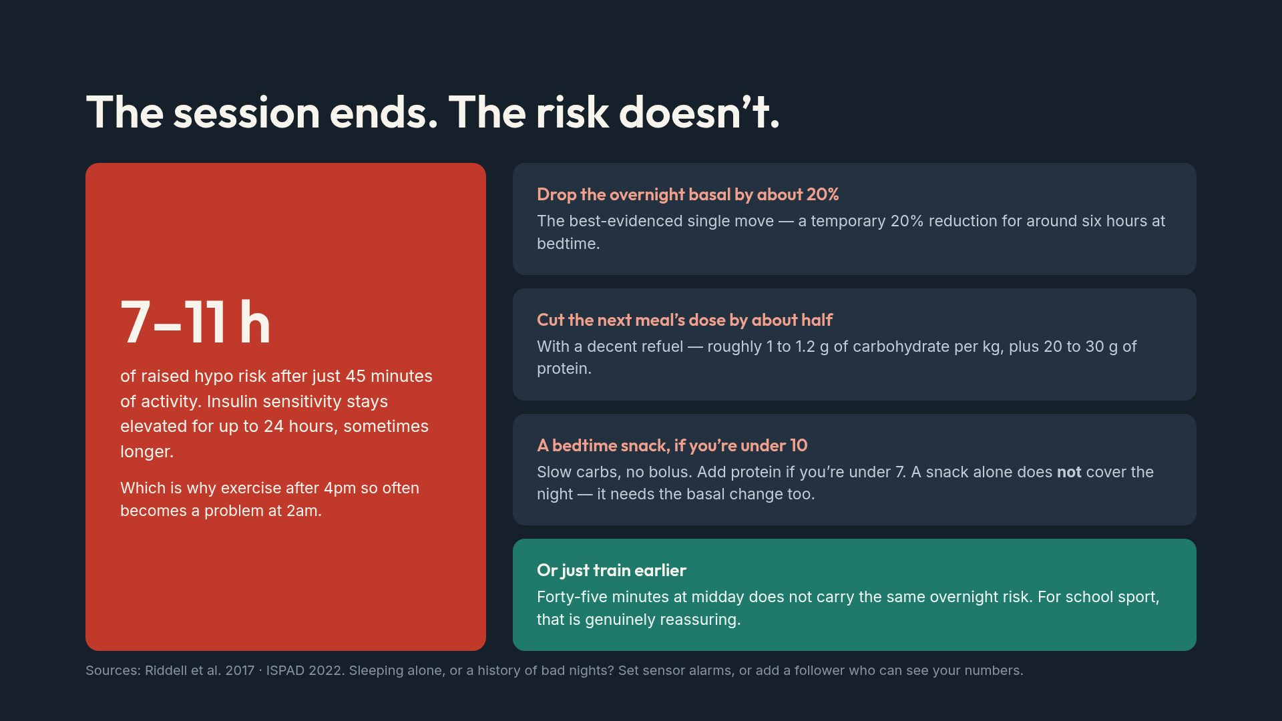
Notes:
The midday point is the one parents and PE teachers most need. Lunchtime sport generally needs no overnight adjustment at all.

Slide 14
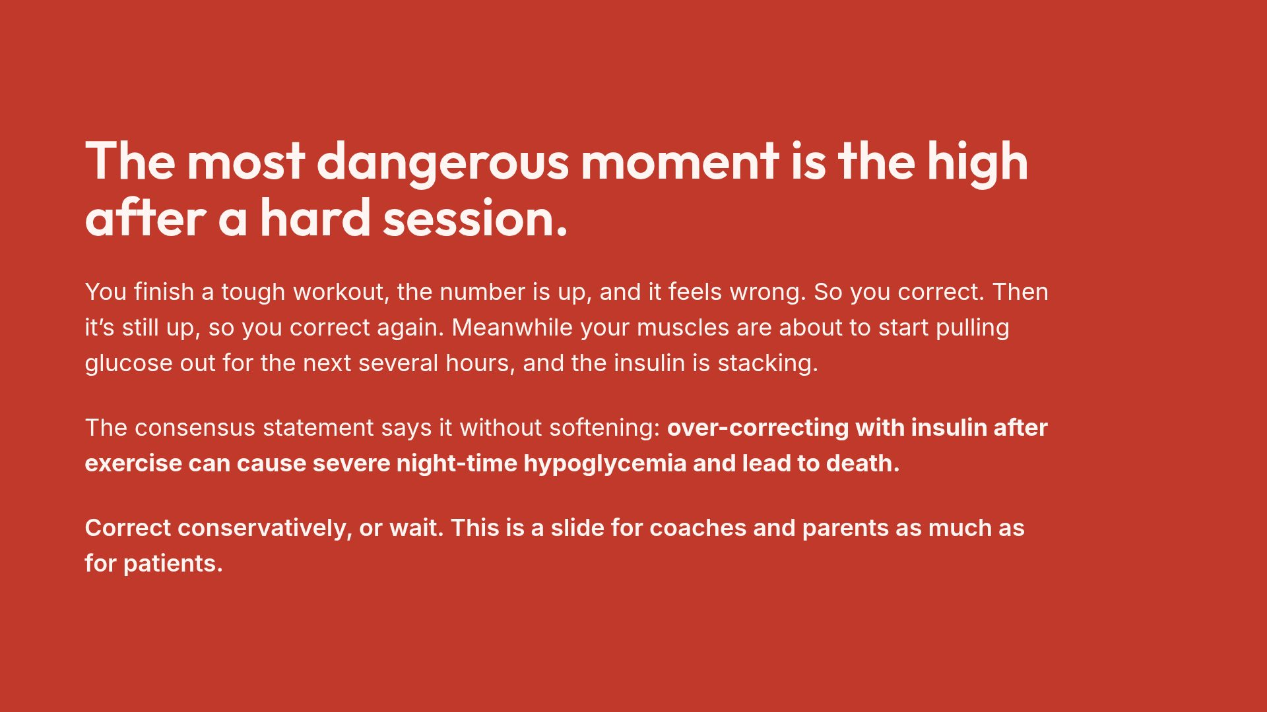
Notes:
There is a live research disagreement about the right correction size after interval training. For a general audience, stay with the conservative guideline position and refer the question to their team.

Slide 15
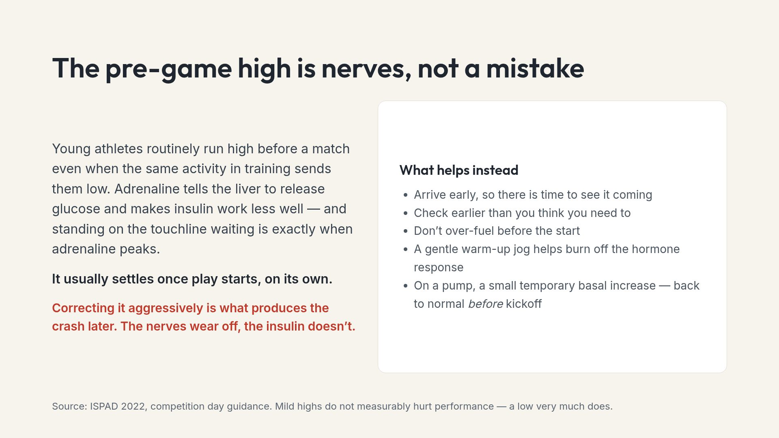
Notes:
Coaches who understand this one slide stop pushing for a correction on the sideline, which is where the harm usually begins.

Slide 16
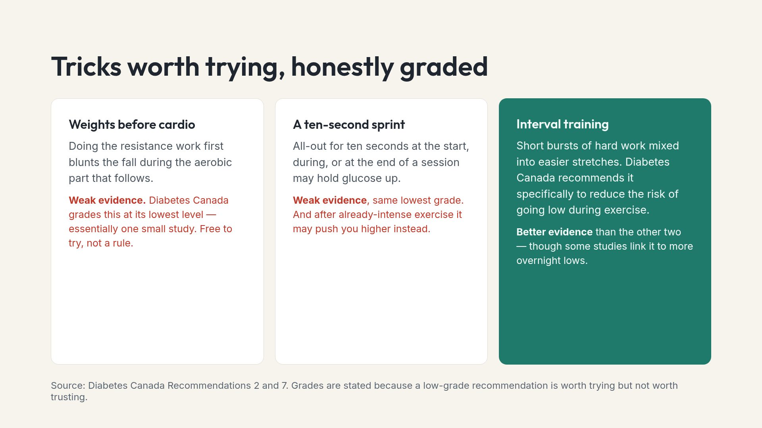
Notes:
Showing the evidence grade openly is unusual in patient material and tends to increase trust rather than reduce it.

Slide 17
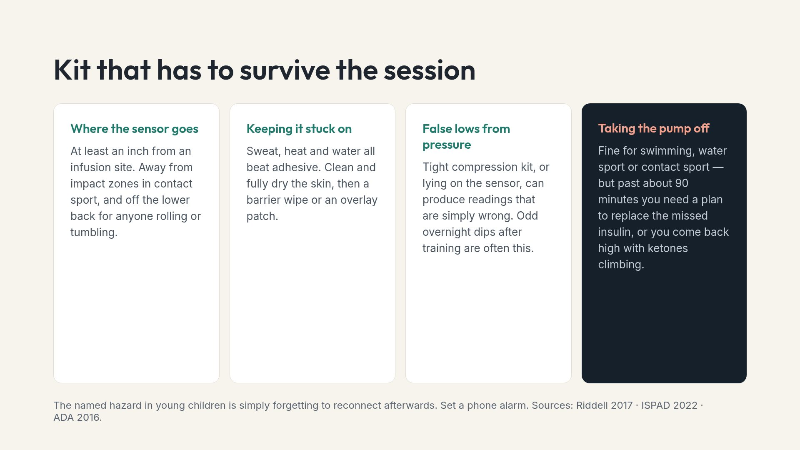
Notes:
Some competitions prohibit wearing devices. Worth checking rules in advance rather than at the start line.

Slide 18
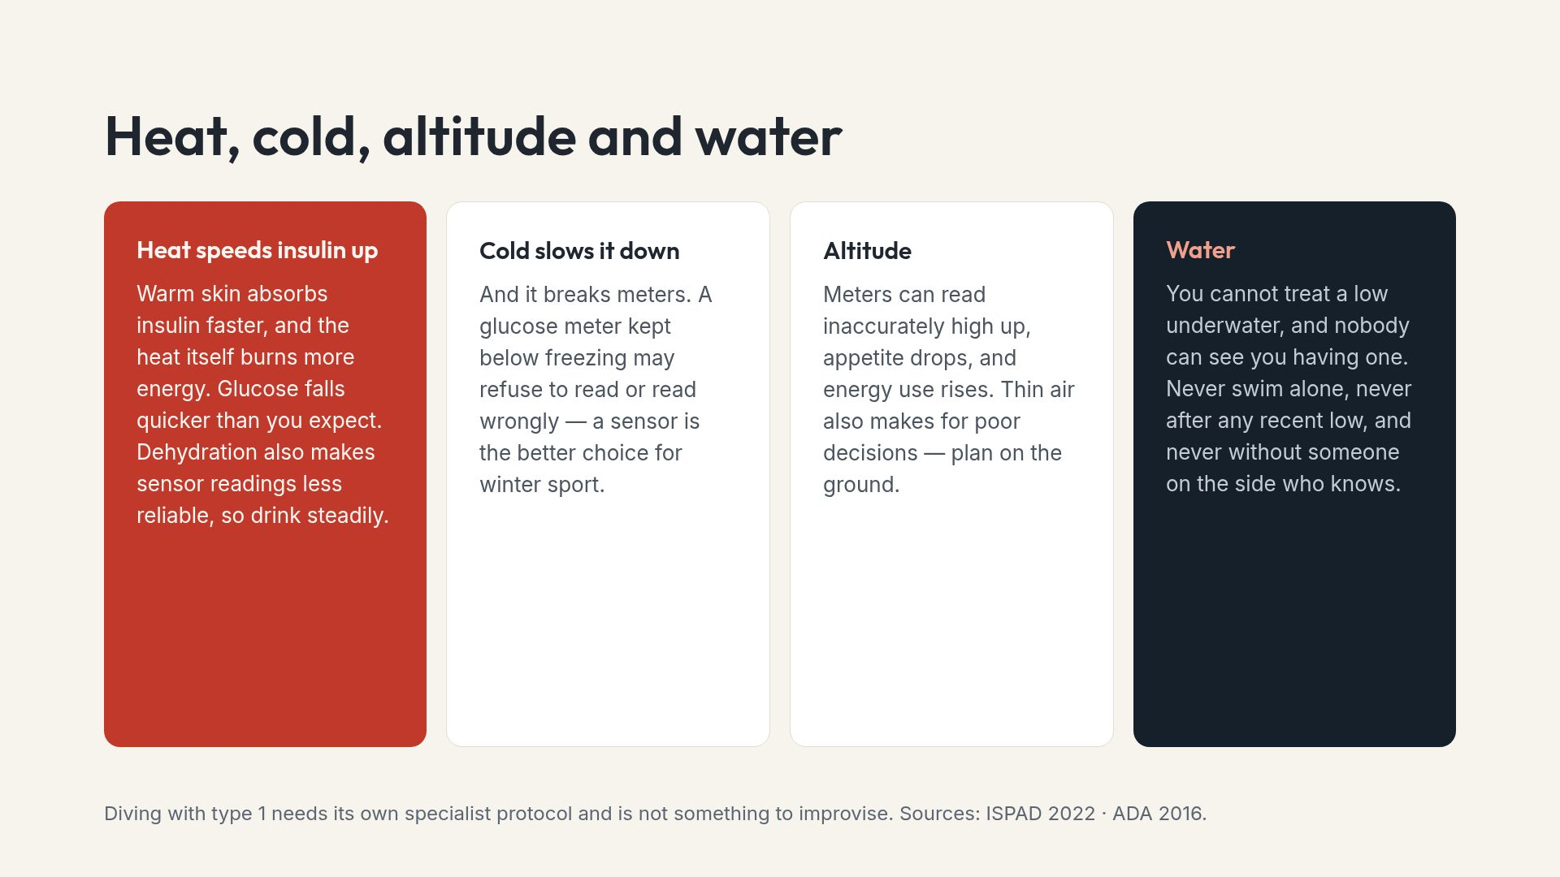
Notes:
Alpine skiing, climbing, trekking alone and open water are the four settings the consensus statement singles out as unsafe after any recent low.

Slide 19
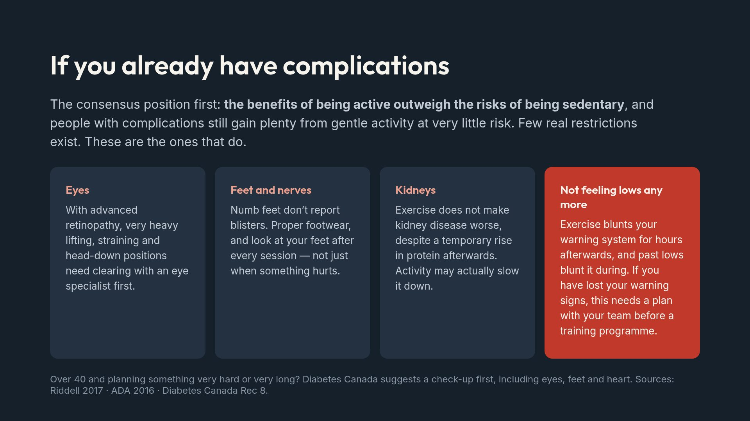
Notes:
The ADA pushes back on over-screening: for people with type 1 at any age, the only common exercise-related adverse event is hypoglycemia. Don't medicalise a decision to go for a walk.

Slide 20
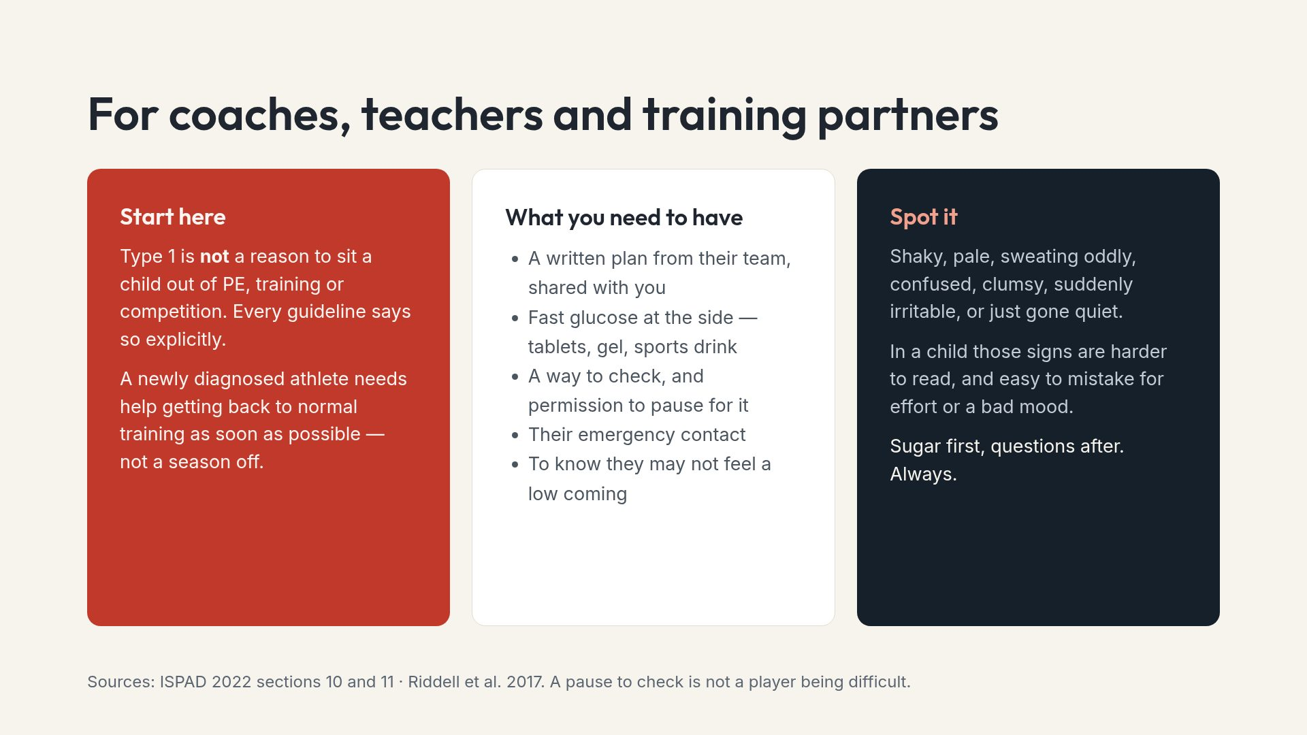
Notes:
Ask whether the coach has actually been given the written plan. Usually the answer is no, and that is the most useful outcome of the session.

Slide 21
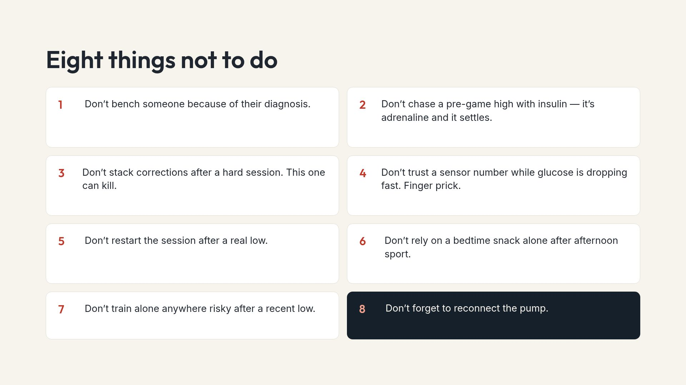
Notes:
Numbers two and three are the ones that produce genuine emergencies. If a coach remembers only two lines from the whole deck, make it those.

Slide 22
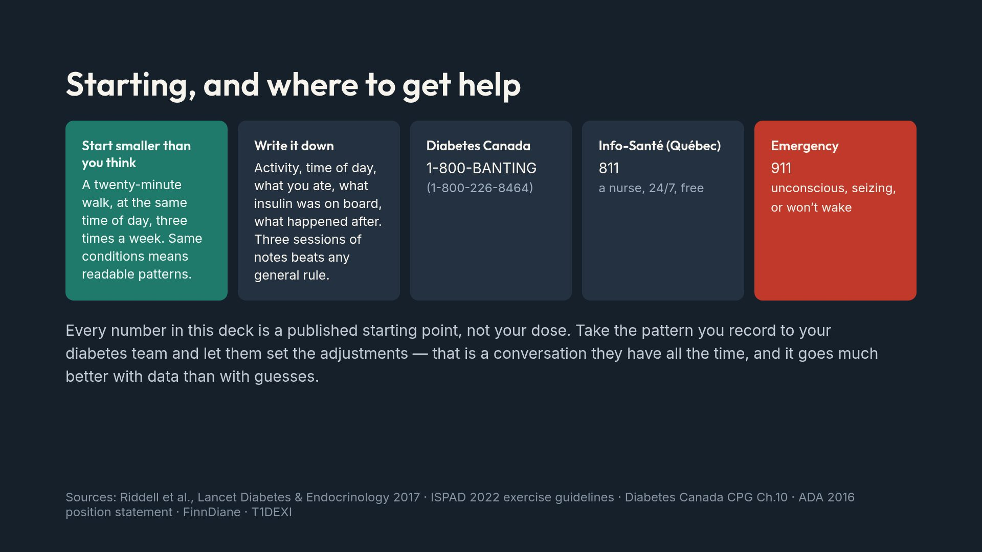
Notes:
Close on the log. It converts a scary, variable problem into a personal pattern, and it gives the clinic something to work with.

