Slide 1
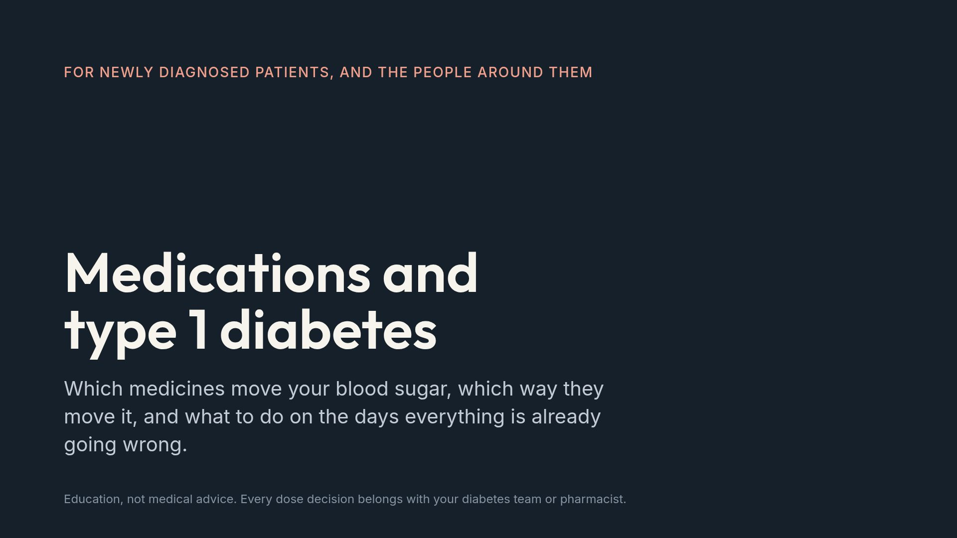
Notes:
Open by saying what this is not: nobody should change a dose because of a slide. The goal is knowing which conversations to start.

Slide 2
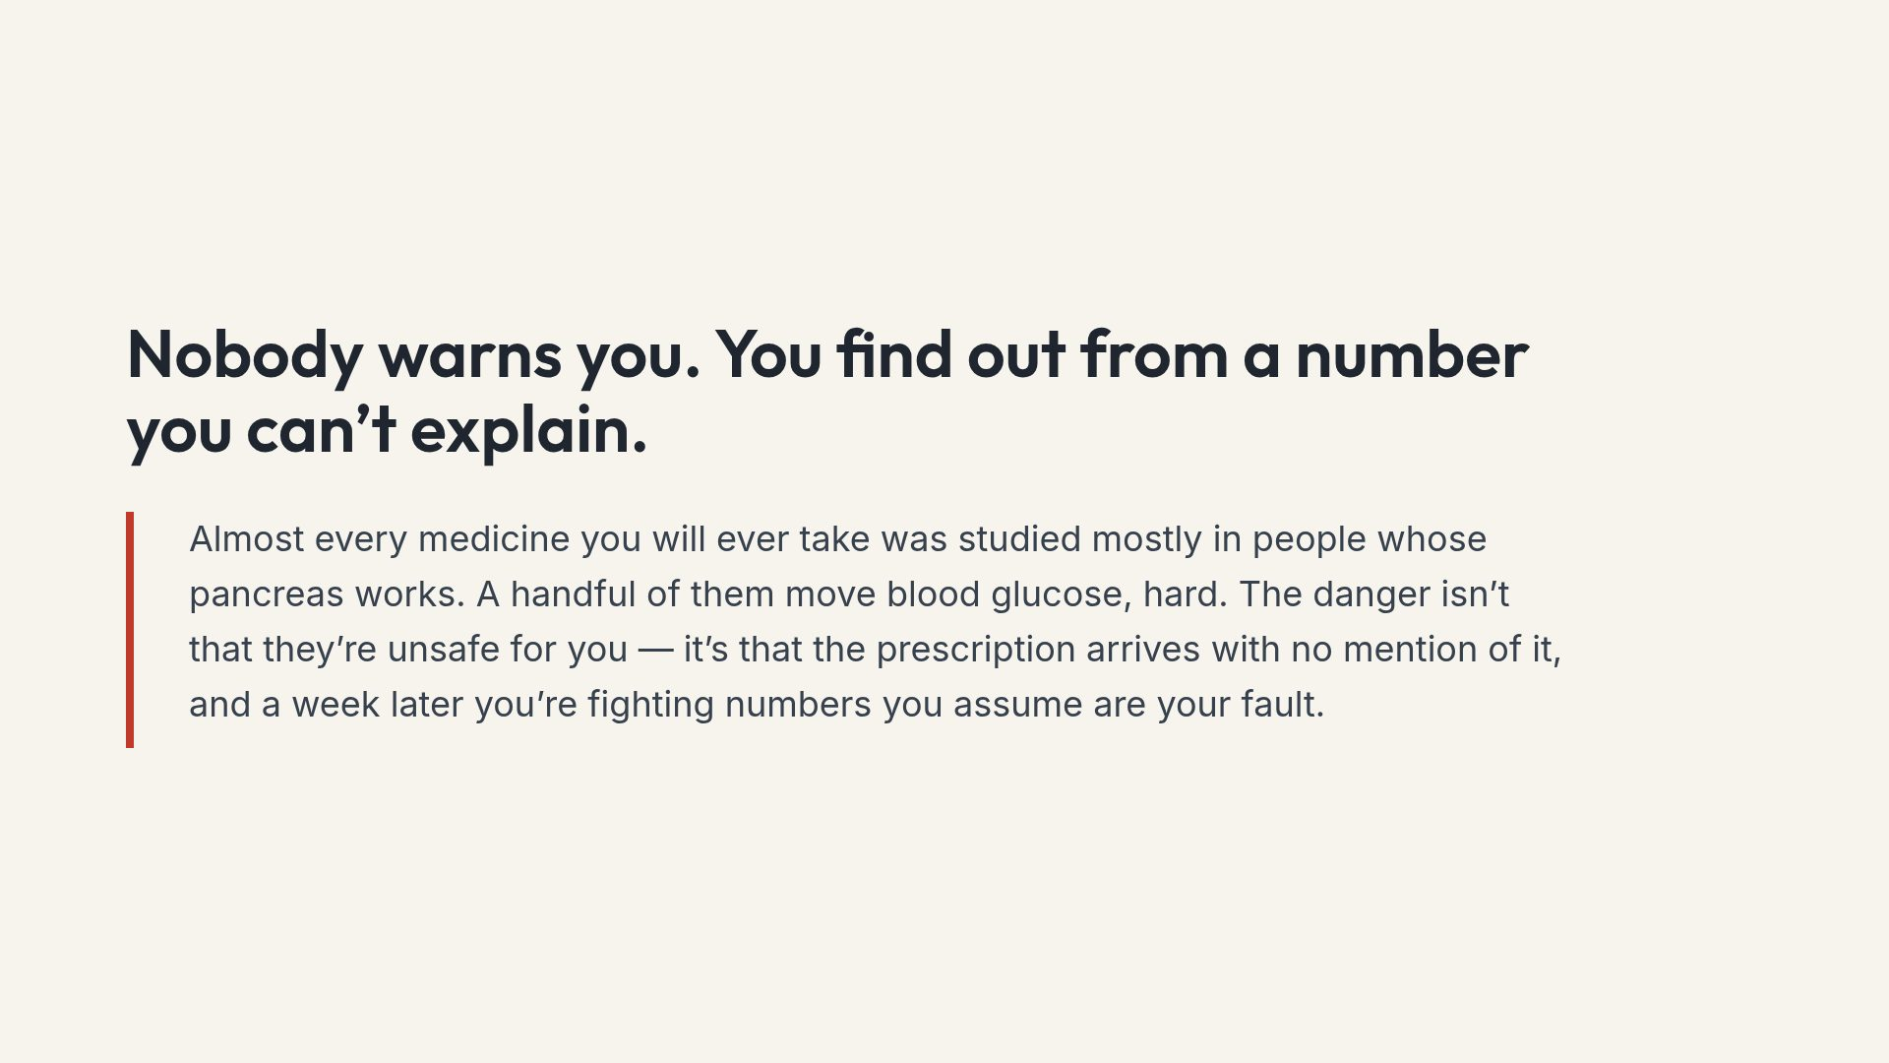
Notes:
The tone to set: this is not a list of drugs to refuse. It is a list of drugs to expect something from.

Slide 3
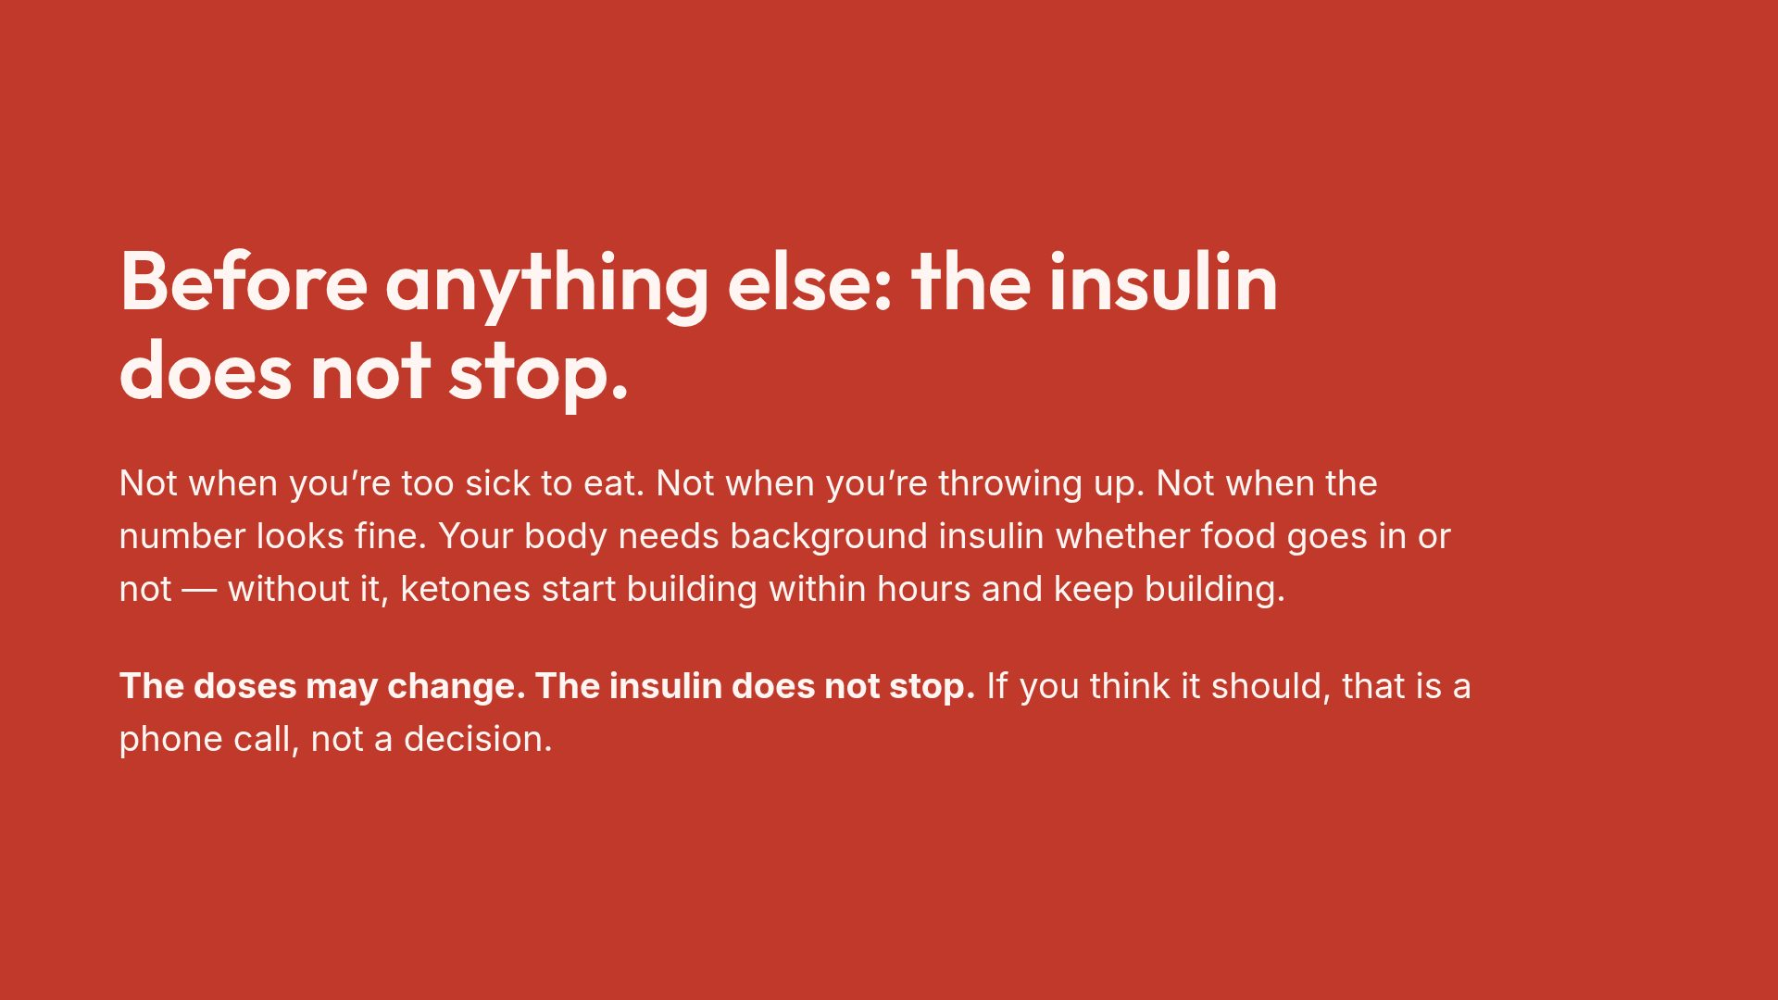
Notes:
This is the single most important slide in the deck. Everything else is detail by comparison.

Slide 4
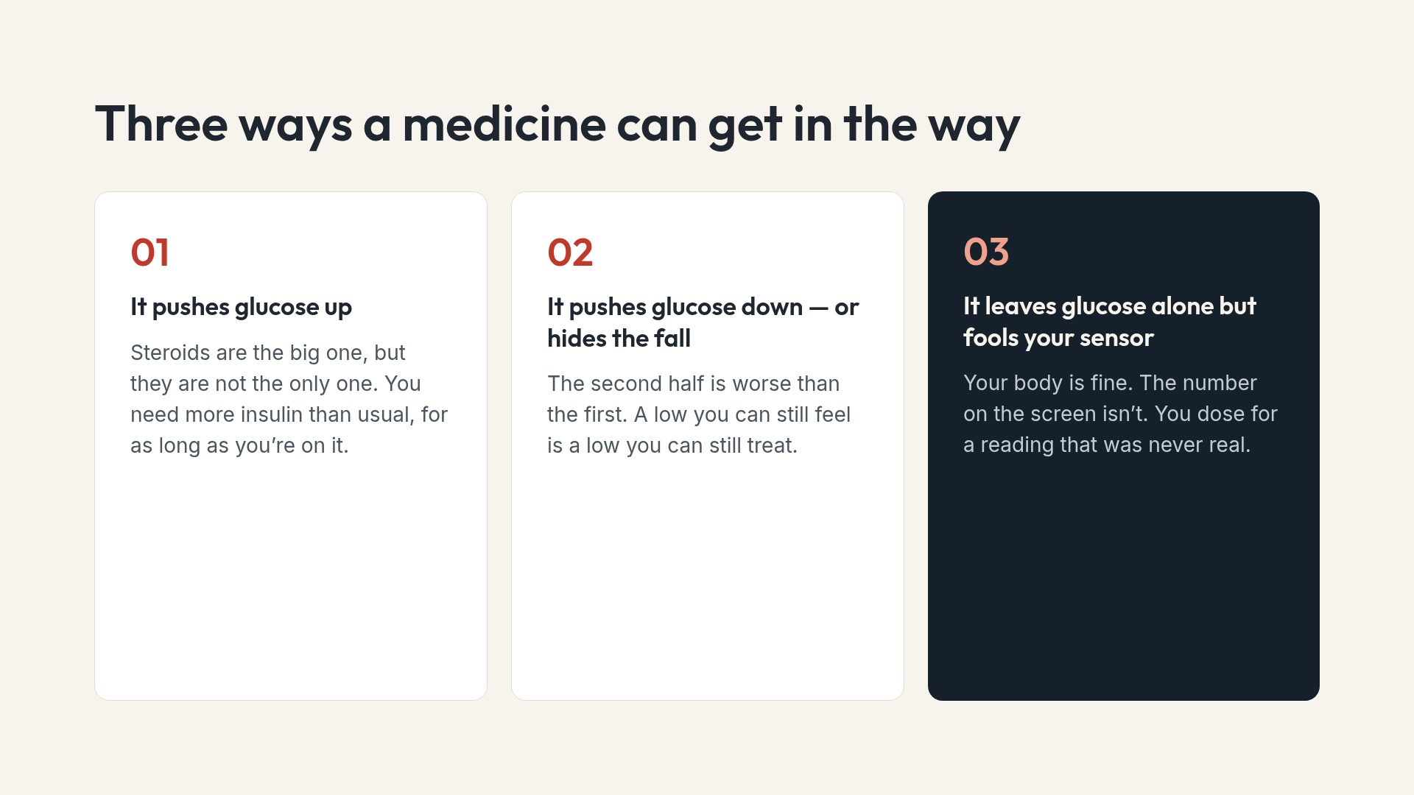
Notes:
Category three surprises almost everyone, including some prescribers. It comes back later in the deck.

Slide 5
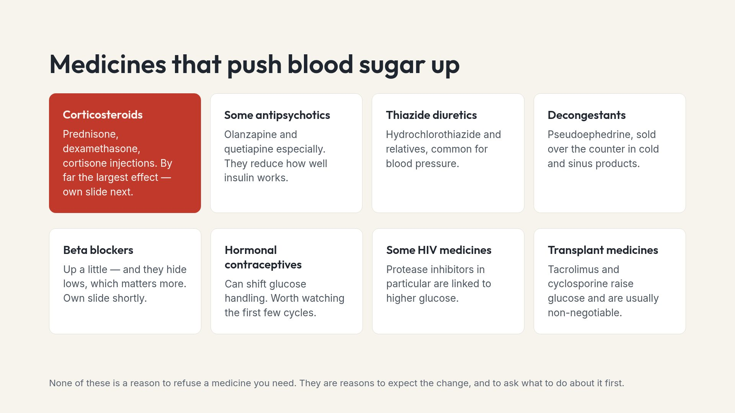
Notes:
Say the footer out loud. People do stop needed medication over slides like this, and that is a worse outcome than a high week.

Slide 6
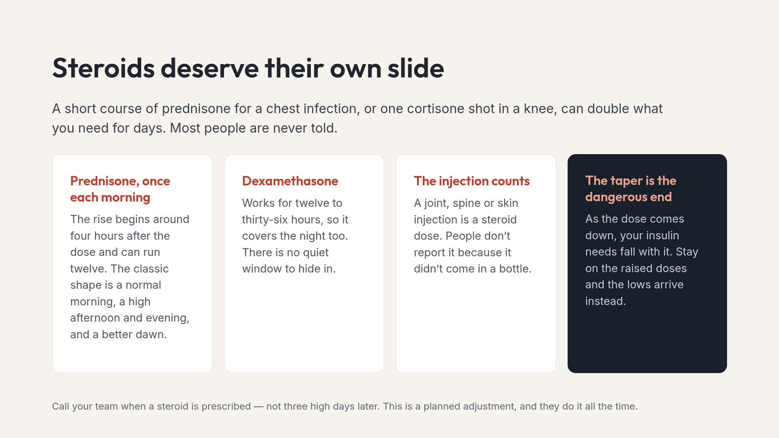
Notes:
Ask people to say "I have type 1 diabetes" at the moment any steroid is offered, including by a physio or a surgeon.

Slide 7
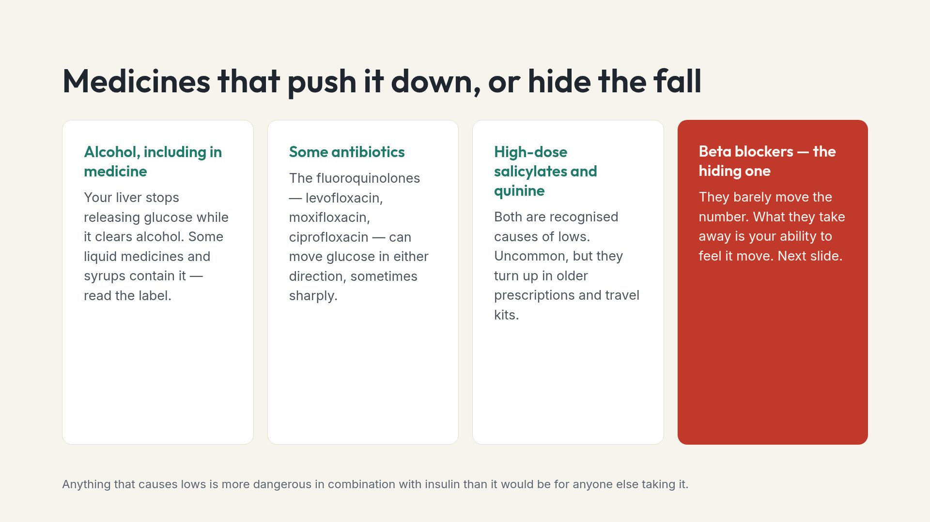
Notes:
Fluoroquinolones are the practical one here. They are prescribed often and the dysglycemia warning rarely gets mentioned at the counter.

Slide 8
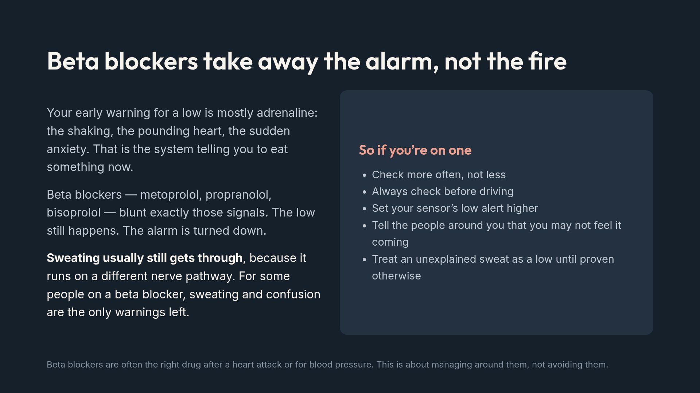
Notes:
Emphasise the sweating point. It is the one warning people can still trust, and almost nobody is told it survives.

Slide 9
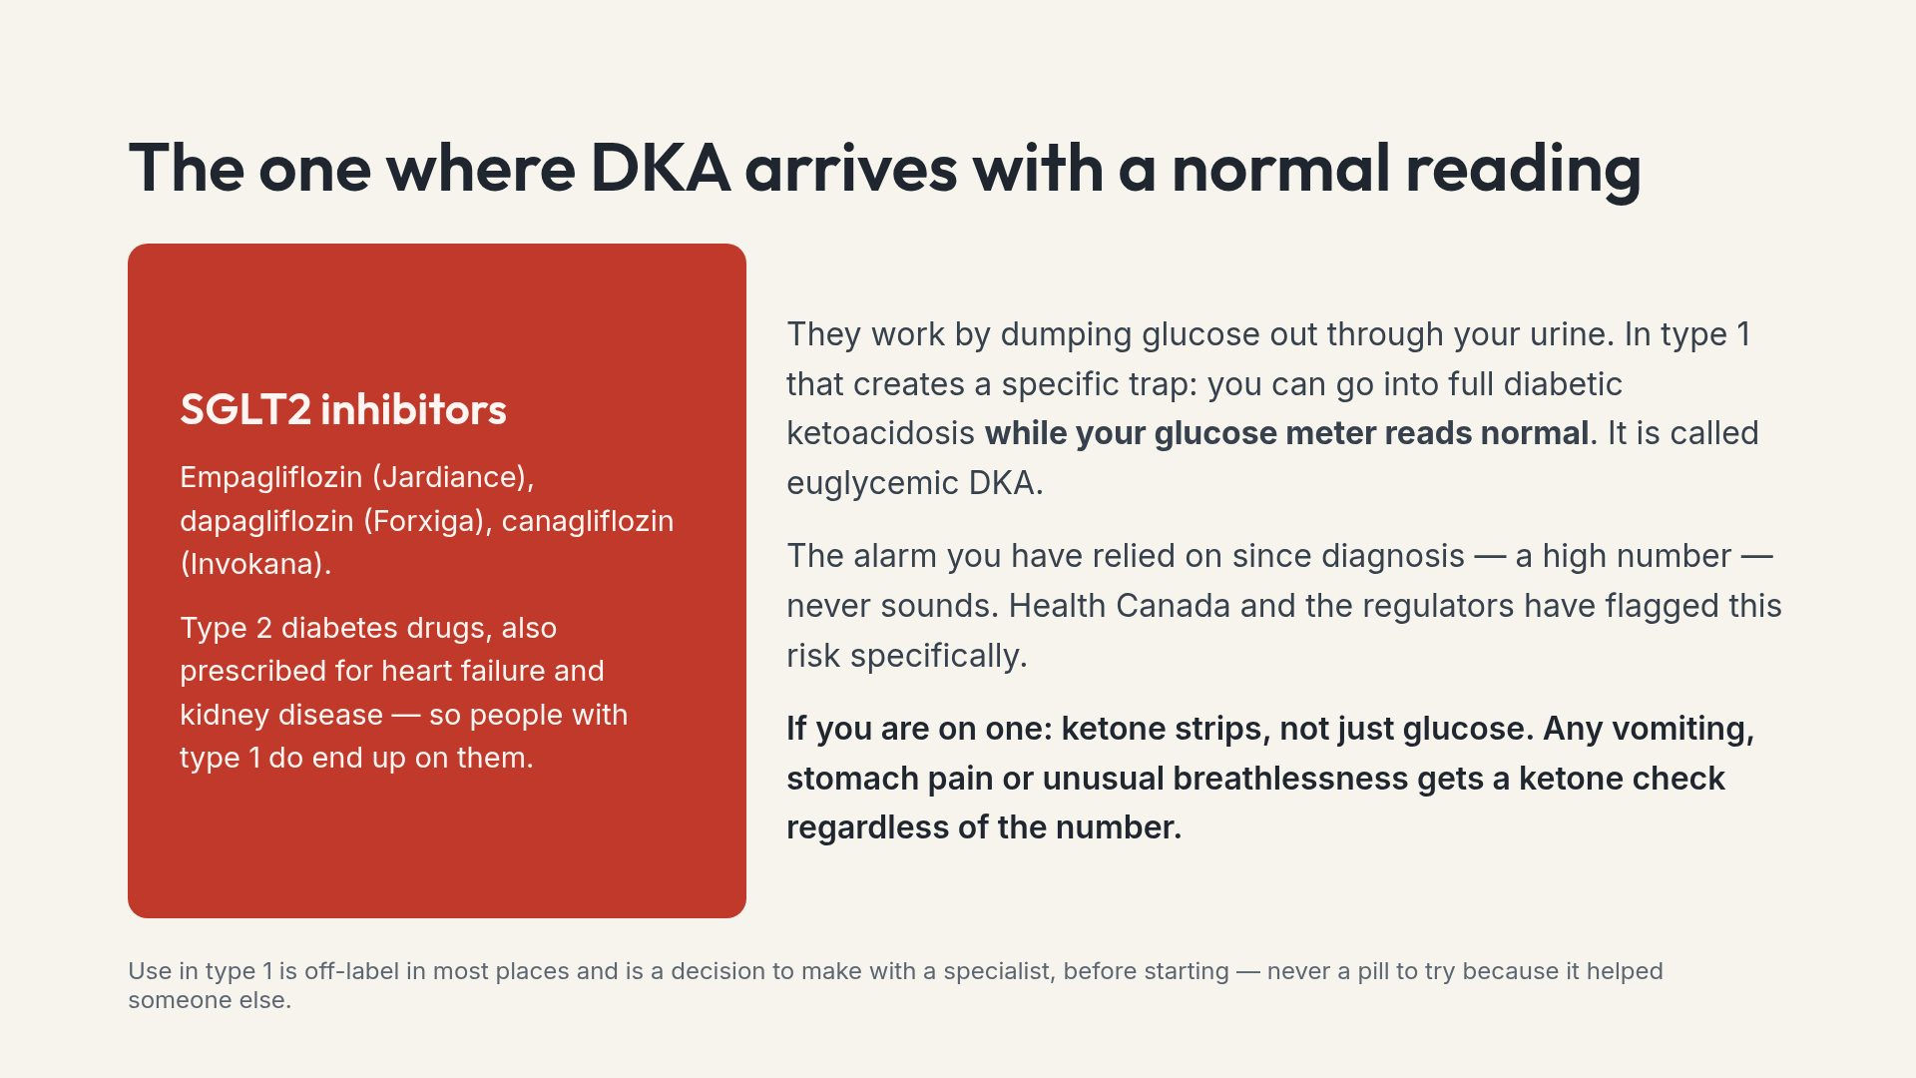
Notes:
If someone in the room is already taking one and did not know this, that is the most valuable thirty seconds of the whole deck.

Slide 10
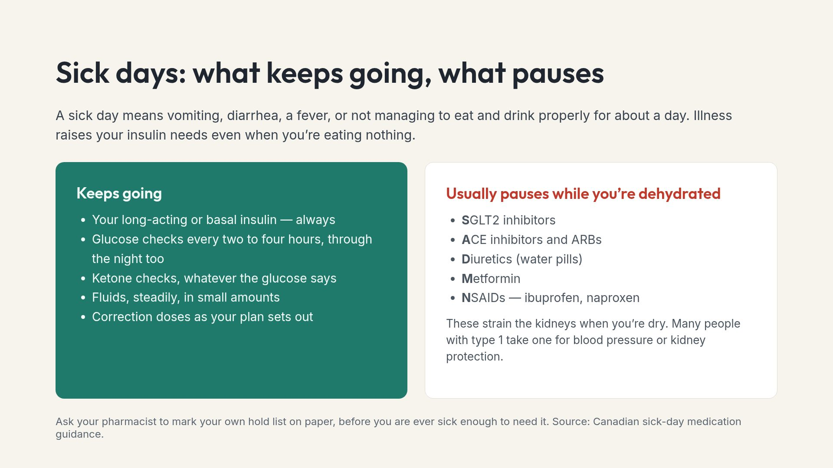
Notes:
The hold list is not universal. Someone with heart failure may be told to keep a diuretic going. That is why it gets personalised in advance.

Slide 11
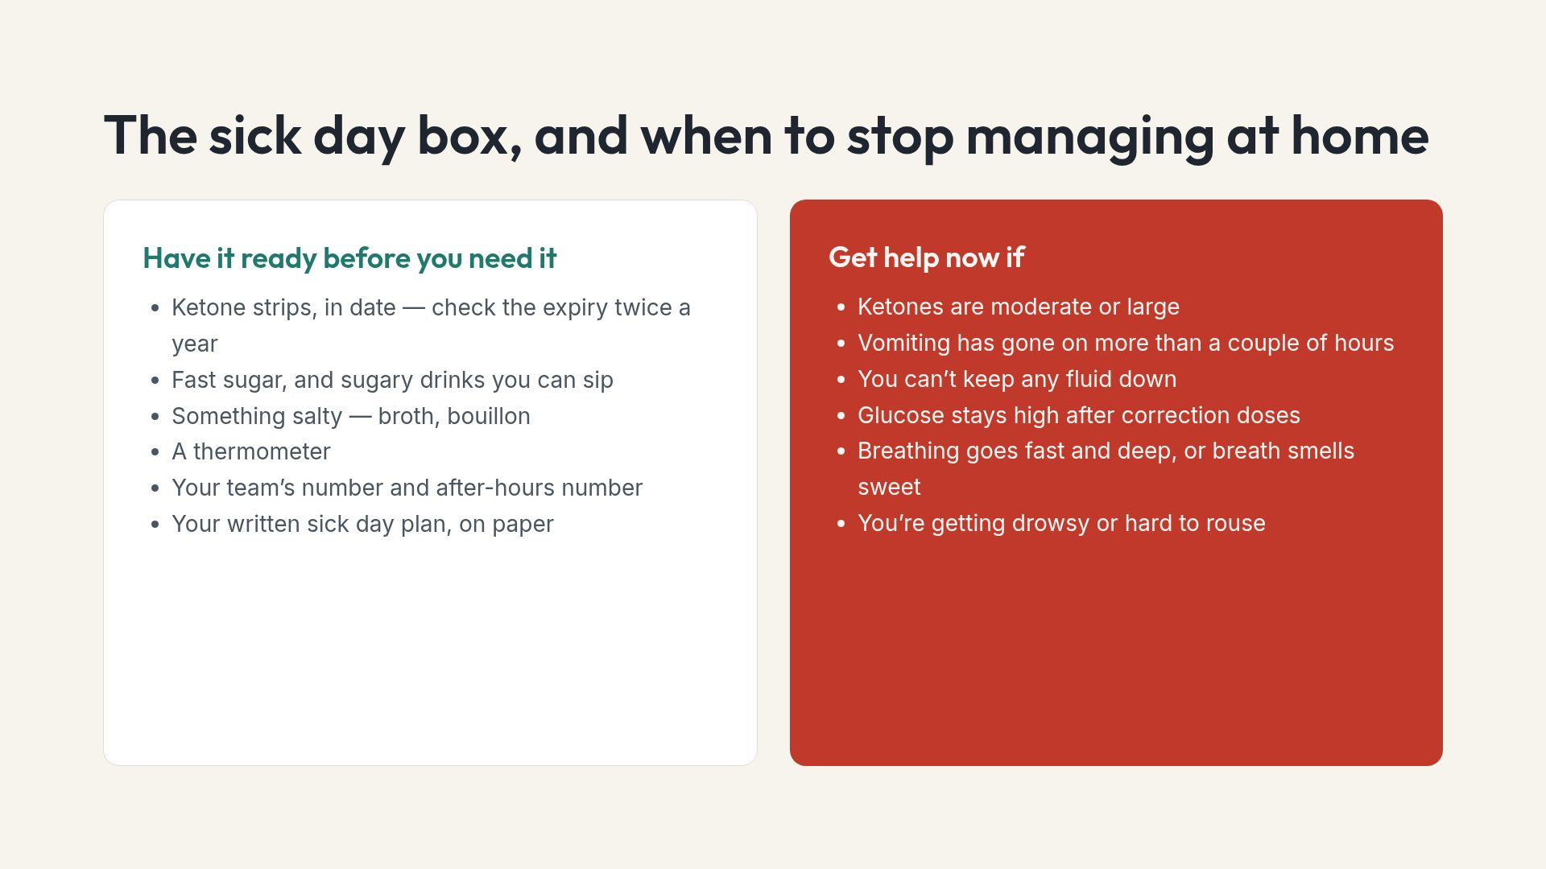
Notes:
A written plan matters because sick judgement is bad judgement. The person reading it may also be a parent or partner, not the patient.

Slide 12
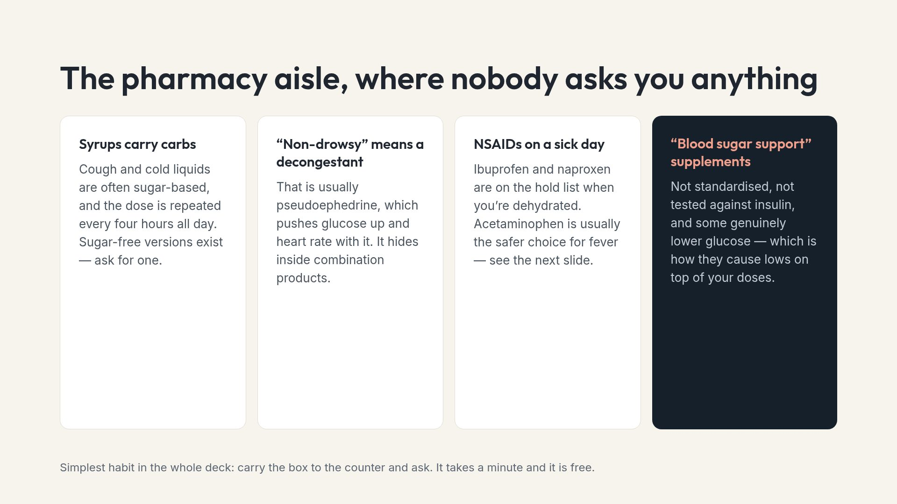
Notes:
Supplements are the one people conceal, because they do not think of them as drugs. Ask about them by name.

Slide 13
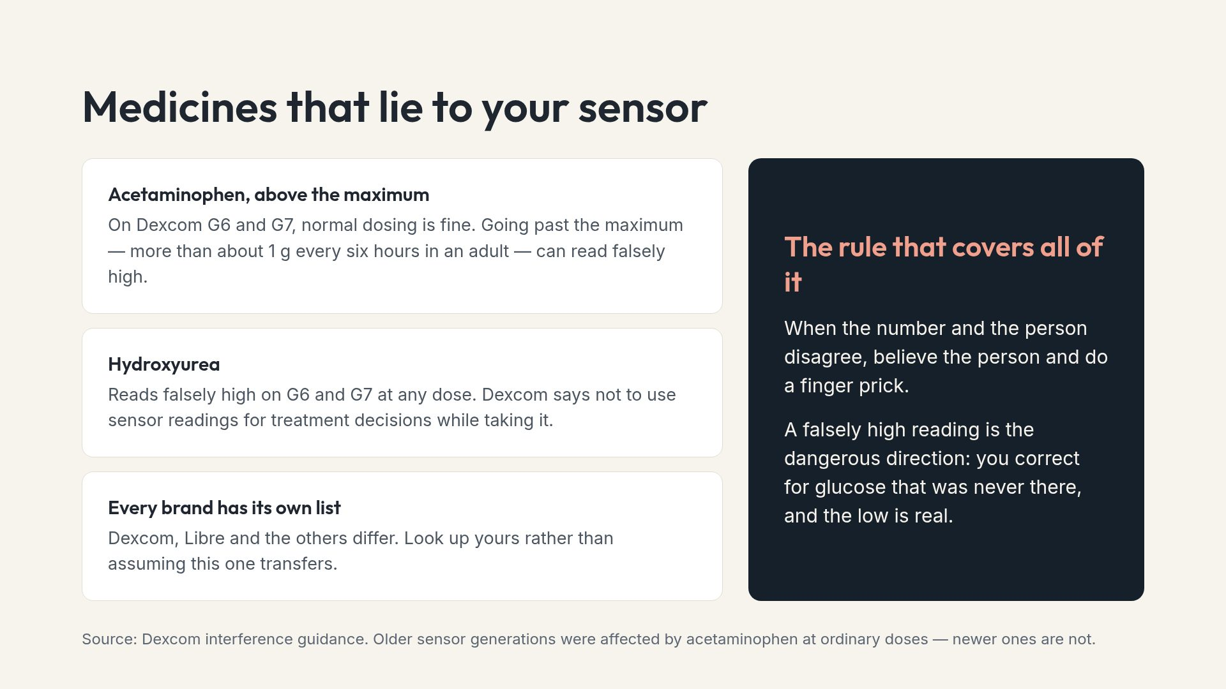
Notes:
Worth saying that this is not a reason to avoid acetaminophen. At normal doses on a current sensor it is a non-issue.

Slide 14
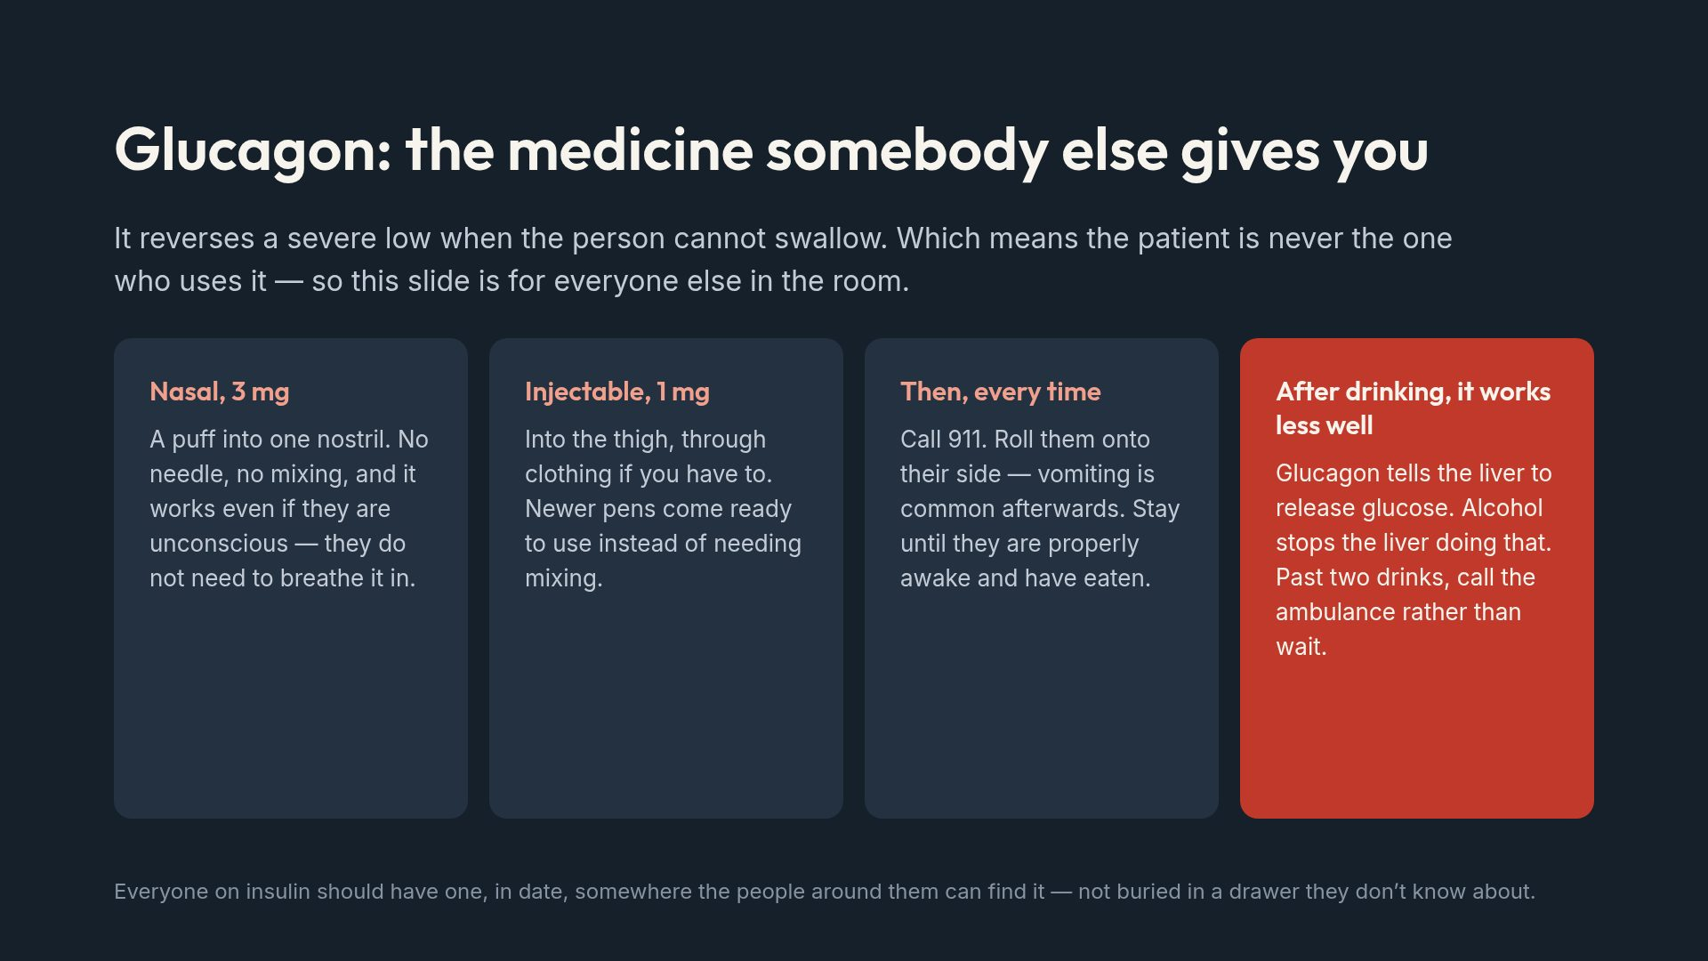
Notes:
Ask the room, honestly: who knows where their person's glucagon is right now? The usual answer is the point of the slide.

Slide 15
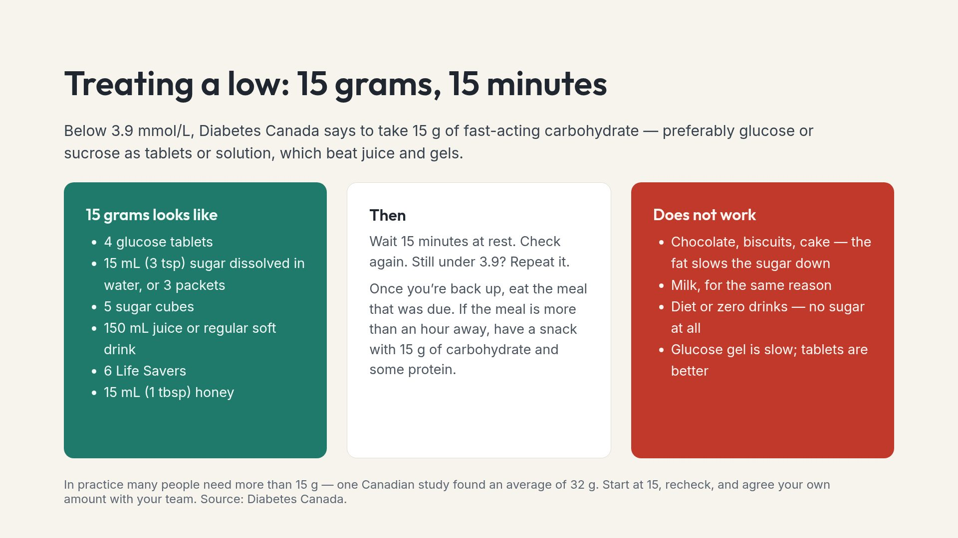
Notes:
The diet drink mix-up is the one that catches families at a dinner table, where both cans look the same. Say it explicitly.

Slide 16
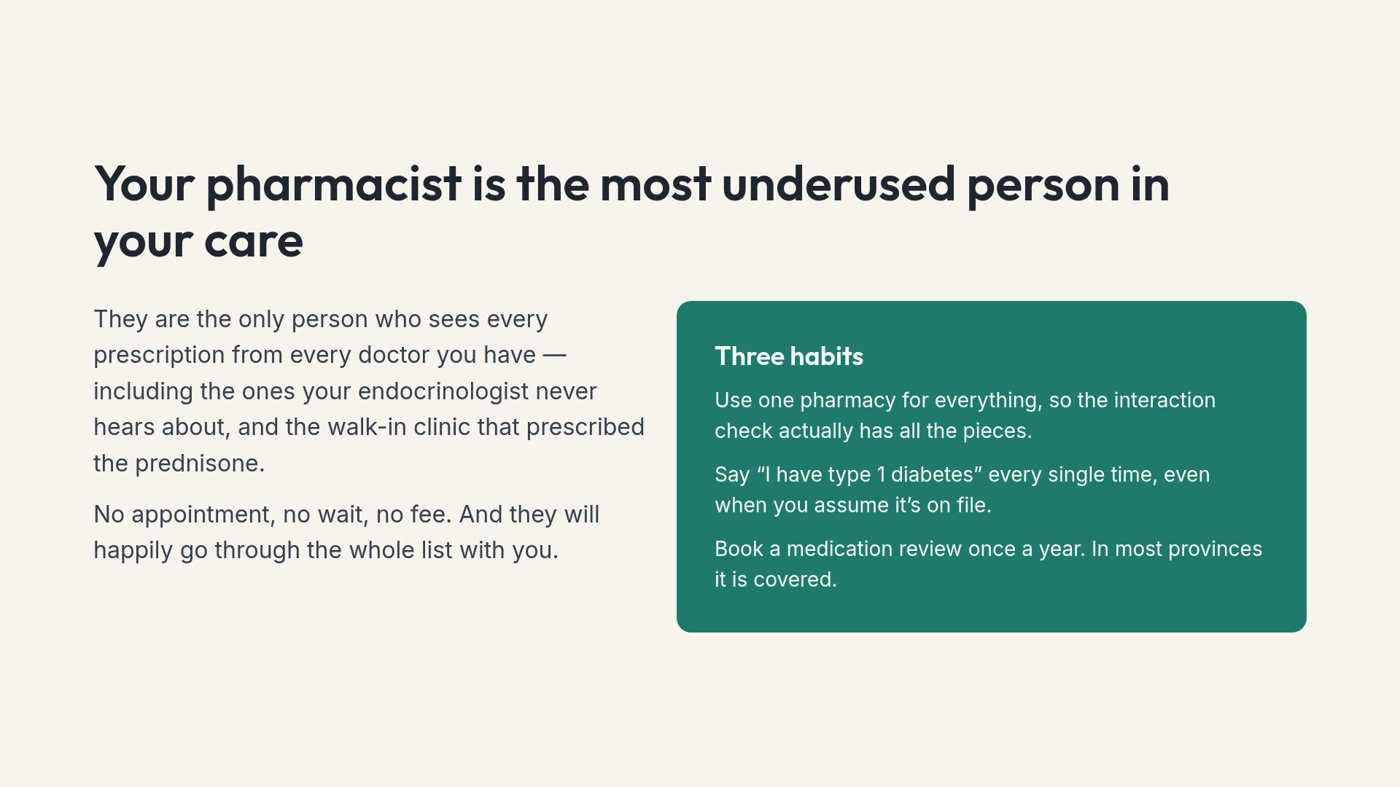
Notes:
For a newly diagnosed person, naming the pharmacist as part of the care team is genuinely new information.

Slide 17
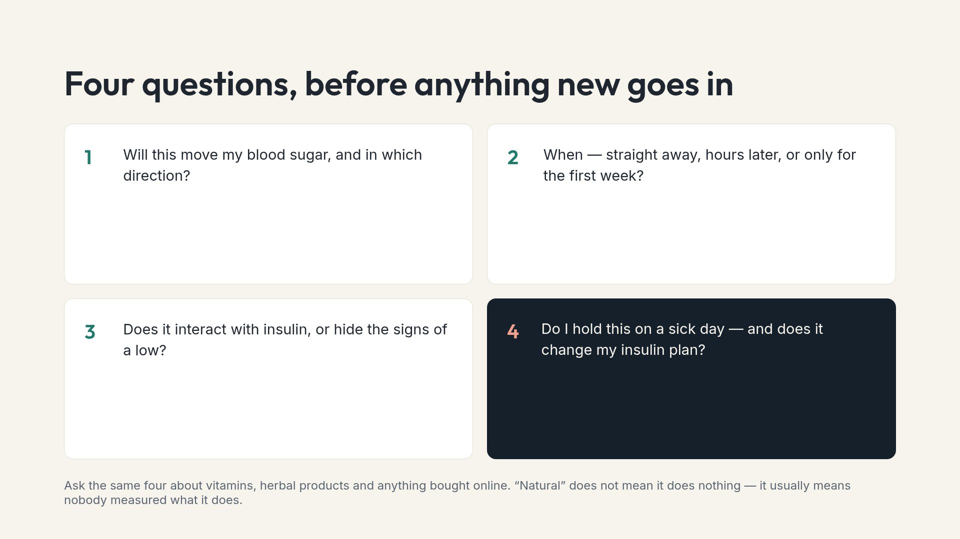
Notes:
Suggest putting these four in a phone note. At the counter, under pressure, nobody remembers them unprompted.

Slide 18
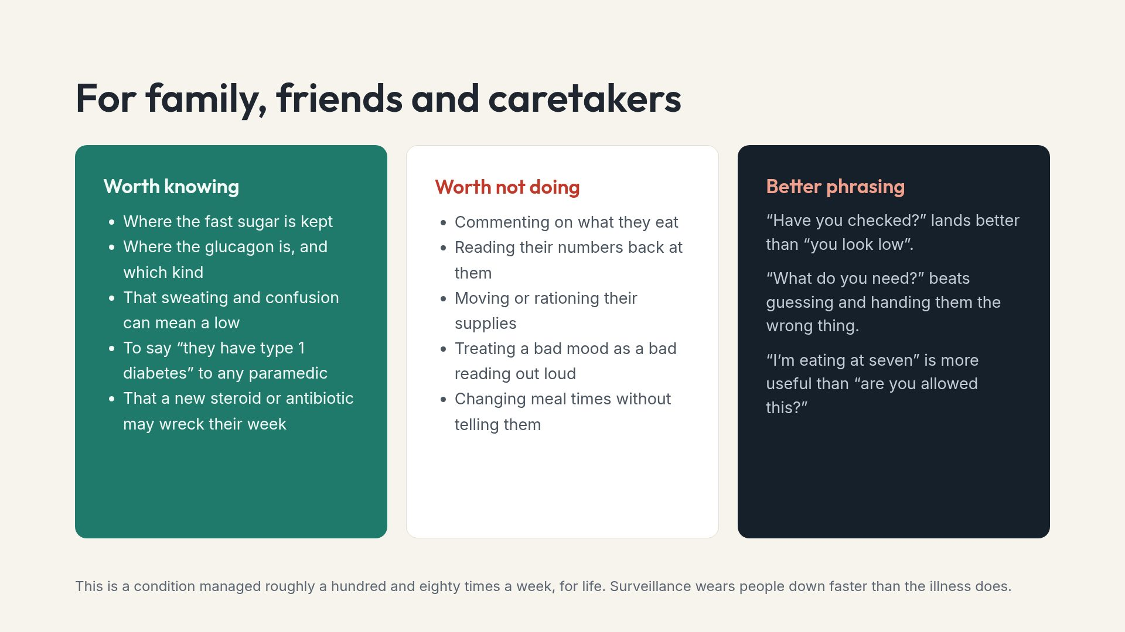
Notes:
If caretakers take one thing away, make it the middle column. Good intentions cause most of what is listed there.

Slide 19
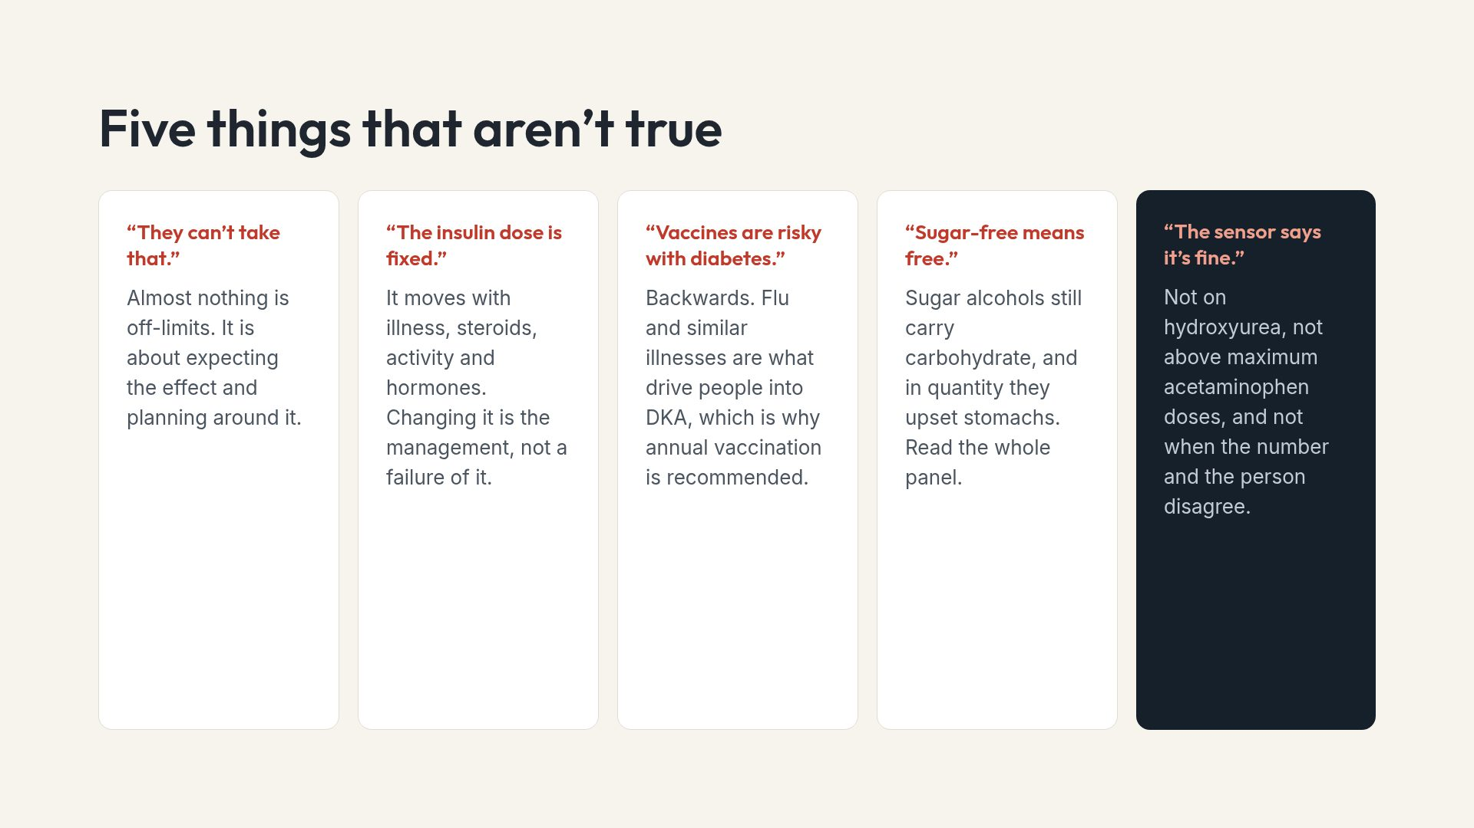
Notes:
The vaccine one is worth stating plainly. It circulates widely and it gets people hospitalised.

Slide 20
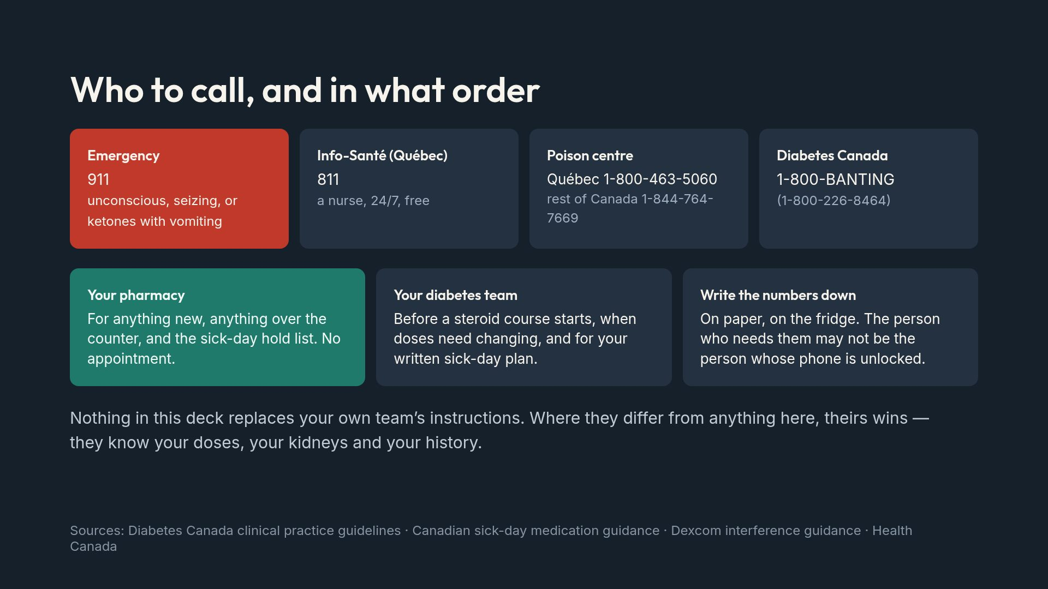
Notes:
Close on the deference line. A deck that sets itself above the treating team is a dangerous deck.

