Slide 1
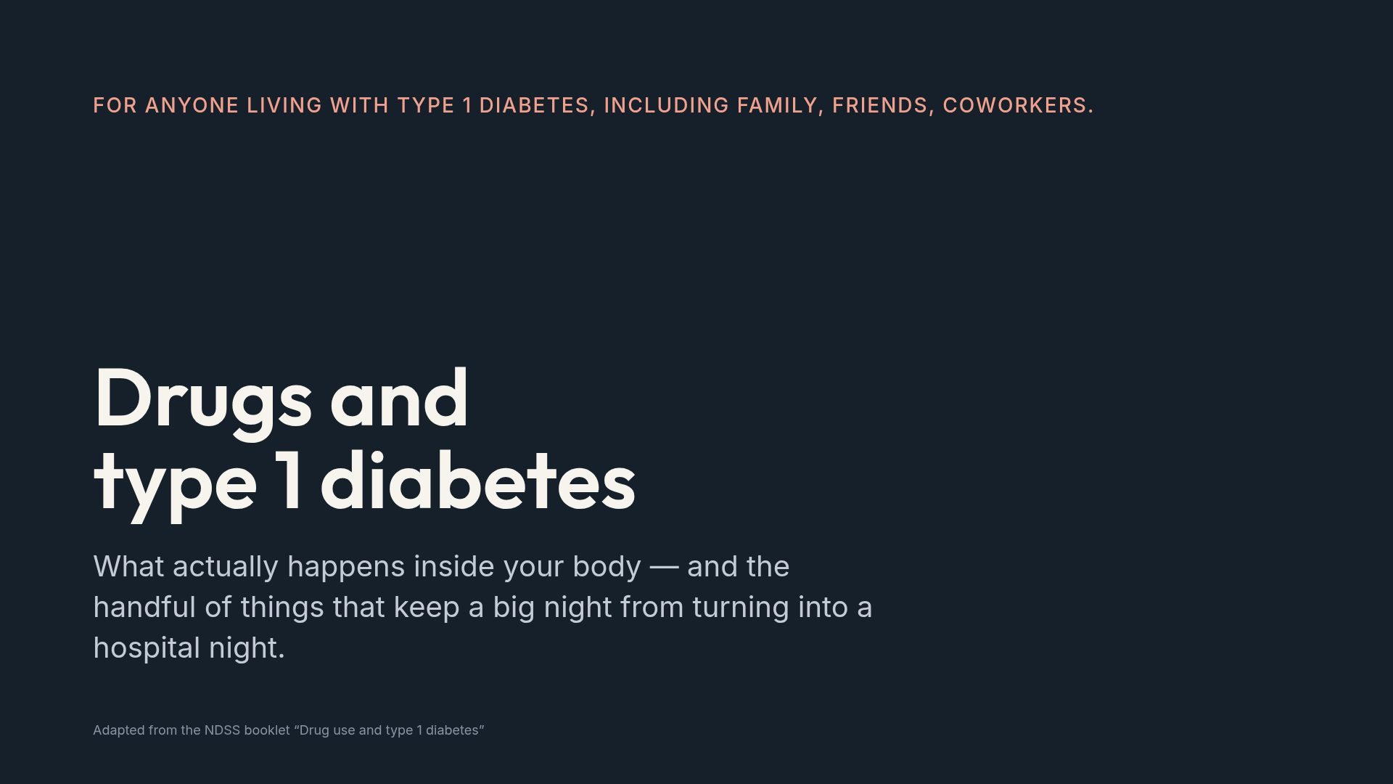
Notes:
Set the tone straight away: this is not a lecture, it is information they will actually need. Say plainly that nothing here is permission and nothing here is judgement.

Slide 2
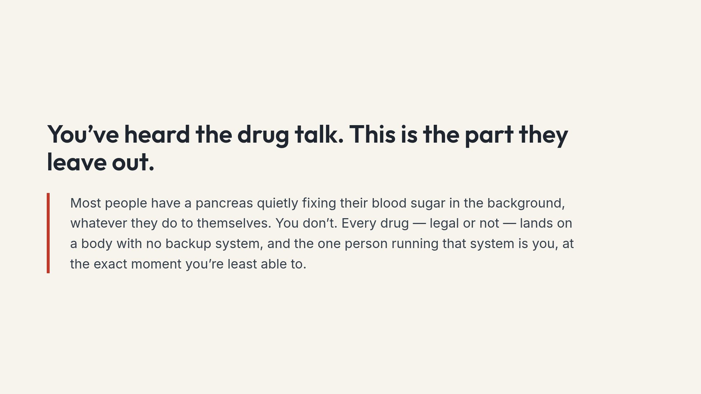
Notes:
The point of this slide is respect, not fear. Their risk is genuinely different from their friends' risk, and that is a fact rather than a scare tactic.

Slide 3
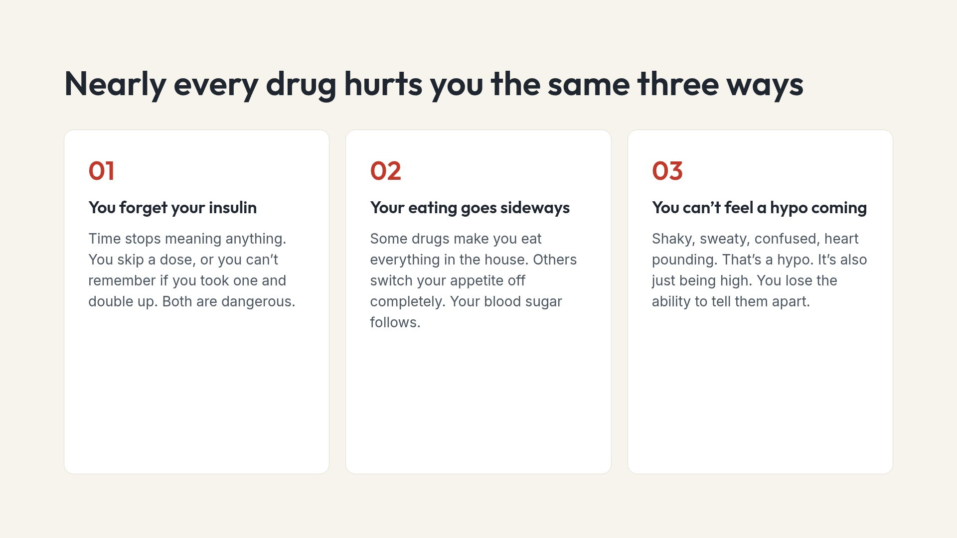
Notes:
Number three is the one that surprises people. The warning system they have been trained to trust for years stops being readable.

Slide 4
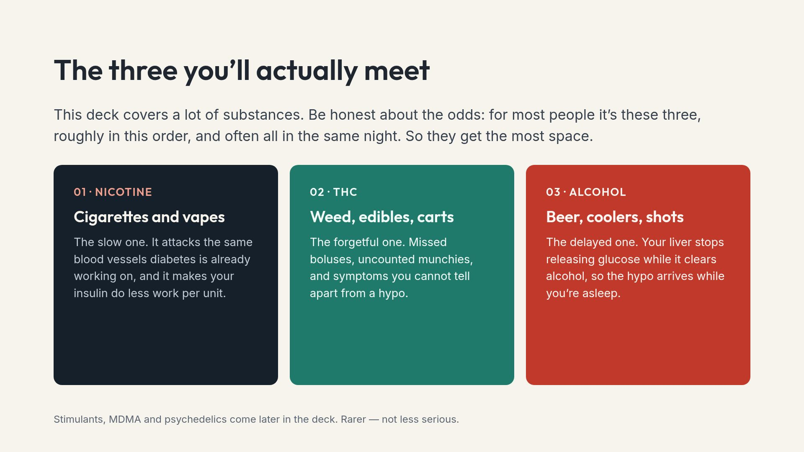
Notes:
This slide sets expectations. Spending most of the time on the common three is a deliberate choice, not an oversight.

Slide 5
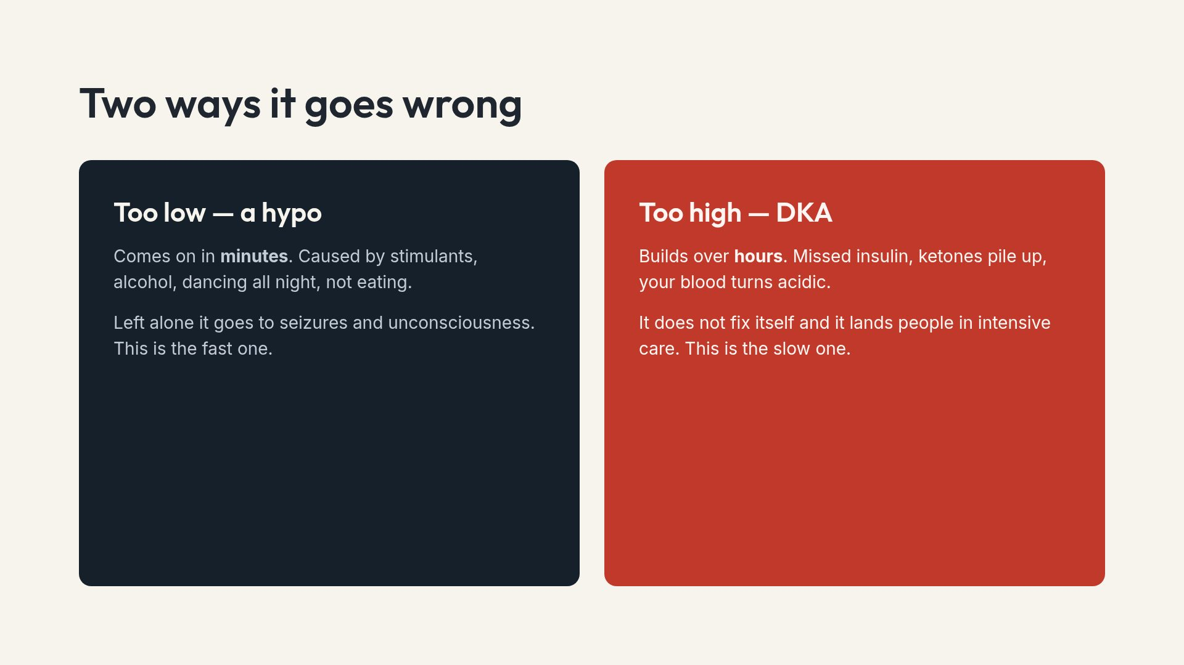
Notes:
Fast versus slow is the useful mental model. A hypo is minutes and needs sugar now. DKA is hours and needs a hospital.

Slide 6
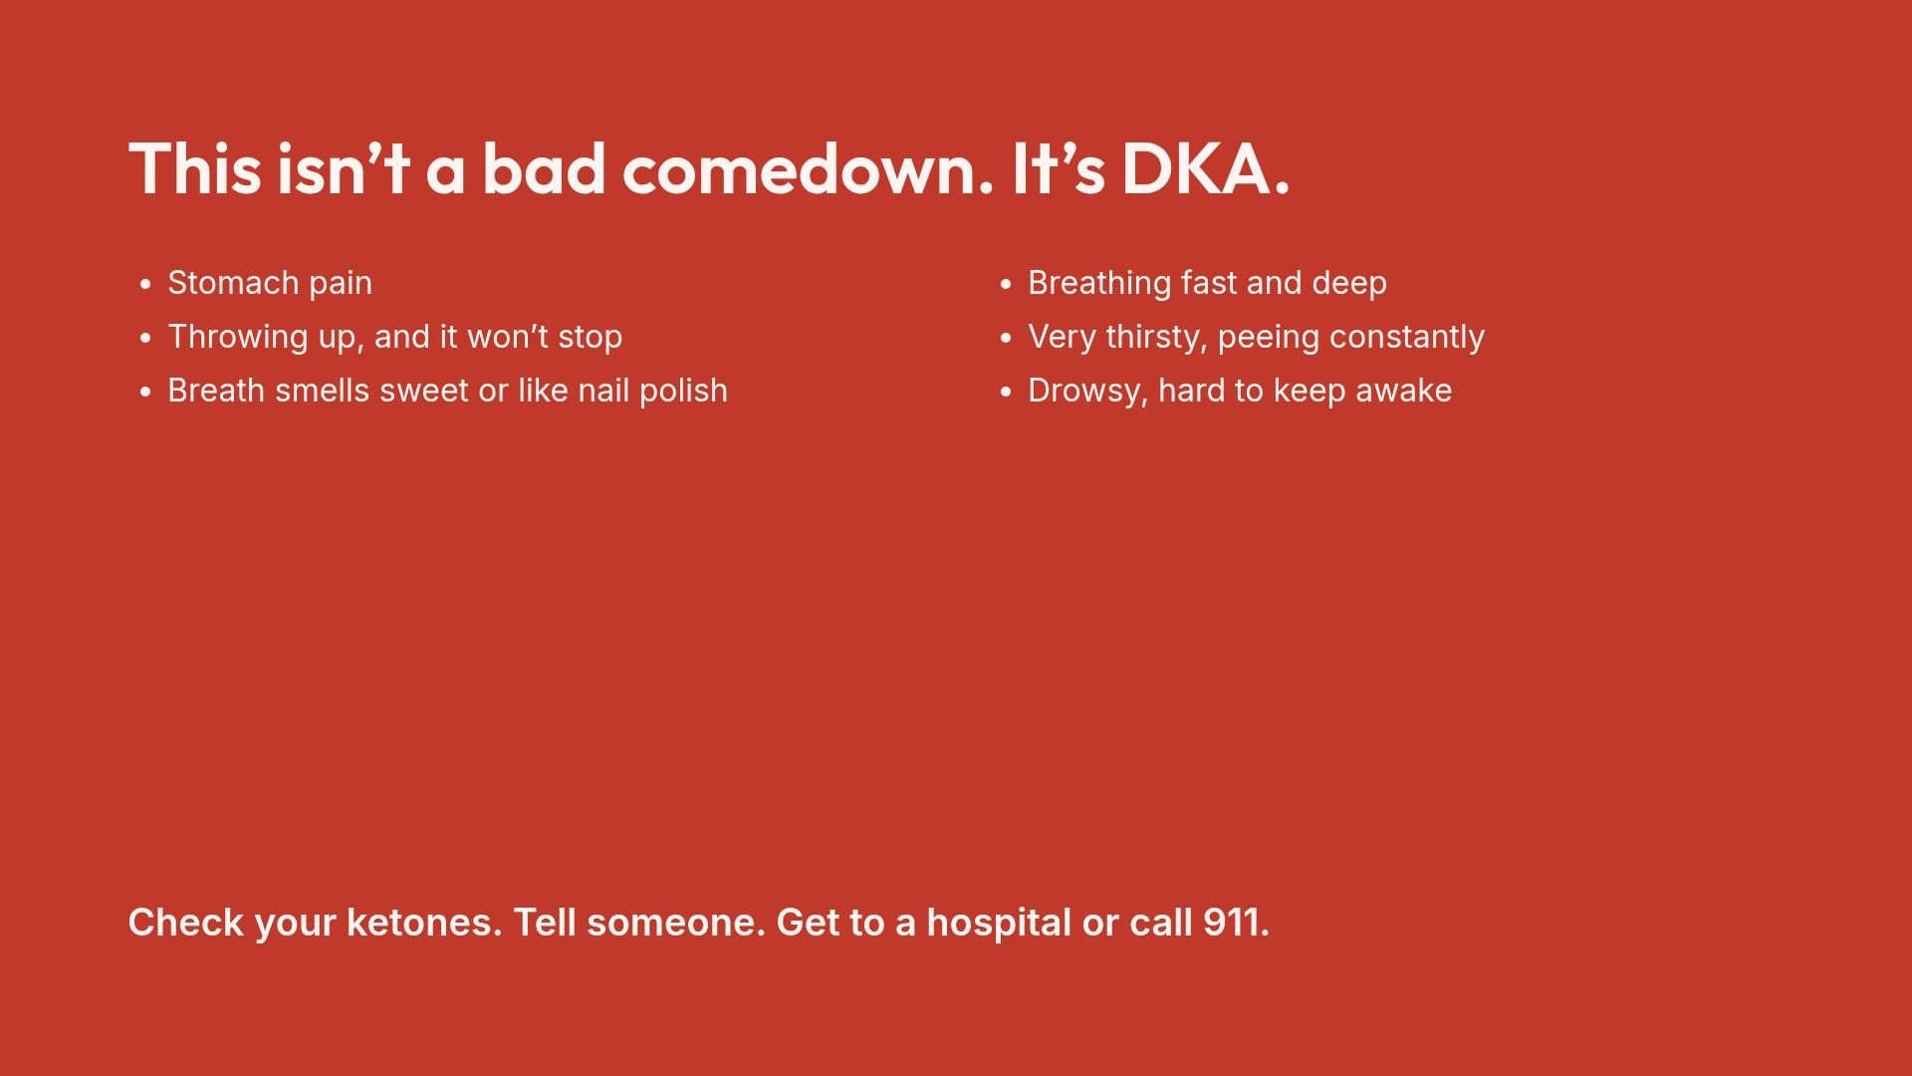
Notes:
Say it out loud: nobody has ever been in trouble for arriving at an emergency department with ketones. The delay is what does the damage.

Slide 7
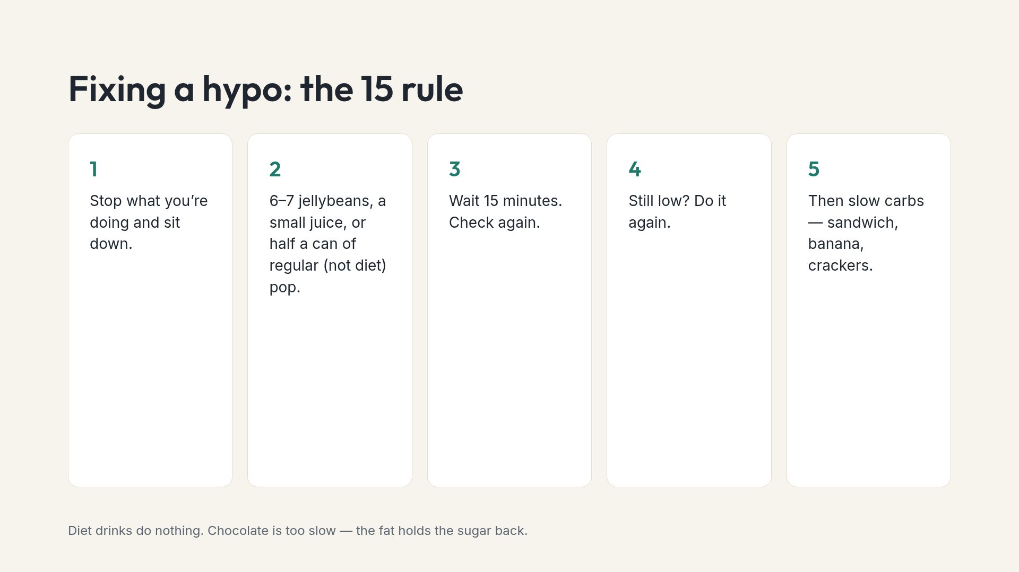
Notes:
Worth rehearsing. In a real hypo they will not be reading a slide, so the sequence has to already be in their head.

Slide 8
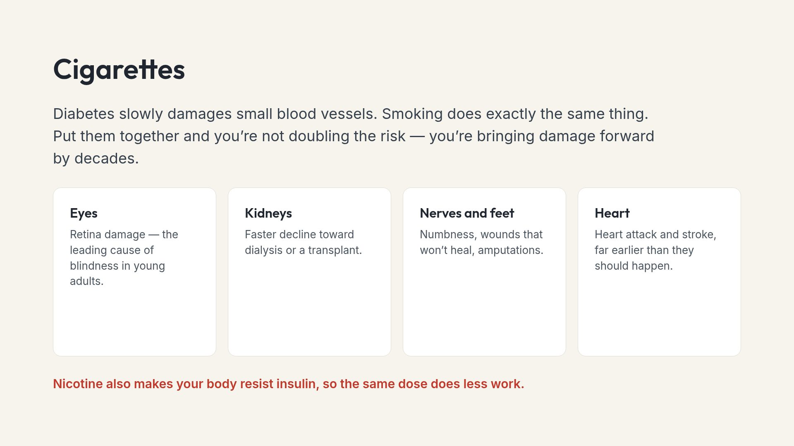
Notes:
Teenagers discount things that happen in forty years. The insulin resistance line matters more here because it changes their numbers this month.

Slide 9
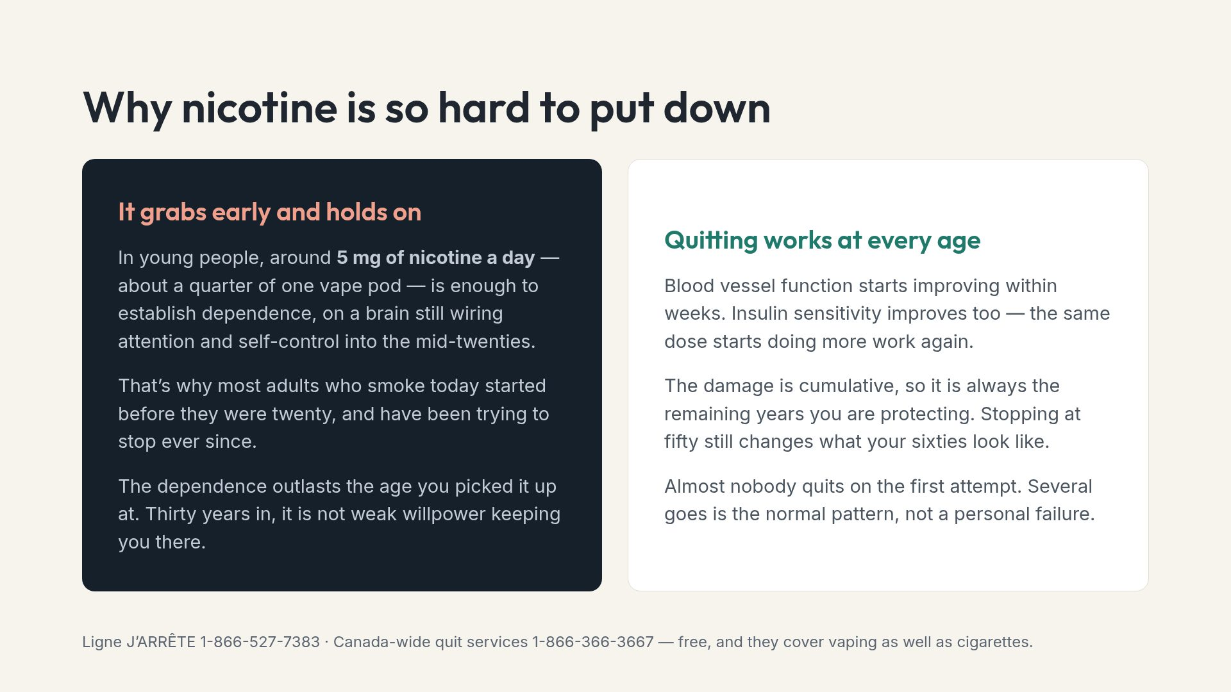
Notes:
Two audiences on one slide: the person who has not started, and the person who has smoked for decades and assumes it is too late. Neither should leave thinking the slide was about someone else.

Slide 10
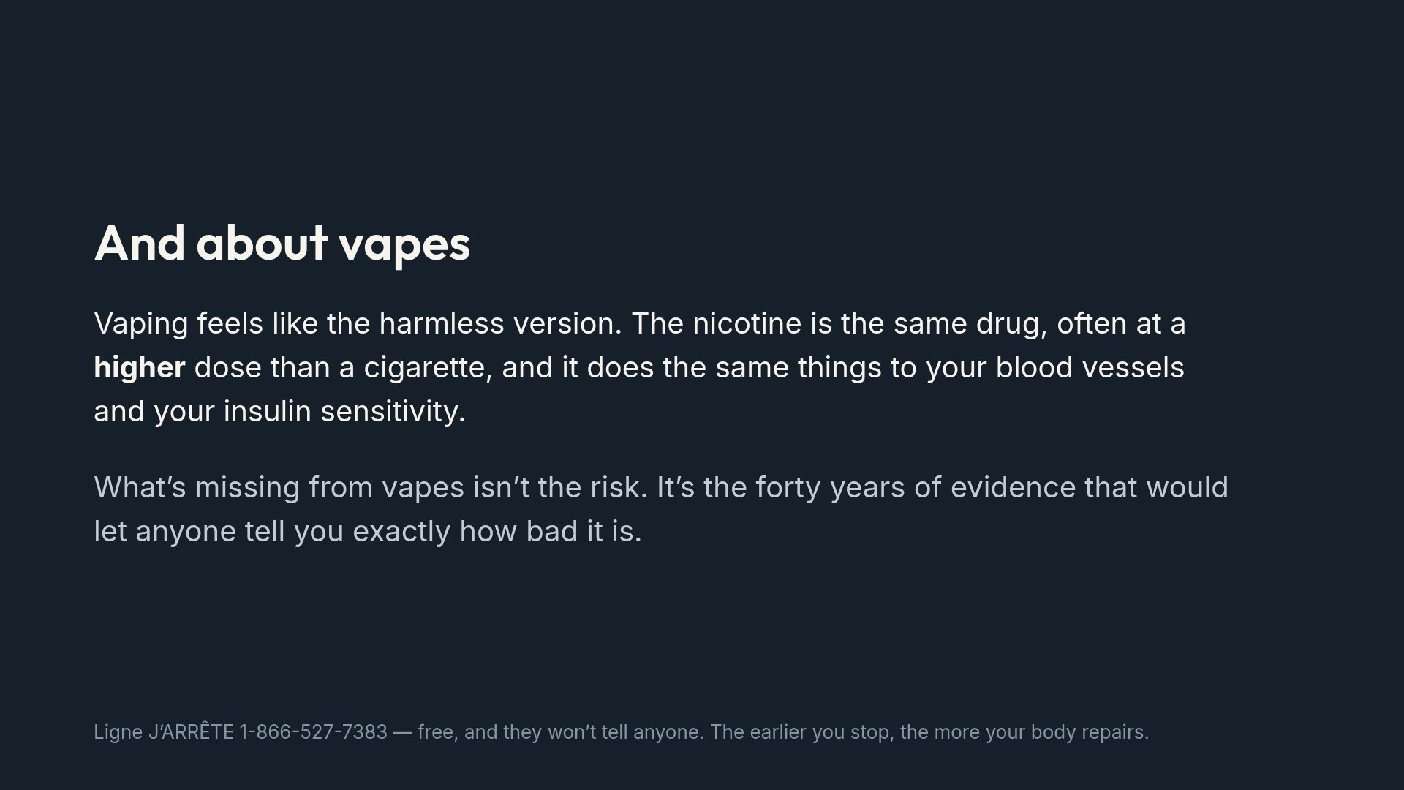
Notes:
Do not oversell certainty about vaping harms. The honest framing is the unknown, plus the nicotine effects that are well established.

Slide 11
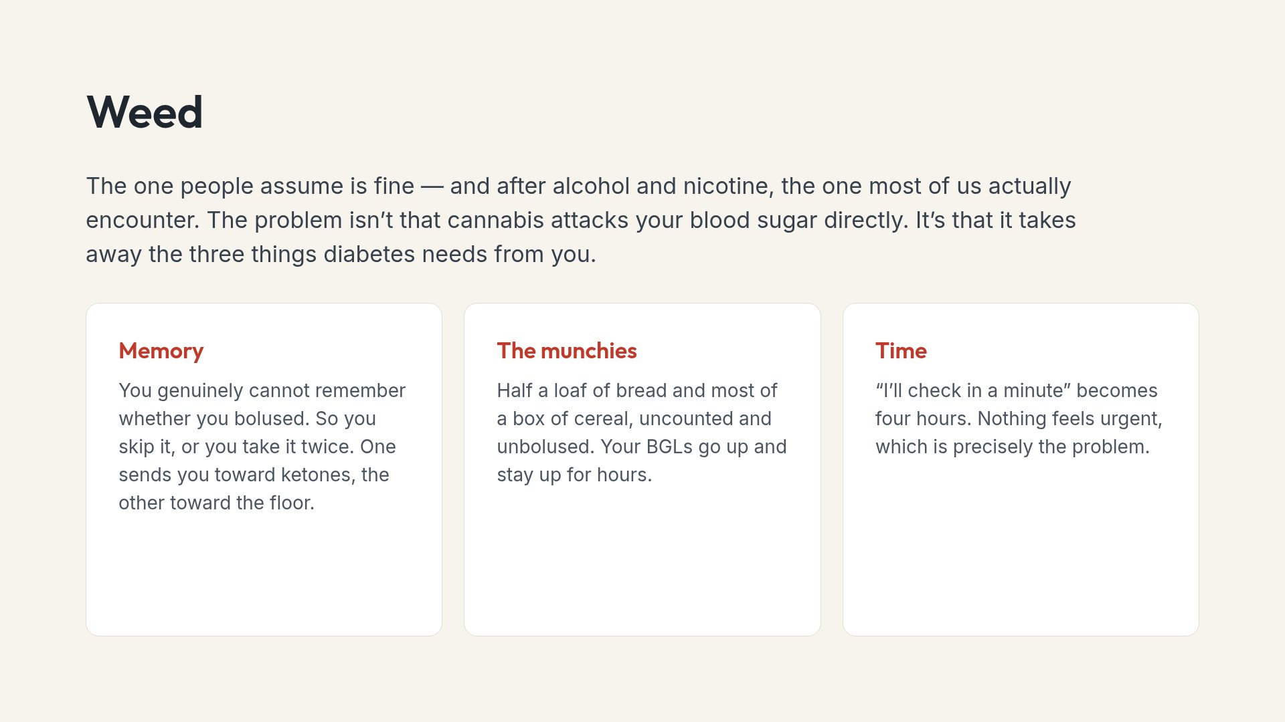
Notes:
This is the slide that usually changes minds, because it avoids the moral argument entirely and sticks to mechanism.

Slide 12
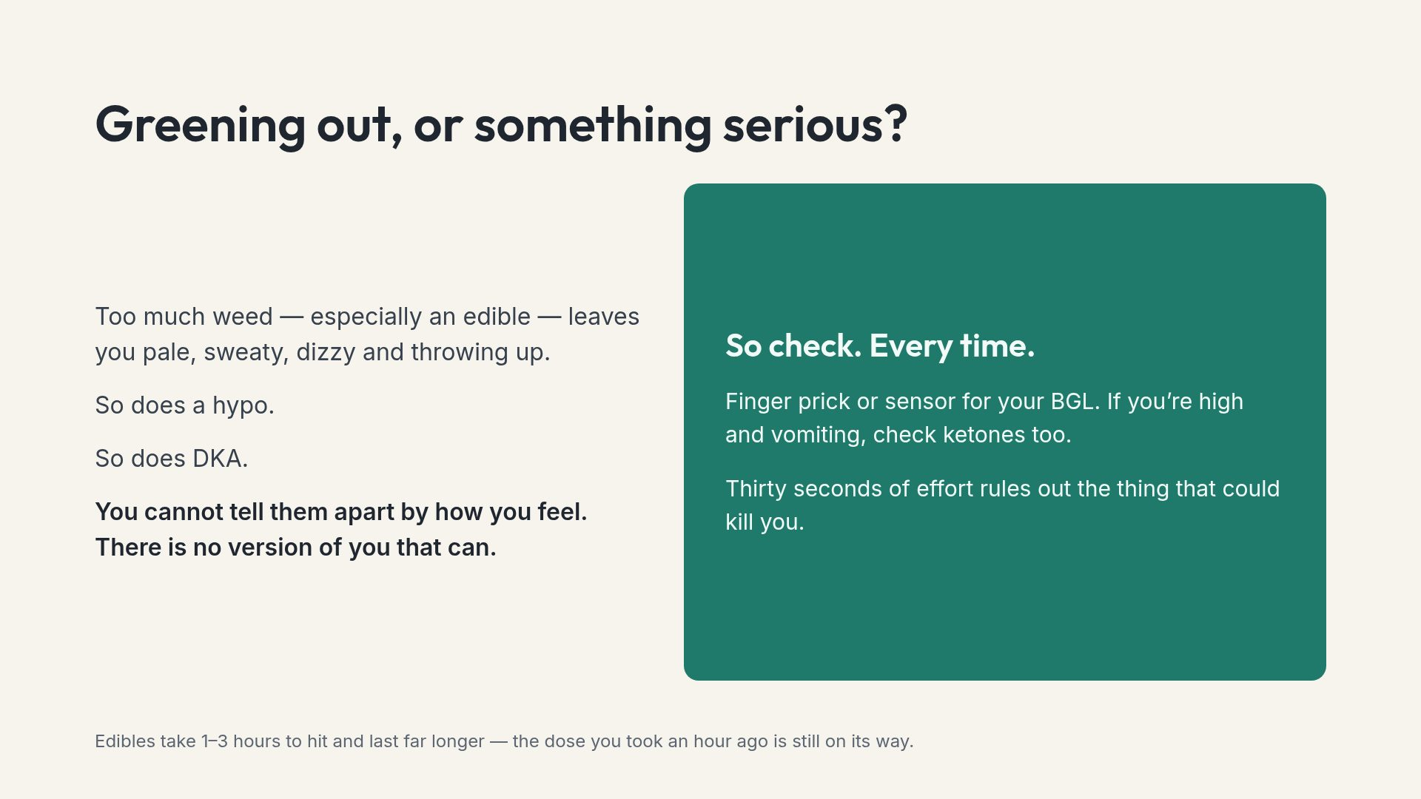
Notes:
The edible timing note prevents the classic mistake of redosing because nothing seemed to happen.

Slide 13
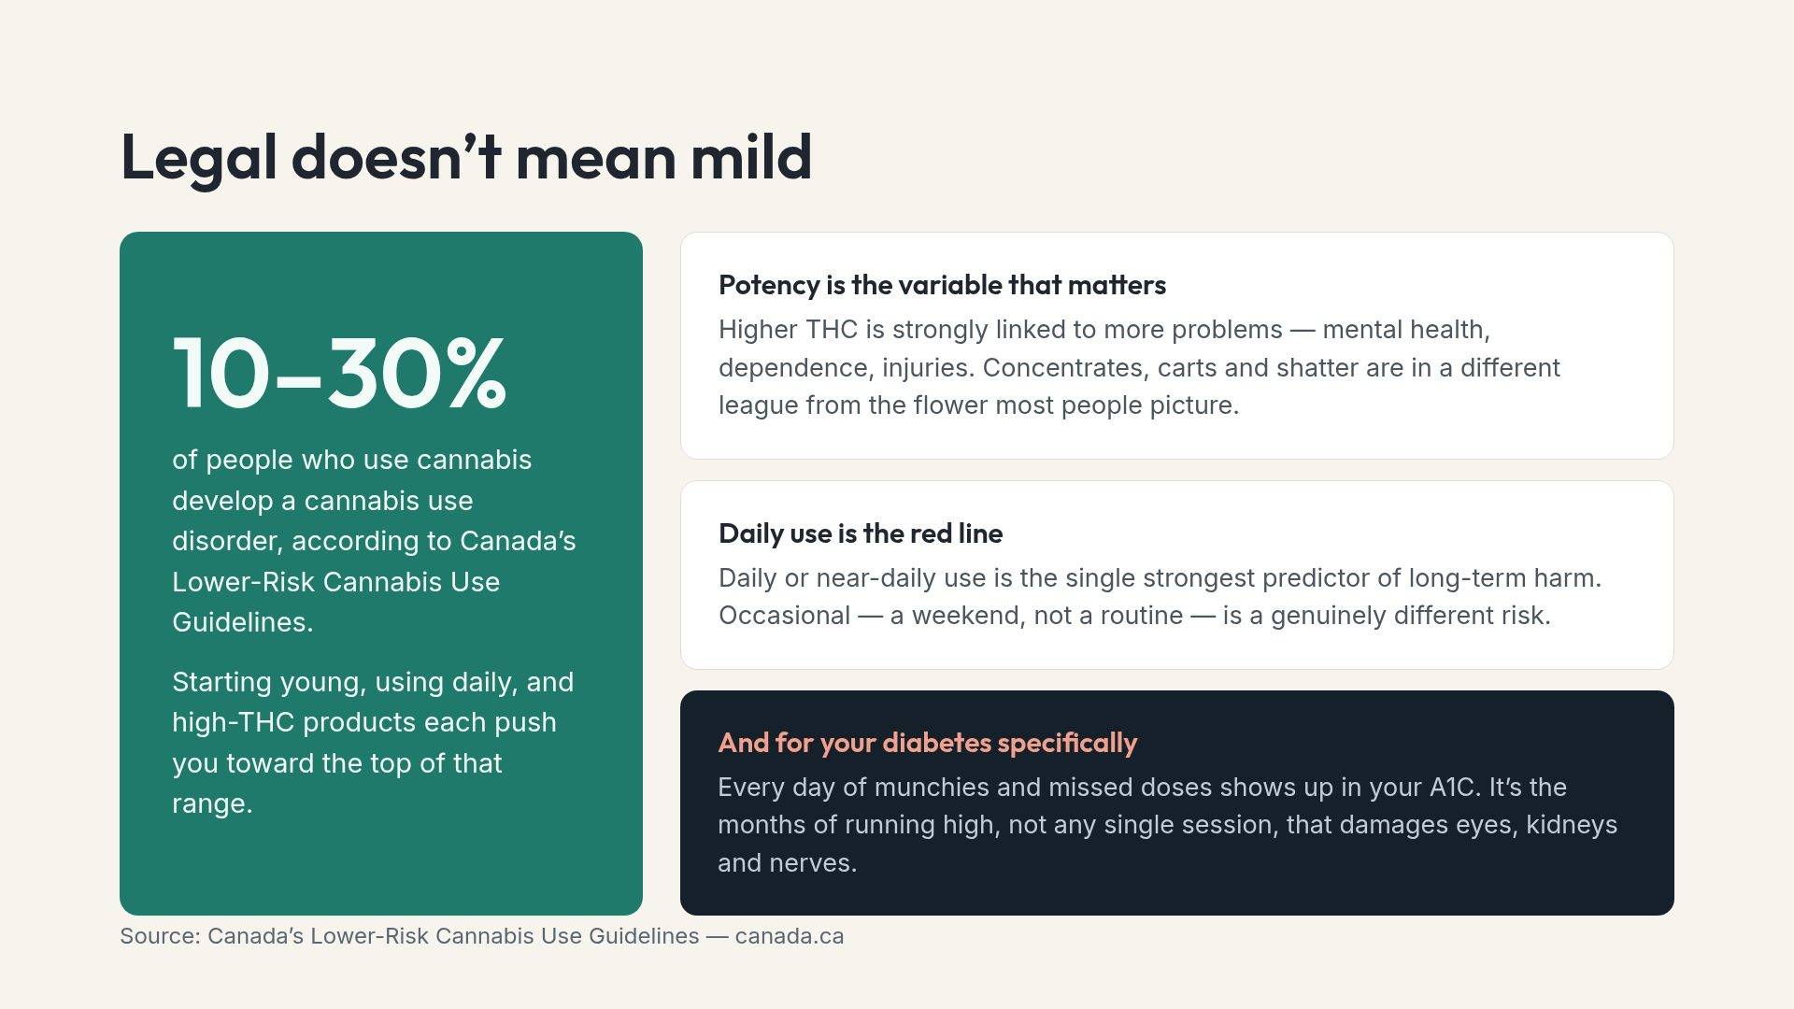
Notes:
The occasional-versus-daily distinction is the practical takeaway. It gives a realistic target instead of an abstinence message that gets ignored.

Slide 14
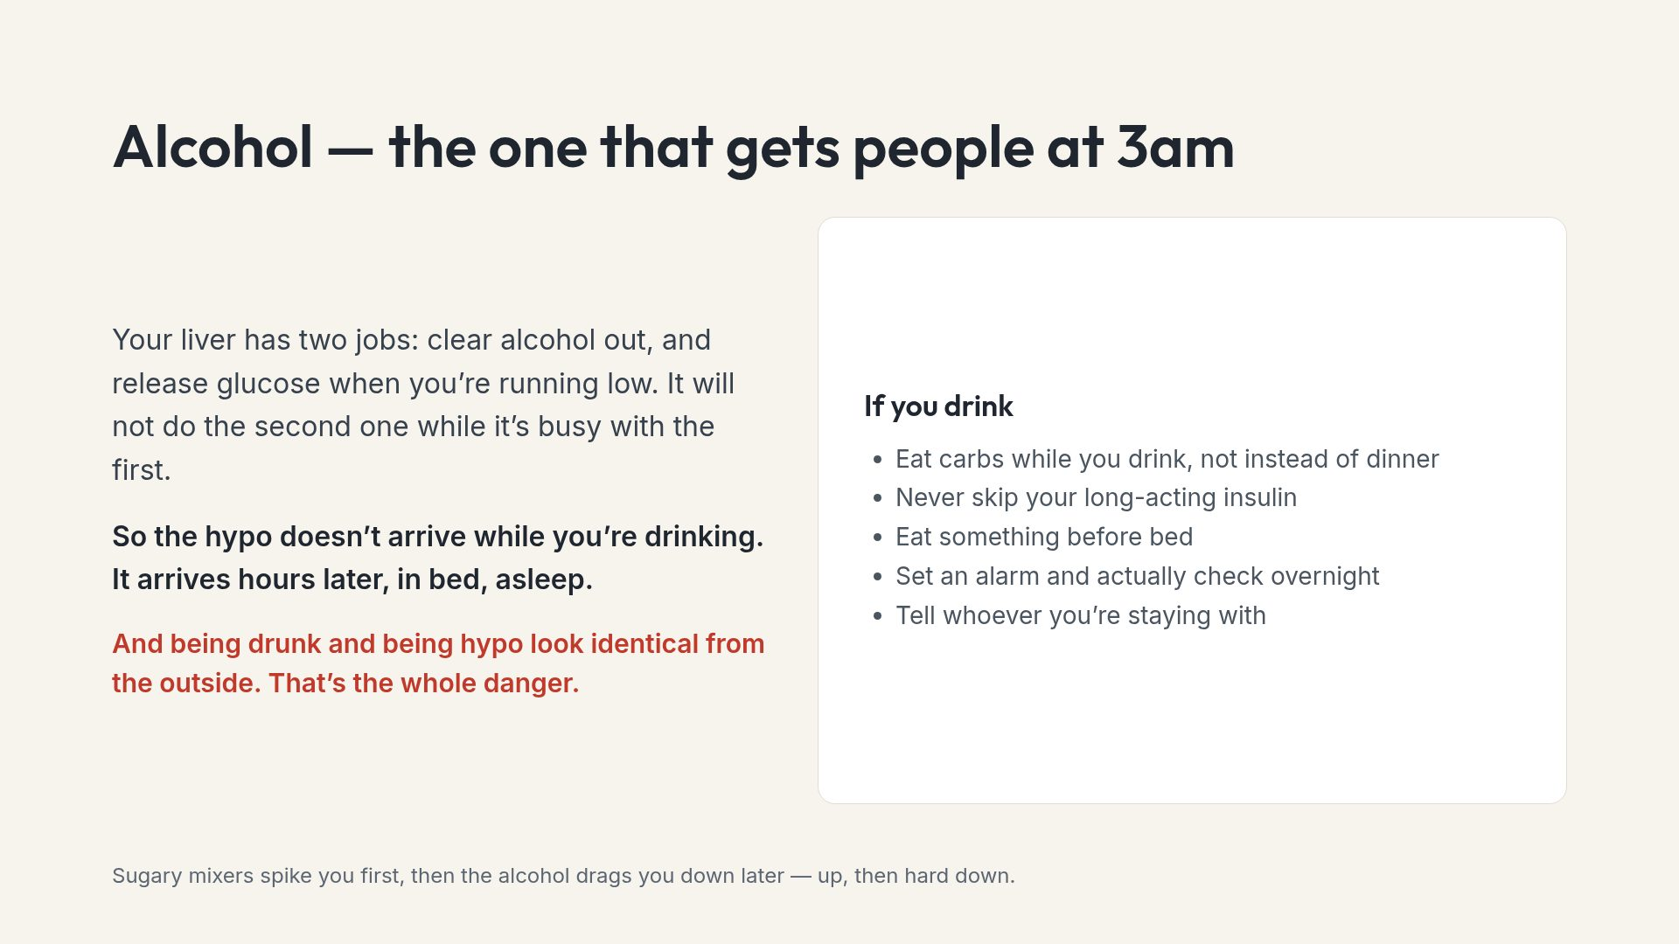
Notes:
Alcohol is statistically the one they will meet first, so give it the same weight as the illegal drugs.

Slide 15
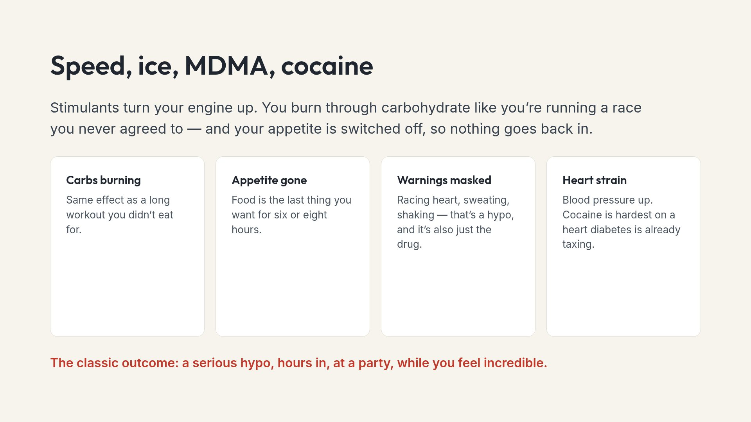
Notes:
Emphasise the timing. The danger point is not the peak, it is three or four hours in when the carbs have gone.

Slide 16
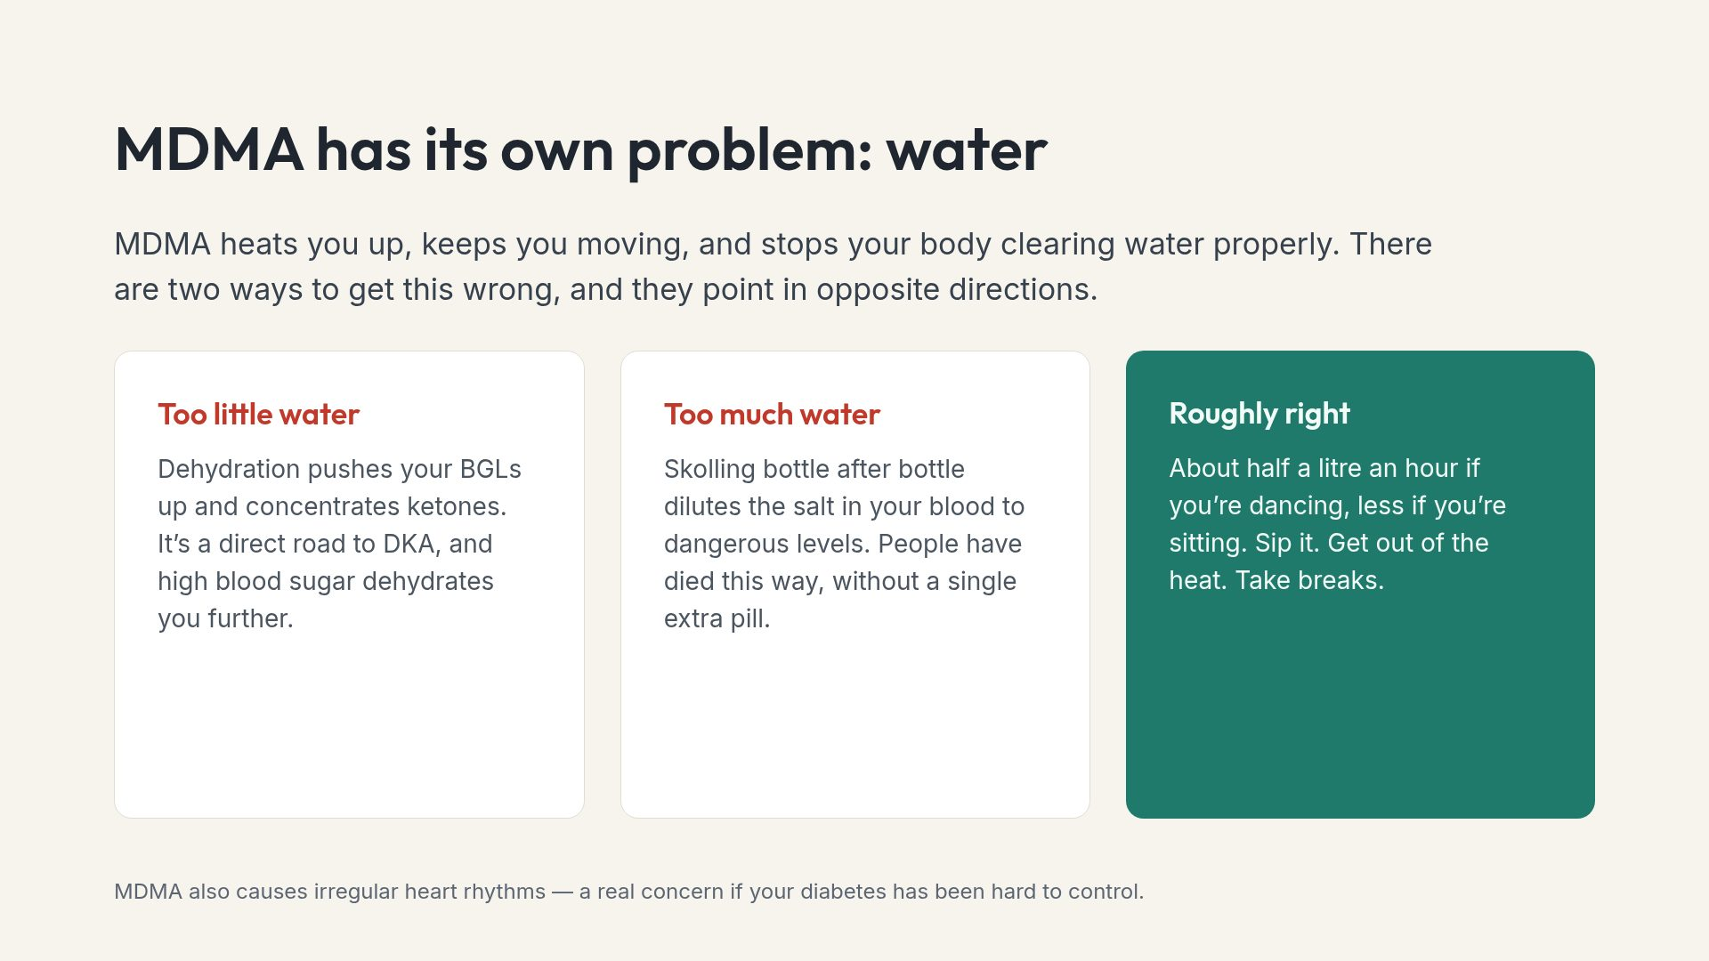
Notes:
Stress that the water advice is a rate, not a target. Steady sipping, not catching up in one go.

Slide 17
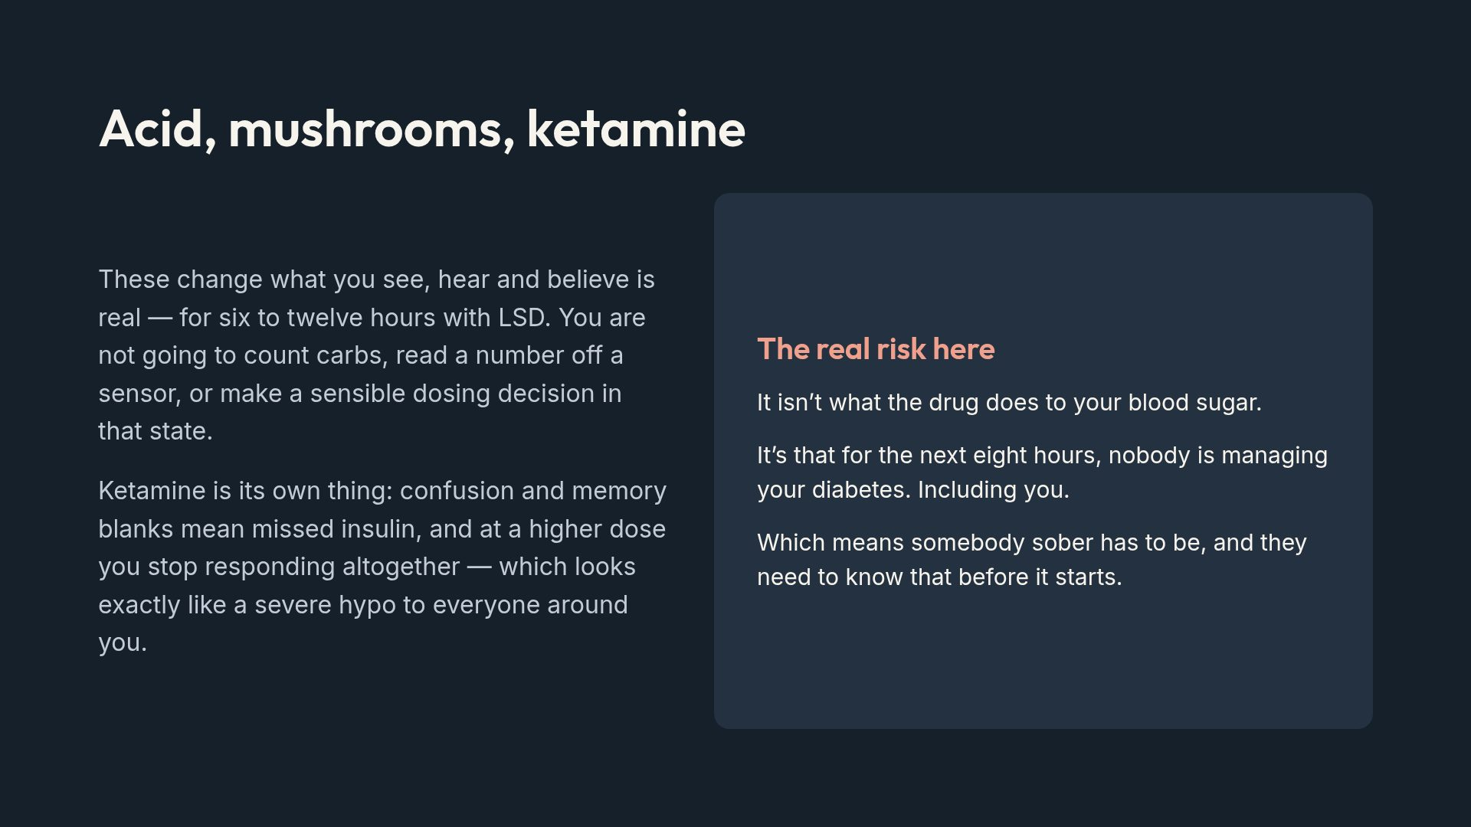
Notes:
The ketamine-looks-like-a-hypo point is worth repeating for friends: if in doubt, treat for hypo and call for help.

Slide 18
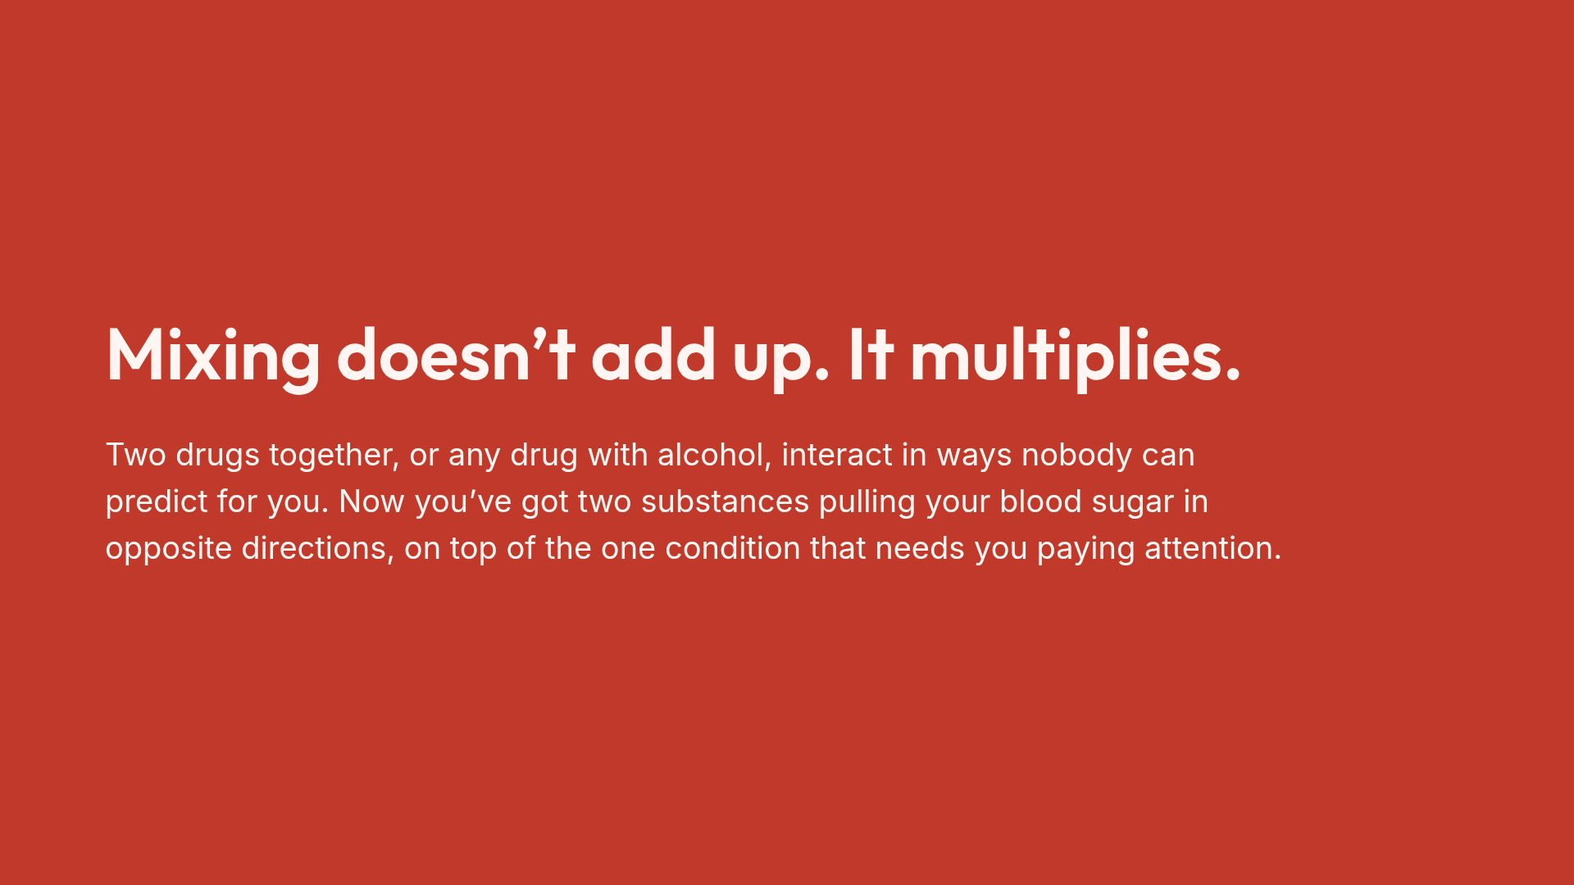
Notes:
Keep this short and let it land. It is the single highest-yield behaviour change on offer.

Slide 19
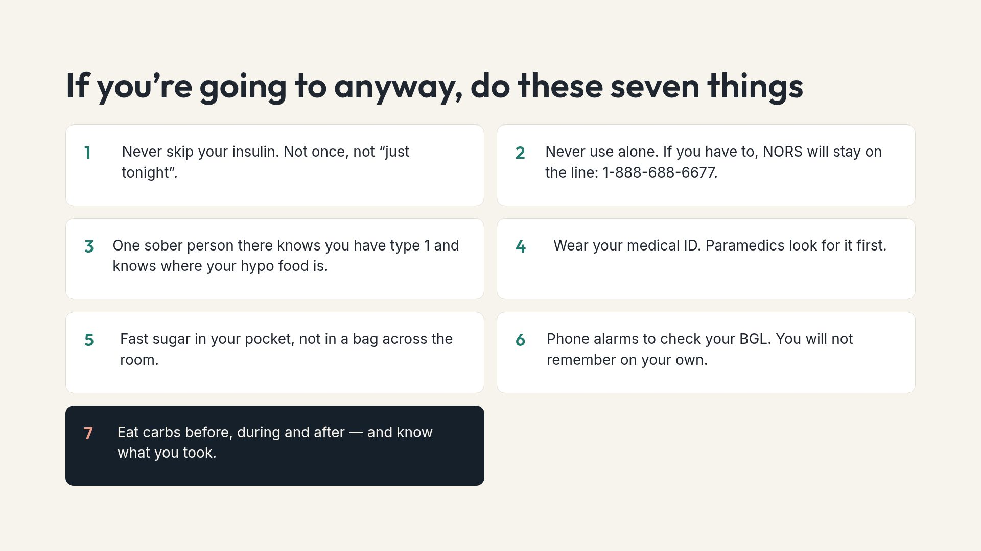
Notes:
Frame this as harm reduction, not permission. The alternative to saying it is them doing all of it with none of it.

Slide 20
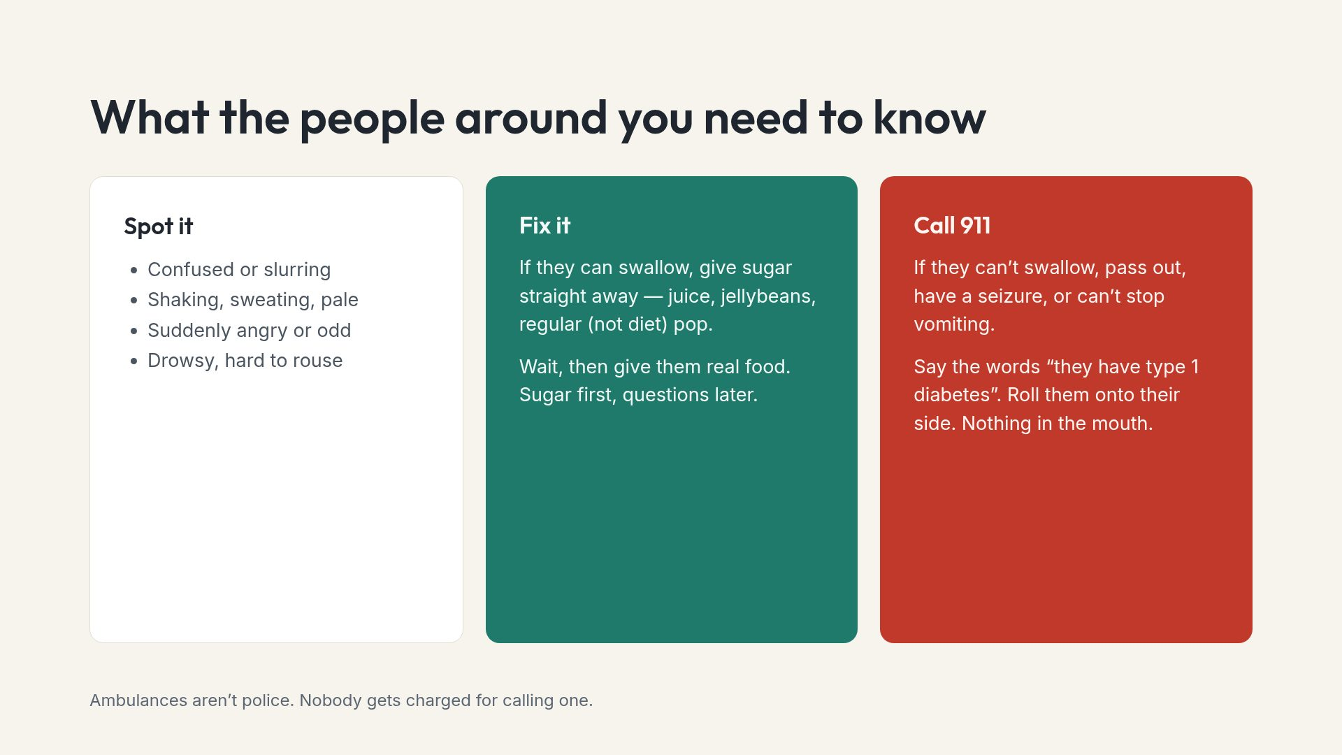
Notes:
Suggest they actually show this slide to two people &mdash; a partner, a roommate, a sibling, whoever is usually there. A plan nobody else knows about is not a plan.

Slide 21
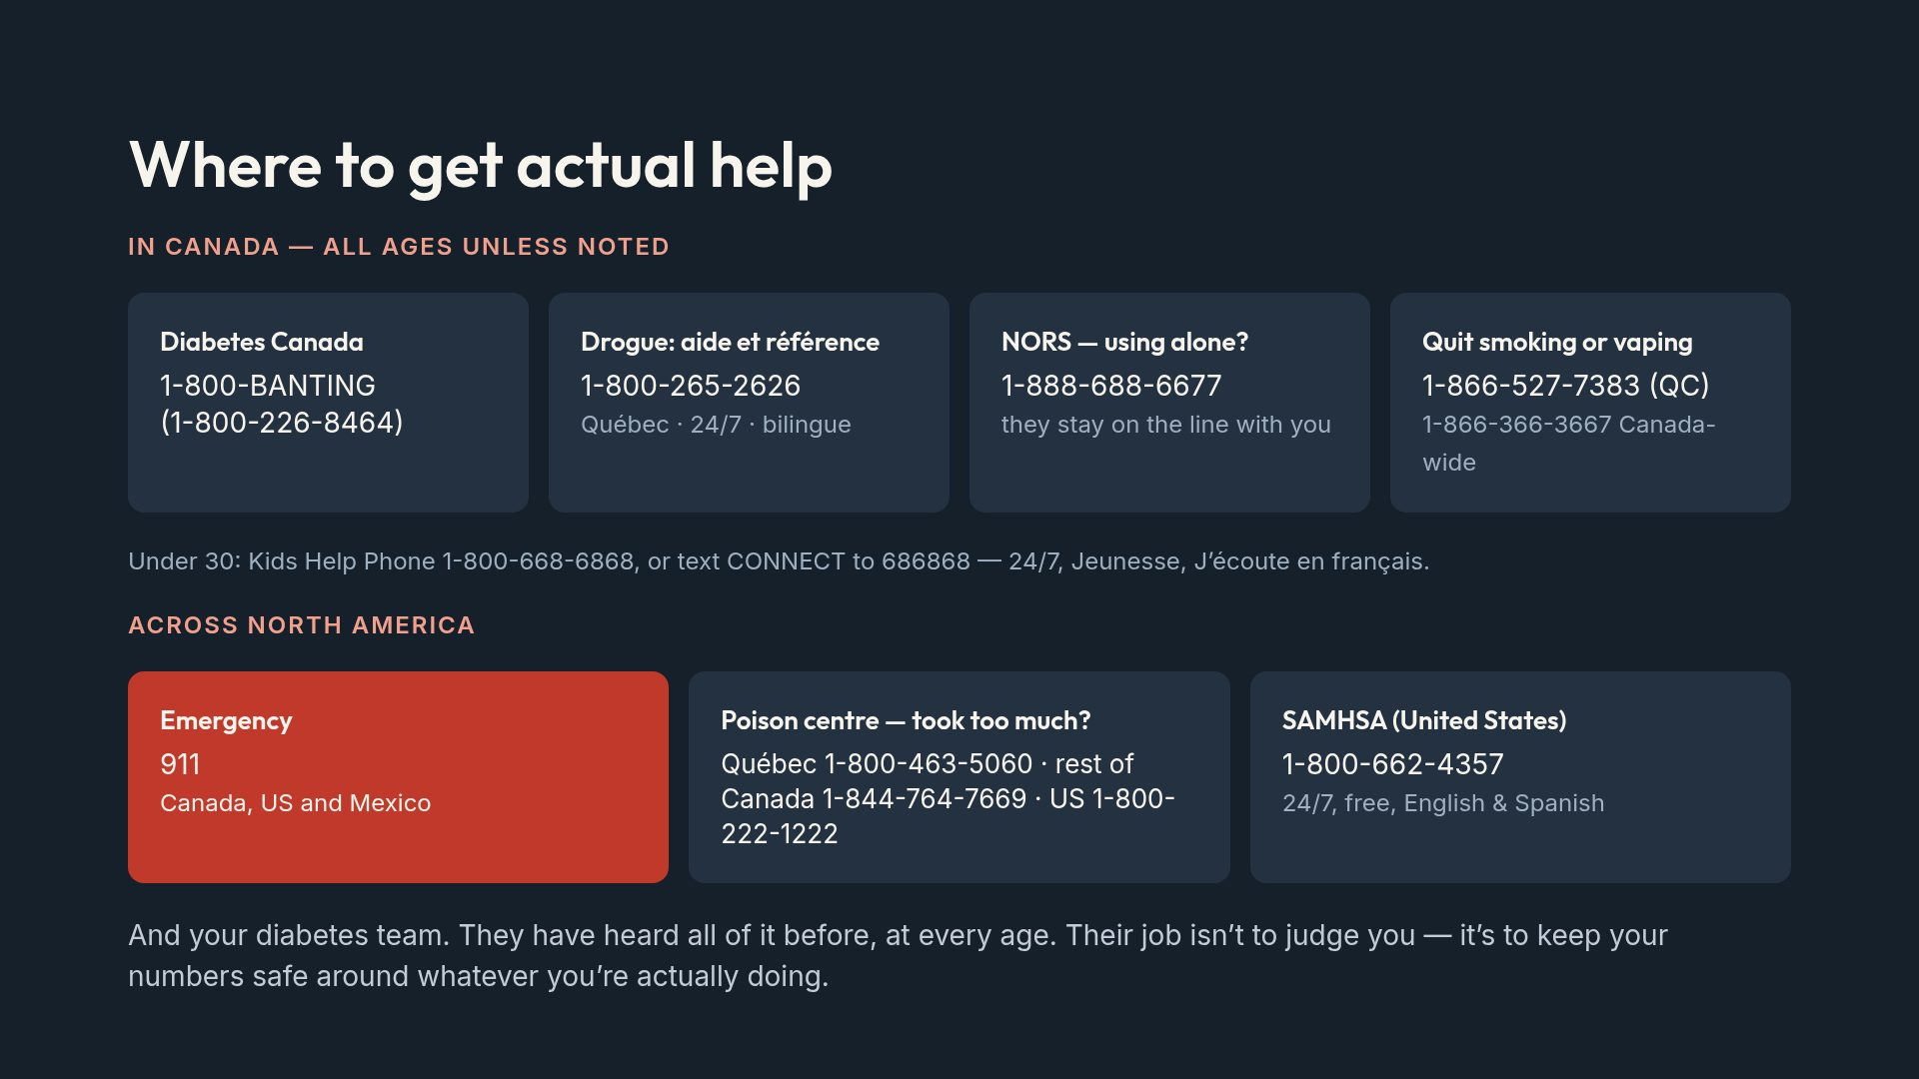
Notes:
NORS and the poison centres are the two most underused. Neither is police, both take calls about recreational doses, and both will tell you whether this needs an emergency department.

Slide 22
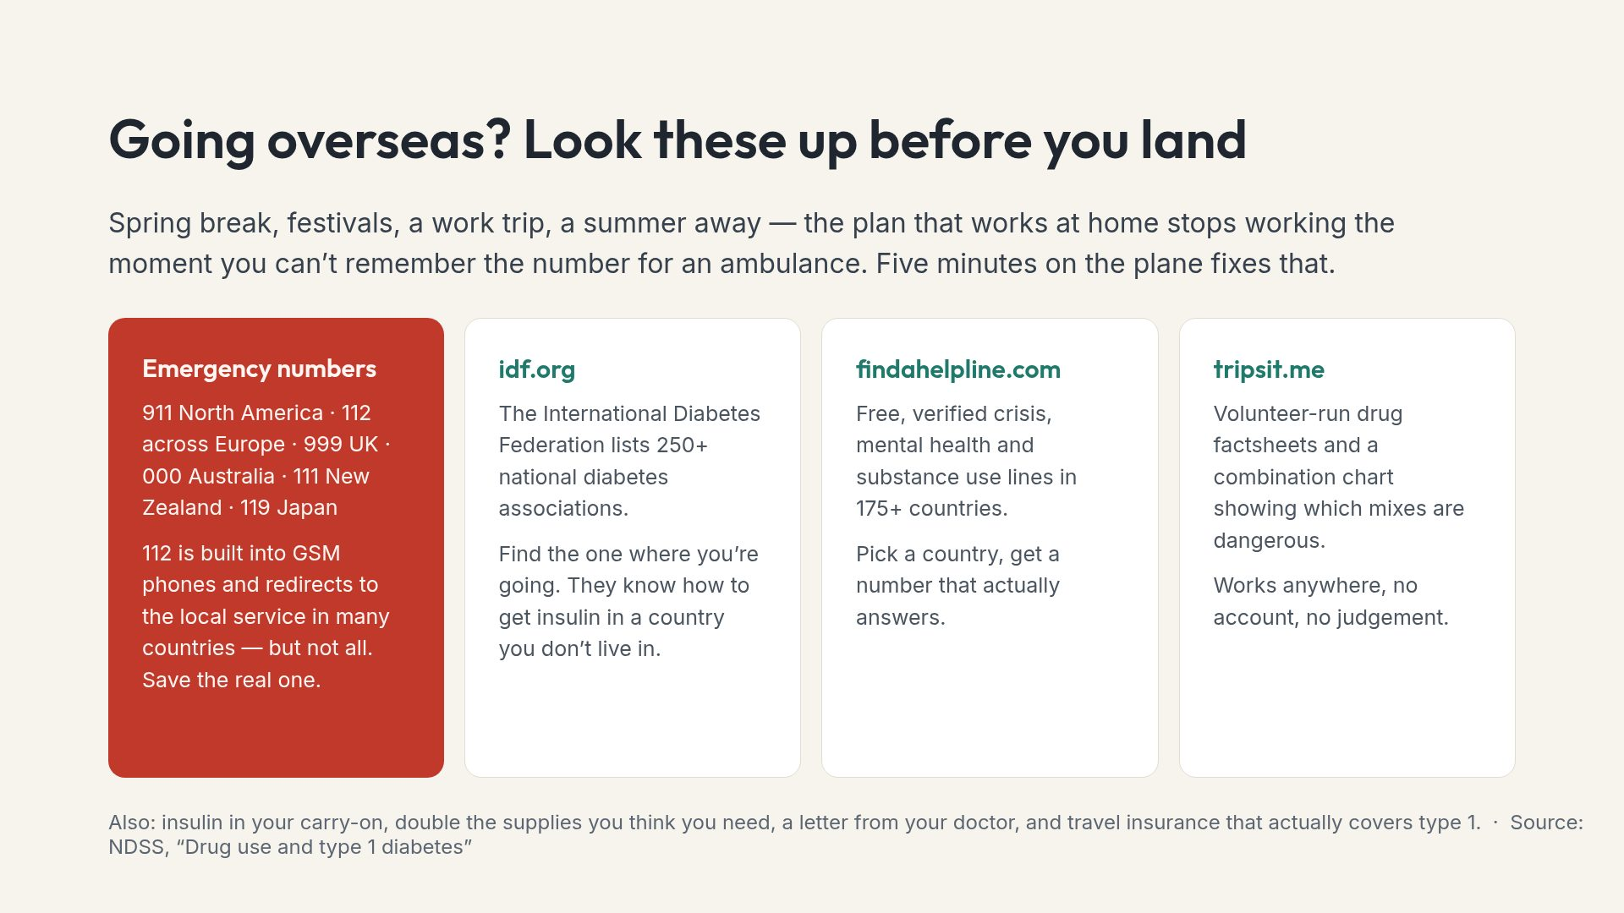
Notes:
The insurance point is worth pausing on. A lot of policies exclude pre-existing conditions unless you declare type 1 when you buy.

