Slide 1
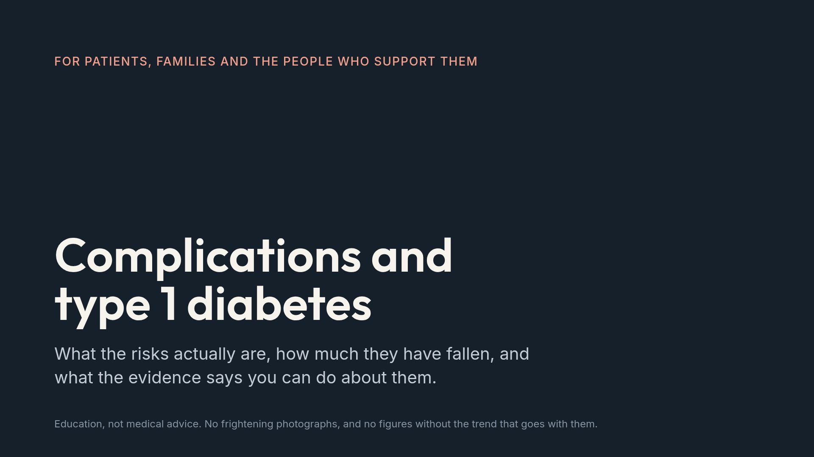
Notes:
This is the deck people most dread. Say up front that it contains no images of wounds or amputations and no worst-case stories, and that it is built to make an existing fear the right size rather than to install a new one.

Slide 2
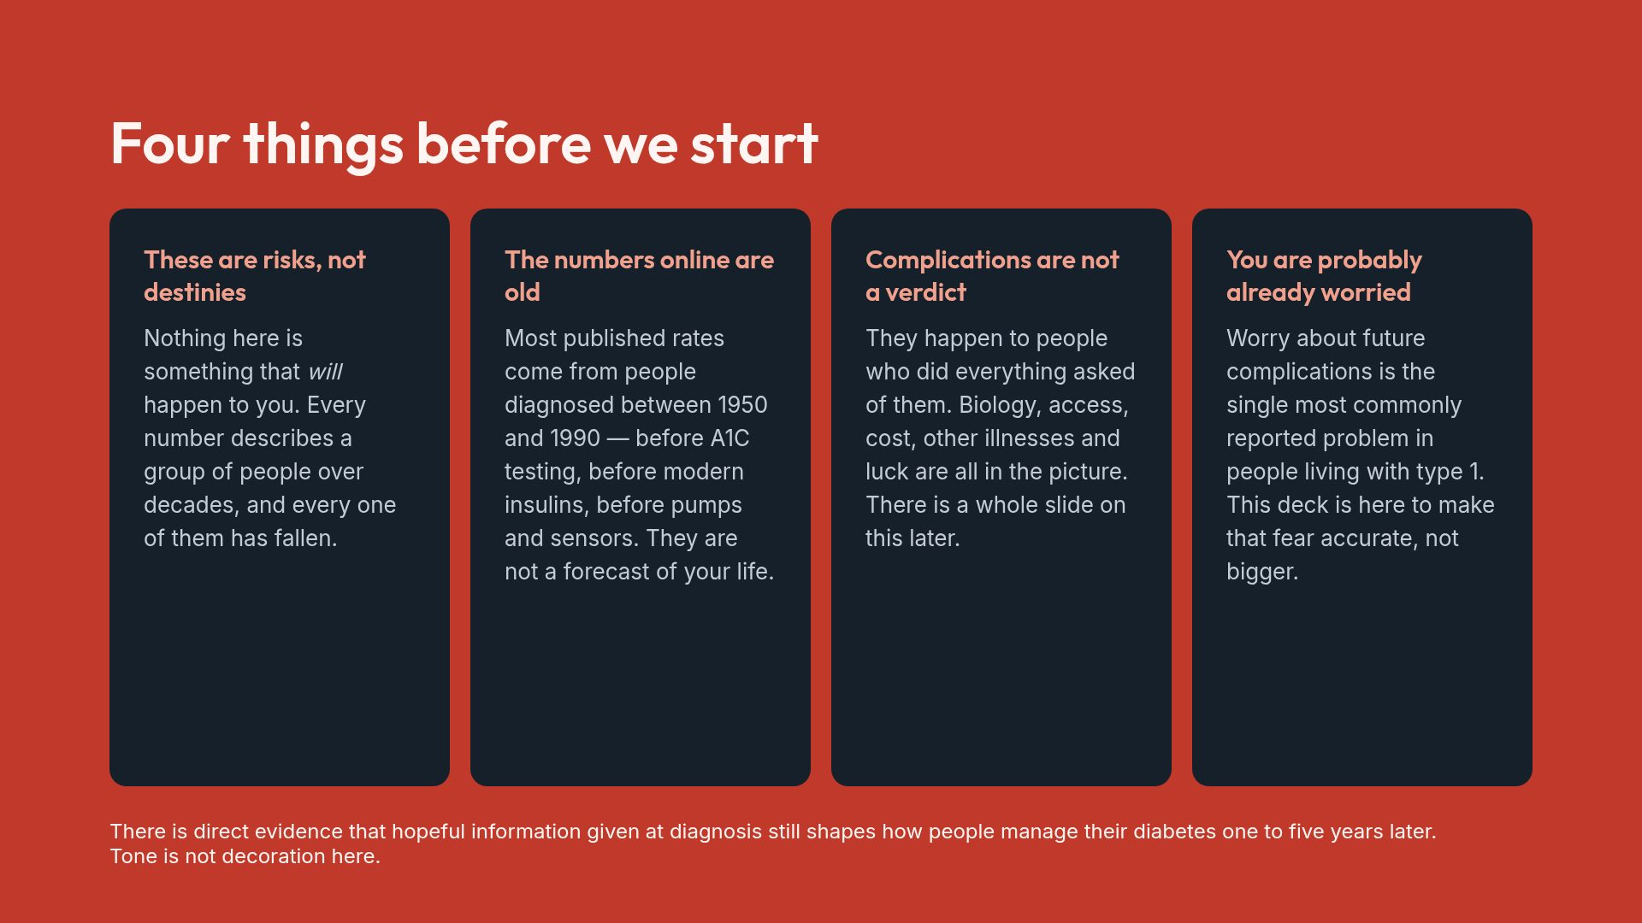
Notes:
Read this slide out loud rather than skipping it. The literature on complications messaging is clear that how this material is introduced changes whether people engage with it or avoid care.

Slide 3
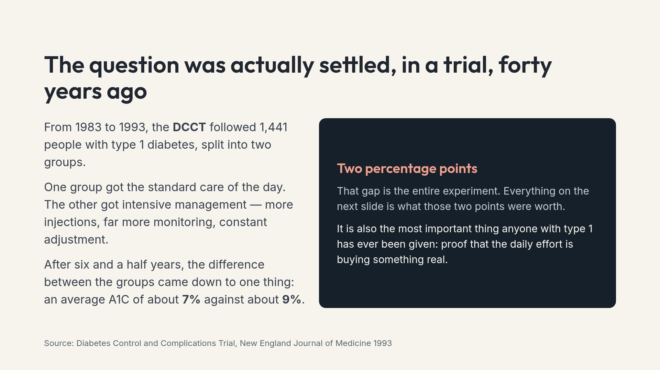
Notes:
Emphasise that this was a randomised trial, not an observation. It is the reason the whole care model exists.

Slide 4
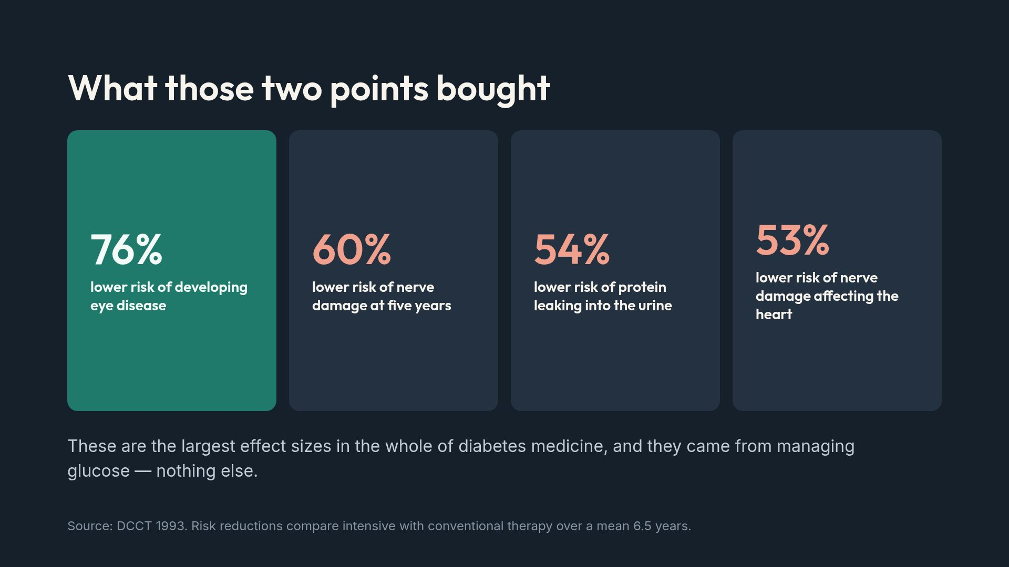
Notes:
Note that these reduce risk substantially; none of them abolishes it. That distinction is the honest framing and it matters for the later slides.

Slide 5
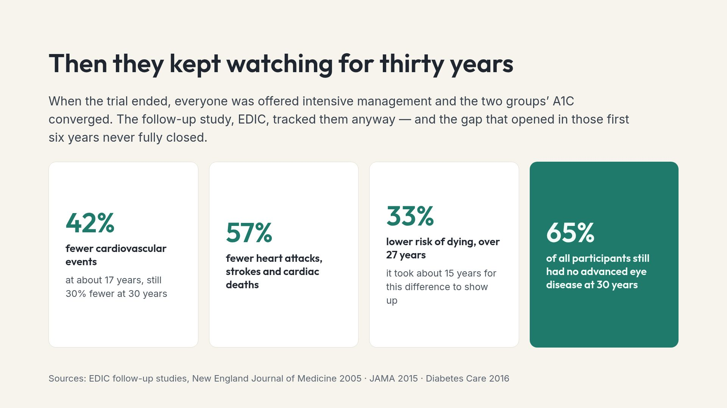
Notes:
The last card is the one to dwell on. Two-thirds of people from a 1980s cohort, using 1980s tools, reached thirty years without advanced retinopathy.

Slide 6
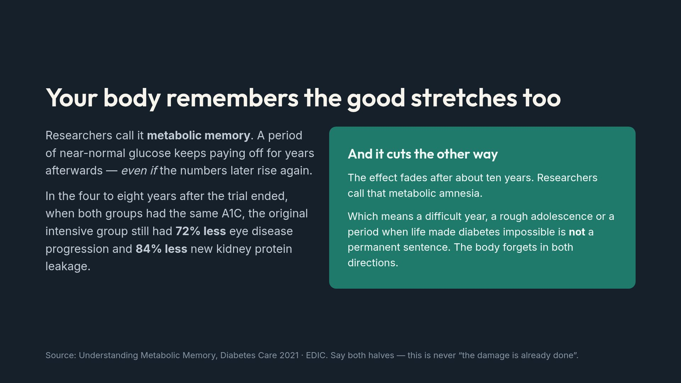
Notes:
People who have had a bad stretch often conclude their future is already fixed. The attenuation evidence says otherwise, and it is the most useful thing you can tell them.

Slide 7
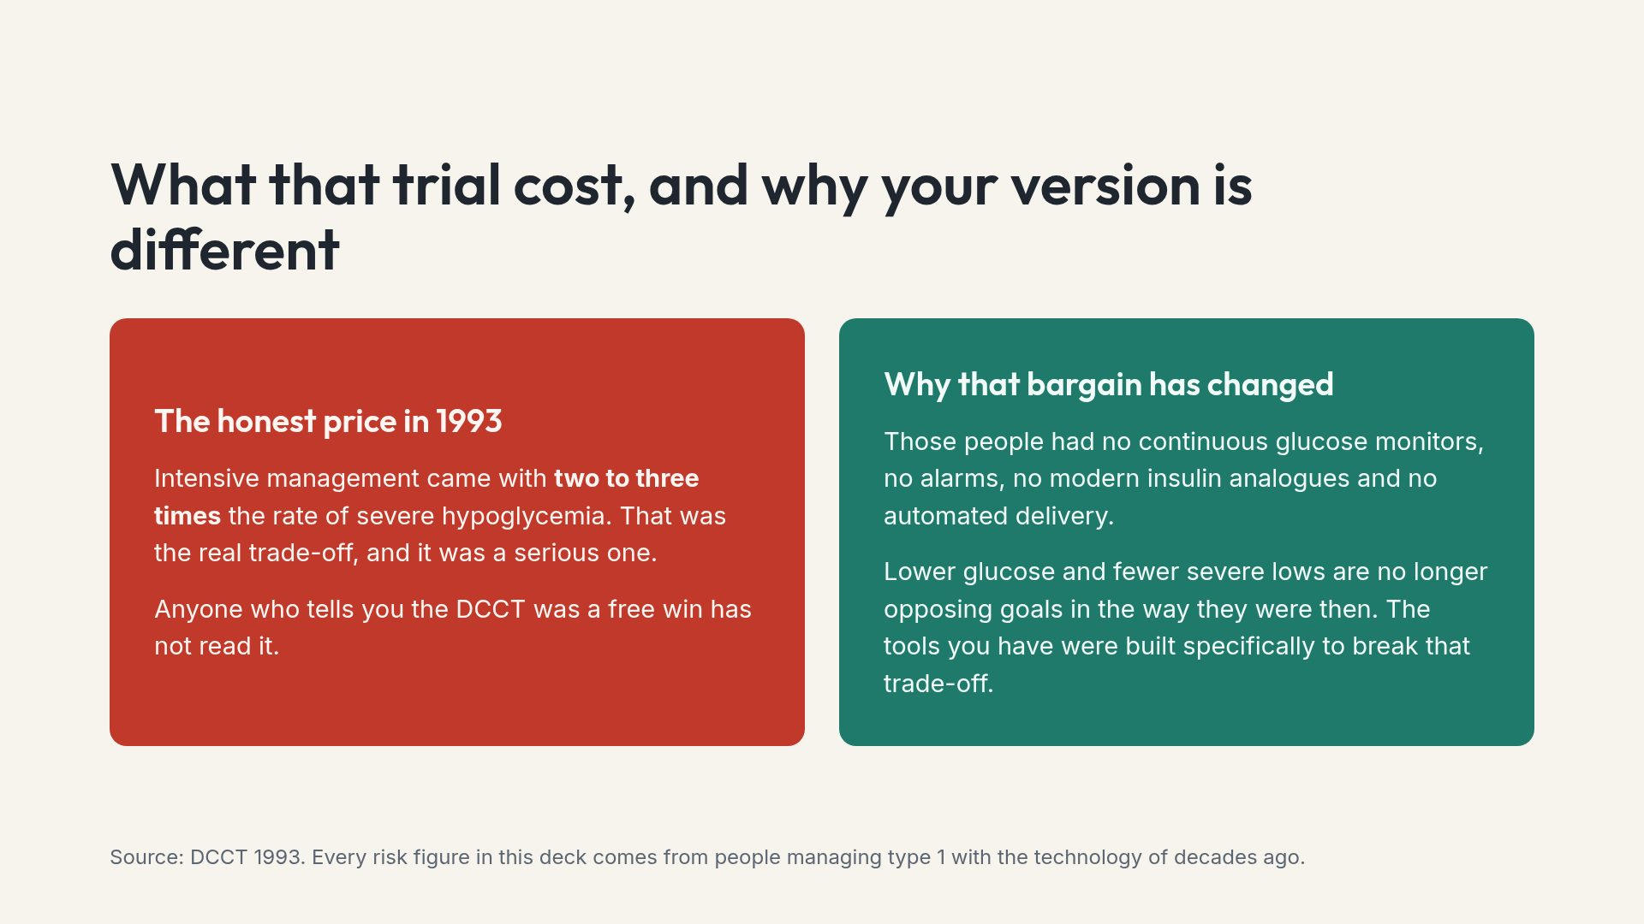
Notes:
Stating the downside of the landmark trial openly is what makes the rest of the numbers believable.

Slide 8
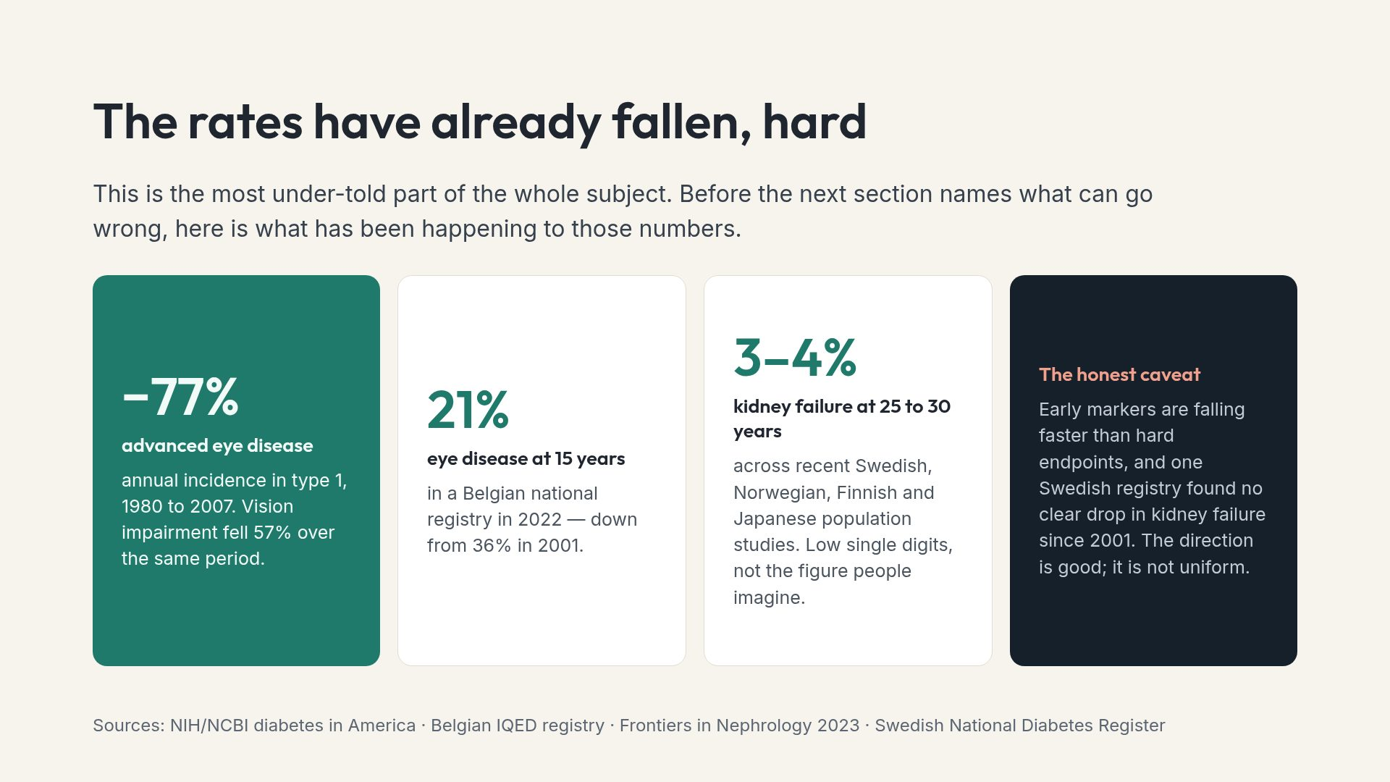
Notes:
Putting this before the complications section is deliberate. Context first, then detail — the reverse order produces fear rather than understanding.

Slide 9
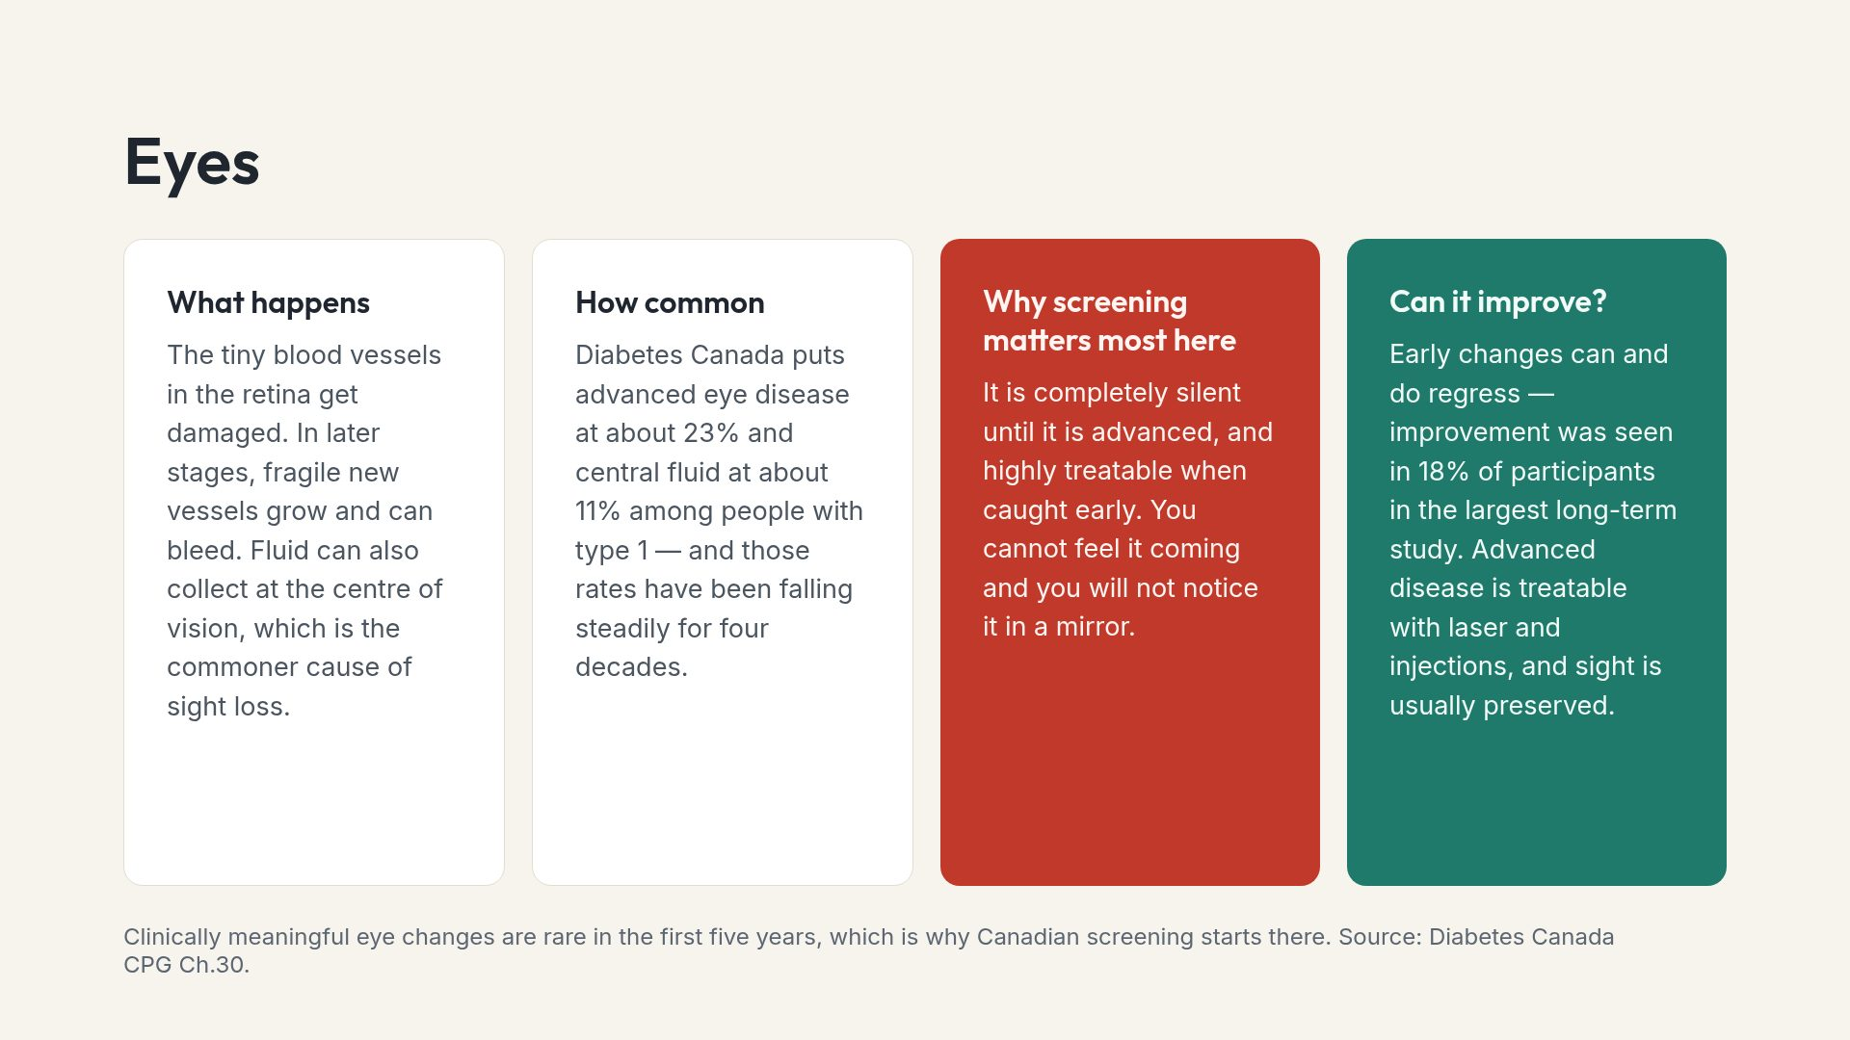
Notes:
The single action item from this slide is booking the annual eye appointment. It is the highest-value hour in the calendar.

Slide 10
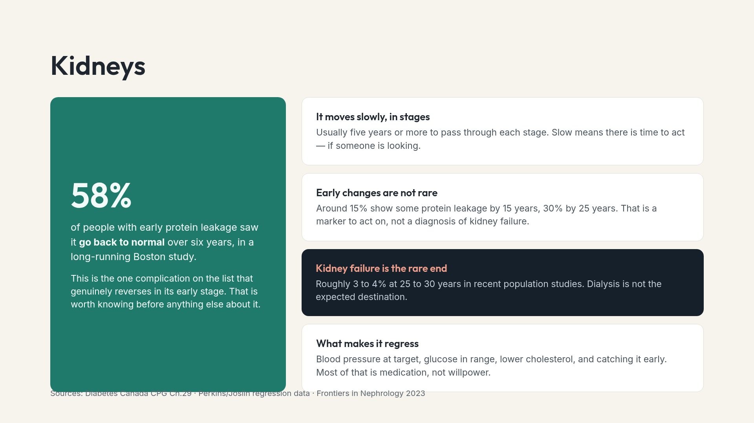
Notes:
Lead with the regression figure. Kidney disease is what people fear most after blindness, and it is the one most likely to reverse.

Slide 11
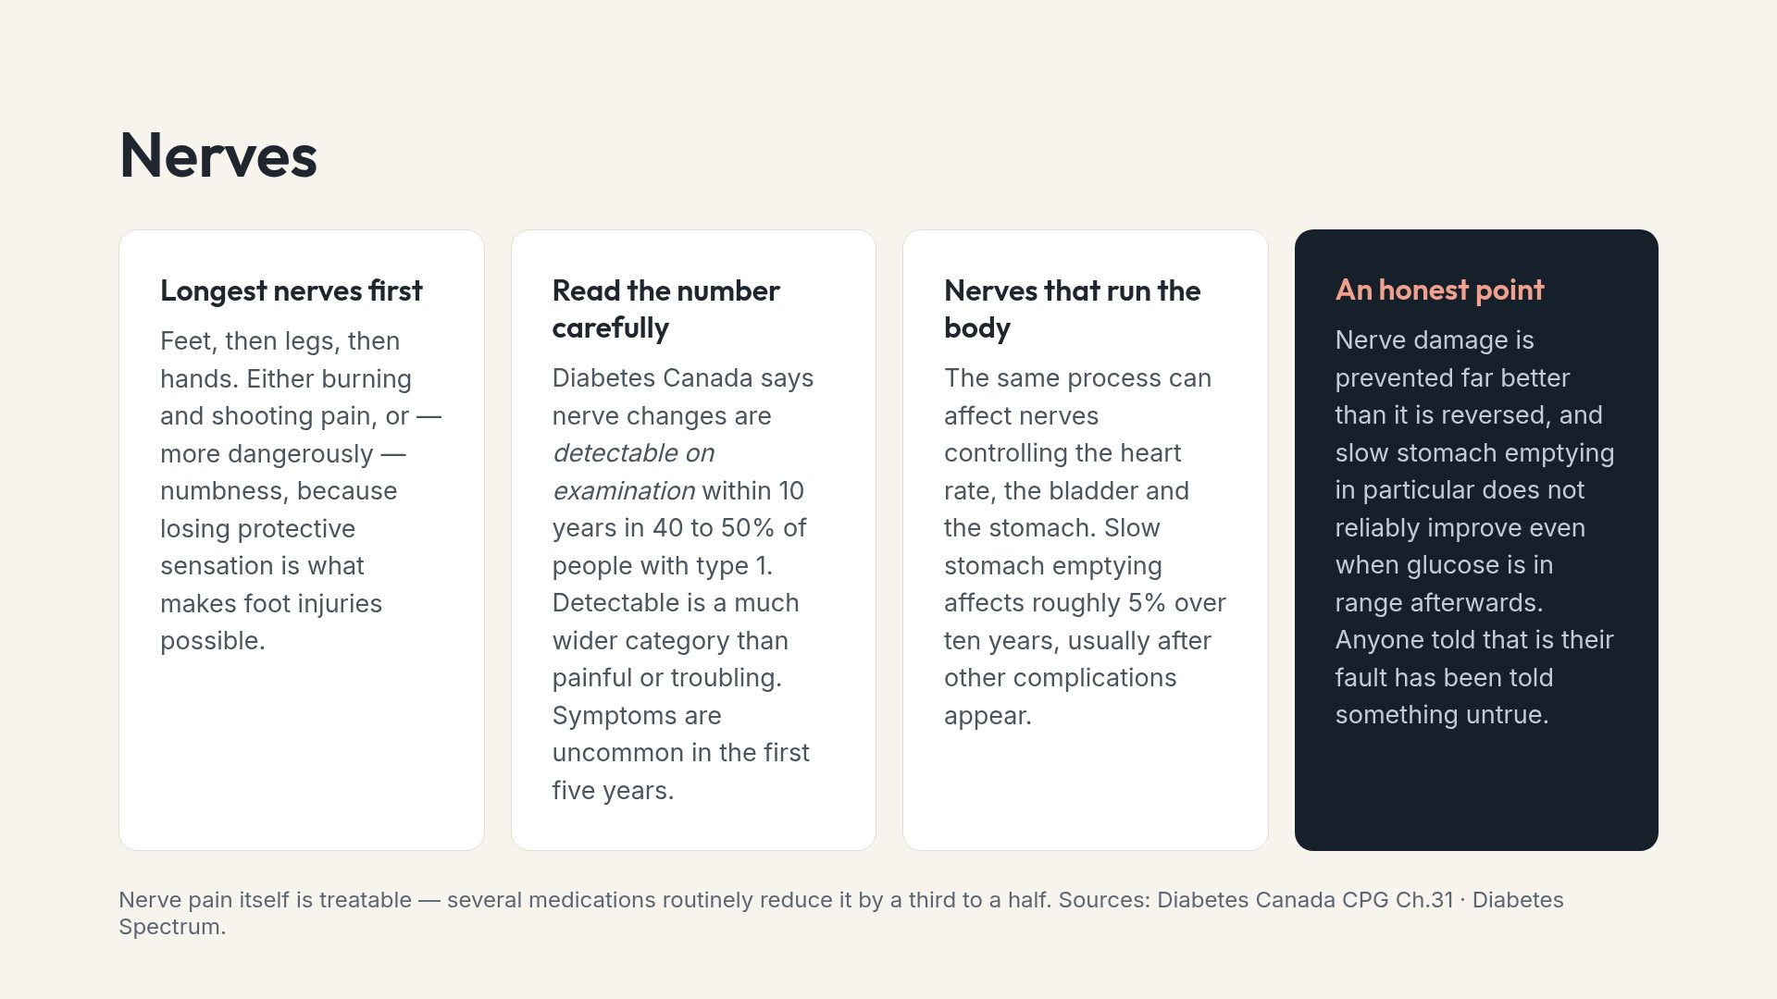
Notes:
The last card exists because gastroparesis is the complication most often blamed on the person who has it, and the evidence does not support that blame.

Slide 12
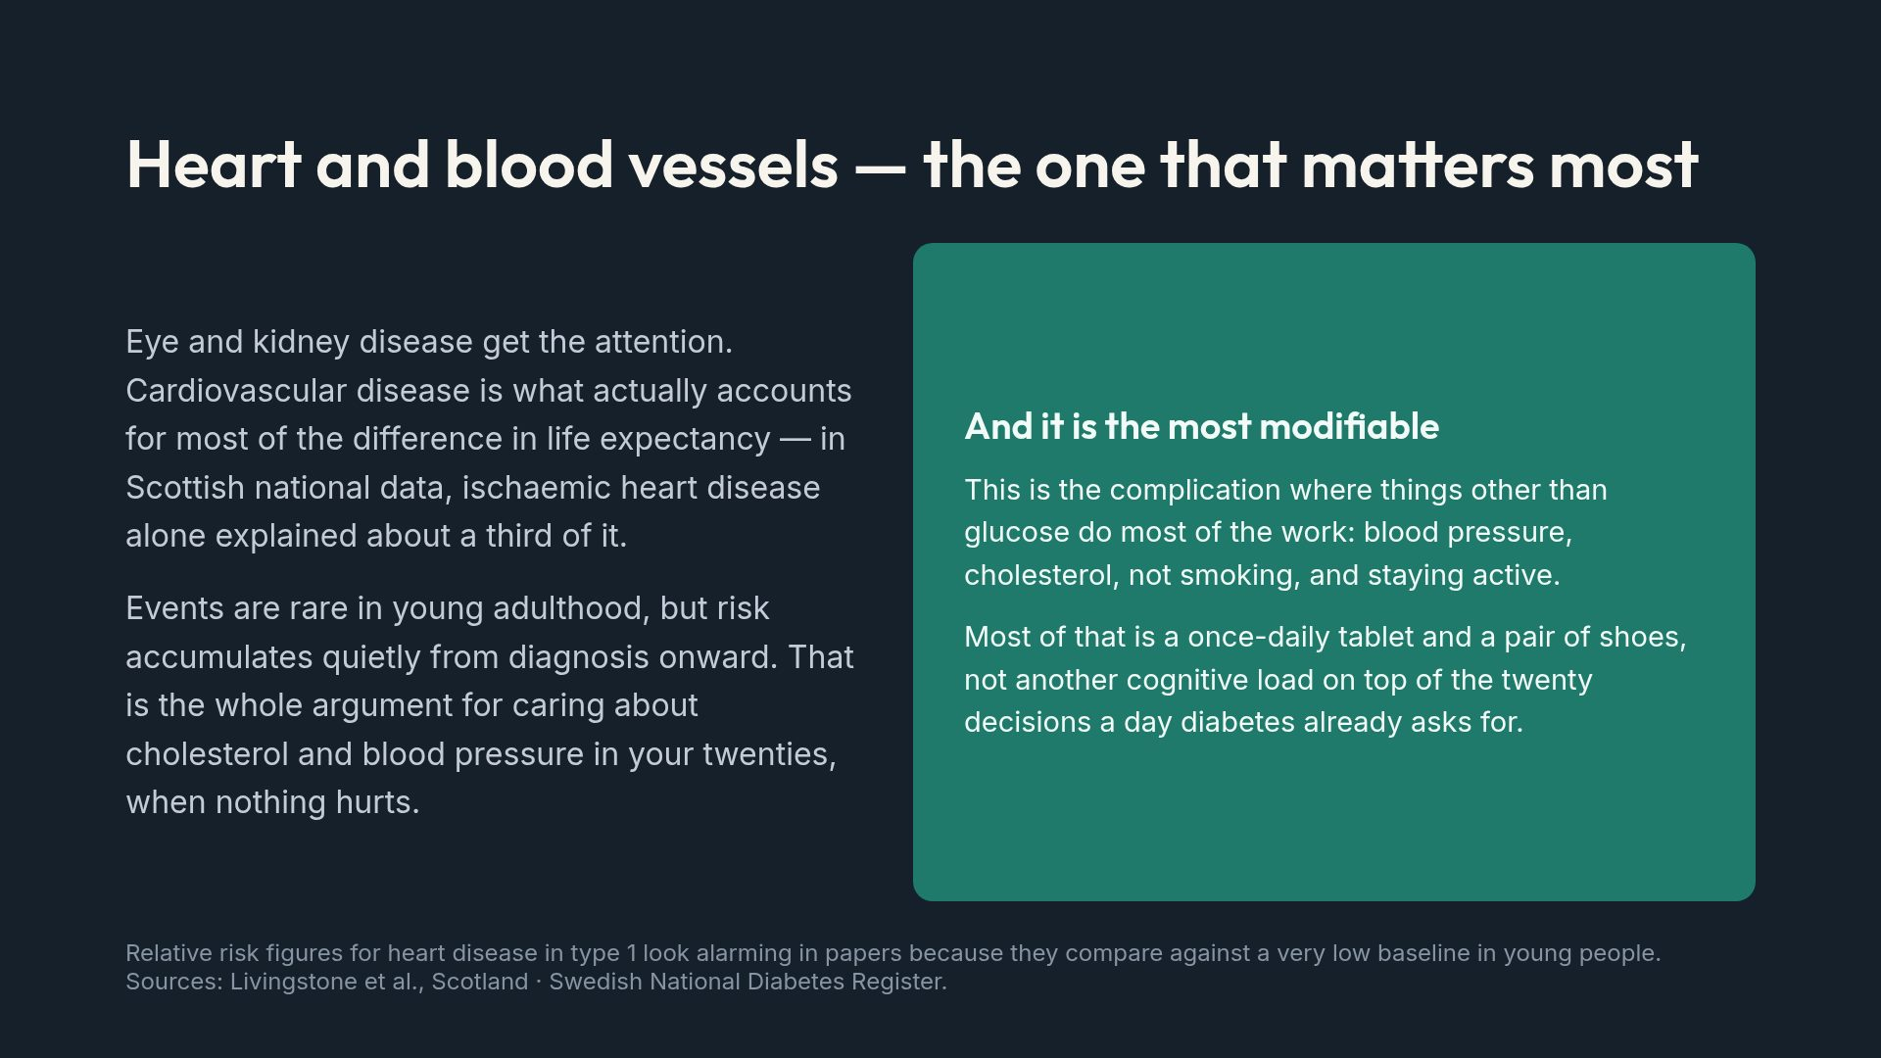
Notes:
Deliberately no hazard ratios on this slide. They are real, but against a tiny young-adult baseline they mislead badly in a patient setting.

Slide 13
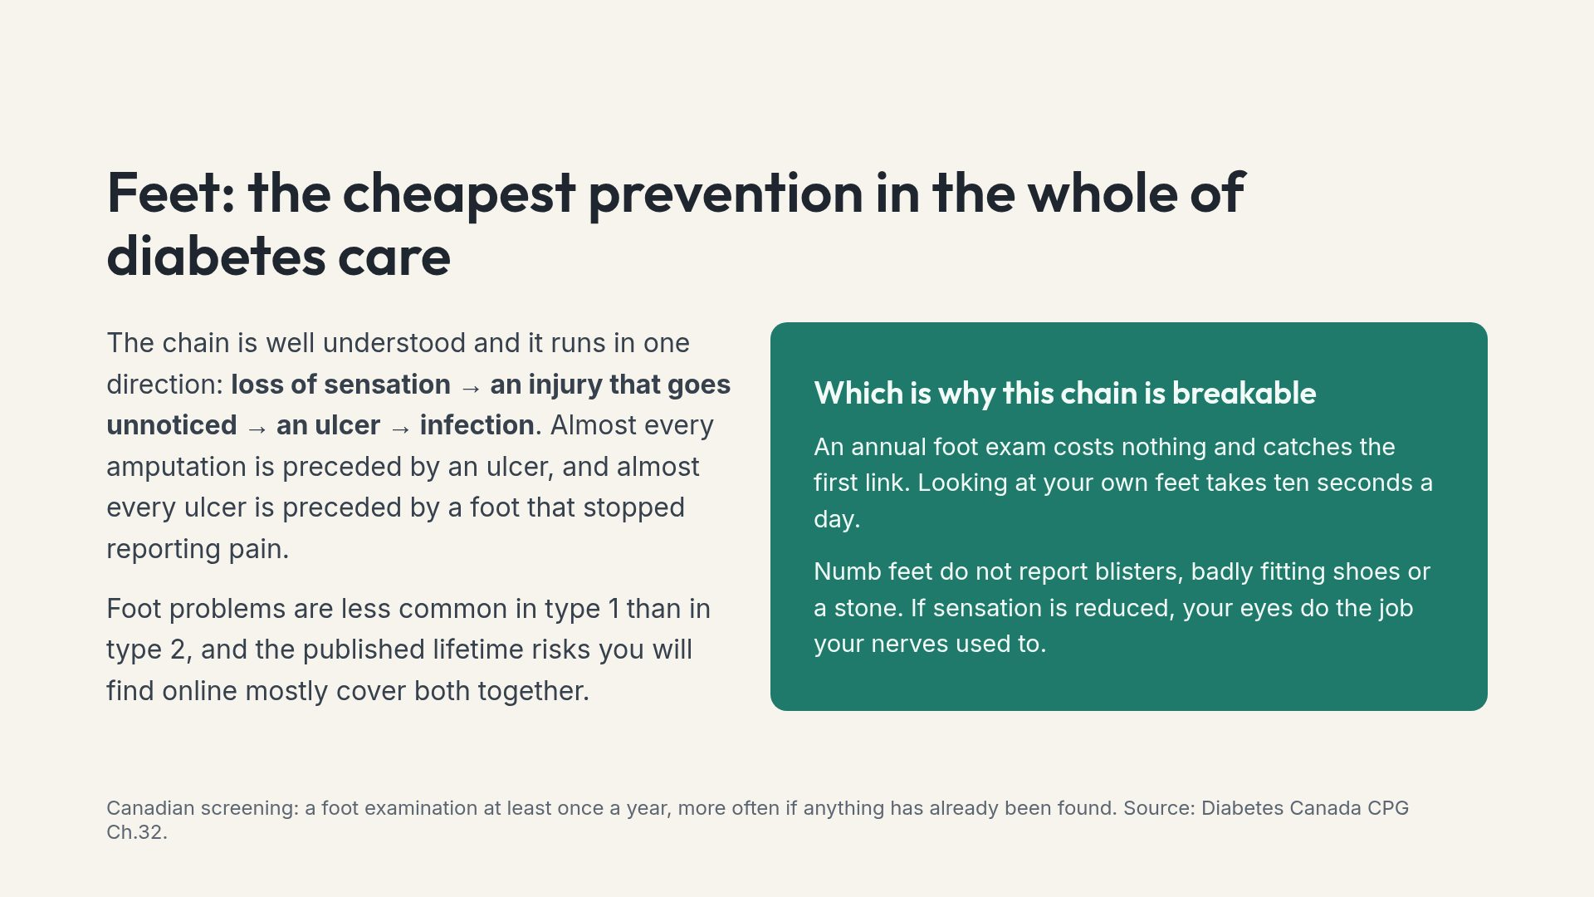
Notes:
Frame this as the highest-leverage, lowest-cost item in the deck. No technology, no cost, no burden — just a look.

Slide 14
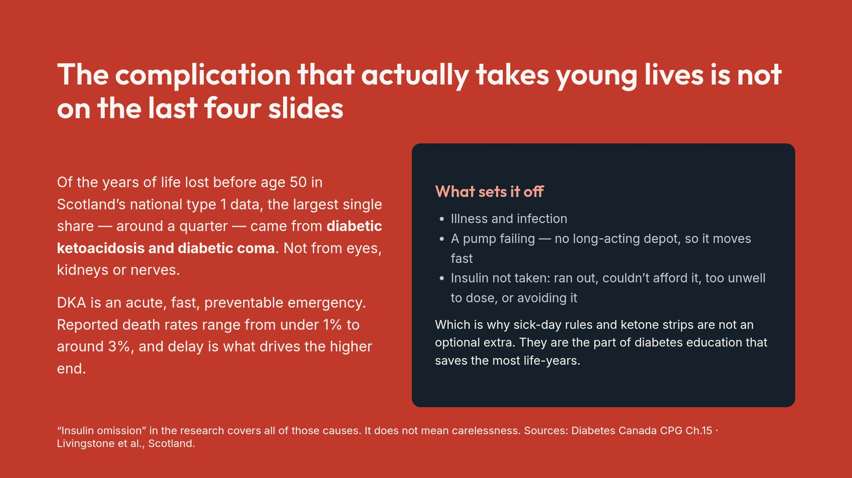
Notes:
This slide re-prioritises the whole subject. Most patient material spends its time on complications that take decades and skips the one that can kill this weekend.

Slide 15
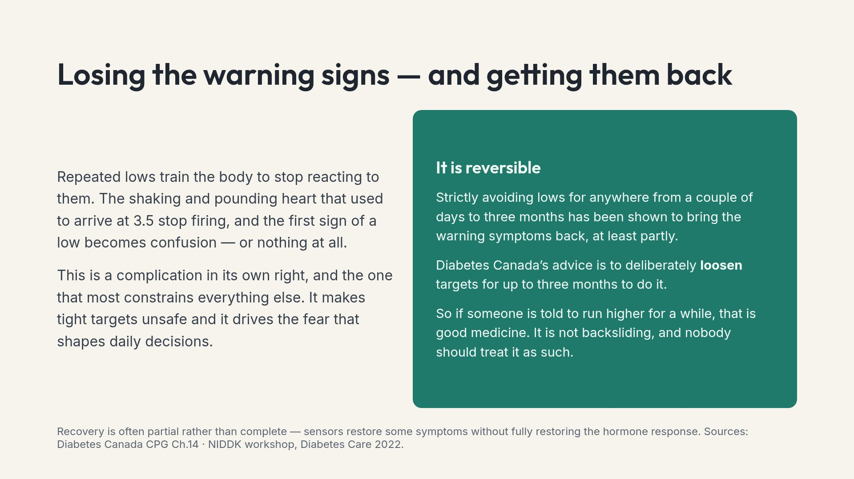
Notes:
The deliberate-loosening point is a powerful antidote to the idea that lower is always better and anything else is failure.

Slide 16
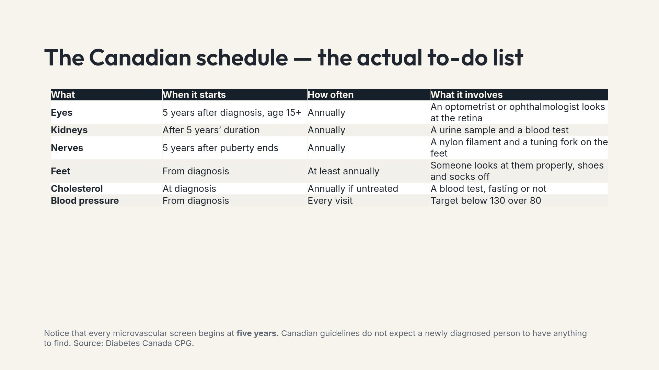
Notes:
This is the deck's action slide. If someone leaves having booked one appointment, the session worked.

Slide 17
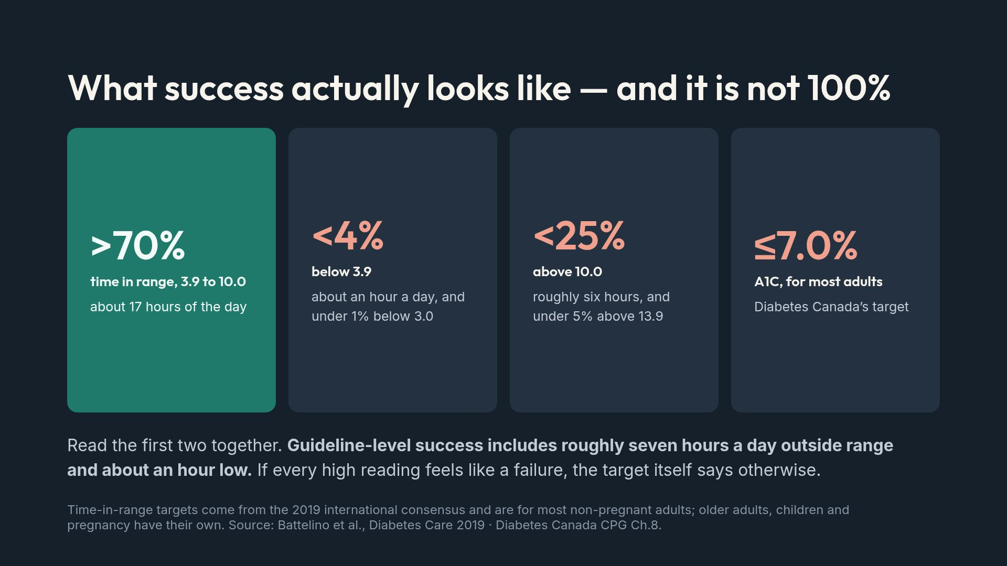
Notes:
The closing line is the point of the slide. Perfectionism drives burnout, and the guideline itself is the best argument against it.

Slide 18
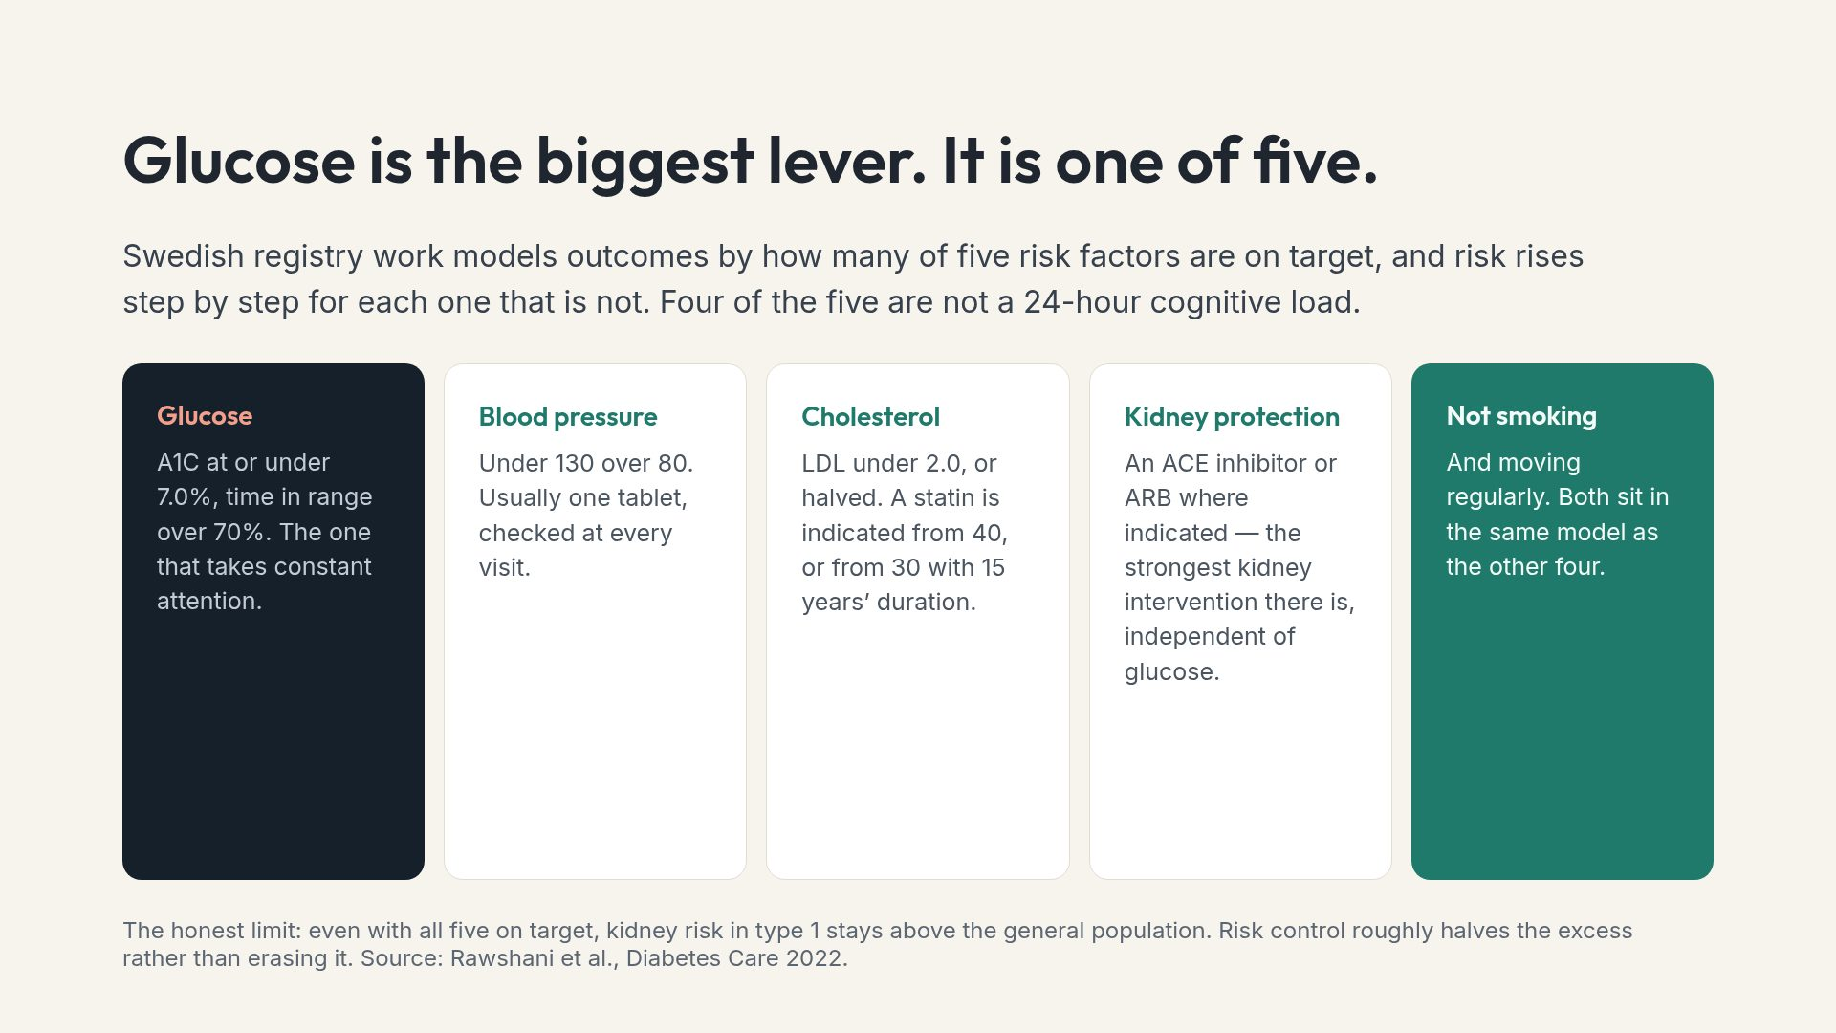
Notes:
This slide is genuinely good news and is chronically undersold. Four of the five levers are handled at an appointment, not at every meal.

Slide 19
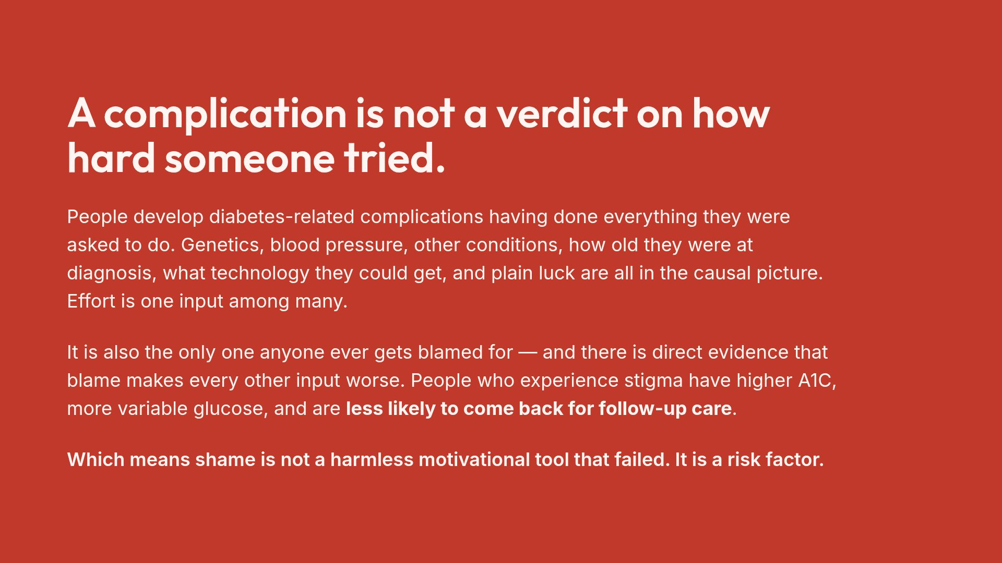
Notes:
Say this one slowly. In a room with families in it, this is the sentence the person with diabetes most needs the others to hear.

Slide 20
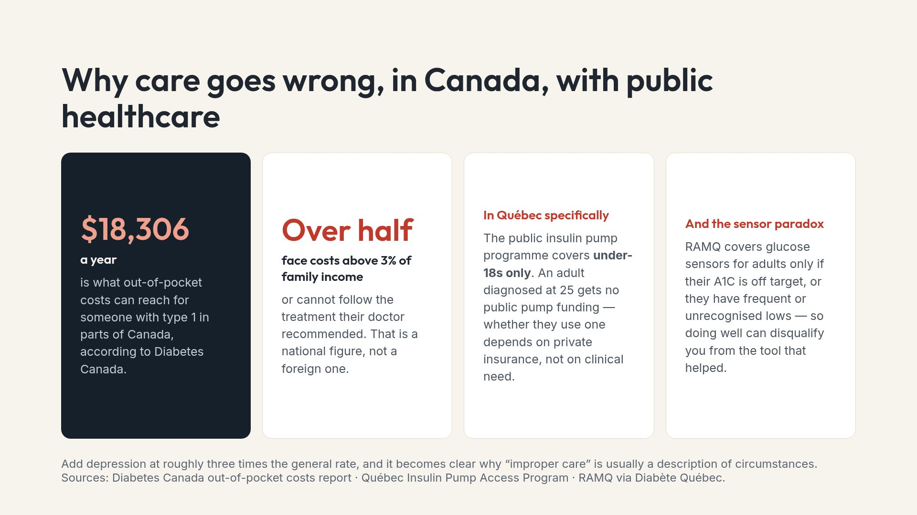
Notes:
Concrete and checkable beats abstract sympathy. Naming the Québec pump age cut-off lands harder than any general statement about access.

Slide 21
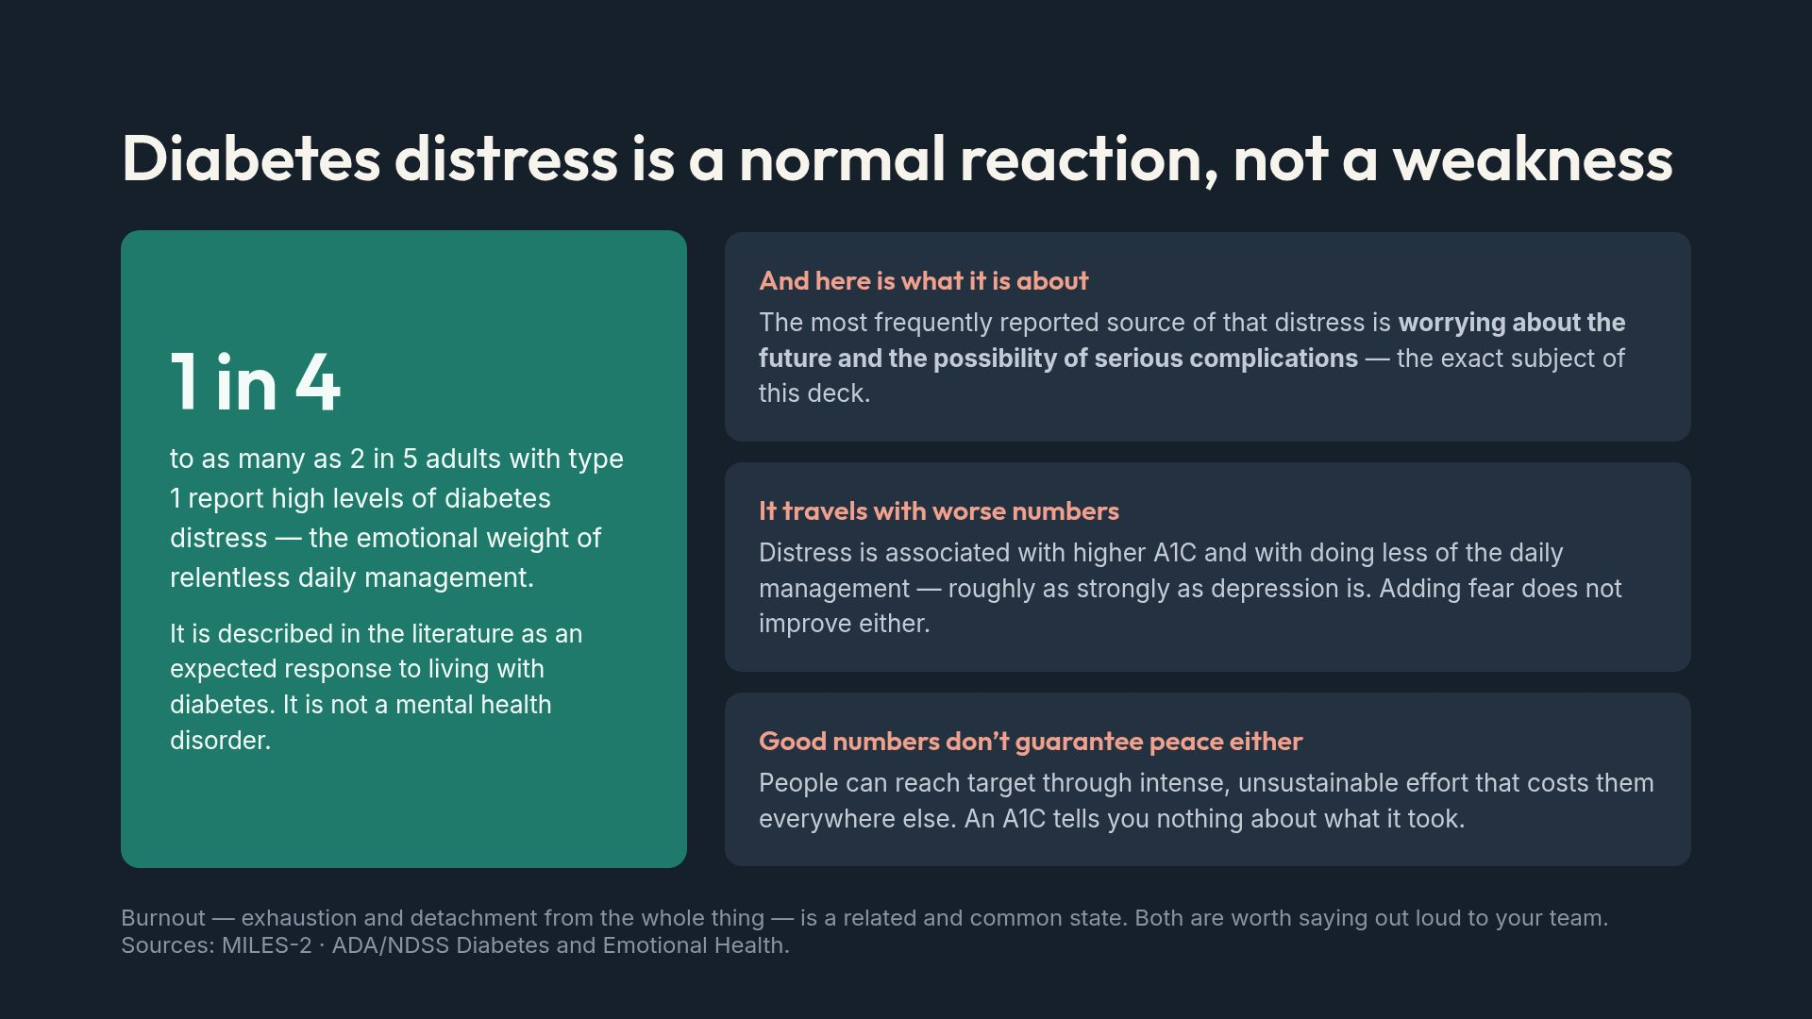
Notes:
If someone in the room recognises themselves here, that is the outcome. Distress is treatable and routinely goes unmentioned in appointments.

Slide 22
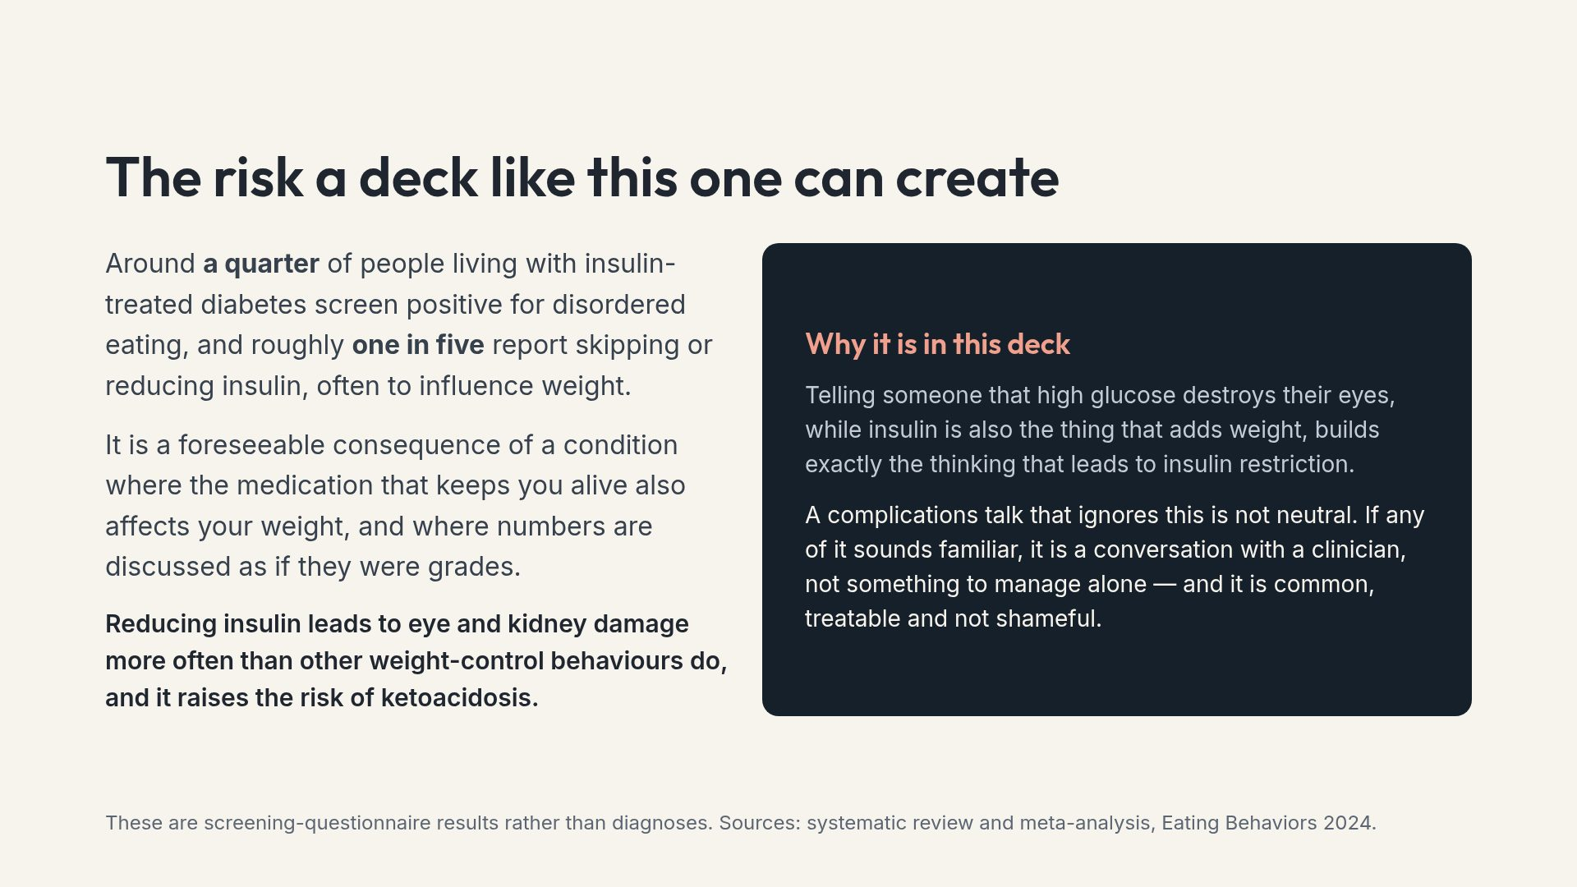
Notes:
This is a sensitive topic. If anyone recognises themselves, the right next step is a clinician, and support is available — offer to help find it rather than pressing for detail.

Slide 23
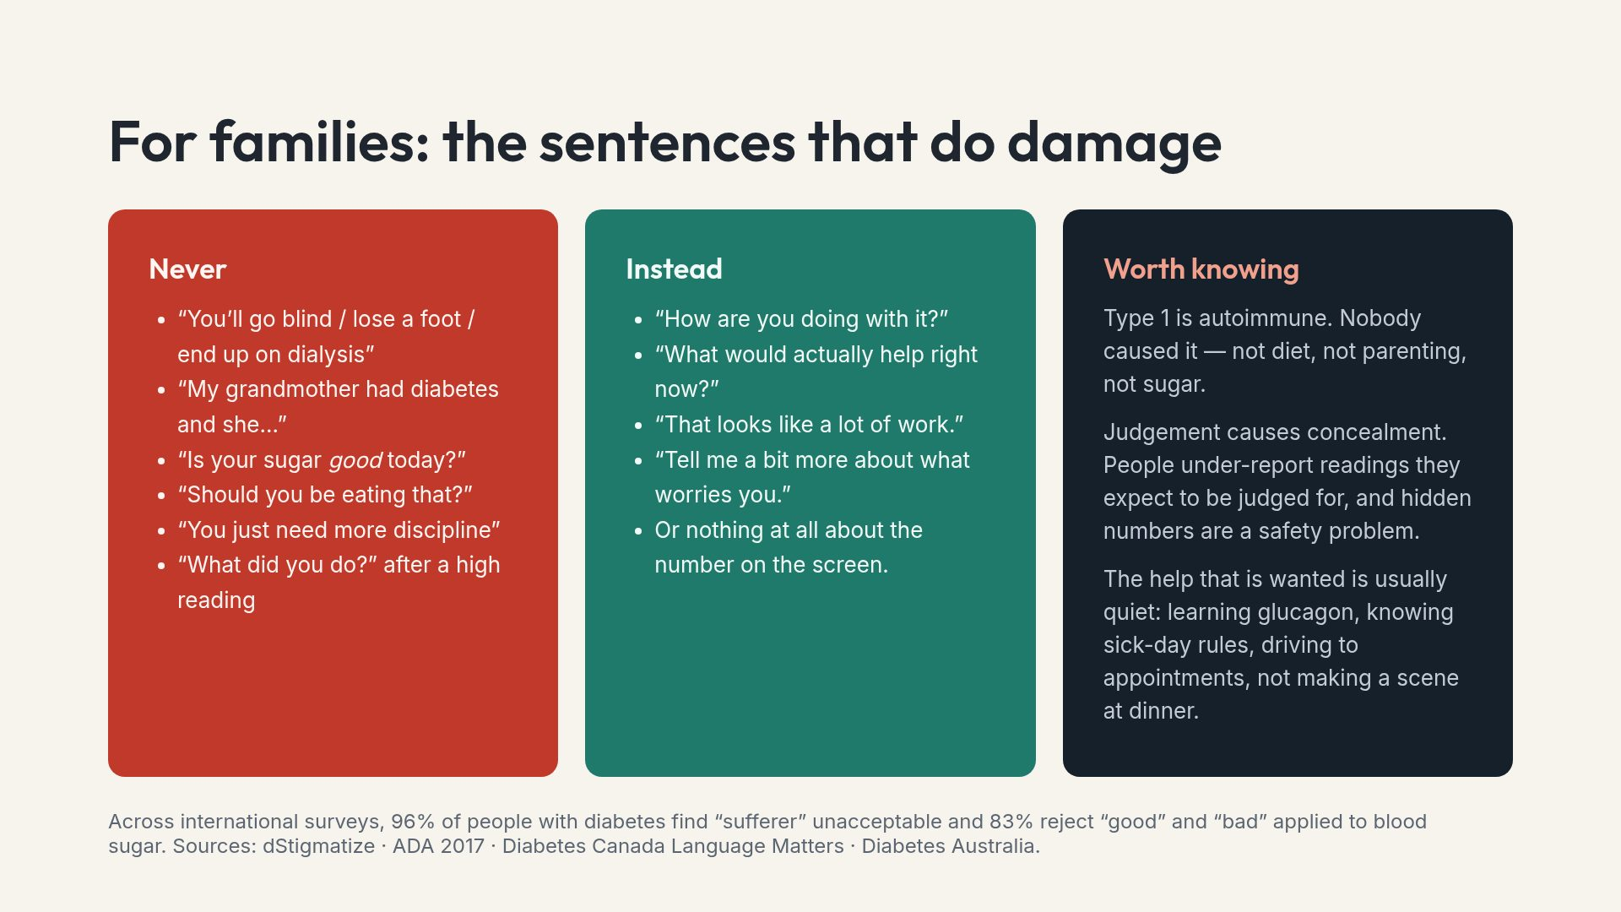
Notes:
The left column is drawn verbatim from published avoid-lists, not from opinion. Say so — it stops the slide being heard as a personal rebuke.

Slide 24
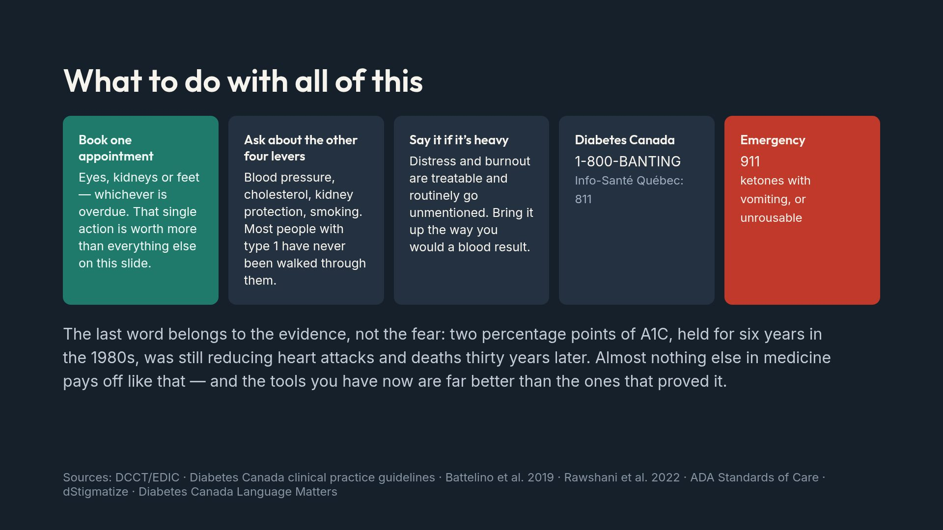
Notes:
End on the legacy effect. It is the most hopeful true thing in this entire body of evidence, and hope delivered at diagnosis measurably changes behaviour years later.

