Slide 1
Physical DPE
Each time slice, resource manager and hardware select a layer to run on the physical tile
vT
vT
vT
vT
vT
vT
vT
vT
vT
vT
vT
vT
vT
vT
vT
vT
T
T
T
T
vT
vT
vT
vT
vT
vT
vT
vT
vT
vT
vT
vT
vT
vT
vT
vT
vT
vT
vT
vT
vT
vT
vT
vT
vT
vT
vT
vT
T
T
T
T
vT
vT
vT
vT
vT
vT
vT
vT
vT
vT
vT
vT
vT
vT
vT
vT
vT
vT
vT
vT
vT
vT
vT
vT
vT
vT
vT
vT
T
T
T
T
vT
vT
vT
vT
vT
vT
vT
vT
vT
vT
vT
vT
vT
vT
vT
vT
vT
vT
vT
vT
vT
vT
vT
vT
vT
vT
vT
vT
T
T
T
T
vT
vT
vT
vT
V EXTERNAL IO INTERFACE
vT
vT
vT
vT
V EXTERNAL IO INTERFACE
vT
vT
vT
vT
V EXTERNAL IO INTERFACE
vCTRL
V EXTERNAL IO INTERFACE
EXTERNAL IO INTERFACE
vCTRL
V EXTERNAL IO INTERFACE
vCTRL
V EXTERNAL IO INTERFACE
vCTRL
v EXTERNAL IO INTERFACE
CTRL
vCTRL
vCTRL
vCTRL
Each time slice the resource manager controls which virtual stream layer is mapped to the physical DPE
The physical hardware is managed by resource manager e.g. OS
Virtual DPE stream layers

Slide 2
Replicated CTRL
Replicated eDRAM Buffer
TILE
MP
σ
CTRL
OR
eDRAM
Buffer
S+A
IMA
IMA
IMA
IMA
IMA
IMA
IMA
IMA

Slide 3
In-Situ Multiply Accumulate
OR
S+A
DAC
XB
DAC
XB
IR
ADC
S+H
S+H
ADC
DAC
XB
DAC
XB
ADC
S+H
S+H
ADC
CTRL
Replicated CTRL

Slide 4
T
T
T
T
vT
vT
vT
vT
T
T
T
T
vT
vT
vT
vT
T
T
T
T
vT
vT
vT
vT
T
T
T
T
vT
vT
vT
vT
EXTERNAL IO INTERFACE
CTRL
v EXTERNAL IO INTERFACE
vCTRL

Slide 5
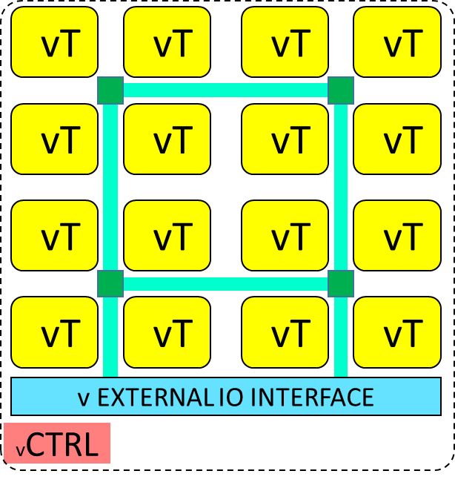
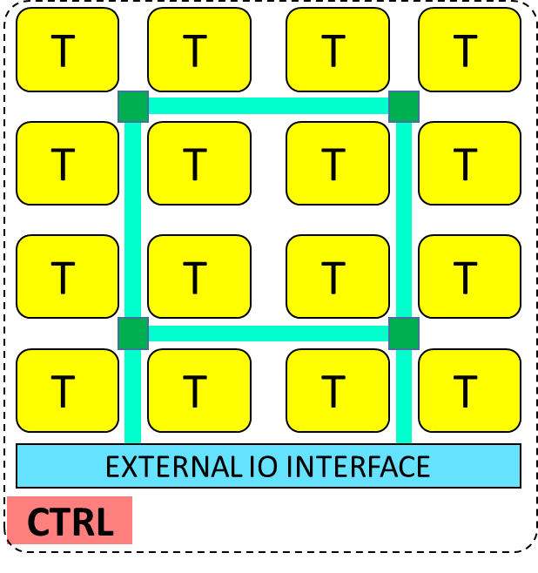
User 1
User 2
User 3
User 4
Virtual Stream Layers
Physical DPE

Slide 6
User 1
User 2
User 3
User 4
User 5
User N
Virtual Stream Layers
DPE Grid Manager
Physical DPEs

