Slide 1
Review: A Hybrid System Model of Seasonal Snowpack Water Balance
Application of hybrid modeling to natural systems

Slide 2
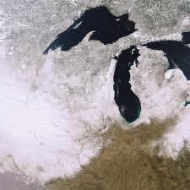
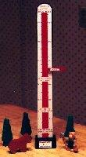
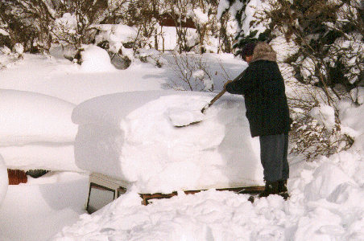
Personal Motivation
Notes:
I grew up in this place.
394” of snow, that is 10 meters.
Now only about 3 meters on the ground at one time (unless you count the drifts).

Slide 3
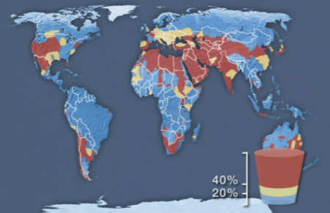
Motivation
Notes:
To save the world.
There are many systems that are not designed by people but for which
simulations and models would be very helpful.
Water management is important.
Shortage are currently happening world wide.
In the american west most water comes from the seasonal snowpack.

Slide 4
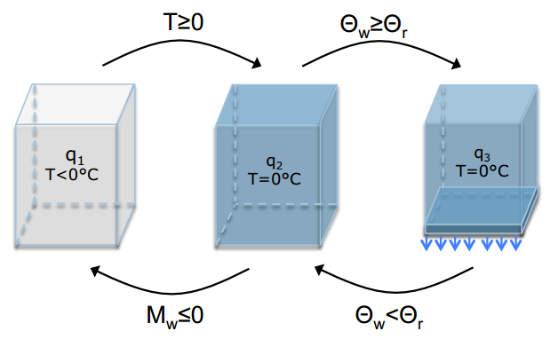
The Discrete Model
M = 0
Notes:
Aside from the “no snowpack” state
There are three states for the snowpack itself.
Frozen :
Thawing : snow is acting like a sponge
Melting : water is leaving the saturated state

Slide 5
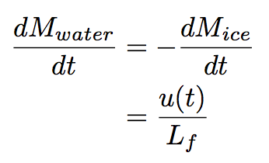
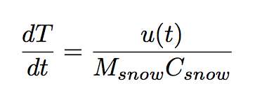
The Basics
Notes:
Temperature change in the frozen mode is proportional to the mass of the snow and its heat capacity.
Phase change mode holds the temperature constant.

Slide 6
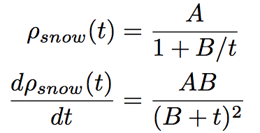
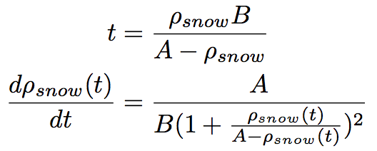
The Settling
B = 20 days
A = 450 kg/m³
Notes:
Snow is a mixture of ice and air.
As it ages it undergoes many changes:
sublimation
re-crystallization
compaction
Compaction, where the density of the snow increases due to the air being forced out.

Slide 7
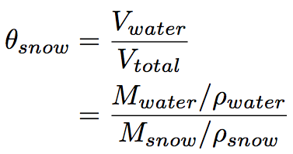
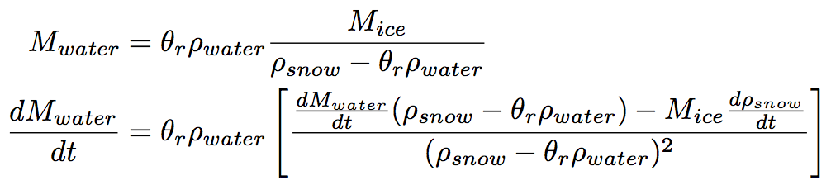
The Melting Sponge
Notes:
The interesting mode is when the snowpack is saturated and melting and settling.

Slide 8
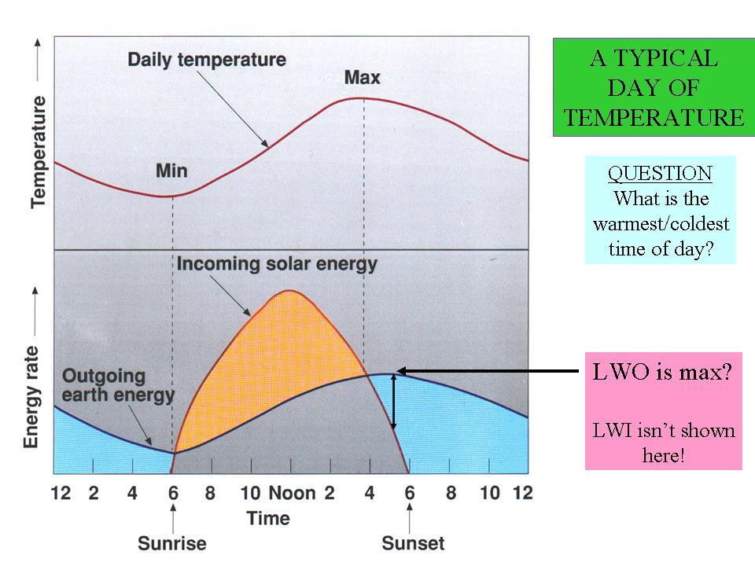

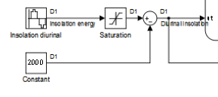
Energy Input / Calibration
kJ / m / day (not kW)
http://courses.knox.edu/envs150/overheads/dailytvariation.JPG
Notes:
Staying in the state for at least one time step.
Calibration working with time steps bigger than one second (one day).
Deciding on appropriate units generally.
Modelling diurnal insolation.
Energy is by radiation only in this model.
Insolation is shown here.
Night time radiation is constant.

Slide 9
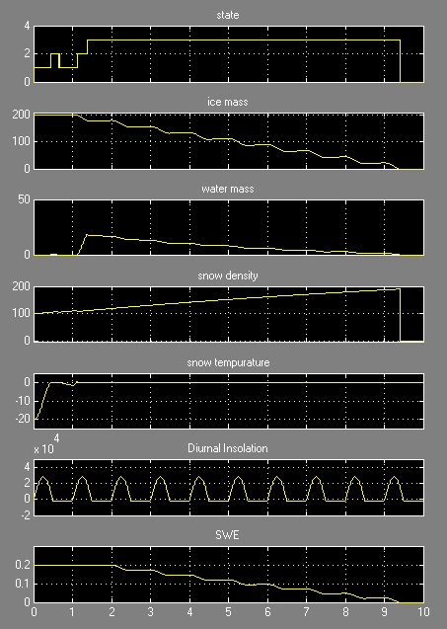
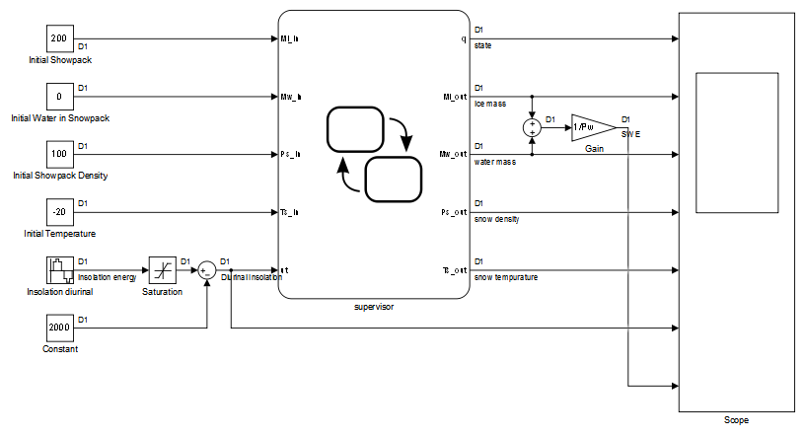
Main Model

Slide 10
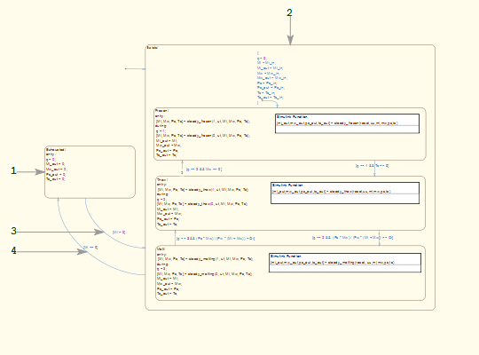
Discrete Model

Slide 11
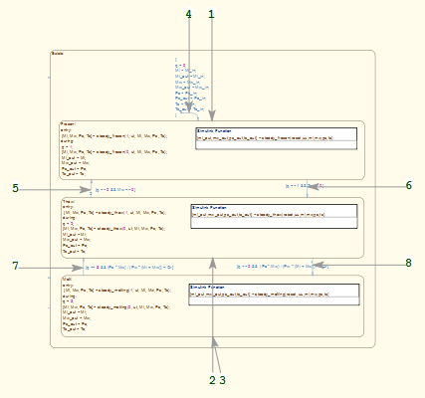
Discrete Model

Slide 12
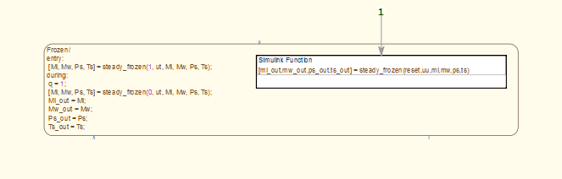
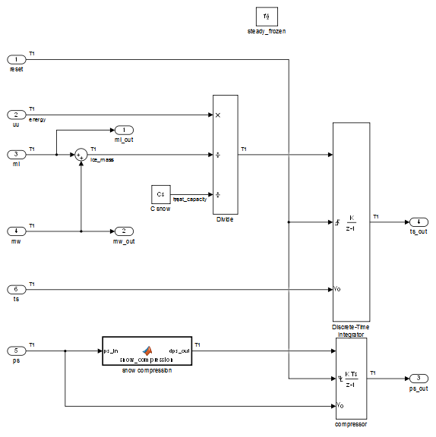
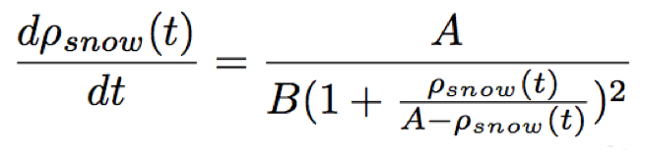
Dynamic Model / Frozen

Slide 13
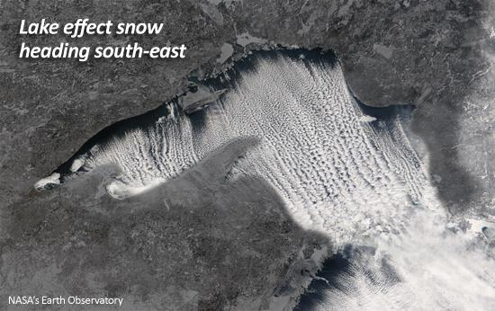
Questions

