Slide 1
Collaborative Network Mining
Discovering patterns in sequential event streams using distributed processing

Slide 2
Network Mining Components
Network Mining Process
  Event Stream
  Typed
  Timed
  Clean
  Episode Set
  Pattern
  Circuit
  Graph
Pre Processing
Data Warehousing
Data Collection
Soft Real Time Control
Post Processing
Visualization
Monitoring
Notes:
Why Prospecting and not Mining?
Mining is the extraction of specific resources from a place containing a deposit.
Prospecting is locating the place showing signs of containing a deposit.
Soft real time systems

Slide 3
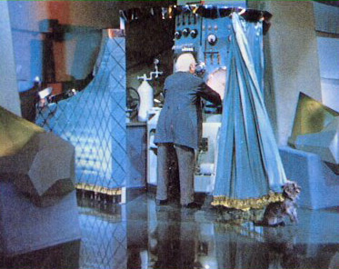
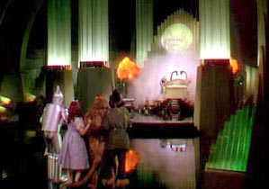
An Ancient Problem
To see reality when all we have is perception
This is prospecting
Notes:
This is prospecting to identify the actor (and by extension the directory, script writer, etc.) when all we have is the play.
A miner is interested in extracting a known resource from a known location is large quantities, cheaply.
A prospector is interested in surveying large tracts of land to identify the locations of known resources, cheaply.
Clearly prospecting will extract some quantity of a resource but that is not its primary goal
Whereas for Mining resource, episode instance, extraction is exactly the goal.
The algorithm used for mining needs to be through while
The algorithm used for prospecting must be efficient and capture episode parameters.

Slide 4
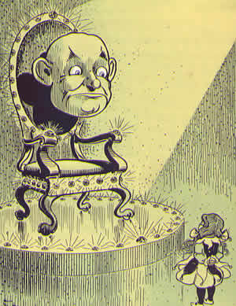
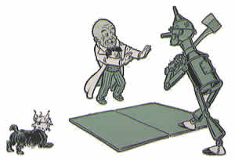
An Ancient Problem
To see reality when all we have is perception
“Perception is reality”?
Notes:
This is prospecting to identify the actor (and by extension the directory, script writer, etc.) when all we have is the play.
A miner is interested in extracting a known resource from a known location is large quantities, cheaply.
A prospector is interested in surveying large tracts of land to identify the locations of known resources, cheaply.
Clearly prospecting will extract some quantity of a resource but that is not its primary goal
Whereas for Mining resource, episode instance, extraction is exactly the goal.
The algorithm used for mining needs to be through while
The algorithm used for prospecting must be efficient and capture episode parameters.

Slide 5
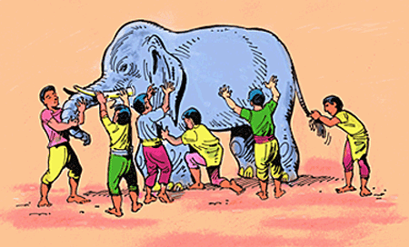
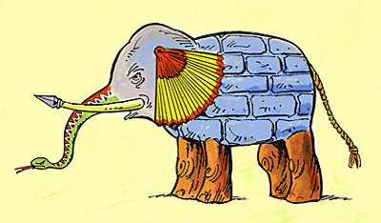
Perception v. Reality
Notes:
Blind Men and the Elephant (a.k.a., "Blindmen")
(by John Godfrey Saxe)
American poet John Godfrey Saxe (1816-1887) based this poem,
"The Blind Men and the Elephant", on a fable that was told in India many years ago.
It is a good warning about how our sensory perceptions can lead to misinterpretations.
It was six men of Indostan
To learning much inclined,
Who went to see the Elephant
(Though all of them were blind),
That each by observation
Might satisfy his mind
The First approached the Elephant,
And happening to fall
Against his broad and sturdy side,
At once began to bawl:
“God bless me! but the Elephant
Is very like a wall!”
The Second, feeling of the tusk,
Cried, “Ho! what have we here
So very round and smooth and sharp?
To me ’tis mighty clear
This wonder of an Elephant
Is very like a spear!”
The Third approached the animal,
And happening to take
The squirming trunk within his hands,
Thus boldly up and spake:
“I see,” quoth he, “the Elephant
Is very like a snake!”
The Fourth reached out an eager hand,
And felt about the knee.
“What most this wondrous beast is like
Is mighty plain,” quoth he;
“ ‘Tis clear enough the Elephant
Is very like a tree!”
The Fifth, who chanced to touch the ear,
Said: “E’en the blindest man
Can tell what this resembles most;
Deny the fact who can
This marvel of an Elephant
Is very like a fan!”
The Sixth no sooner had begun
About the beast to grope,
Than, seizing on the swinging tail
That fell within his scope,
“I see,” quoth he, “the Elephant
Is very like a rope!”
And so these men of Indostan
Disputed loud and long,
Each in his own opinion
Exceeding stiff and strong,
Though each was partly in the right,
And all were in the wrong!
Moral:
So oft in theologic wars,
The disputants, I ween,
Rail on in utter ignorance
Of what each other mean,
And prate about an Elephant
Not one of them has seen!

Slide 6
Network Mining Process
Event Stream
Event Types
Primer
Prospector
Pruner
Harvester
Episode Set
Candidate
Quantified
Validated
Nominator
Mutator
Trimmer
Notes:
(Green represents stateful objects)
(Blue represents functional objects)
Episode/Pattern/Circuit Set/Rule/Miner:
The information that describes the things being mined.
Prospector/Counter/Miner/Search:
Transverses an Event Stream, in order, looking for a set (possibly of size 1) of episode instances
It has a visitor object that identifies each object as they are found.
Typically, the Prospector will traverse the Event Stream one time. It need not start at the beginning and stop at the end, but this is typical.
Nominator/Candidate Generator/Miner:
Creates new episode candidates.
Typically from previously identified episodes.
A special type of nominator generates a starting set of candidates from the event types identified in the event stream.
It is probably a good idea for the episode to retain an association with those objects used in its nomination in particular its ancestor episodes.
In general the arrows/edges represent a producer/consumer relationship.
This is presently enforced via a single threaded loop starting with the X-Nominator and concluding when the Puner produces no additional validated episodes.
The Prospector may also be halted due to feedback from the counter indicating that it has enough information to permit the Pruner (or whatever) to perform its job.

Slide 7
Type Relationships
Event Stream
Visitor
Episode
Visitor
Prospector
Harvester
Nominator
Mutator
Primer
Notes:
The Episode Visitor can be further sub-typed into
Nominator which builds higher order (i.e. longer) candidates from episodes.
Mutator converts from one type of episode to another. Serial to branch or join.
Primer creates episodes from event types.

Slide 8

The Key to Graphs
T
E
A
B
The non-overlapping episode
Signature: (A [T:E] B)
Total Length: Lt
B
A
B
A
A
B
B
junk
junk
junk
junk
junk
Lt
T
Lt
Lt
T
T
Lt
T
Notes:
So, given that prospecting is about identifying reality from perceptions.
The key to effective prospecting is the key to reality.
What is a non-overlapping episode?
A graph is identified by its episodes.
Just as the Declaration of Independence may be recognized by a single signature
So to a graph may be characterized by its signatures.
A non-overlapping episode is defined by its signature
Event type names separated by intervals

Slide 9
Total Non-overlapped Length
Develop a no connection formulation
  Expected value (first moment)
  Variation (second moment)
Develop a connected formulation
  Expected value (first moment)
  Variation (second moment)
Notes:
The development of a episode motif.
First determine the formulation for the frequency of fake episodes.
This is necessary as it forms the basis for the formulation for true episodes.
Once the expected values are formulated the variation follows from the derivation of the second moment (as expected value is the first moment).

Slide 10
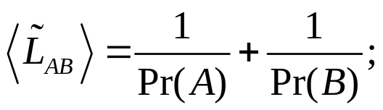
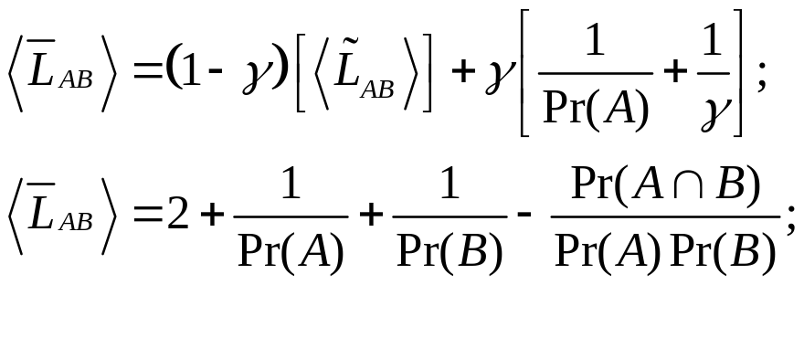
Chain Motif
If there is no connection between A and B
If there is a connection between A and B, expressed as a conditional probability. The probability that A causes B.
Notes:
The Apriori episode is of this type.
The amount of time between A and B is not constrained.
The chain episode is a special case of the chain interval episode where beta is 1 and T = 1/Pr(B).

Slide 11




Chained Interval Motif
The chained interval is an episode where there is an occurrence of A followed by an occurrence of B after an interval of time T.
If there is no connection between A and B.
How many times will A be repeated before a B appears in time T?
If there is a connection between A and B with a delay T.
Notes:
The chained interval motif is the general case of the chain motif.
In the independent case, the question is how many times must A fire before B fires at time Tab after A?
Of course, this presumes a certain range around Tab where an occurrence of B would be taken as occurring then.
Then lets take T0 as the start of Tab and T1 as the end.
Given that B is an independent process the Poisson assumption holds and the probability is the area under the exponential.
There are different definitions of an episode.
One definition allows for an episode A->B where only A fires. This formulation is not consistent with this definition.
Another definition asserts that in order for an A event to be part of an A->B episode instance B must fire.
I this formulation gamma is the probability that A causes B.

Slide 12
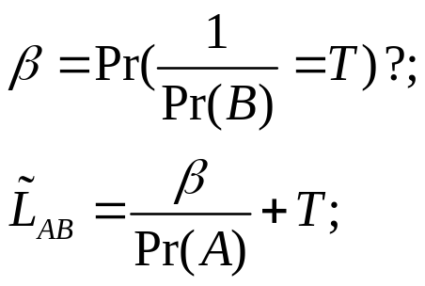
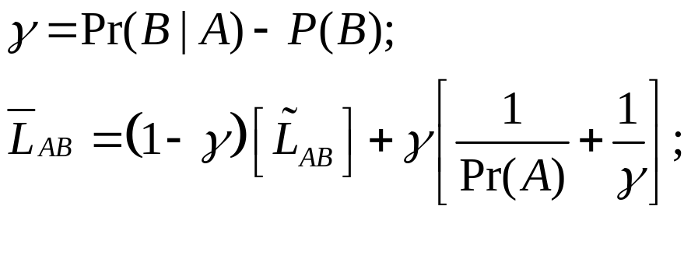
Branching Interval Motif
The branch interval is an episode where there is an occurrence of A followed by an occurrence of B and an occurrence of C after intervals of time Tb and Tc, respectively.
There is no connection between A and B.
How many times will A be repeated before a B appears in time T?
There is a connection between A and B, expressed as a conditional probability.
Notes:
The branching interval has a special type where the common node A is hidden.
This is not generally a problem as A is typically preceded by a node Z which can serve as A’s proxy.

Slide 13
Joining Interval Motif
The join interval is an episode where there is an occurrence of A and an occurrence of B both followed by the same occurrence of C after intervals of time Tac and Tbc, respectively.
There is no connection between A and B.
How many times will A be repeated before a B appears in time T?
There is a connection between A and B, expressed as a conditional probability.

Slide 14
Porting Components
Define episode set structure in candidate environment
Provide a typical episode prospector as prototypical C function
Provide a corresponding nominator as an environment native function
Provide a simple threshold pruner as an environment native function
Notes:
Essentially, three R functions, one being implemented as a wrapped C/C++ function.
The other two be R native functions.
One of the key deliverables would be a description of the episode qualifiers and an identification of the other related components.
This activity should take about two months.

Slide 15
Demonstration Problem
Specify the demonstration problem
Demonstrate the use of the components against the problem
Notes:
Validation criteria.
This should be worked out BEFORE any coding work is done.
This demonstration problem should not be something where the answer is unknown but rather a well studied problem that may benefit from even a bit more understanding.

Slide 16
Rationalization
Examine/evaluate current (sub) frameworks in the target environment as possible integration points.
Notes:
In particular arules and arulesSequence.

