Slide 1
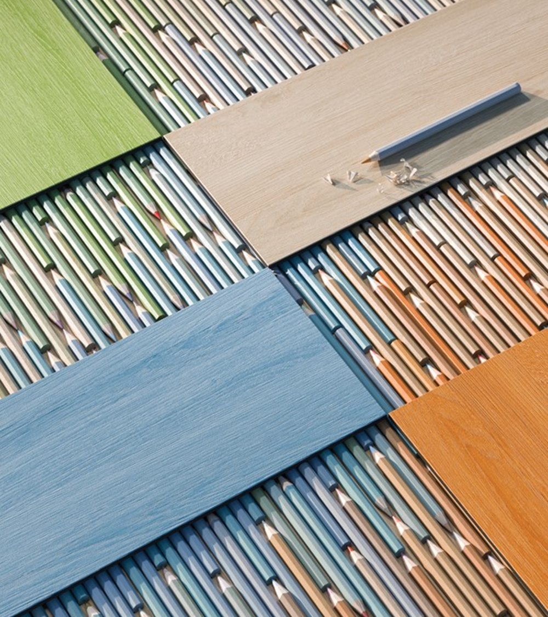

1
Going Beyond Carbon Neutral
01
Net-Positive Carbon:
03
No Ortho-Phthalates:
100% carbon neutral with an additional 5% offset.
Safer material choice
02
Low VOC Emissions:
04
UL Certified EPD:
Floorscore® certified for healthier indoor air quality
Third-party verified Environmental Product Declaration
Notes:
ε

