Slide 1
Taxonomic classification of representative sequences
Pengfan Zhang
SPP workshop
MPIPZ, Cologne
29/Oct/2019

Slide 2

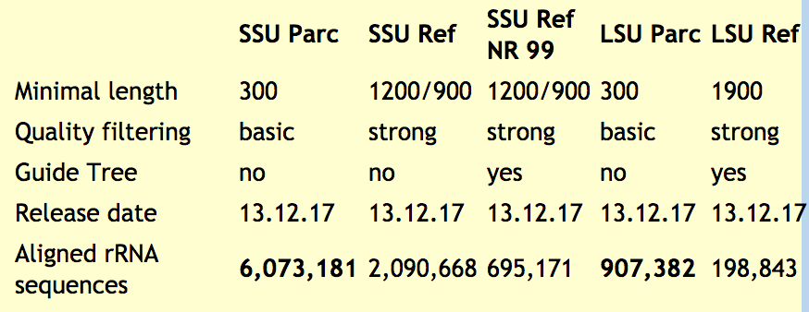


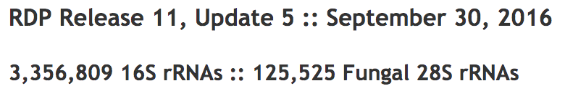
Databases

Slide 3
Software
Alignment:
Blast: Local alignment, followed by lowest common ancestor
Vsearch: Global alignment, followed by lowest common ancestor
Naive Bayesian:
RDP classifier: Kmer composition based
Commands:
qiime2-blast
qiime2-vsearch
qiime2-classify-sklearn

Slide 4
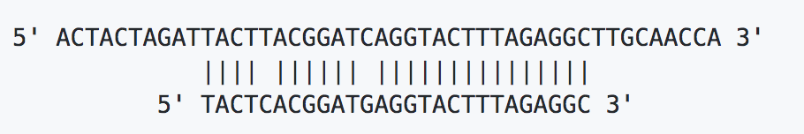
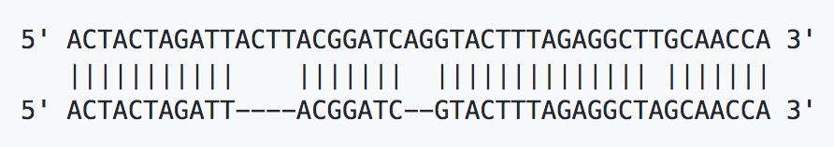

Slide 5
LCA algorithm
Query:
ATAGCG…..TGCA
Phylum | Class | Order | Family | Genus | Species
P1 | C1 | O1 | F1 | G1 | S1
P1 | C1 | O1 | F1 | G1 | S2
P1 | C1 | O1 | F1 | G1 | S3
P1 | C1 | O1 | F1 | G2 | S4
P1 | C1 | O1 | F1 | G3 | S5
100% | 100% | 100% | 100% | 60% | 20%
P1 | C1 | O1 | F1
P1 | C1 | O1 | F1 | G1
Ref 1: 100.0
Ref 2: 95.0
Ref 3: 95.0
Ref 4: 93.0
Ref 5: 90.0
100%
50%

Slide 6
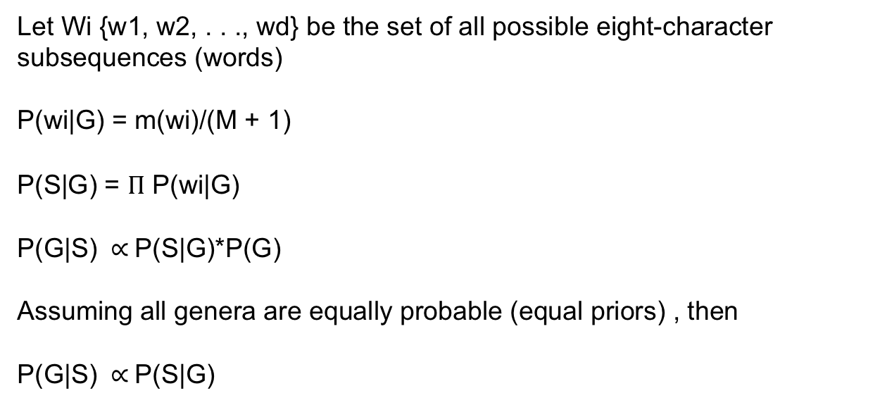
Naïve Bayesian approach
Let Wi {w1, w2, . . ., wd} be the set of all possible eight-character subsequences (words)
P(wi|G) = m(wi)/(M + 1)
P(S|G) = $Π$ P(wi|G)
P(G|S) $∝$P(S|G)*P(G)
Assuming all genera are equally probable (equal priors) , then
P(G|S) $∝$P(S|G)

Slide 7
Thanks!

