Slide 1
SE-GAN : Sentiment-Enhanced GAN for Stock Price Forecasting
A Comprehensive Analysis of Short-Term Prediction
Phrugsa Limbunlom 2311569
Master of Science in Artificial Intelligence and Its Application
School of Computer Science and Electronic Engineering
University of Essex

Slide 2
SE-GAN : Sentiment-Enhanced GAN for Stock Price Forecasting
AGENDA
Introduction
Methodology
Evaluation
Conclusion

Slide 3
SE-GAN : Sentiment-Enhanced GAN for Stock Price Forecasting
INTRODUCTION

Slide 4
Introduction
Problem Statement and Research Questions
The limitation of the data diversity can lead to an over-fitting problem that has a negative impact on the model prediction for the current stock price in the market. When trained on limited historical data, the model becomes too specific to the data, highlighting this problem. This is because the model fails to generalize to different patterns in unseen data.
Furthermore, the high volatility of stock prices makes it difficult for the model to provide precision due to the influence of numerous complex factors, unpredictable market sentiment, unexpected events, and economic changes.
Therefore, this study aims to address two primary research questions.
It seeks to determine whether utilizing closing prices generated by a Generative Adversarial Network (GAN) model can improve the overall accuracy of the model and mitigate the issue of overfitting.
The research investigates whether incorporating headline sentiment analysis of stock data can enhance the precision of short-term forecasts for future closing prices.
By exploring these questions, the study aims to contribute to the advancement of stock price prediction methodologies.

Slide 5
Introduction
Goal
The primary goal of this research is to implement a robust predictive model for stock price forecasting.
The model aims to adopt a Generative Adversarial Networks (GANs) architecture integrating sentiment analysis from financial headlines to predict Microsoft stock prices.

Slide 6
Introduction
Scope and Limitation
This study focuses on three key areas of its approach to stock price prediction.
The model developed will exclusively predict the daily closing price of Microsoft stocks (MSFT).
The predictions will be limited to daily intervals, rather than intraday or longer-term forecasts.
The model will utilize data from six major stock market indices as input for its predictions: S&P 500, Dow Jones, NASDAQ 100, Nikkei 225, FTSE 100, and DAX 30.
By concentrating on these specific parameters, the study aims to create a focused and targeted approach to predicting Microsoft’s stock performance within the context of global market trends

Slide 7
Introduction
Objectives
This study sets out to achieve four main objectives.
It aims to develop a Generative Adversarial Networks (GANs) model that incorporates sentiment analysis of financial headlines.
The research aims to predict Microsoft stock’s daily closing price using input data from previous dates.
The study will evaluate the closing price prediction results using input data from various sequential date ranges, including 7, 15, 30, and 60 days.
The research will assess and compare the impact on prediction results when integrating sentiment analysis for short-term forecasts.
Through these objectives, the study aims to enhance the accuracy and reliability of stock price prediction models.

Slide 8
SE-GAN : Sentiment-Enhanced GAN for Stock Price Forecasting
METHODOLOGY

Slide 9
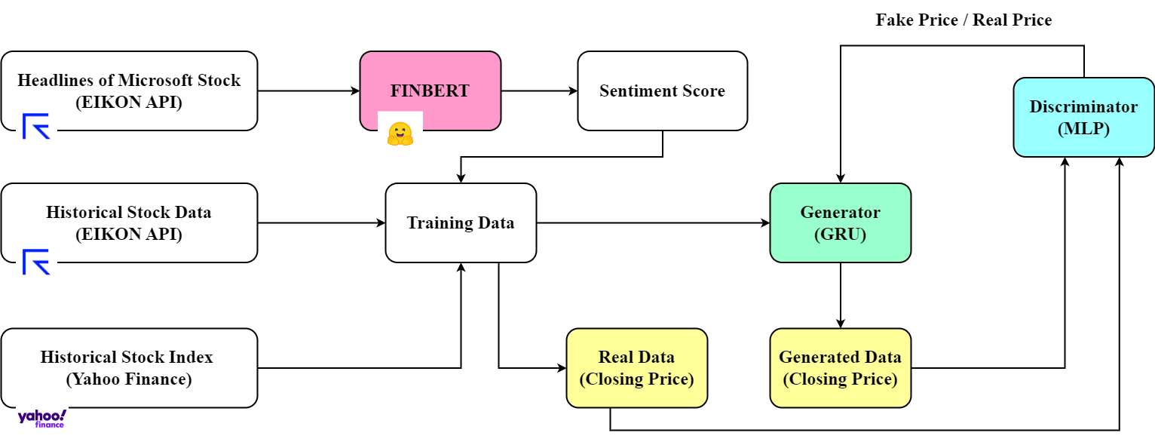
SE-GAN : Sentiment-Enhanced GAN for Stock Price Forecasting
The diagram illustrates model development process of SE-GAN

Slide 10
Methodology
Data Collection
The diagram illustrates model development process of SE-GAN

Slide 11
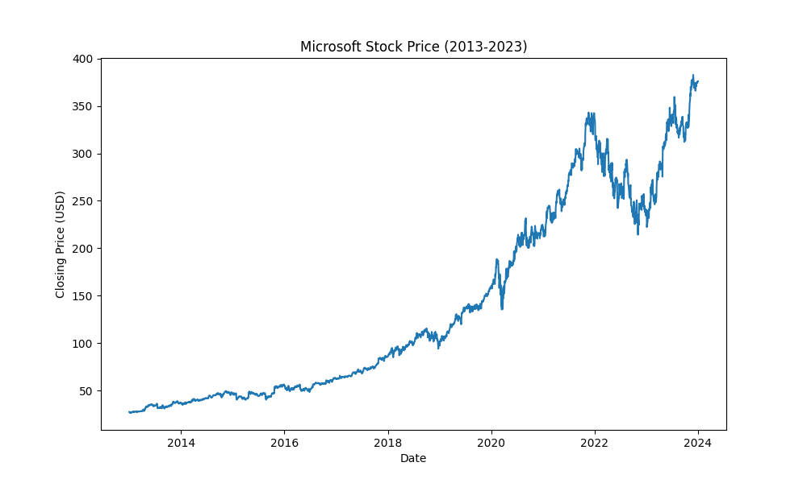
Methodology
Data Collection
Stock : Microsoft (MSFT)
Training set
Date range : 2013-01-01 to 2023-12-31
Historical stock data : 2768 records
Stock Indexes : 2861 records
Date range : 2023-03-29 to 2023-12-01
Headlines : 11012 records
Testing set
Date range : 2024-01-01 to 2024-05-31
Historical stock data : 105 records
Stock Indexes : 108 records
Date range : 2024-01-01 to 2024-05-31
Headlines : 5243 records
The movement of the Microsoft stock prices from 2013 to 2023

Slide 12
Methodology
Sentiment Analysis
The diagram illustrates model development process of SE-GAN

Slide 13
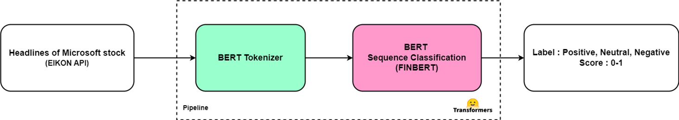
Methodology
Sentiment Analysis Using FINBERT (Cont.)
Training set
Date range : 2023-03-29 to 2023-12-01
Headlines : 11012 records
Testing set
Date range : 2024-01-01 to 2024-05-31
Headlines : 5243 records
Sentiment analysis pipeline of Microsoft stock headlines

Slide 14
Methodology
Sentiment Analysis Using FINBERT (Cont.)
Conversion of sentiment scores from minute-level to daily-level
To aggregate these sentiment scores from minute-level to daily-level, the following transformations were applied:
Positive Sentiment
The original score from the model output is retained.
Neutral Sentiment
The score is converted to zero.
Negative Sentiment
The score is converted to the negative of the original score from the model output.
After these transformations, the average score for each date was calculated to produce a daily sentiment indicator.

Slide 15
Methodology
Sentiment Analysis Using FINBERT (Cont.)
Example
Input Text | Output | After Transformation
CallMiner Collaborates with Microsoft to Enhance AI and Machine Learning Capabilities | label: Positive score: 0.9842389822006226 | score: 0.9842389822006226
5 things Microsoft co-founder Bill Gates wishes he knew in his early 20s | label: Neutral score: 0.9726649522781372 | score: -0.9726649522781372
MICROSOFT STATUS PAGE SHOWS TEAMS AND OUTLOOK.COM ARE HAVING PROBLEMS | label: Negative score: 0.9999890327453613 | score: 0

Slide 16
Methodology
Data Incorporation
The diagram illustrates model development process of SE-GAN

Slide 17
Methodology
Data Incorporation
Historical stock prices, daily sentiment scores, and index prices were combined based on their corresponding dates.
This combined dataset then underwent further pre-processing steps.
This aggregation method allows for a nuanced daily sentiment score that reflects both the direction and strength of the sentiment expressed in the news headlines throughout each day.

Slide 18
Methodology
Data Pre-processing
Checking null values
Addressing any missing dates
Time Interpolation
Data normalization
Min-max scaler : Feature range -1 to 1

Slide 19
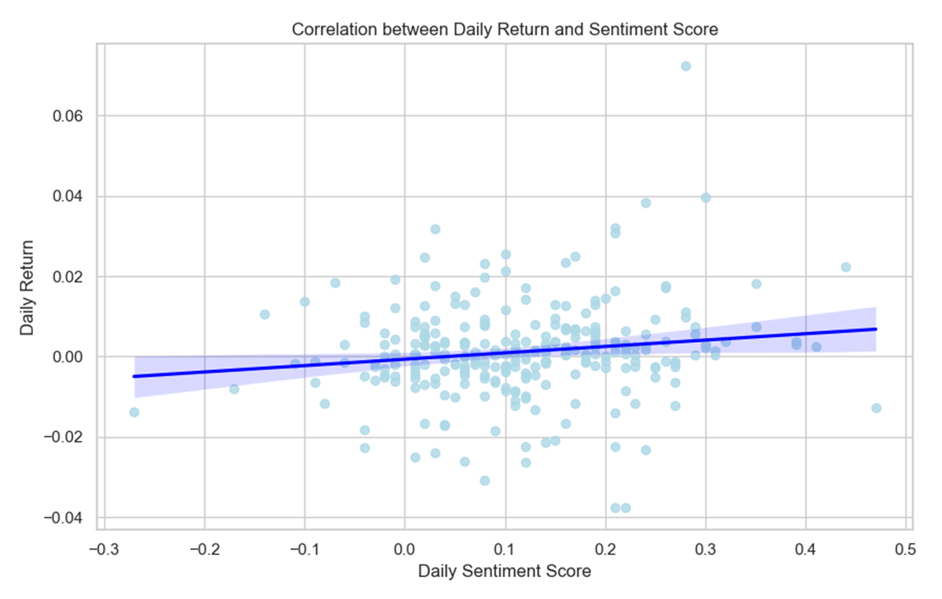
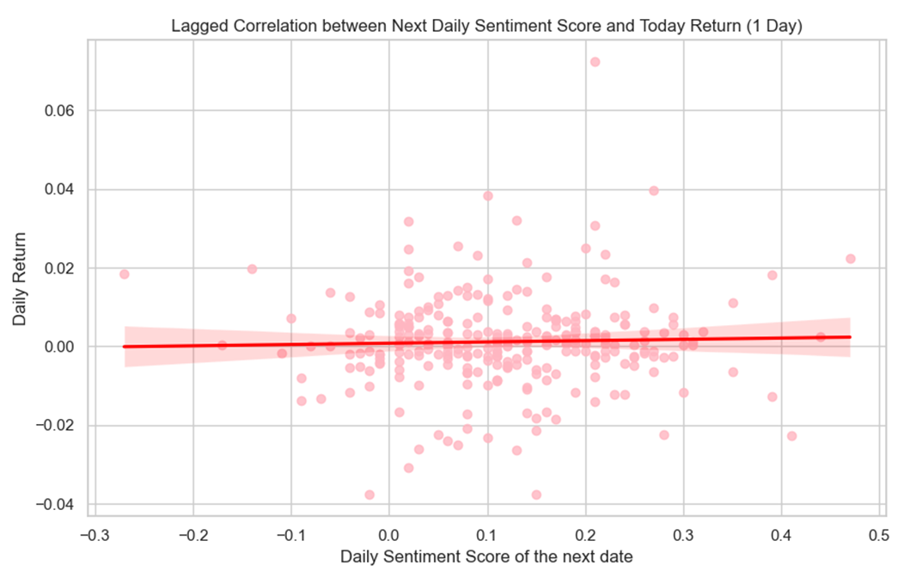
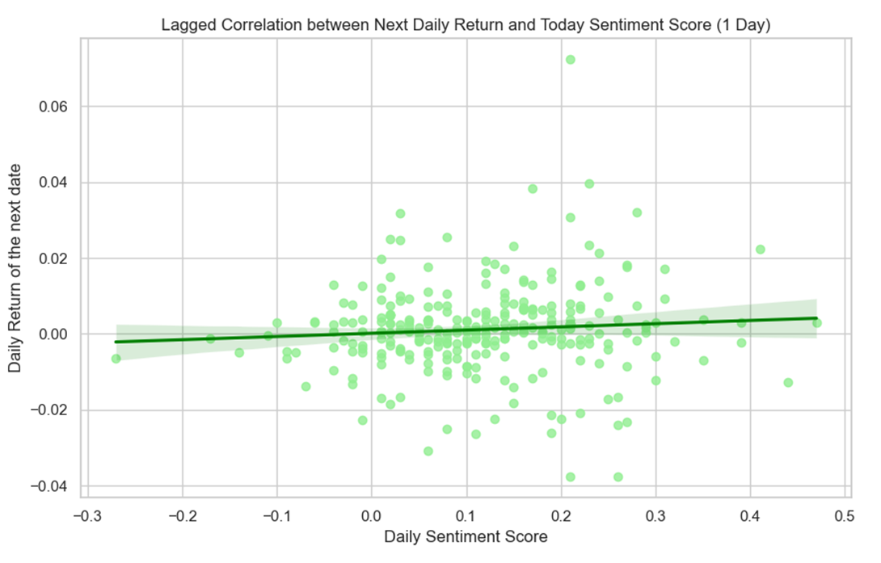
Methodology
Data Correlation
Correlation score : 0.147
Correlation score : 0.03
Correlation score : 0.078
The correlation between daily returns and sentiment scores
at the same date
The correlation between daily returns
and the sentiment scores of the next dates
The correlation between the current dates
of sentiment scores and the next dates of daily returns

Slide 20
Methodology
Final Dataset
Dataset | Records
Training set | 4017
Testing set | 152
The table represents the final dataset used to train and evaluate the models

Slide 21
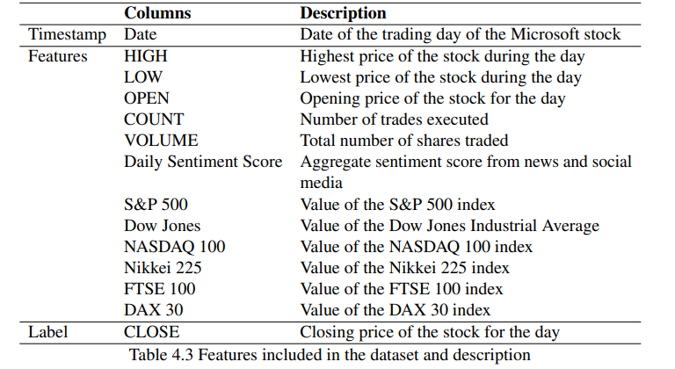
Methodology
Final Dataset (Cont.)
Input
Output

Slide 22
Methodology
Model Training
The diagram illustrates model development process of SE-GAN

Slide 23
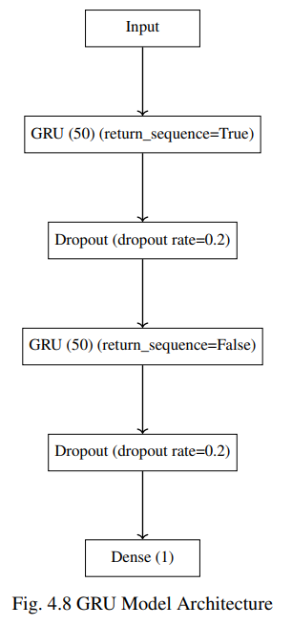
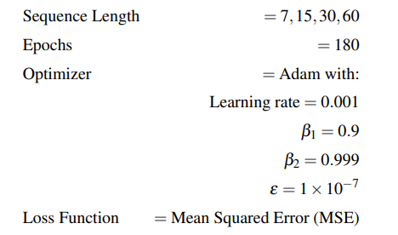


Methodology
Generator
Parameters
Generator Equation
Loss Function

Slide 24
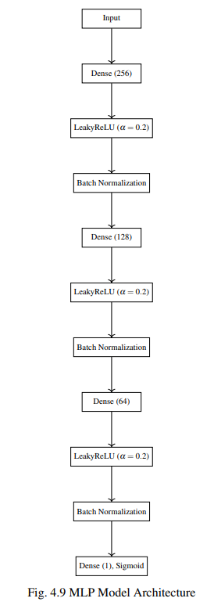
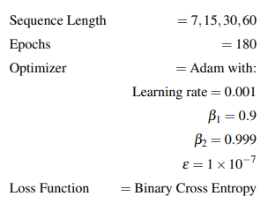

Methodology
Discriminator
Parameters
Discriminator Equation
Loss Function

Slide 25
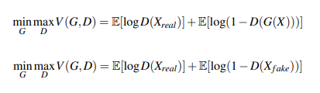
Methodology
GAN Optimization
Objective Function

Slide 26
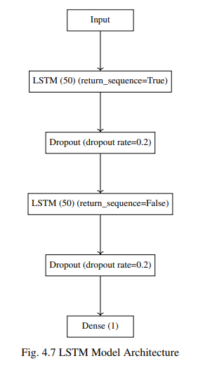
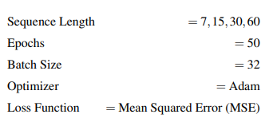
Methodology
Baseline Models
LSTM
GRU
Data Split
80% Training, 20 % Validation
Hyperparameters

Slide 27
Methodology
TimeGPT, a pre-trained model optimized for time-series data analysis, offers a robust framework for forecasting future price movements. This study employs the Nixtla library, specifically its forecast function, to generate closing prices based on historical data and exogenous variables.
TimeGPT
The primary input variables are:
• Temporal indicator: Date (timestamp)
• Target variable: CLOSE price
Exogenous variables incorporated in the model include:
• Price indicators: HIGH, LOW, OPEN
• Trading metrics: COUNT, VOLUME
• Market sentiment: Daily Sentiment Score
• Major market indices: S&P 500, Dow Jones, NASDAQ 100, Nikkei 225, FTSE 100, DAX 30
Parameters
Fine-tune steps: 10
Loss: MSE

Slide 28
SE-GAN : Sentiment-Enhanced GAN for Stock Price Forecasting
EVALUATION

Slide 29


Evaluation
Root Mean Squared Error (RMSE)
$$RMSE=\sqrt{\frac{1}{n}\sum_{i=1}^{n}{{(yi−y^i)}^{2}}}$$
Where:
$yi$ : The actual closing price and
$y^i$: The predicted closing price of the model
$n$ : The number of the dates of the closing prices observed

Slide 30
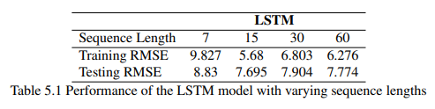
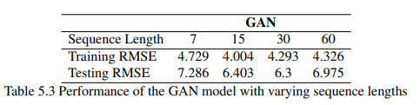
Evaluation
Comparative result of LSTM and GAN models

Slide 31
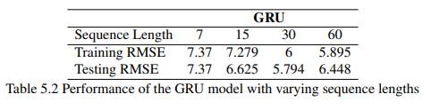
Evaluation
Comparative result of GRU and GAN models

Slide 32
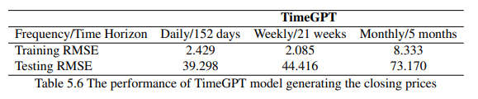
Evaluation
Comparative result of TimeGPT and GAN models

Slide 33
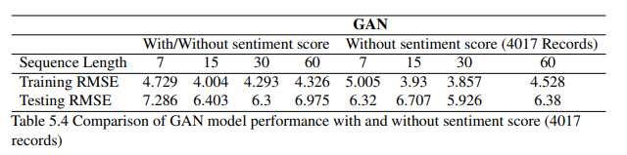
Evaluation
Comparative Dataset Evaluation of GAN model
The dataset includes dates both having sentiment score and without sentiment score and the dataset includes only dates without sentiment score. The dataset is equal as 4017 records for comparison.

Slide 34
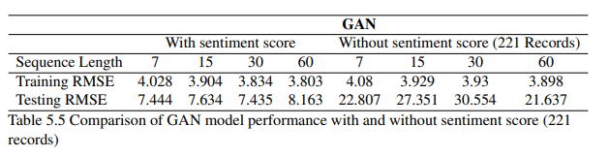
Evaluation
Comparative Dataset Evaluation of GAN model (Cont.)
The dataset includes dates having sentiment score only and the dataset includes only dates having no sentiment score. The dataset is equal as 221 records for comparison.

Slide 35
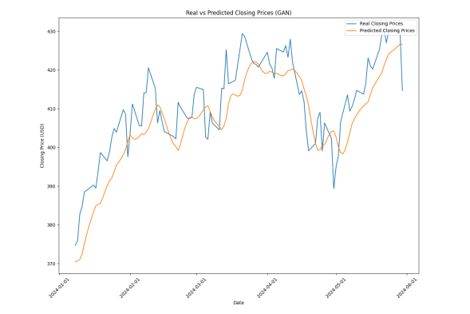
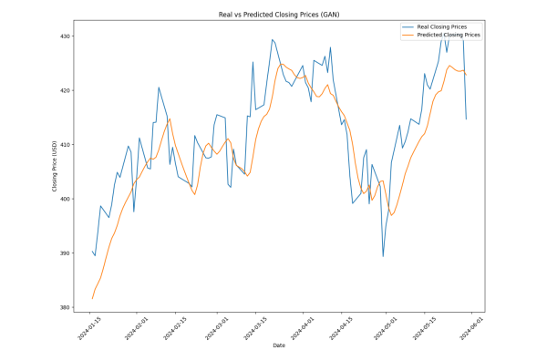
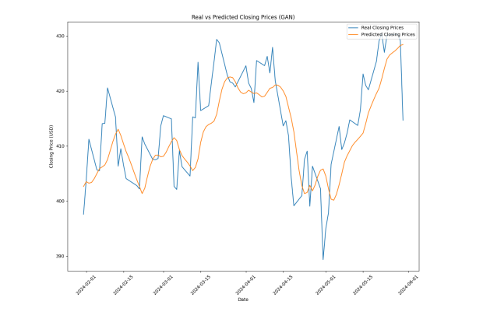
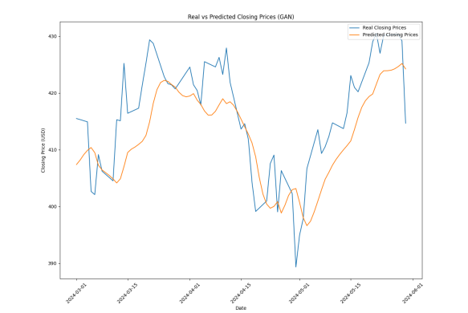
Evaluation
The closing price of real price and predicted price
from the GAN model for the sequence length of 7 days
The closing price of real price and predicted price
from the GAN model for the sequence length of 15 days
The closing price of real price and predicted price
from the GAN model for the sequence length of 30 days
The closing price of real price and predicted price
from the GAN model for the sequence length of 60 days

Slide 36
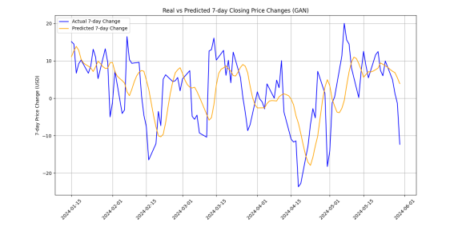
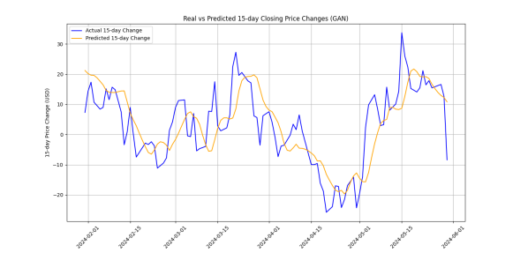
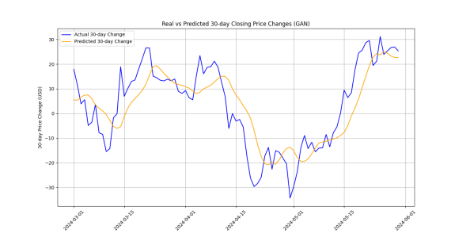
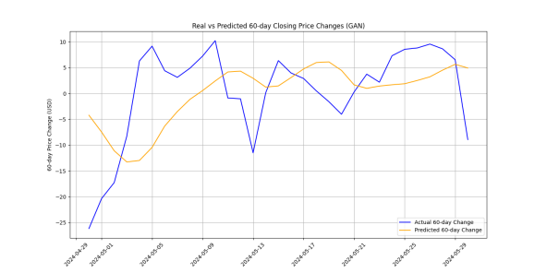
Evaluation
The change of the real closing prices and the forecasted closing prices from the GAN model for the sequence length of 7 days
The change of the real closing prices and the forecasted closing prices from the GAN model for the sequence length of 15 days
The change of the real closing prices and the forecasted closing prices from the GAN model for the sequence length of 30 days
The change of the real closing prices and the forecasted closing prices from the GAN model for the sequence length of 60 days

Slide 37
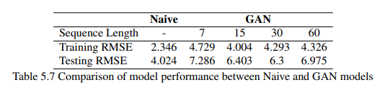
Evaluation
The GAN model has been compared to the baseline of the "predict same price as yesterday" model.
The baseline was created from the naive calculation between distance of current price and the price of yesterday

Slide 38
Evaluation
Accuracy
$$Accuracy (\%)= \frac{Number of Correct Predictions}{Total Number of Predictions}×100$$

Slide 39
Evaluation
The change of the real closing prices and the forecasted closing prices from the GAN model for the sequence length of 7 days
The change of the real closing prices and the forecasted closing prices from the GAN model for the sequence length of 15 days
The change of the real closing prices and the forecasted closing prices from the GAN model for the sequence length of 30 days
The change of the real closing prices and the forecasted closing prices from the GAN model for the sequence length of 60 days

Slide 40
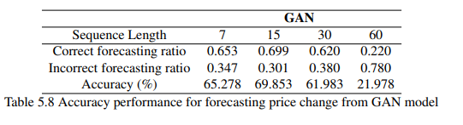
Evaluation
Effectiveness of the GAN model for forecasting the change of the prices was evaluated by accuracy metric, which provides a distinct measure of proficiency of the model to anticipate directional movement of stock prices, offering insights of its potential utility in trading decisions considering future trends of predicted prices.

Slide 41

Evaluation
Sharpe Ratio
$$S= \frac{R_{p}−R_{f}}{σ_{p}}$$
Where:
$R_{p}$ : The portfolio return
$R_{f}$: The risk-free rate
$σ_{p}$ : The portfolio standard deviation

Slide 42
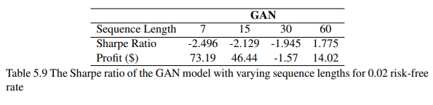
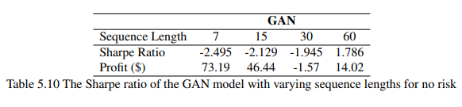
Evaluation
To analyze the Sharpe Ratio score, a trading strategy was created.
The strategy is that the system will purchase stock when the forecasted price change over specified periods (7, 15, 30, and 60 days) is positive and sell or maintain zero holdings otherwise.
To be more precise, if the current date is 20/8/2024, the current price is 400$, and the day of price change is set to 7 days, the system will validate whether the future price forecasted by the model for the next date, 27/8/2024, is greater than 400$ (positive price change). If there is a positive price change, the system will buy the stock at the price of that day (27/8/2024).
The trading days are 252 days and the risk-free rate is 2% and no risk (0%).

Slide 43
SE-GAN : Sentiment-Enhanced GAN for Stock Price Forecasting
CONCLUSION

Slide 44
Conclusion
Conclusion
Sentiment-enhanced GAN (SE-GAN) model demonstrates the significant promise, especially for short-term price forecasting using historical data spanning from 7 days to 15 days. However, an effective trading strategy necessarily requires long-term sequence for the change of the prices, such as 60-day period. This is because the model still requires involvement of the balanced approach to deploy model in real-world trading systems.
Due to this, the model has to leverage both predictive capabilities and human judgment for the optimization of risk-adjusted returns as well as to ensure the robustness of the overall trading strategy.
While output of the model and the proposed trading strategy providing valuable guidance, the judgment of human input is still unavoidable. The synergy between both of them can foster the optimization of the outcome from actual investment setting. For this reason, this collaboration between model forecasting and human insight is crucial for effective real-world application.

Slide 45
Conclusion
Further Research
Further research direction aims to expand and refine capability of the SE-GAN model.
Predict stock prices across various time horizons, from on daily basis to forecasting prices on weekly, monthly, and yearly basis.
Apply a wide range of stock dataset to assess versatility and robustness of the model.
Advanced techniques for hyper-parameter tuning will be explored : Bayesian optimization, genetic algorithms, or neural architecture search.
A new transformer model will be built using the existing dataset without relying on pre-trained weights from the pre-trained model like TimeGPT.

Slide 46
SE-GAN : Sentiment-Enhanced GAN for Stock Price Forecasting
THANK YOU

