Slide 1

BLACK-SCHOLES MODEL
How we interpret and deploy black-scholes model for CW Valuation and risk hedging

Slide 2

DERIVATION OF BLACK-SCHOLES

Slide 3
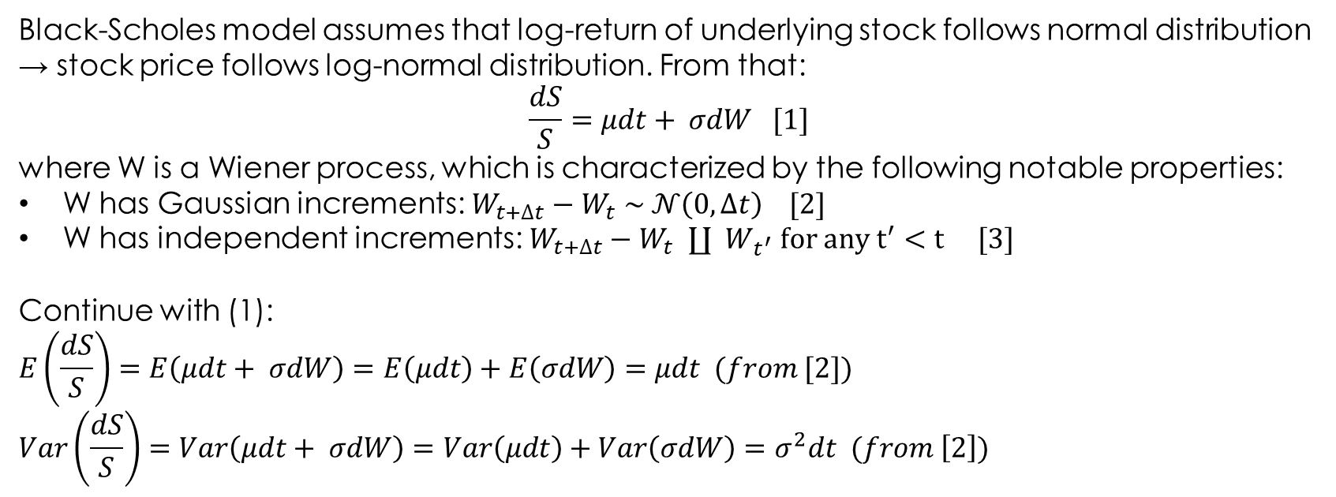
derivation
Black-Scholes model assumes that log-return of underlying stock follows normal distribution → stock price follows log-normal distribution. From that:
$$\frac{dS}{S}=μdt+ σdW [1]$$
where W is a Wiener process, which is characterized by the following notable properties:
W has Gaussian increments: $W_{t+∆t}−W_{t} \sim 𝒩\left(0,∆t\right) [2]$
W has independent increments: $W_{t+∆t}−W_{t} ∐{ W}_{t^{′}} for any t^{′}<t [3]$
Continue with (1):
$$E\left(\frac{dS}{S}\right)=E\left(μdt+ σdW\right)=E\left(μdt\right)+E\left(σdW\right)=μdt (from [2])$$
$$Var\left(\frac{dS}{S}\right)=Var\left(μdt+ σdW\right)=Var\left(μdt\right)+Var\left(σdW\right)=σ^{2}dt (from \left[2\right])$$

Slide 4
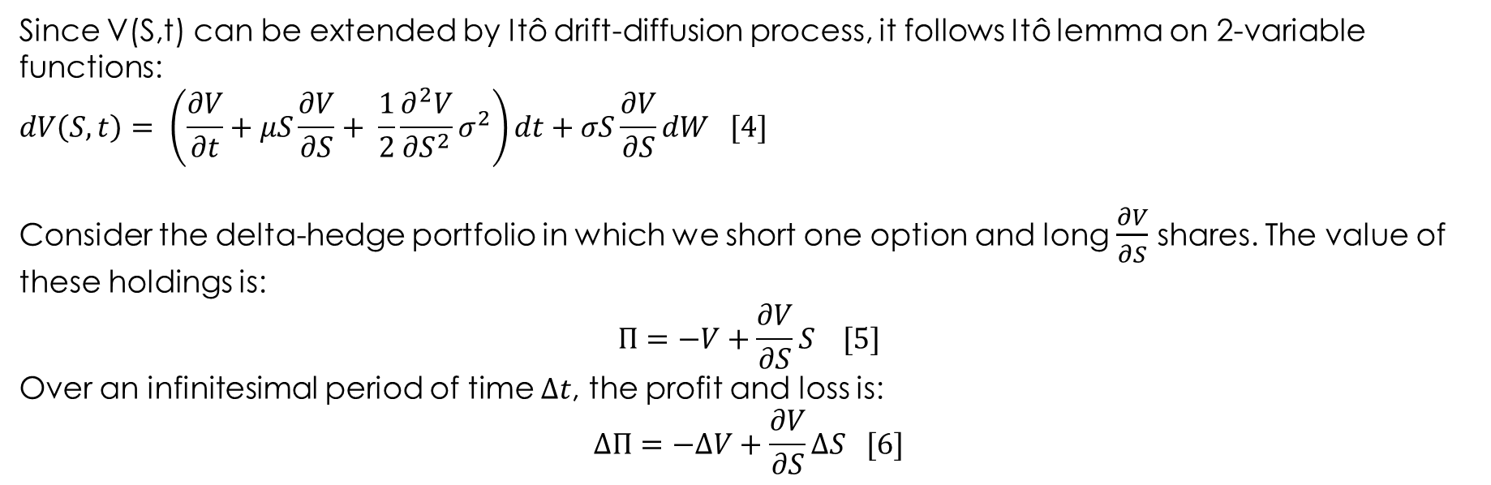
derivation
Since V(S,t) can be extended by Itô drift-diffusion process, it follows Itô lemma on 2-variable functions:
$$dV\left(S,t\right)= \left(\frac{∂V}{∂t}+μS\frac{∂V}{∂S}+ \frac{1}{2}\frac{∂^{2}V}{∂S^{2}}σ^{2}\right)dt+σS\frac{∂V}{∂S}dW [4]$$
Consider the delta-hedge portfolio in which we short one option and long $\frac{∂V}{∂S}$ shares. The value of these holdings is:
$$Π=−V+\frac{∂V}{∂S}S [5]$$
Over an infinitesimal period of time $∆t$, the profit and loss is:
$$∆Π=−∆V+\frac{∂V}{∂S}∆S [6]$$

Slide 5
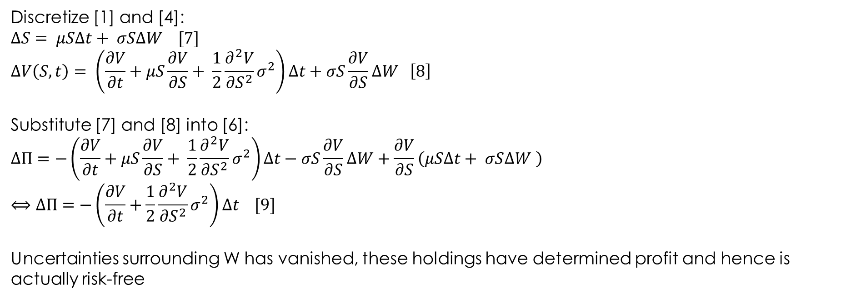
derivation
Discretize [1] and [4]:
$$∆S= μS∆t+ σS∆W [7]$$
$$∆V\left(S,t\right)= \left(\frac{∂V}{∂t}+μS\frac{∂V}{∂S}+ \frac{1}{2}\frac{∂^{2}V}{∂S^{2}}σ^{2}\right)∆t+σS\frac{∂V}{∂S}∆W \left[8\right]$$
Substitute [7] and [8] into [6]:
$$∆Π=−\left(\frac{∂V}{∂t}+μS\frac{∂V}{∂S}+ \frac{1}{2}\frac{∂^{2}V}{∂S^{2}}σ^{2}\right)∆t−σS\frac{∂V}{∂S}∆W+\frac{∂V}{∂S}\left(μS∆t+ σS∆W \right)$$
$$⟺∆Π=−\left(\frac{∂V}{∂t}+\frac{1}{2}\frac{∂^{2}V}{∂S^{2}}σ^{2}\right)∆t [9]$$
Uncertainties surrounding W has vanished, these holdings have determined profit and hence is actually risk-free

Slide 6
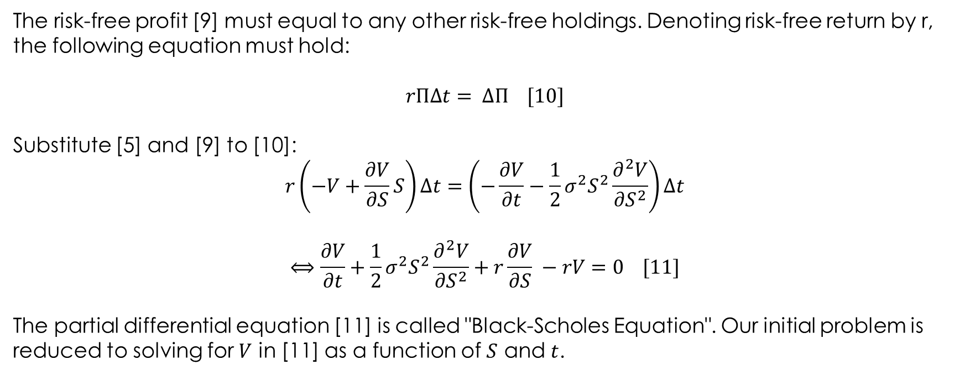
derivation
The risk-free profit [9] must equal to any other risk-free holdings. Denoting risk-free return by r, the following equation must hold:
$rΠΔt= ΔΠ [10]$
Substitute [5] and [9] to [10]:
$$r\left(−V+\frac{∂V}{∂S}S\right)∆t=\left(−\frac{∂V}{∂t}−\frac{1}{2}σ^{2}S^{2}\frac{∂^{2}V}{∂S^{2}}\right)∆t$$
$$⟺\frac{∂V}{∂t}+\frac{1}{2}σ^{2}S^{2}\frac{∂^{2}V}{∂S^{2}}+r\frac{∂V}{∂S} −rV=0 [11]$$
The partial differential equation [11] is called "Black-Scholes Equation". Our initial problem is reduced to solving for $V$ in [11] as a function of $S$ and $t$.

Slide 7
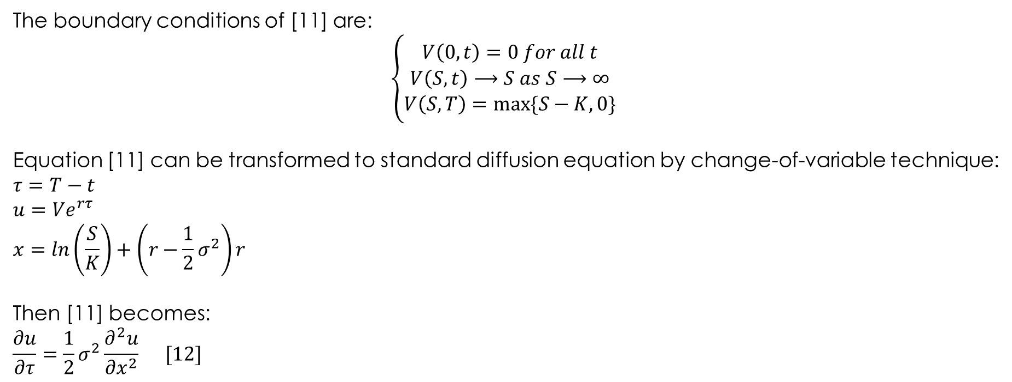
derivation
The boundary conditions of [11] are:
$$\left\{\begin{matrix}V\left(0,t\right)=0 for all t \\ V\left(S,t\right)⟶S as S⟶∞ \\ V\left(S,T\right)=max⁡\{S−K,0\} \end{matrix}\right.$$
Equation [11] can be transformed to standard diffusion equation by change-of-variable technique:
$$τ=T−t$$
$$u=Ve^{rτ}$$
$$x=ln\left(\frac{S}{K}\right)+\left(r−\frac{1}{2}σ^{2}\right)r$$
Then [11] becomes:
$$\frac{∂u}{∂τ}=\frac{1}{2}σ^{2}\frac{∂^{2}u}{{∂x}^{2}} [12]$$

Slide 8
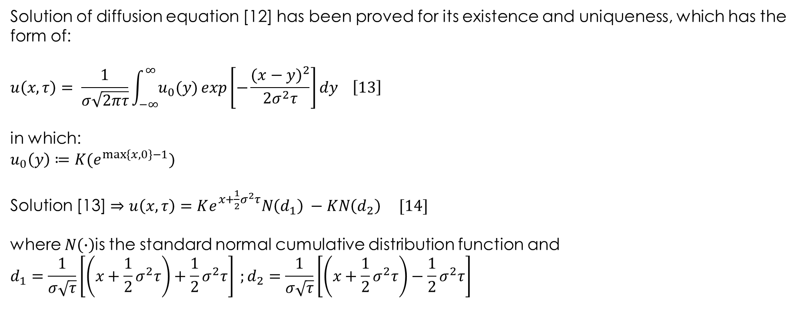
derivation
Solution of diffusion equation [12] has been proved for its existence and uniqueness, which has the form of:
$$u\left(x,τ\right)= \frac{1}{σ\sqrt{2πτ}}\int_{−∞}^{∞}{u_{0}(y)}exp\left[−\frac{{(x−y)}^{2}}{2σ^{2}τ}\right]dy \left[13\right]$$
in which:
$$u_{0}\left(y\right)≔K(e^{\max\left\{x,0\right\}−1})$$
Solution [13]$⇒u\left(x,τ\right)=Ke^{x+\frac{1}{2}σ^{2}τ}N\left(d_{1}\right) −KN\left(d_{2}\right) [14]$
where $N\left(∙\right)$is the standard normal cumulative distribution function and
$$d_{1}=\frac{1}{σ\sqrt{τ}}\left[\left(x+\frac{1}{2}σ^{2}τ\right)+\frac{1}{2}σ^{2}τ\right] ;d_{2}=\frac{1}{σ\sqrt{τ}}\left[\left(x+\frac{1}{2}σ^{2}τ\right)−\frac{1}{2}σ^{2}τ\right]$$

Slide 9
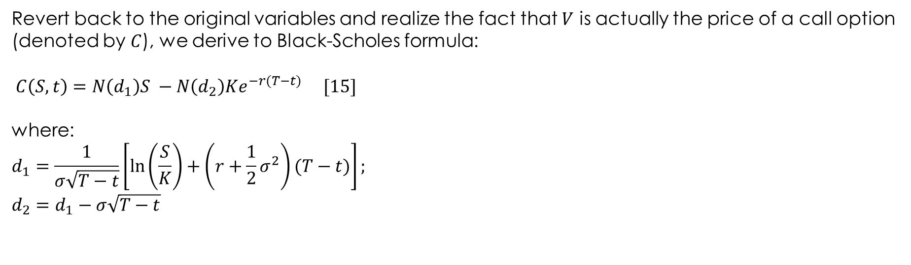
derivation
Revert back to the original variables and realize the fact that $V$ is actually the price of a call option (denoted by $C$), we derive to Black-Scholes formula:
$$C\left(S,t\right)=N\left(d_{1}\right)S −N\left(d_{2}\right)Ke^{−r(T−t)} [15]$$
where:
$$d_{1}=\frac{1}{σ\sqrt{T−t}}\left[\ln\left(\frac{S}{K}\right)+\left(r+\frac{1}{2}σ^{2}\right)(T−t)\right];$$
$$d_{2}=d_{1}−σ\sqrt{T−t}$$

Slide 10
DELTA-GAMMA HEDGING

Slide 11
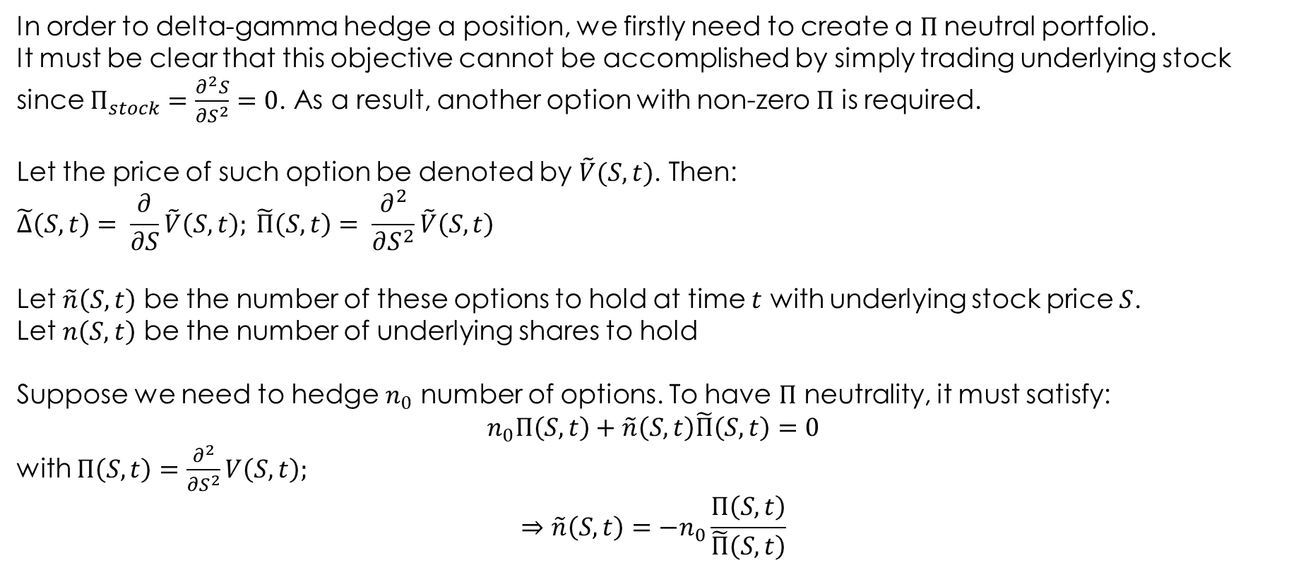
Delta-Gamma Hedging
In order to delta-gamma hedge a position, we firstly need to create a $Π$neutral portfolio.
It must be clear that this objective cannot be accomplished by simply trading underlying stock since $Π_{stock}=\frac{∂^{2}S}{∂S^{2}}=0$. As a result, another option with non-zero $Π$ is required.
Let the price of such option be denoted by $\tilde{V}(S,t)$. Then:
$$\tilde{∆}\left(S,t\right)= \frac{∂}{∂S}\tilde{V}\left(S,t\right); \tilde{Π}\left(S,t\right)= \frac{∂^{2}}{∂S^{2}}\tilde{V}\left(S,t\right)$$
Let $\tilde{n}\left(S,t\right)$ be the number of these options to hold at time $t$ with underlying stock price $S$.
Let $n\left(S,t\right)$ be the number of underlying shares to hold
Suppose we need to hedge $n_{0}$ number of options. To have $Π$ neutrality, it must satisfy:
$$n_{0}Π\left(S,t\right)+\tilde{n}\left(S,t\right)\tilde{Π}\left(S,t\right)=0$$
with $Π\left(S,t\right)=\frac{∂^{2}}{∂S^{2}}V\left(S,t\right);$
$$⇒\tilde{n}\left(S,t\right)=−n_{0}\frac{Π\left(S,t\right)}{\tilde{Π}\left(S,t\right)}$$

Slide 12
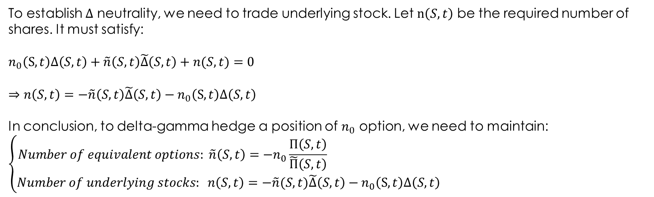
Delta-Gamma Hedging
To establish $∆$ neutrality, we need to trade underlying stock. Let $n\left(S,t\right)$ be the required number of shares. It must satisfy:
$$n_{0}\left(S,t\right)∆\left(S,t\right)+\tilde{n}\left(S,t\right)\tilde{∆}\left(S,t\right)+n(S,t)=0$$
$$⇒n\left(S,t\right)=−\tilde{n}\left(S,t\right)\tilde{∆}\left(S,t\right)−n_{0}\left(S,t\right)∆\left(S,t\right)$$
In conclusion, to delta-gamma hedge a position of $n_{0}$ option, we need to maintain:
$$\left\{\begin{matrix}Number of equivalent options: \tilde{n}\left(S,t\right)=−n_{0}\frac{Π\left(S,t\right)}{\tilde{Π}\left(S,t\right)} \\ Number of underlying stocks: n\left(S,t\right)=−\tilde{n}(S,t)\tilde{∆}\left(S,t\right)−n_{0}\left(S,t\right)∆\left(S,t\right)\end{matrix}\right.$$

Slide 13
Example
For two Covered Warrants (or European call options), CW-I and CW-II, on FPT. Our calculation provides:
 | CW-I | CW-II
Delta | 0.5825 | 0.7773
Gamma | 0.0651 | 0.0746
Suppose Phu Hung Securities sold 100 units of CW-I
Determine the numbers of CW-II and FPT Phu Hung must buy or sell in order to both delta-hedge and gamma-hedge the position in CW-I.

Slide 14
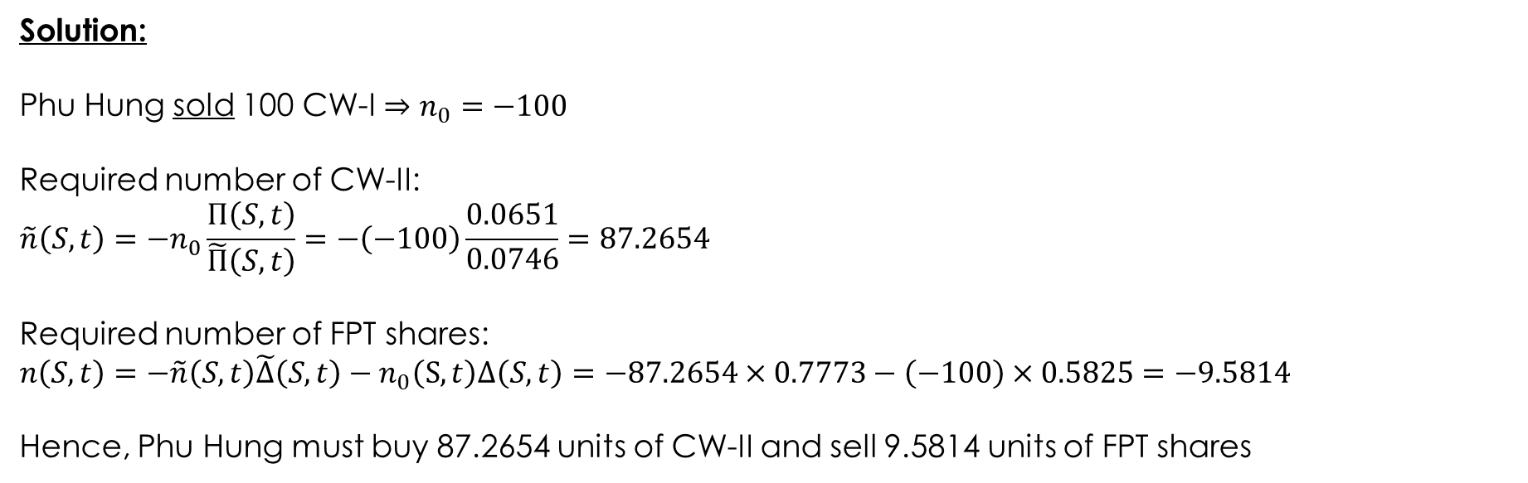
Example
Solution:
Phu Hung sold 100 CW-I $⇒n_{0}=−100$
Required number of CW-II:
$$\tilde{n}\left(S,t\right)=−n_{0}\frac{Π\left(S,t\right)}{\tilde{Π}\left(S,t\right)}=−\left(−100\right)\frac{0.0651}{0.0746}=87.2654$$
Required number of FPT shares:
$$n\left(S,t\right)=−\tilde{n}\left(S,t\right)\tilde{∆}\left(S,t\right)−n_{0}\left(S,t\right)∆\left(S,t\right)=−87.2654×0.7773−\left(−100\right)×0.5825=−9.5814$$
Hence, Phu Hung must buy 87.2654 units of CW-II and sell 9.5814 units of FPT shares

Slide 15
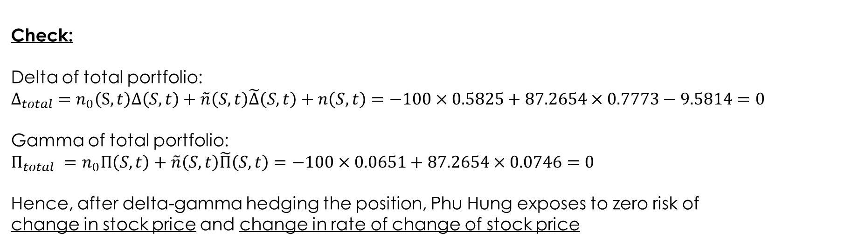
Example
Check:
Delta of total portfolio:
$$∆_{total} =n_{0}\left(S,t\right)∆\left(S,t\right)+\tilde{n}\left(S,t\right)\tilde{∆}\left(S,t\right)+n\left(S,t\right)=−100×0.5825+87.2654×0.7773−9.5814=0$$
Gamma of total portfolio:
$Π_{total} =n_{0}Π\left(S,t\right)+\tilde{n}\left(S,t\right)\tilde{Π}\left(S,t\right)=−100×0.0651+87.2654×0.0746=0$
Hence, after delta-gamma hedging the position, Phu Hung exposes to zero risk of
change in stock price and change in rate of change of stock price

Slide 16
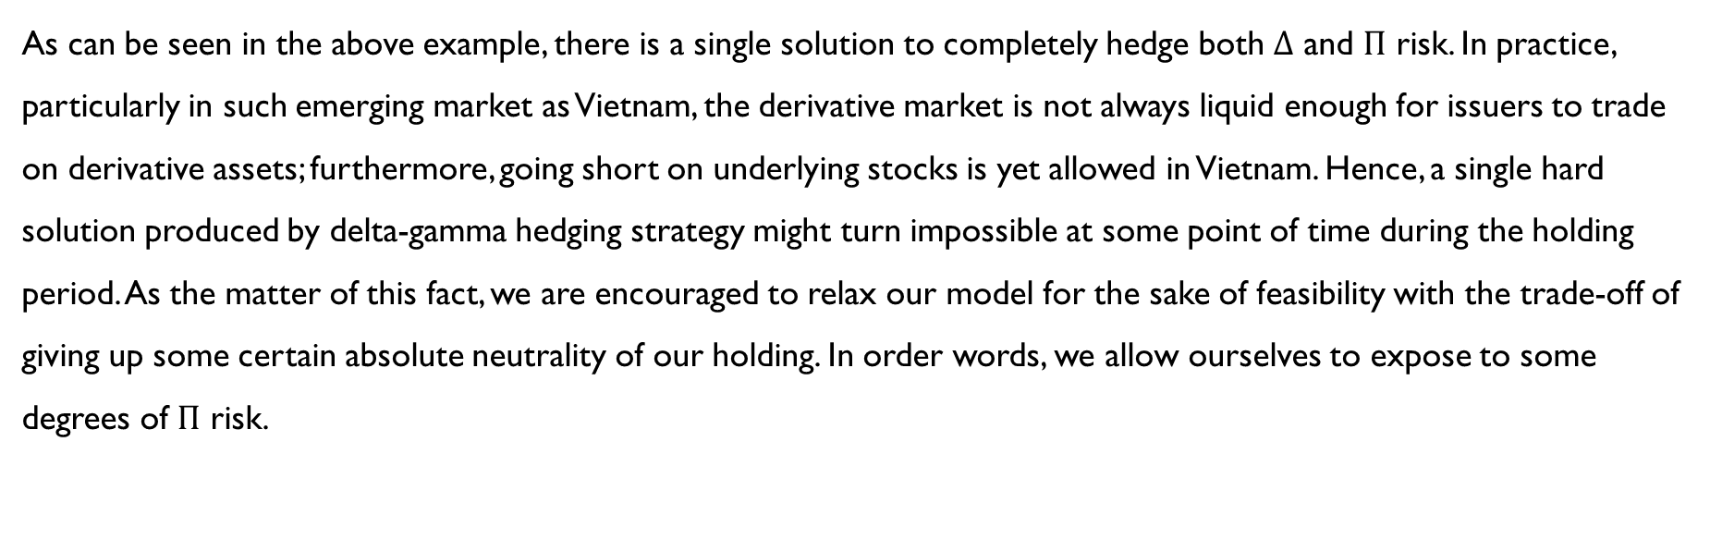
Delta-Gamma Hedging
As can be seen in the above example, there is a single solution to completely hedge both $∆$ and $Π$ risk. In practice, particularly in such emerging market as Vietnam, the derivative market is not always liquid enough for issuers to trade on derivative assets; furthermore, going short on underlying stocks is yet allowed in Vietnam. Hence, a single hard solution produced by delta-gamma hedging strategy might turn impossible at some point of time during the holding period. As the matter of this fact, we are encouraged to relax our model for the sake of feasibility with the trade-off of giving up some certain absolute neutrality of our holding. In order words, we allow ourselves to expose to some degrees of $Π$ risk.

Slide 17
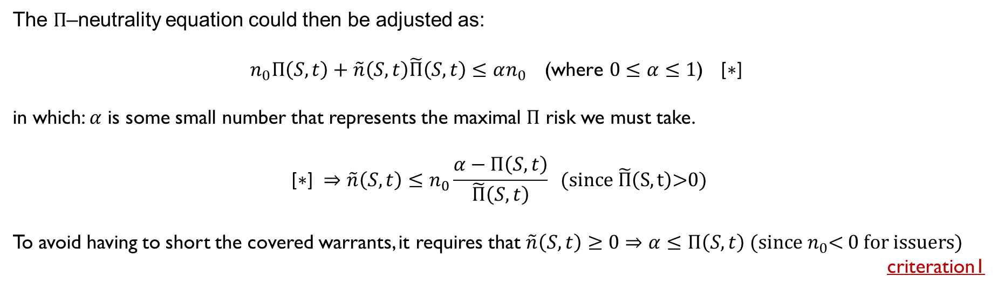
Delta-Gamma Hedging
The $Π$–neutrality equation could then be adjusted as:
$n_{0}Π\left(S,t\right)+\tilde{n}\left(S,t\right)\tilde{Π}\left(S,t\right)≤αn_{0} \text{(}\text{where} 0≤α≤\text{1}\text{)}$ $\text{[∗] }$
in which: $α$ is some small number that represents the maximal $Π$ risk we must take.
$$\text{[∗]} ⇒\tilde{n}\left(S,t\right)≤n_{0}\frac{α−Π\left(S,t\right)}{\tilde{Π}\left(S,t\right)} \text{(}\text{since} \tilde{Π}\left(S,t\right)\text{>0)}$$
To avoid having to short the covered warrants, it requires that $\tilde{n}\left(S,t\right)≥\text{0}⇒α≤Π\left(S,t\right)\text{ (}\text{since} n_{0}\text{<}\text{ 0} \text{for} \text{issuers}\text{)}$
criteration1

Slide 18
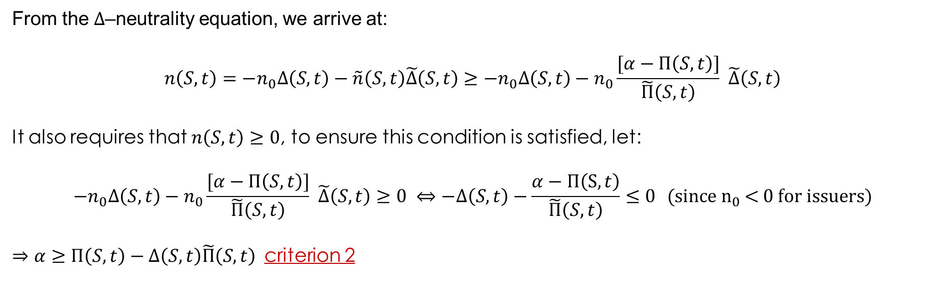
Delta-Gamma Hedging
From the $∆$–neutrality equation, we arrive at:
$$n\left(S,t\right)={−n}_{0}∆\left(S,t\right)−\tilde{n}\left(S,t\right)\tilde{∆}\left(S,t\right)≥{−n}_{0}∆\left(S,t\right)−n_{0}\frac{[α−Π\left(S,t\right)]}{\tilde{Π}\left(S,t\right)} \tilde{∆}\left(S,t\right)$$
It also requires that $n\left(S,t\right)≥0$, to ensure this condition is satisfied, let:
$${−n}_{0}∆\left(S,t\right)−n_{0}\frac{[α−Π\left(S,t\right)]}{\tilde{Π}\left(S,t\right)} \tilde{∆}\left(S,t\right)≥0 ⇔−∆\left(S,t\right)−\frac{α−Π\left(S,t\right)}{\tilde{Π}\left(S,t\right)}≤0 \text{(}\text{since} n_{0} \text{<}\text{ 0 }\text{for} \text{issuers}\text{)}$$
$⇒$ $α≥Π\left(S,t\right)−∆\left(S,t\right)\tilde{Π}\left(S,t\right)$criterion 2

Slide 19
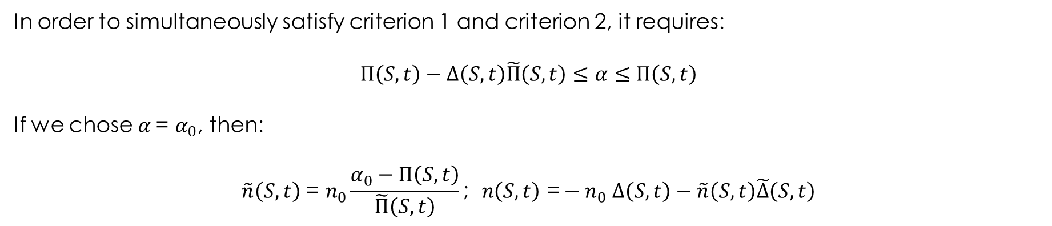
Delta-Gamma Hedging
In order to simultaneously satisfy criterion 1 and criterion 2, it requires:
$$Π\left(S,t\right)−∆\left(S,t\right)\tilde{Π}\left(S,t\right)≤α≤Π\left(S,t\right)$$
If we chose $α \text{=} α_{0}$, then:
$$\tilde{n}\left(S,t\right) \text{= }n_{0}\frac{α_{0}−Π\left(S,t\right)}{\tilde{Π}\left(S,t\right)}\text{;} n\left(S,t\right)\text{ =}{− n}_{0}∆\left(S,t\right)−\tilde{n}\left(S,t\right)\tilde{∆}\left(S,t\right)$$

Slide 20
Delta-Gamma Hedging
Get back to the earlier example on FPT, the table below presents feasible solutions with varying $α$.

Slide 21

Thank You
someone@example.com

