Slide 1
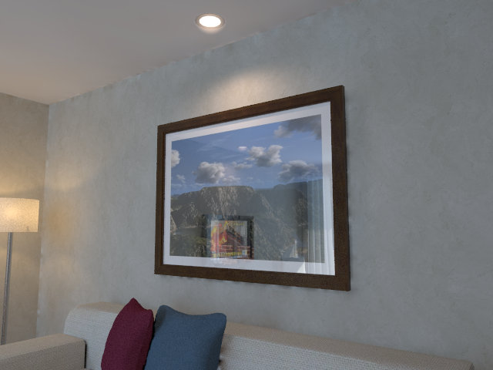
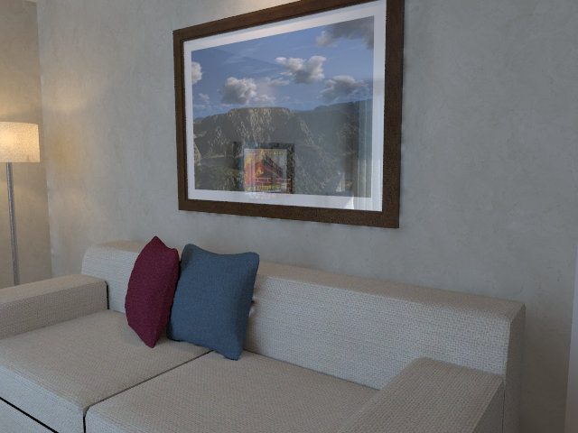
p’
p
Target image
Source image

Slide 2
p’
p
Target image
Source image

Slide 3
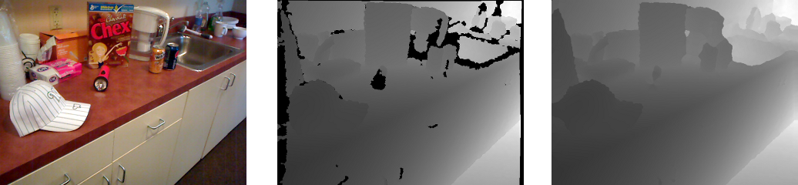
RGB image (input)
Depth image (output)
Monocular
Depth
Estimation

Slide 4
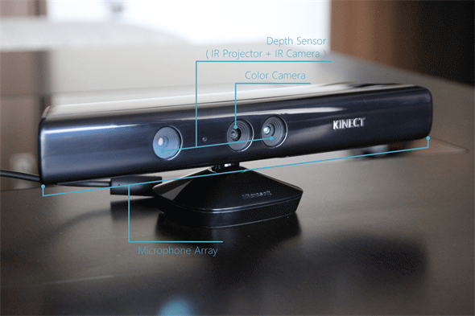
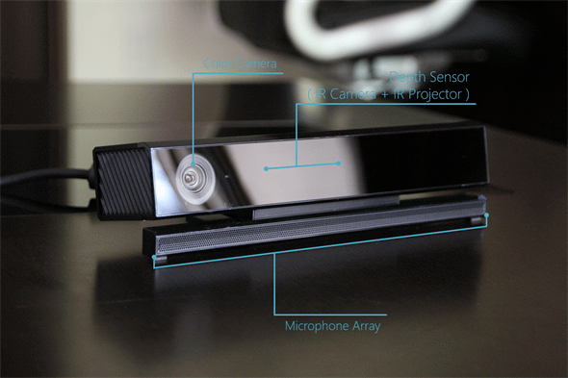

Slide 5
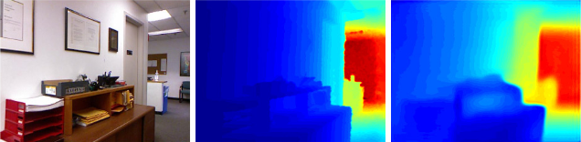
RGB image
Depth image
Depth prediction
Monocular
Depth
Estimation
─
Training

Slide 6
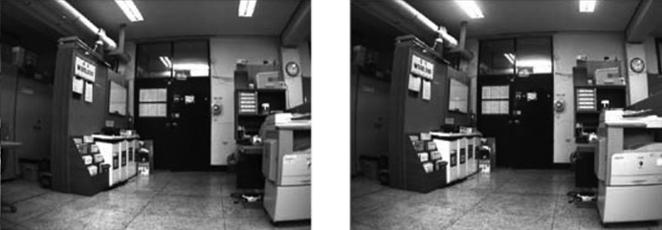
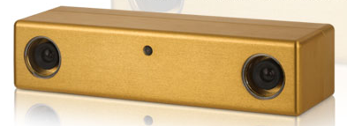
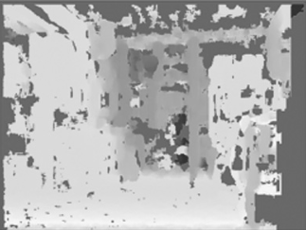

Slide 7
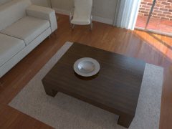
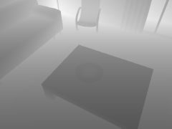
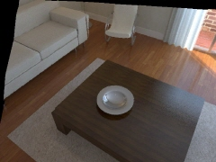
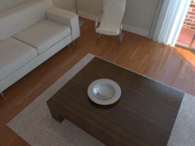
Left disparity
prediction
Left image
Monocular
Depth
Estimation
Photometric loss
─
Reconstructed
right image
True right image

Slide 8
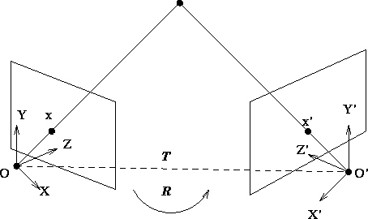
source image
target image
source frame
target frame

Slide 9
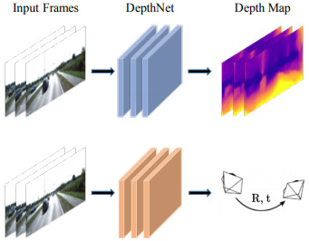
Photometric loss
input frames
DepthNet
depth prediction
─
reconstructed
target frame
true target frame
source frame
PoseNet
pose prediction
Photometric loss

