Slide 1

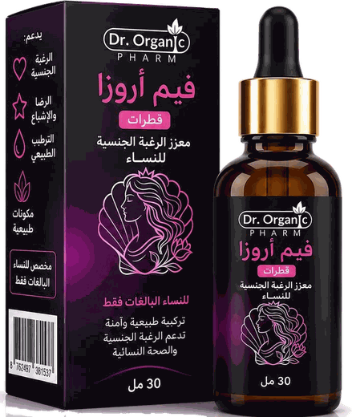
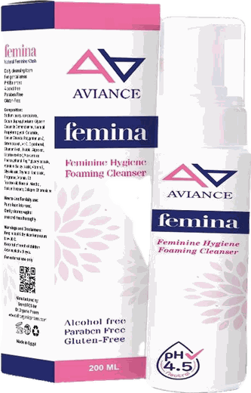
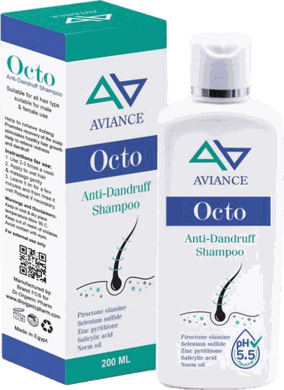
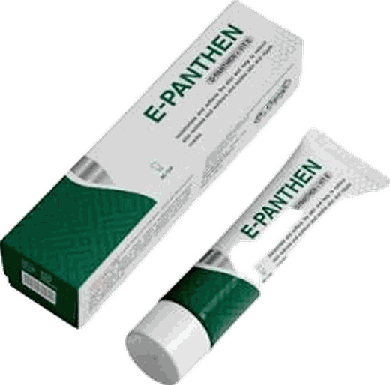
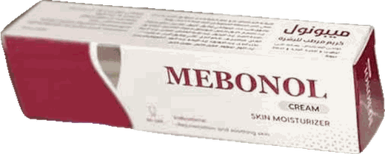
Medical Rep Product Training
Five products · Women's Health · Dermatology & Hair · Skin Care
Notes:
Welcome the reps. Goal: every rep should know, for each of the five products, what it is, what each ingredient does, the scientific evidence, who it is for, and how to present it to the doctor. Memory Boost has a separate training.

Slide 2
Training agenda
Women's Health
Dermatology & Hair
Cracked & Irritated Skin
Ob/Gyn clinics · Pharmacies
Dermatology clinics · Pharmacies
Dermatology · Gyn · Pediatrics · Surgery
Fem-Arosa
Octo
Mebonol
Food supplement · 30 ml drops
Anti-dandruff shampoo · 200 ml
Liposome cream · 40 g
Femina
E-Panthen
Intimate foaming cleanser · 200 ml
Moisturizing cream · 40 g
Notes:
Products are grouped by the clinic the rep will visit. Products in the same clinic are presented together (cross-selling): Fem-Arosa with Femina in gynecology, Octo with E-Panthen in dermatology.

Slide 3
Women's Health
Fem-Arosa and Femina — two complementary products for the same Ob/Gyn visit

Slide 4
Fem-Arosa — product profile
Brand name
Dr. Organic Fem-Arosa
Category
Food supplement
Form & size
Drops · 30 ml
Flavour
Natural mixed berry
Age group
Women over 18 years
SFDA reg.
FOM-24-56091-FOP-110126-10077-C-12688-5160
Barcode
00762497361537
Shelf life & storage
24 months · below 25°C
Manufacturer
ASTRIX PHARMA — Al-Kharj, Saudi Arabia
Public price
SAR 49 (excl. VAT)
Notes:
Fem-Arosa is registered with the SFDA as a food supplement, for women over 18. Reps should know the registration number and barcode, as pharmacies ask for them. Public price: SAR 49 excluding VAT.

Slide 5
Fem-Arosa — 12 active ingredients and their roles
1
L-Arginine
2
Maca · Damiana · Muira Puama
3
Ginseng · Ginkgo Biloba
Amino acid; precursor of nitric oxide, which relaxes blood vessels and supports blood flow.
Traditional botanicals used to support vitality and desire in women.
Ginseng for energy and stress adaptation; ginkgo for microcirculation.
4
Saffron · Fenugreek
5
Ginger · Cinnamon
6
Vitamin B6 · Niacin (B3)
Saffron studied for arousal and lubrication; fenugreek is a traditional women’s-health herb.
Support circulation and a warming sensation.
B6 contributes to the regulation of hormonal activity; niacin to the reduction of tiredness and fatigue.
Notes:
Teach the ingredients in four groups rather than twelve names: (1) L-arginine for blood flow, (2) vitality and desire botanicals, (3) circulation and energy botanicals, (4) vitamins. The rep must be able to say why each ingredient is there.

Slide 6
Fem-Arosa — scientific evidence on the ingredients
73.5%
Ito, 2001 · RCT
Dording, 2015 · RCT
Kashani, 2013
77 women · arginine + ginseng + ginkgo + damiana · 4 weeks
45 women · maca 3 g/day · 12 weeks
38 women · saffron 30 mg · 4 weeks
vs 37.2% on placebo
Improved desire and satisfaction, no notable side effects
Clearer benefit in post-menopausal women; well tolerated
Improved arousal and lubrication
Improved overall satisfaction — Ito 2001
Oh, 2010 · RCT (Korean red ginseng)
Studies are on the ingredients or similar combinations, not the finished product.
Study doses may differ from the product dose.
We say "supports vitality" — never "treats".
Menopausal women · double-blind crossover · 8 weeks
Significant improvement in arousal vs placebo
Notes:
Make clear these studies are on the ingredients or similar combinations, not on Fem-Arosa itself, and doses may differ. The strongest number: the Ito 2001 trial of L-arginine, ginseng, ginkgo and damiana — 73.5% of women reported improvement vs 37.2% on placebo.

Slide 7
Fem-Arosa — presenting to the doctor
KEY SELLING POINT
A complete herbal formula supporting vitality in adult women, in easy-to-use drops
1
Target doctor & customer
2
Strengths
3
Expected questions
Ob/Gyn doctors
Pharmacies
Women over 18 with low vitality and fatigue
12 ingredients in one product
Berry-flavoured, easy-to-use drops
Presented with Femina in the same visit
Pregnancy / breastfeeding? Not recommended.
Dose? As directed on the pack.
For men? No — a women’s product.
Notes:
Target: Ob/Gyn first, then pharmacies. Core message: a complete formula in one product instead of several supplements. If asked about pregnancy: not recommended during pregnancy and breastfeeding. If asked about the dose: as directed on the pack.

Slide 8
Femina — product profile
Brand name
AVIANCE Femina — Feminine Hygiene Foaming Cleanser
Category
Cosmetic (skin products)
Form & size
Foaming cleanser · 200 ml
pH
3.5 – 4.5
Free from
Alcohol · parabens · gluten
SFDA notification
CN-2023-36519 (valid to 23/11/2027)
Barcode
6772505023146
Use
Twice daily, diluted or neat
Manufacturer
Brand International — Egypt
Public price
SAR 65 (excl. VAT)
Notes:
Femina is a notified cosmetic (not a medicine). We can talk about cleansing, soothing, moisturising and freshness — but never "treats infections". Public price: SAR 65 excluding VAT.

Slide 9
Femina — science: the natural vaginal defence system
95%
3.8–4.5
pH 3.5–4.5
Chen, 2017: international guidelines support gentle daily external cleansing with a pH-appropriate wash
of healthy flora
Normal vaginal pH
Femina pH
Lactobacilli
Acidic environment that protects
Compatible with the natural environment
1
How does acidity protect?
2
What disturbs the balance?
Lactic acid produced by lactobacilli keeps the environment acidic, limiting the growth of harmful microbes and their adhesion to vaginal cells.
Alkaline soap, antibiotics, hormonal changes (pregnancy, menstruation, menopause) and excessive internal douching.
Notes:
This is the core of the doctor conversation: a healthy vaginal environment is acidic because of lactobacilli. Ordinary soap is alkaline and disturbs this balance. Femina is buffered to pH 3.5–4.5 to respect it.

Slide 10
Femina — formula: 4 roles in one product
1
Antiseptic
2
Soothing & anti-itch
3
Moisture & barrier
4
Cleansing & pH
Chlorhexidine 0.2%
Tea tree oil 1%
Thyme oil 1%
Neem oil 3%
Chamomile 1%
Bisabolol 1%
Aloe vera 1%
Licorice 1%
Menthol 0.3%
Glycerin 5%
Ceramide 2%
D-Panthenol 1%
Allantoin 1%
Vitamin E 1%
Gentle foaming base
Lactic acid 0.5%
Glycolic acid 0.5%
pH 3.5–4.5
Evidence: tea tree oil has broad antibacterial and antifungal activity including Candida (Carson, 2006); panthenol restores and moisturises the skin barrier (Proksch, 2017).
Notes:
Split the formula into four roles. Percentages are the manufacturer’s actual levels. Chlorhexidine 0.2% with tea tree, thyme and neem oils gives cleansing and protection; chamomile and bisabolol calm itching.

Slide 11
Femina — use and presentation
KEY SELLING POINT
pH-balanced intimate foam (pH 3.5–4.5), alcohol- and paraben-free
1
Suitable for
2
How to use
3
Strengths
Daily and menstrual hygiene
Pregnancy and postpartum
Dryness at menopause
Discharge and unpleasant odour
Twice daily
Diluted with water or neat
External area only, then rinse
Pleasant, fresh scent
No staining (unlike iodine)
Large 200 ml size
Complements Fem-Arosa
Notes:
Focus on everyday situations where a woman needs a safe wash: menstruation, pregnancy, postpartum and menopausal dryness. If the doctor prescribes treatment for an infection, Femina is daily hygiene alongside it, not a replacement.

Slide 12
Dermatology & Hair
Octo and E-Panthen — scalp and dry skin in the same visit

Slide 13
Octo — product profile
Brand name
AVIANCE Octo Anti-Dandruff Shampoo
Category
Hair & scalp cosmetic
Size
200 ml
Actives
Piroctone olamine · ZPT · Selenium sulfide · Salicylic acid
pH
5.5
SFDA notification
CN-2023-84129 (valid to 23/11/2027)
Barcode
6772505023108
Use
2–3 times weekly
Manufacturer
Brand International — Egypt
Public price
SAR 55 (excl. VAT)
Notes:
Octo is a notified hair and scalp cosmetic. Its key advantage: four anti-dandruff actives in one shampoo. Public price: SAR 55 excluding VAT.

Slide 14
Octo — science: dandruff
50%+
How does dandruff develop?
Malassezia breaks scalp oils into irritating fatty acids, so scalp cells turn over faster than normal and form visible flakes around the hair shaft. It is more common in adolescents and young adults and worsens in winter.
of people
have moderate-to-severe dandruff
Ways to control dandruff — Octo covers all three
1
Antifungal
2
Cytostatic
3
Keratolytic
Reduces Malassezia
Slows excessive scaling
Loosens and removes flakes
Piroctone olamine · ZPT
Selenium sulfide
Salicylic acid
Notes:
Dandruff is chronic and controlled rather than cured, which is why patients need a shampoo they keep using. The main driver is Malassezia yeast breaking down scalp lipids, causing irritation and excessive scaling.

Slide 15
Octo — the four-active formula
0.7%
1%
0.5%
2%
Piroctone Olamine
Zinc Pyrithione
Selenium Sulfide
Salicylic Acid
Broad antifungal and antibacterial; binds to hair keratin, reducing recurrence
Reference antifungal in anti-dandruff shampoos
Slows excessive scalp-cell turnover
Dissolves flakes so actives reach the scalp
+
Natural antifungal oils
+
Moisturising & soothing
Tea tree oil 1% · Neem oil 3% · Ginger extract
Panthenol · Jojoba · Squalane · Castor oil · Menthol · Peppermint
Notes:
The strongest Octo slide: most competing shampoos contain one or two actives; Octo has four, plus natural oils that calm itching and condition the hair. Octopirox binds to hair keratin, which helps reduce recurrence.

Slide 16
Octo — scientific evidence on the ingredients
Schmidt-Rose, 2011
Danby, 1993 · RCT
Satchell, 2002 · RCT
Moderate-to-severe dandruff · half-head comparison
246 patients · moderate-to-severe dandruff
126 patients · 5% tea tree shampoo · 4 weeks
Piroctone olamine shampoo reduced dandruff as well as ZPT 1%; 90% reported less itch after 4 weeks
Selenium sulfide clearly better than placebo at every visit, with less itching
41% improvement vs 11% on placebo
Supplier data on Octopirox:
fast action and high efficacy · low recurrence because it binds to hair keratin and is also antibacterial · non-irritating to the eyes · negligible systemic absorption.
Notes:
All three studies are on the actives. The tea tree study used 5%; Octo contains 1%. The point is that the oil itself has proven activity, and in Octo it supports the four main actives.

Slide 17
Octo — use and presentation
KEY SELLING POINT
Four anti-dandruff actives in one shampoo, at scalp-friendly pH 5.5
Treatment
Prevention
How to use
2–3 times weekly
Once weekly
Lather on the scalp
for 3 weeks
for 3 months
leave 3–5 min, then rinse
1
Target doctor
2
Cross-selling
Dermatology · pharmacies · dandruff and seborrhoeic scalp patients
Present E-Panthen with Octo in the same visit
Notes:
Explain both regimens: treatment for 3 weeks, then prevention. Remind the rep to tell patients to leave the lather 3–5 minutes before rinsing so the actives work. Link to E-Panthen: a doctor who prescribes Octo usually has dry-skin patients too.

Slide 18
E-Panthen — product profile
Brand name
E-Panthen Moisturizing Cream
Brand
Dr Organic
Category
Skin-care cosmetic
Size
40 g
Key active
5% D-Panthenol + Vitamin E
SFDA notification
CN-2026-65086 (valid to 12/5/2031)
Barcode
6224010064195
Use
1–2 times daily or as needed
Manufacturer
Brand International — Egypt
Public price
SAR 30 (excl. VAT)
Notes:
E-Panthen is a moisturising cream, a notified cosmetic under the Dr Organic brand. Key feature: 5% D-panthenol stated on the pack, plus vitamin E and ceramide. At SAR 30 it is very competitively priced.

Slide 19
E-Panthen — the ten powers
1
2
3
4
5
D-Panthenol 5%
Vitamin E 0.5%
Ceramide 1%
Allantoin 1%
Glycerin 2%
Deep hydration, soothing, barrier repair
Antioxidant; protects skin lipids
Replenishes barrier lipids
Soothes and smooths rough skin
Humectant; holds moisture
6
7
8
9
10
Sweet Almond Oil 3%
Shea Butter 1%
Argan Oil 0.5%
Wheat Germ Oil 0.5%
Dimethicone 0.5%
Emollient rich in vitamins A and E
Emollient and soothing
Rich in vitamin E; skin repair
Moisturises and nourishes
Light film that reduces water loss, non-greasy
Notes:
Ten ingredients at the manufacturer’s levels. Start with the most important: 5% panthenol converts to pantothenic acid in the skin, moisturises and restores the barrier. Then ceramide, which replenishes barrier lipids, and vitamin E, an antioxidant.

Slide 20
E-Panthen — evidence and indications
KEY SELLING POINT
5% D-panthenol + vitamin E, with 10 moisturising ingredients including ceramide
Gehring & Gloor, 2000
Proksch, 2017
Coderch, 2003
Double-blind human study · 1 week
Review of 70 years of panthenol use
Review on ceramides
Increased stratum-corneum hydration and reduced water loss
Moisturiser and barrier restorer; supports skin healing
Restores the barrier of dry skin
Suitable for: dry, rough skin (hands, elbows, feet) · redness after sun exposure · pressure marks · mild superficial burns
Notes:
Indications per the leaflet: stressed and irritated but intact skin (not open wounds). The panthenol evidence is strong: the double-blind Gehring 2000 study and the Proksch 2017 review.

Slide 21
Mebonol
17 natural ingredients with liposome technology

Slide 22
Mebonol — product profile
Brand name
Mebonol Cream
Brand
Dr Organic
Category
Skin-care cosmetic
Size
40 g
Technology
Liposome — better delivery of ingredients
Ingredients
17 natural ingredients
SFDA notification
CN-2026-65103 (valid to 12/5/2031)
Barcode
6224010064188
Use
2–3 times daily, thin layer
Public price
SAR 55 (excl. VAT)
Notes:
Mebonol is a notified cosmetic. We present it as supporting the recovery of cracked and irritated skin. We do not say it treats diabetic foot or bed sores — those are therapeutic claims not allowed for a cosmetic. Public price: SAR 55 excluding VAT.

Slide 23
Mebonol — 17 ingredients by function
1
Supports healing
2
Anti-infective
3
Anti-inflammatory
4
Soothing & emollient
Calendula · Honey · Panthenol
Emu oil · Aloe vera
Olive oil · Sesame oil · Beeswax
Chlorhexidine
Tea tree oil · Garlic oil
Bee propolis
Arnica oil · Vitamin E
Bee propolis · Aloe vera
Emu oil
Glycerin · Jojoba oil
Rose oil · Vitamin E
Honey · Olive oil
17
Liposome
natural ingredients
Better delivery of ingredients into the skin
Notes:
Instead of memorising 17 names, the rep learns four functions: supports healing, anti-infective, anti-inflammatory, soothing and emollient. Some ingredients (vitamin E, propolis, aloe) do more than one job.

Slide 24
Mebonol — skin recovery phases and Mebonol’s role
1
2
3
4
Cleansing
Inflammation
Regeneration
Remodelling
Reduce microbes
Calm redness and swelling
New tissue and collagen
Smooth, supple skin
Chlorhexidine · Tea tree · Propolis · Garlic oil
Arnica · Propolis · Vitamin E · Aloe
Calendula · Honey · Panthenol · Emu oil
Olive · Sesame · Jojoba · Rose oil · Glycerin
Notes:
Walk through the four phases in order and name the ingredients that help in each. This gives the doctor a scientific picture: the formula is built on how skin recovers.

Slide 25
Mebonol — evidence and uses
KEY SELLING POINT
17 natural ingredients with liposome technology that help cracked, irritated skin recover
Jull, 2015 · Cochrane
Preethi, 2009
Carson 2006 · El Maghraby 2008
Honey · 992 patients with superficial burns
Calendula · experimental study
Tea tree oil · liposomes
Healed about 4.7 days faster than conventional dressings
Wound closure ~90% vs ~51% by day 8
Broad antimicrobial activity; better delivery of actives into the skin
Suitable for: heel fissures · nipple fissures · diaper rash · minor burns and sunburn · superficial wounds · dry, scaly skin
Notes:
Strongest evidence: the Cochrane review on honey for superficial burns — 992 patients, high-quality evidence. The calendula study was in animals, so present it as experimental. Uses we mention: heel and nipple fissures, diaper rash, minor burns, superficial wounds, and dry scaly skin.

Slide 26
The five products at a glance
Product | Category | Key selling point | Clinic | Public price*
Fem-Arosa | Food supplement | Complete 12-ingredient herbal formula for women’s vitality | Gynecology | 49
Femina | Cosmetic | pH 3.5–4.5 intimate foam, alcohol- and paraben-free | Gynecology | 65
Octo | Cosmetic | Four anti-dandruff actives in one shampoo | Dermatology | 55
E-Panthen | Cosmetic | 5% panthenol + vitamin E + ceramide | Dermatology | 30
Mebonol | Cosmetic | 17 natural ingredients with liposome technology | Derm · Gyn · Pediatrics | 55
* SAR, excluding 15% VAT
Notes:
Quick-review summary. Ask each rep to state the key selling point of every product from memory before going out on visits.

Slide 27
Cross-selling: every visit = two products
Gynecology clinic
Dermatology clinic
Several clinics
Fem-Arosa + Femina
Octo + E-Panthen
Mebonol
Vitality from within + hygiene and protection outside
A clean scalp + moisturised skin
Gyn (nipple fissures) · Pediatrics (diaper rash) · Derm
Notes:
Final message: never enter a clinic with one product. Gynecology: Fem-Arosa with Femina. Dermatology: Octo with E-Panthen. Mebonol fits dermatology, gynecology (nipple fissures) and pediatrics (diaper rash).

Slide 28
Thank you — questions?
Areej Najd Est. for Cosmetics & Medical Supplies
Notes:
Open the floor for questions, then run a quick quiz: each rep states the key selling point, category and price of a product chosen by the trainer.

