Slide 1
Reactivation of the dormant tumor suppressor BASP1
cBioPortal data analysis
Philemon Schöpf – 2020-10-05

Slide 2
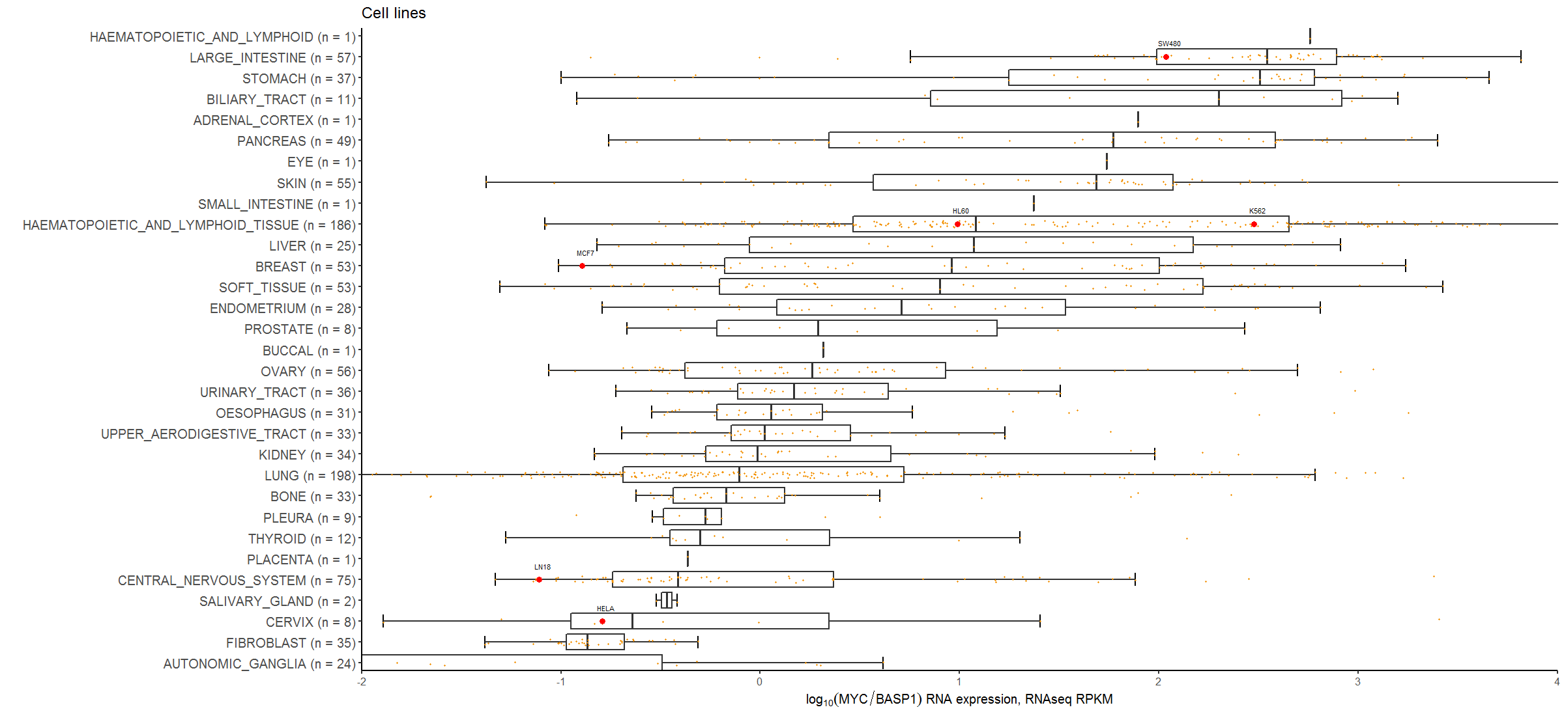
MYC/BASP1 RNA expression ratios (cell lines)

Slide 3
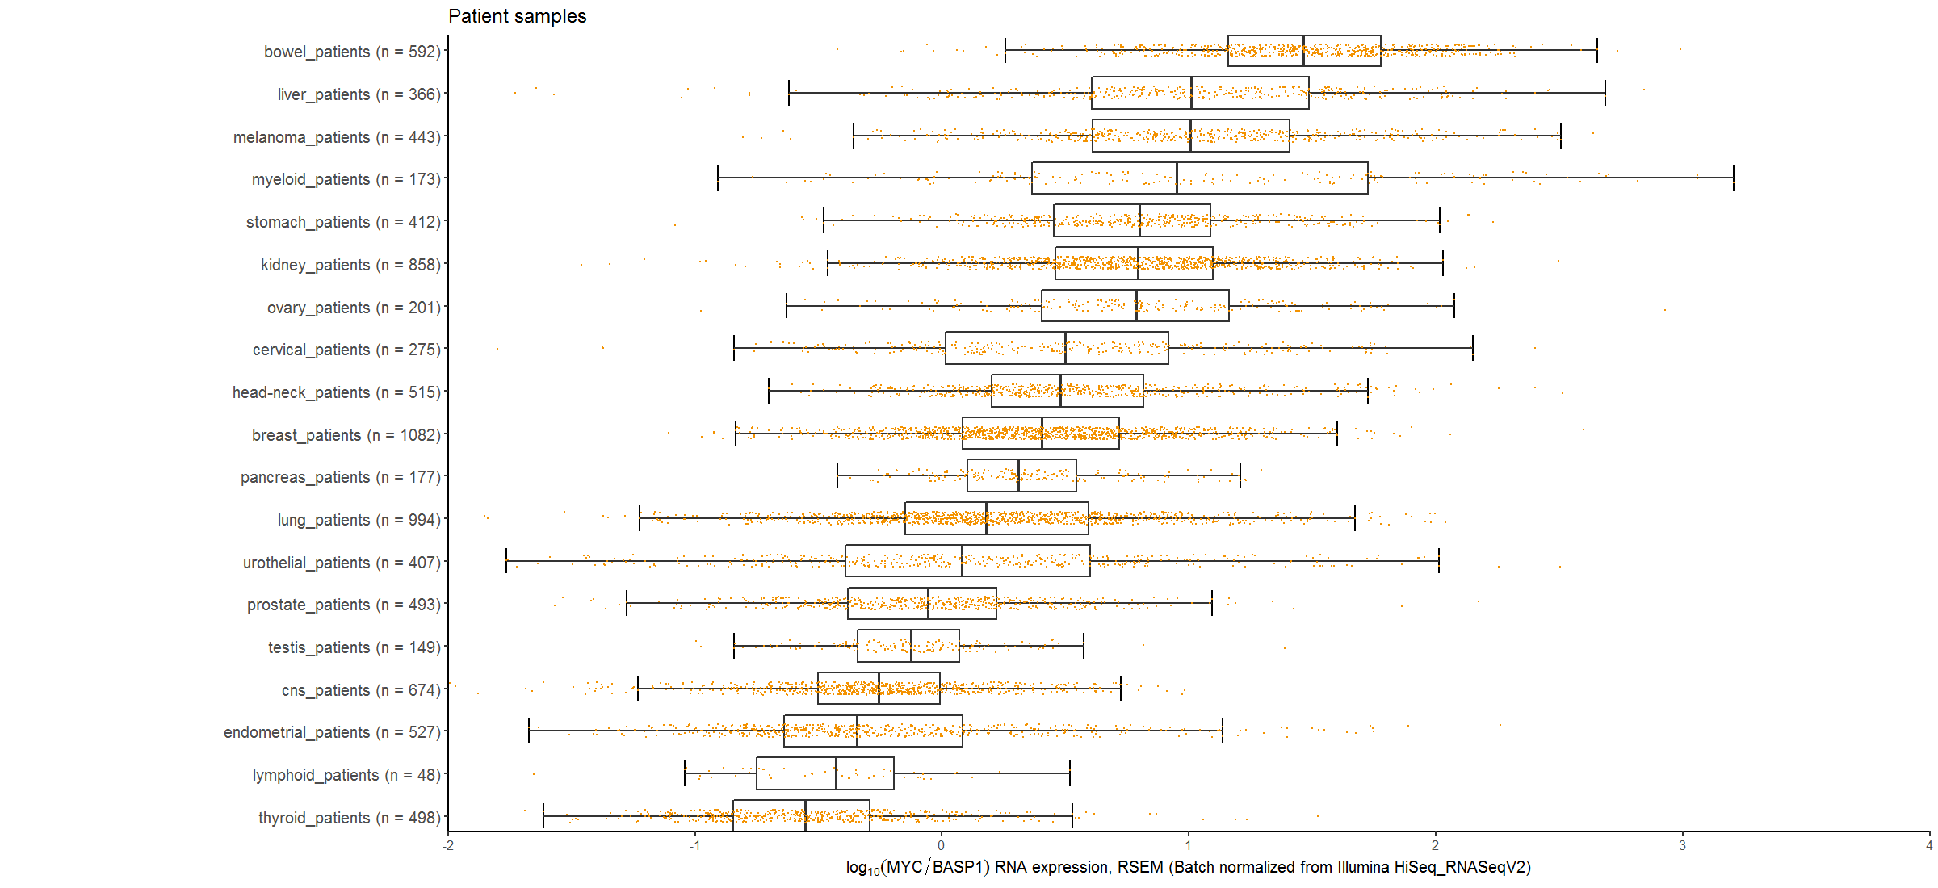
MYC/BASP1 RNA expression ratios (patients)

Slide 4
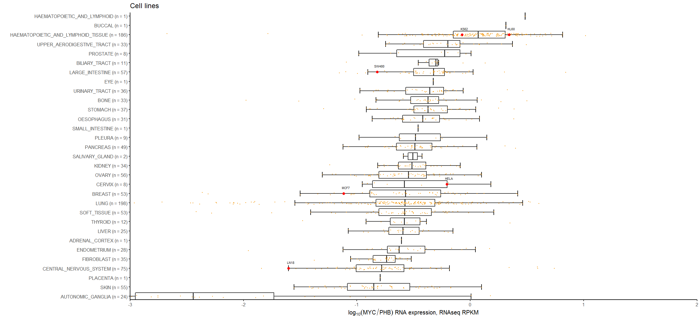
MYC/PHB1 RNA expression ratios (cell lines)

Slide 5
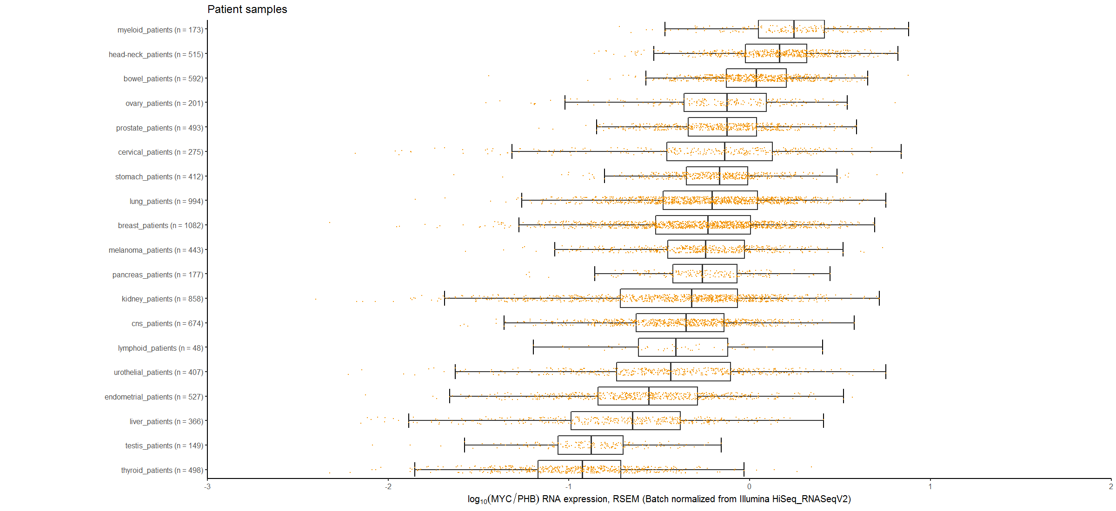
MYC/PHB1 RNA expression ratios (patients)

Slide 6
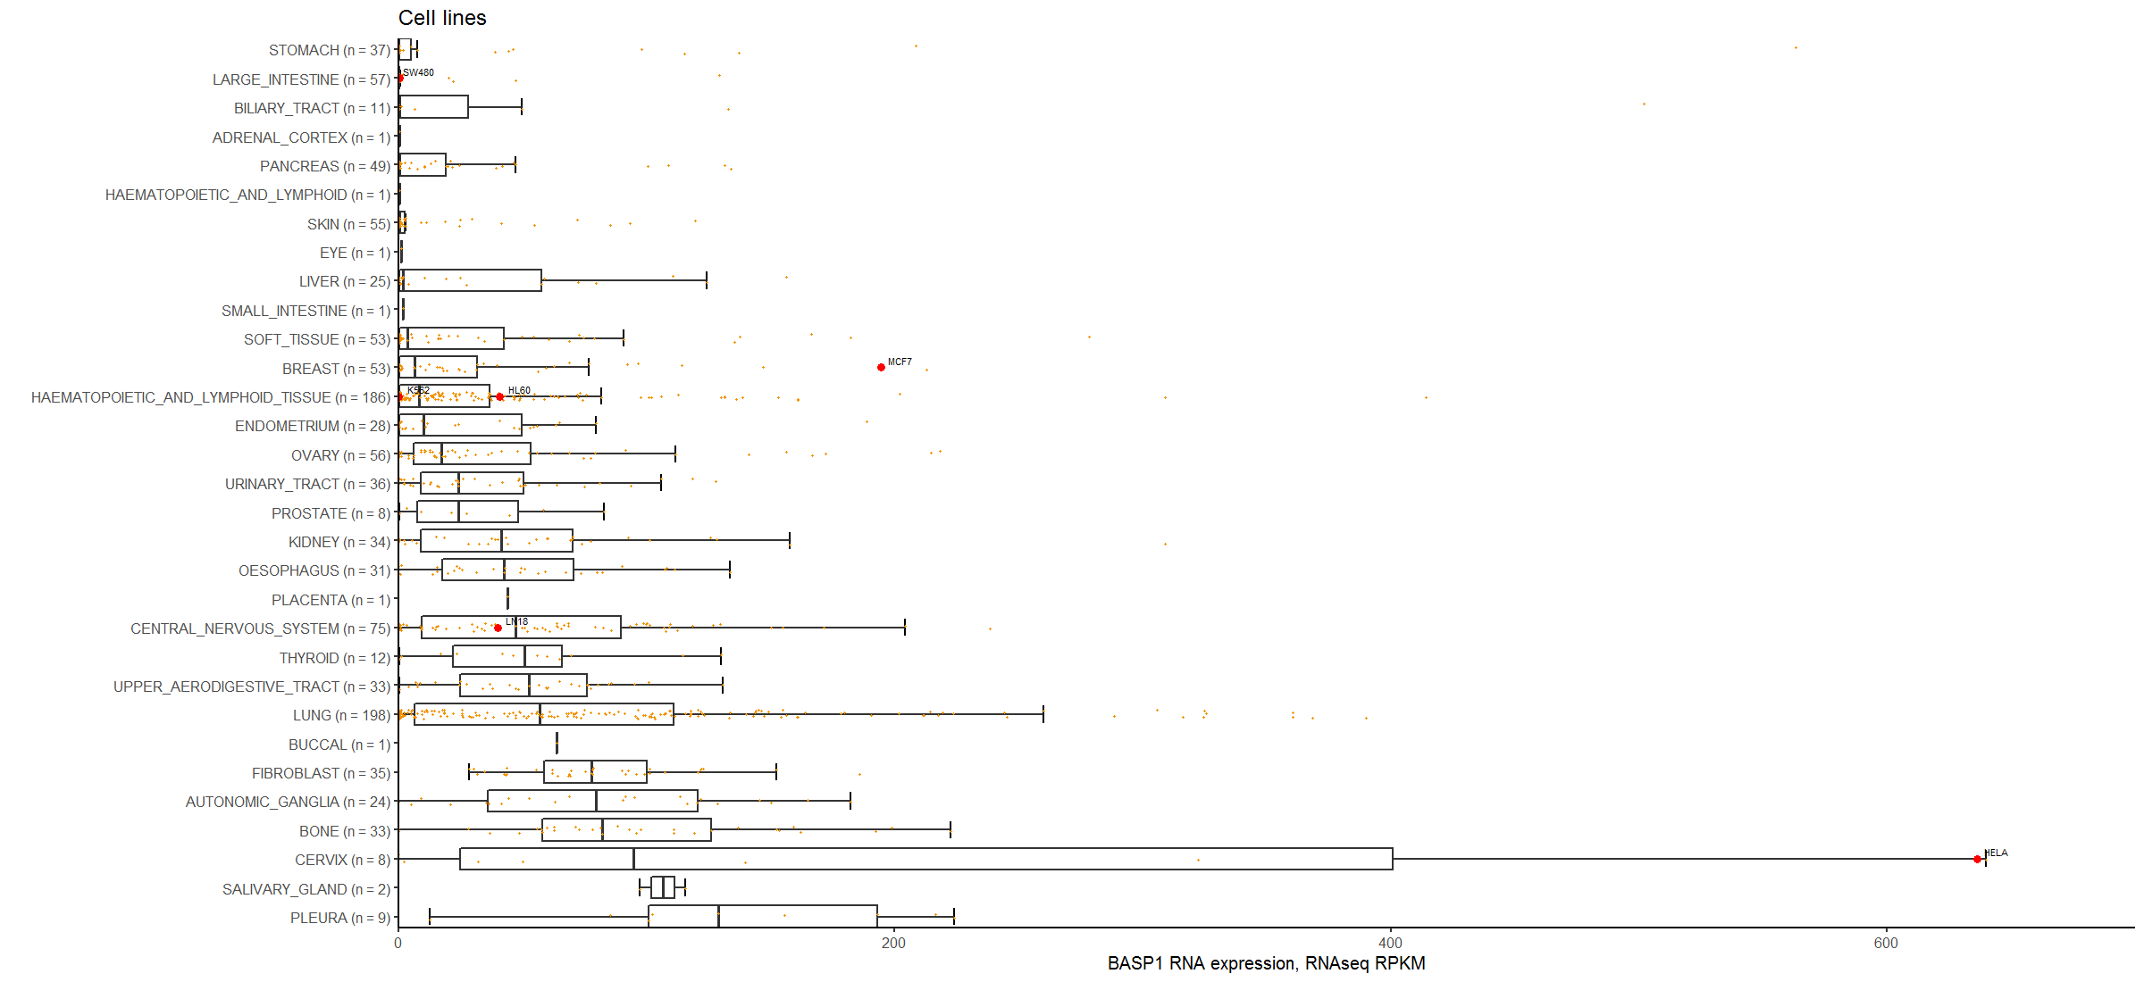
BASP1 RNA expression (cell lines)

Slide 7
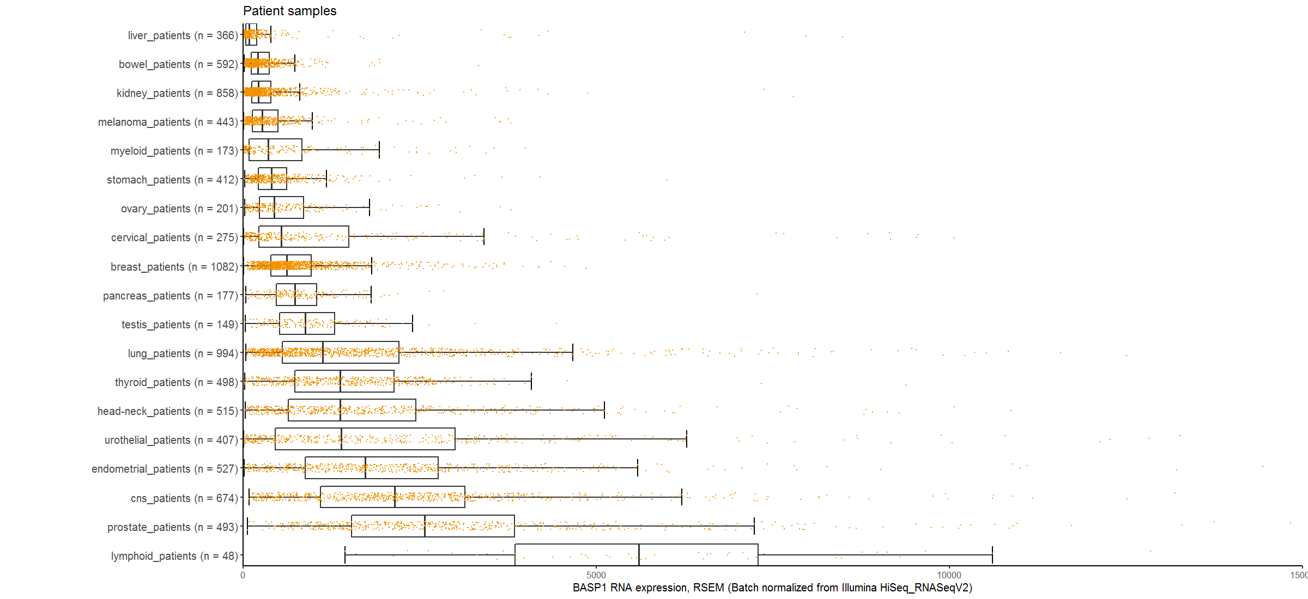
BASP1 RNA expression (patients)

Slide 8
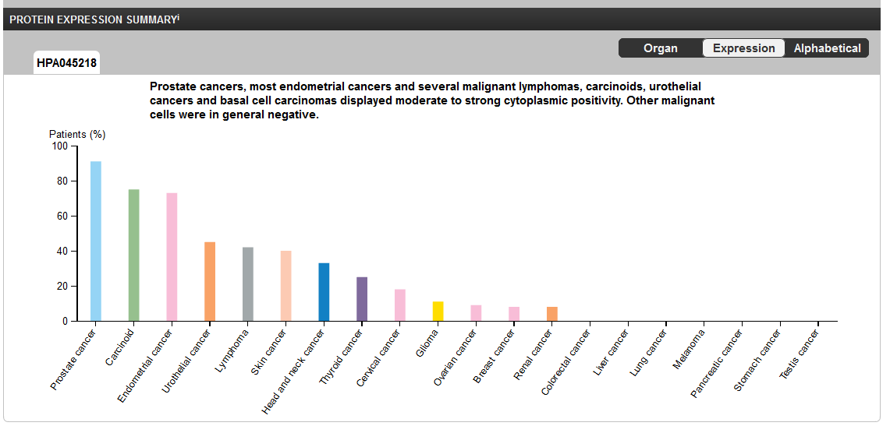
BASP1 protein expression (patients)
https://www.proteinatlas.org/ENSG00000176788-BASP1/pathology

Slide 9
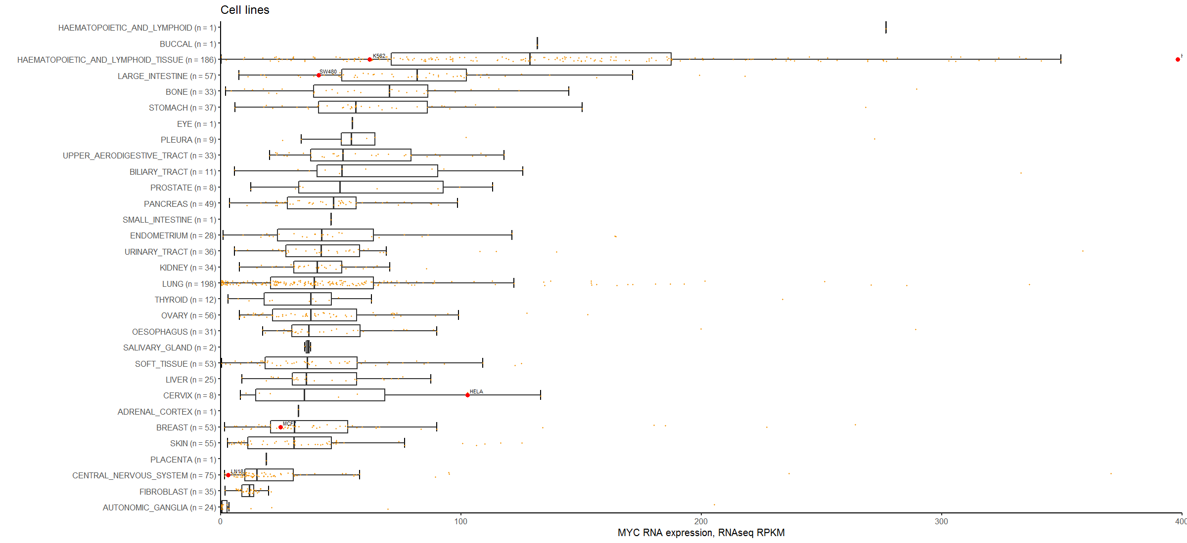
MYC RNA expression (cell lines)

Slide 10
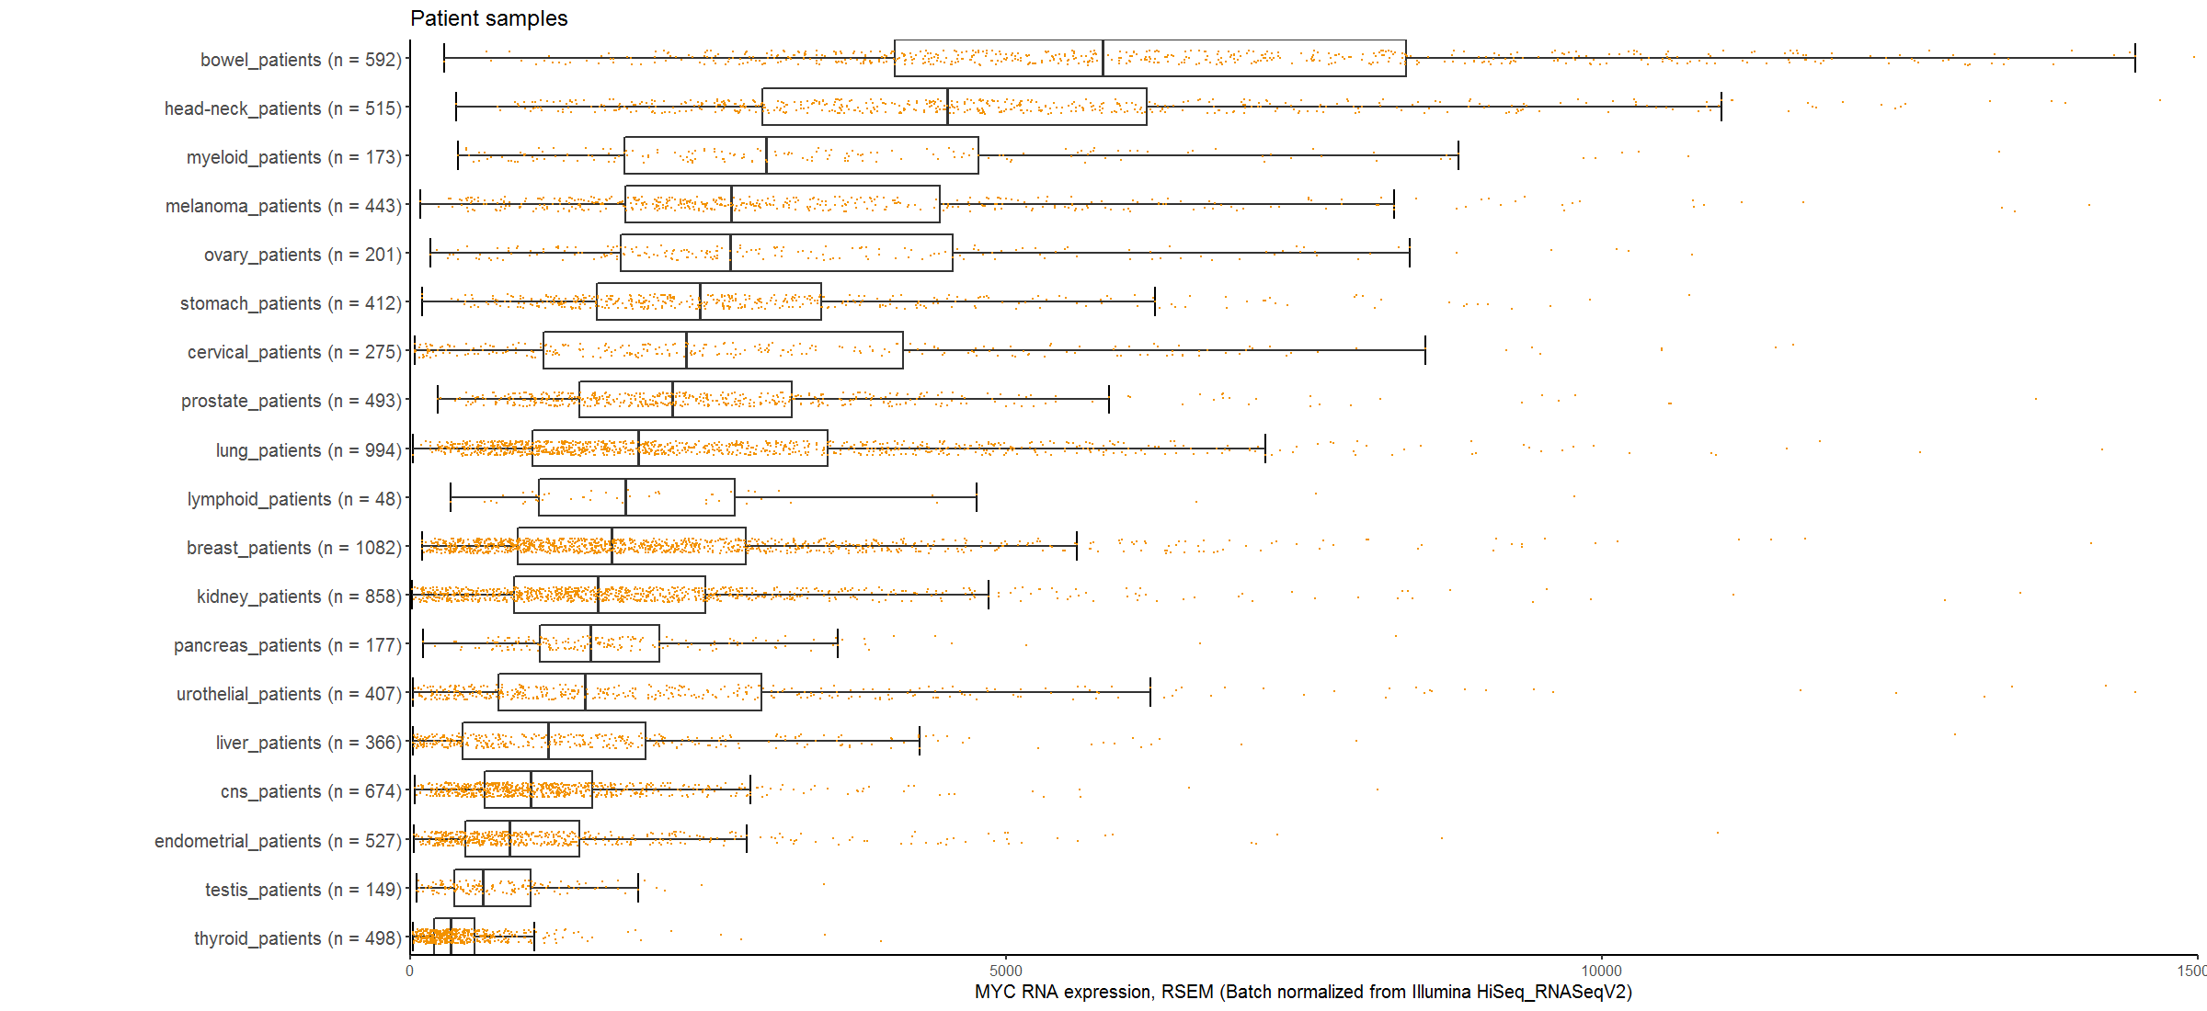
MYC RNA expression (patients)

Slide 11
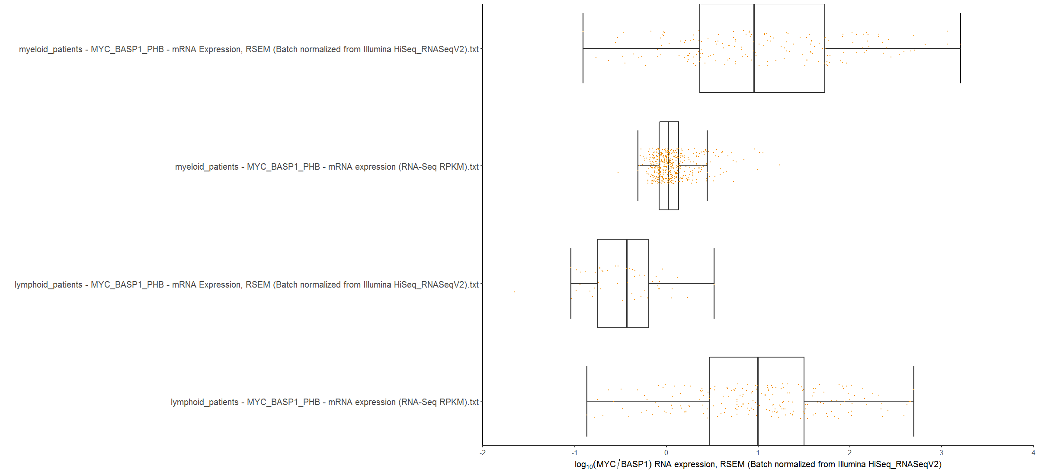
RPKM vs. RSEM problem

Slide 12
Appendix (high-res combined images)

Slide 13
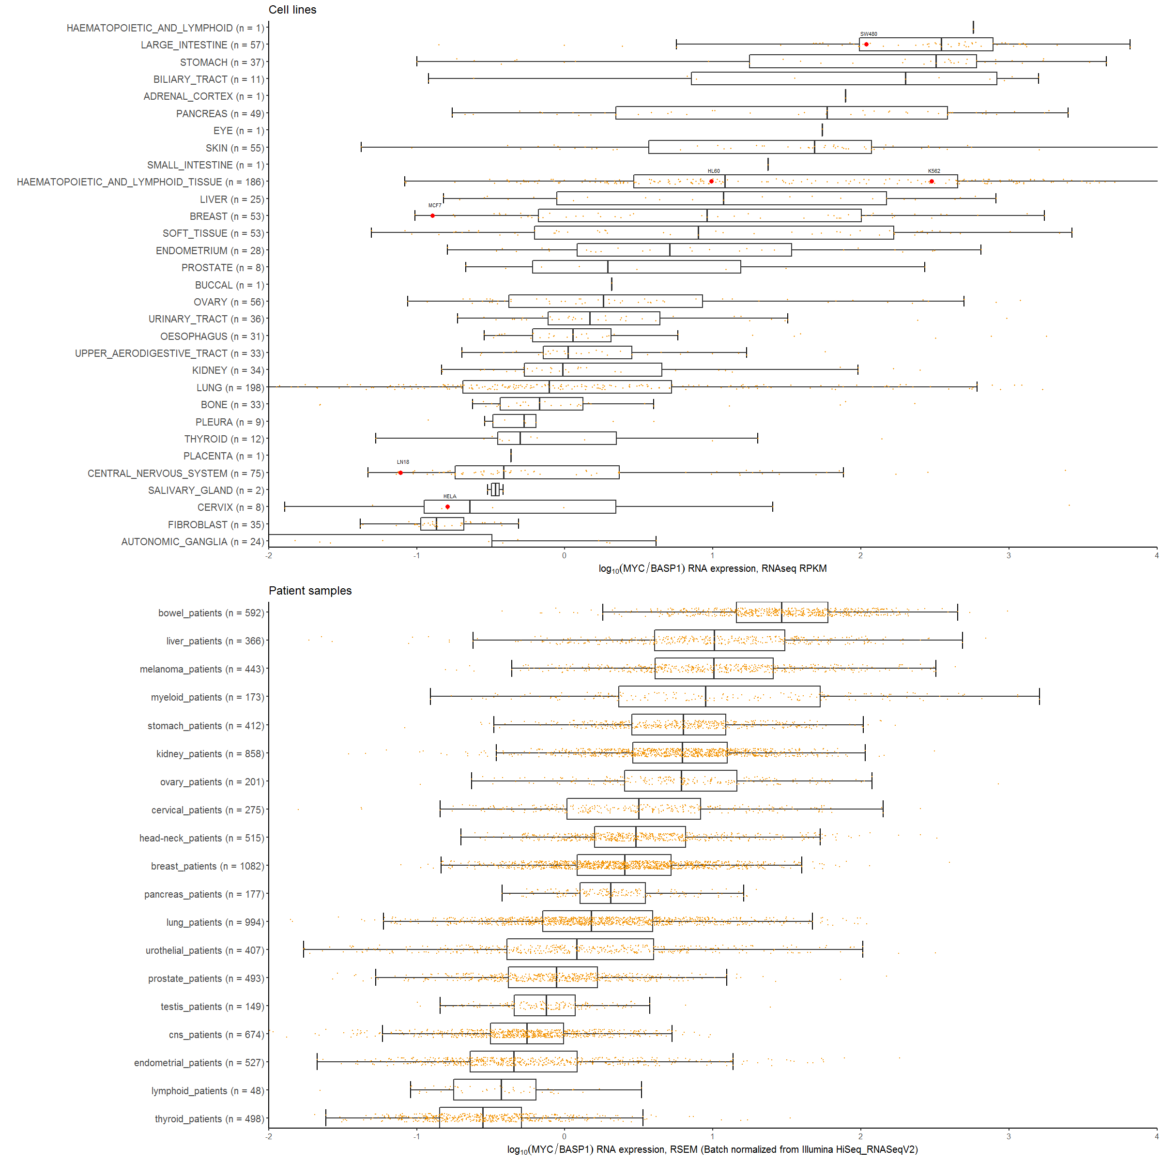
MYC / BASP1 RNA expression ratio

Slide 14
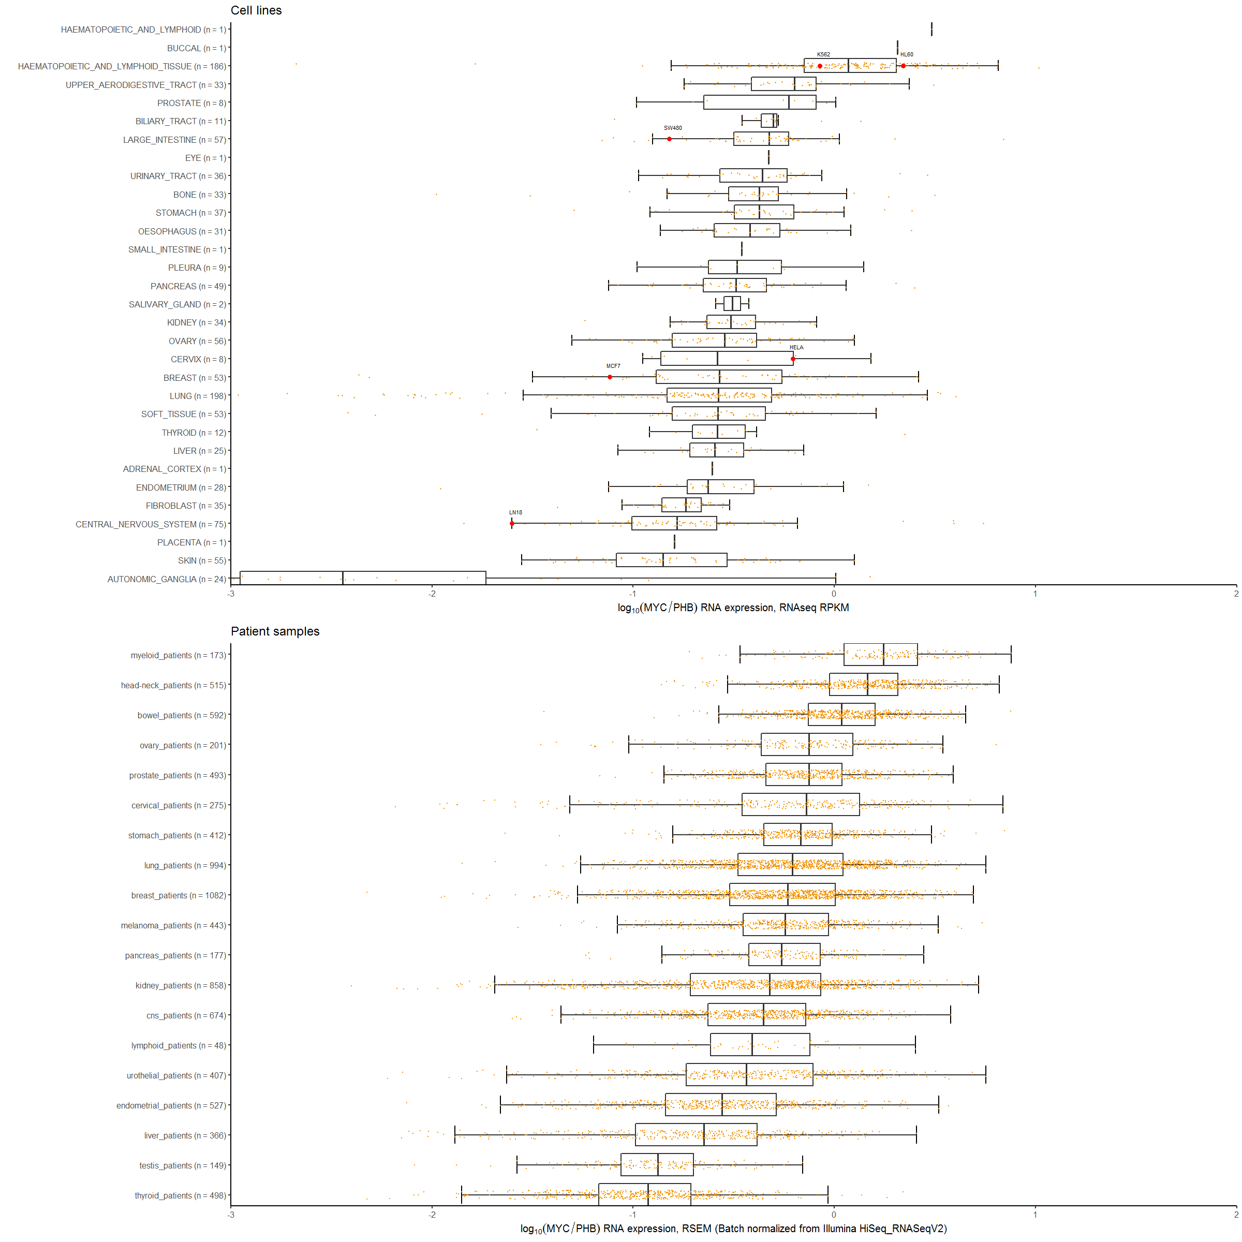
MYC / PHB1 RNA expression ratio

Slide 15
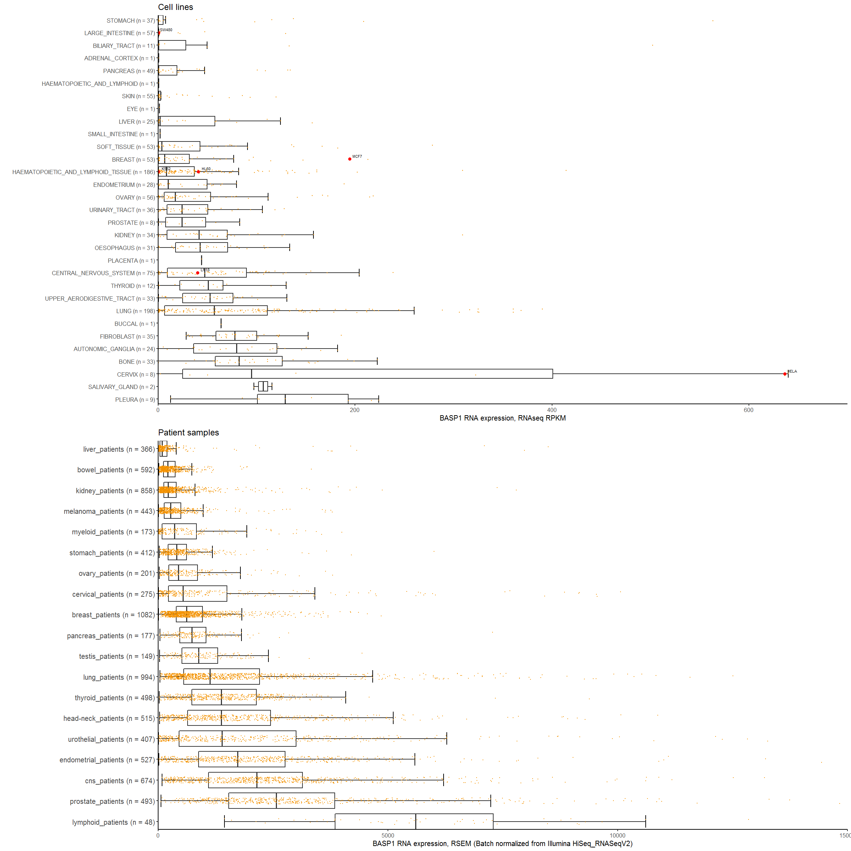
BASP1 RNA expression

Slide 16
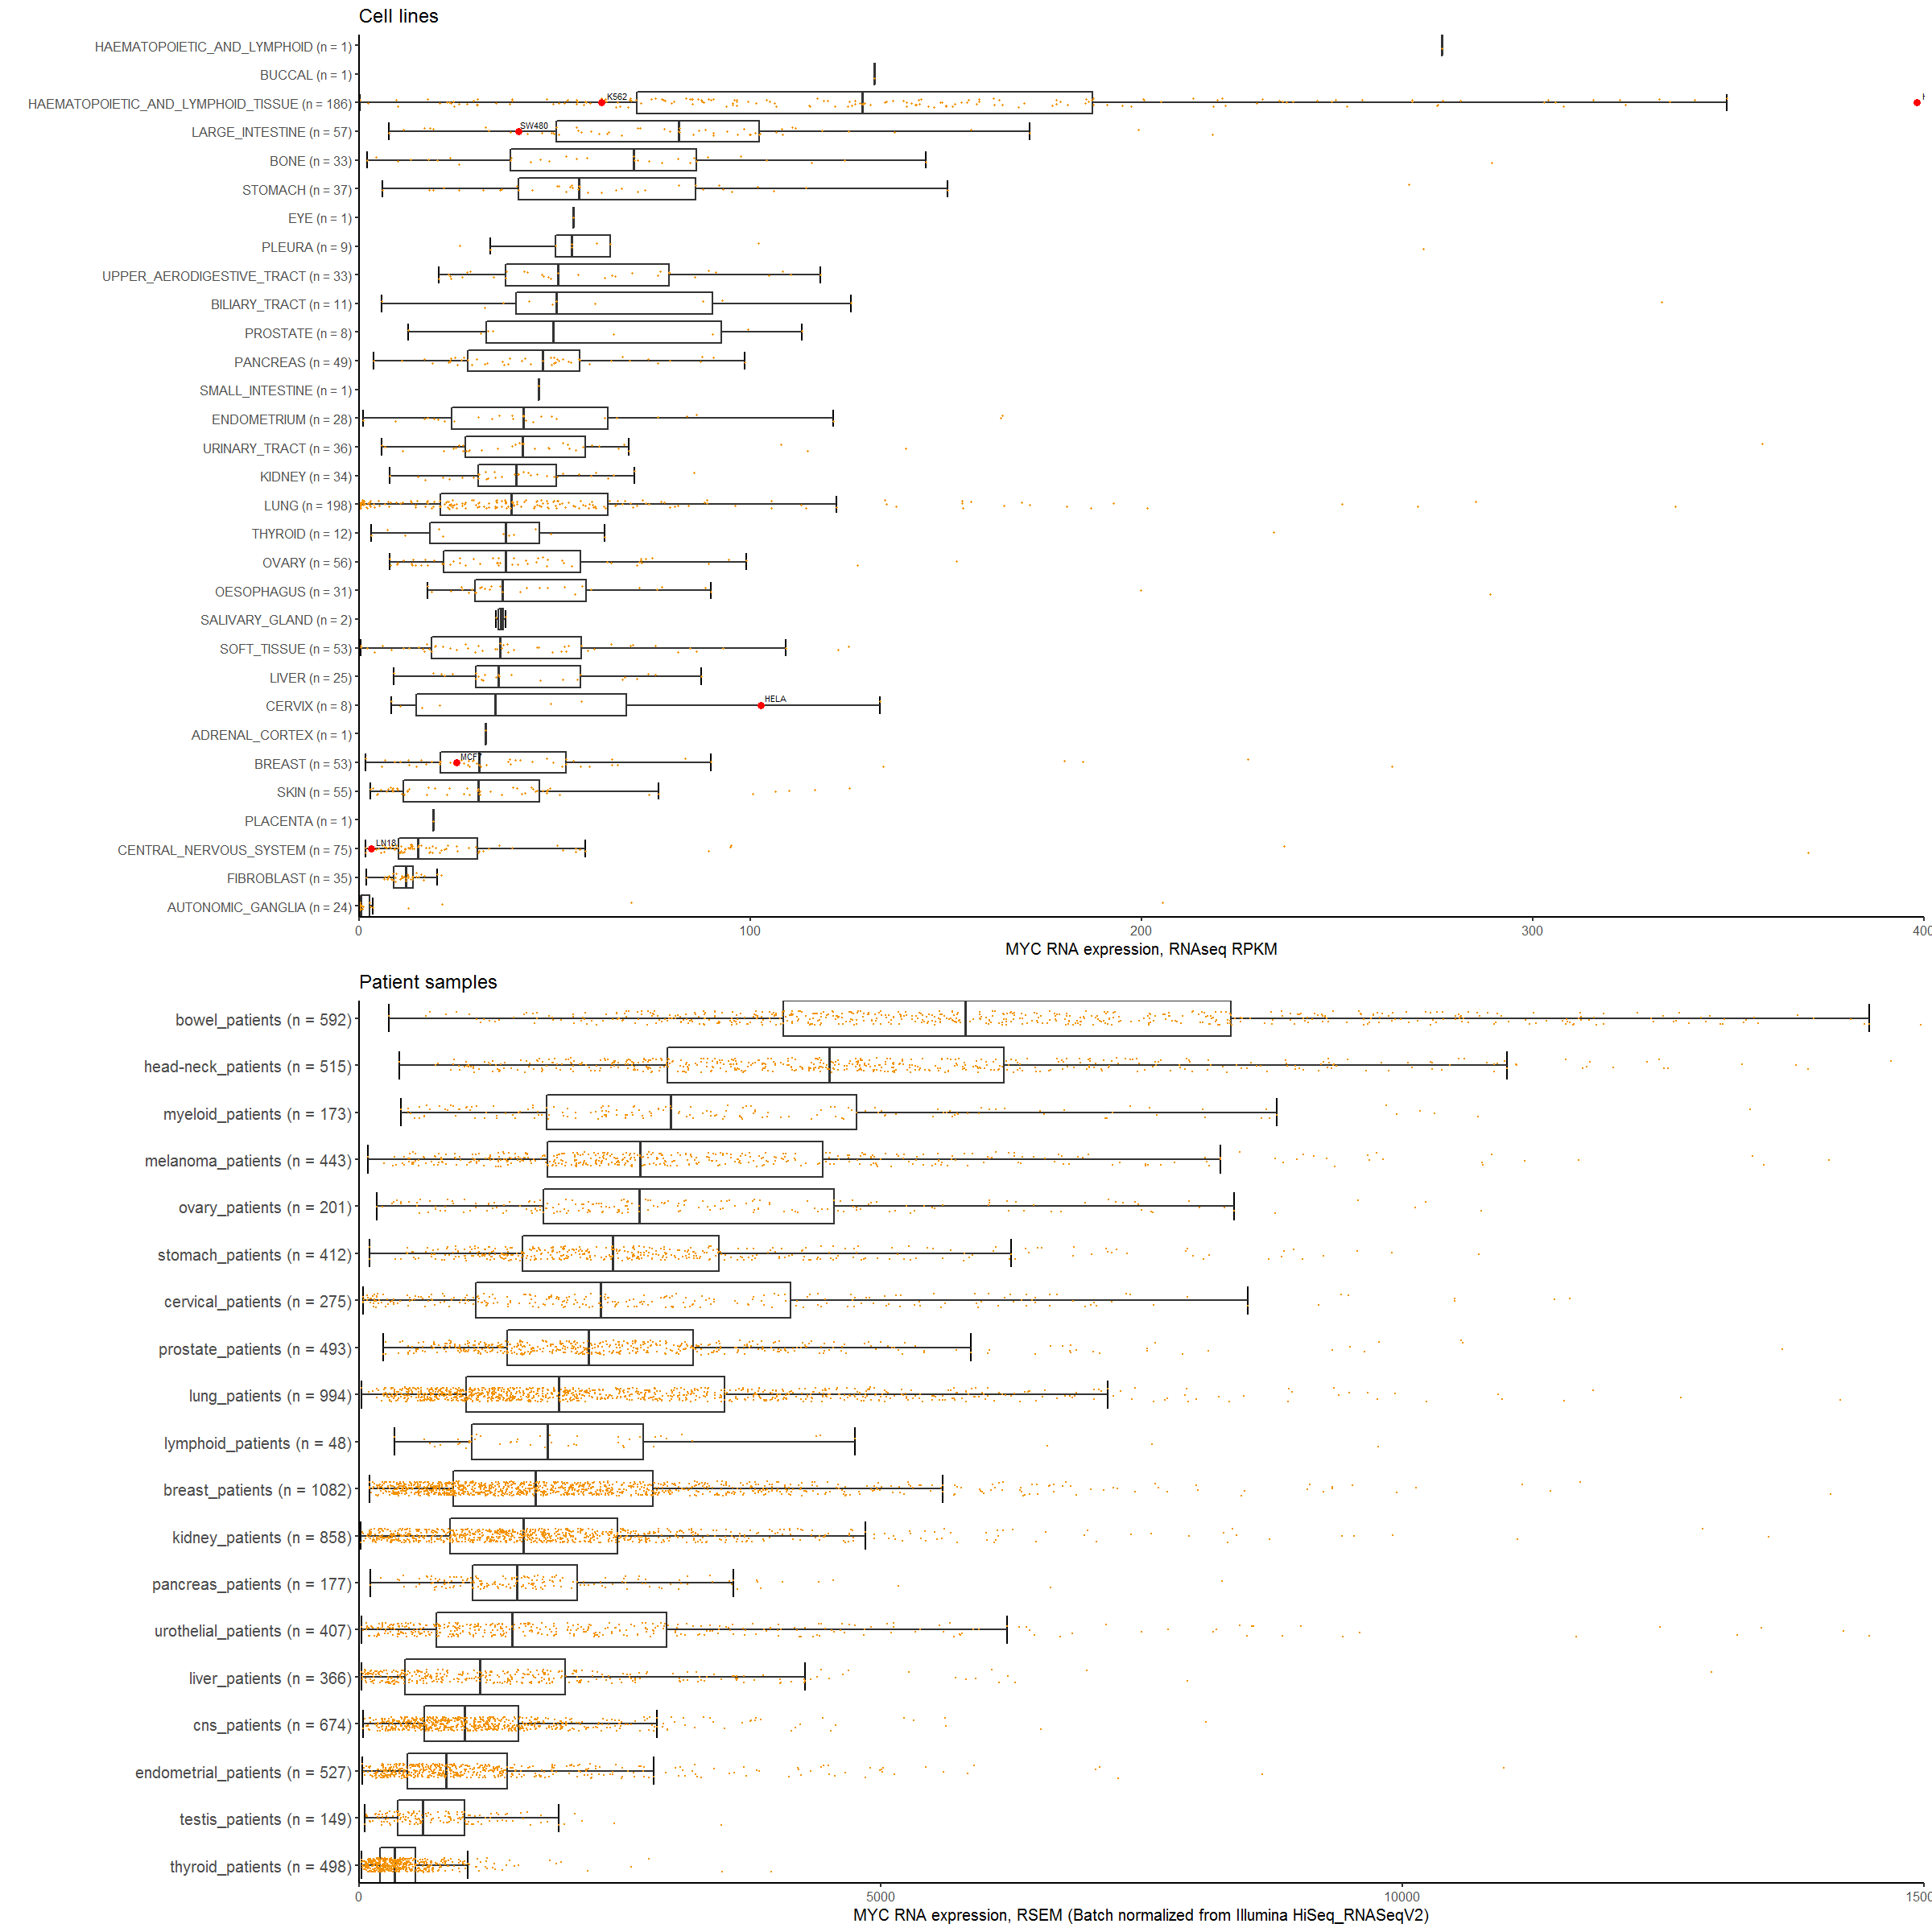
MYC RNA expression

Slide 17
References

