Slide 1
Auto Scaling Guided by Code

Slide 2
Cloud Computing
Pay-as-you-go
Scale Resources up or down based on demand (Elastic Architecture)
http://aws.amazon.com/

Slide 3
Auto Scaling steps

Slide 4
Instance provisioning
Manually
  Image (preconfigured)
Automated
  Chef
  Puppet
  CloudFormation
http://aws.amazon.com/

Slide 5
Create a launch configuration. The launch configuration are parameters to launch instances, such as image (AMI), instance type, security group, key pair and user data.

Slide 6
Create an auto scaling group. The auto scaling group defines the auto scaling conditions, minimum and maximum number of instances, available zones, default cool down and load balancer (ELB).

Slide 7
Create a scaling policy. The scaling policy defines how the auto scaling should scale up or down, if it is by size or percent and the cool down.

Slide 8
Create an alarm metric. The alarm metric is the metric used to decide when to increase or decrease the instances. Usually by response time. The metrics are provided by CloudWatch.

Slide 9
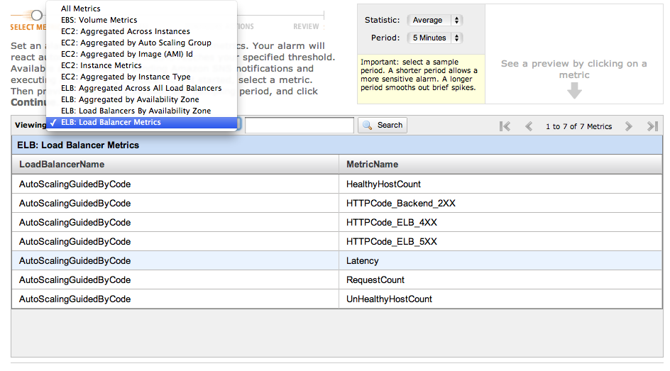
Alarm metrics

Slide 10
Create an alarm request. It is the last step to setup the Auto Scaling. The alarm request defines how to measure the metrics defined by the alarm metric, for example the time and period to evaluate the metric.

Slide 11
Talk is cheap. Show me the code.

Slide 12


Slide 13
Some advices

Slide 14
Don’t name your instances
You should change your instances as you change your underwear. Lucas Teixeira

Slide 15
Don’t forget to remove your tests

