Slide 1
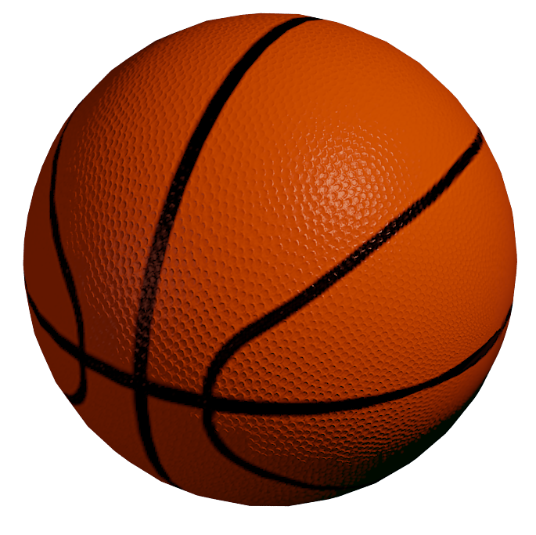
Question 1: Count the number of balls.

Slide 2
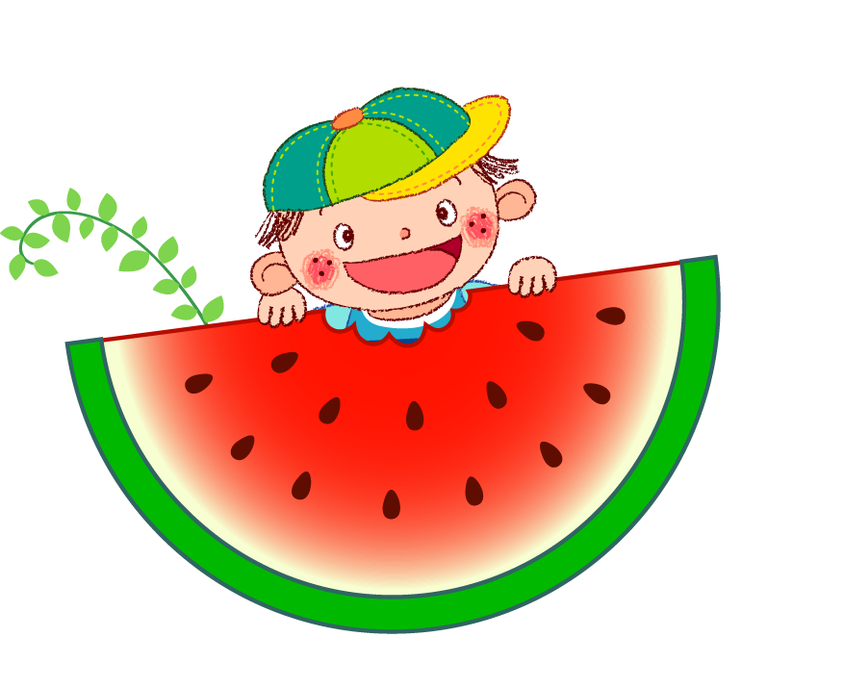
Question 2: Fill in the blank.
He is _________ a watermelon.

Slide 3
Question 3: What shape do you see?

Slide 4
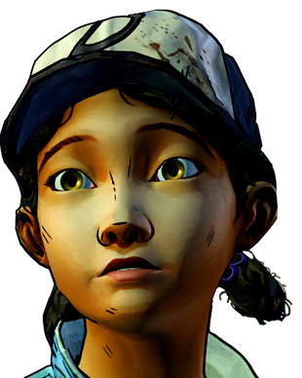
Question 4: What is the name of the circled body part?

Slide 5

Question 5: What is the color of the Sun?

