Slide 1
Quantifying the Impact of Edge Computing on Mobile Applications
Wenlu Hu, Ying Gao, Kiryong Ha, Junjue Wang,
Brandon Amos, Zhuo Chen, Padmanabhan Pillai (Intel),
Mahadev Satyanarayanan
Notes:
25 min including Q&A

Slide 2



Different Names of Edge Computing
Mobile Edge Computing
Fog Computing
Micro Data Centers
Cloudlets

Slide 3

What is a cloudlet?
Mobile Device
Cloud
Cloudlet
One-hop wireless network
Internet
Median RTT (ms) | Cloud | Cloudlet
WiFi | 75 | 1
LTE | 121 | 15
What if an application is both compute-intensive and latency-critical?
Average RTT to optimal cloud = 74ms (measured from 260 global vantage points) [1]
[1] A. Li, X. Yang, S. Kandula, and M. Zhang. Cloudcmp:comparing public cloud providers. In Proceedings of the 10th annual conference on Internet measurement, page 1-14. ACM, 2010.
Latency
Bandwidth
Scalability
95% RTT (ms) | Cloud | Cloudlet
WiFi | 92 | 11
LTE | 135 | 21

Slide 4
Of course cloudlets help.
But by how much?

Slide 5
Our Contribution
Quantified the difference between cloudlet and cloud
with a variety of applications
with WiFi and LTE network.

Slide 6
List of Evaluations
WiFi offloading – response time
LTE offloading – response time
WiFi offloading – energy
LTE offloading – energy tradeoff
Effects of interactivity
Effects of radio link management

Slide 7
List of Evaluations
WiFi offloading – response time
LTE offloading – response time
WiFi offloading – energy
LTE offloading – energy tradeoff
Effects of interactivity
Effects of radio link management

Slide 8
Experimental Setup - Application
Compute-intensive, latency-critical
3 pre-partitioned applications
Face Recognition
Mobile Augmented Reality
Fluid Simulation
3 dynamically partitioned applications
Linpack
CPU Benchmark
PI Benchmark

Slide 9

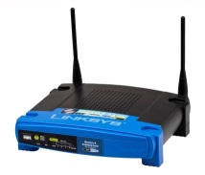
Experimental Setup - Network
EC2 West
EC2 Europe
EC2 East
EC2 Asia
Internet
No offload
WiFi cloudlet
WiFi cloud
LTE cloud
LTE cloudlet
Cloudlet
Cloudlet
In-lab Base Station
WiFi Access Point
Commercial Cell Tower
LTE (cloud)
WiFi
(cloudlet and cloud)
LTE (cloudlet)
Mobile Device

Slide 10
List of Evaluations
WiFi offloading – response time
LTE offloading – response time
WiFi offloading – energy
LTE offloading – energy tradeoff
Effects of interactivity
Effects of radio link management

Slide 11
WiFi Offloading – Response Time
Cumulative Distribution Function (CDF)
Typical cloud, EC2-West
(FACE)

Slide 12
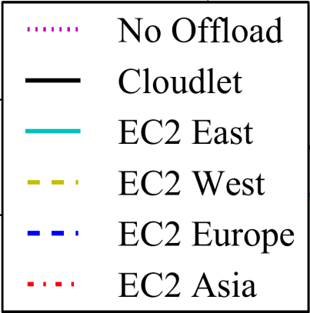
WiFi Offloading – Response Time
Valid across applications
MAR
Fluid
Linpack
CPU Benchmark
PI Benchmark

Slide 13
List of Evaluations
WiFi offloading – response time
LTE offloading – response time
WiFi offloading – energy
LTE offloading – energy tradeoff
Effects of interactivity
Effects of radio link management

Slide 14
LTE Offloading – Response Time
(FACE)
(FACE)

Slide 15
List of Evaluations
WiFi offloading – response time
LTE offloading – response time
WiFi offloading – energy
LTE offloading – energy tradeoff
Effects of interactivity
Effects of radio link management

Slide 16
WiFi Offloading - Energy
Energy consumed by the mobile device
Offloading to cloud usually saves energy
Offloading to cloudlet saves much more
Offload | None | Cloudlet | Cloud
Face (J/query) | 12.4 |  | 6.1
Fluid (J/query) | 0.8 |  | 0.9
MAR (J/query) | 5.4 |  | 4.3
Linpack (J/run) | 40.3 |  | 16.9
CPU (J/run) | 9.6 |  | 5.8
PI (J/run) | 129.7 |  | 107.6
Offload | None | Cloudlet | Cloud
Face (J/query) | 12.4 | 2.6 | 6.1
Fluid (J/query) | 0.8 | 0.3 | 0.9
MAR (J/query) | 5.4 | 0.6 | 4.3
Linpack (J/run) | 40.3 | 13.0 | 16.9
CPU (J/run) | 9.6 | 5.7 | 5.8
PI (J/run) | 129.7 | 53.9 | 107.6

Slide 17
More Details in the Paper
LTE offloading – energy tradeoff
Effects of interactivity
Effects of radio link management

Slide 18



Conclusion
Choice of offloading site is important
Cloudlet wins significantly over cloud
Valid across applications and networks
New genre of applications
compute-intensive and latency-critical
Cloudlet

Slide 19








Thank you!
Wenlu Hu
Ying Gao
Kiryong Ha
Junjue Wang
Brandon Amos
Zhuo Chen
Padmanabhan
Pillai (Intel)
Mahadev
Satyanarayanan

