Slide 1
Ubiquitous Keyboard for Small Mobile Devices: Harnessing Multipath Fading for Fine-Grained Keystroke Localization
J.J. Wang, Kaichen Zhao
and Xinyu Zhang
Chunyi Peng
University of Wisconsin-Madison
The Ohio State University

Slide 2
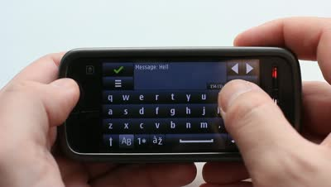
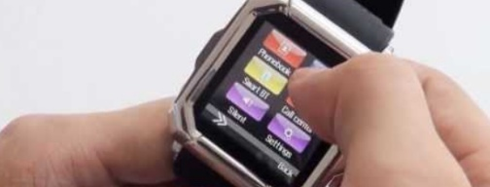
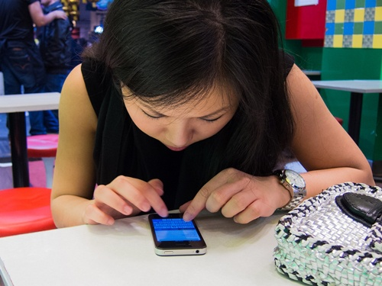

Touch screen is a bottleneck of mobile devices
Touch screen is shrinking. Fingers won’t change
Typing can be painful.
Notes:
Portable computing devices : powerful
Size of screen keeps shrinking
Typing hard: 1. screen too small 2. on screen virtual keyboard is error prone
Joke: yell at your smartphone

Slide 3
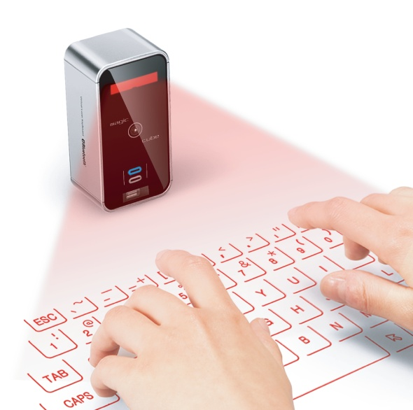
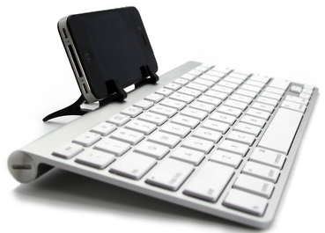
Existing Solutions -- Hardware
Bluetooth keyboard
Projection keyboard
Apple Wireless Keyboard $69
Celluon Laser Projection Keyboard $79.99
Notes:
Bluetooth keyboard and projection keyboard:
--- bulky hardware
--- expensive

Slide 4
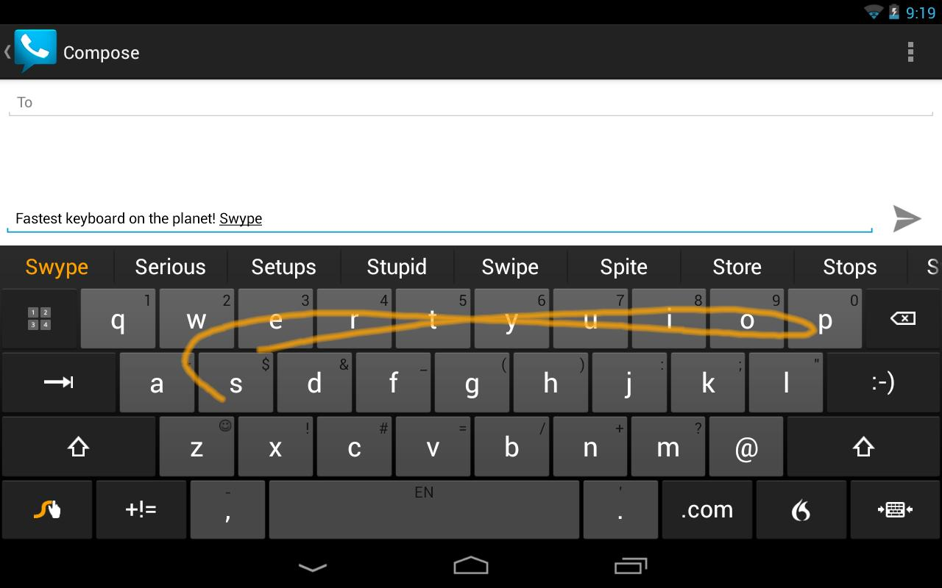
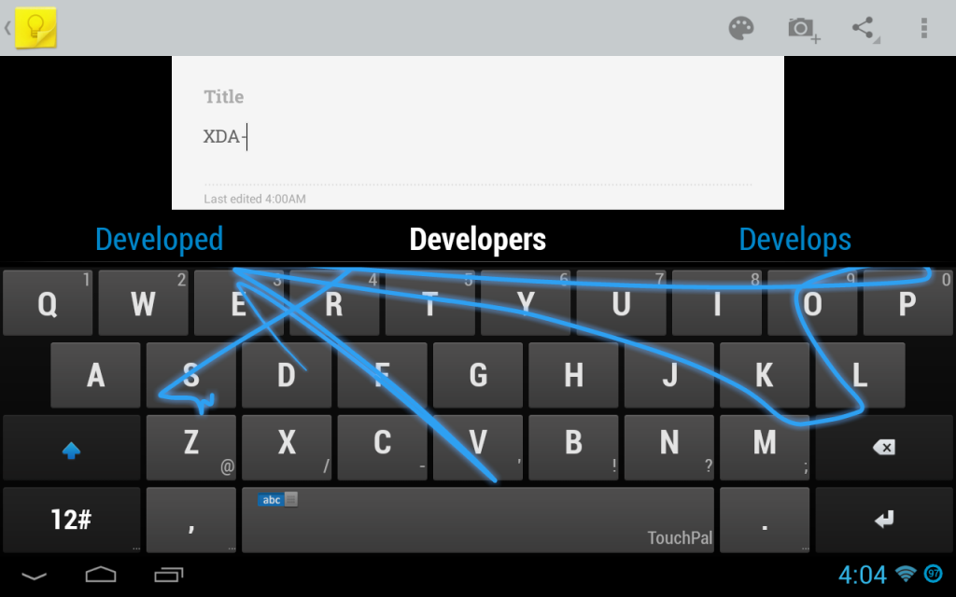
Existing Solutions -- Software
SwiftKey/Swype
Word
TouchPal X
Sentence
Notes:
swype
facilitate entering in one fingers
small screen

Slide 5
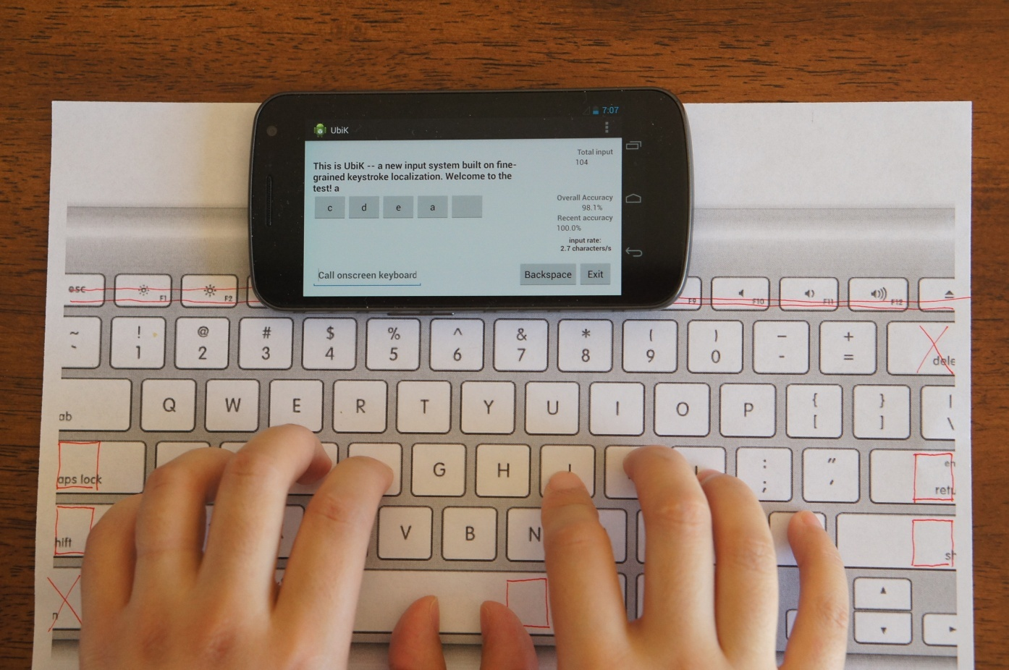
UbiK: The Ubiquitous Keyboard
Table (or other flat surface)
Smartphone
Printed keyboard
Notes:
PC-like typing experience on a normal size keyboard;
Using inherent sensing and computation components to identify keystrokes.
Spontaneous setup; no external hardware

Slide 6
UbiK: A Short Demo

Slide 7
UbiK: Challenges
#1: Is fine-grained keystroke localization feasible?
#2: How to make it work on COTS smartphones?
#3: How to make it reliable and robust?
Notes:
2cm of key distance
real-time sensing/computation
Reliable and robustness: phone/keyboard may be displaced during usage

Slide 8
#1: Is fine-grained keystroke localization feasible?
Notes:
At first, with gyroscope, 100 samples per second
Move to audio, several experiments
Experiment Setup:

Slide 9
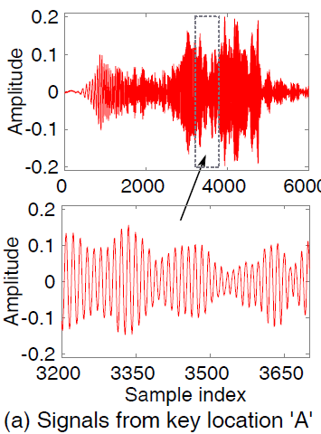
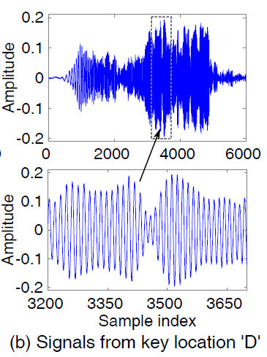
Evidence 1: multipath channel profile as signature
Experiment 1: a chirp tone sent from two different key locations, received by the same microphone
Notes:
Setup:
chirp signals two different key locations. Chirp signal same magnitude
Time Domain Signal Received by microphones:
different frequency suffer from fading differently
Around same frequency, fading effects are also different ??

Slide 10
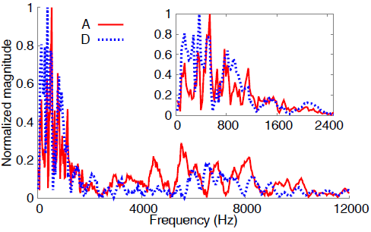
Evidence 1: multipath channel profile as signature
Experiment 2: Amplitude spectrum density of keystrokes at two different key locations
Notes:
Frequency Domain: (normalized)
Within first 1 KHz
different pattern
Question: is such signature consistent? Is it location based?

Slide 11
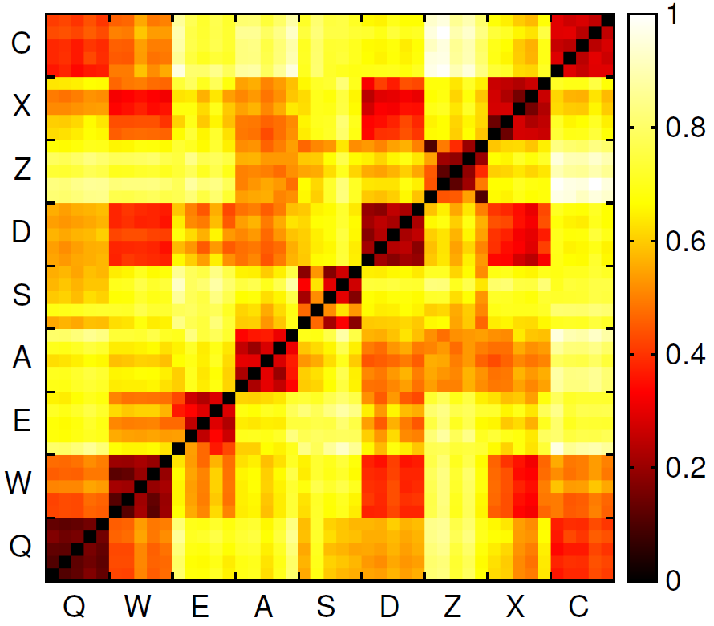
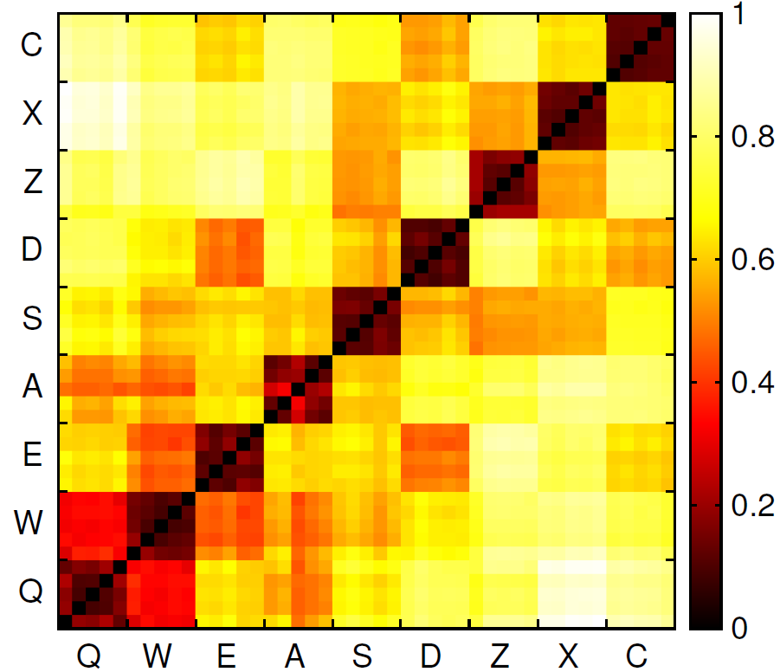
Evidence 2: Spatial Granularity
Experiment: Euclidean distance between ASD of sounds at 9 key locations, each repeated 5 times
(a) each sound source is created by finger/nail clicking on the key locations;
(b) the sound source is a chirp tone emitted from the key locations.
Notes:
Setup:
keystroke and chirp signal
plot their Euclidean distance of signature ASD
a):
each region represents the distance between corresponding two letters
the darker the color, the closer of signatures
question: 5 times, average of the
b):
Is it because of the surface ? Heterogeneous surface? Is it really location based?
use chirp signal

Slide 12
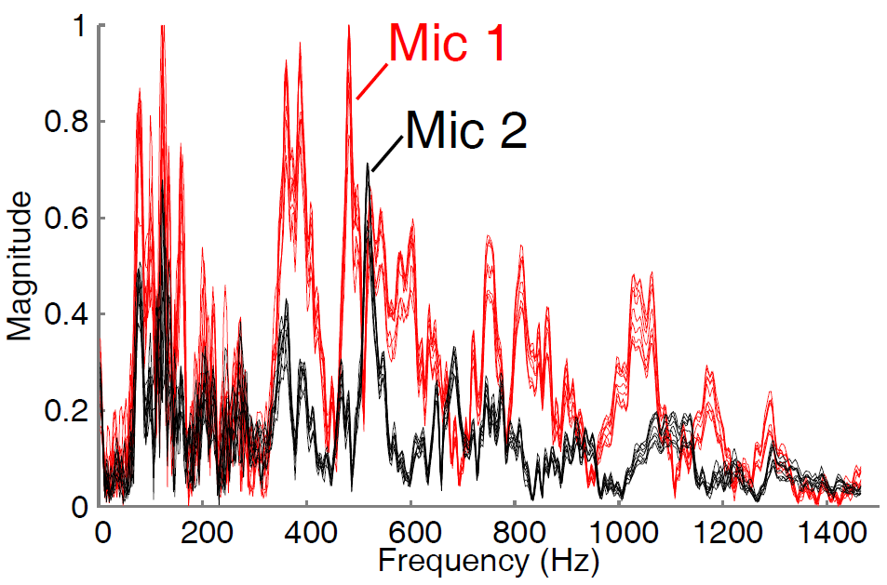
Evidence 3: Diversity from multiple microphones
Experiment: ASD of 10 key presses received by two microphones on the same Smartphone.
Notes:
10 key strokes, normalization, richer set of features

Slide 13
#2: How to make it work on COTS smartphones?

Slide 14
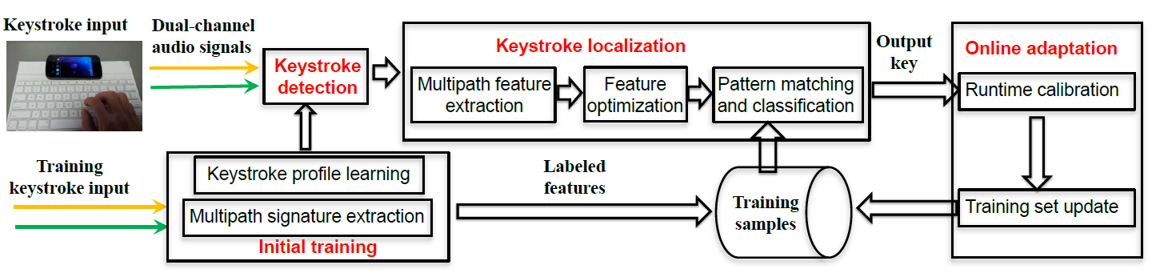
Solution Framework
Core components
Detection, localization, adaptation
Flow of operations
Training => typing & adaptation
Notes:
Core components:
detection
localization
adaptation
From initial training to keystroke detection is the noise level:

Slide 15
Keystroke detection
Basic detection
Energy level detection: key detected when sound signal energy passes a threshold (a bit above noise floor)
How to set the threshold?
Adapt threshold using Constant False Alarm Rate (CFAR) algorithm
Moving average of noise variance
Threshold =
Moving average of noise energy
A scalar (>1) for safe margin

Slide 16
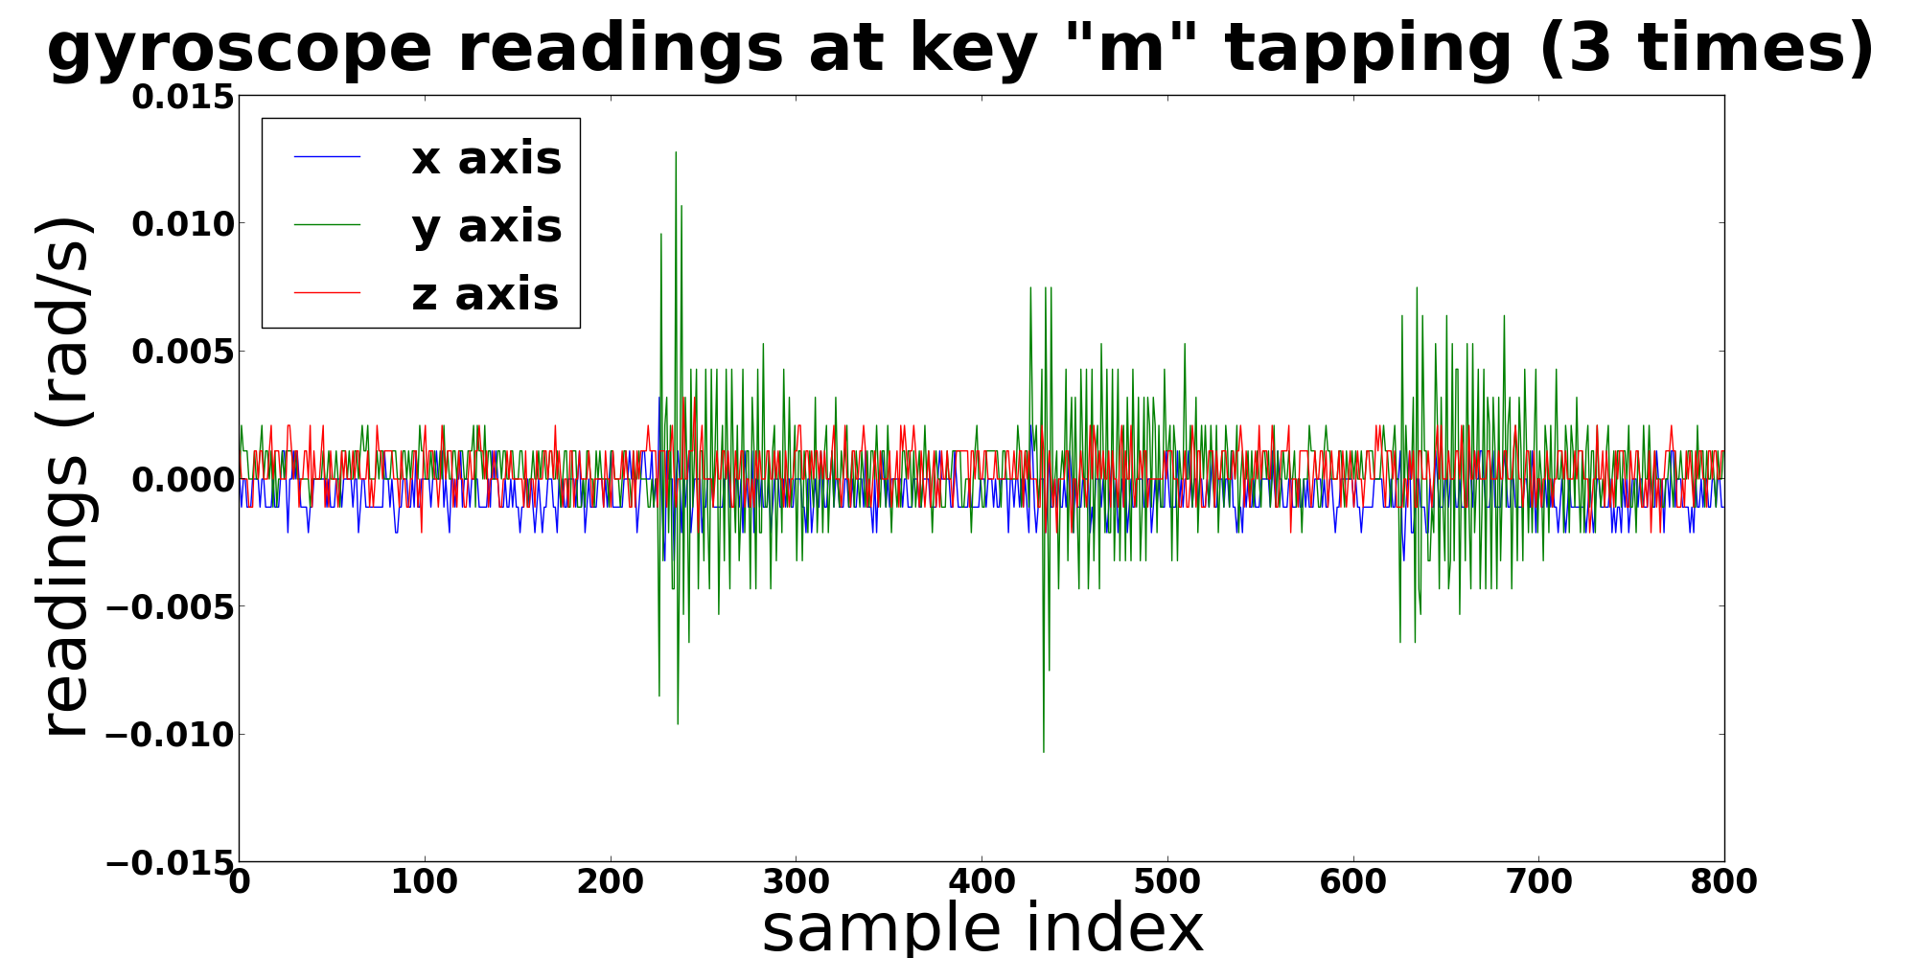
Keystroke detection
Combating bursty noise
Use motion sensor (gyro) to filter out bursty noise
Notes:
Keystrokes cause small vibration of phone body; human voice does not
On-screen touch noise causes much more significant shaking than on-surface keystrokes

Slide 17
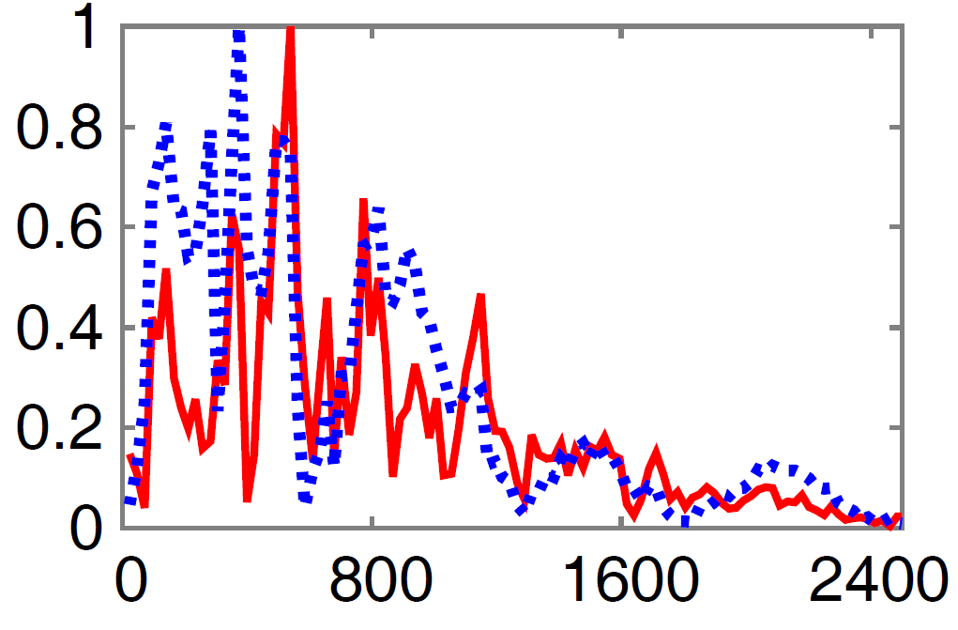
Localization signature design
Frequency-domain filtering of audio samples
High-frequency noise compromise stability of signature
Only use ASD below cutoff frequency J in signature
J differs on different surfaces
Cutoff frequency J
Normalized amplitude
Frequency (Hz)
Notes:
What frequency to use for ASD?
high-frequency usually are noises

Slide 18
Localization signature design
Determining cutoff frequency J
Our problem: finding optimal cutoff J, assuming all elements in the ASD feature vector have the same weight 1
Converted into a feasibility problem: finding the first J that satisfies:
For all training instances
Notes:
To find the best cutoff frequency,
1. assume all elements in ASD fetaure has same weight
2. find a hyperplane that separate correctly identified data with uncorrectly predicted data

Slide 19
Localization algorithm
Simplest pattern matching algorithm
Nearest neighbor algorithm
Experience: signature design matters more than matching algorithm
Signal conditioning before matching
Normalize ASD
Combat variation in click strength
Notes:
Note:
do tried neural network

Slide 20
#3: How to make it reliable and robust?

Slide 21
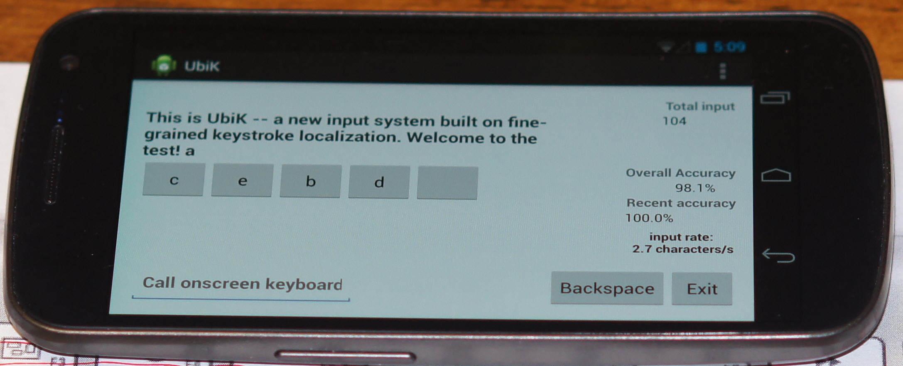
Runtime Adaptation
Runtime feedback provides unique opportunity for improving localization accuracy
User’s run-time correction, leveraging a candidate list
Implicit feedback: uncorrected keys => likely located correctly

Slide 22
Runtime Adaptation
For correctly located keys
Weight of training instance
Insert its ASD into training set
Increase weight of training instance that matched it
#of right matches
For wrongly located keys
Weight of training instance
Decrease weight of training instance that matched it
Remove from training set if it ranks lower than set size
#of wrong matches

Slide 23
Evaluation on Android Phone

Slide 24
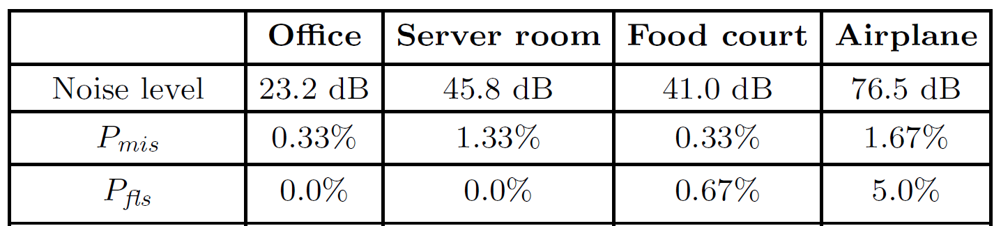
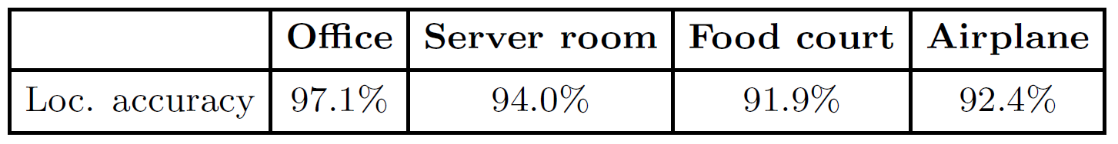
Baseline test of accuracy
Detection accuracy
Localization accuracy

Slide 25
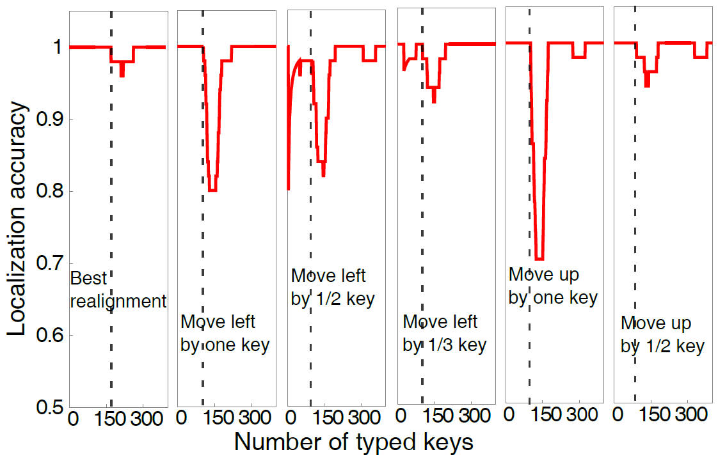
Impact of run-time adaptation
Quickly recover from disposition of smartphone
Best practice: reposition phone to original position (Best realignment)

Slide 26

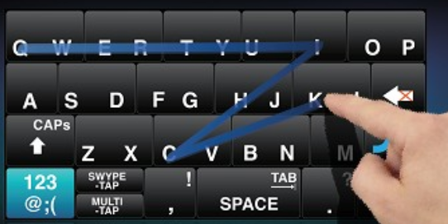
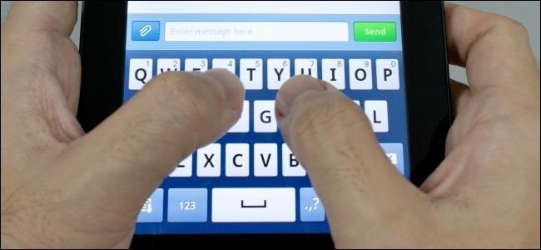
User study
Setup
7 users, 1 experienced, 2 familiar, 4 new to UbiK
Test UbiK in different environment: office, home, library
Benchmarks
PC keyboard, on-screen keyboard, Swype

Slide 27
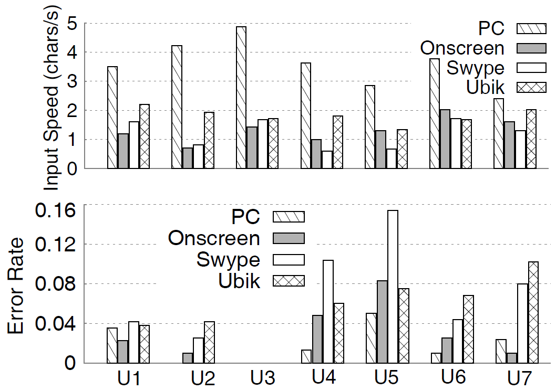
User study
Real text input
Experienced
Familiar
New

Slide 28
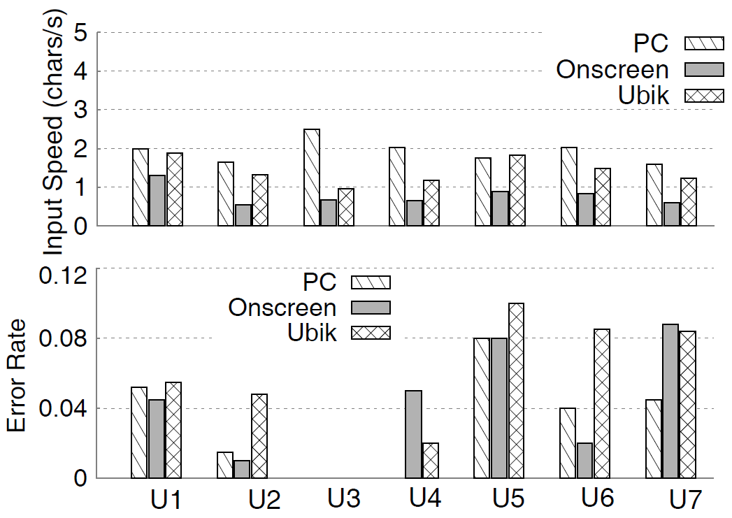
User study
Random text input

Slide 29
Other concerns
Lack of kinesthetic feedback
Hard to type on the correct keys for inexperienced users
Keystroke sound may be contaminated by noise

Slide 30
Conclusion
Text-entry: a major problem for mobile devices
UbiK: cast it as a fine-grained localization problem
Amplitude Spectrum Density as Features
Detection => localization => run-time adaptation
Ongoing work
Full migration to application-level to support more mobile devices
Further enhancement, e.g., dictionary

Slide 31
Thank you!
Welcome to our Ubik demo!
UbiK online demo: https://www.youtube.com/watch?v=RIIQGNYCFyk&feature=youtu.be

Slide 32
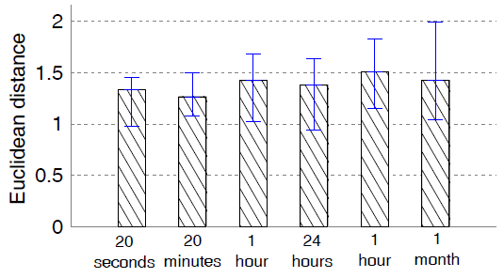
Evidence 2: Temporal Granularity
Experiment 2: Temporal variation of location signature (the ASD)
Notes:
Change this to the spatial correlation graph

Slide 33
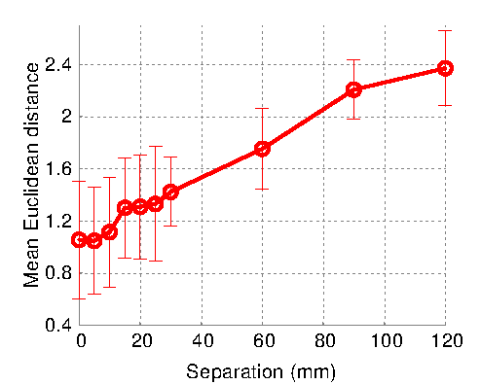
Evidence 2: Spatial Granularity
Experiment 2:
Mean Euclidean Distance between Testing and Anchoring Position
Notes:
Setup: (normalization)
Anchoring group of 25 clicks on a fixed position
Generate test keystrokes 5mm to 120 mm
Why doesn’t it go through the origin ? ( 0 is the mean within 25 clicks at anchoring grp?)
Keystrokes 10 cm apart has a larger separation than within 10 cm

Slide 34
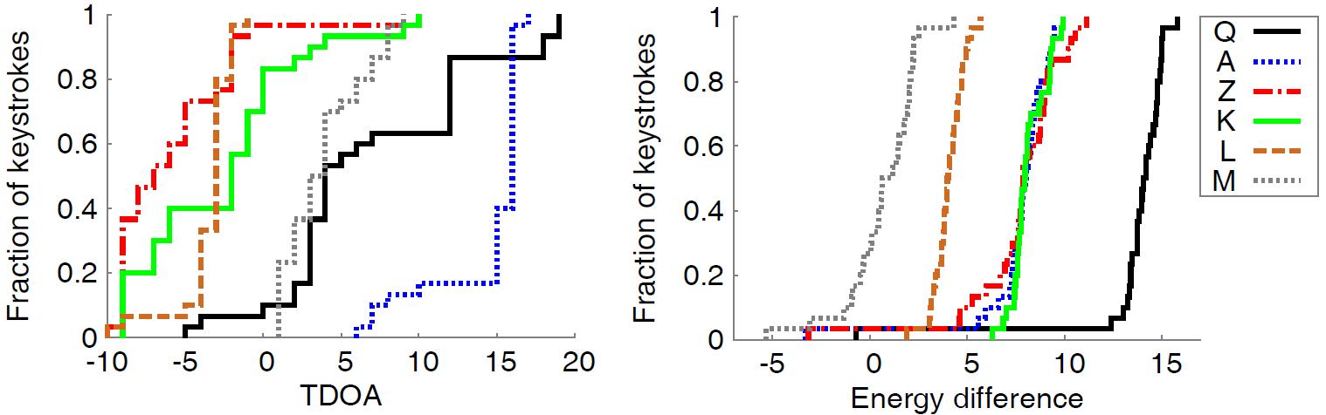
Traditional dual-mic acoustic localization algorithms
Ideally, TDOA and energy difference between the two mics can be used to pinpoint the keystroke sound
In reality, TDOA and energy difference are very unstable

Slide 35
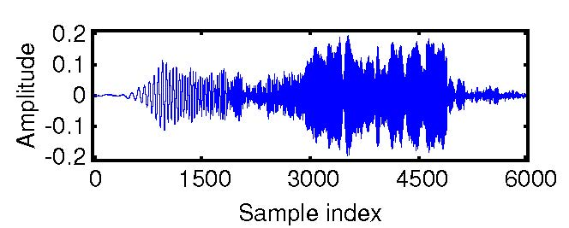
Localization signature design
Truncate time-domain audio samples
Onset point
Cutoff point: mean energy too low
Notes:
When to extract ASD?
noise level obtained from training setup, when there is a jump in energy ( which will quickly reaches to Pmax), then start
end is kept at 10% above the noise level

Slide 36
Notes:
Ubik user case

Slide 37

UbiK: Video
Notes:
PC-like typing experience on a normal size keyboard;
Using inherent sensing and computation components to identify keystrokes.
Spontaneous setup; no external hardware

Slide 38
Implementing UbiK on Android
Audio capturing
Dual-mic blocked by Android OS
Enabled through driver hacking
Detection/localization/adaptation
Implemented at application-level
Simple pattern matching algorithm => efficient processing
~50 ms localization delay

Slide 39
Localization signature design
Determining cutoff frequency J
Review: classical optimal separating hyperplane problem in statistical learning
Binary classification for a given feature vector
Equivalent to finding optimal weight vector and offset
that define the hyperplane.
is training label for i-th training instance.

Slide 40
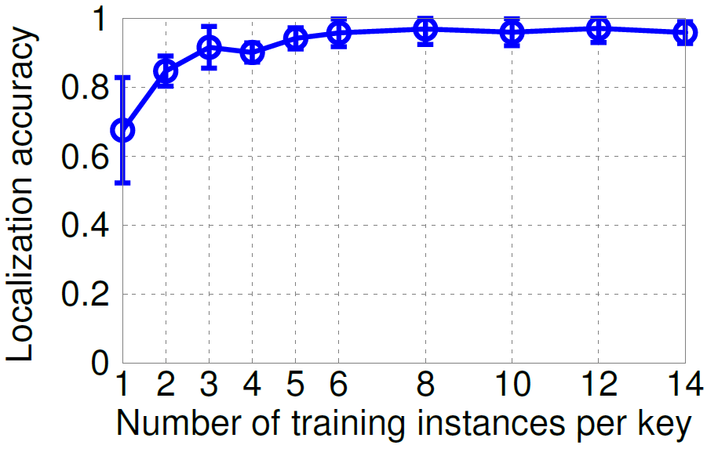
Impact of training
Accuracy increase quickly with training set size
~95% accuracy with training set size 5

Slide 41
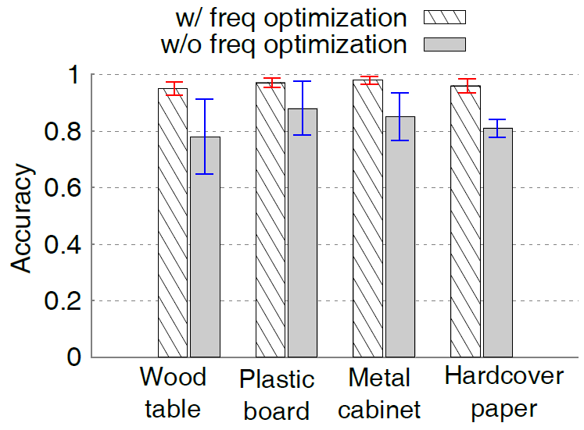
Impact of feature design
esp. Frequency range optimization

Slide 42
Keystroke detection
Basic detection
Energy level detection: key detected when sound signal energy passes a threshold (a bit above noise floor)
How to set the threshold?
Adapt threshold using Constant False Alarm Rate (CFAR) algorithm
Moving average of noise variance
Threshold =
Moving average of noise energy
A scalar (>1) for safe margin
Provable performance: false alarm rate is a constant given ; decreases exponentially with

