Slide 1




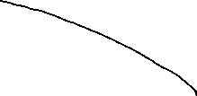






CMSC204
Kartchner
V(StateGraph) = {Oregon, Alaska, Texas, Hawaii, Vermont, NewYork, California}
E(StateGraph) = {(Alaska, Oregon), (Hawaii, Alaska), (Hawaii, Texas), (Texas, Hawaii), (Hawaii, California), (Hawaii, New York), (Texas, Vermont), (Vermont, California), (Vermont, Alaska)}
1. Draw the StateGraph

Slide 2
a. Show the adjacency matrix that would describe the edges in the graph. Store the vertices in alphabetical order
A C H N O T V
States
Alaska
California
Hawaii
NewYork
Oregon
Texas
Vermont
0 0 0 0 1 0 0
0 0 0 0 0 0 0
1 1 0 1 0 1 0
0 0 0 0 0 0 0
0 0 0 0 0 0 0
0 0 1 0 0 0 1
1 1 0 0 0 0 0
3. b. Show the adjacency lists
that would describe the edges in the graph
A -> O C -> none H -> A, C, N, T N -> none O -> none T -> H, V V -> A, C

Slide 3
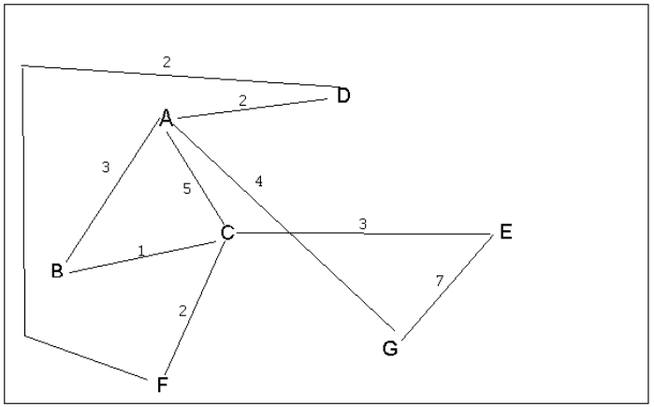
4 a. Which of the following lists the graph nodes in depth first order beginning with E?
A) E, G, F, C, D, B, A
B) G, A, E, C, B, F, D
C) E, G, A, D, F, C, B
D) E, C, F, B, A, D, G
4 b. Which of the following lists the graph nodes in breadth first order beginning at F?
A) F, C, D, A, B, E, G
B) F, D, C, A, B, C, G
C) F, C, D, B, G, A, E
D) a, b, and c are all breadth first traversals

Slide 4
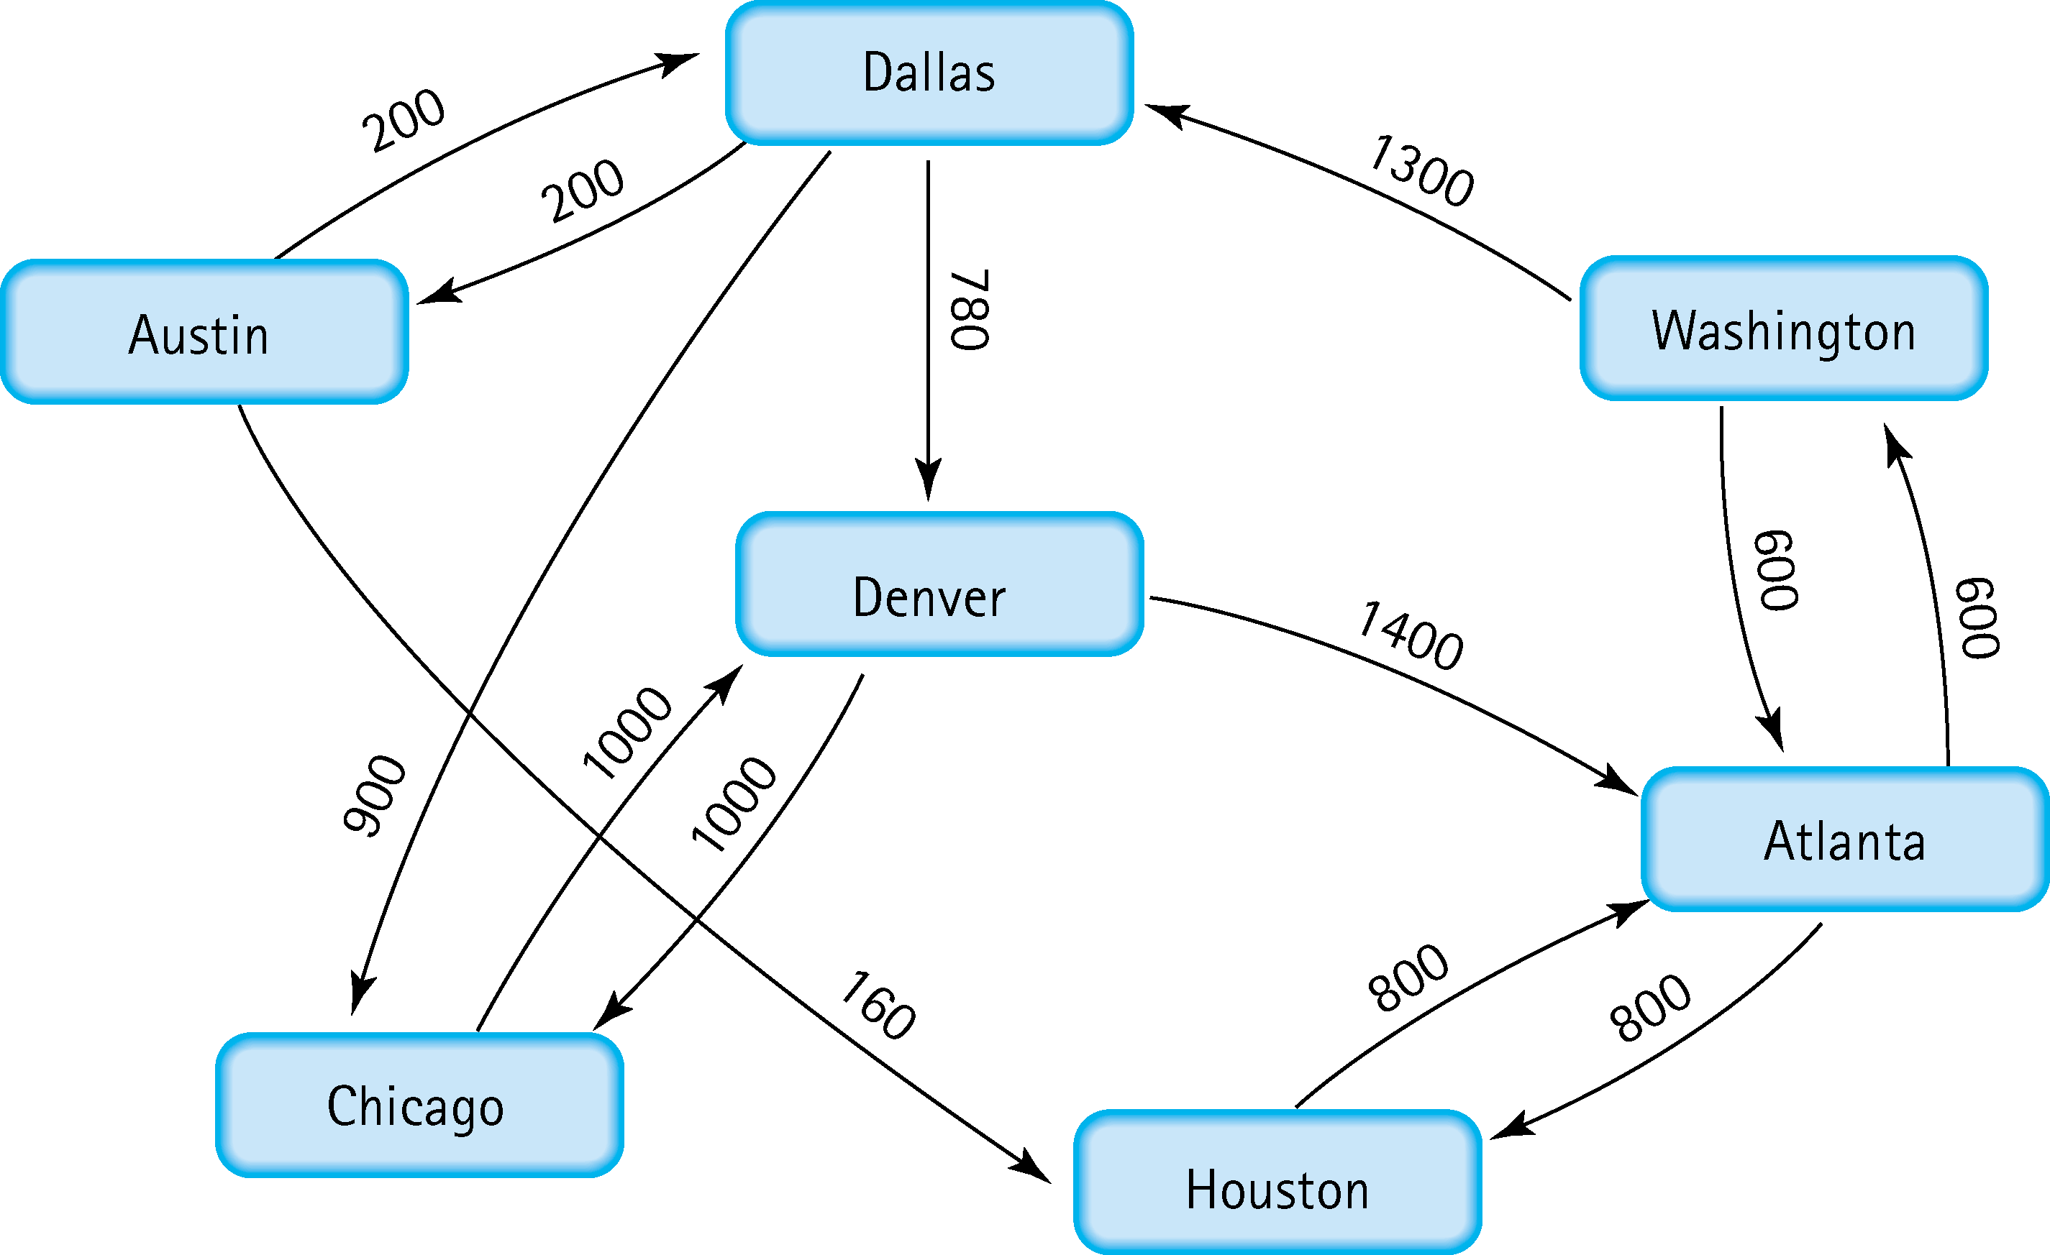
5. Find the shortest distance from Atlanta to every other city
Atlanta – Washington: 600
Atlanta – Houston: 800
Atlanta – Denver: 2680
Atlanta – Chicago: 3680
Atlanta – Dallas: 1980
Atlanta – Austin: 2100

Slide 5
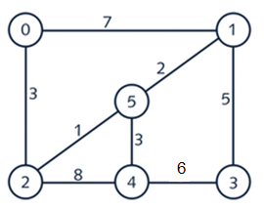
6. Find the minimal spanning tree using Prim’s algorithm. Use
0 as the source vertex . Show the steps.
Least cost is from 0 to 2, (3)
Least cost is from 2 to 5, (1)
Least cost is from 5 to 1, (2)
Least cost is from 5 to 4, (3)
Least cost is from 1 to 3, (5)
Min Spanning tree complete

Slide 6
7. Find the minimal spanning tree using Kruskal’s algorithm.
Show the weights in order and the steps.
Minimum is 2 to 5, (1)
Minimum is 5 to 1, (2)
Minimum is 5 to 4, (3)
Minimum is 0 to 2, (3)
Minimum is 1 to 3, (5)
Min Span Tree is complete,
Every other edge forms a cycle

Slide 7
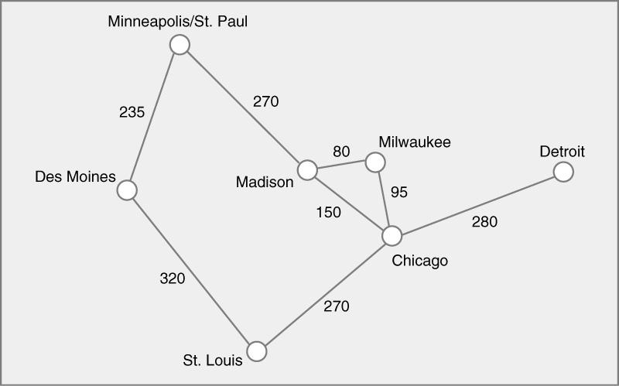
8. Find the minimal spanning tree using the algorithm you prefer. Use
Minneapolis/St. Paul as the source vertex
Prims:
St. Paul and Des Moines
St. Paul and Madison
Madison and Milwaukee
Milwaukee and Chicago
Chicago and St. Louis
Chicago and Detroit
Min Spanning Tree complete

Slide 8
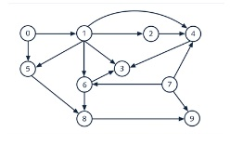
9. List the nodes of the graph in a breadth first topological ordering. Show the
steps using arrays predCount, topologicalOrder and a queue
0 → 1, 5
1 → 2, 3, 4, 5, 6
2 → 4
4 → 3
5 → 8
6 → 3, 8
7 → 4, 6, 9
8 → 9:
Node | predCount
0 | 0
1 | 1
2 | 1
3 | 3
4 | 3
5 | 2
6 | 2
7 | 0
8 | 2
9 | 2
Queue = [0, 7], remove 0, Topological Order = [0], update: 1 → 0, 5 → 1, Queue = [7, 1]
Queue = [7, 1], remove 7, Topological Order = [0, 7], update: 4 → 2, 6 → 1, 9 → 1, Queue = [1]
Queue = [1], remove 1, Topological Order = [0, 7, 1], update: 2 → 0, 3 → 2, 4 → 1, 5 → 0, 6 → 0, Queue = [2, 5, 6]
Queue = [2, 5, 6], remove 2, Topological Order = [0, 7, 1, 2], update: 4 → 0, Queue = [5, 6, 4]
Queue = [5, 6, 4], remove 5, Topological Order = [0, 7, 1, 2, 5], update: 8 → 1, Queue = [6, 4]
Queue = [6, 4], remove 6, Topological Order = [0, 7, 1, 2, 5, 6], update: 3 → 1, 8 → 0, Queue = [4, 8]
Queue = [4, 8], remove 4, Topological Order = [0, 7, 1, 2, 5, 6, 4], update: 3 → 0, Queue = [8, 3]
Queue = [8, 3], remove 8, Topological Order = [0, 7, 1, 2, 5, 6, 4, 8], update: 9 → 0, Queue = [3, 9]
Queue = [3, 9], remove 3, Topological Order = [0, 7, 1, 2, 5, 6, 4, 8, 3], Queue = [9]
Queue = [9], remove 9, Topological Order = [0, 7, 1, 2, 5, 6, 4, 8, 3, 9], Queue = []
topologicalOrder =
[0, 7, 1, 2, 5, 6, 4, 8, 3, 9]

Slide 9
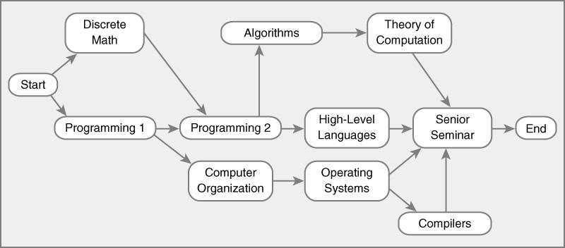
10. List the nodes of the graph in a breadth first topological ordering.
Discrete Math, Programming 1, Programming 2, Computer Organization, Algorithms, High-Level Languages, Operating Systems, Theory of Computation, Senior Seminar, Operating Systems, End, Compilers

