Slide 1
Minesweeper Game Project
AI • JavaFX • Undo/Redo • DSA • Ranking System

Slide 2
Live Demo
  Demonstration of gameplay mechanics
  AI Move acting on the board
  Undo/Redo illustrating state history control
  Mine counter and timer updates in real-time

Slide 3
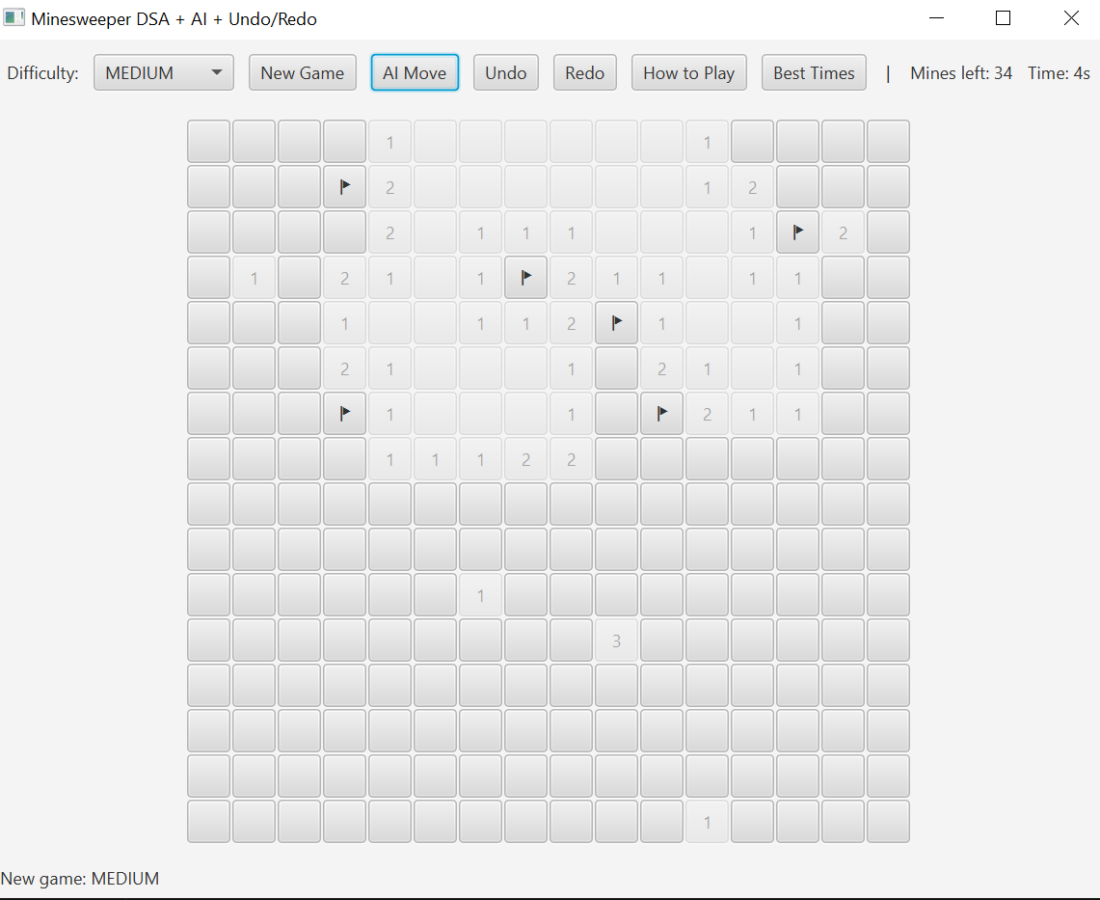
Gameplay Interface (Real Screenshot)

Slide 4
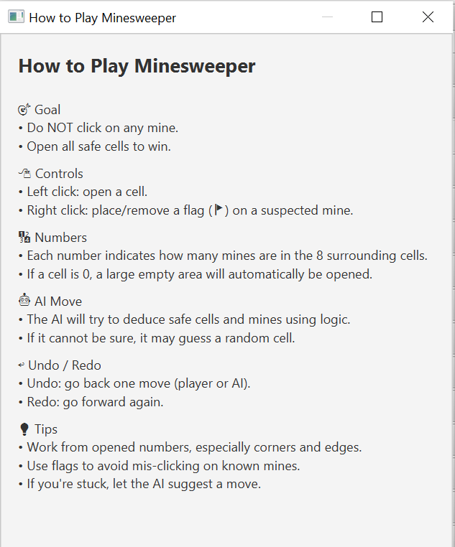
How to Play Tutorial Window

Slide 5
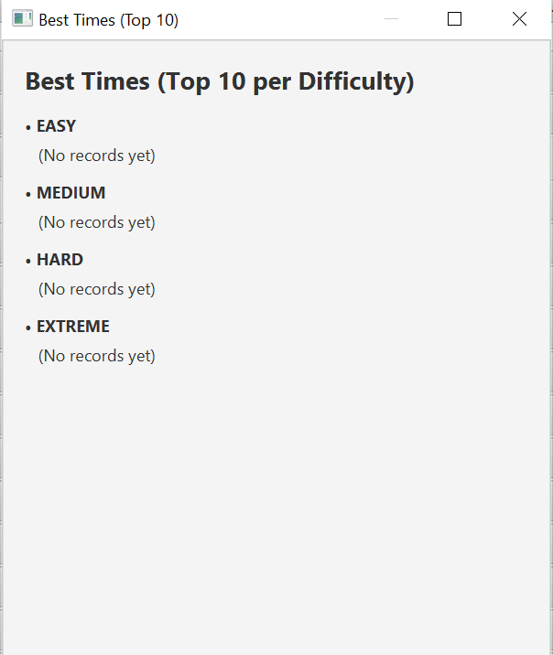
Best Times Record Window

Slide 6
Architecture Diagram
  System layered architecture:
  UI Layer → Service Layer → Model Layer → Utility Layer
  High cohesion, low coupling
  Supports extensibility and unit testing

Slide 7
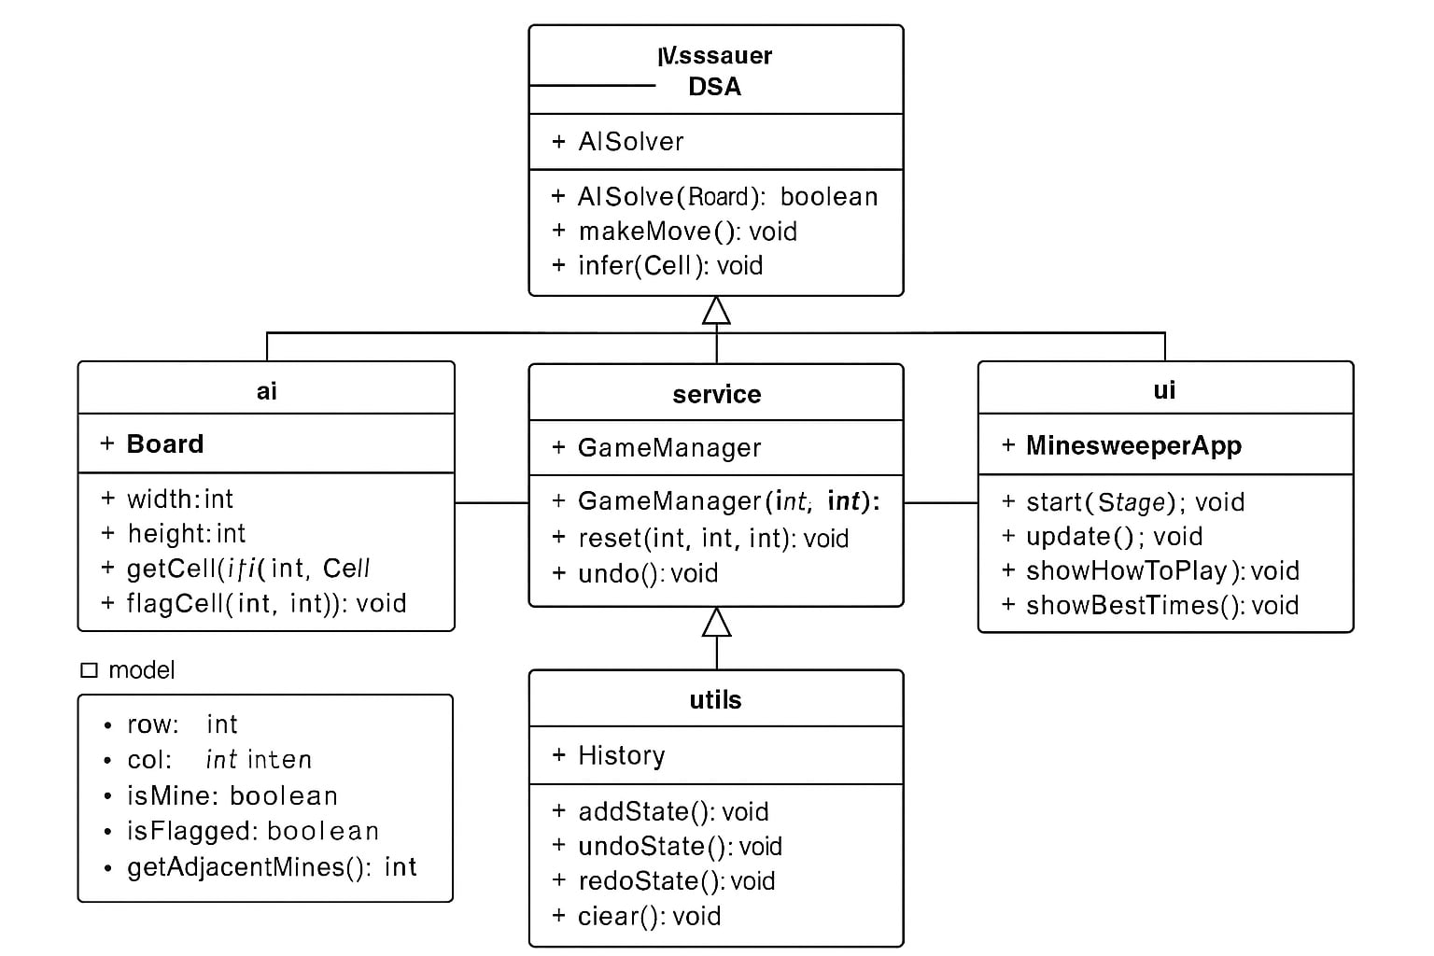
UML Diagram (Image)

