Slide 1
Minesweeper DSA Project
  JavaFX • AI • Undo/Redo • Ranking System

Slide 2
Live Demo Overview
  AI Move demonstration
  Undo/Redo
  Timer
  Mine counter
  Gameplay flow

Slide 3
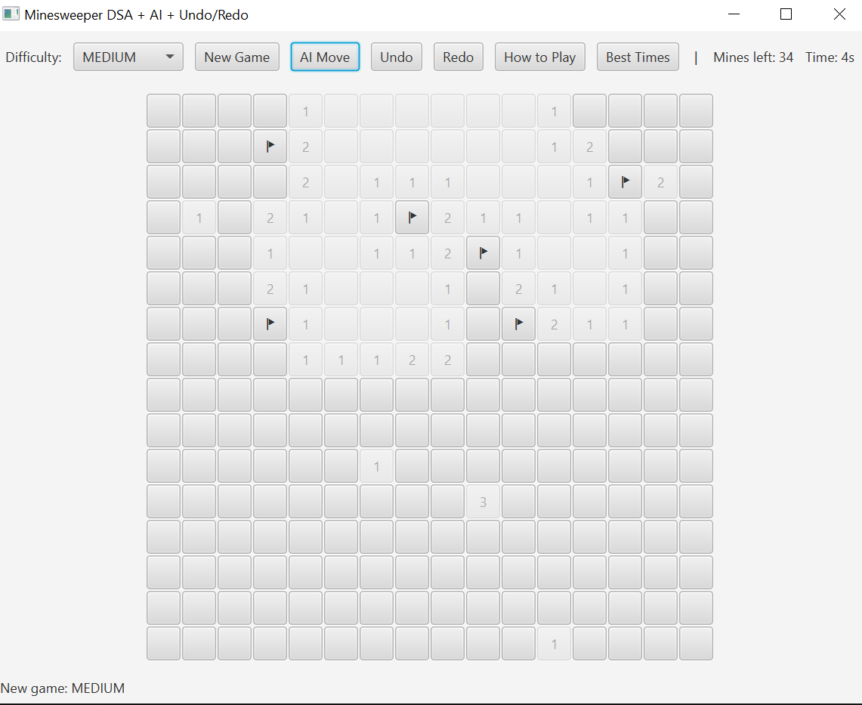
Gameplay Interface

Slide 4
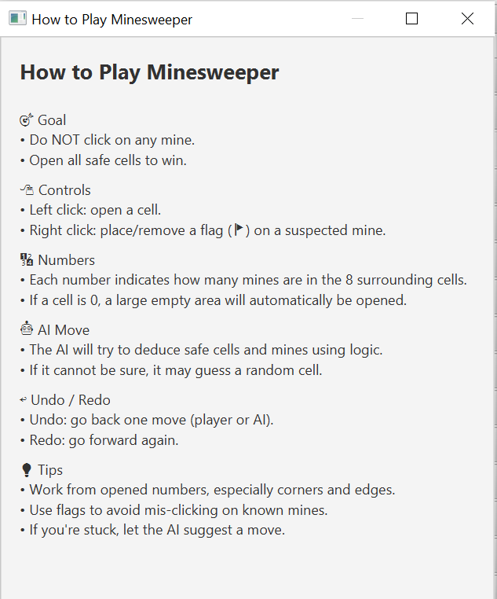
How to Play Window

Slide 5
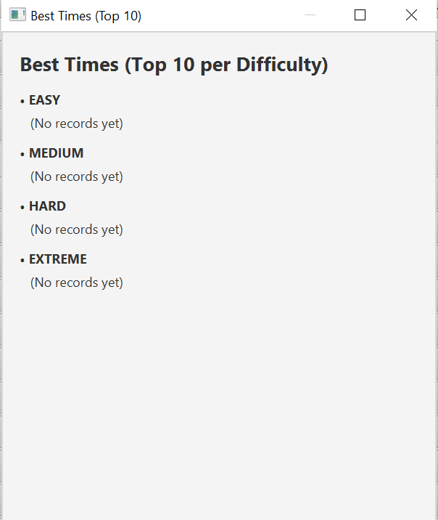
Best Times Window

Slide 6
System Architecture Overview
  UI Layer
  Service Layer
  Model Layer
  Utils Layer

Slide 7
Architecture Diagram
  UI → Service → Model → Utils
  Loose coupling, high cohesion

Slide 8
UML Class Diagram
  GameService
  AISolver
  StatisticsService
  Board
  Cell

Slide 9
Classes Overview – Core
  GameService: main logic
  AISolver: logical inference
  StatisticsService: rankings

Slide 10
Classes Overview – Supporting
  Board / Cell
  FloodFill
  BoardGenerator
  MinesweeperApp

Slide 11
Data Structures Used
  2D Array
  Queue
  Stacks
  PriorityQueue
  EnumMap

Slide 12
Why These Structures?
  Efficient access
  Undo/Redo model
  Fast BFS
  Top-10 management

Slide 13
BFS Flood-Fill Algorithm
  Expands zero regions
  Reveals boundary numbers
  Avoids recursion issues

Slide 14
Undo/Redo Mechanism
  Two stacks
  Command Pattern
  Full state restore

Slide 15
AI Solver Algorithm
  Deterministic inference
  Logical deduction rules
  Random safe guess fallback

Slide 16
GUI Layout
  JavaFX GridPane
  Toolbar controls
  Dynamic tile rendering

Slide 17
Gameplay Interactions
  Left click: reveal
  Right click: flag
  AI Move
  Undo/Redo

Slide 18
Testing Strategy – Functional
  Reveal logic
  Flag logic
  Flood-fill
  AI tests

Slide 19
Testing Strategy – System-Level
  Undo/Redo stress test
  Persistence testing
  Extreme board performance

Slide 20
Evaluation
  Stable performance
  Accurate AI
  Reliable Undo/Redo
  Smooth GUI

Slide 21
Future Work
  Probabilistic AI
  Online leaderboard
  Themes & animations
  Mobile version

Slide 22
Conclusion
  Strong DSA integration
  Scalable architecture
  Complete feature-rich game

