Slide 1
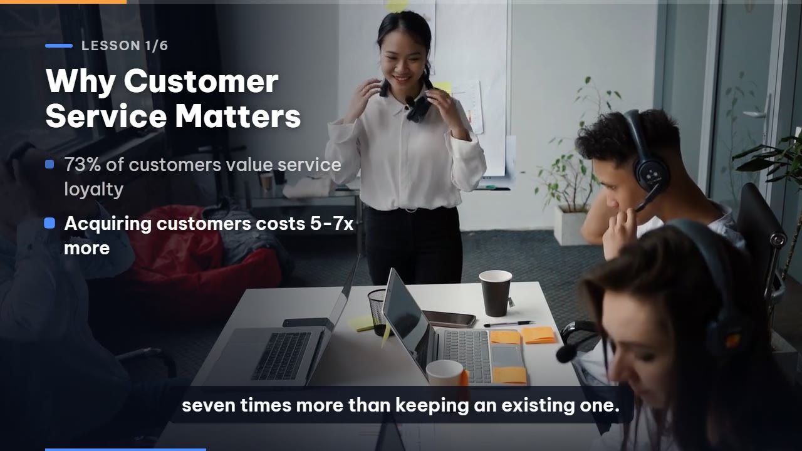
SmartTutor
Turn any document into a training course
One upload. A narrated video under 5 minutes and a one-page infographic, in a few minutes.
Real output: a frame from a video SmartTutor generated
[Your name] · [Position] · October 2026
Notes:
Good morning. Thank you for your time today. I am [name], applying for [position]. My solution is SmartTutor: a mobile app that turns any document, such as a policy, a process or an onboarding guide, into a complete training course: a narrated video under five minutes and a one-page infographic. It takes a few minutes and costs about six cents per course. In about eight minutes I will cover four parts: what the app is, a demo, how the system works, and finally the current limitations and the roadmap.

Slide 2
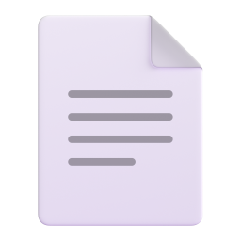


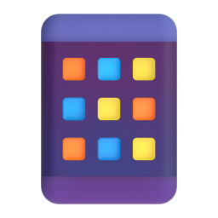


What is SmartTutor?
For HR and training teams who have plenty of documents but no time to produce training videos.
Training video
Narrated, real footage, captions, under 5 minutes
AI · a few minutes
INPUT
One document
Infographic
PDF, DOCX or TXT: a policy, process or onboarding guide
Key numbers, ideas, steps, do / avoid and a quick quiz
Works on a phone
Written in the document's language
About $0.06 per course
Notes:
SmartTutor is for HR and training teams who have plenty of documents but no time to produce training videos. You open the app on your phone, pick a document and tap Generate. A few minutes later you get two things. First, a training video under five minutes, with narration, real footage, and on-screen points and captions that follow the voice. Second, a one-page infographic with the key numbers, key ideas, steps, do and avoid tips, and a quick check question. Employees watch the video to understand and keep the infographic as a reference. The app writes and narrates in the language of the document. Let me show you.

Slide 3


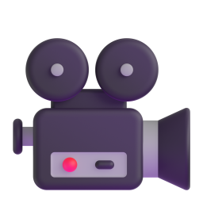

Demo
Pick a document
A 2-page onboarding guide
Generate
The app shows each AI step live
Watch the video
Voice, real footage, captions
Save or share
Video and infographic
Insert or link the demo video here
Notes:
This is a two-page onboarding guide for new employees. I open the app, pick the file and tap Generate. The app shows each step the AI is working on: reading the document, writing the script, recording the voice, finding footage and rendering. I have sped this part up; in real time it takes about four minutes. Here is the result: narration, real footage, key points that appear exactly when they are spoken, and captions. And this is the infographic: key numbers, key ideas, steps, do and avoid, and a quick check. Both can be saved or shared with colleagues.

Slide 4
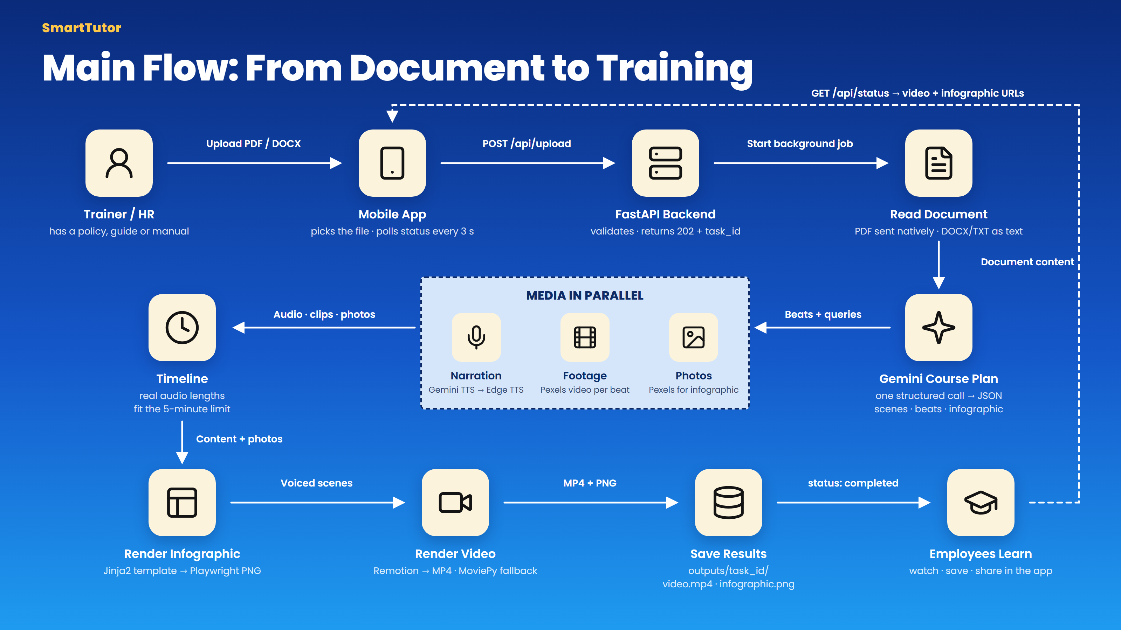
Notes:
The pipeline has four main steps. One: Gemini reads the document and writes the whole course in a single structured call, so the video and the infographic always agree. Two: media is produced in parallel: narration, real footage from Pexels, and photos for the infographic. Three: the system measures the real length of the voice-over to guarantee the video stays under five minutes. Four: the infographic and the video are rendered by code, so every word is spelled correctly, including Vietnamese diacritics. Finally the app polls the status and downloads the results.

Slide 5
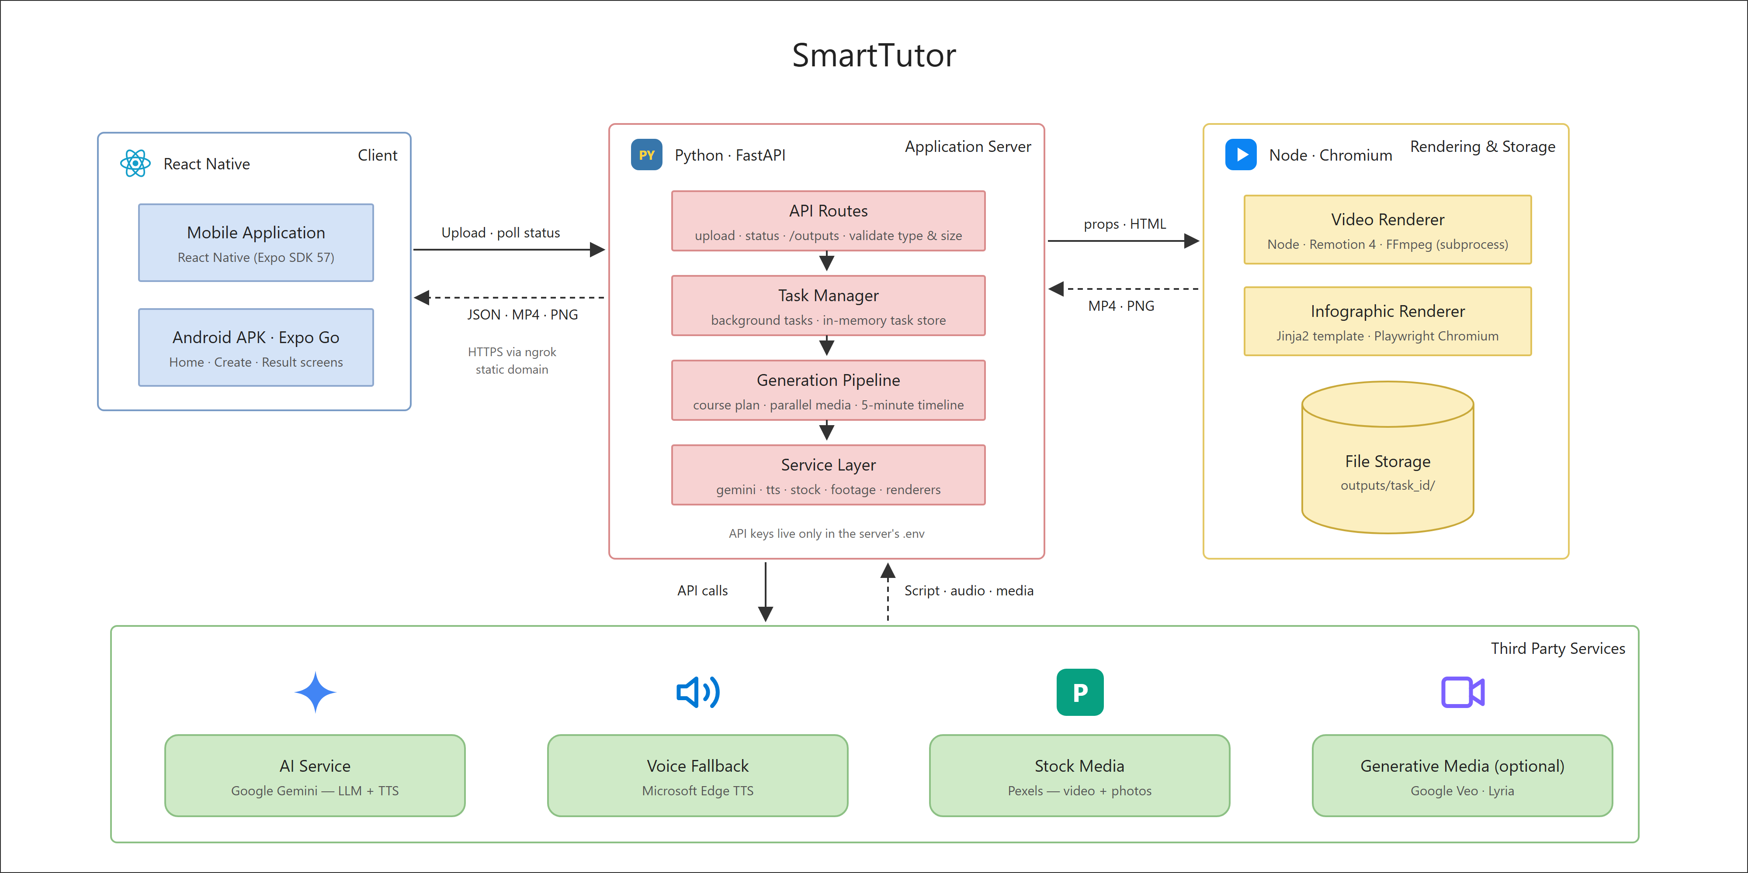
System architecture
Notes:
The system has four blocks: the mobile app, the application server, the video and infographic renderers, and external AI services. The app uploads the document; the server immediately returns a task id and works in the background while the app polls for progress, so an unstable mobile connection never loses the result. On security: the mobile app holds no API keys; every key lives only on the server.

Slide 6
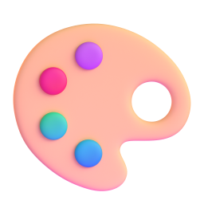


Three key decisions
AI writes, code designs
Real footage over AI video
A fallback for every step
The AI only produces structured content. Templates render every word, so text is always correct and the result looks designed.
We tested Google Veo: impressive, but hundreds of times more expensive and quota-limited. Veo stays available behind one setting.
Voice falls back to free Microsoft voices, the renderer to a simpler engine. Running out of quota still produces a video.
Notes:
Three decisions I want to highlight. First, the AI writes content and code owns the design. Image models still misspell text, so I never let the AI draw text. Second, I tested Google Veo for AI-generated video. The shots look great, but it costs hundreds of times more and has a daily quota. For training, real footage is cheaper and never shows the wrong thing. Veo is still in the code, enabled with one setting. Third, every step has a fallback: if Gemini voices run out of quota the app switches to free Microsoft voices, and if the animated renderer fails it uses a simpler one.

Slide 7
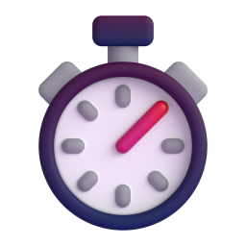

Cost and time
$0.06
3–6 min
< 5 min
per course
per course on a laptop
video length, guaranteed
Estimated. Only the AI writing and voice are paid; footage, photos and rendering are free.
Mostly video rendering, which runs at about real time frame by frame.
Enforced from the measured length of the voice-over, not a guess.
In the cloud, Remotion Lambda renders the video in parallel chunks: minutes become tens of seconds.
Notes:
The estimated cost is about six cents per course. Footage, photos and rendering are free; only the AI writing and voice are paid. A course takes three to six minutes, mostly rendering, because the video is drawn frame by frame. The five-minute limit is guaranteed from the measured voice-over. In the cloud, Remotion Lambda renders chunks in parallel and brings this down to tens of seconds.

Slide 8




Current limitations
Runs on a laptop
No limit on parallel jobs
Task status lives in memory and is lost on restart.
Several uploads at once slow the machine down.
Next: cloud VM, Redis or a database
Next: a job queue and render workers
Minutes per course
No accounts yet
Rendering runs at about real time.
No login, roles or file retention policy.
Next: parallel rendering in the cloud
Next: authentication and auto-cleanup
Notes:
I also want to be clear about the limits of this version. The server runs on a laptop and task status is kept in memory, so a restart loses it. Several uploads at once slow the machine down because there is no queue yet. A course takes minutes to render. And there are no accounts or roles yet. This is a demo built within the assignment time, and each point already has a planned fix, which brings me to the roadmap.

Slide 9


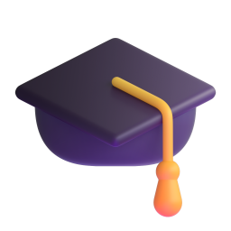


Roadmap
Cloud, queue and parallel rendering
Review before rendering
Many users at once, seconds per course
HR edits the script to control content
Scored quizzes and LMS export
Accounts and learning history
Fits the company's existing learning platform
Track who has completed each course
SmartTutor: a training module for an HR platform
Notes:
If I continue, I would prioritise three things. One: move to the cloud with a job queue and parallel rendering, so many users can generate at once in seconds. Two: let HR review and edit the script before rendering, to stay in control of the content. Three: scored quizzes and export to the company's LMS. I see SmartTutor as a training module in an HR platform: HR uploads processes and policies, the system builds the lessons, and tracks which employees completed them.

Slide 10

Thank you
SmartTutor: turn any document into a training course
Source code github.com/phucdhcoder19/smarttutor
APK and demo video linked in the README
Notes:
Thank you for listening.

Slide 11


Questions & answers
Why not AI-generated video?
Why does it take minutes?
Can the AI make things up?
Veo is supported behind one setting, but costs hundreds of times more.
Frame-by-frame rendering; cloud rendering in parallel takes seconds.
It reads the source directly; numbers come only from the document.
Is it secure?
Does it support Vietnamese?
What about many users?
No keys in the app; documents go only to our server and Gemini.
Yes. It writes and narrates in the language of the document.
Next step: a job queue with separate render workers.
Notes:
Why not AI-generated video like the ones online? Those are made with Veo, which costs hundreds of times more and has a daily quota. The code supports it behind one setting, but for training I chose real footage: cheap and never wrong.
Why does it take minutes? The video is rendered frame by frame at about real time on a laptop. In the cloud it renders in parallel chunks and takes tens of seconds.
Can the AI make things up? It reads the original document directly and numbers are only taken from the document. The next step is to let HR review the script before rendering.
Is it secure? The app holds no keys. Documents only go to our server and Gemini. Production would add login, roles and automatic file cleanup.
Vietnamese? Yes: the course is written and narrated in the language of the document; English, Vietnamese and Indonesian are supported today.
Many users at once? Today it runs on one machine, so it slows down. In production, rendering moves to separate workers behind a queue that scale with demand.

