Slide 1
Function of Hive & Pig
Collection
Preparation
Presentation
Stages of Processing Large Data
Hive & Pig

Slide 2

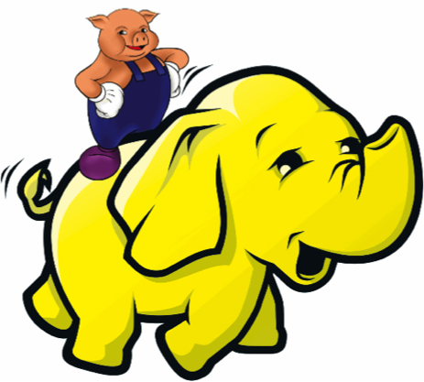
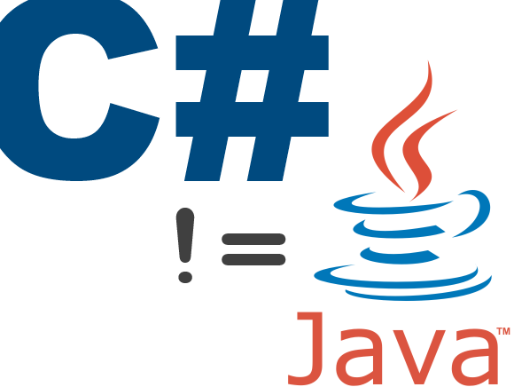
When to use each?
Vs.
Vs.
C#/Java MapReduce
Pig
Notes:
Hive appeals to the existing community that is comfortable with SQL, which let’s be honest, has been around for a long time and predates even C++. The idea behind Hive is that we don’t need another scripting language when we have an existing one. SQL integration allows for BI integrations. It also has an ODBC driver which lets your applications query your data directly.

Slide 3
Why Hive?
SQL spoken here (HiveQL)
ODBC driver
BI Integration
Supports only Structured Data
Hive
Notes:
Hive appeals to the existing community that is comfortable with SQL, which let’s be honest, has been around for a long time and predates even C++. 70% of all the map reduce functions performed by data researchers at Yahoo last year were hive operations. The idea behind Hive is that we don’t need another scripting language when we have an existing one. There is so much infrastructure and legacy code that depend on huge amounts of SQL code. SQL compatibility makes these migrations much less troublesome. SQL integration allows for BI integrations. It also has an ODBC driver which lets your applications query your data directly. However the biggest downside to Hive is that it only supports structured data. You need established relationships… Which some would argue defeats the entire purpose of Hadoop. Hadoop by nature is designed to store data, structure and unstructured, which allows it flexibility. The idea of Hadoop is that data is coming at you in such volume and velocity that you don’t have time to structure it.

Slide 4

Why Pig?
No Java required
Rapid development
Built in Operations (Join, Group, Filter, Sort)
Supports Structured & Unstructured Data
Don’t need to login the cluster
Handles live and incoming new data well
Pig
Notes:
So why Pig? Let’s pull back for a minute. So Hadoop is a Java based framework and you used to have to write 200ish lines of Java/C# code every time you wanted to perform a map reduce job. You had to log into the cluster. You had to think about the data transformations associated with just querying data. ToLowercase() this, and substring() that, it was just not a slow way of doing things. You also did not want to train your data scientists in Java, or have a process whereby the data guys sent jobs to the java guys to perform, then sent back to the data guys. So Yahoo research developed a solution called PIG. Its a high level scripting language that allows you to perform those old 200 line java based map reduce operations with about 10 lines of code in PIG. PIG allows you to bypass Java. So PIG is an alternative to Java that allows you to perform fast and ad hoc map reduce queries. The idea is to spend less time as a developer and more time as a data scientist.

Slide 5
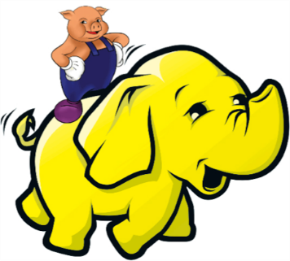
Data Preparation (ETL)
Functions
Data Presentation (Data Warehouse)
Functions
Users
Raw data is loaded, cleaned, conformed, joined to other datasets.
Users
Engineers
Data Specialists
Researchers
Analysts
Decision makers
Diagnosis & Reporting
Stores data that has been processed and formatted, ready to be used.
Notes:
So should you use pig or hive? Well that depends on your needs and who you are. Within the 3 stages of data processing, you have data preparation and data presentation. Data presentation is where the data has been cleaned formatted, and structured, because the data is so clean you can just simply perform SQL queries. That’s where Hive excels. However with big data, it is rarely the case that data is so pristine to begin with. Therefore you should use Pig when the datasets get too raw for hive because of the data transformation requirements, parsing, and if the data lacks structure.

