Slide 1
Blockchain Interoperability
Market Analysis
Market Opportunity, Coverage Gap, and Strategic Direction
Prepared for Concero Leadership | May 2025
Dr. Phuc Le | Market Research & Analysis
1 / 17

Slide 2
Agenda
01
Executive Summary
Key findings at a glance
02
Methodology
Data sources and approach
03
Ecosystem Growth
Platform expansion 2013-2025
04
Ecosystem Composition
Layer distribution and rollup types
05
Growth Projection
Exponential model to 2027
06
Provider Landscape
Five major interoperability providers
07
Coverage Gap Analysis
The core market problem
08
Strategic Recommendations
Actionable next steps for Concero
2 / 17

Slide 3
Executive Summary
498
191
37.1%
313
Total Blockchain
Platforms
New Platforms
in 2024
Interoperability
Coverage Rate
Unserviced
Chains
Core Finding: The interoperability market faces a structural supply-demand imbalance. Blockchain platforms are being created faster than providers can integrate them. The coverage gap is widening in absolute terms, representing a significant market opportunity for Concero.
3 / 17

Slide 4
Data Collection Methodology
Dataset | Source | Records
Layer 1 Platforms | CoinGecko, DeFiLlama | 338
Layer 2 Platforms | L2Beat, DeFiLlama | 131
Layer 3 / Appchains | L2Beat, Protocol docs | 29
LayerZero | Protocol documentation | 87
Wormhole | Protocol documentation | 35
Hyperlane | Protocol documentation | 125
Axelar | Protocol documentation | 19
Chainlink CCIP | Protocol documentation | 50
Approach: Primary data from public registries and protocol docs. Platforms categorized by layer architecture. Provider coverage mapped via official chain support lists. Growth projections use exponential curve fitting on 2017-2025 data.
4 / 17

Slide 5
Ecosystem Growth: New Platforms by Year
2024 saw 191 new platforms launched, a 133% increase over 2023. Layer 2 rollups drove the majority of growth.
5 / 17

Slide 6
Cumulative Ecosystem Growth
The ecosystem has grown from 22 platforms in 2017 to 498 in 2025, with an inflection point beginning in 2021.
6 / 17

Slide 7
Year-over-Year Ecosystem Growth Rate
Average annual growth rate (2019-2024): ~48.6%. 2025 partial year data (through May).
7 / 17

Slide 8
04
Ecosystem
Composition
Layer distribution and rollup type analysis
8 / 17

Slide 9
Layer Composition (2025)
Rollup Type Breakdown
Type | L2 Count | L3 Count
Optimistic Rollup | 72 | 2
ZK Rollup | 59 | 1
Optimium | 0 | 21
Validium | 0 | 3
EDU Chain | 0 | 1
Layer 2 and Layer 3 together now account for 32.1% of the ecosystem, up from 0% in 2019.
9 / 17

Slide 10
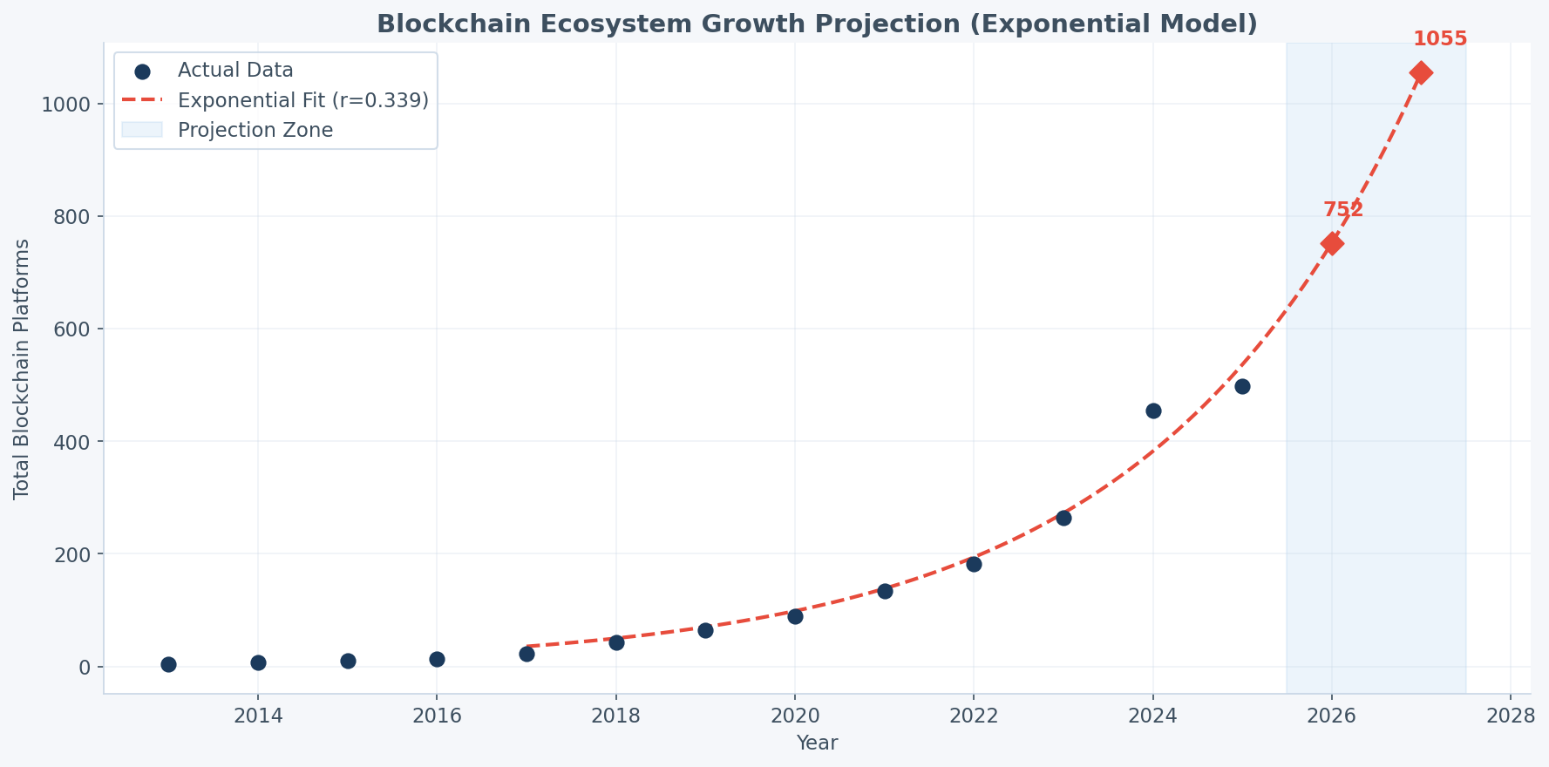
Ecosystem Growth Projection (Exponential Model)
Projections
Year | Platforms
2025 (actual) | 498
2026 (proj.) | ~750
2027 (proj.) | ~1,055
Growth rate: ~34% annual (exponential fit) Doubling time: ~2 years
10 / 17

Slide 11
06
Provider
Landscape
Five major interoperability protocols compared
11 / 17

Slide 12
Provider Chain Coverage (2025)
Provider | Model
Hyperlane | Permissionless ISM
LayerZero | Ultra Light Node
CCIP | DON-based
Wormhole | Guardian Network
Axelar | Proof-of-Stake
Hyperlane leads in coverage due to its permissionless deployment model, allowing any chain to deploy without protocol approval.
12 / 17

Slide 13
Provider Growth Timeline
Hyperlane's permissionless model drove rapid scaling in 2024, adding 88 chains in a single year.
13 / 17

Slide 14
The Coverage Gap: Core Market Problem
62.9%
of all blockchain platforms have zero cross-chain messaging support
The absolute number of unserviced chains has grown from 64 (2019) to 313 (2025). Even as providers scale, the ecosystem grows faster.
This gap represents Concero's core market opportunity.
14 / 17

Slide 15
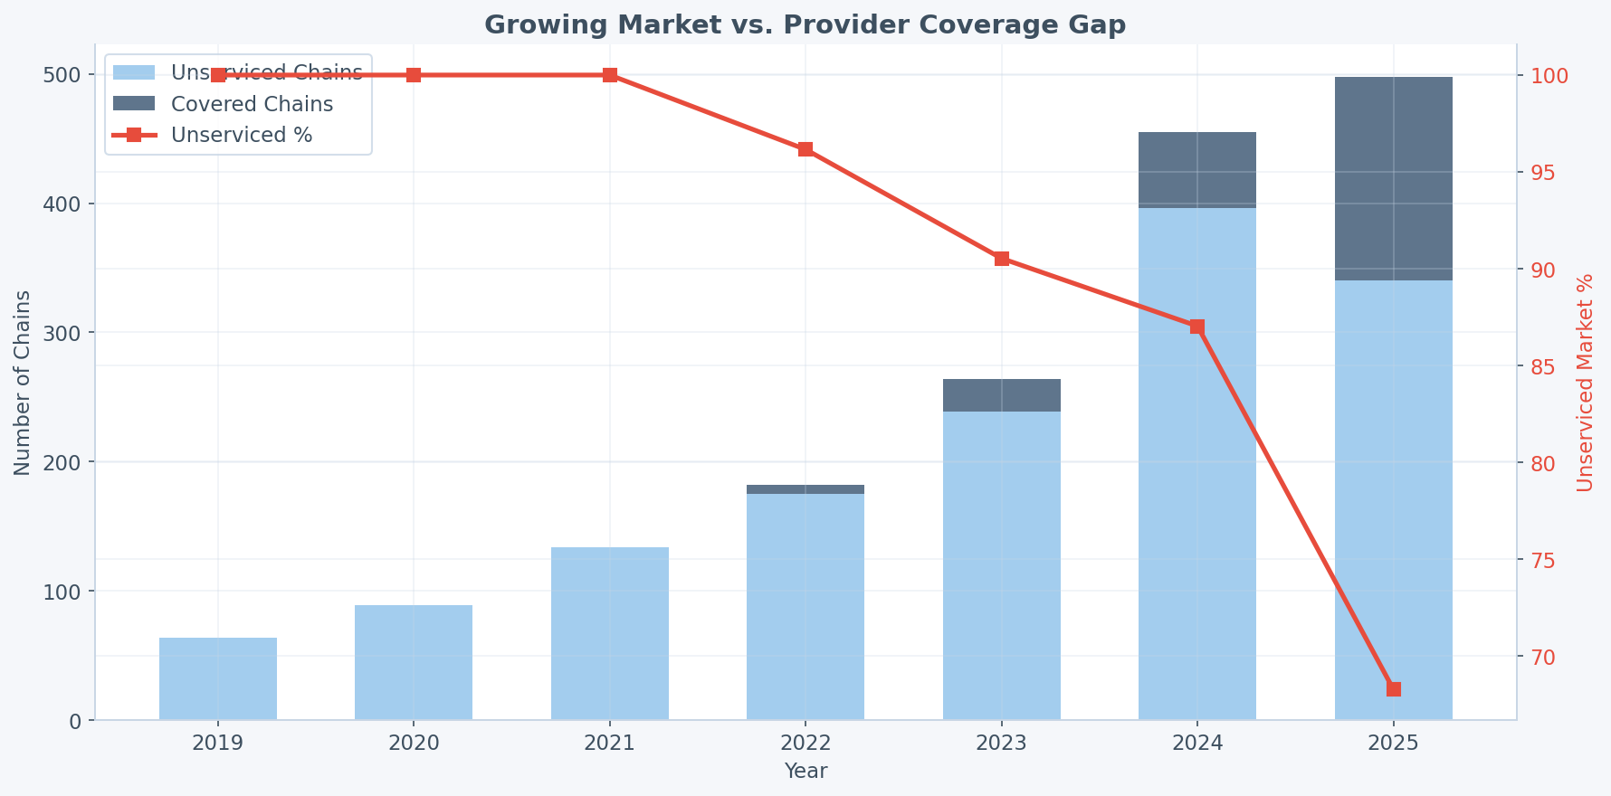
Unserviced Market Growth Trend
While coverage rate improved from ~100% unserviced (2019) to 68% (2025), the absolute gap grew from 64 to 313 chains.
15 / 17

Slide 16
Strategic Recommendations
01
Lead with the Coverage Gap Narrative
Use the 62.9% unserviced rate in investor and partner communications. Frame Concero as solving a structural market problem.
02
Prioritize Automated Integration
Reduce per-chain integration time from weeks to hours. This is the key competitive differentiator against incumbent providers.
03
Target Layer 2/3 Growth Segment
55% of 2024 launches were L2/L3. Early coverage of these chains positions Concero as the default interop layer.
04
Partner with RaaS Providers
Integrate with Caldera, Conduit, AltLayer to provide automatic cross-chain support at chain deployment.
05
Publish Coverage Tracking Dashboard
Ongoing market intelligence + thought leadership positioning. Reinforces the opportunity narrative publicly.
16 / 17

Slide 17
Thank You
Questions & Discussion
Dr. Phuc Le – Reaserch Lead @ Concero Labs| lh.phucc@gmail.com
17 / 17

