Slide 1
CUSTOMER ANALYSIS REPORT
Customer shopping
behavior analysis
Turning transaction data into growth priorities for retail.

Slide 2

DATASET SCOPE
3,900 transactions reveal a high-potential customer base
01
02
03
3,900
18
25
transactions
data variables
products across four categories
USD 59.76
3.75 / 5
Average purchase amount
Average rating
The data was cleaned, standardized, and loaded into Microsoft SQL Server for analysis.

Slide 3
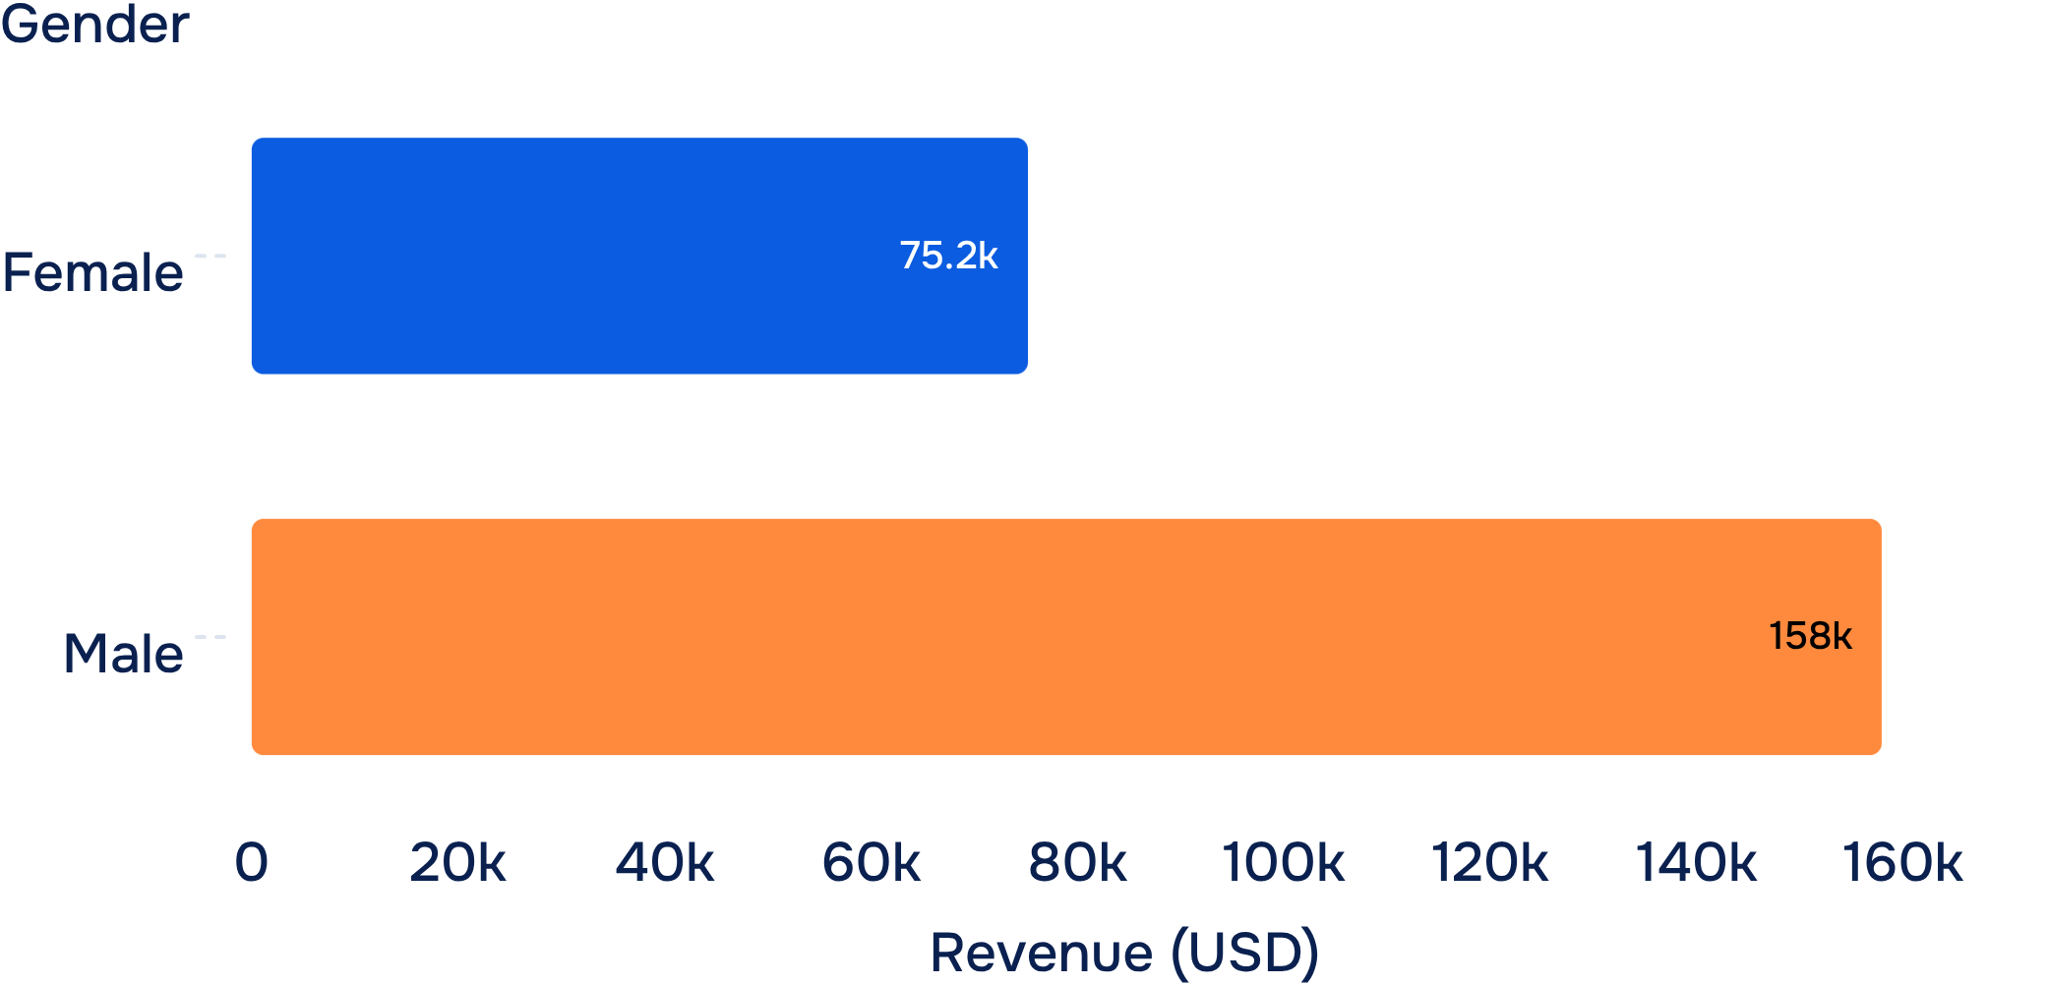
REVENUE BY GENDER
Male customers generate 68% of revenue in the dataset
Revenue (USD)
MALE REVENUE
157,890
USD · Revenue from male customers
Revenue from female customers: USD 75,191.
A deeper view by product, message, and channel could unlock additional growth.

Slide 4
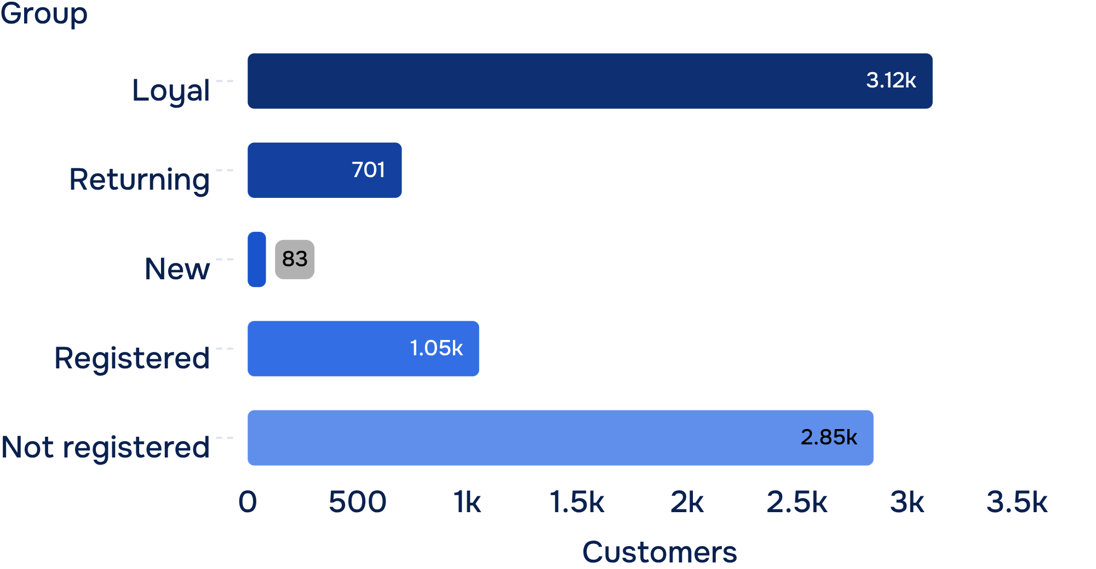
LOYALTY AND SUBSCRIPTION
The loyal customer base is large, but subscription remains low
Customer segment and subscription status · customers
73%
2,847 customers are not registered.
There are 3,116 Loyal customers, compared with 701 Returning and 83 New customers.
Average spend is almost identical: USD 59.49 for registered customers and USD 59.87 for those not registered.

Slide 5
CATEGORIES AND PRODUCTS
Clothing leads, while several products rely heavily on discounts
REVENUE LEADER
DISCOUNT-DEPENDENT PRODUCTS
~USD 100K
Products to review
Hat
50.00%
Sneakers
49.66%
Clothing
Coat
49.07%
Sweater
48.17%
Approximately 1,800 orders in the dashboard.
Pants
47.37%
Top products by order count: Jewelry, Sunglasses, Belt; Blouse, Pants, Shirt; Sandals, Shoes, Sneakers; Jacket and Coat.

Slide 6
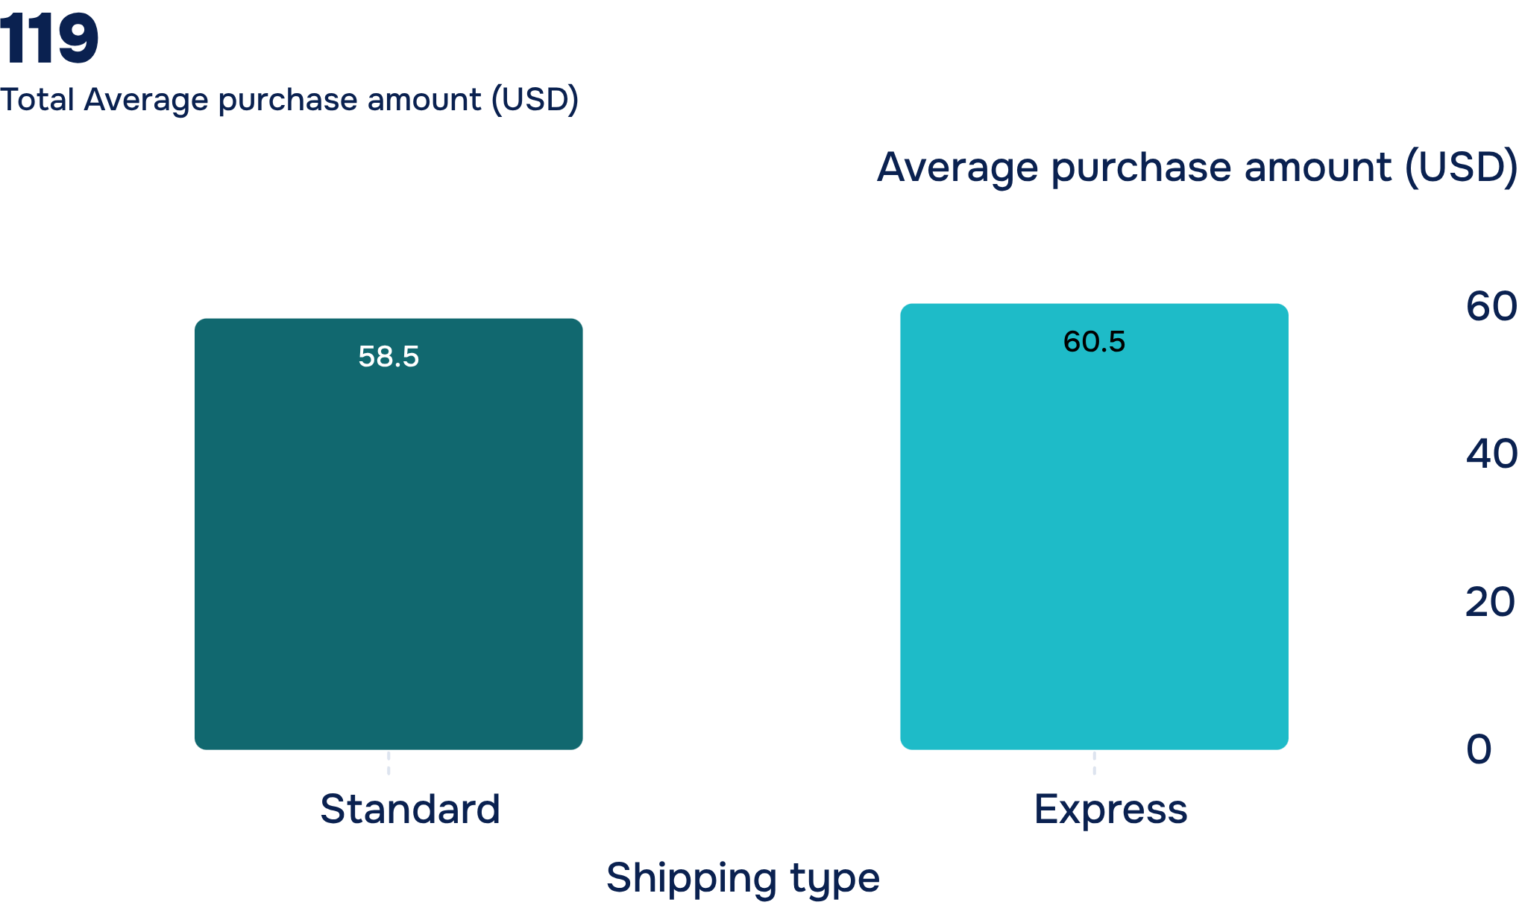
SHIPPING AND RATINGS
Express shipping is associated with higher order value
+USD 2.02
Average purchase amount (USD)
Higher average purchase value for Express than Standard.
Top five products by rating: Gloves 3.86; Sandals 3.84; Boots 3.82; Hat 3.80; Skirt 3.78.
Test a membership offer linked to faster shipping and highly rated products.

Slide 7
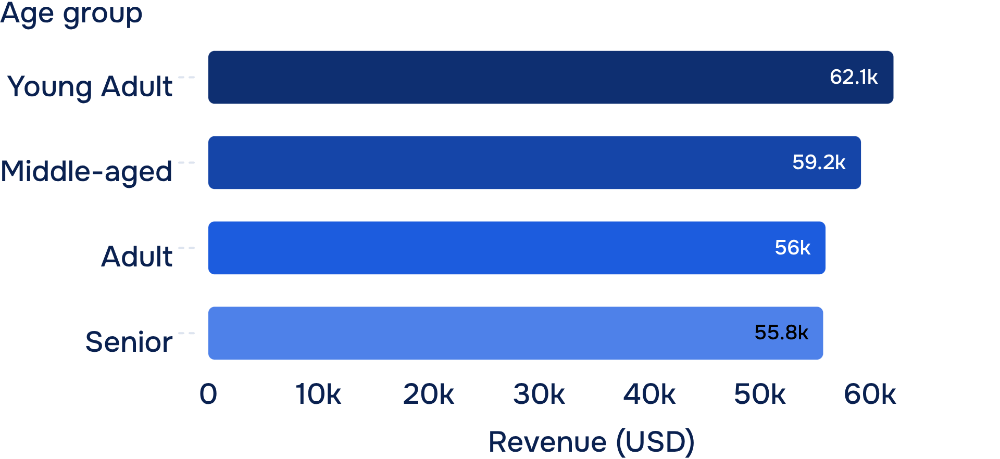
REVENUE BY AGE GROUP
Young Adult contributes the highest revenue
Revenue (USD)
USD 62,143
Young Adult revenue
The gap between the highest and lowest groups is USD 6,380.
Age-based campaigns should start with Young Adult, then expand to Middle-aged.

Slide 8
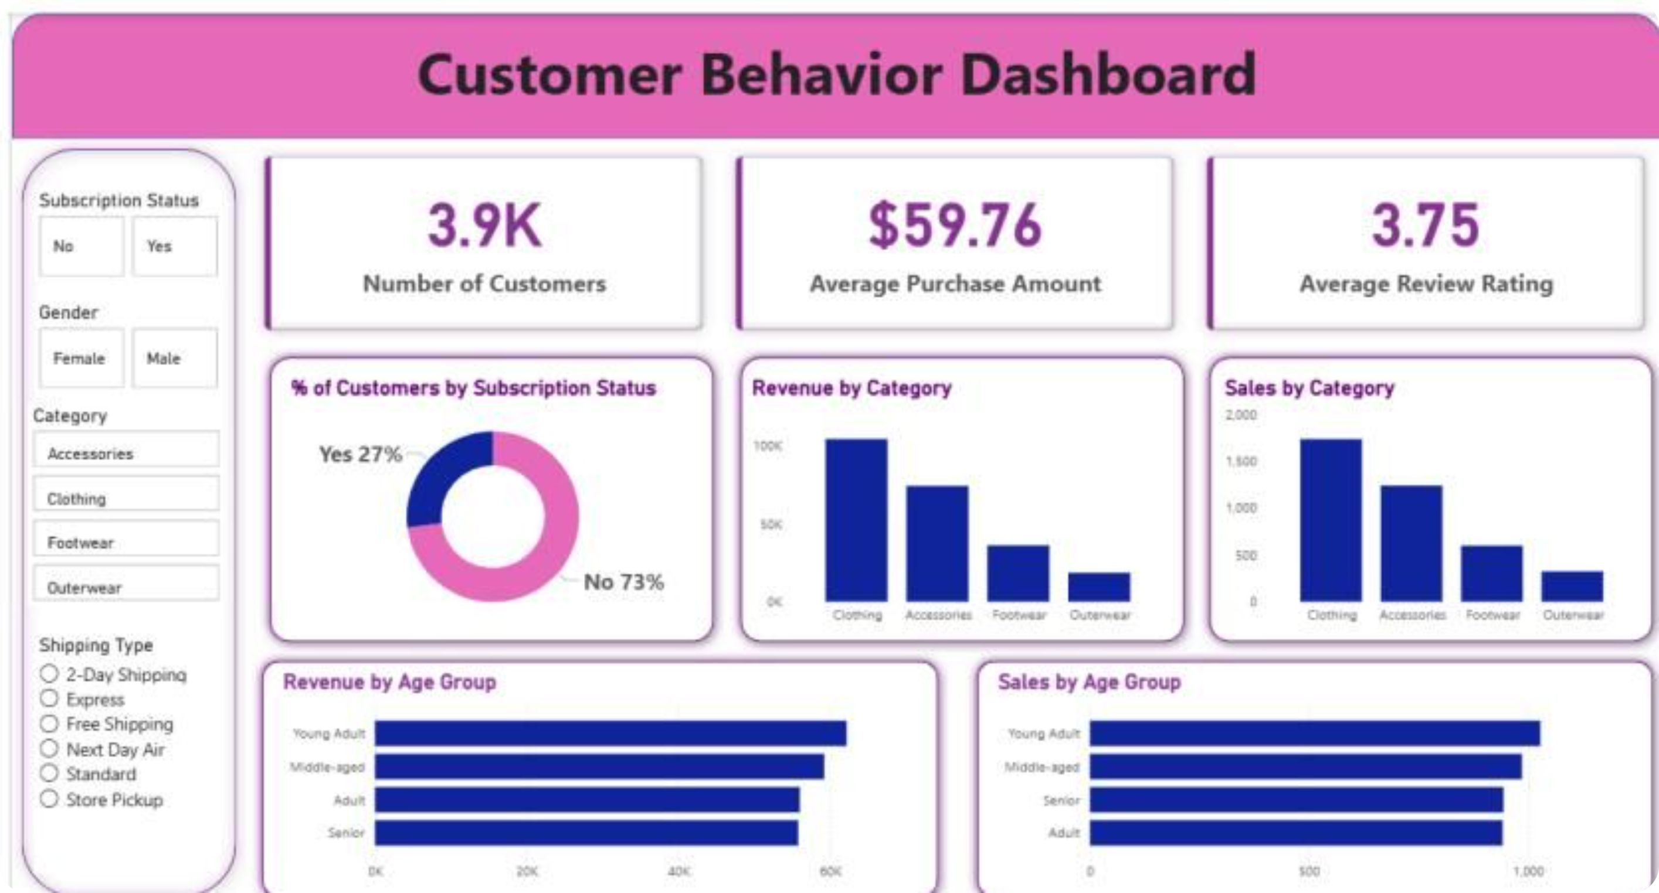
FROM DATA TO MONITORING
The dashboard turns data into a behavior-monitoring system
Filters for subscription, gender, category, and shipping type move the analysis from a total view to individual customer segments.

Slide 9

FROM ANALYSIS TO ACTION
Five growth priorities
01
02
03
Strengthen membership benefits
Build a rewards program
Review discount-dependent products
Convert Loyal customers who are not yet registered.
Encourage repeat purchases.
Protect margin while keeping demand healthy.
04
05
Feature highly rated bestsellers
Target Young Adult
Make them part of core campaigns.
Test a membership offer linked to Express shipping.

