Slide 1
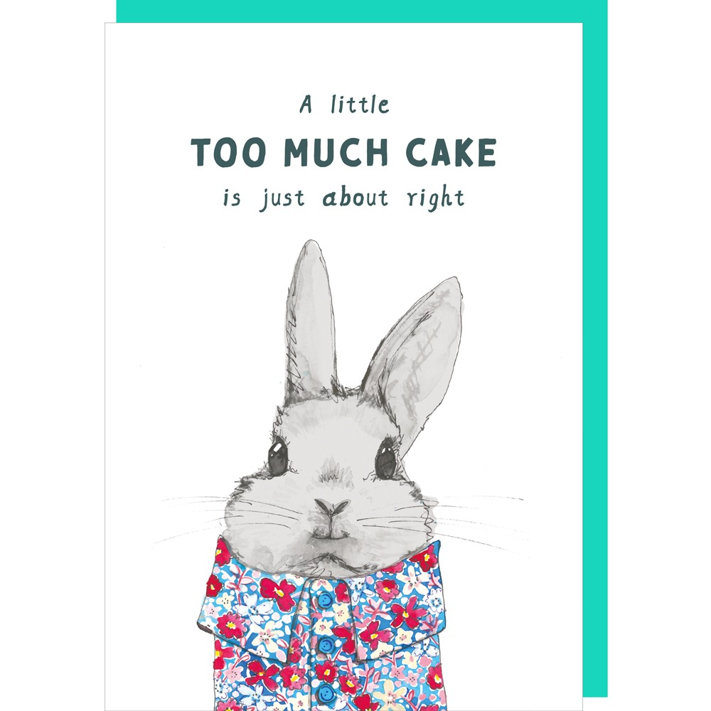
Free Just – About – Right Methodology
Lê Tuấn Phúc - HUST

Slide 2
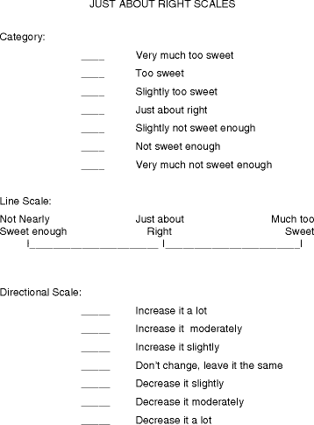
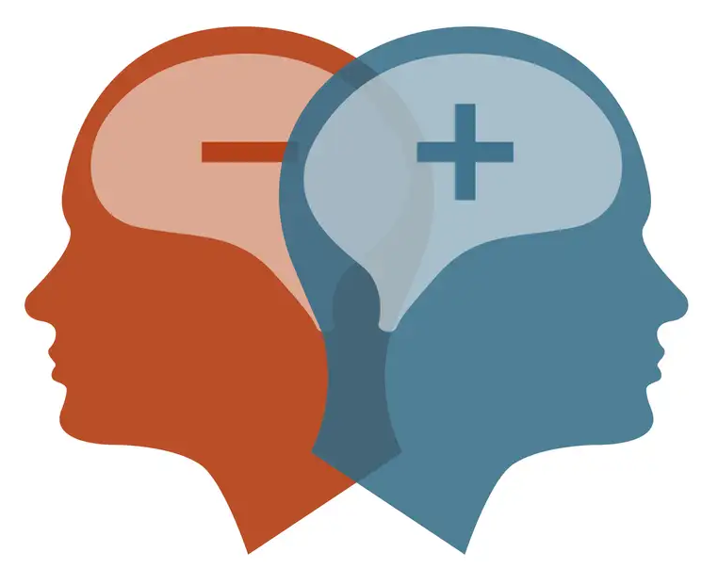
Let’s start with what a JAR is
(JAR) scaling is widely applied in the food industry for product development
The JAR scale is a bipolar measurement. In JAR scaling, two semantically opposite anchors and the midpoint is labeled “Just About Right”
JAR scales are very to be an easy way to determine if an attribute’s intensity is at an optimal level
Notes:
The JAR scale is a bipolar measurement. In JAR scaling, two semantically opposite anchors, “Not Sweet At All” and “Much Too Sweet”, are placed at each end of the scale, and the midpoint is labeled “Just About Right” or “Just Right”

Slide 3
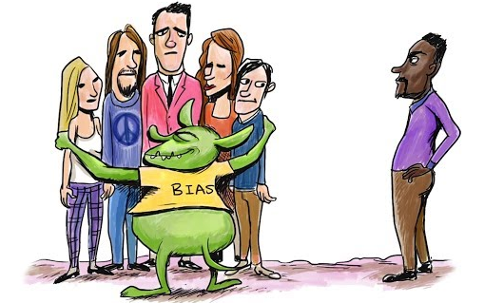
Limitation
Predefined, uniform attribute lists are a limitation in sensory evaluation.
Key attributes may be overlooked if they are not included in the list.
Consumers may interpret attributes differently, leading to inconsistency.
Presenting attributes to consumers can bias their evaluations.
Attributes on the list may be given more importance than warranted, skewing focus.
A flexible method to capture authentic consumer insights without relying on predefined attribute lists
Notes:
A flexible method is needed to capture authentic consumer insights without relying on predefined attribute lists, enabling more spontaneous and meaningful feedback.

Slide 4

Free JAR Methodoly
Attribute
JAR scales
Too much
I like this product because
????
????
Not enough
JAR
Make a nudge for focus on strengths and weaknesses of product
Freely express
The Free JAR process uses structured text to capture consumer insights without predefined attributes, leveraging the JAR scale to highlight product strengths and weaknesses.
Notes:
In this context, we developed a new method of evaluation called Free JAR. It stands as a compromise between the JAR procedure, with a fixed list of attributes, and the completely unconstrained expression of the consumers in free comments.

Slide 5
Free JAR Protocol
The Free JAR is a two-step methodology:
I DON’T LIKE
I LIKE MODERATELY
I LIKE VERY MUCH
1
STEP
Categorization
P3
P7
P1
P9
P5
P2
P8
P4
P6
2
STEP
Description with
JAR qualifiers
This product is not firm enough
This product is too salty
I would prefer that this product be less rubbery
This product is perfectly creamy but could be less acidic
(Luc et al., 2022)
Notes:
In Free JAR, the consumers are first invited to sort the products into three hedonic categories, namely "I don't like", "I like moderately" and "I like very much". Then, they are invited to describe the products using their own words, but being invited to use such terms as “just right”, “too much” and “not enough”, in the spirit of the JAR scales. By so doing, Free JAR procedure aims to provide a structured verbalization of the products’ improvement keys.

Slide 6
Free JAR Protocol
I DON’T LIKE
I LIKE MODERATELY
I LIKE VERY MUCH
1
STEP
Categorization
P3
P7
P1
P9
P5
P2
P8
P4
P6
2
STEP
Description with
JAR qualifiers
This product is not firm enough
This product is too salty
I would prefer that this product be less rubbery
This product is perfectly creamy but could be less acidic
Structured sentence
ML classification
Unstructured sentence
Sentimentaion Analysis
IRMuteQ Software
NLP
Large Language Model
Approach

Slide 7
Free JAR Procedure
DATA STRUCTURE
Jugde | Product | Hedonic category | Free JAR comment
1 | 709 | B | ngọt_không_đủ,mùi_thơm_vừa_đủ,màu_quá_đậm
1 | 495 | C | ngọt_không_đủ,mùi_thơm_không_đủ,màu_không_đủ
1 | 913 | C | đắng_quá_nhiều,chát_quá_nhiều,màu_vừa_đủ
1 | 582 | B | mùi_thơm_vừa_đủ,chát_vừa_đủ,đắng_không_đủ,màu_không_đủ
1 | 136 | C | mùi_thơm_vừa_đủ,chát_vừa_đủ,đắng_quá_nhiều,màu_vừa_đủ
Association between a text and a hedonic category
A
I like very much
Association between a text and a hedonic category
B
I like moderately
C
I don’t like
Notes:
The Free JAR data can be considered as labeled data in the sense that each Free JAR comment is associated with a hedonic information, namely the hedonic category in which the respondent has placed the product under consideration prior to the description step.

Slide 8
Free JAR Analysis
Y
X
Hedonic | Free JAR comment | chua_vừa_đủ | chát_không_đủ | chát_quá_nhiều | chát_vừa_đủ
1 | chát_vừa_đủ,đắng_không_đủ,mùi_thơm_vừa_đủ | 0 | 0 | 0 | 1
2 | chát_vừa_đủ,mùi_thơm_vừa_đủ | 0 | 0 | 0 | 1
1 | chát_quá_nhiều,mùi_thơm_vừa_đủ | 0 | 0 | 1 | 0
3 | chát_không_đủ,mùi_thơm_vừa_đủ | 0 | 1 | 0 | 0
1 | chát_quá_nhiều,đắng_quá_nhiều,mùi_thơm_vừa_đủ | 0 | 0 | 1 | 0
2 | ngọt_vừa_đủ,chát_quá_nhiều,mùi_thơm_vừa_đủ,màu_vừa_đủ | 0 | 0 | 1 | 0
Supervised classification
Y = f(X)
3
I like very much
Label Encoding
2
I like moderately
1
I don’t like

Slide 9
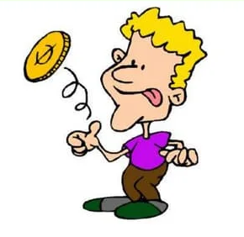
Free JAR Analysis
Implementation of a Random Forest classifier:
Modeling of the link between the attributed presence and the hedonic category
Define the valency score of a given comment:
Valency score = p (« I like very much ») – p (« I don’t like »)
-1 ≤ Valency score ≤ 1
Quantitative analyses
Valency score high
The comment is Positive
(I like this product very much)
Valency score low
The comment is Negative
(I don’t like this product)
Luc et al., 2022b
Notes:
By applying the RF classifier to Free JAR comments, we obtain membership probabilities to each of the three hedonic categories. We define the valency score of a given comment as the difference between the membership probability that the comment belongs to the category "I like very much" and the membership probability that the comment belongs to the category "I don't like". Therefore, this score ranges between -1 and 1 and the higher it is, the more positive is the comment.

Slide 10
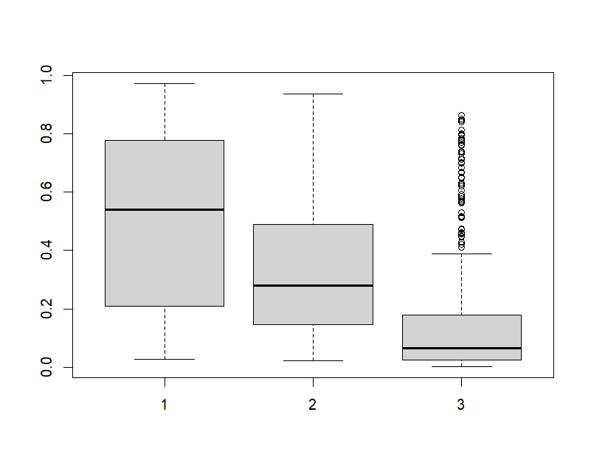
Free JAR Results
best_params_
'criterion': 'entropy’,
'max_depth': 15,
'max_features': 'log2’,
'n_estimators': 100
 | precision | recall | f1-score | support
1 | 0.85 | 0.95 | 0.9 | 304
2 | 0.86 | 0.79 | 0.82 | 213
3 | 0.94 | 0.76 | 0.84 | 99
accuracy | 0.87 |  |  | 616
macro avg | 0.88 | 0.83 | 0.85 | 616
weighted avg | 0.87 | 0.87 | 0.86 | 616
I like very much
I like moderately
I don’t like

Slide 11
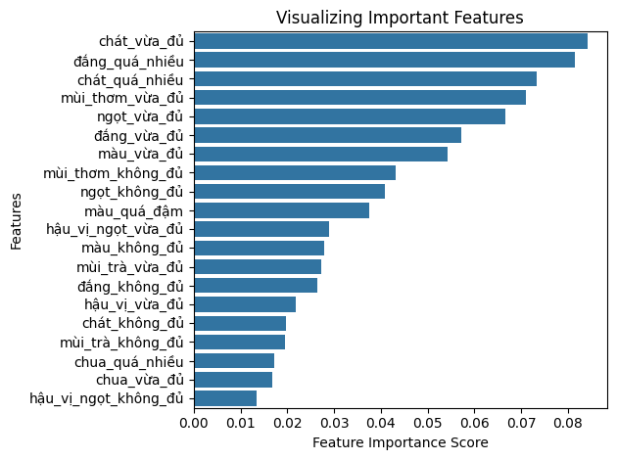
Free JAR Results
20 feature importance variable
Feature importance refers to techniques for determining the degree to which different features, or variables, impact a machine learning model’s predictions
Astringency just right, Astringency too much, Bitter too much, Aroma just right is the main attribute for classify hedonic categories

Slide 12
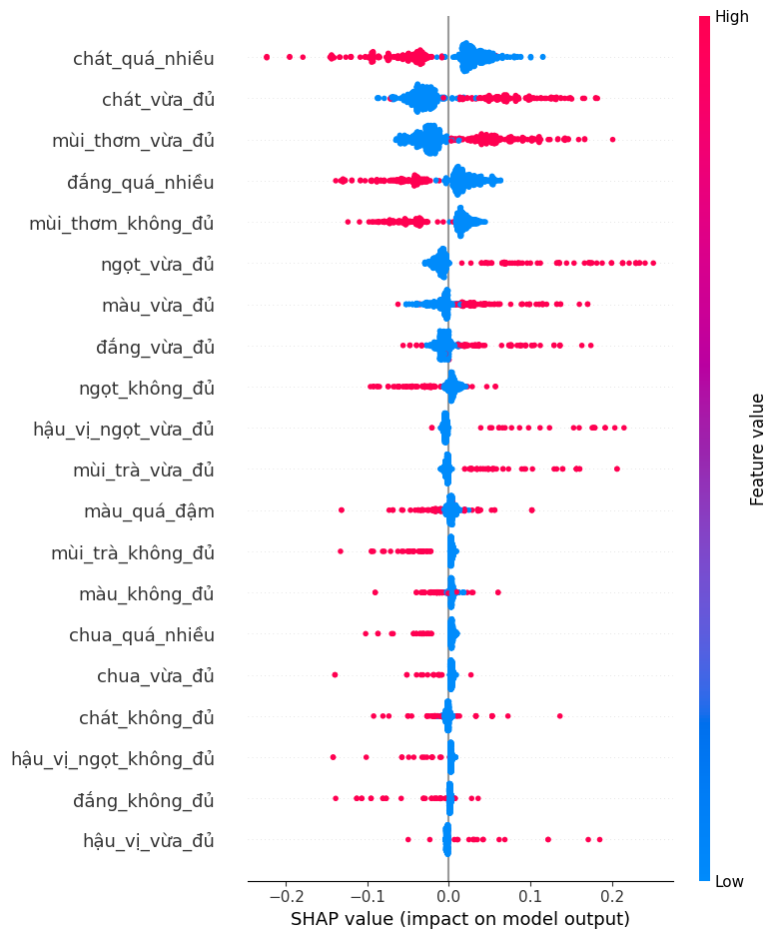
Free JAR Results
SHAP (SHapley Additive exPlanations) is theoretic approach to explain the output of any machine learning model
Apply SHAP to interpret model
Astringency too much, Bitter too much, Aroma not enough is the main attribute that negatively affects the occurrence of "I like product".
Astringent just right and Aroma just right have a positive influence on the occurrence of higher “I like product”.

Slide 13
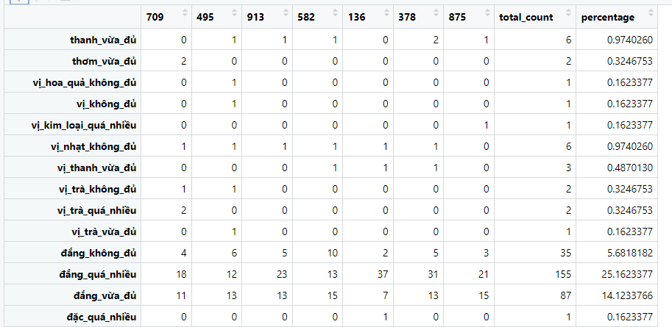
Free JAR Results
88 Jugde and 7 Product. In the maximum case, that 1 attribute can receive 88x7 = 616
Each attribute was count and calculated its % with maximum case.
Terms that are too few (<5%) can be considered as not contributing much to the product description

Slide 14
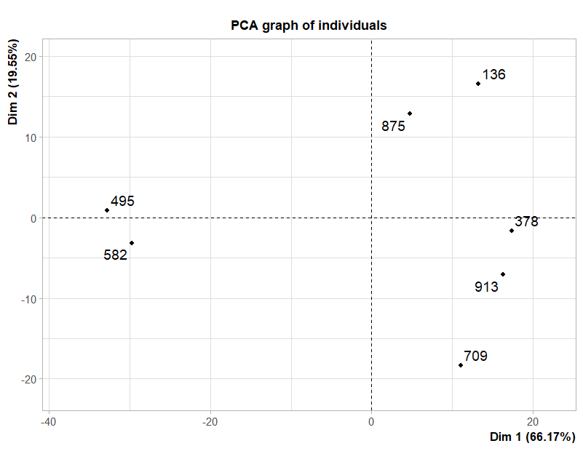
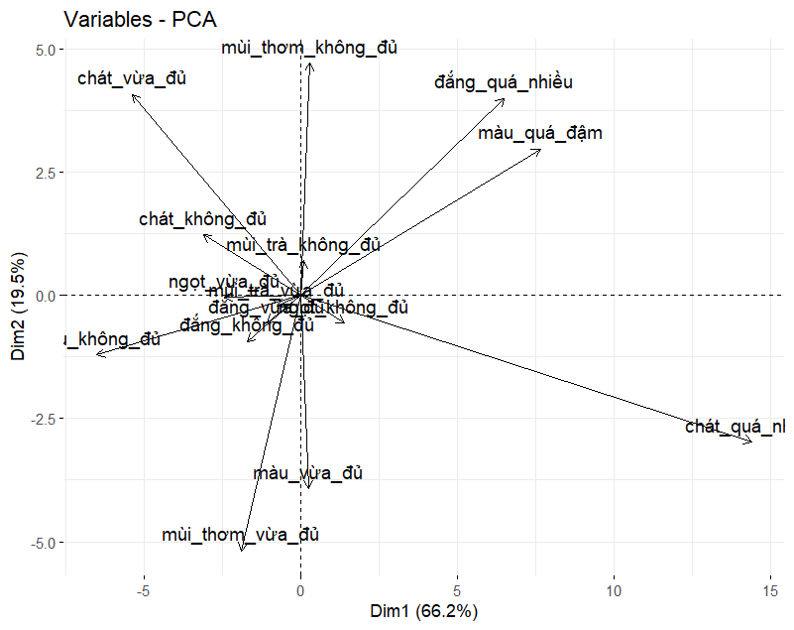
Free JAR Results

Slide 15
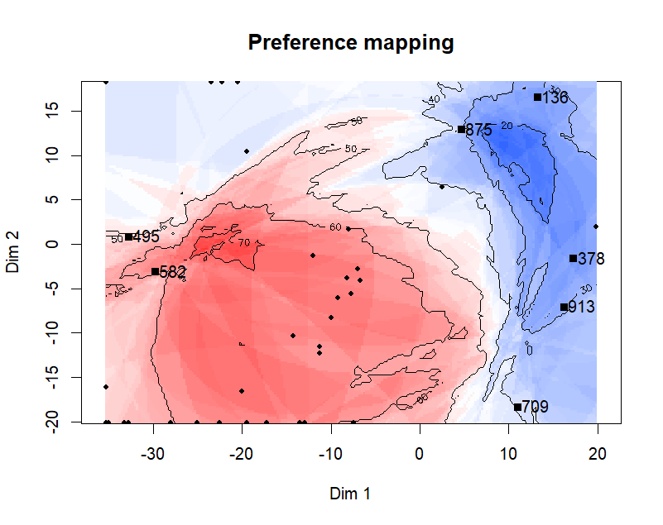
Free JAR Results
Make product that are not like
Bitter too much
Color too much
Astringency too much

Slide 16
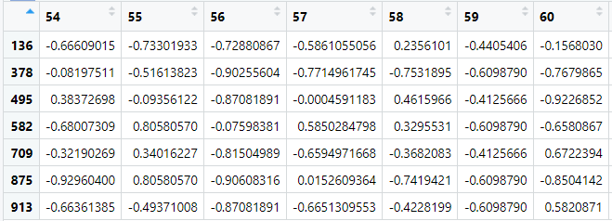
Free JAR Results
Each entry of this table is the valency score associated with the description of a given respondent and product.
→ Make an internal preference mapping by PCA to identifying which products correspond to groups of consumers.

Slide 17
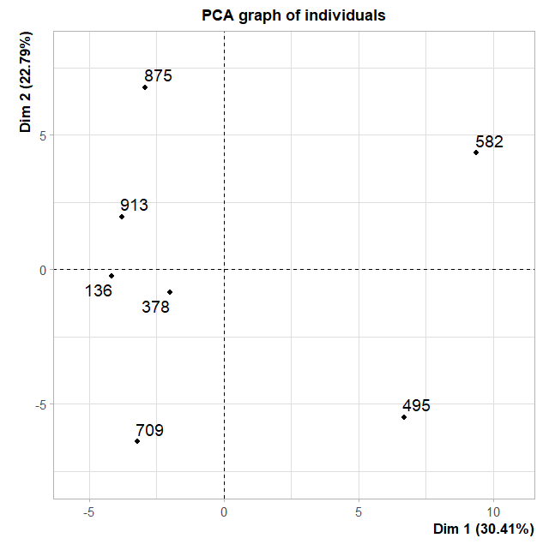
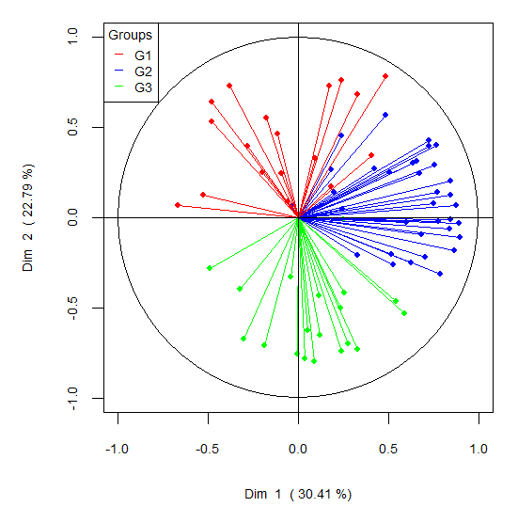
Free JAR Results
The two first components explained 53% of the variability in the data
Group1 is the group of consumer prefer 875 or 913
Group2 is the group of consumer like 582
Group3 is the group of consumer who like 709 or 495

Slide 18
Conclustion
Free JAR methodology:
Through a nudge approach, bring the consumer to provide product improvement keys
Rich data
The Machine Learning and SHAP approach for FreeJAR is an easy approach and the explanation is good:
Get the most out of the data
From structured textual data to quantitative data
Interpretability for sensory data: highlight drivers of liking and disliking.

